Slide 1
Fig. 1. Range of onion thrips densities per plant across the 26 fields for 3 sample dates: in situ and whole plant wash
Notes:
Thrips densities generally increased over the season. Thrips counts in whole plant wash samples on the late season date were 2-3 times higher than the in situ counts on the same date (different plants in the same plot)

Slide 2
Fig. 2. No relationship between bulb size on the late sample date and onion thrips densities on plants
in early, mid or late season (in situ or whole plant wash samples)

Slide 3
Table 1. Incidence of IYSV in August in seven onion fields in relation to presence of two weeds that are thrips
hosts on field edges, and early, mid, and late-season thrips counts (in situ and whole plant wash samples).
Weeds present (mature common mallow and prickly lettuce) | Field ID | Early-In Situ Thrips Count | Mid-In Situ Thrips Count | Late-In Situ Thrips Count | Late-Wash Thrips Count | % positive IYSV onion sample
No | 1 | 0 | 0.4 | 4.1 | 20.9 | 0
No | 3 | 0.1 | 33.3 | 27.1 | 15.2 | 4
No | 4 | 0.2 | 16.1 | 32.1 | 117.2 | 14
Yes | 7 | 0 | 11.7 | 115.2 | 241.0 | 64
No | 17 | 6.8 | 21.1 | 0.1 | 2.6 | 0
No | 22 | 4.7 | 12.8 | 3.9 | 14.3 | 10
No | 24 | 1.3 | 22.2 | 1.2 | 18.9 | 0

Slide 4
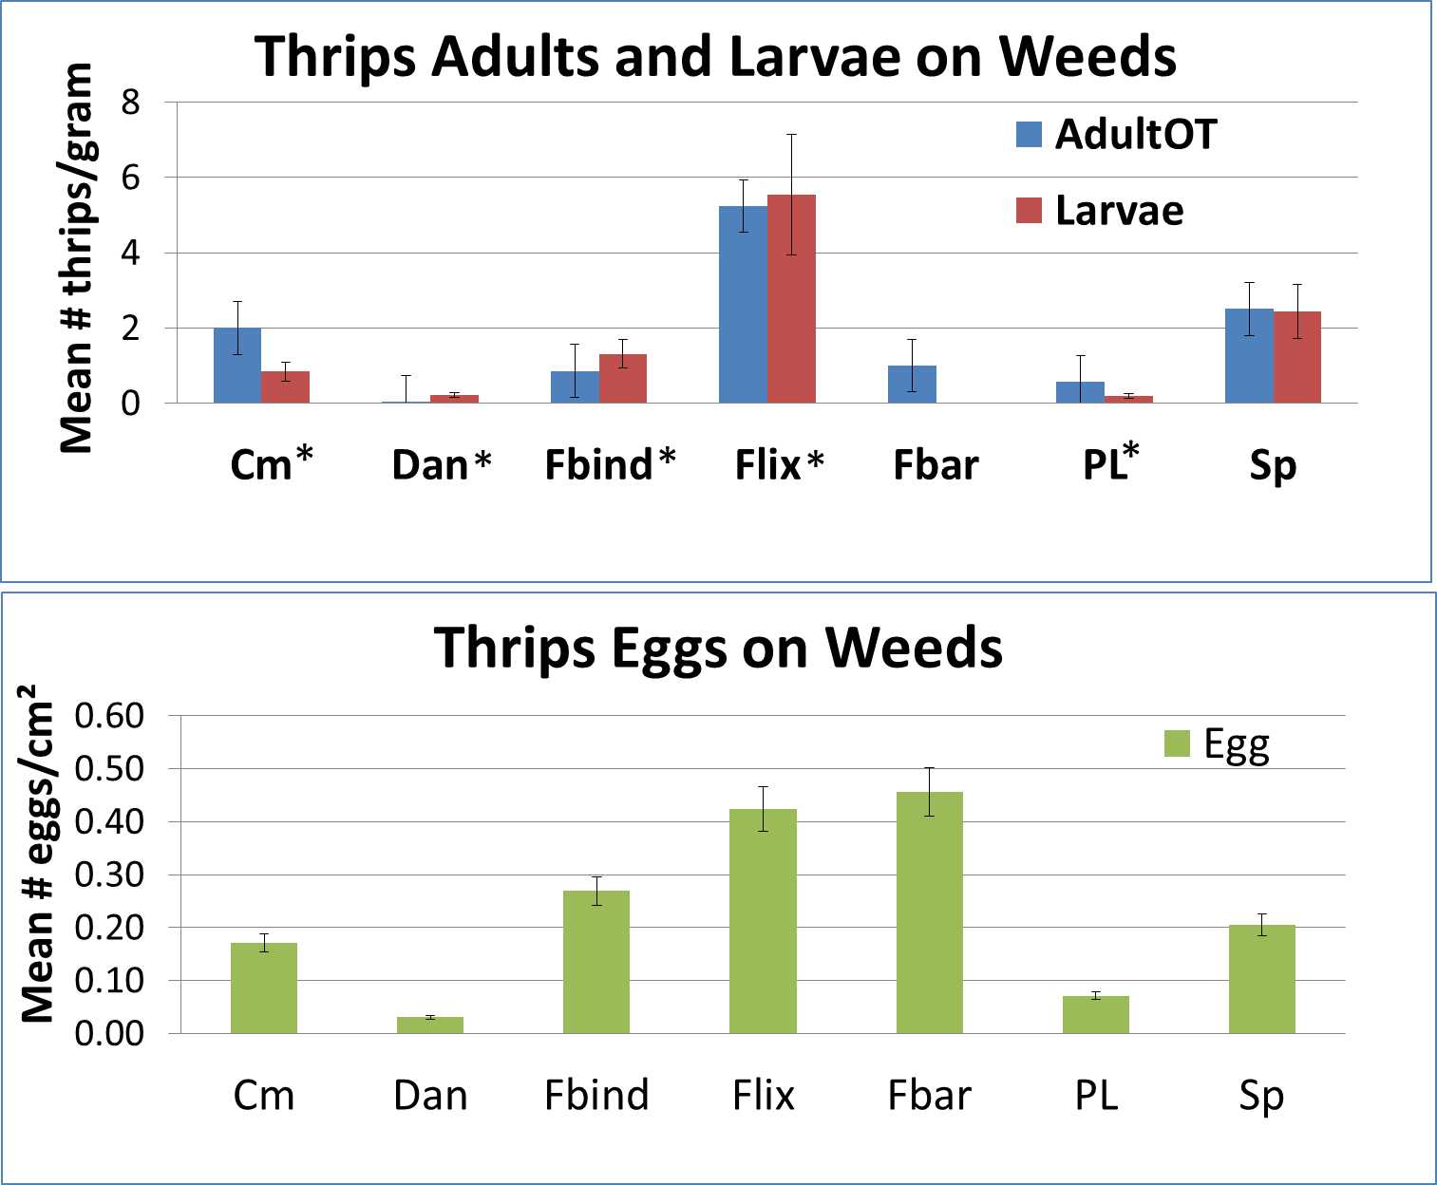
Fig. 3. Densities of onion thrips on seven weed species in 2013 with the potential to serve as green bridge hosts.
Notes:
Flixweed, field bindweed, and common mallow are biennial or perennial weeds, supported thrips reproduction, and IYSV was found in plant tissue samples; thus they are all good candidates for green bridge plants. Shepherd’s purse is a winter annual and supported thrips adults, eggs, and larvae. SP could serve as a source of thrips for onion fields in the spring; however no SP samples tested positive for IYSV. The suitability of foxtail barley, prickly lettuce, and dandelion as green bridge hosts appears to be less.

