Slide 1

Lessons from a Local and Seasonal Foods
Micro-Distribution System
Based on the experience of

Slide 2
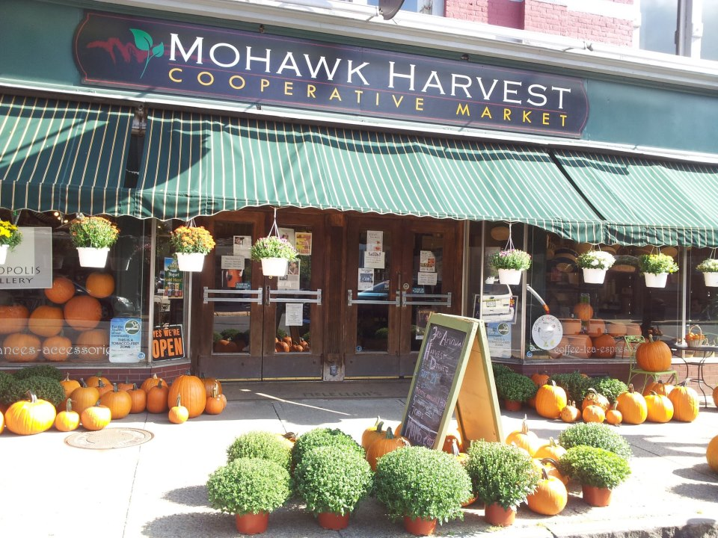
Introduction
Prior to this project, Mohawk Harvest had previously established a retail grocery store
with a reputation for selling local products

Slide 3
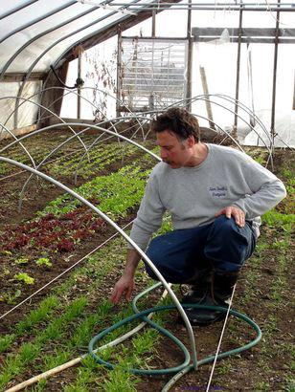
Introduction Continued
Mohawk Harvest had previously
created a network of local produce growers

Slide 4
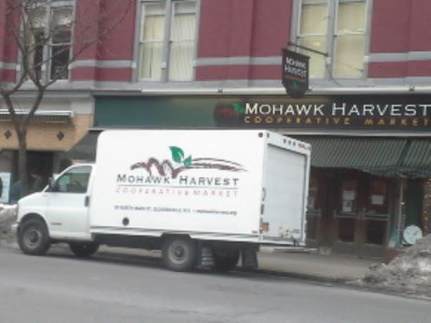
Introduction Continued
Mohawk Harvest had previously
run regular pick-up routes for local produce

Slide 5

Introduction Continued
Mohawk Harvest had previously hosted local foods events with area chefs

Slide 6
Goals
With this project Mohawk Harvest sought to
-Offer local foods to other businesses/institutions
-Fill a niche market desired by other businesses
-Increase purchases of local agriculture products
-Create a model for other adopters

Slide 7



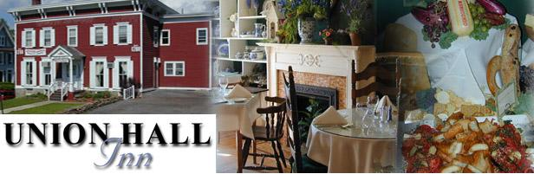

First Steps
We established that an interest in local foods existed in our region’s food service industry through conversations and publicity

Slide 8
Methods
-Engaged our growers to educate them on the needs of our wholesale buyers
-Meet with the local produce auction managers to explain our wholesale service
-Updated potential buyers on product availability and price levels twice weekly
-Purchased and delivered and local product to match needs of wholesale buyers, invoiced weekly
-We tracked purchases and sales, both retail and wholesale
-Surveyed wholesale buyers and potential buyers

Slide 9
Results
-Successful wholesale orders from 11 food service providers, 48% of those contacted
-Found our retail operations were assisted through our wholesale service
-Increased purchasing of local product by 27% over previous year
-Small accounting profit accumulated despite de-emphasis of price over product quality and wholesale order fulfillment
-Cross-promotion benefitted us and our buyers

Slide 10
Basic Conclusions
-Building relationships with individuals within food service institutions and restaurants opens doors
-Mission-orientation and commitment to local economy validates our service
-Communication with potential buyers is essential to clear flow of ordering information
-Inventory management and quality control require preparation and constant attention
-Flexibility and openness to needs of potential buyers creates opportunities
-Profitability is a realistic near-term expectation

Slide 11
Follow Up
Please refer to Sustainable Agriculture, Research and Education web page for full report, more information, and additional documents including examples of
Letter to potential wholesale buyers
Weekly produce availability bulletin
Invoice sample
Profitability analysis
Exit survey
Contact: Christopher Curro, Mohawk Harvest Cooperative Market
30 N. Main Street, Gloversville, NY, 12078, (518) 706-0681
Contact: Crystal Stewart, Cornell Cooperative Extention
141 Fon Clair Terrace, Johnstown, NY, 12095, (518) 775-0018

