Slide 1
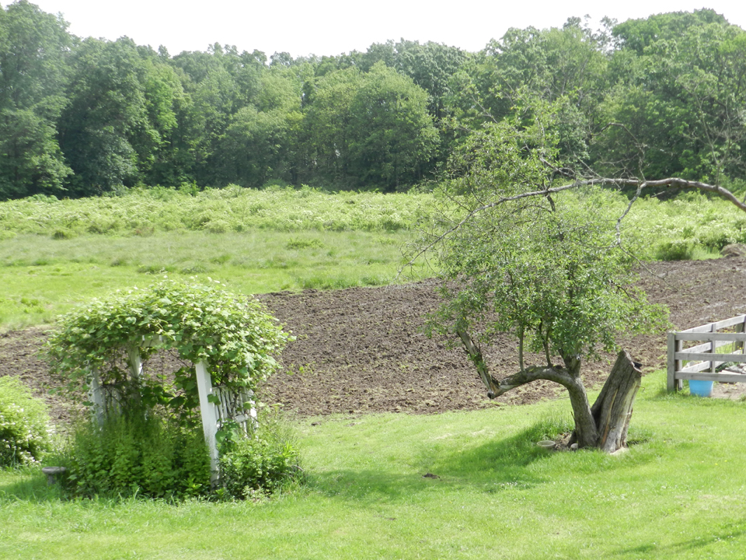
Alternative Honeybee Nutrition
Beyond Sugar Syrup

Slide 2
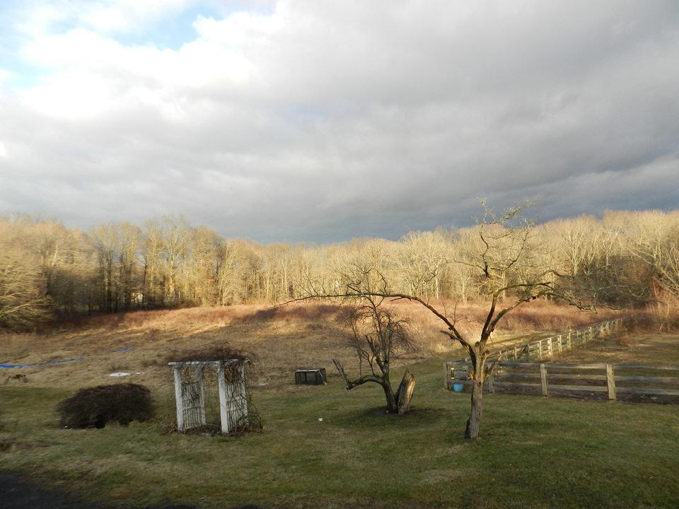
Primary Investigator: Petrusia Kotlar DC Linden Hill Farm and Apiary, Towaco NJ USA Technical Advisor: Nancy Ostiguy PhD. Associate Professor of Entomology, Pennsylvania State University, University Park, PA USA
Funded by: Northeast Sustainable Agriculture, Research and Education Program, USDA

Slide 3
Honey Bee Nutrition
Lack of adequate natural forage
Monoculture farming
Weather
Feeding honeybees syrup & artificial pollen – economic but…
refined sugar cane
beet sugar
HFCS (high fructose corn syrup)
Feeding of artificial syrup, candy and pollen widely taught to novice beekeepers (U.S.A.)
Widely practiced by experienced beekeepers too
Recommendations can be 45-136 kg/colony
Notes:
100-300

Slide 4
METHODS
Twelve honeybee colonies starting with 1.3 kg (3 lbs) of bees
Upon installation of packages, 50 bees per colony analyzed to determine varroa mite, tracheal mite, and Nosema levels
Random assignment of treatments
Treatment groups: No supplemental carbohydrates, sugar syrup, sugar syrup w/ Linden
Syrup applied: April, May (3), June, July, August, October (2)
Varroa and general health parameters monitored from April 2012 until February 2013 (sole remaining colony continues to be monitored)
Upon death, Nosema & tracheal mites were determined from a sample of 50 bees
Comparison of a sample of honey (July) from each colony

Slide 5
Initial Hive Parameters
Brood: 10 frame deep
1 frame of drawn comb
Super: 10 frame medium
Foundation: beeswax coated plastic
Screened bottoms
Mite board tray

Slide 6
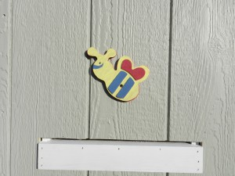
Study Location
New Jersey (east coast of USA)
Suburban area
Bee house
No electric fencing required
Distinctive entrances for each colony
South, west, & north facing entrances

Slide 7
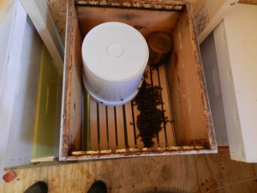
TEST GROUPS
Four colonies per treatment
1:1 sugar syrup April-August, 2:1 Sept & Oct.
2 gallon feeder pails placed directly onto frames
TEST GROUP 1:
plus concentrated infusion of linden flowers and leaves (Tilia sp.)
TEST GROUP 2
sugar syrup only
TEST GROUP 3- controls.
Notes:
16 teabags per 3.7 liters (gallon) of sugar syrup

Slide 8
Chemical Composition of Linden Infusion
Linden flowers and leaves of Tilia cordata
Contains Farnesol, a volatile oil which gives Linden flowers its characteristic smell.
Antibacterial and natural pesticide/miticide.
Contains flavonoid glycocides including hesperidin and quercitin
Other flavonoids include astragalin, isoquercitin, kempferitin, quercitin, tiliroside, hydroxycoumarins
Other compounds include saponins, condensed tannins, mucilage, manganese salts.

Slide 9
Results
Nosema disappear over time (Colonies were not treated.)
No tracheal mites
Survivorship until November was not impacted significantly by treatment (p=0.71)
50% of controls were dead
15% of sucrose fed were dead
None of sucrose/Linden fed were dead
One colony (Linden treated) survived winter

Slide 10
Results
There was a non-significant trend towards fewer mites in the colonies treated with linden.
Control – 201.3 + 280
Sugar only – 157.7 + 121.1
Sugar plus linden – 99.8 + 99.7
There was an interaction between treatment and colony strength on the number of mites (p=0.047).
Weak colonies (those with the smallest number of bees) had fewer mites (p=0.03)
The effect of colony strength on mite numbers was not the same across treatment. More mites were observed in the weak control colonies than in the linden or sugar only treated weak colonies.

Slide 11
The amount of sucrose in honey is greater if bees are fed sugar syrup
F = 4.85
p = 0.059
No Sucrose
Sucrose
Treatments (fed sucrose or not)

Slide 12
Conclusions
While linden-infused sucrose syrup may have a positive impact on colony health and survivorship, a larger sample size would have been required to determine if the impact was statistically significant.
The quantity of sugar syrup provided to colonies was substantially less than the amount used by some American beekeepers.
Nearly all colonies dying overwinter contained sufficient quantities of honey that starvation was not the primary cause of death.

Slide 13
THE END

