Slide 1
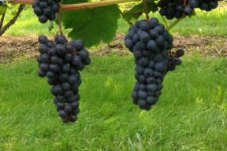
Seedless Table Grape Cultivar Evaluation Grown on Vertical Shoot Positioned (VSP) Training System
John Lastowka
Lastowka's Maple Gate Farm
183 Amherst Rd
Merrimack, NH 03054

Slide 2
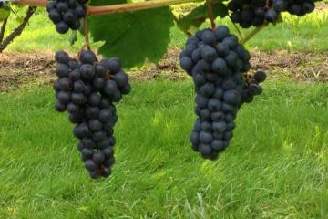
Seedless Table Grape Cultivar Evaluation Grown on Vertical Shoot Positioned (VSP) Training System
Supported by the following funding sources:
Type : Farmer/Rancher Project
Region : Northeast
Project Number : FNE10-692
2010 -2013
New England Vegetable and Berry Growers Association – 2010 Research Grant

Slide 3
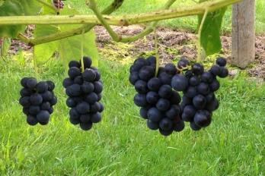
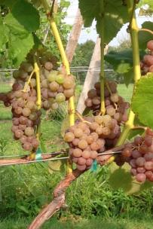
Seedless Table Grape Cultivar Evaluation
Farmers and growers that sell agricultural crops directly to the consumers are looking for new crops to expand their marketing opportunities.
The purpose of the project was to look at sixteen seedless table grape cultivars to see which cultivars are adaptable to southern New Hampshire growing conditions during the first three to four years after planting.

Slide 4
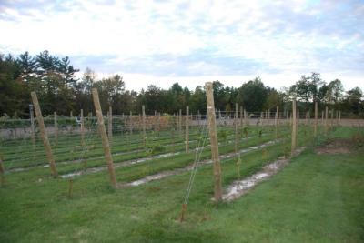
Seedless Table Grape Cultivar Evaluation
Ten vines of each of fifteen cultivars were purchased from two nurseries and planted in May of 2010.
150 grape vine roots were planted in one day on May 15, 2010.
Sixteenth cultivar in the spring of 2011; this was due to a crop failure in the production of the grape vine roots in 2009 for this cultivar.
One vine of each cultivar was planted on the outside row of the planting.
Nine vines were planted (three vines per post length) with two cultivars per row.

Slide 5
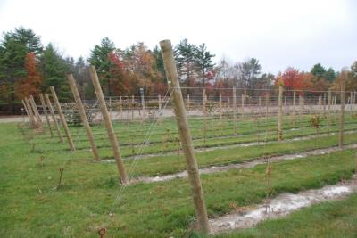
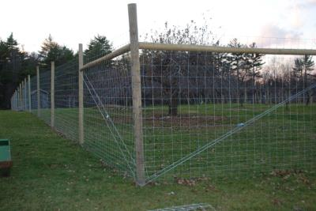
Seedless Table Grape Cultivar Evaluation
The trellis was constructed for the grape vines training the vines in the Vertical Shoot Positioned (VSP) system over three weeks (end of May into June 2010).
We installed all of the trellis and catch wire for the ¼ acre vineyard.
There are four horizontal catch wires with the first wire installed at 32” off the ground and the other three are vertically one foot apart.
The fall of 2011, a deer fence was constructed around the grape vineyard to prevent deer damage to the grape vine.

Slide 6
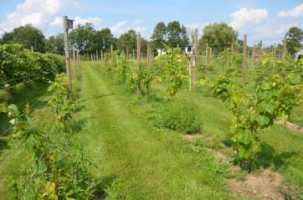
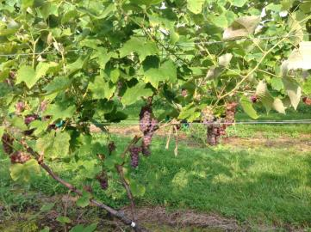
Seedless Table Grape Cultivar Evaluation
Why Vertical Shoot Positioned (VSP) Training System?
The VSP has the grapes at the bottom of the canopy and then the shoots grow towards the sky, vertically.
Shoots are held upright by using catch wires that keep the shoots close to the trellis system.
Concentrating the fruit zone around the bottom wire was favorable. This allowed us to spray the grape clusters, not the whole grape vine canopy, for controlling insect pest.
The VSP training system helped us in cluster thinning after bloom and leaf removal for helping in cluster ripening prior to harvesting. However, training the shoots during the growing season is quite time consuming.

Slide 7
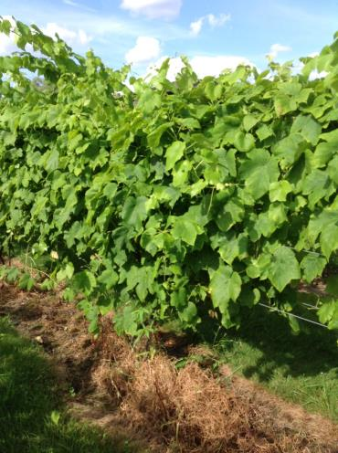
Seedless Table Grape Cultivar Evaluation
Why Vertical Shoot Positioned (VSP) Training System?
Based on the growth seen so far, all cultivars are adapting to the VSP Training System, however, some of the cultivars may not be adaptable to this system for the longer term.
Additional evaluation is needed to see how the different seedless table grape cultivars adapt to the VSP training system as the vines mature.

Slide 8
Local Grown Seedless Table Grapes - What’s Important to Know:
Flavor! Customer Demand!
Know your market.
U-Pick? Farmers Markets? Farm Stand Sales? Wholesaling?
Match variety to your growing conditions (hardiness)
Control pests – weeds, diseases and insects.
Special vineyard practices to improve appearance:
cluster thinning
berry thinning
GA to size berries
leaf removal
Special Harvest Handling

Slide 9
Seedless Table Grape Cultivar Evaluation
Canadice (Red) 2010
Einset (Red) 2010
Reliance (Red) 2010
Somerset Seedless (Red) 2011
Suffolk Red (Red) 2010
Vanessa (Red) 2010
Himrod (White) 2010
Interlaken (White) 2010
Lakemont (White) 2010
Marquis (White) 2010
Concord Seedless (Blue/Black) 2010
Glenora (Blue/Black) 2010
Jupiter (Blue/Black) 2010
Mars (Blue/Black) 2010
Thomcord (Blue/Black) 2010
Venus (Blue/Black) 2010

Slide 10
Seedless Table Grape Cultivar Evaluation
Canadice
Cornell – 1978
Color: Red
Harvest: Early
Growth: Weak, Semi Upright
Cold Hardy: Hardy, 5a Zone USDA Winter Hardiness
Disease: Slightly Susceptible to Susceptible
Flavor: Sweet, American
Texture: Crisp to Soft Once Ripe, Slip-Skin Variety
Cluster: 130 grams, Open and Full Clusters
Berry: 1.8 grams

Slide 11
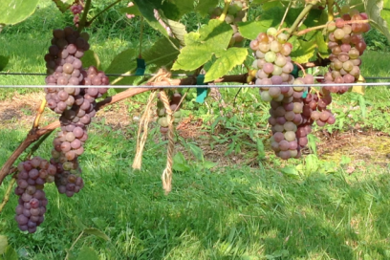
Canadice

Slide 12
Seedless Table Grape Cultivar Evaluation
Einset
Cornell – 1985
Color: Red
Harvest: Early
Growth: Very Weak, Semi Upright
Cold Hardy: Not Hardy, 5a Zone USDA Winter Hardiness
Disease: Moderately Susceptible or Sensitive
Flavor: ?, (Distinctive Strawberry Jam Flavor)
Texture: ? (firm, slightly tough skin)
Cluster: ?
Berry: ? (small to medium)

Slide 13
Einset

Slide 14
Seedless Table Grape Cultivar Evaluation
Reliance
Arkansas – 1982 – Interspecific hybrid (includes V. labrusca and V. vinifera)
Color: Red
Harvest: Early
Growth: Excellent but Balance, Trailing
Cold Hardy: Hardy, 5a Zone USDA Winter Hardiness
Disease: Susceptible or Sensitive
Flavor: Sweet
Texture: Crisp to Soften Once Ripe, with Tender Skin
Cluster: 191 grams, Open and Full Clusters
Berry: 2.3 grams
Other: Fruit Does Not Always Color Well

Slide 15
Reliance

Slide 16
Seedless Table Grape Cultivar Evaluation
Somerset Seedless
Wisconsin. Bred by Elmer Swenson – 2002 – Interspecific Hybrid (V. labrusca;
V. riparia; and V. vinifera and other small amounts of American Vitis species)
Color: Red
Harvest: Early
Growth: Weak to Medium, Trailing
Cold Hardy: 4a Zone USDA Winter Hardiness
Disease: Some Resistant, Downy Mildew Susceptible
Flavor: ? (strawberry like)
Texture: ?
Cluster: ? (small)
Berry: ? (medium, adherent skin)

Slide 17
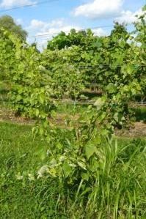
Somerset Seedless

Slide 18
Seedless Table Grape Cultivar Evaluation
Suffolk Red
Cornell – 1972
Color: Red
Harvest: Midseason
Growth: Very Weak, Semi Trailing
Cold Hardy: NOT HARDY, 5a Zone USDA Winter Hardiness
Disease: Susceptible
Flavor: ? (mild, distinctive)
Texture: ? (meaty)
Cluster: ? (tight and full clusters)
Berry: ? (large)
Problems: Winter Damage and Poor Fruit Set

Slide 19
Suffolk Red

Slide 20
Seedless Table Grape Cultivar Evaluation
Vanessa
Ontario – 1984 – Interspecific hybrid (includes V. labrusca and V. vinifera)
Color: Red
Harvest: Early-Midseason
Growth: Weak to Little Average, Trailing
Cold Hardy: Hardy , 5a Zone USDA Winter Hardiness
Disease: Susceptible or Sensitive
Flavor: Mild and Fruity
Texture: Crisp to Semi Crisp
Cluster: 66 grams, Open
Berry: 1.5 grams, Semi-oval

Slide 21
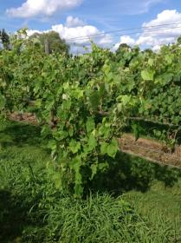
Vanessa

Slide 22
Seedless Table Grape Cultivar Evaluation
Himrod
Cornell – 1952
Color: White
Harvest: Early
Growth: Excellent but Balance, Semi Upright
Cold Hardy: Moderate, 5a Zone USDA Winter Hardiness
Disease: Susceptible
Flavor: Honey-Like
Texture: Soft - Melting
Cluster: 70 Grams, Open Cluster
Berry: 2.4 Grams, Shell Berries, Shot Berries

Slide 23
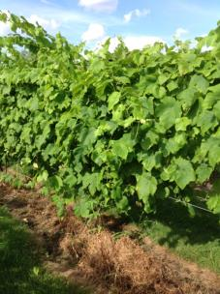
Himrod

Slide 24
Seedless Table Grape Cultivar Evaluation
Interlaken
Cornell – 1947
Color: White
Harvest: Early
Growth: Medium to Good Vigor, Semi Upright
Cold Hardy: 6a Zone USDA Winter Hardiness
Disease: Highly Susceptible or Sensitive
Flavor: Fresh
Texture: Crisp to Soft Once Ripe
Cluster: 115 Grams, Full and Open Cluster
Berry: 2.5 Grams, Shell Berries, Shot Berries
Other: Phylloxera problem

Slide 25
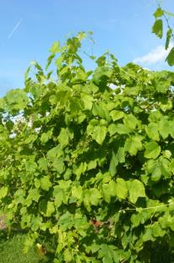
Interlaken

Slide 26
Seedless Table Grape Cultivar Evaluation
Lakemont
Cornell – 1972
Color: White (Fruit yellow-green color)
Harvest: Midseason
Growth: Reliable to Average, Semi Upright
Cold Hardy: Medium, 6a Zone USDA Winter Hardiness
Disease: Susceptible
Flavor: Mild, Clean Taste
Texture: Crisp to Firm
Cluster: 89 Grams, Full and Open Cluster
Berry: 1.5 Grams, (? Split Fruit)
Concern: Cluster Thinning Will Prevent Over Cropping

Slide 27
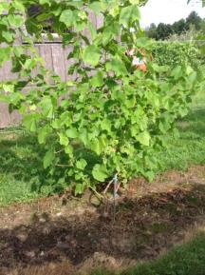
Lakemont

Slide 28
Seedless Table Grape Cultivar Evaluation
Marquis
Cornell – 1996 – Interspecific Cross (includes V. labrusca and V. vinifera)
Color: White
Harvest: Midseason
Growth: Reliable to Good, Semi Trailing
Cold Hardy: Moderate, 5a Zone USDA Winter Hardiness
Disease: Susceptible or Sensitive
Flavor: Mild, Fresh
Texture: Soft to Melting
Cluster: 192 Grams, Full and Open Cluster
Berry: 2.5 Grams, Spherical

Slide 29
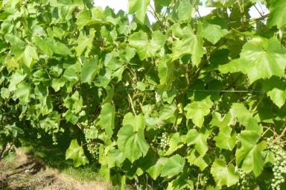
Marquis

Slide 30
Seedless Table Grape Cultivar Evaluation
Concord Seedless
A sport of Concord with clusters and berries smaller than seeded Concord.
Color: Blue/Black
Harvest: Midseason
Growth: Medium to Good Vigor but Balance, Trailing
Cold Hardy: Very Hardy, 4a Zone USDA Winter Hardiness
Disease: Moderately to Slightly Susceptible or Sensitive
Flavor: Pleasant Flavor, True Labrusca Taste
Texture: Soft to Melting, Skins Medium Tough
Cluster: 105 Grams, Full and Open Cluster
Berry: 1.4 Grams

Slide 31
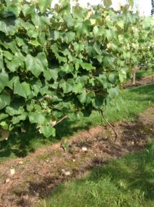
Concord Seedless

Slide 32
Seedless Table Grape Cultivar Evaluation
Glenora
Cornell – 1976
Color: Blue/Black
Harvest: Midseason
Growth: Average to Reliable, Upright
Cold Hardy: Questionable, 6a Zone USDA Winter Hardiness
Disease: Highly to Moderately Susceptible or Sensitive
Flavor: delicate, sweet
Texture: Soft to Melting
Cluster: 71 Grams, Open Cluster
Berry: 2.0 Grams, Spherical
Problems: Shot Berry, Not Fully Winter Hardy, Disease Problems

Slide 33
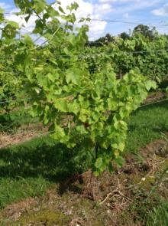
Glenora

Slide 34
Seedless Table Grape Cultivar Evaluation
Jupiter
Arkansas – 1998 – Interspecific hybrid (includes V. labrusca and V. vinifera)
Color: Blue/Black
Harvest: Midseason
Growth: Medium to Good Vigor, Semi Upright
Cold Hardy: Moderate, 5a Zone USDA Winter Hardiness
Disease: Slightly Susceptible or Sensitive
Flavor: Mild, Muscat
Texture: Firm
Cluster: 129 Grams, Open Cluster
Berry: 4.2 Grams, Large, Spherical
Problems: Shot Berry

Slide 35
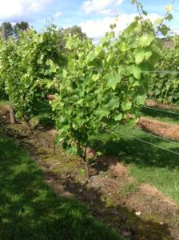
Jupiter

Slide 36
Seedless Table Grape Cultivar Evaluation
Mars
Arkansas – 1984 – Interspecific hybrid (includes V. labrusca and V. vinifera)
Color: Blue/Black
Harvest: Midseason
Growth: Good Vigor, Trailing
Cold Hardy: Moderate, 5a Zone USDA Winter Hardiness
Disease: Resistant to Slightly Susceptible or Sensitive
Flavor: Mild, Somewhat Musty if Not Ripe
Texture: Soft
Cluster: 107 Grams, Full, Tight, Cluster
Berry: 3.7 Grams
Problems: Potential for Bull Canes

Slide 37
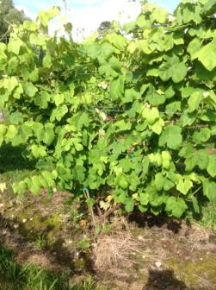
Mars

Slide 38
Seedless Table Grape Cultivar Evaluation
Thomcord
California – 2003 – Interspecific hybrid (includes V. labrusca and V. vinifera) Cross Between Thompson Seedless and Concord
Color: Blue/Black
Harvest: Midseason
Growth: Good to Very Good Vigor, Trailing
Cold Hardy: Moderate, 5b Zone USDA Winter Hardiness
Disease: Moderately Susceptible or Sensitive
Flavor: Pleasant, Juice, Sweet, Concord-Like
Texture: Soft
Cluster: 124 Grams, Open, Full Cluster
Berry: 2.4 Grams

Slide 39
Thomcord

Slide 40
Seedless Table Grape Cultivar Evaluation
Venus
Arkansas – 1977 – Interspecific hybrid (includes V. labrusca and Muscat - V. vinifera)
Color: Blue/Black
Harvest: Early
Growth: Good Vigor, Trailing
Cold Hardy: Moderate, 5a Zone USDA Winter Hardiness
Disease: Moderately to Slightly Susceptible or Sensitive
Flavor: Somewhat Musty if Not Ripe
Texture: Soft
Cluster: 60 Grams, Open Cluster
Berry: 3.3 Grams, Slipskin
Problems: Shot Berry

Slide 41
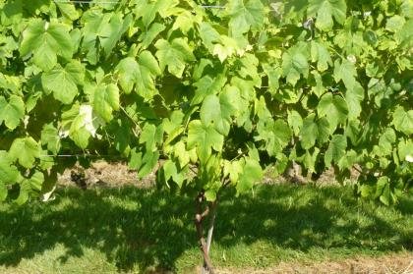
Venus

Slide 42
Seedless Table Grape Cultivar Evaluation
Evaluating “Seedless Table Grape Cultivars” requires a longer term project than is typical for a SARE project in order to collect meaningful data.
This project should continue for another two to three years to track the progress of all the seedless table grape cultivars that were planted for a fairer evaluation.
The results as of the end of the fourth year had two of the cultivars being very productive and two additional cultivars showing great promise.
However, two of the cultivars were not adaptable to the given site and it would be questionable to advise other growers to plant them.

Slide 43
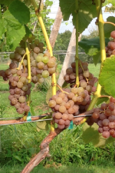
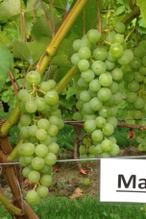
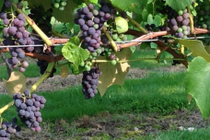
Seedless Table Grape Cultivar Evaluation
Within the first four years of establishing the vineyard in Merrimack, New Hampshire, four cultivars surfaced to be reliable and productive; one red cultivar, one white cultivar and two blue/black cultivars. They are:
Reliance (red) Marquis (white) Thomcord (blue/black) Concord Seedless (blue/black)

Slide 44
Seedless Table Grape Cultivar Evaluation
It was impossible to get two cultivars to grow and over-winter indicating that they are not adaptable to the site in Merrimack NH.
By far the two weakest growing cultivars were:
Einset (red)
Suffolk Red (red)

Slide 45
Seedless Table Grape Cultivar Evaluation
The ten remaining cultivars have strengths and weaknesses that the grape grower needs to “weigh.”
• Canadice (red), Somerset Seedless (red), and Vanessa (red) were the weaker growing cultivars at the Merrimack, NH, site. However, all three cultivars have or have been advertised to have good to excellent eating qualities. Somerset Seedless (red) was planted one year later than other fifteen cultivars and needs another year in order to be evaluated and to be compared fairly.
• Glenora (blue/black) was a reliable growing cultivar but had some concern about disease susceptibility and the potential of producing bull canes.
• Interlaken (white), Himrod (white) and Lakemont (white) are good growing vines. All three cultivars produced a modest crop of good flavor fruit. There was concern on the possibility of shattering of berries and cracking fruit, as ripening preceded harvesting, and about disease susceptibility.
• Mars (blue/black), Venus (blue/black) and Jupiter (blue/black) had fair production and the fruit flavor was somewhat musty. Mars (blue/black) may have potential of producing bull canes.

Slide 46
Final Thoughts!
What is the customer demand?
Do you have the dollars to invest in a vineyard?
Will the cultivars you choose grow at your site?
Do you have the time and labor to take care of the grape vineyard?

