Slide 1
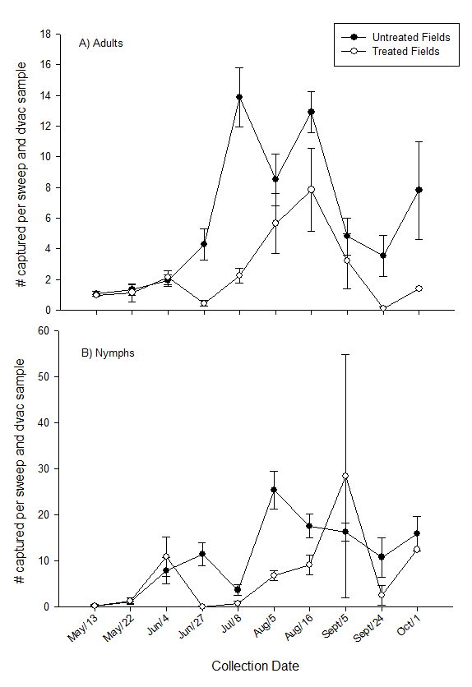
Figure 1. Damsel bug (Nabis sp.) adults (A) and nymphs (B) in fields treated and untreated for alfalfa weevil. These data represent the average number of specimens obtained per sweep net sample (20 sweeps in a 180 ⁰ arc) combined with the average number of specimens obtained per dvac sample (50 suction contact points with the soil).

