Slide 1
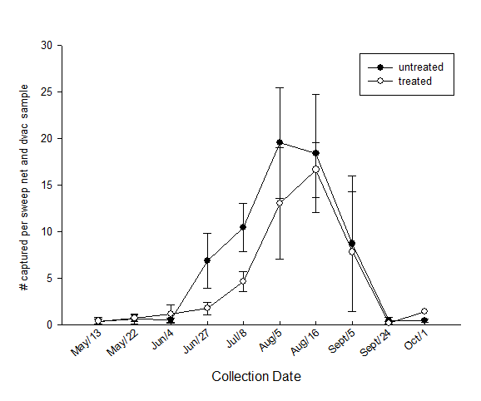
Figure 2. Big eyed bug (Geocoris sp.) in fields treated and untreated for alfalfa weevil. These data represent a combination of both adults and nymphs where the average number of specimens obtained per sweep net sample (20 sweeps in a 180 ⁰ arc) combined with the average number of specimens obtained per dvac sample (50 suction contact points with the soil).

