Slide 1
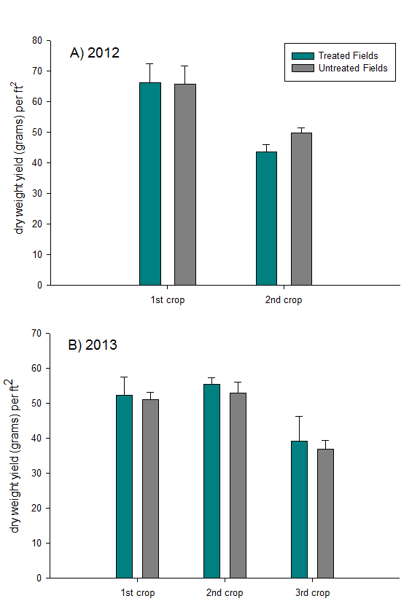
Figure 4. Yield comparison for treated and untreated fields in 2012 (A) and 2013 (B). No statistical differences (p>.05) were found in yield between treated and untreated fields for each crop in both years.

