Slide 1
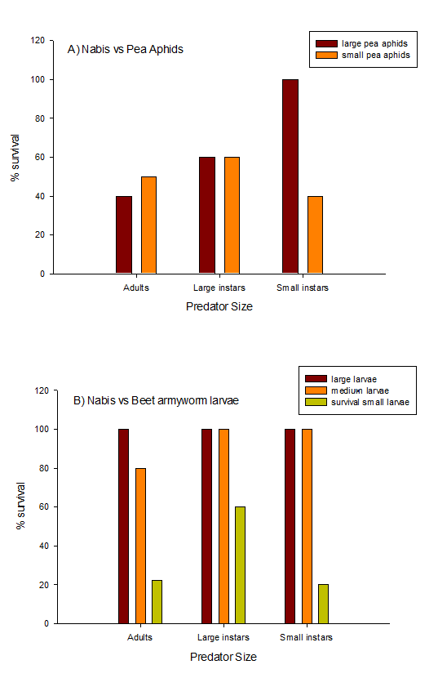
Figure 5.Pea aphid (A) and beet armyworm (B) % survival rates after 2 hours when paired with different various life stages of damsel bugs (Nabis sp.).

