Slide 1
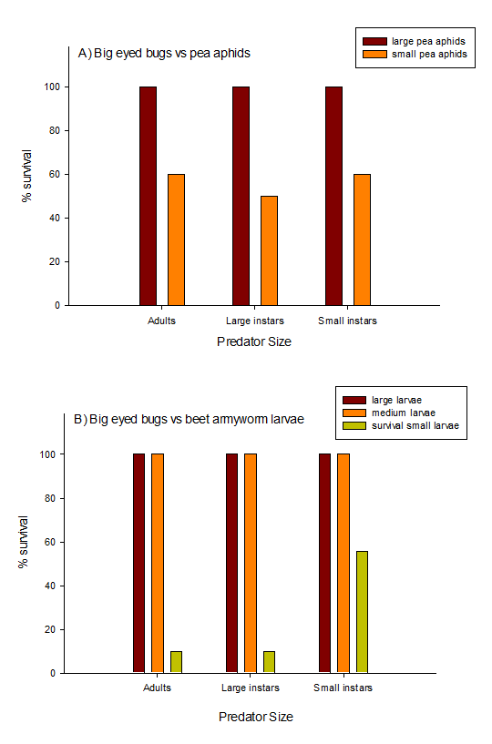
Figure 6. Pea aphid (A) and beet armyworm (B) % survival rates after 2 hours when paired with various life stages of big eyed bugs (Geocoris sp.).

