Slide 2
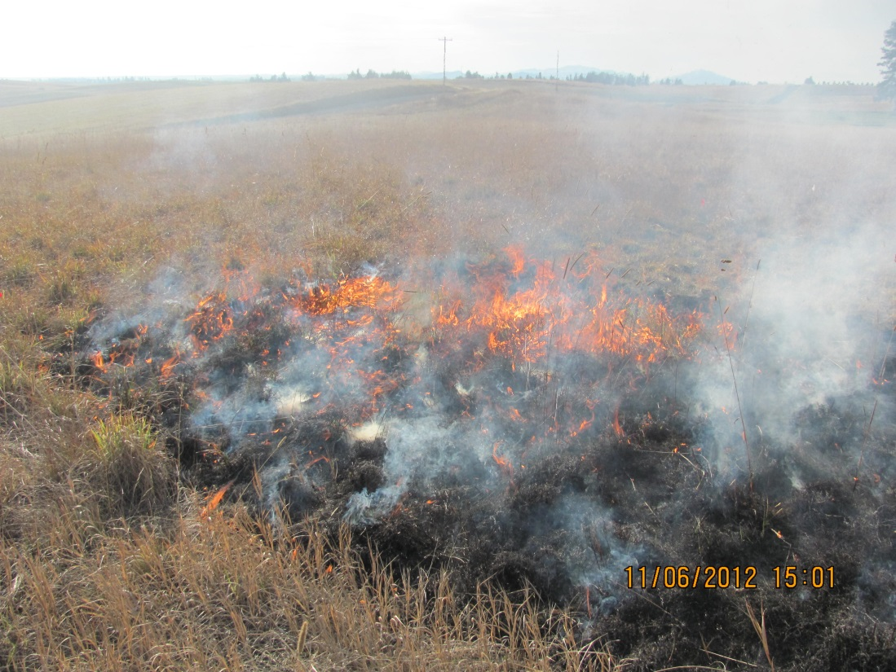
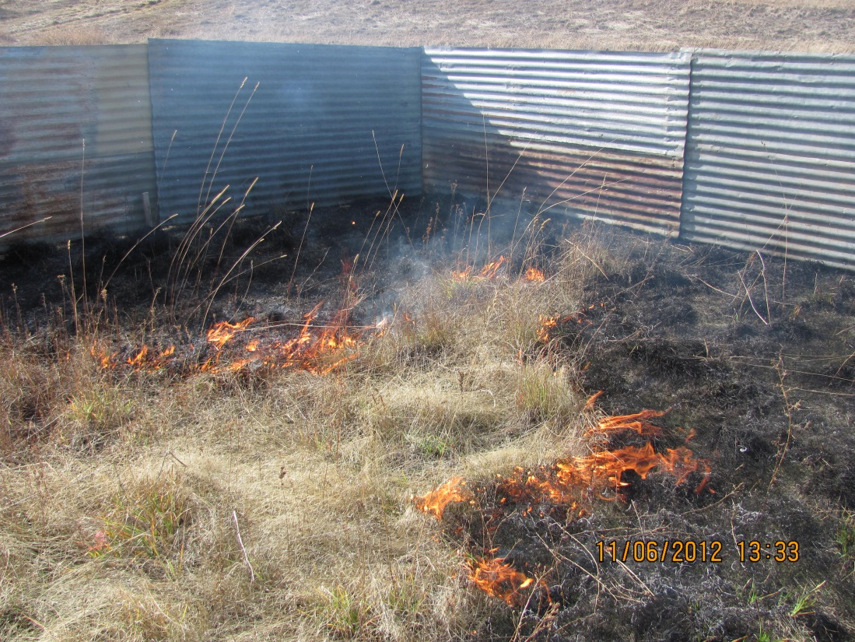
Low Ventenata – Fall Burn
High Ventenata – Fall Burn
Low Ventenata – Spring Burn
High Ventenata – Spring Burn

Slide 3
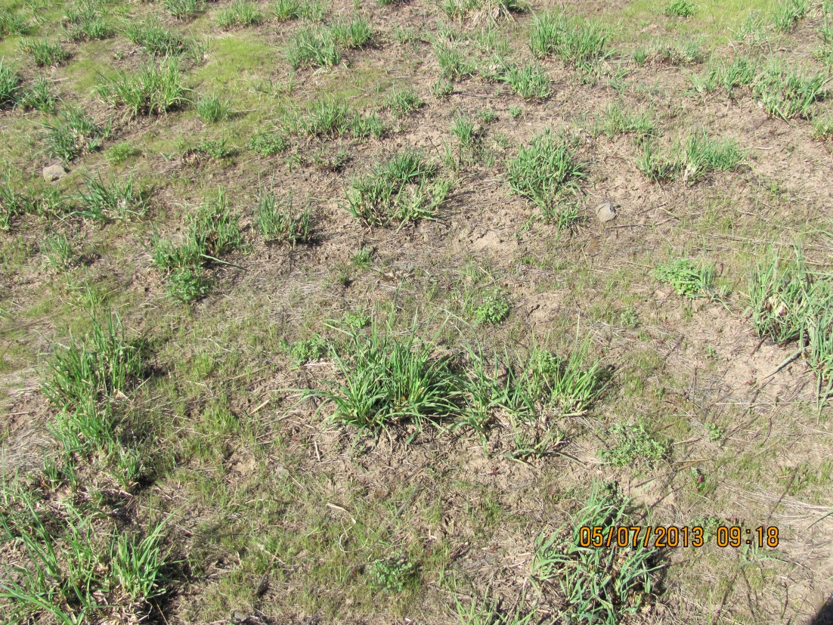
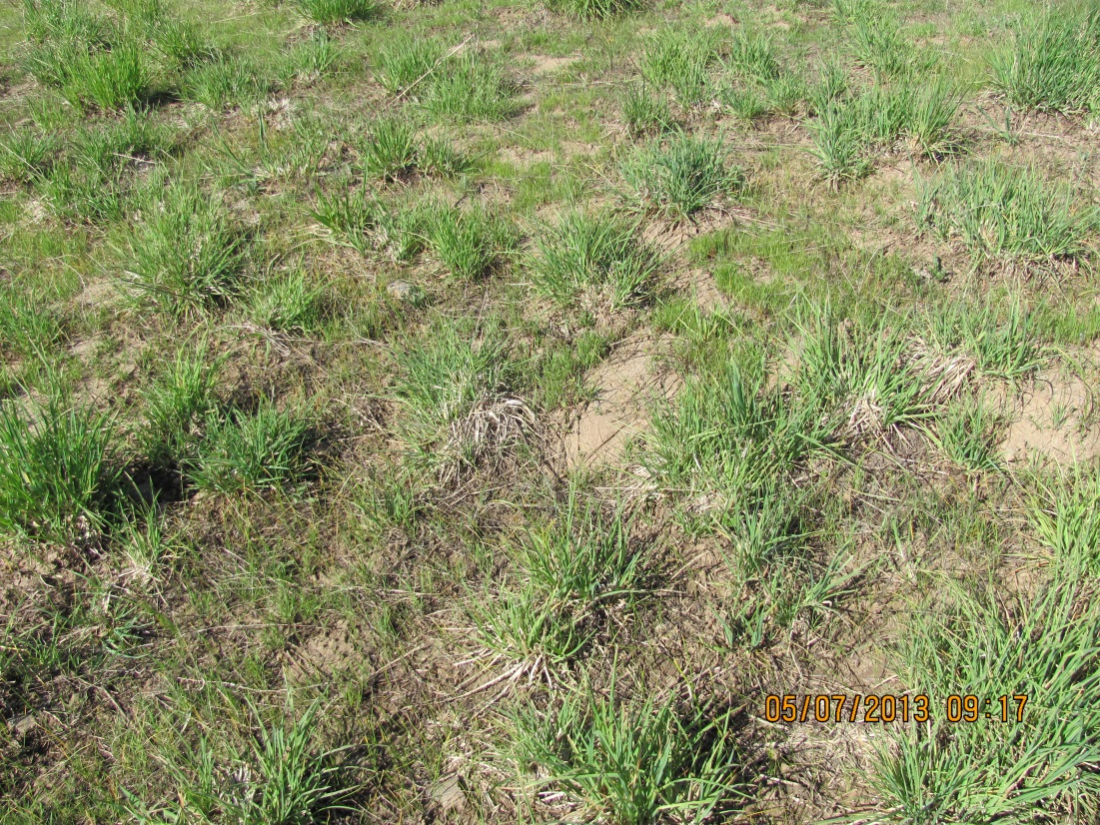
Control
Spring Burn and Spray
Fall Burn Only
Fall Burn and Spray

