Slide 1
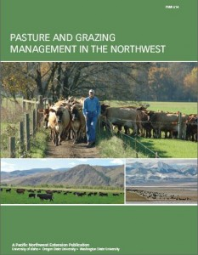
Fertilizer and Herbicide Application
Nitrogen – Phosphorous – Potassium
Applied in November
Axiom 8 oz/A
Fertilizer | Analysis applied
Nitrogen | 50–0–0
Phosphorous | 0–4 to 100–0
Potassium | 0–0–150
Notes:
How nitrogen is split
How fall P&K is timed and how spring N is timed
Explain how plants access nutrients and why this is important as an IPM treatment

Slide 2
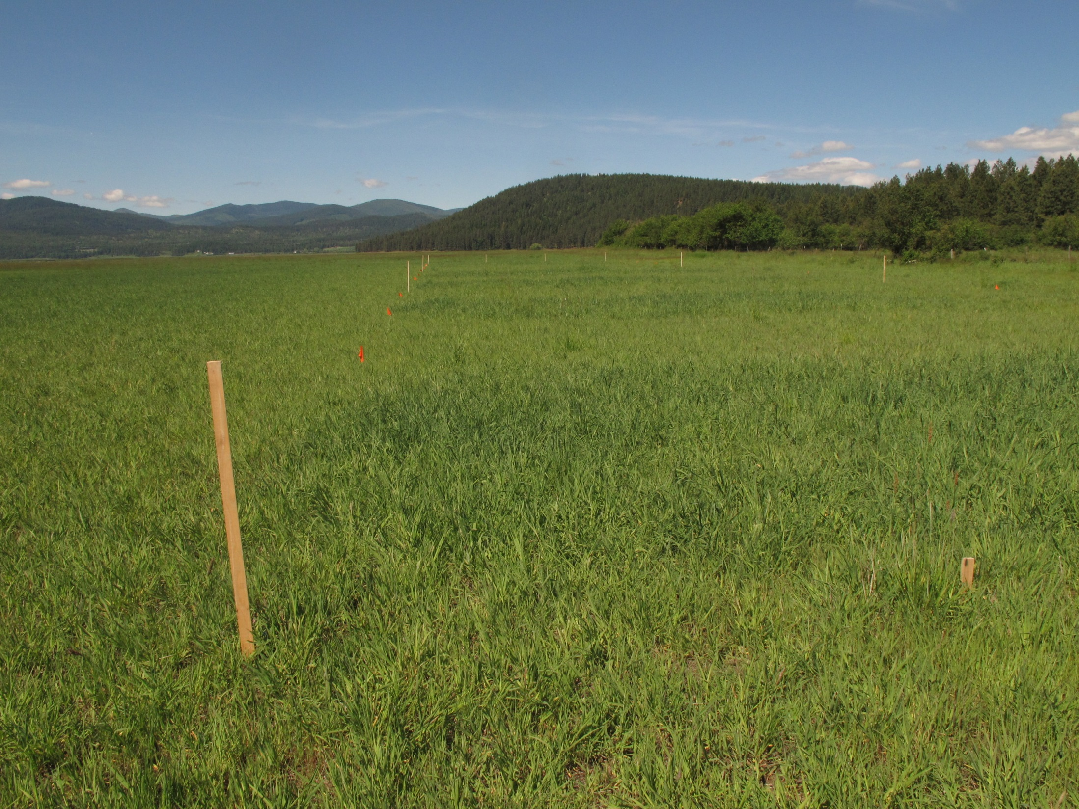
Fertilizer and Spray at 4 inch Height

Slide 3
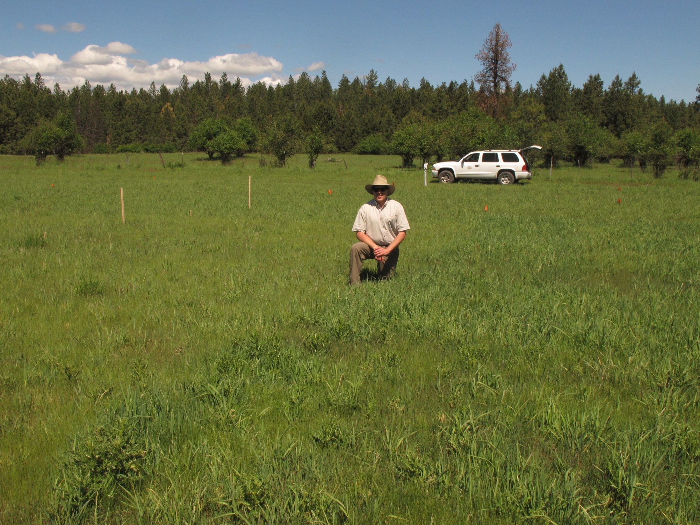
Not Sprayed/Sprayed at High Ventenata

Slide 4
Cut Height and Yield

Slide 5
Ventenata Biomass For High Ventenata Cover

Slide 6
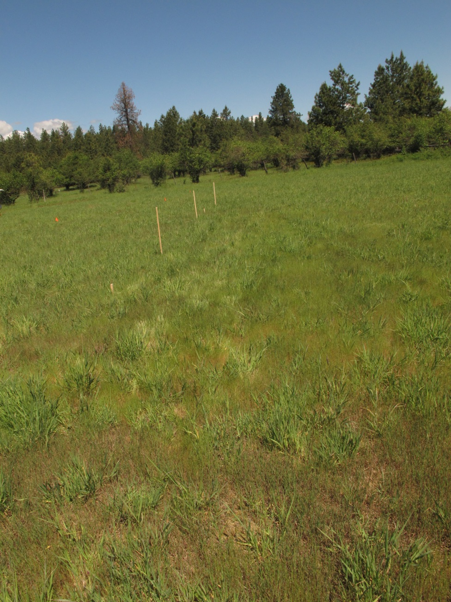
Hay Summary
Keep cut height at 4 inches
Axiom applied in fall either pre or post emergent
Fertilization
  Fall for P and K
  Spring for N
Ventenata control allows for overseas markets
Notes:
-Similar composition of species between systems
-Primarily silt loam dominated soils
-Similar slopes and aspects for each studied system
-High/Low based off of percent cover estimates and varies across systems

