Slide 1
Grit application controls weeds in organic crop production
Mauricio Erazo-Barradas¹
Sharon Clay¹
Frank Forcella²
February 5th, 2014
¹Plant Science Department, South Dakota State University, Brookings, SD 57007, USA
²USDA-ARS North Central Soil Cons. Res. Lab., Morris, MN 56267, USA

Slide 2
Weed management in organic systems
Most challenging production problem.
Limited control methods (Liebman and Davis, 2009).
Often include:
Flaming,
Steaming,
Inhibitory natural products (Walz, 1999; Walz, 2004).
Repeated soil tillage (Green et al., 2009; van de Schans et al., 2006).
Soil tillage.
Increased CO₂ evolution, soil erosion potential.
Decreased soil cover, soil organic matter, water holding capacity.

Slide 3
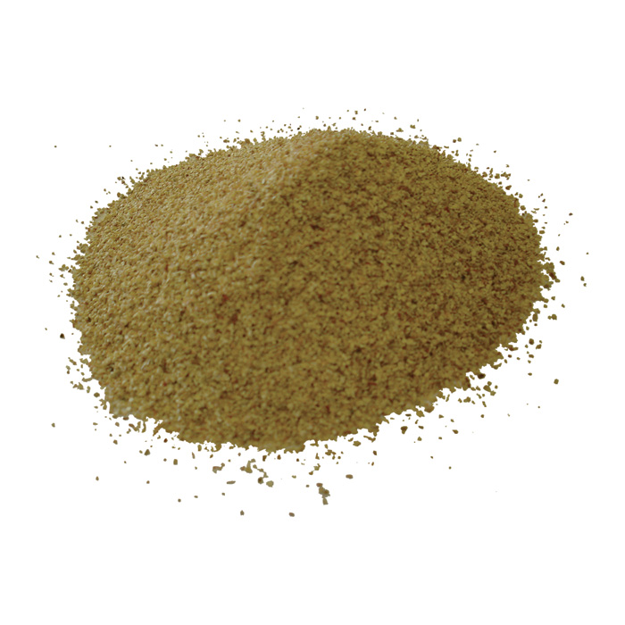
Importance of grits in weed control
Grits derived from agricultural residues.
Have been demonstrated to control weed seedlings
selectively in corn (Forcella, 2009).
Would not involve soil disturbance.
Types include:
Biochar
N-rich meals such as distillers grain
Other crop residues
Nut shells
Corn cobs

Slide 4
Objective
To examine weed control and corn yield using:
- air-propelled abrasive corn-cob grit (within-row control)
- and flame-weeding or cultivation (between-row control)
- at varying timings and frequencies in an organic system.

Slide 5
Methods
- Morris, MN.
- Split-split plot design with four replications (plot: 6 m long by 4.5 m wide).
- Main plot: Application dates at Corn growth stages
- Season long weedy
- Weed-free
- Split-plot: Grit, No grit application (Within-row control).
- Split-split plot: Flaming and Cultivation (Between-row control) done once at
V5.
Single grit applications | Double grit applications | Triple grit application
V1 | V1+V3 | V1+V3+V5
V3 | V1+V5
V5 | V3+V5

Slide 6
Methods
Parameters measured (August 20):
- Corn yield (silage): One meter long sections along two center
rows.
- Weed biomass:
Taken in quadrats (40 cm x 15 cm)
In row (centered over the corn row)
Between-row (centered in inter-row area)

Slide 7
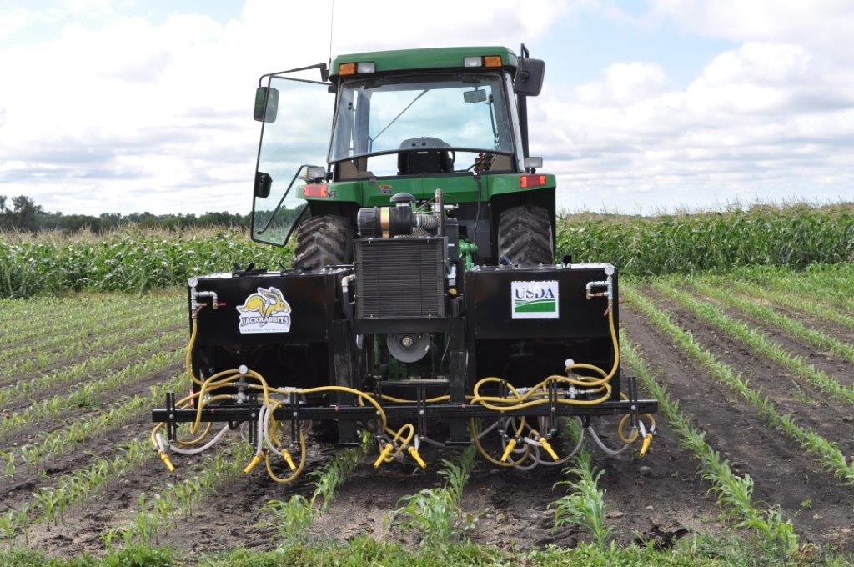
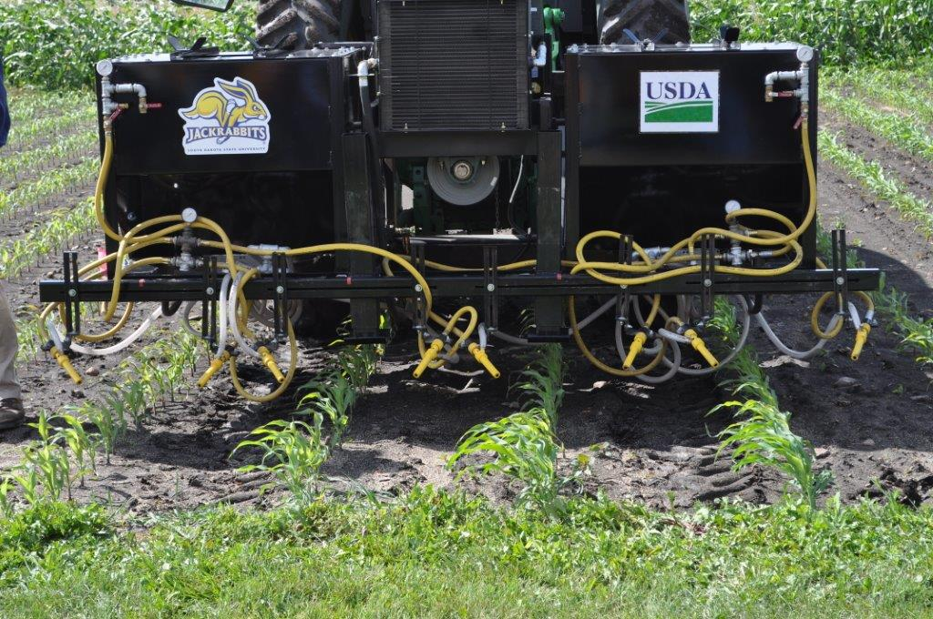
Methods
Grit applicator
Four-row grit applicator – 8 nozzles with one along each side of the row
Grit applied at 480kg/ha with 100 psi.

Slide 8
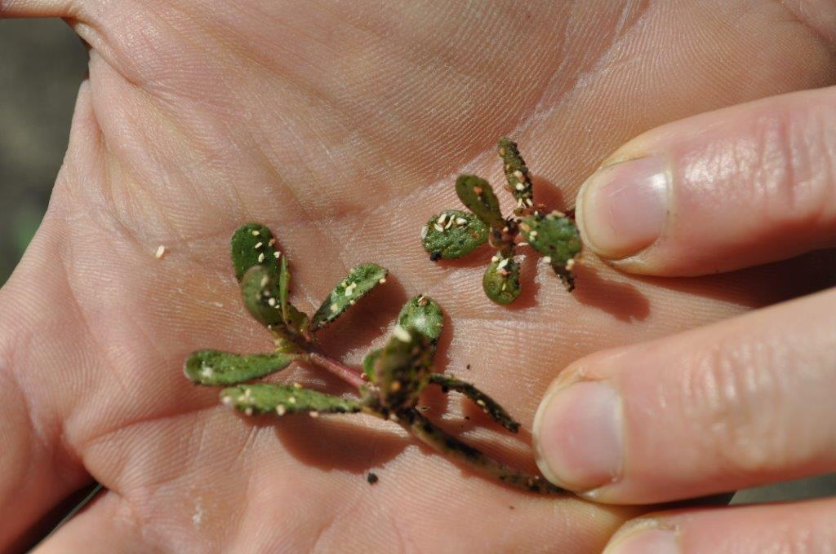
Results
Weed species present
Common lambsquarters (Chenopodium album)
Common buckwheat (Fagopyrum esculentum)
Common purslane (Portulaca oleracea)
Pennsylvania smartweed (Polygonum pensylvanicum)
Redroot pigweed (Amaranthus retroflexus)
Grasses: Yellow foxtail (Setaria pumila)
Green foxtail (Setaria viridis)
Common purslane damaged by corn-cob grit

Slide 9
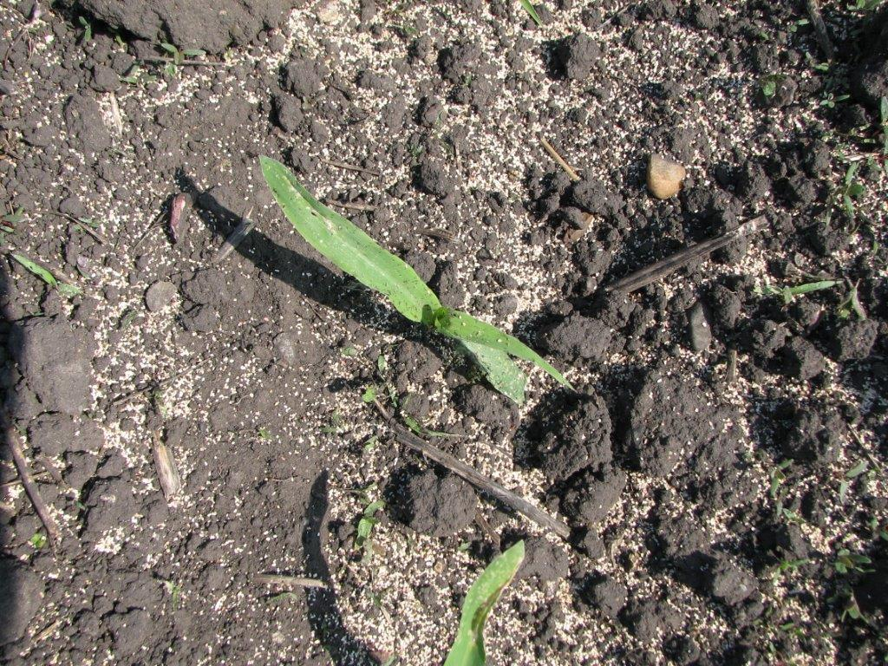
Results
Post-grit application
Treated at V1 (June 15)

Slide 10
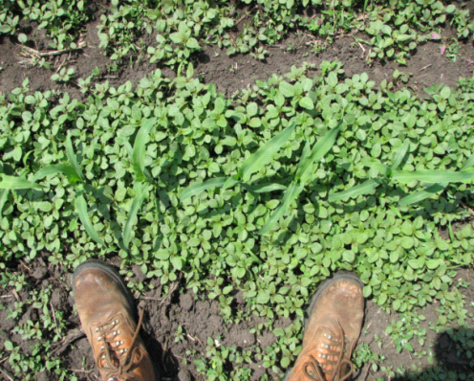
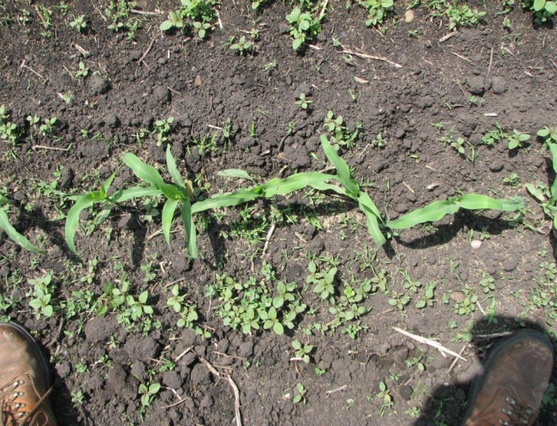
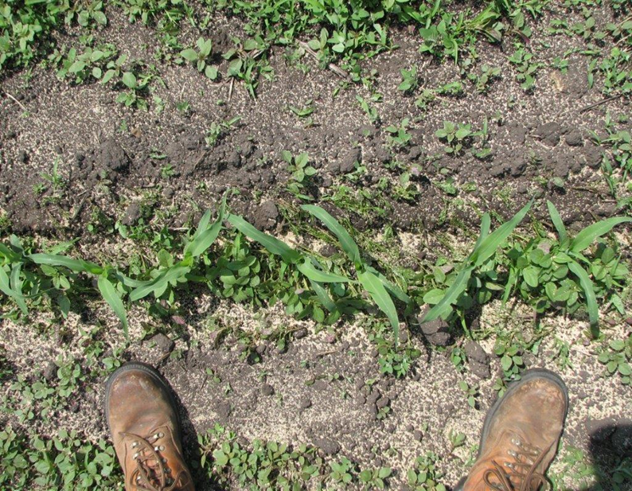
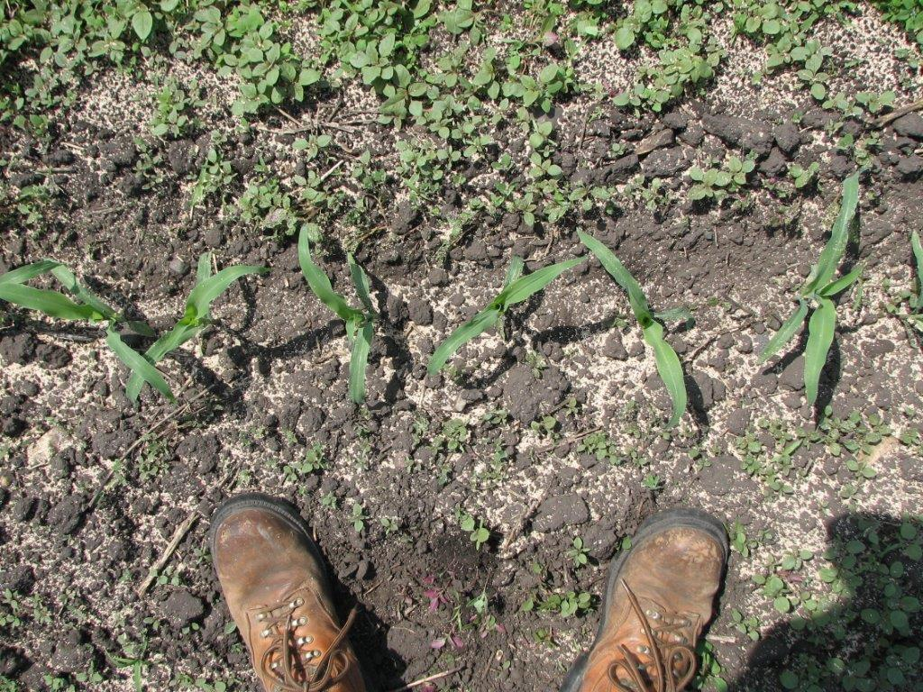
Weedy V3
Hand-weeded
Treated at V3 (June 23)
Treated at V1 (June 15) + V3 (June 23)

Slide 11
Yield and weed biomass in-row
 | Stage | Within-Row | Yield (Kg/ha) | % increase over SLWC | Weed Biomass Row (Kg/ha) | % reduction from SLWC
Single applications | V1 | Grit | 19,010 | +40 | 846 | -71
 | V3 | Grit | 17,540 | +29.5 | 1,346 | -54
 | V5 | Grit | 14,500 |  | 502 | -83
Double applications | V1+V3 | Grit | 19,200 | +41.8 | 592 | -80
 | V1+V5 | Grit | 14,800 |  | 567 | -80
 | V3+V5 | Grit | 13,550 |  | 372 | -87
Triple application | V1+V3+V5 | Grit | 14,900 |  | 670 | -77
 | SLWC | Control | 13,540 |  | 2,948
 | HWC | Control | 15,740 |  | 672
LSD (0.05) |  |  | 2,200 |  | 368
SWLC: Season Long Weedy Check , HWC: Hand Weeded Check

Slide 12
Inter-row and in-row percentage of broadleaf biomass and grass biomass compared with season long weedy check.
Stage | Flaming |  | Cultivated |  | In-row
 | Weed Biomass (Kg/ha) |  | Weed Biomass (Kg/ha) |  | Weed Biomass (Kg/ha)
 | Broadleaf | Grass | Broadleaf | Grass | Broadleaf | Grass
V1 | 93 (-94%) | 25 (-80%) | 347 (-78%) | 7 (-94%) | 795 (-71%) | 51 (-64%)
V3 | 682 (-57%) | 2 (-98%) | 590 (-63%) | 0 (-100%) | 1,319 (-53%) | 27 (-81%)
V5 | 1167 (-28%) | 13 (-90%) | 295 (-82%) | 0 (-100%) | 502 (-82%) | 0 (-100%)
V1+V3 | 670 (-58%) | 67 (-48%) | 414 (-74%) | 0 (-100%) | 574 (-79%) | 18 (-87%)
V1+V5 | 735 (-54%) | 120 (-7%) | 613 (-62%) | 6 (-95%) | 465 (-83%) | 102 (-28%)
V3+V5 | 168 (-89%) | 127 (-1%) | 467 (-71%) | 5 (-96%) | 361 (-87%) | 11 (-92%)
V1+V3+V5 | 885 (-45%) | 78 (-39%) | 402 (-75%) | 129 (0%) | 657 (-76%) | 13 (-91%)
SLWC | 1,619 | 129 | 1,619 | 129 | 2,805 | 143
 | 1,748 Kg/ha inter-row weed biomass |  |  |  | 2,948 Kg/ha in-row weed biomass
SWLC: Season Long Weedy Check

Slide 13
% yield change compared with grit application alone.
Weed biomass % reduction (or increase) in inter-row weed biomass compared with season long weedy check.
Stage | Flaming | Cultivated | Flaming | Cultivated
 | Yield (Kg/ha) |  | Weed Biomass (Kg/ha)
V1 | -4% | +4% | 118 (-93%) | 354 (-80%)
V3 | -3% | +9% | 684 (-60%) | 590 (-66%)
V5 | 0 | +2% | 1,179 (-32%) | 295 (-83%)
V1+V3 | -4% | +4% | 737 (-57%) | 414 (-76%)
V1+V5 | -7% | 0 | 855 (-51%) | 619 (-64%)
V3+V5 | 0 | 0 | 295 (-83%) | 472 (-73%)
V1+V3+V5 | -6% | 0 | 973 (-44%) | 531 (-70%)
SLWC |  |  | 1,748 inter row weed biomass
HWC |  |  | 408
LSD (0.05) |  |  | 265
SWLC: Season Long Weedy Check, HWC: Hand Weeded Check

Slide 14
Conclusions
COMPARED TO THE SEASON LONG WEEDY TREATMENT
Corn-cob grit reduced in-row weed biomass from 54 to 80%.
In-row grit application at V1 or V1+V3 increased corn yield by 40%.
Grit application at V5:
Resulted in 80% in-row weed biomass reduction but,
Weed interference permanently stunted corn growth and yield was similar to the season-long weed treatment.
Inter-row flaming or cultivation:
Minimal influence on corn yield but,
Inter-row weed biomass was reduced an average of 63%.

Slide 15
Acknowledgements
USDA - SARE GRANT No. SA1100159
South Dakota State University.
USDA-ARS North Central Soil Cons. Res. Lab Morris, MN.
University of Minnesota at Morris, MN.

Slide 16
Questions?

