Slide 1
Alternative Honeybee Nutrition
Beyond Sugar Syrup

Slide 2
Primary Investigator: Petrusia Kotlar DC
Linden Hill Farm and Apiary, Towaco NJ USA
Technical Advisor: Nancy Ostiguy PhD.
Professor of Entomology,
Pennsylvania State University, University Park, PA
Sponsored by: NorthEast Sustainable Agriculture
Research and Education Program
University of Vermont

Slide 3
PROGRAM GOALS
Twelve honeybee colonies were installed into a new environment, fed according to traditional and an alternative method and monitored since April 2012. Qualitative testing of the honey was performed to compare products. Upon completion of the study,a communication on honey bee feeding practices will be offered to educate beekeepers and promote an effective nutritional alternative to a common practice that might be detrimental to honeybee health.

Slide 4
THE PROBLEM AND WHY THIS IS SO IMPORTANT
The general practice of feeding honeybees syrup made of refined sugar cane, beet sugar, HFCS or other artificial solutions, while highly economical in dearth periods of the year, fails to provide honeybees with the broad range of nutrients they might find in natural forage. This method of manipulating the honeybee diet is widely taught to novice beekeepers and practiced in the United States.

Slide 5
The sick honeybee appears to be an indicator species that depicts the interruption of the essential practice of sustainable agriculture: pollination. When honeybees feed on sugar syrup, the resulting substandard honey may measure greater than 8% sucrose permitted by the U.S. Pure Food Law
The colony uses this honey to feed its queen, brood and entire population of workers. On the other hand, a hive processing nectar from natural honey plant sources produces a honey of presumed better quality and different sugar composition.

Slide 6
OBJECTIVE/PERFORMANCE TARGET
The study included procedures of baseline sampling of 12 colonies of honeybees purchased as 3lb. packages from a reputable apiary.
A sample of 50 bees collected in alcohol from each of the 12 hives was sent to the USDA Agricultural Research Service in Bethesda, Maryland to provide a baseline of Varroa, Nosema and trachial mites. During the course of this two year study, samples will be provided periodically (to the USDA) to monitor infestations. Sticky boards, an Integrative Pest Management (IPM) method, were used for a five day period monthly on all hives to monitor Varroa mites.

Slide 7
METHODS
The 12 colonies are labeled A-L; with the control hives randomly placed. The counting of mites by an unbiased individual (Technical Advisor, Dr. N. Ostiguy of Penn State University agreed to perform this) will present a double blind study.

Slide 8
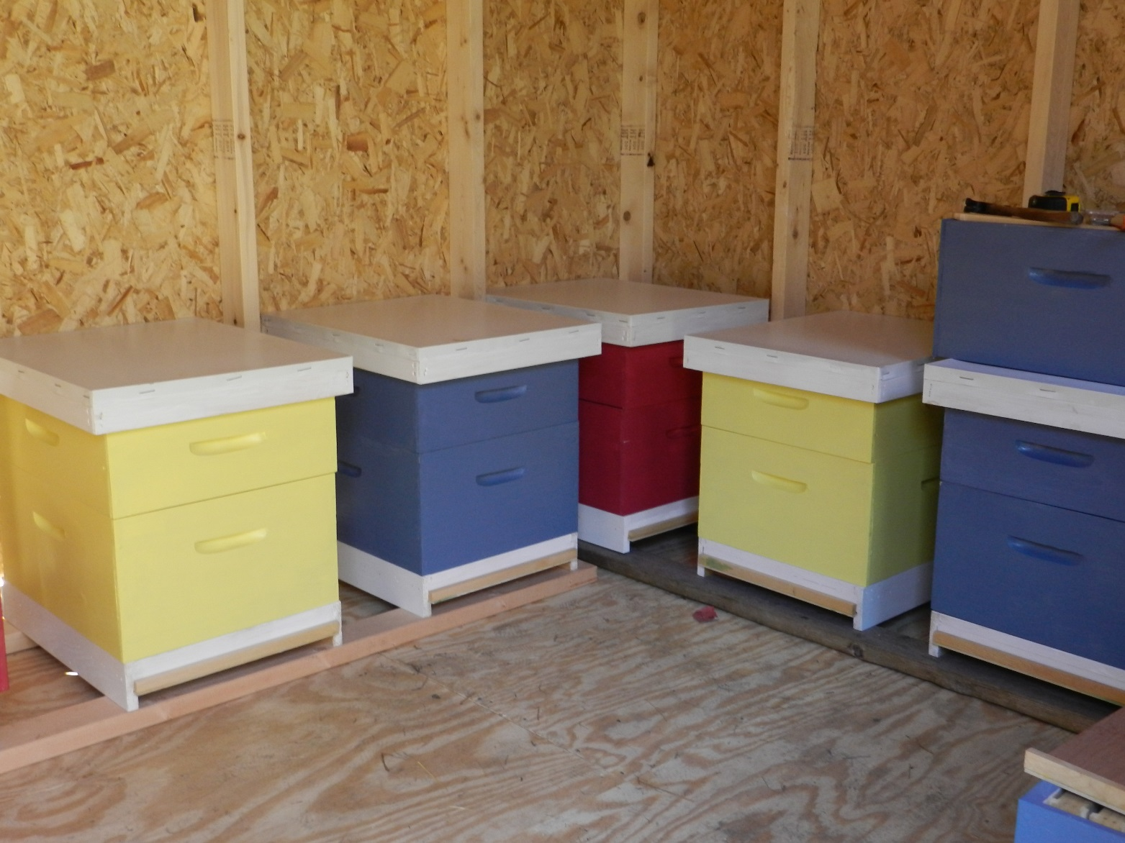
HIVES
Each hive consists of (1) 9 frame deep for brood rearing and (1) 9 frame medium will be used for surplus. Foundation will be plastic coated with beeswax (Duragilt). Each hive contains 1 frame of drawn wax comb to allow the queen to begin laying right after installation.

Slide 9
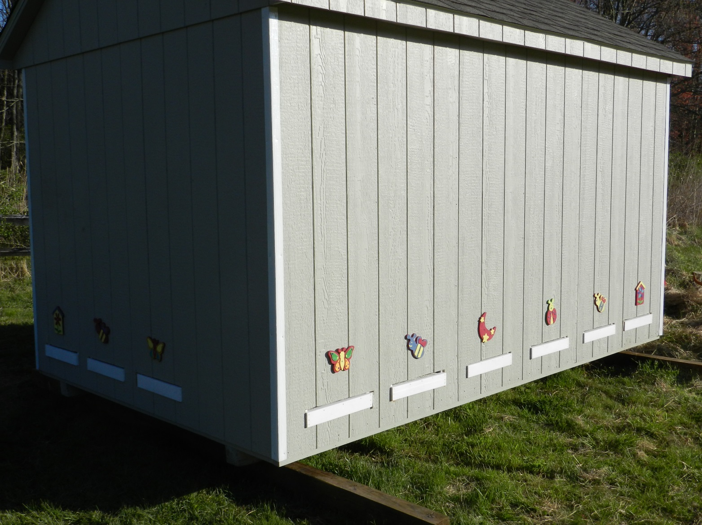
BEE HIVE LOCATION
The hives were situated in an easterly facing barn/shed, an enclosed structure to protect them from winter freezing as an overwintering hazard and access to the inside of the hives will be available all year round. This design would protect the bees from predators such as bears without the need for electric fencing.

Slide 10
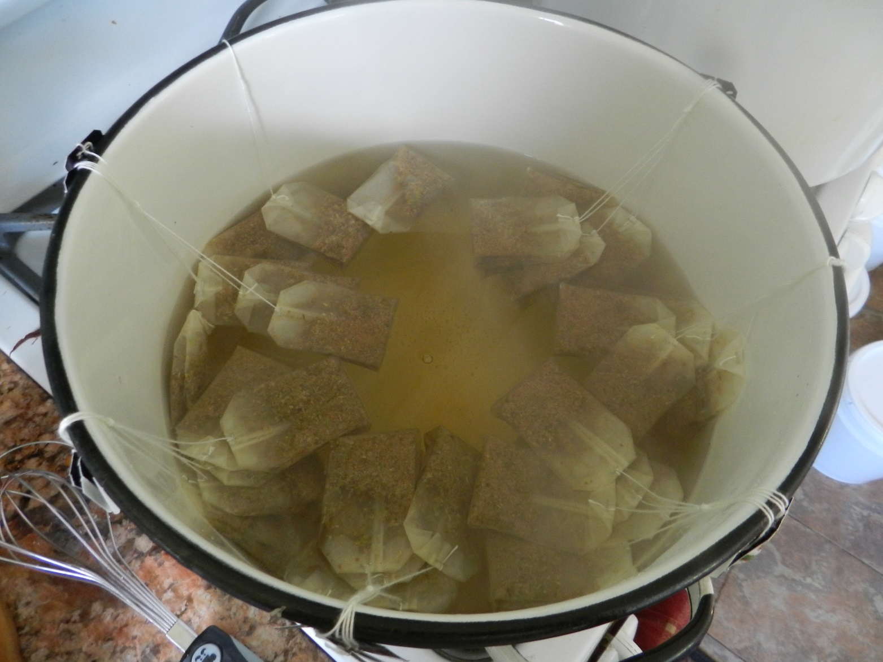
INSTALLATION/TEST GROUPS
12 packages were installed on April 11,2012. The queens were released after the third day.
TEST GROUP 1- Four colonies were fed with 2 gallon feeder pails placed directly onto frames. The proposed feed was be 1:1 sugar syrup made with sucrose (cane sugar) combined with prepared concentrated infusion of linden flowers and leaves (Tilia sp.)
TEST GROUP 2- Four colonies will be fed only 1:1 sugar syrup
TEST GROUP 3- Four colonies will not be fed.
The feed was increased to a 2:1 syrup beginning Sept. 2012 for winter preparation.

Slide 11
CHEMICAL COMPOSITION OF INFUSION
Linden flowers and leaves (Tilia cordata sp.) is the specific medicinal/nectar plant from which the infusion will be made. It contains Farnesol, a volatile oil which gives Linden flowers its characteristic smell. It is also an antibacterial and natural pesticide against mites. It contains flavonoid glycocides including hesperidin and quercitin, saponins, condensed tannins, mucilage, manganese salts. Abundant flavonoids such as astragalin, isoquercitin, kempferitin, quercitin, tiliroside, hydroxycoumarins also exist in linden. (PDR from Herbal Medicine, Fourth Edition). The concentrated infusion will be two teabags/pint or 16 teabags per gallon of sugar syrup.

Slide 12
DATA ANALYSIS:
At this time collected results and the Varroa mites counts have not been completely analyzed and interpreted by the technical advisor and will be available at the time of the Final Report. As a cooperator of this study, Dr. Nancy Ostiguy, entomologist, has been a helpful and contributing advisor regarding aspects of honey bee health and procedure. I have met with her twice at PSU campus and have had numerous exchanges with her via email.

Slide 13
TESTING OF HONEY SAMPLES
On July 8-10,2012 the honey was extracted manually from 10 out of the twelve hives. Samples were submitted to an independent lab for sugar profile testing using Gas Chromatography/Mass Spectrometry(GC-MS)to check for relative sugar percentages.

Slide 14
SUGAR PROFILES
Roman Brukh, PhD
Department of Chemistry
Rutgers, The State University of New Jersey
73 Warren St., Newark, NJ 07102

Slide 15
SUGAR PROFILES 2
Warren Analytical Laboratory
650 O St.
Greeley, CO

Slide 16
RESULTS
The results from the project so far have given insight to this investigator regarding sugar profile testing for sucrose levels in the honey product. Sucrose is a disaccharide, it is broken down into its individual components, glucose and fructose, by the digestive processes of the honeybee. We will not find it in the honey sample unless pure cane sugar syrup was added to the honey. In honey produced by control bees the sucrose obtained entirely from nectar sources is a significantly lower percentage compared to those sugar fed. For the information of the reader 600 lbs of cane sugar were fed to and consumed by 8 hives between April and November,2012. These results will be further interpreted in the final report.

Slide 17
RESULTS
In spring of 2012, 8 hives were fed a 1:1 solution of syrup or infused/syrup from April-Aug offering 7 feedings of 16c cane sugar or 8lbs per feeding/hive (X7=56 lbs of sugar /hive). Fall feeding was 2:1 solution from Sept – late Oct. offering 3 feedings of 32c. of cane sugar or 16lbs. per feeding/hive (X3=48lbs of sugar/hive). Total feed offered between April and Oct. was 104lb./hive. The consumed amount ranged between 67.25 lbs. and 95.5lbs of feed. Quantitative analysis of the honey by GC-MS revealed sucrose levels ranging between 0.16-3.91 signifying that invertase converts it to glucose and fructose by the honeybee. This test was therefore inconclusive regarding purity of honey

Slide 18
POPULATION DATA
Population data revealed highest survival rate during period of April- Dec to be with the group fed both sugar syrup and linden flower extract (all 4 survived). 3 out of 4 hives of control group (not fed) were abandoned(2) or dead out (1). ¾ survived in group fed sugar syrup but appeared to have low food stores.

Slide 19
Varroa mite counts

Slide 20
Statistical evidence proves that the Tilia sp. infusion had a positive effect on the overall survival of the honey bee colonies.
We cannot exclude the role of poor nutrition as it relates to declining bee health. These observations indicate the importance of supplementing with specific medicinal adaptogens such as Tilia sp. Adaptogen demonstrates an enhancement of the body's ability to resist a stressor.

