Slide 1
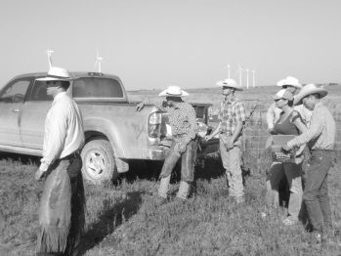
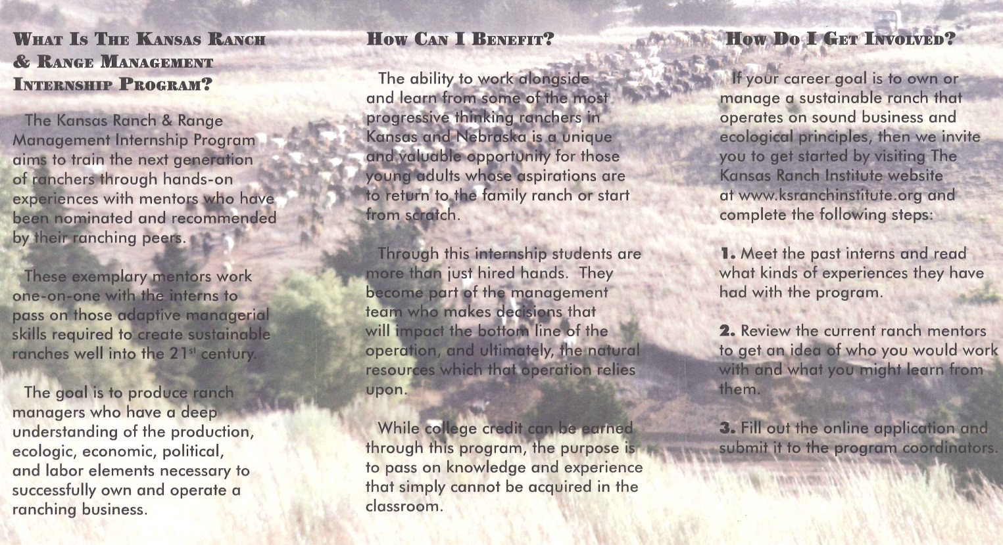
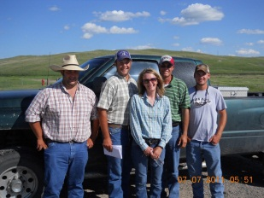
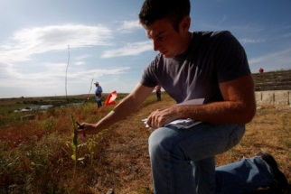
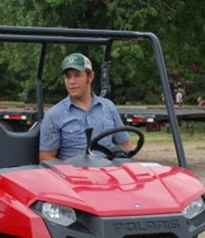
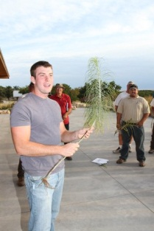
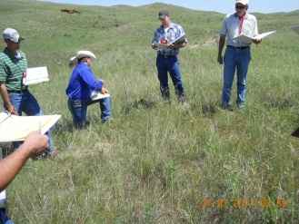
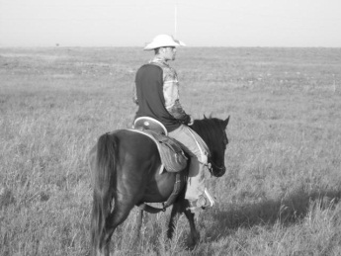
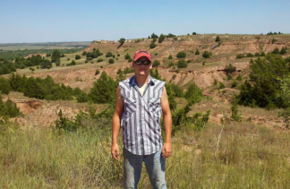
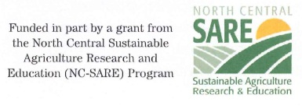
Objectives
Transfer essential knowledge and skills to future ranch managers
Expand the formal classroom and foster lifelong learning
Facilitate the generational transfer of the ranching industry
Mentor Areas of Expertise
Grazing Systems
Ecological Monitoring
Wildlife Enhancement
Alternative Forages
Cool-Season Grass Production
Drought Mitigation
Ranching Business Models
Prescribed Burning
Invasive Species Control
Water Management

