Slide 1
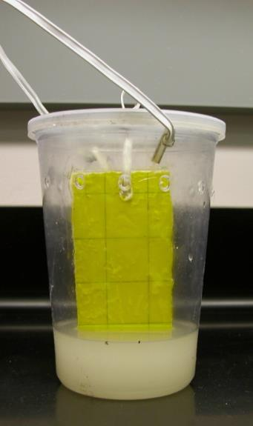
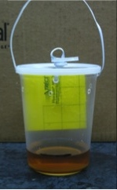
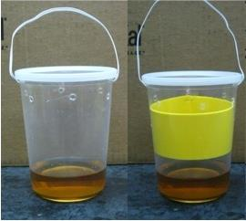
Figure 6: Trap treatments for Objective 2b in year 2013. From left to right: 1) basic cup trap (described above), 2) cup + yellow stimulus band + detergent, 3) cup + yellow sticky card inside, and 4) cup + yellow sticky card inside baited with a 150 ml yeast + sugar mixture.

