Slide 1
Primer effects of a queen pheromone on drone physiology and behavior
Gabriel Villar, Peter Teal, Christina Grozinger
Center for Pollinator Research
Department of Entomology
Pennsylvania State University
Notes:
What I’d like to highlight today is some recent work in the Grozinger lab that been motivated by a desire to better understand and characterize the experience of drones in the social context of the colony.

Slide 2
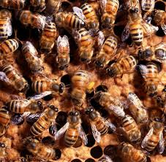
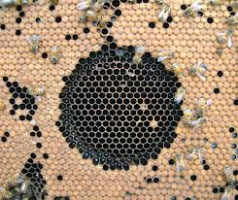
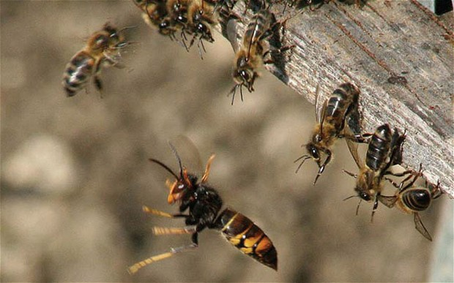
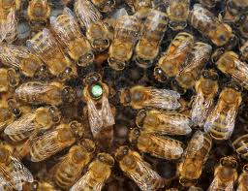
Social Organization is Largely Chemically Mediated
sciencedaily.comreleases/2011/02/110211183857.htm; http://scientificbeekeeping.com/the-primer-pheromones-part-4-reproduction-and-survival;
beeinformed.org;
Notes:
We really know a lot about how workers experience the colony, and the central role that chemical communication plays in mediating a variety of complex social behaviors, but we can’t say the same about drones. It is possible that the reason for this is the reputation drones have for being one trick ponies, serving as reproductives but not doing much more than that. Regardless, of whether this opinion is true or not (and I think that it’s not), the question of how drones experience the social context remains outstanding.
Organization of the social features in honey bees are largely chemically mediated. Colony provisioning, disease management (hygiene), nest defense, reproductive division of labor, sexual reproduction and many other features are facilitated through chemical communication. And the list goes on…

Slide 3
Releaser and Primer Effects of 9-ODA
Workers
Social Attractant
(Retinue response)
Inhibition of queen rearing
Alters brain-gene expression
Slows Behavioral Maturation
(Reduction of JH biosynthesis/
up-regulation of Vg)
Drones
Sexual Attractant
???
Pheromone mode-of-action classifications
Releaser (acute behavioral response)
Primer (long-term effects on physiology and behavior)
Notes:
To address this question we selected 9-ODA as a system that’s been well studied in workers but only minimally in drones. We know that 9-ODA has specific primer and releaser effects on workers, where primer effects are characterized as eliciting acute behavioral responses and releaser effects elicit long term impacts on physiology and behavior.
My primary system of study entails the queen pheromone component 9-ODA. This chemical is fascinating because it elicits a suite of primer and releaser effects in workers and a releaser effect in drones.
In drones, it acts as a long range attractant, facilitating copulation, which happens on the wing. However, whether 9-ODA is responsible for mediating or modulating any other aspect of drone behavior is unknown.

Slide 4
Examining Primer Effects of 9-ODA on Drones
Primer pheromones regulate critical features of HB society through its effects on pathways regulating behavioral maturation in workers
The same physiological pathways in drones may also be impacted by 9-ODA, affecting the onset of reproductive behavior
Is the JH/Vg pathway similarly modulated in drones as in workers by 9-ODA?
Notes:
Alternatively, due to social context, primer effects on workers may have indirect effects on drones

Slide 5
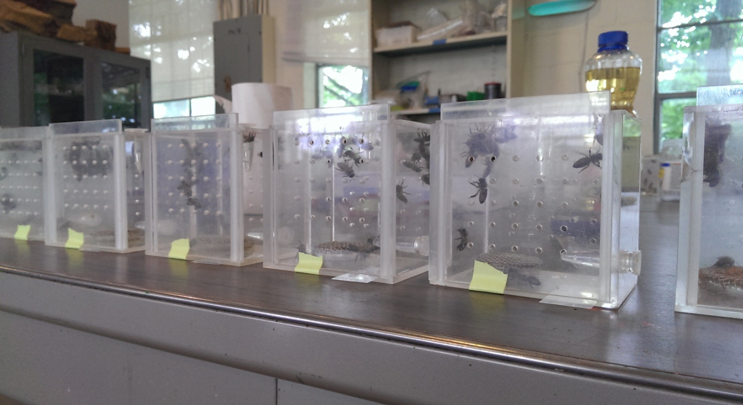
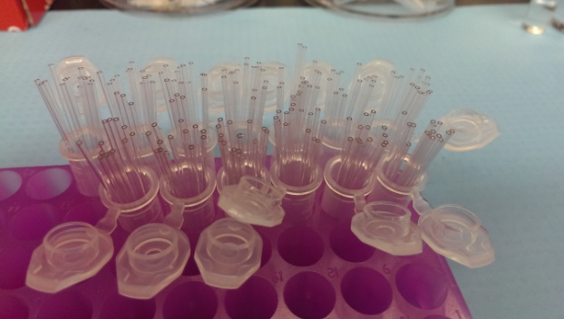
Methods
Cage Experiment
20 callow workers, 10 callow drones
Ad libitum food and water
Exposed daily to 20μg 9-ODA tmt or solvent control for 3 days
Hemolymph collected from live bees JH analysis
Subset of bees frozen at -80⁰C. Eight samples/tmt used for Vg expression study

Slide 6
9-ODA modulates Vg/JH in Drones
9-ODA

Slide 7
Direct or Indirect Primer Effect?
Direct Effects
Photos: Alex Wild
Notes:
Workers exposed to queen pheromone/9-ODA exhibit a nurse-like phenotype, which includes more developed hypopharyngeal glands, the sites of food production. This, in turn, could result in improved nutrition for the drones they are tending, resulting in the higher Vg and lowered JH levels since JH, Vg, and nutrition are all correlated.

Slide 8
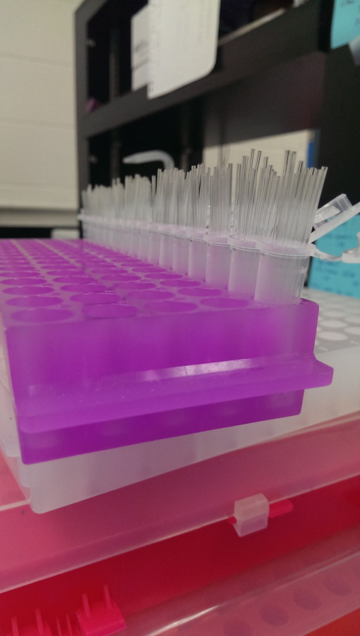
Modified Assay
Assay was repeated
Housed drones with mature nurses and callow workers
Mature nurses should be less impacted by 9-ODA effects

Slide 9
Results (Trial 1)

Slide 10
Results (Trial 2)

Slide 11
Drone Nutritional Environment
Does drone nutritional experience different across our treatments?
Trophallaxis quantified
6 cages/treatment
# events/cage was counted every 5 minutes for 40 min. Replicated across 3 days with 3 colony sources.

Slide 12
Worker-Drone Trophallaxis

Slide 13
Worker-Drone Trophallaxis

Slide 14
Are worker nutritional stores impacted by pheromone exposure?
Is nutritional quality and environment playing a role in producing observed effects of 9-ODA on drone physiology?
Nutrient producing gland size assessed for impacts of 9-ODA exposure/drone rearing, and used as a measure of nutritional quality.

Slide 15
9-ODA Effects on worker hypopharyngeal gland development

Slide 16
9-ODA Effects on worker hypopharyngeal gland development

Slide 17
9-ODA Effects on worker hypopharyngeal gland development

Slide 18
Is Drone Reproductive Behavior Impacted by 9-ODA exposure?
2 Colonies Established
100 newly emerged drones introduced
Pheromone sources removed
Daily colony exposure to 2 Qeq 9-ODA
Onset of mating flights quantified

Slide 19
9-ODA Exposure Impacts Reproductive Behavior

Slide 20
Conclusions
9-ODA exposure elicits a primer effect in drones, impacting the Vg/JH pathway. Reproductive behavior is also altered.
The mechanism mediating these effects appears to be direct, but social context may modulate these effects

Slide 21
Acknowledgments
Grozinger Lab
Dr. Christina Grozinger
Lab members
Research Assistants
Dustin Betz
Mariam Khraibani
Sydney Tabaac
Collaborators
Dr. Peter Teal

