Slide 1
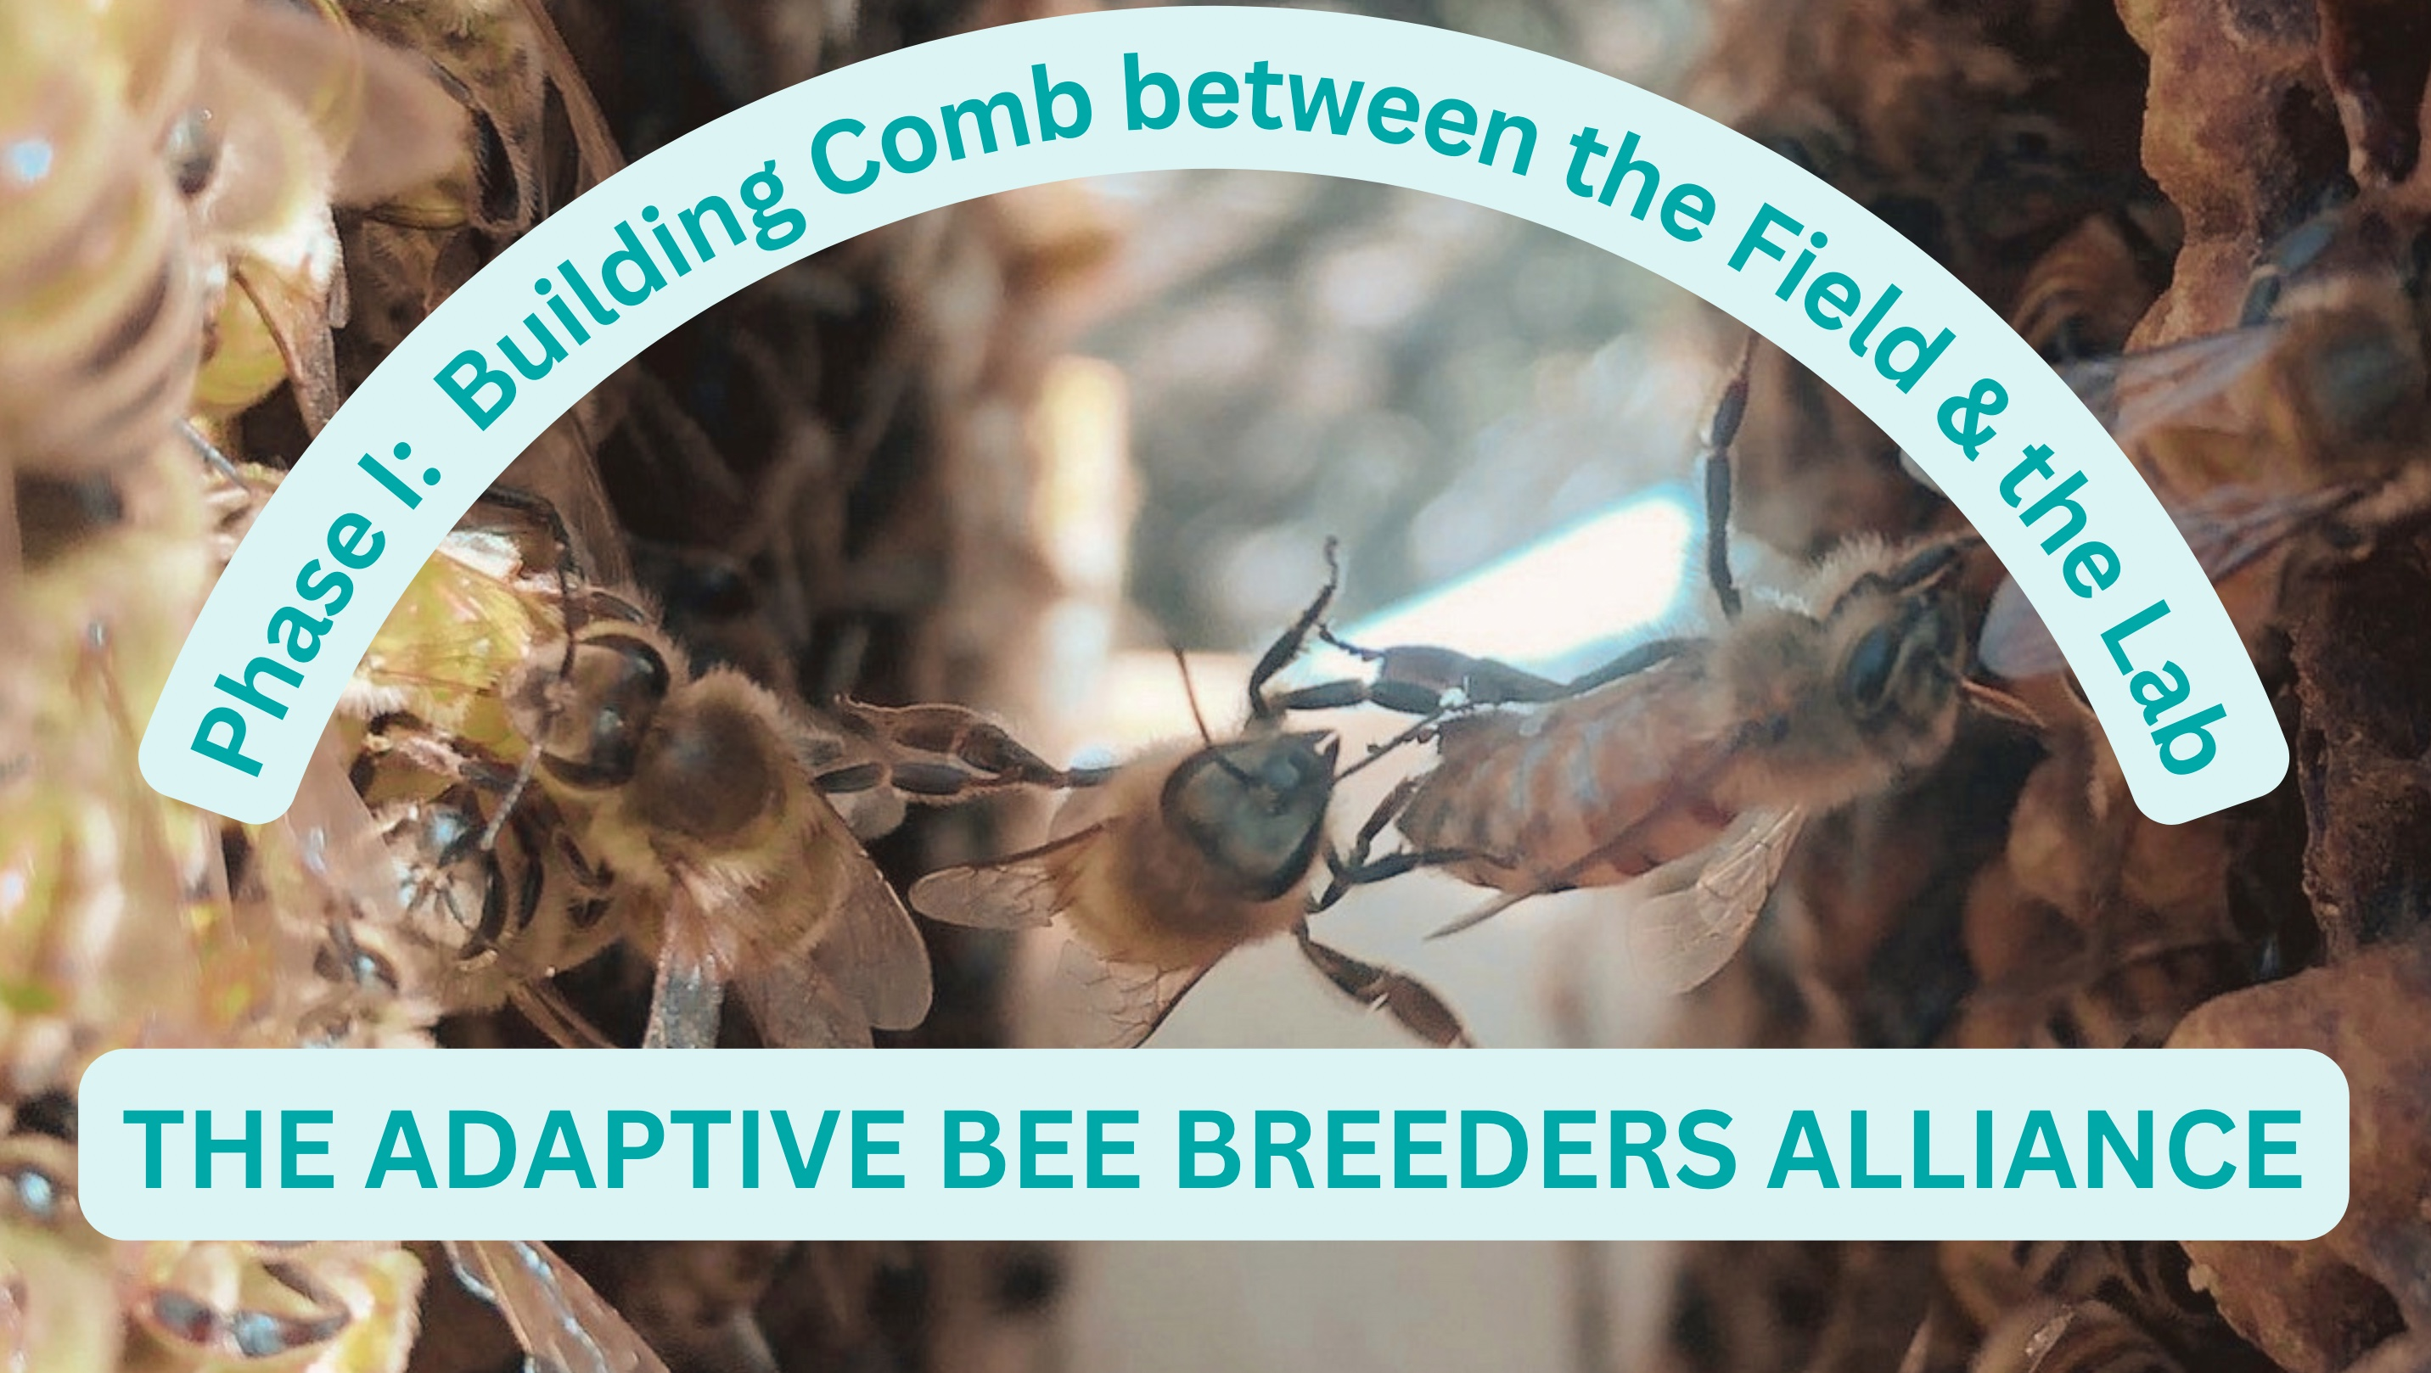

Slide 2
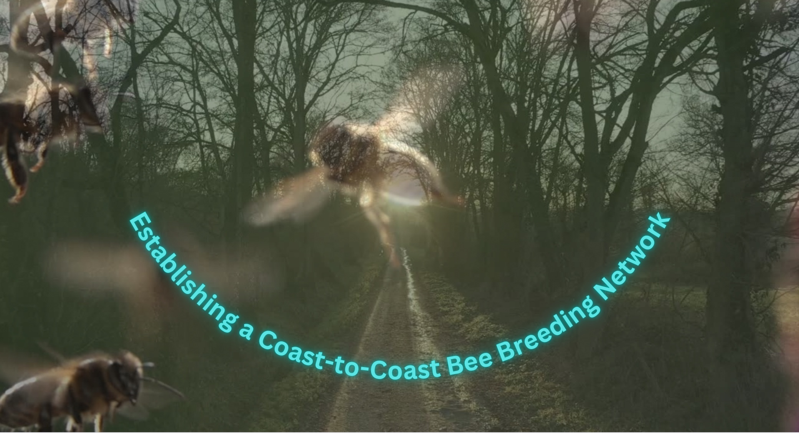

Slide 3

Connecting the Crowns

Slide 4
Connecting the Crowns:
Selecting & Breeding Adaptive Stock for Changing Times
Ready or not, times and landscapes are changing.
As the clock moves forward, and seasons shift, we are realizing more and more how collaboration supercedes competition.
For the reality is, we are all in this together- locally to globally.
To keep our bees healthy and productive, we are learning to adapt legacies that support the evolving endurance of American beekeeping traditions.
The Adaptive Bee Breeders Alliance is a network of seasoned and aspiring bee breeders from across the country and beyond sharing experiences, abilities, and aspirations to better support our livelihood needs, and responsibilities to our bees into the future.

Slide 5

Ready or Not…
Change is HERE.

Slide 6
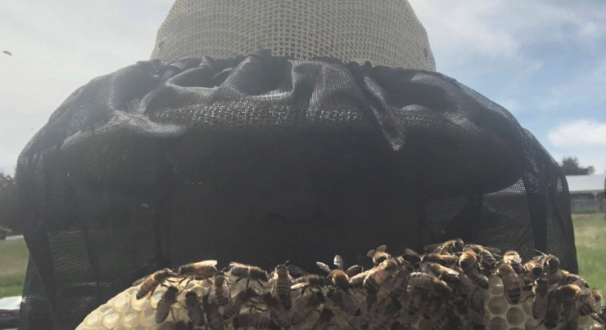

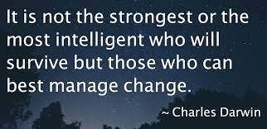
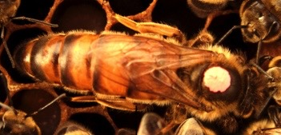

Slide 7

“The secret of change is to focus all of your energy, not on fighting the old, but on building the new.” ---Socrates

Slide 8

Strategies

Slide 9

Know your Enemy

Slide 10

Needs:
Migratory: Commercial/Professional
Sedentary: Hobbyist/ Novice
The Importance of Finding Resilient and Adaptable Stock & “Sustainable/Regenerative” Propagation
AgroEcosystem/ Landscapes

Slide 11

TRIUMPH

Slide 12

Strategies: Rearranging the Puzzle
Nutrition/ Food as Medicine
Environmental Impressions:
Nature vs. Nurture
Selective Pressures
Integrated Systems: Pest Management, Supplements/ Treatments
Land Stewardship, Consilience, Applied Research
Biomimicry

Slide 13
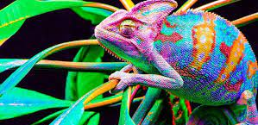
Adaptation

Slide 14
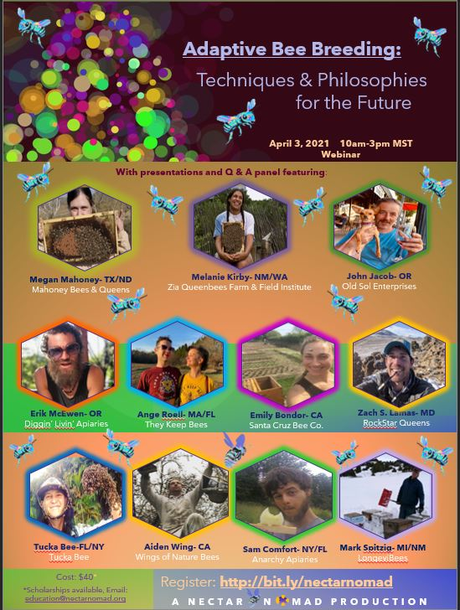
THE OUTLIERS:
Migratory and Sedentary representation
Small, Mid, Large Scale Rearing
Diverse management styles & philosophies

Slide 15
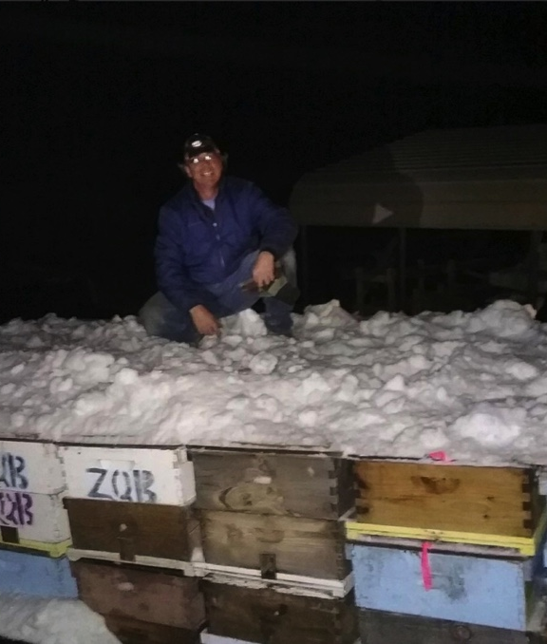


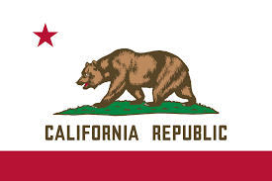
LongeviBees
Mark Spitzig
Michigan
New Mexico
California
Notes:
Here’s the Wizard behind the Curtain- making sure all the bees are loved and thriving. This is Mark Spitzig of LongeviBees by Zia (as he calls himself). Mark is part of the dynamic duo or die-o of @ziaqueenbees He hails from da U.P.-eh (Upper Peninsula of Michigan) and began keeping bees 21 years ago with two packages, 2 books, and 2 buddies. After a couple years, his buds found other interests and he was left with swarms hanging in the basswood trees and thought, “I need to go work for a professional!” And the rest is history... He grew his (Lake) Superior Honey Farms up to 50 hives and was supplying the local Marquette Food Coop with pure, raw, basswood and wild berry honeys. Then he decided to try the migratory meandering map and took his flock to Florida for the winter for a few years to make orange blossom honey in the winter and learn to make starter nucleus hives, queens, and packages at Honey Land Farms under the tutelage of Garry Orescovich.

Slide 16
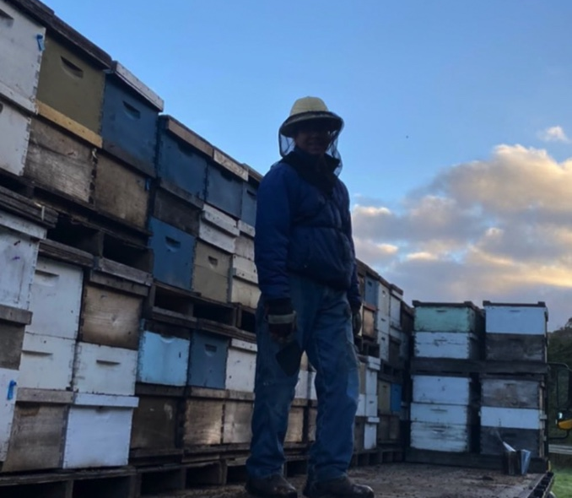
"Beekeeping is like a game of chess…always gotta think as many moves ahead, all the what-ifs, and then strategize to avoid the worst.”
Notes:
That’s where he met Melanie @nectarnomad and they teamed up to establish Zia Queenbees as a sister op to Superior Honey Farms. SHF shared its initial winter-hardy survivor bee stock with ZQB and the two farms shared resources and personnel (2 people- Mark & Mel) developing trans-regional “Father Time Tested~Mother Nature Approved” resilient bees that can handle sincere winters, dry deserts, and wavy coasts. From the shores of Lake Superior to the banks of the Rio Grande. Flash forward 16 years and two children and 200 hives later, Mark is still to bee found kneeling in his outdoor church-office, loving his bees and helping to raise his children- Buzz & Blossom (code names used to protect the wizard’s social media innocence)!

Slide 17
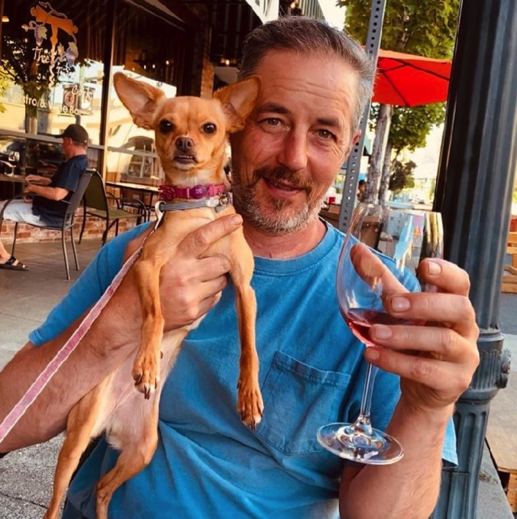
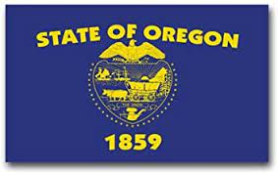
Old Sol Apiaries
Notes:
John Jacob, founder @oldsolbees Enterprises (est 1997). He served as president of So. Oregon Beekeepers Assoc. from 2004-2018 and is now a lifetime honorary member. Currently, John is serving his third term as President of the Oregon State Beekeepers Association. Old Sol has specialized in bee breeding and finding innovative, sustainable agricultural solutions such as dual use solar, known as agrivoltaics. John’s educational background includes a BS in biology, with minors in Chemistry and Economics from Southern Oregon State University.
Old Sol’s business endeavors include queens, nucs, commercial pollination, honey, mead making, and consulting for pollinator habitat development and the beekeeping industry. Old Sol is the largest commercial queen producer in the state of Oregon and has built a highly respected national brand. Old Sol Enterprises has pioneered disease resistant bee breeding and innovative solutions for utility scale solar dual use operations such as the development of four 10-15 megawatt solar pollinator habitat sites. John’s core values include:
“Through knowledge, wisdom, education, and innovation Old Sol strives to reduce the negative impacts of modern agriculture in an effort to preserve biodiversity and quality of life for all generations, in all regions by implementing and sharing healthy farming practices whenever and wherever possible. In essence Old Sol Enterprises leads by example and demonstrates that healthy sustainable food production can be profitable.”

Slide 18
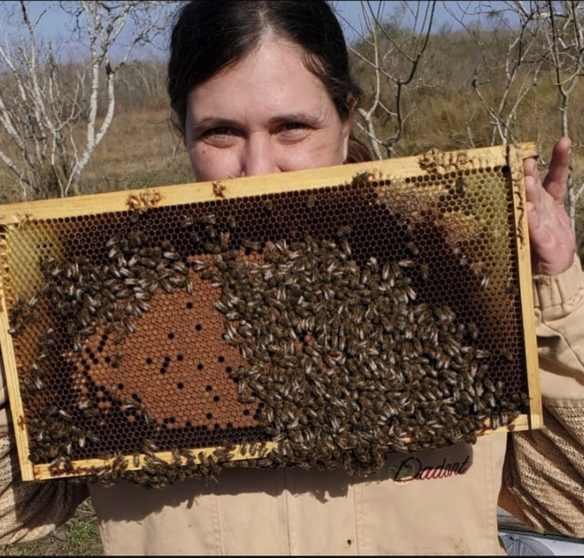
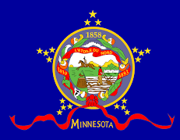
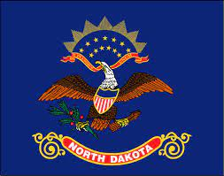
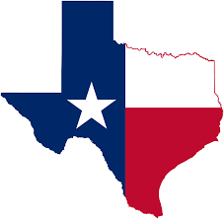

Mahoney Queens & Bees
New Mexico
Hawaii
Notes:
Megan Mahoney has been fascinated by honey bees ever since being fortuitously introduced to them in Marla Spivak’s lab in 2003. Her enthusiasm for bees, beekeepers, and bee breeding has grown over time, and inspired her to build up a repertoire of beekeeping experiences and skills across the US and other parts of the world. She has worked with bees in many different capacities, from top bar hives in the backyard, to pest and disease monitoring for commercial beekeepers with thousands of hives. She has worked with commercial queen producers, package producers, pollinators and migratory honey producers, as well as learning instrumental insemination techniques and working with national bee breeding/selection programs. In 2019, she and her partner (Ross Klett), founded a bee breeding company “MaHoney Bees and Queens,” and are currently managing a satellite breeding population within a larger migratory beekeeping company. Specializing in Instrumental Insemination, breeder queens, and selection models, they travel (with the bees) between South East Texas and Central North Dakota.

Slide 19
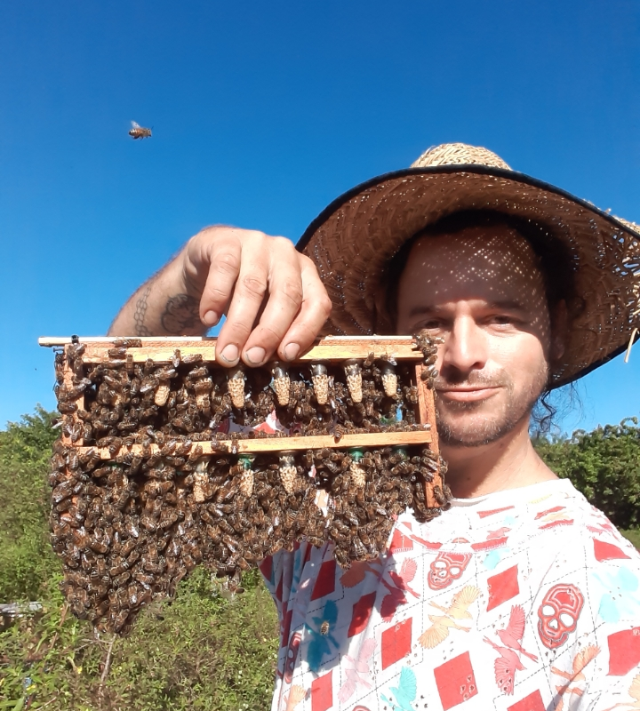

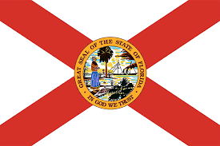
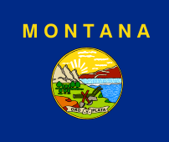
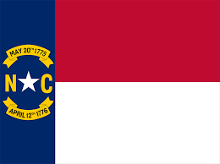
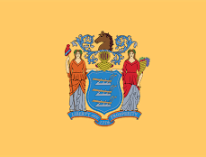
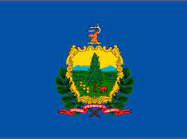
Anarchy Apiaries
Sam Comfort
New York
Hawaii
New Jersey
Vermont
Notes:
After winning 6 hives in a poker game, Sam Comfort worked for several years in commercial beekeeping across America. He started Anarchy Apiaries in 2005 to explore permaculture ideas of low input natural cycles. He breeds queen bees from hardy survivors, experiments with splitting techniques, and messes around with hive designs.
So the mission is to 1) make more beehives than there are televisions, and 2) have a good time, all the time (with bees). Anarchy Apiaries runs around 1000 hives that split seasonally into around 2000 mating nucs with no treatments, minimal feeding, and do-it-yourself hive boxes in New York and Florida and spots in beetween. Through teaching independent, biological beekeeping, he hopes to really mess up the paradigm. And, set the record straight- for bees and beeple!

Slide 20
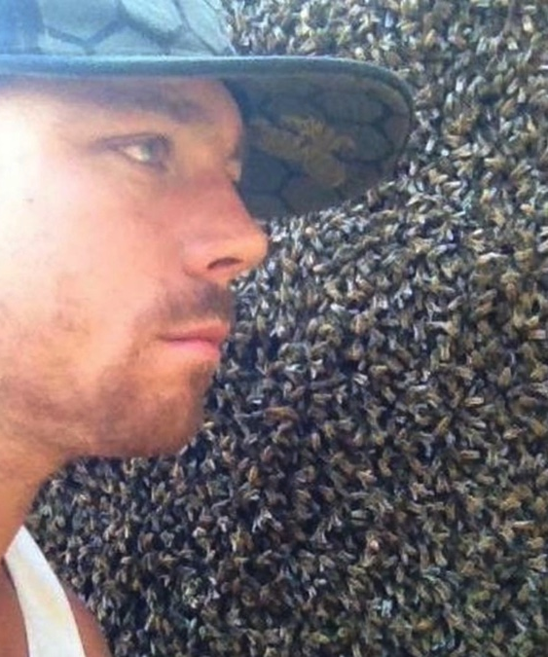
Wings of Nature Bees
Aiden Wing
Notes:
Wings of Nature produces high-grade artisanal honeys, produces nucleus colonies, and works hand-in-hand with farmers to provide pollination of their crops. Aidan also specializes in queen breeding. He has designed a breeding program to help improve honey bee stock by selecting for mite-resitance, resilience, gentleness and productivity. In 2018 Aidan received a grant thru @westernsare to research and share his breeding program. The following year he traveled to Montreal to share his program at the Apimondia World Beekeeping Conference. Aidan believes that beekeeping is a key role in a much bigger land-based regenerative agriculture solution to the environmental mental degradation our planet is facing. Aidan works with like-minded farmers and ranchers to help support soil regeneration, habitat preservation, diversity and carbon sequestering. As a life-long student of permaculture, Aidan strives to integrate permaculture principals and ethics into his own company. Aidan lives with his two children in the hills of Pescadero. Before becoming a beekeeper Aidan worked as commercial fisherman, carpenter, natural builder, farmer and musician.

Slide 21
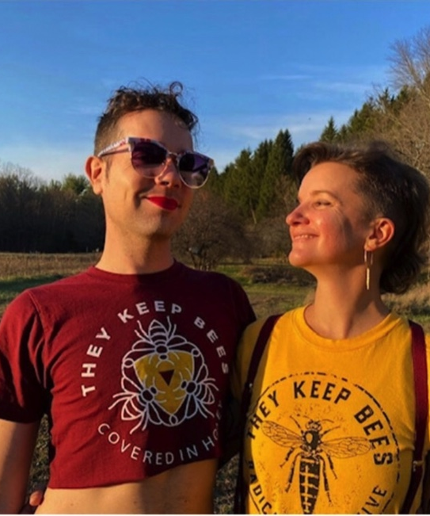
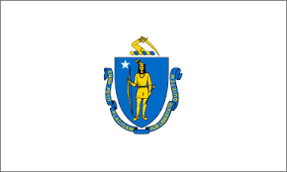

They Keep Bees
Ange Roell + Bi Kline
Massachusetts
Notes:
Ang Roell and Bi Kline of @theykeepbees - a nonbinary led beekeeping business. Ang got started in beekeeping studying with Jean Claude Bourutt in Boston and was a co-founder of the Tour de Hives and the Boston Area Beekeepers Association. They learned queen production methods from Kirk Webster (Vermont). They’ve visited the behemoth hives of Dee Lusby in AZ and worked with Sam Comfort’s innovative small box hives in FL & NY. Bi (pronounced “bee”) Kline joined the team in 2020 after a decade working as an educator. They have worked with and learned from Sam Comfort over the past two seasons. In 2020, Ang and Bi went into COVID locked down while living in their van on top of 2 weeks worth of rice and beans and raising bees in the Allapattah Flatlands on the Central Coast of Florida. Ang and Bi currently raise queens in Central FL & Western MA and select for adaptive bees for both bio regions who demonstrate Varroa resistance. They were recently awarded a Northeast Sustainable Ag Research and Education (NESARE) Grant in collaboration with Sam Comfort to conduct a NE Queen Bee School teaching methods from their collective research on novel queen rearing methods for their region. Ang likes to ponder the question, “If all beekeeping is “treatment,” what are the best practices for living in relationship with bees while making a living from working with bees?”

Slide 22
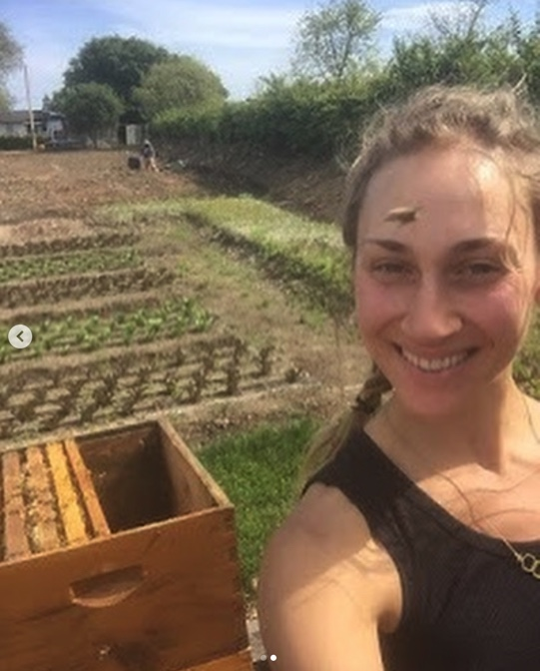
Santa Cruz Bee Co.
Emily Bondor
Hawaii
Notes:
Emily Bondor- Apiarist and Educator. She started queen rearing with the Maui Queen Bee Company in 2013 and from 2014-2020 worked with the Napa Valley Bee Company. Emily started the Santa Cruz Bee Company in 2015. Through the business, Emily mentors new beekeepers, provides full-service hive management in the San Fran and Monterey Bay Area, and teaches beekeeping courses through the local community college and UC Santa Cruz.
Santa Cruz Bee Company has a small scale queen-rearing operation that mainly utilizes walk-away splits and harvesting queen cells from recently-swarmed hives. Since SCBC is a treatment-free operation, implementing additional brood breaks by way of splits helps control Varroa mite loads.

Slide 23
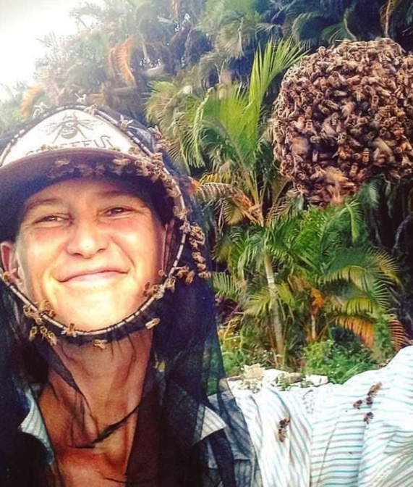

Tucka Bee LLC
Tucka Saville
Vermont
UK
New York
Notes:
Tucka navigates the compass- running about 300 colonies in Upstate NY and South Florida. Her primary mentors are Mike Palmer in upstate Vermont and Sam Comfort, creator of the Comfort Hive. She produces about 1000 queens per year, plus some honey and wax. She shares her love of bees with enthusiasts near and far via workshops, presentations, and international trainings. She also enjoys standing in swarms, swimming in rivers, and long days queen-catching with her pup in the sun. It's a pirate's life with bees!

Slide 24
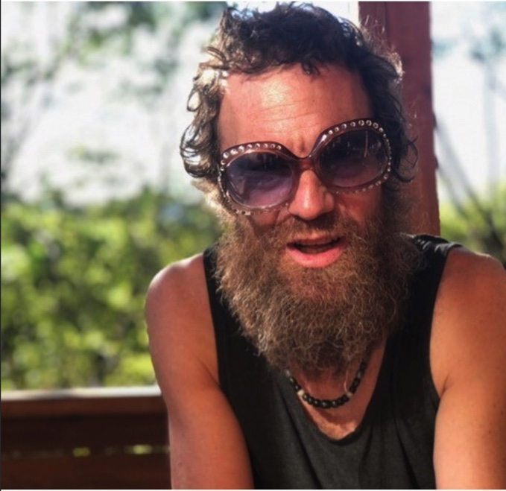
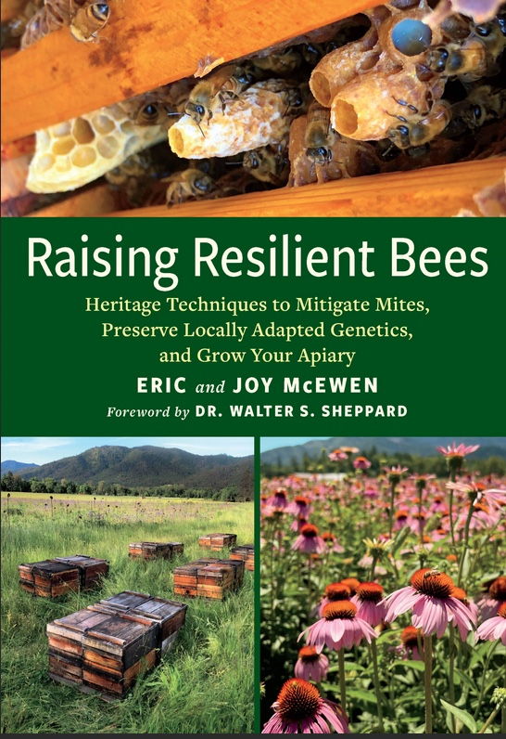
Diggin’ Livin’
Eric McEwan
Notes:
Eric McEwen heads the beekeeping operation for @digginlivin located in the Illinois River Valley of Southwest Oregon. Eric and his wife, Joy, steward beehives from the Applegate Valley to the East, and to the Smith River drainage west to the coast. They have kept bees here for 18 years after moving south from Corvallis, OR where he and Joy met attending Oregon State University and were gifted their first hive by students from the OSU Honeybee Lab. Eric specializes in the development of organic management practices for their 700 colonies. He and Joy craft a whole line of value-added honeybee products including varietal honeys, beeswax candles, a line of honey-based medicines, propolis tincture, and a line of Jun kombucha (made with honey of course)! In addition to nurturing bees and a family, Eric and Joy also run a natural market and organic kitchen cafe @digginlivinstore . He has been a mentor for the OSU Master Beekeeper Program, and currently serves as Southern Oregon Representative on the Oregon State Beekeepers’ Association’s Administrative Board. He is also the designer and manufacturer of Natural Nest Beehives, a line of 8-frame Langstroth equipment for organic beekeeping packed with features. Eric is also a trained naturalist, and loves the wild side of the great outdoors.

Slide 25
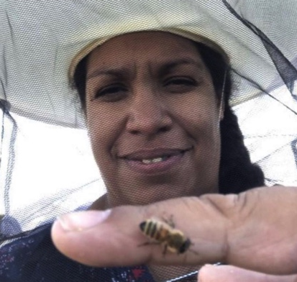
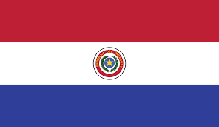

Zia Queenbees
Melanie Kirby
Paraguay
Hawaii
Michigan
New Mexico

Slide 26
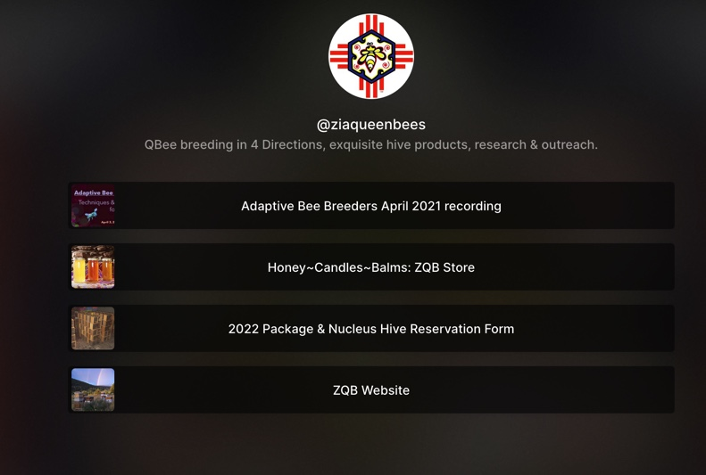
Adaptive Bee Breeding
4/3/21 webinar recording https://linktr.ee/ziaqueenbees

Slide 27

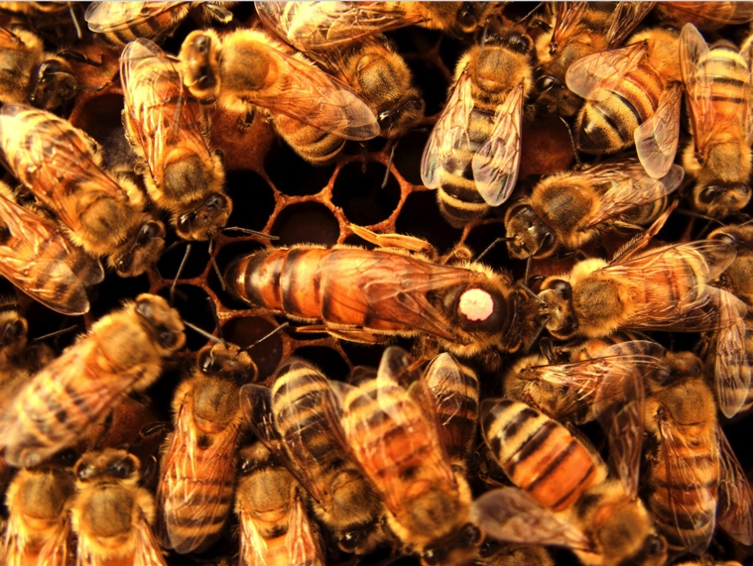
Strategies for the Future…
Germplasm
Resources
Mentor
Professional Development
Open Source
Outreach
Network
Research

Slide 28

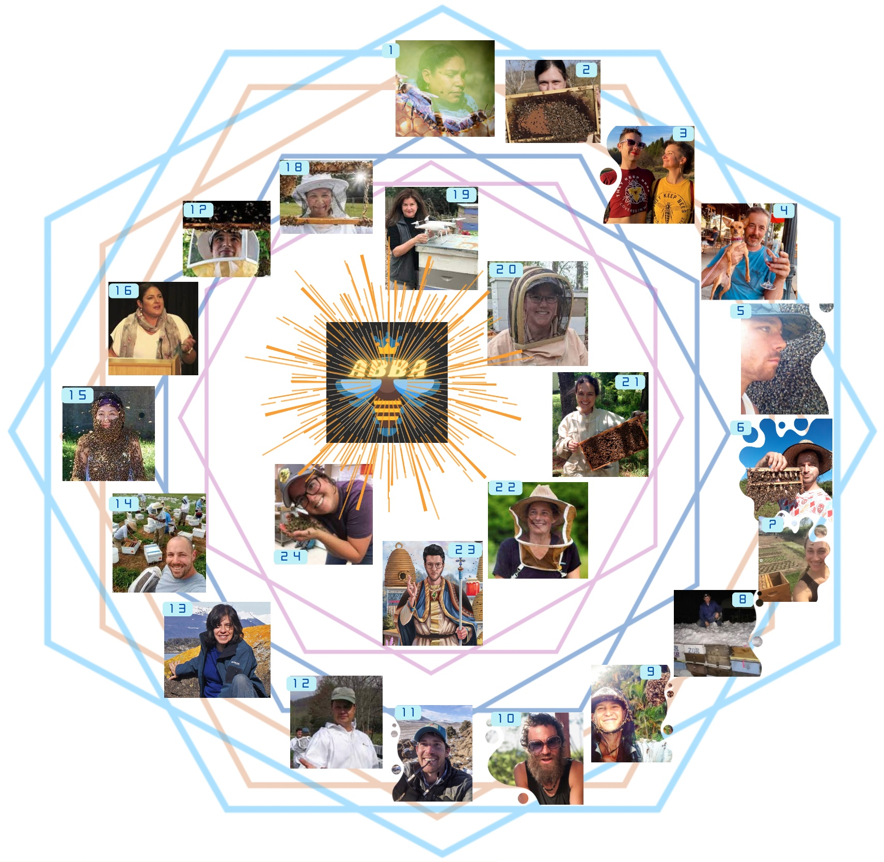
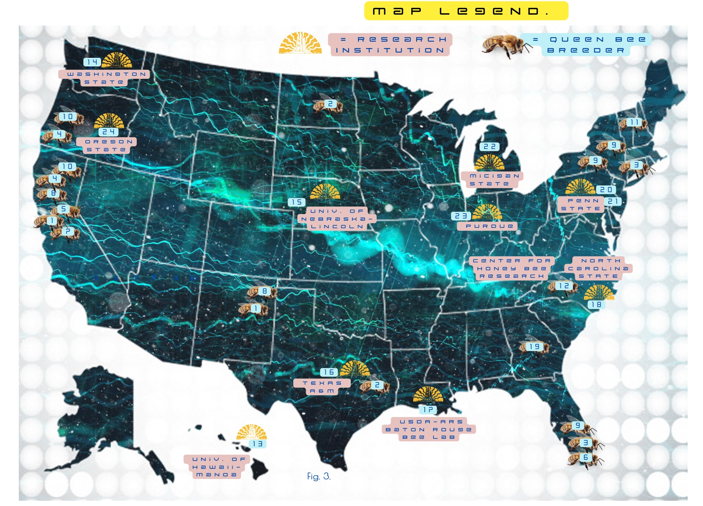
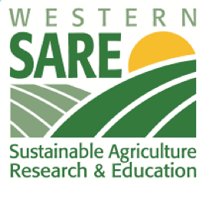
ABBA is a coast-to-coast network of bee breeders and researchers with the aim of connecting field and lab to support small to large scale bee breeders in their efforts to investigate and preserve:
2023-2025 OBJECTIVES:
Genomics
American Honey Bee Germplasm Program (Cryopreservation)
DCA surveys
Comparative Studies
Pest & Pathogen Surveys
Breeding Practices Anthology
FUTURE OBJECTIVES:
Expand Program (Open to all interested in learning more about breeding practices)
Applied Research
Professional Development for participants
Educational events
Explore field observations

Slide 29
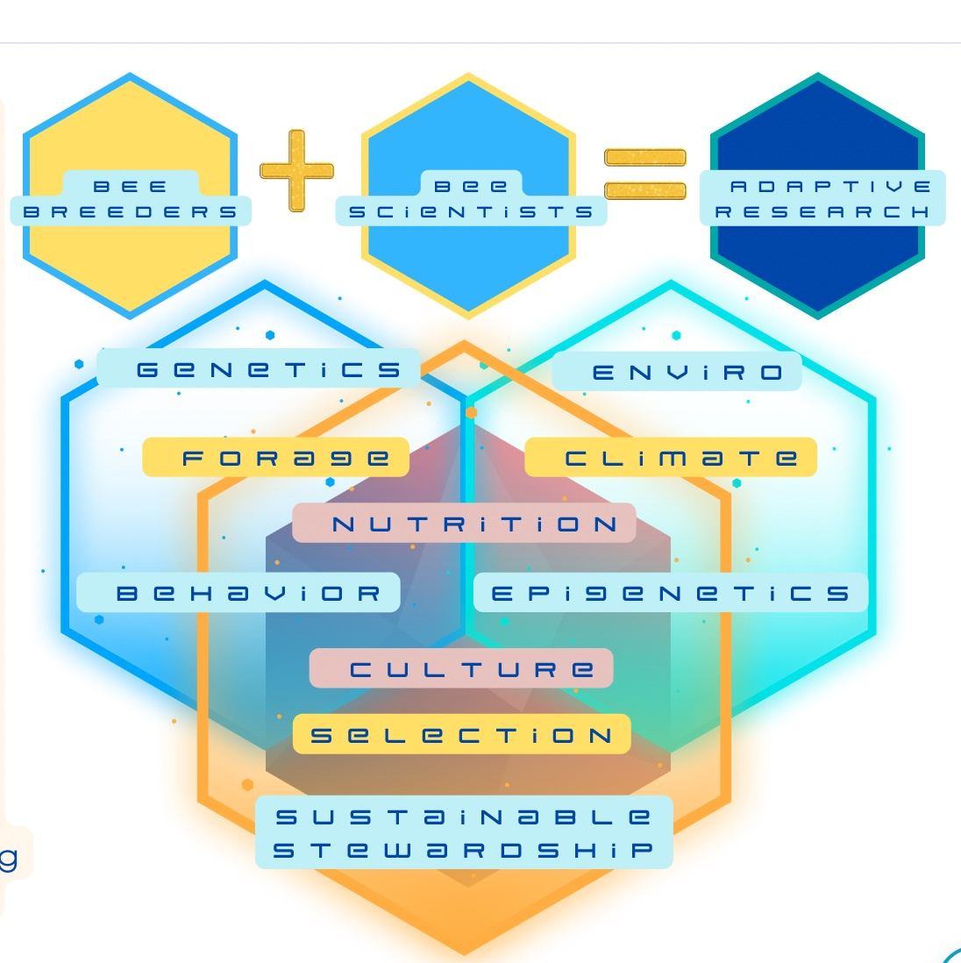
Genomics
Germplasm Collection
DCA assessments
Genetic marking and mapping
Best Bee Breeding Reference Guide
Breeding Anthology

Slide 30
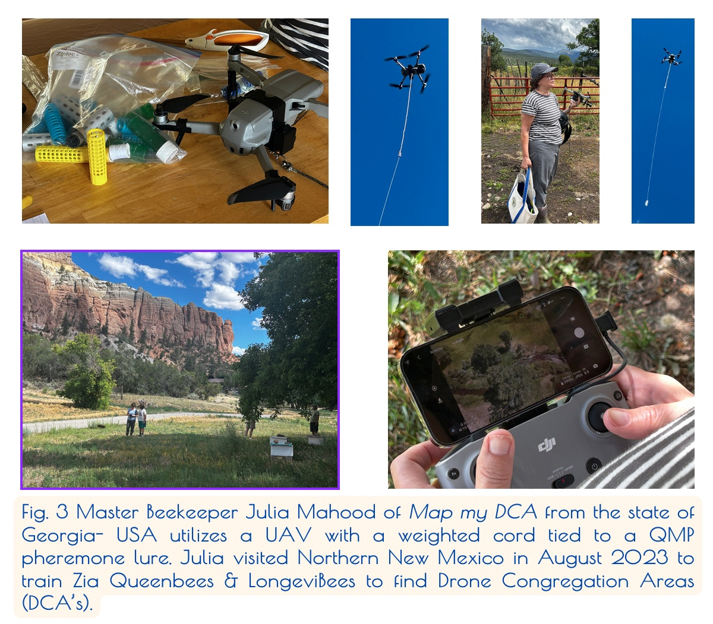

Slide 31
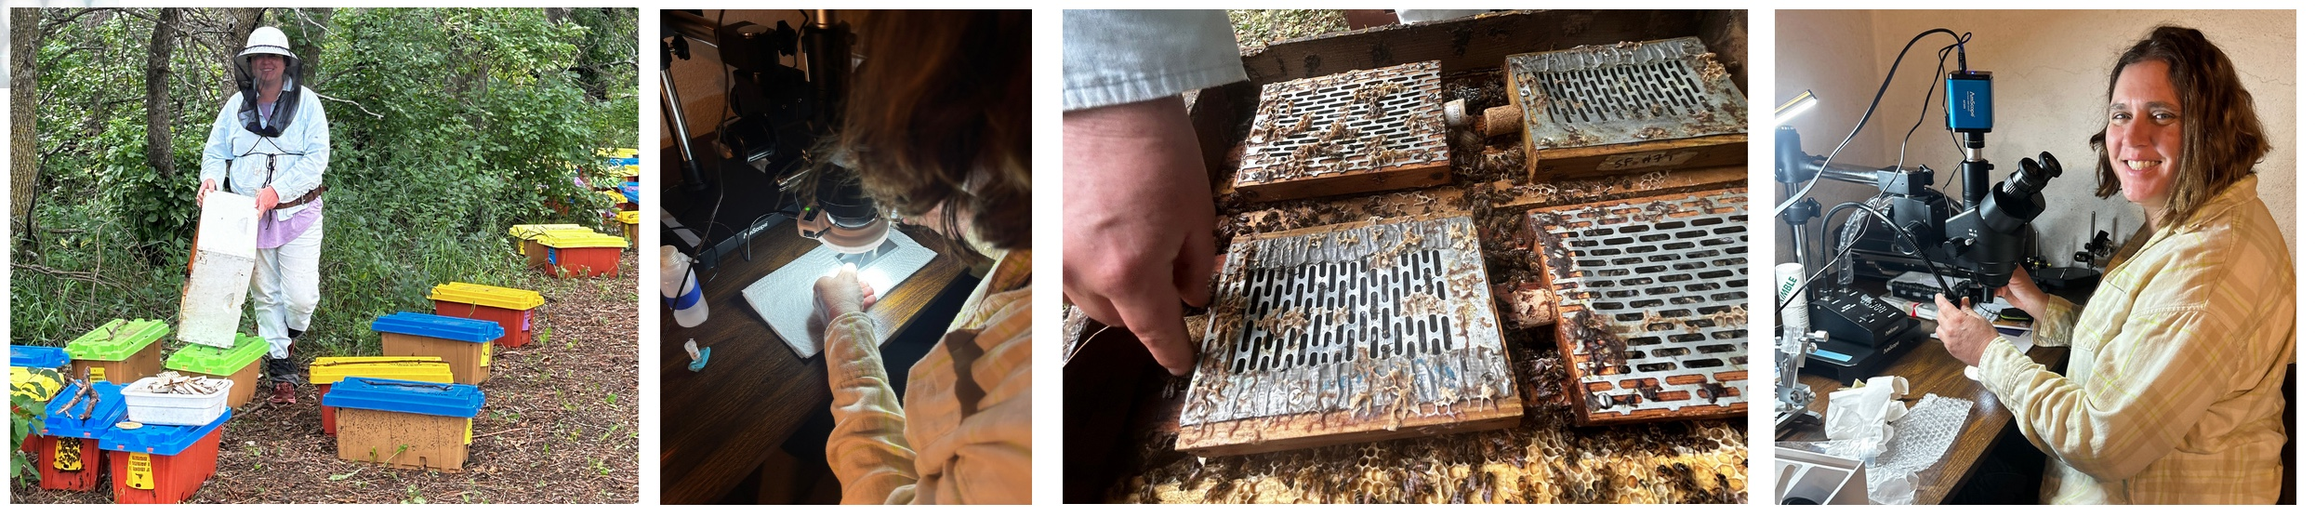
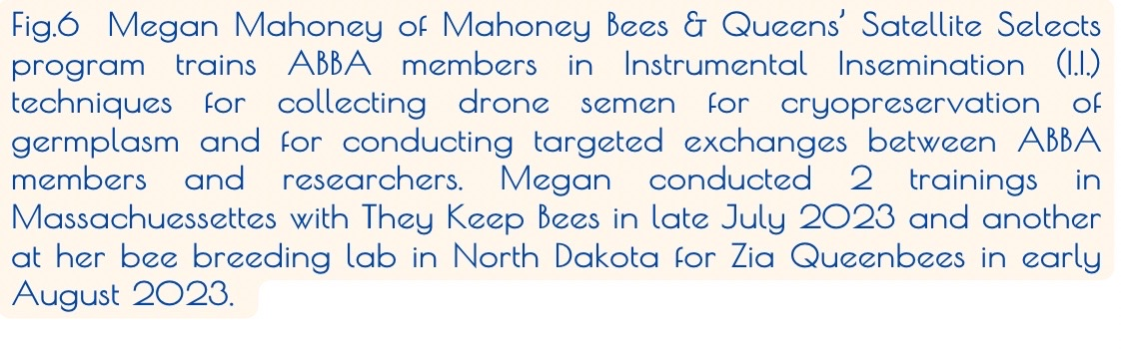

Slide 32

Collaboration supercedes Competition

Slide 33
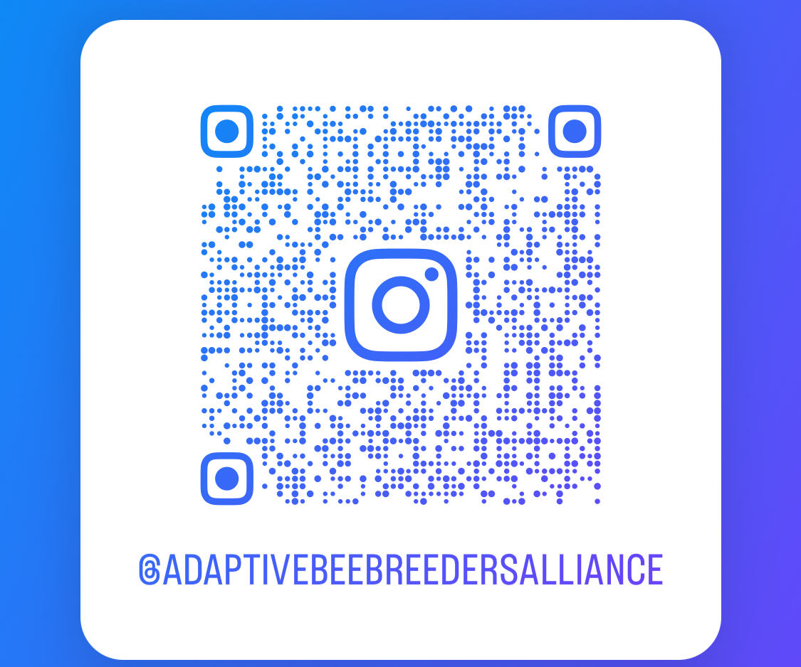
Thank you!
adaptivebeebreedersalliance@gmail.com

