Slide 1
Using Social Science to Communicate More Effectively: Research, Public Understanding of Farming, and Reframing Your Messages
Jim Farrar

Slide 2
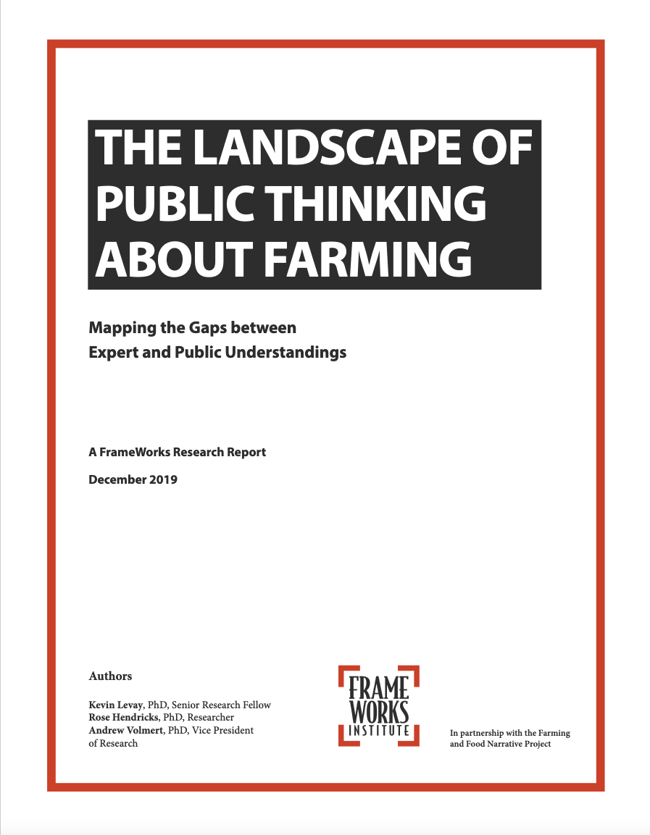
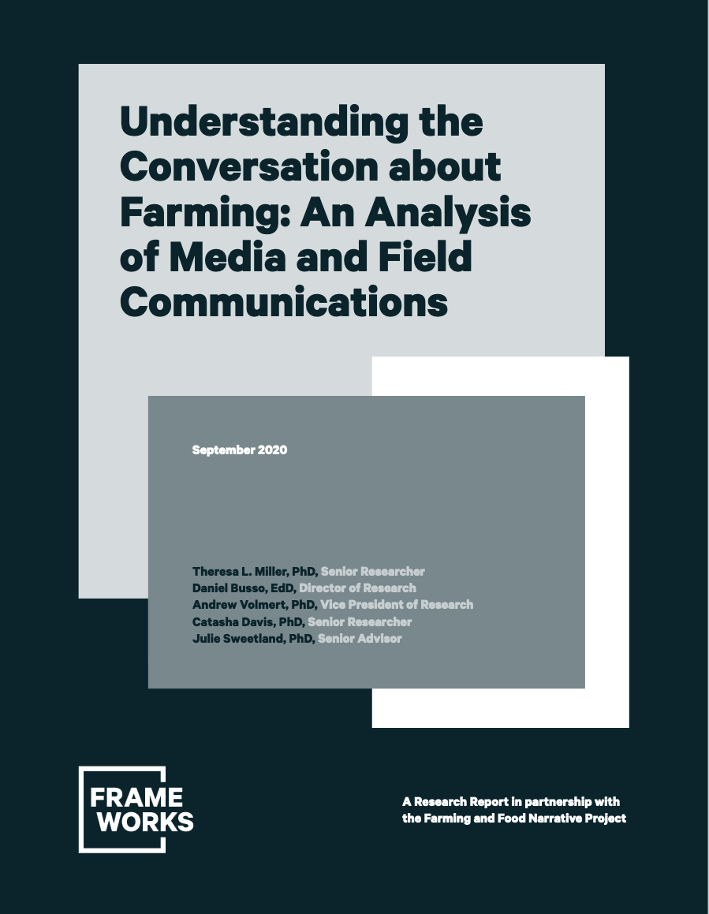
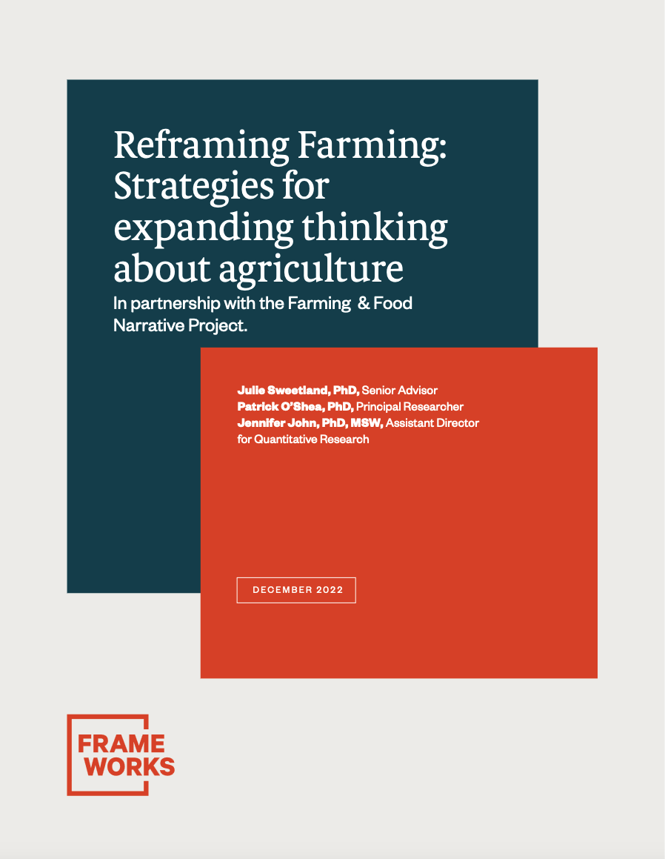
Farming and Food Narrative Project
A Collaboration of IPM Voice, Red Tomato, and Frameworks Institute

Slide 3
Problem
Difficulty communicating Integrated Pest Management to the public
Expanded to difficulty communicating good farming (crop production) practices to the public
  Binary good / bad traps
  You say / they hear
  Difficulty communicating science
More data, more science is not working
Can social science help us communicate more effectively?

Slide 4
How do people think?
Heider and Simmel video demonstration

Slide 5
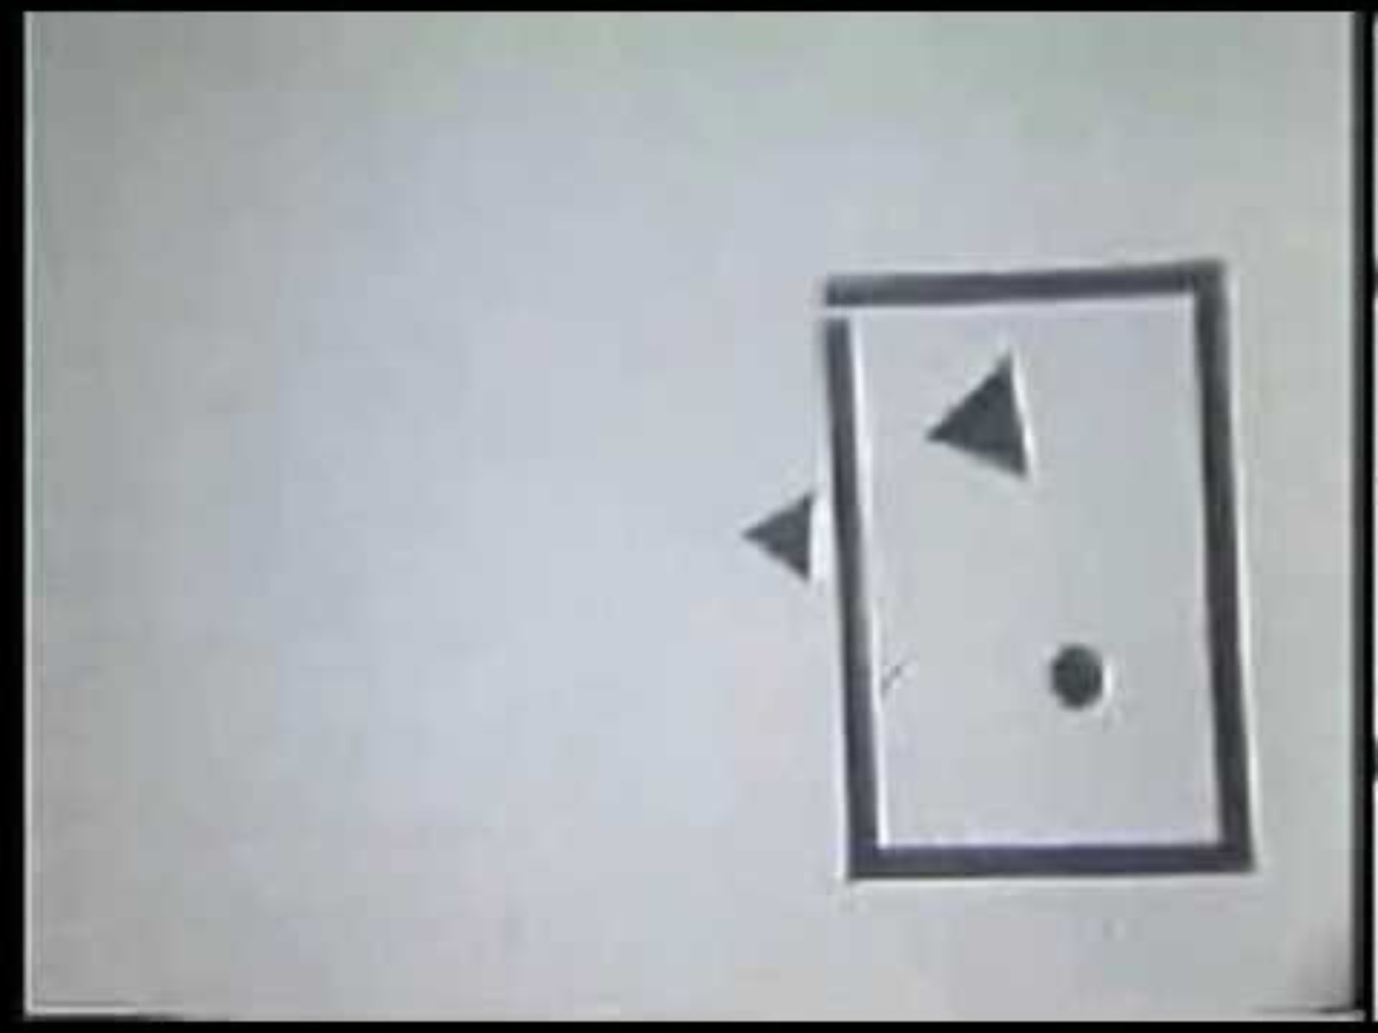

Slide 6
The Ah-ha Moment
Humans interpret the world through stories
Humans have mental models (=frames) to understand the world
What are the existing mental models and how can we communicate better?

Slide 7







Frameworks Institute Research Process
1
E
2
3
CM
Descriptive
Expert
Interviews
Cognitive
Interviews
Media Content & Field Frame Analysis
What needs to be communicated?
How does
the public think?
What frames
are in play already?
4
5
OTS
6
7
On-the-Street / On-line
Interviews
Reframe Candidates
Controlled
Experiments
Qualitative Frame Testing
Prescriptive
What reframes are plausible?
Which reframes seem to work?
Which reframe drives people’s preferences?
How will this frame fare in the world?

Slide 8
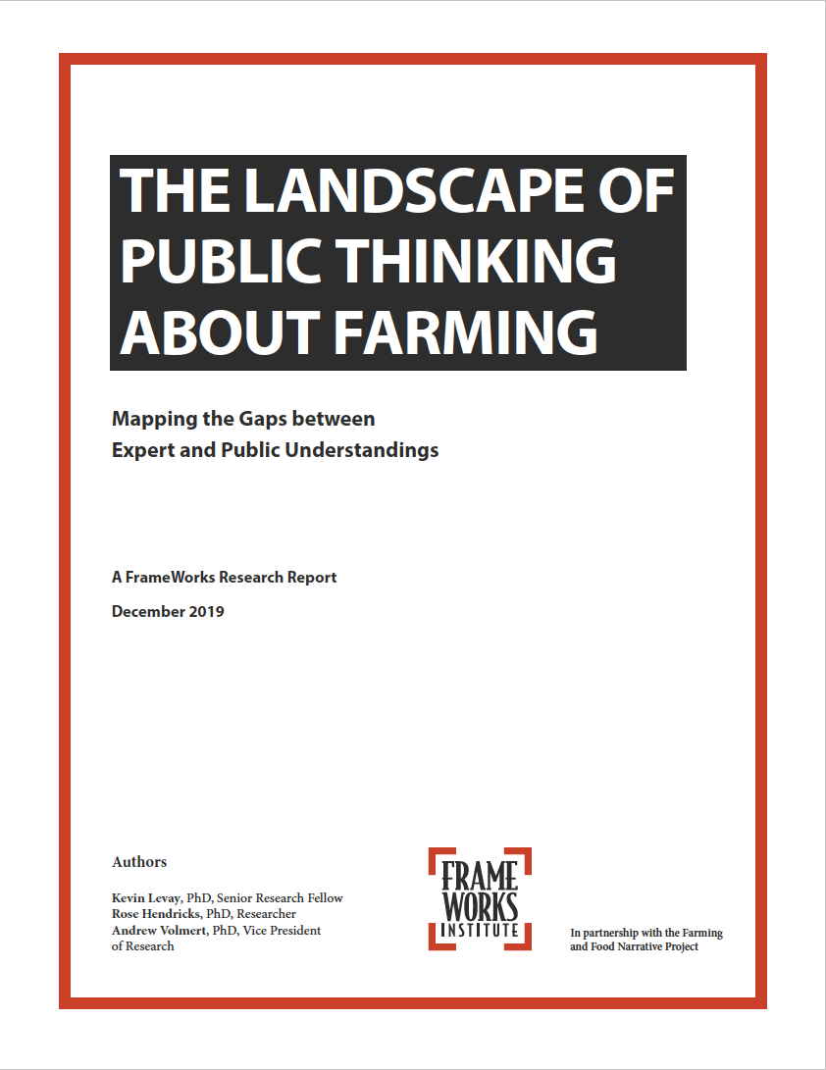
What is farming?
Why is farming important?
What are the challenges involved in farming?
How can farmers effectively meet the challenges of farming?
What should society do to help meet the challenges of farming?

Slide 9
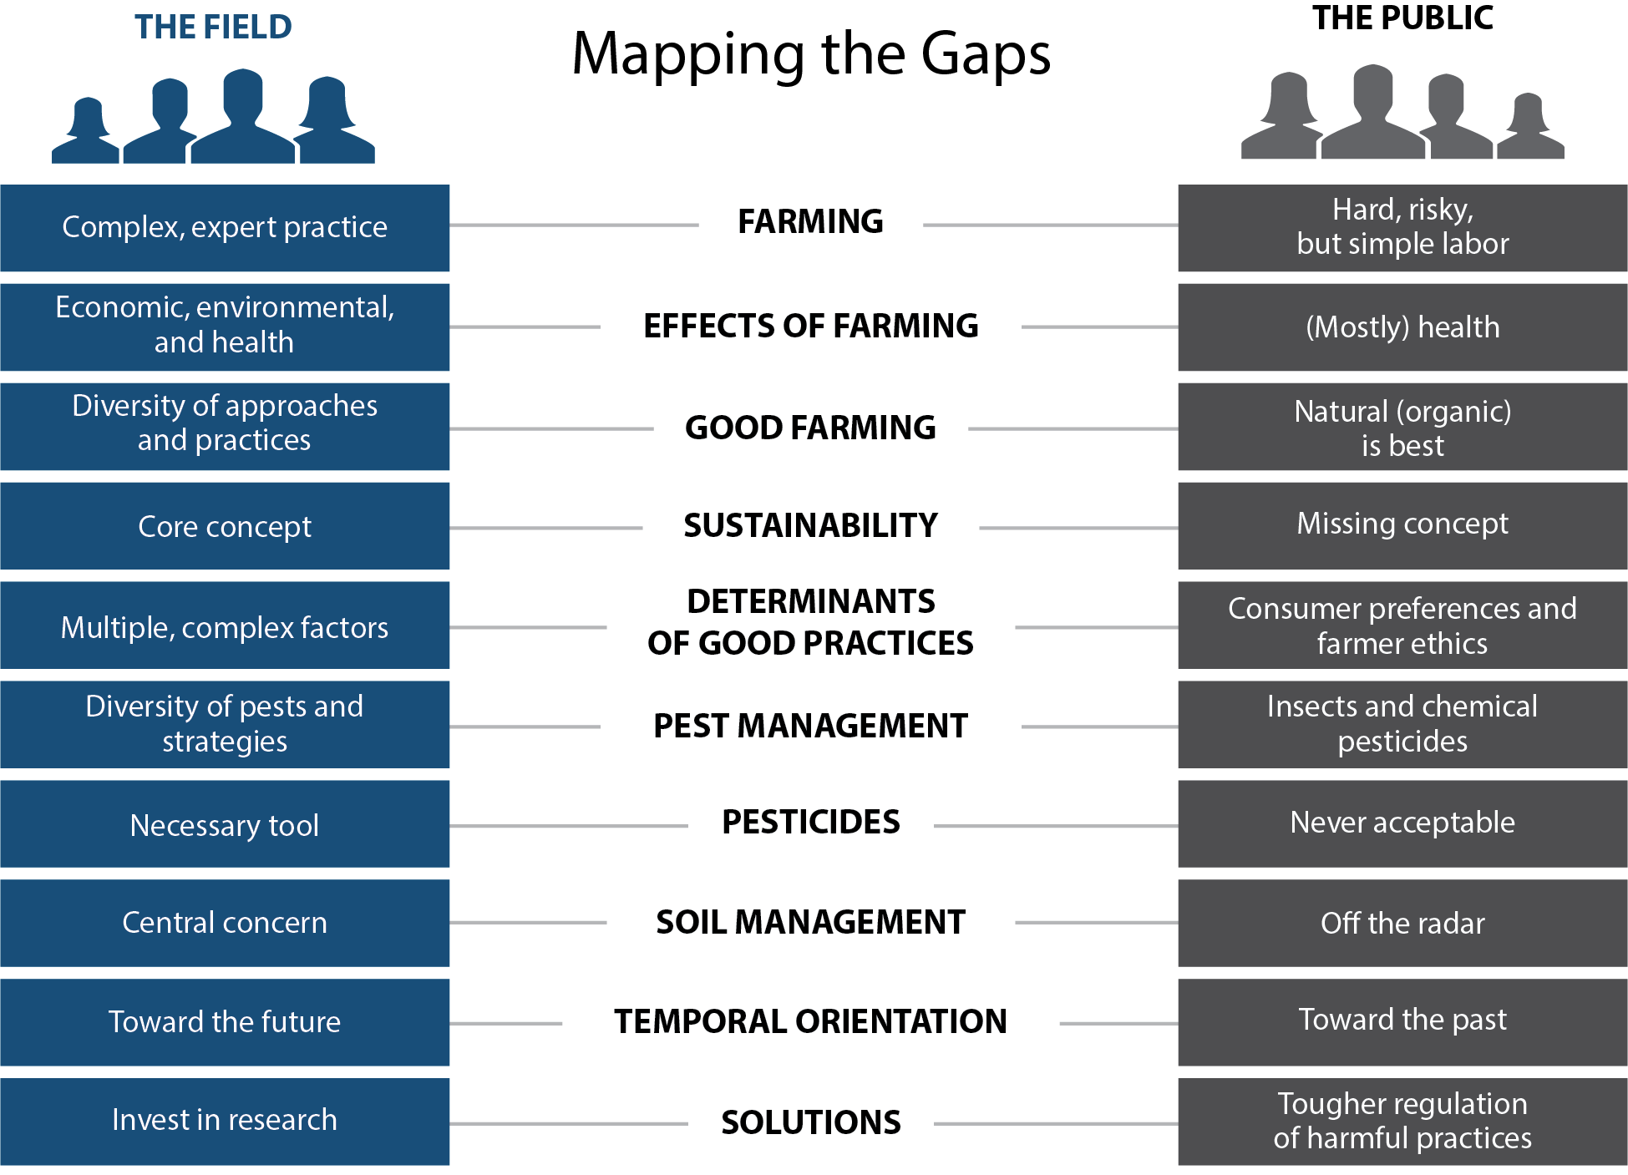

Slide 11
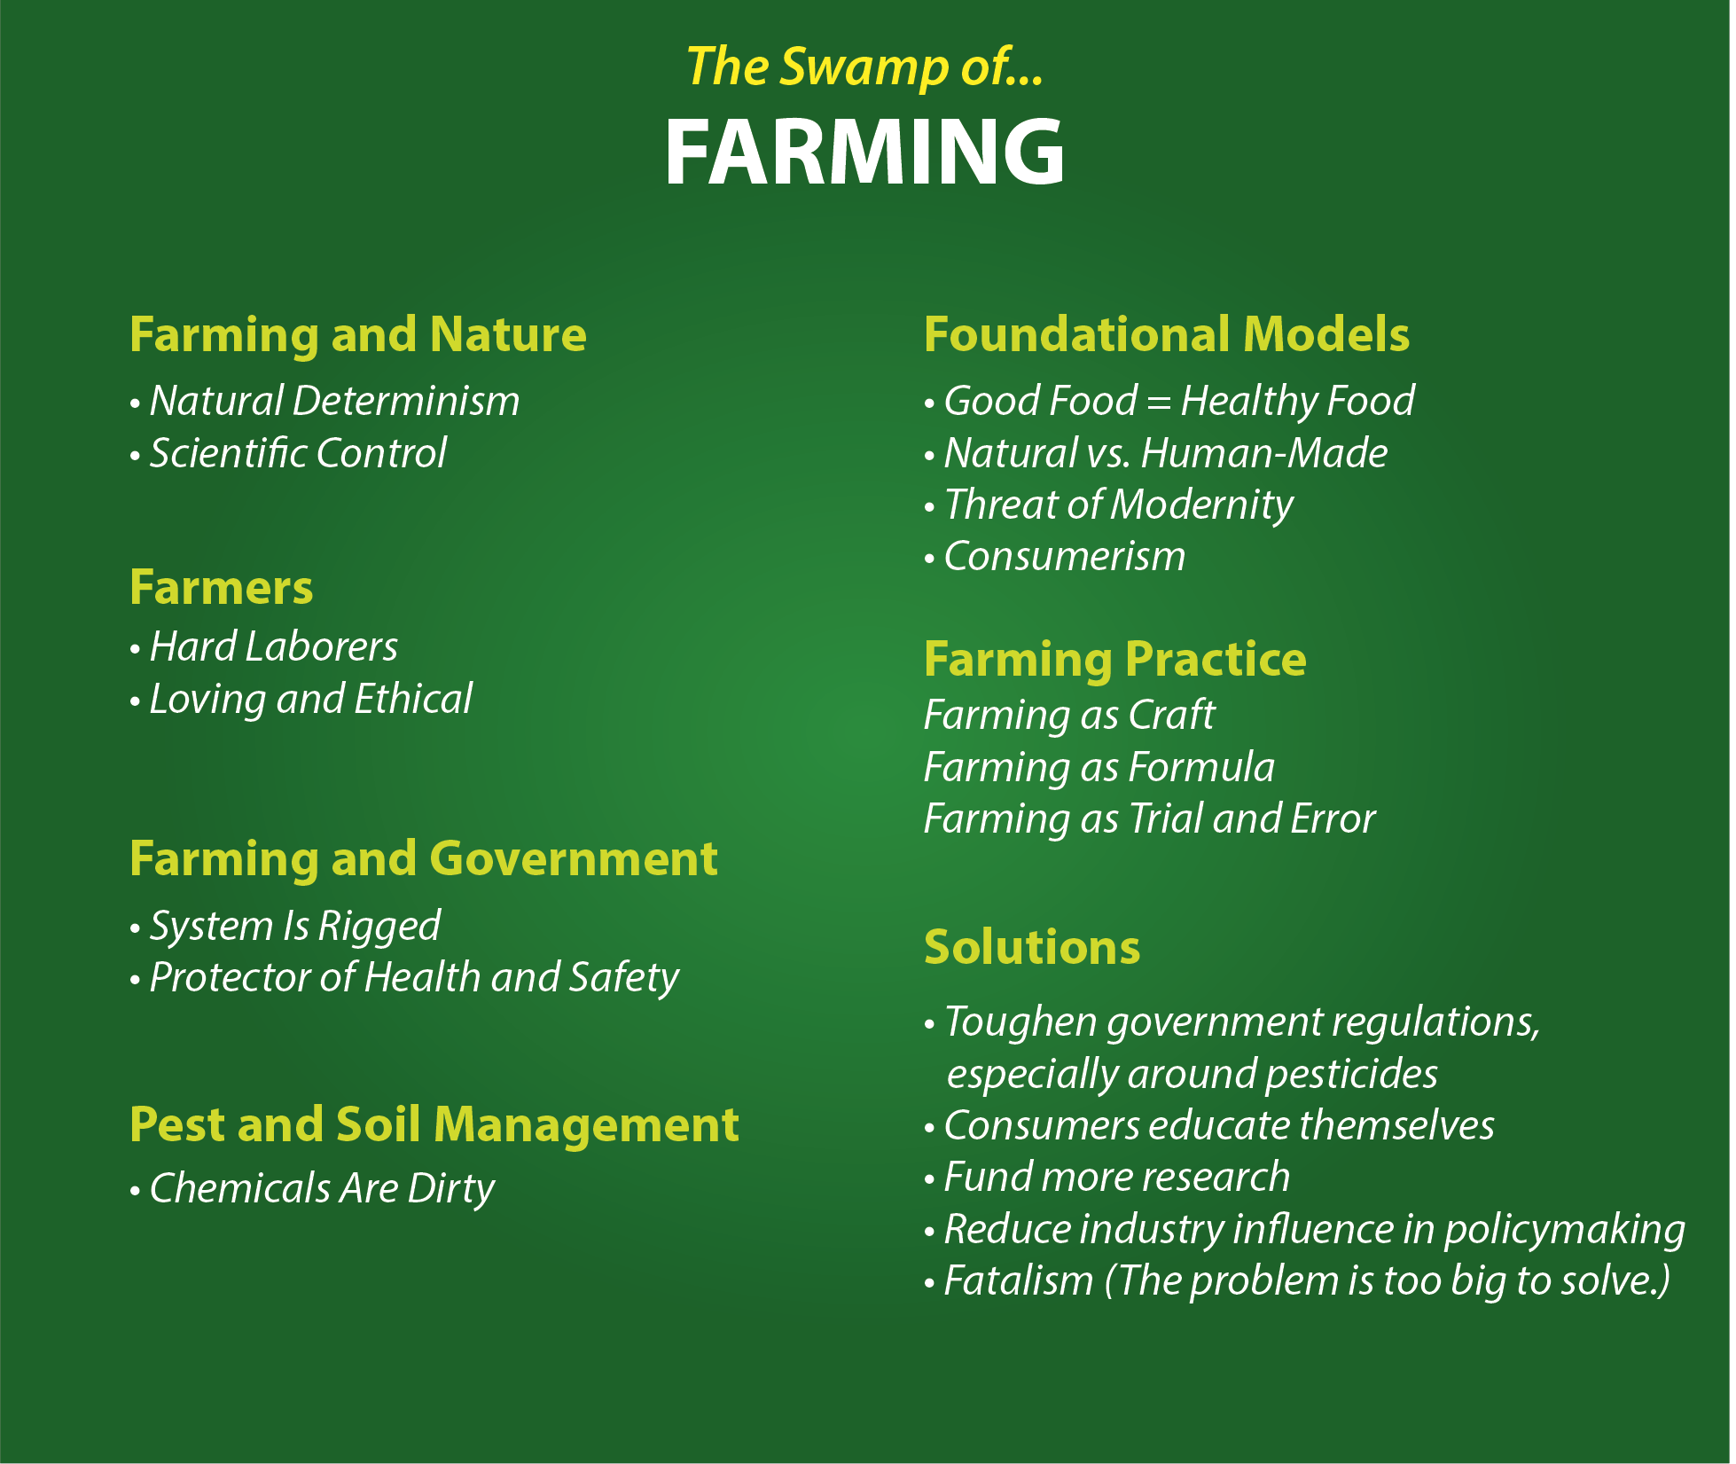

Slide 12
Core Concepts to Communicate
Farming involves complex decision-making and risk management.
Farming is a business where it is challenging to make a profit.
Because farming is diverse in both scale and practice, there are many approaches to sustainable farming, but they all involve integrating multiple goals (economic, environmental, and social).
Farming practices that benefit the environment and society can be expensive for farmers yet go unacknowledged and undercompensated by society.

Slide 13
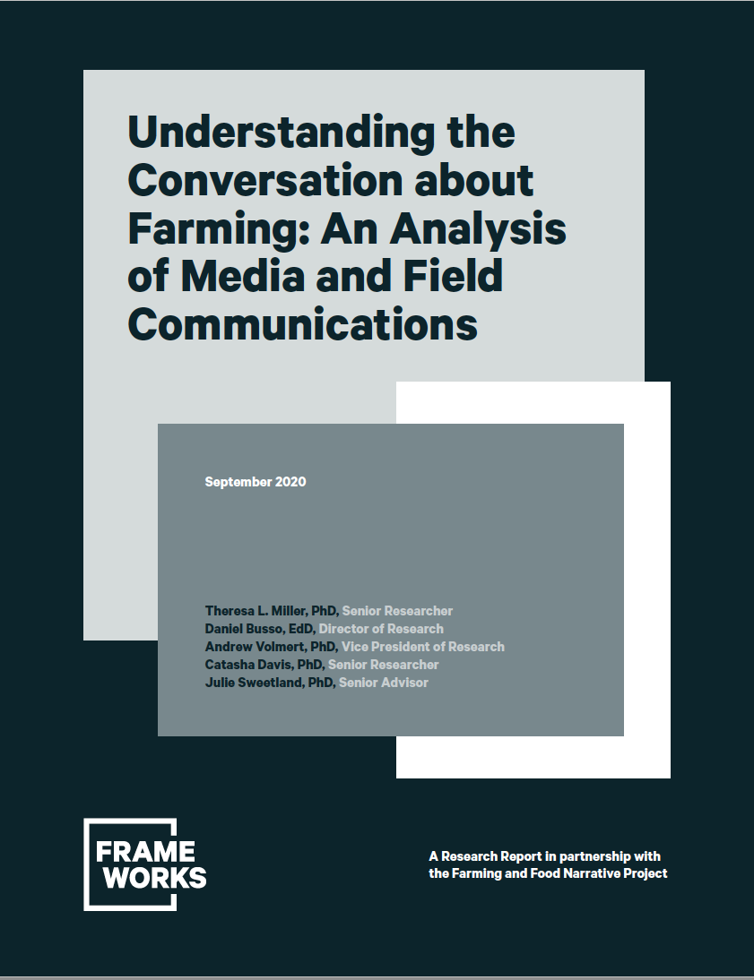
How are farming and its impacts portrayed?
How are farmers portrayed?
How is pest management portrayed?

Slide 14
General Takeaways
General media – Farmers are older, white males at the mercy of weather and macro-economic forces. Descriptions romanticized and nostalgic for a simple agrarian past.
Farming media – Describes farming using terms that are understood in the field but not by the public.
  No-till farming, adaptive soil health systems, sustainability, science-based decision making, bioenergy feedstocks
Neither provide clear explanations of pest management practices.

Slide 15
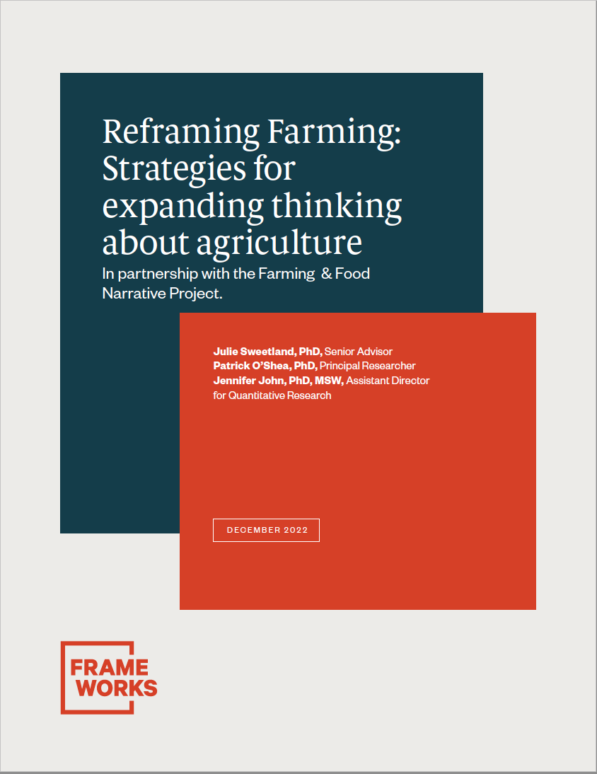

Slide 16
Recommendations
Start with farming, not food
Make the story about interconnection
Show how adjusting farming practices and policies can contribute to the type of communities we want
Talk about the tightrope that farms must cross
Tell science-rich stories about innovative practices on farms
Speak directly to historic and contemporary inequities

Slide 17
Start with farming, not food
When we start with food…
  We evoke people’s direct experience with food, we prompt them to think only like consumers
  The public focuses on individual risk rather than broader systems
Starting with farming allows for people to begin grappling with the complexity of farming

Slide 18
Make the story about interconnection
Shared values messaging
Taps into the belief that farms are essential
Boosts people’s sense that farming is an important profession and allows space to think of farming as complex rather than simple manual labor

Slide 19
Show how adjusting farming practices and policies can contribute to the type of communities we want
Farming is often far out on the horizon in public thinking and public discourse
Connecting on-farm challenges with off-farm concerns is an important way to build public understanding that there are multiple ways to farm sustainably, and multiple aspects of sustainability

Slide 20
Talk about the tightrope that farms must cross
Can help explain risky, complex decision making in farming and how current policy and market conditions make balance more difficult
Testing showed the tightrope metaphor was “sticky”
  Person to person communication
  Helped people incorporate additional information to increase understanding

Slide 21
Tell science-rich stories about innovative practices on farms
When our explanations invite people into a scientific view of a topic, we pique their curiosity and tap into the deep American love of ingenuity and the belief that science and technology can solve problems
Disrupts “good/bad” thinking about farming practices; offers a way to talk about practices with the public that lead to more accurate, nuanced, and inclusive understanding of ‘good farming’

Slide 22
Pest Management Communication Is Difficult
Limit use of words with pest as a root
  Be more specific – insect, disease resistant varieties, herbicide
Tell science rich stories (Appeals to curiosity and love of ingenuity)
  Offer essential background
  Provide examples of biological interventions
  Talk about barriers or trade-offs
  Provide a balanced, realistic solution

Slide 23
Example – part 1 of 2
(Background) Farmers can’t sell food that has been damaged by insects or diseases, so to stay in business, they must make decisions that keep these problems from harming their crops.
(Biological intervention) Many farmers use special traps that help them monitor insect lifecycles and migration patterns. By knowing exactly what insects are around, and when their feeding patterns are about to spike, farmers can select the right treatment and apply it at just the right time. A precise approach is more effective, less expensive, and minimizes environmental problems and risks related to treatments.

Slide 24
Example – part 2 of 2
(Barriers) But monitoring and targeted control takes time and money that farmers are generally not compensated for when they sell their crops. This means that even when they want to adopt practices like monitoring insects with traps, they are not able to take the business risk.
(Balance) We need to change our farming policies and market design so that it’s easier and more accessible for farmers to take on more intensive, precise approaches to managing insects and diseases that make human health and environmental protection a priority. We also need to recognize that problem solving in farming is context-dependent—farmers will apply different solutions to different crops in different climates, soil types, and locations. By supporting farmers’ investments in resource-intensive approaches to warding of insects and crop diseases, we can build a more stable farming system that is good for business, good for people, and good for the planet.

Slide 25
Speak directly to historic and contemporary inequities
People with farming expertise have a unique contribution to make to the nation’s continuing conversation about economic inequality, democratic norms, racial injustice, and gender roles.
If farming voices don’t participate, it’s easy for both the sector and its needs to continue to be overlooked.

Slide 26
Key Take Away
Be aware of common mental frames in the public and navigate them to achieve the purposes of your communications
www.farmingandfoodnarrative.org

