Slide 2
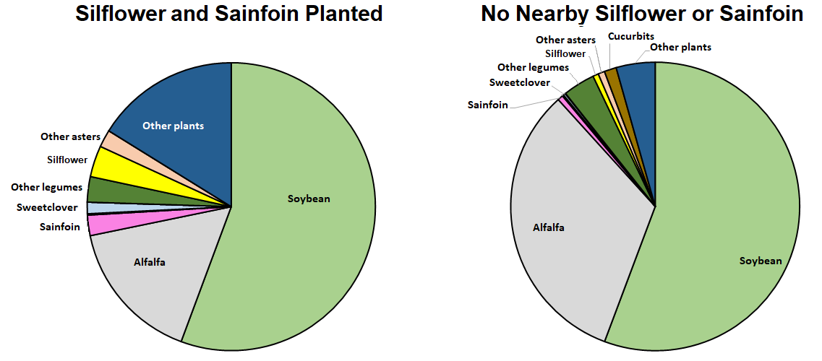
The pie chart on the left is the DNA from honey samples at the Assaria field. From 2022-2024. The pie chart on the right is data from the Rock Quarry, 2023-2024. On average, the honey from Assaria was about 3.5% silphium while the Rock Quarry was 0.6% silphium. Sainfoin content was 2.3% at Assaria and 0.6% at the Rock Quarry.
Notes:
The pie chart on the left is the DNA from honey samples at Charlie’s field. From 2022-2024. The pie chart on the right is data from the Rock Quarry, 2023-2024. On average, the honey from Charlie’s field was about 3.5% silphium while the rock quarry was 0.6% silphium. Sainfoin content was 2.3% at Charlie’s and 0.6% at the rock quarry.

Slide 3
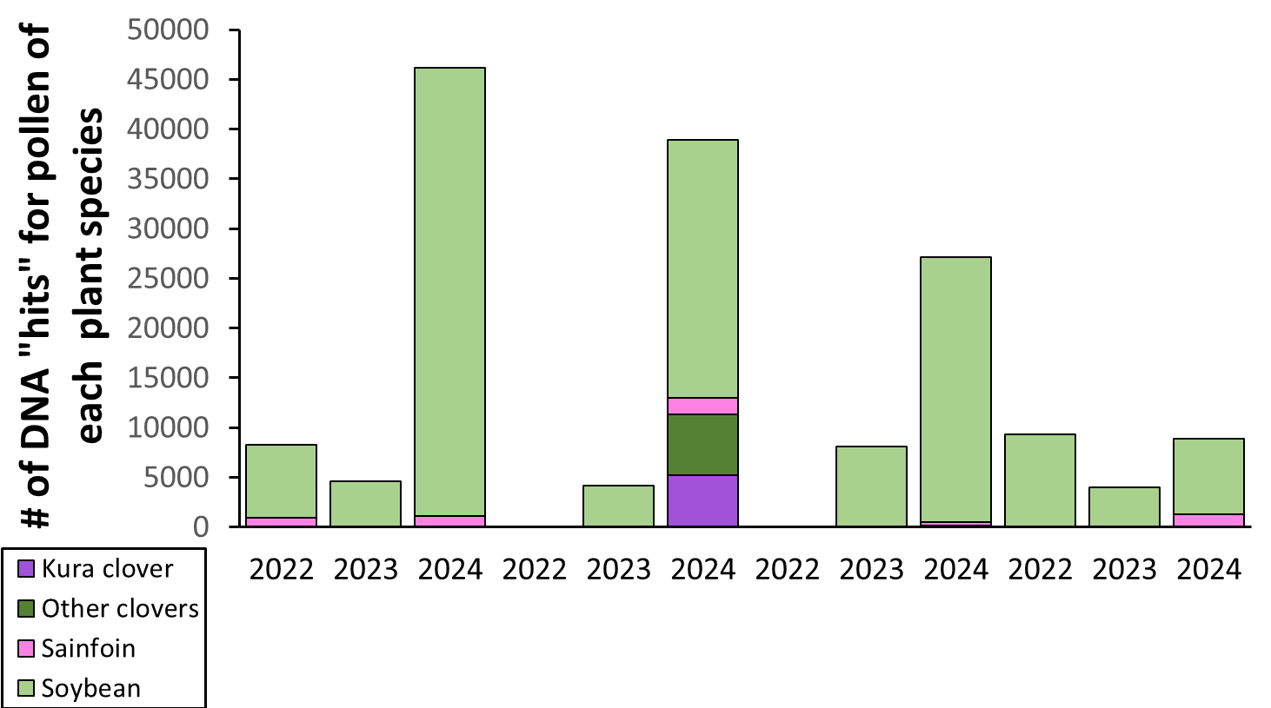
Honey harvest (lbs)
278
486
238
275
4.5
213
213
57
163
16
Charlie’s
Farm
Rock Quarry
Finch
More DNA “hits” in a honey sample means the bees were getting more nectar from those plant species. On average, the more sainfoin, clovers, and soybean pollen in the honey, the higher the honey yield.
Notes:
The pie chart on the left is the DNA from honey samples at Charlie’s field. From 2022-2024. The pie chart on the right is data from the Rock Quarry, 2023-2024. On average, the honey from Charlie’s field was about 3.5% silphium while the rock quarry was 0.6% silphium. Sainfoin content was 2.3% at Charlie’s and 0.6% at the rock quarry.

Slide 4
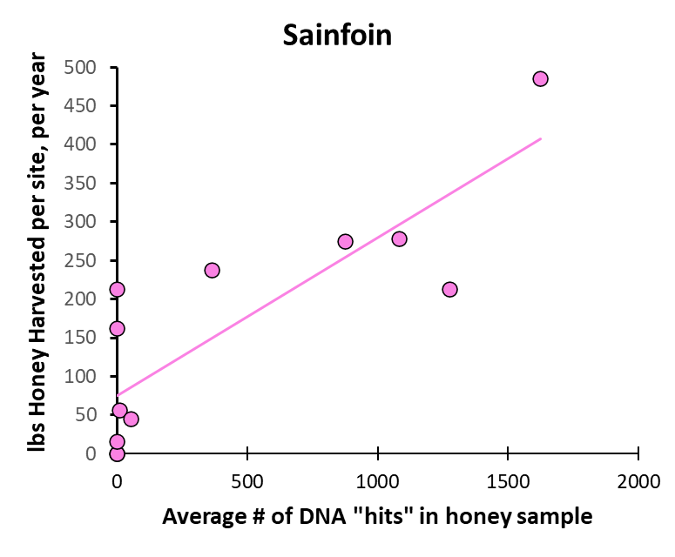
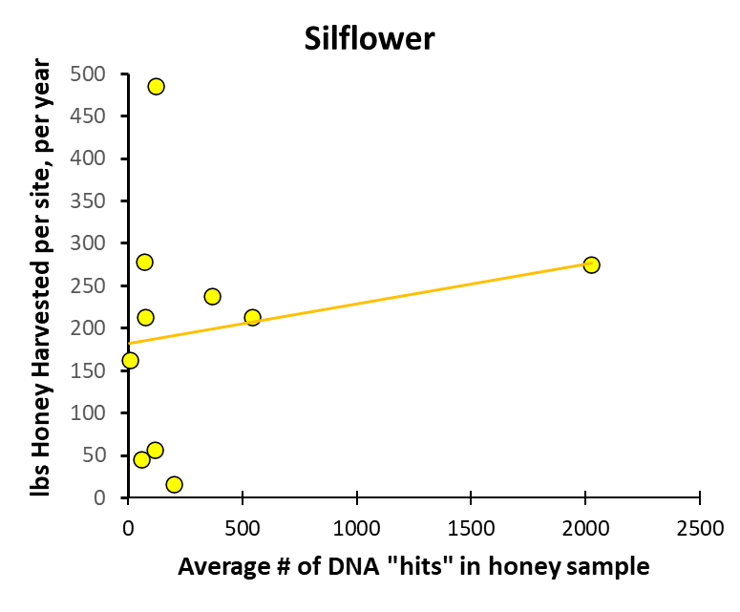
Here’s another way of looking at the DNA. Hives that had more sainfoin pollen in their honey had, on average, higher honey yields than hives with less sainfoin pollen. But there wasn’t a strong relationship between how much silflower pollen in the honey samples, and how much honey those hives produced.

Slide 5
Conclusions
While we did observe honeybees feeding on silflower, silflower doesn’t appear to be the biggest percentage of their diet
The bees also fed on sainfoin. While the sainfoin wasn’t a big % of their nectar source, hives that had more sainfoin pollen in their honey tended to have higher honey yields.
Bees also had higher honey yields when foraging on soybeans and clovers

