Slide 1
Verticillium Wilt Management for Organic Strawberry
Joji Muramoto¹, Steven Koike² and Carol Shennan¹
¹Univ. of California, Santa Cruz
²Univ. of California, Cooperative Extension, Monterey County

Slide 2
Outline
  What is Verticillium Wilt?
  Management for organic strawberries: crop rotations
  Anaerobic soil disinfestation (ASD)
  Goals of the two projects

Slide 3
What is Verticillium Wilt? (1)
Well-known disease that affects over 300 plant species throughout the world
Susceptible crops in CA:
  Fruit crops; avocado, caneberry, grape, olive, pistachio, apricot, nectarine, peach, strawberry
  Field crops; alfalfa, cotton
  Vegetables; artichoke, some cole crops, cucurbits, eggplant, lettuce, pepper, potato, spinach, tomato
  Ornamental plants; chrysanthemum, geranium, gerbera, marigold, snapdragon, stock, maple tree
Over 100 weed species also host this disease

Slide 4
What is Verticillium Wilt? (2)
Symptoms in strawberry: poor growth, wilting, and dieback of foliage
Can be accentuated by stress from environmental extremes, delayed irrigation, or the bearing of a heavy fruit load
Similar symptoms with Fusarium wilt and charcoal rot…..need laboratory analysis for confirmation

Slide 5
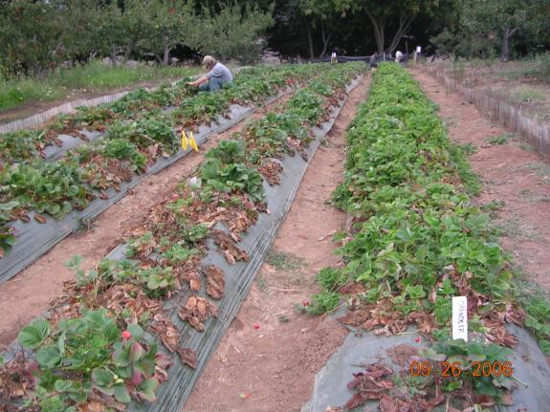
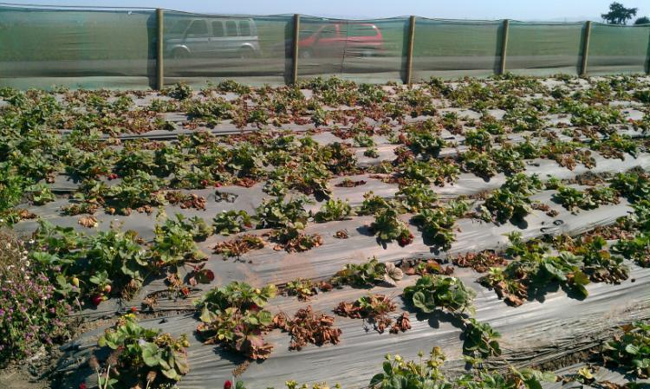
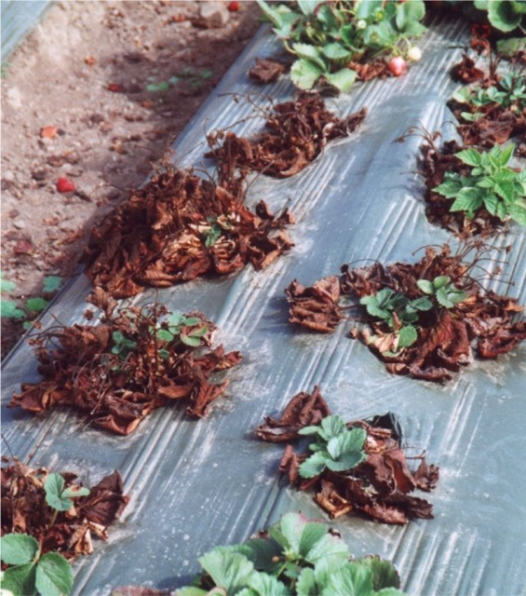
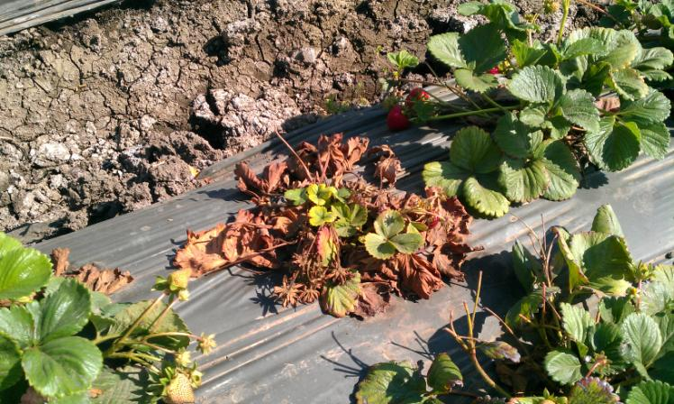
Verticillium Wilt caused by
Verticillium dahliae

Slide 6
What is Verticillium Wilt? (3)
Causal agent: the fungus Verticillium dahliae
Survives in the soil and on crop residues as tiny, dormant structures (microsclerotia) for 8 to 10 years without host crops
Disease is enhanced at temperatures between 68 and 78 °F (cool to moderate weather)

Slide 7
Management for Organic Strawberry
Preventive measures!!
  Very few options if Verticillium wilt starts to occur
Avoid infested fields
Choose good crop rotation
Reduce plant stress
Avoid bringing Verticillium into fields
Integrate all!

Slide 8
Management for Organic Strawberry
Preventive measures!!
  Very few options if Verticillium wilt starts to occur
Avoid infested fields
Choose good crop rotation
Reduce plant stress
Avoid bringing Verticillium into fields
Integrate all!

Slide 9
Sites to Avoid (Site Selection)
Frequently planted to berries
Known problems with diseases
Established pathogen populations
Lettuce fields with Vert. problems
Pathogen pressure from adjacent sites
Poor soil and water factors:
  poorly draining, heavy, or shallow soils;
  high soil/water salinity; low fertility soils

Slide 10
Crop Rotation for Strawberry
  Common method to avoid soil-borne diseases in strawberries worldwide
    20-30% of strawberries in the world are produced by rotation-based IPM approach without using chemical fumigation
    Minimum of a 3-year break between two strawberry plantings in EU and Northeast US and Canada

Slide 11
Crop Rotation for Organic Strawberry
Mandatory by USDA National Organic Program (NOP)
Avoid host crops for 3 to 5 years between two strawberry crops
Keep record of crop history for each field

Slide 12
Host Crops vs. Non-host Crops
Host crops
  caneberry (raspberry, blueberry, blackberry etc), artichoke, cucumber, eggplant, lettuce, cabbage, pepper, potato, spinach, tomato
Non-host crops
  cauliflower*, celery, parsley, radicchio, onion, bean, pea, carrot, sweet potato, asparagus
  * host different strain of Verticillium from one that is hosted by strawberry
Suppressive crop
  broccoli

Slide 13
Good Rotation or Bad Rotation?
Year 1 | Year 2 | Year 3 | Year 4 | Year 5
Strawberry | Potato | Strawberry | Pepper | Strawberry
Strawberry | Sweet potato | Tomato | Spinach Lettuce | Strawberry
Strawberry | Spinach Broccoli | Cauliflower Cabbage | Broccoli Lettuce | Strawberry
Strawberry | Lettuce Broccoli | Onion | Carrot | Strawberry
Strawberry | Bean | Carrot | Broccoli | Strawberry

Slide 14
Good Rotation or Bad Rotation?
Year 1 | Year 2 | Year 3 | Year 4 | Year 5
Strawberry | Potato | Strawberry | Pepper | Strawberry
Strawberry | Sweet potato | Tomato | Spinach Lettuce | Strawberry
Strawberry | Spinach Broccoli | Cauliflower Cabbage | Broccoli Lettuce | Strawberry
Strawberry | Lettuce Broccoli | Onion | Carrot | Strawberry
Strawberry | Bean | Carrot | Broccoli | Strawberry
Host
Non-Host
Suppressive

Slide 15
Good Rotation or Bad Rotation?
Year 1 | Year 2 | Year 3 | Year 4 | Year 5
Strawberry | Potato | Strawberry | Pepper | Strawberry
Strawberry | Sweet potato | Tomato | Spinach Lettuce | Strawberry
Strawberry | Spinach Broccoli | Cauliflower Cabbage | Broccoli Lettuce | Strawberry
Strawberry | Lettuce Broccoli | Onion | Carrot | Strawberry
Strawberry | Bean | Carrot | Broccoli | Strawberry
BAD
BAD
Too many Brassicas
Maybe Okay
Good
Host
Non-Host
Suppressive

Slide 16
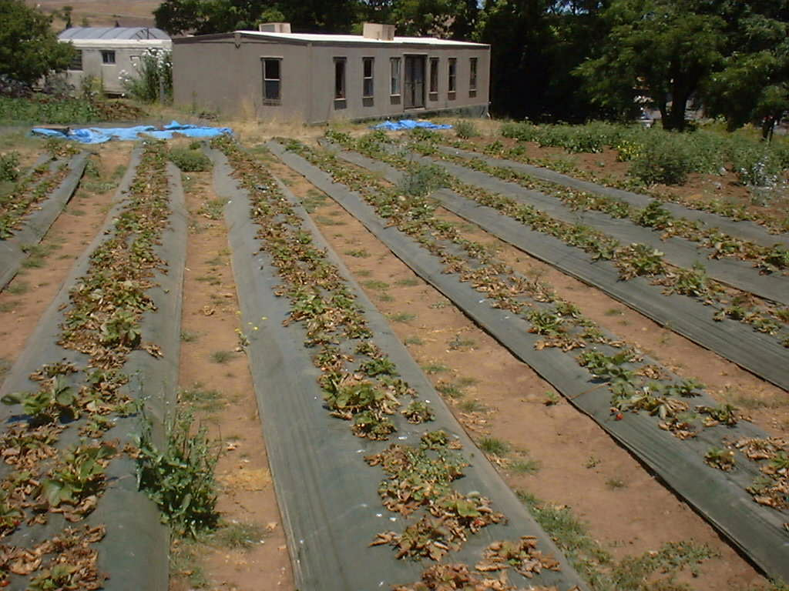
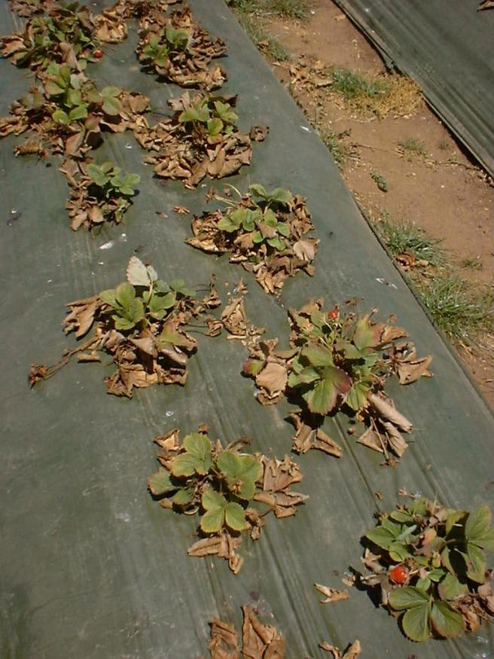
Outbreak of Verticillium wilt + Phytophthora root rot at CASFS farm in 2001 and 2002

Slide 17
Anaerobic Soil Disinfestation (ASD) for suppressing Verticillium dahliae in CA strawberries
C. Shennan¹, J. Muramoto¹,, M. Bolda⁴, S. T. Koike⁴, O. Daugovish⁴, M. Mochizuki⁴, K. Klonsky⁵, E. Rosskopf³, N. K. Burelle³ , D. Butler^{2,3 ,} S. Fenimore⁵ and J. Samtani⁵
¹Univ. of California, Santa Cruz,
²Univ. Tennessee
³USDA-ARS, U.S. Horticultural Research Lab, Florida,
⁴Univ. of California Cooperative Extension
⁵ Univ. of California, Davis
Funded by USDA-CSREES MBTP 2007-51102-03854 and CA Strawberry Commission

Slide 18
ASD: Background
Developed as alternative to Methyl bromide fumigation in Netherlands (Blok et al., 2000; Doug et al., 2004) and Japan (Shinmura & Sakamoto, 1998; Shinmura, 2000, 2004)
Controls range of soilborne pathogens and nematodes across a range of crops
In Japan, used by hundreds of farmers in greenhouse production (small scale)

Slide 19
ASD: some target Pests and Crops
Soil-borne pathogens
  Verticillium dahliae^{1,2,4}
  Fusarium oxysporum^{1,2}
  Fusarium redolens²
  Ralstonia solanacearum²
  Rhizoctonia solani¹
  Sclerotium rolsfii³
Nematode
  Meloidogyne incognita¹
  Pratylenchus fallax²
Weed
  Nutsedge³
Crops tested
  Welsh onion²
  Tomatoes²
  Strawberries^{2,4}
  Eggplant^{2, 3}
  Spinach²
  Peppers³
  Maple¹
  Catalpa¹
  ^{1:} Dutch studies ²: Japanese studies ³: Florida studies ⁴ California

Slide 20
ASD: Mechanisms
      Accumulation of toxic products from anaerobic decomposition (e.g. organic acids, volatiles)
      Biocontrol by anaerobic microorganisms
      Low pH
      Lack of oxygen
      Toxicity of Fe²⁺ and Mn²⁺
      Combination of all of these

Slide 21
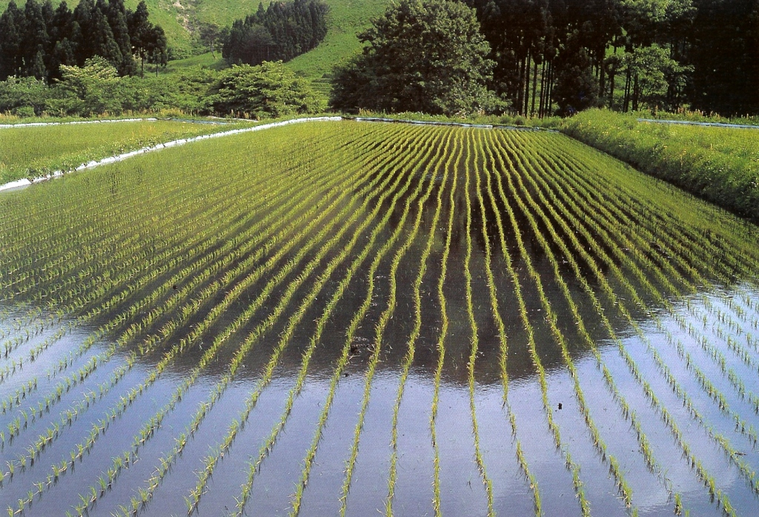
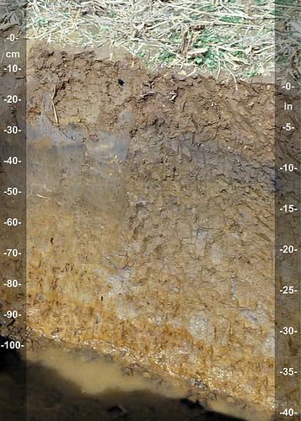

Slide 22
Findings to date:
1. Can get consistently good V. dahliae suppression - 80 to 100%
2. Good yields obtained
    Ventura 2011 – 75% increase yield over UTC
    Castroville 2011- as good or better than pichlor
    Watsonville 2011 – equal to pichlor and steam
3. Standard tarp appears as effective as TIF and VIF (from pot and field studies)
4. Limited weed control (use opaque plastic)

Slide 23
Five Steps for Rice Bran-based ASD
  Step 1: Planning (When? Where?)
  Step 2: Rice bran application & incorporation
Step 3: Drip tapes and plastic mulch application
Step 4: Drip irrigation
Step 5 : Monitoring anaerobic decomposition

Slide 24
  When?
  The warmest time of the year
  Needs > 65 °F at 6” soil depth at least during the first week of the ASD treatment

Slide 25
  Where?
  Fields recently planted with a host crop
  Field with known disease pressure

Slide 26
Good Rotation or Bad Rotation?
Year 1 | Year 2 | Year 3 | Year 4 | Year 5
Strawberry | Potato | Strawberry | Pepper | Strawberry
Strawberry | Sweet potato | Tomato | Spinach Lettuce | Strawberry
Strawberry | Spinach Broccoli | Cauliflower Cabbage | Broccoli Lettuce | Strawberry
Strawberry | Lettuce Broccoli | Onion | Carrot | Strawberry
Strawberry | Bean | Carrot | Broccoli | Strawberry
BAD
ASD
BAD
Too many Brassicas
Maybe Okay
Good
Host
Non-Host
Suppressive

Slide 27
  Step 2: Rice Bran application & incorporation (Option 1)
Rice Bran: 9 tons/acre
Broadcast with a manure spreader, then incorporate with a rototiller

Slide 28
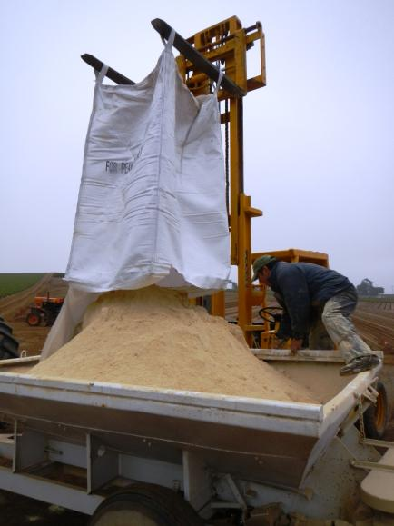
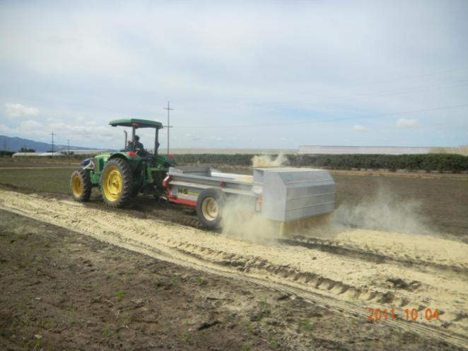
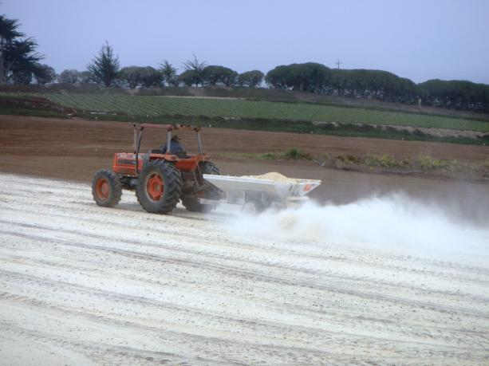
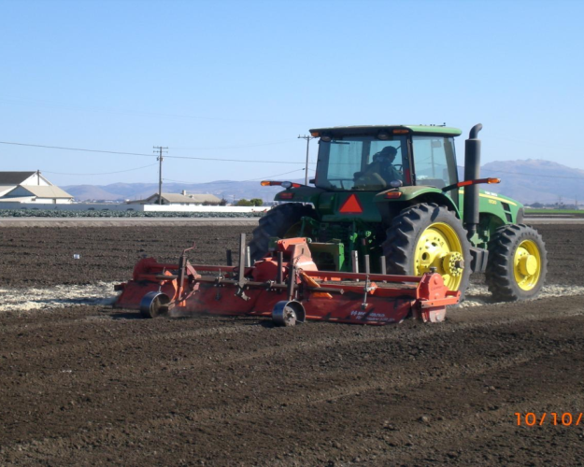

Slide 29
  Rice Bran incorporation after broadcasting
Best: Rototiller (~6” depth. Uniform incorporation)
Okay: Pulling discs from multiple directions
? Maybe not good: Chisel (drop carbon sources to deep layer, uneven mixing)

Slide 30
  Step 2: Rice Bran application & incorporation (Option 2)
Rice Bran: 9 tons/acre
Bed-top application with a special spreader, then incorporate with a bed shaper-attached rototiller
Concentrate rice bran to bed area

Slide 31
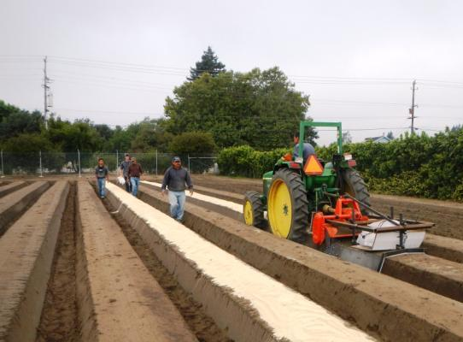
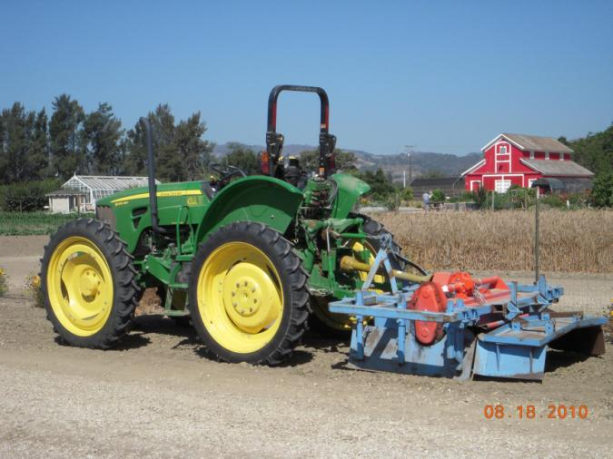
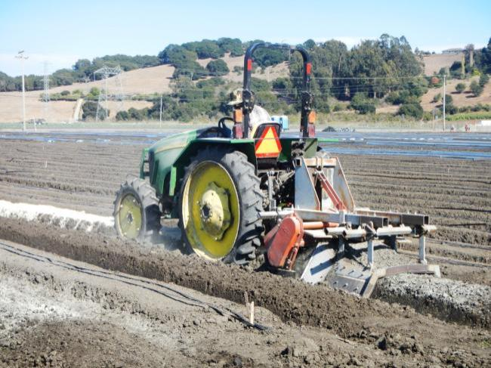
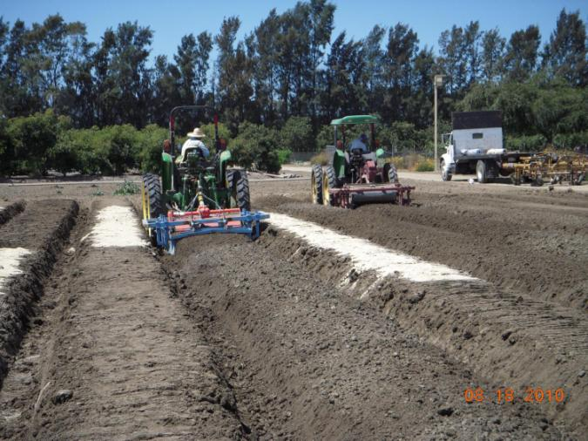

Slide 32
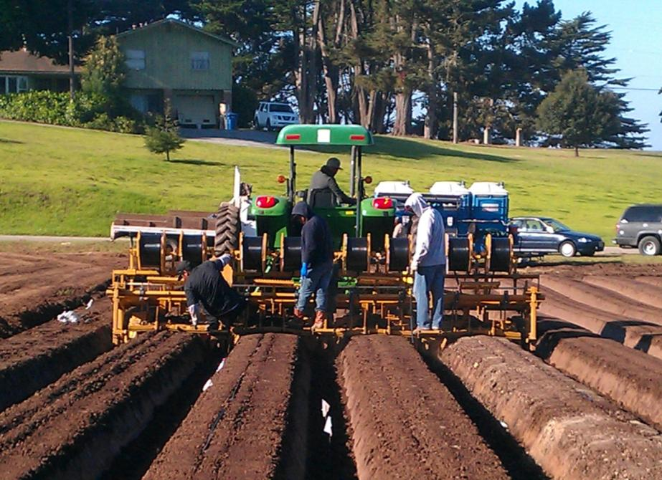
  Step 3: Drip tapes and plastic mulch application

Slide 33
Drip Tapes
2 lines per 48”- 52” center-to-center bed
2 to 3 lines per 64” center-to-center bed
Either low flow or high flow tapes worked fine

Slide 34
Plastic mulch
Regular opaque plastic mulch works fine (e.g. 1.25 mil green polyethylene film)
TIF, VIF did not make difference
Clear mulch…..increase soil temp but allow weeds to grow
…Works in warmer regions (e.g. Central valley in CA, Ventura, Florida)

Slide 35
Plastic mulch
Make it air tight as much as possible!
Duct tape for any rips and major holes
Bury edge of tarp

Slide 36
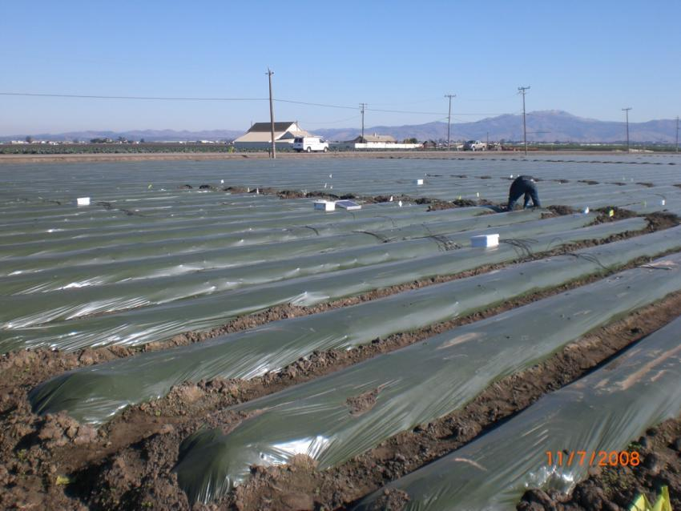
  Step 4: Drip Irrigation

Slide 37
Drip Irrigation
First irrigation: saturate the bed soil w/ 1 (sandy soil) to 2 acre-inches (clayey soil) of drip irrigation
Ideally within 48 hours from bed listing (option 1) or rice bran incorporation (option 2) to avoid loosing the carbon source by aerobic decomposition ….the sooner, the better!
~5 acre block at a time
Do not collapse beds (sandy soil)

Slide 38
First Irrigation
MBA site (Sandy loam)
  52” center-to-center bed width
  2 lines of high flow tapes (0.67 Gallons/min/100 feet)
  4.5 Hours, 1.4 acre-inches
  Bed partially collapsed

Slide 39
First Irrigation
Castroville site (Clayloam)
  48” center-to-center bed width
  2 lines of low flow tapes (0.33 Gallons/min/100 feet)
  10 Hours, 1.6 acre-inches
  Bed never collapsed

Slide 40
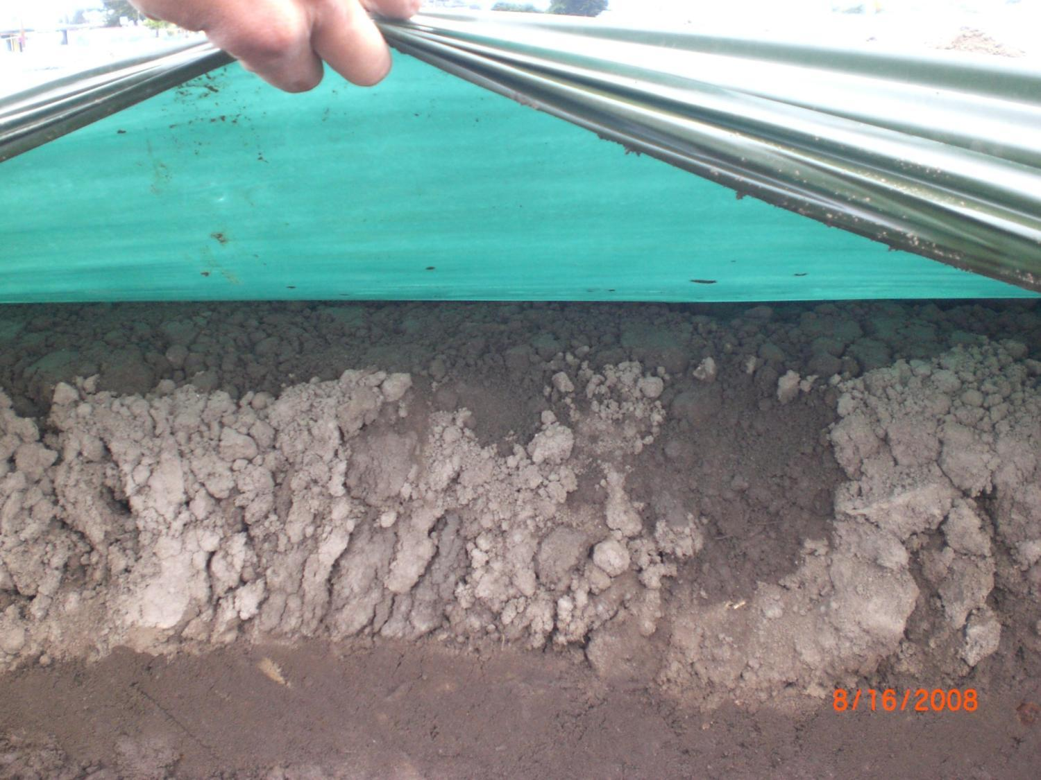

Slide 41
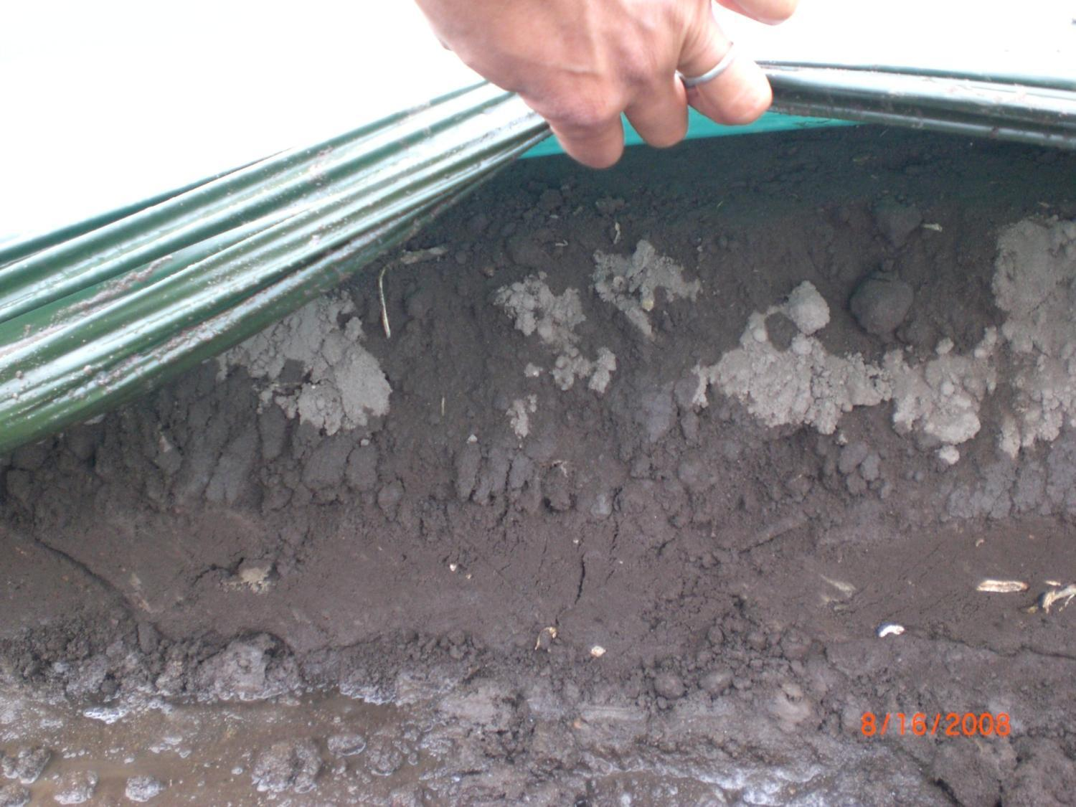

Slide 42
Drip Irrigation
After the first irrigation, maintain above the field capacity for three weeks with intermittent irrigation
Total irrigation rate: ~3 acre-inches for the 3 week period including the first irrigation

Slide 43
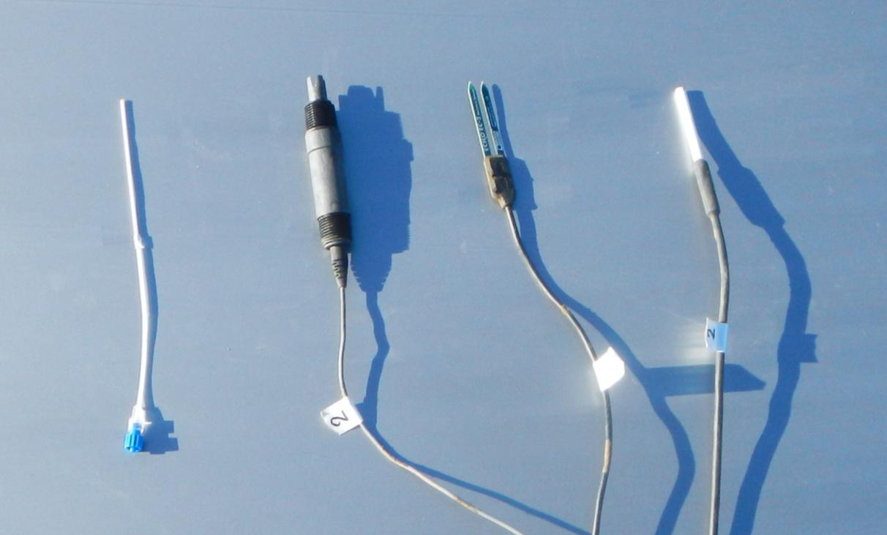
  Step 5: Monitoring Anaerobic Decomposition

Slide 44
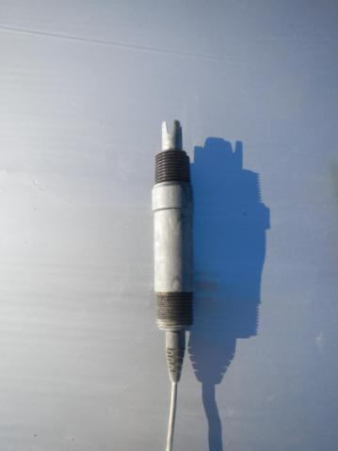
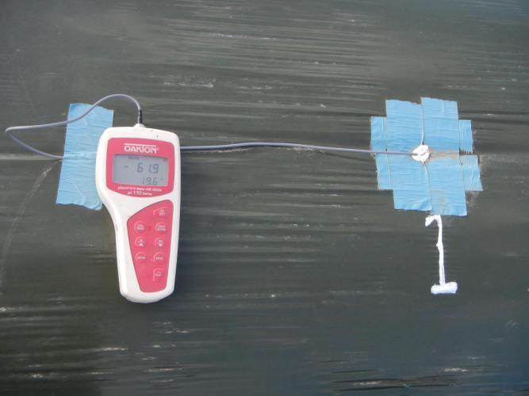
Monitoring Anaerobic Decomposition
ORP sensor
  Measure degree of anaerobisis
  Eh mV
  Sensor $80-100
  Handheld pH/mV meter $200-400
  > 50,000 cum EhmV hrs (under 200 mV threshold)

Slide 45
Monitoring Anaerobic Decomposition
Odor (smell)
  Within a week unpleasant smell of anaerobic decomposition in the field
  Take a core of soil and smell
  Soil core sampler
  Clay soil has less odor

Slide 46
  Other C-sources?
Molasses (liquid)
Grape pomace (skin and seeds)
  ~$180/ton
Summer cover crop
  Sudan grass, buckwheat
Mustard seed meal
1% ethanol (developed in Japan)
  ~$400/ton
Combinations

Slide 47
Remaining questions
1. Does ASD effectively control other soil pathogens like Macrophomina phaseolina and Fusarium oxysporum?
  2. Integration with other practices?....ASD should be a part of crop rotation, ASD + mustard meal
  3. Mechanisms?.....for better integration with other non-chemical options
  4. What is the environmental impacts of ASD?

Slide 48
Trials at ALBA
4-year rotation trial with Rigoberto Bucio
  2011-2014 (Broccoli-Lettuce-Broccoli-Strawberry) ASD, Varying N management
  Evaluate yields, diseases, weeds, economics, N dynamics, Carbon footprint
Demonstration trial
  2012-2013 (broccoli/cauliflower/fallow-strawberries-lettuce)
  ASD, Mustard seed meal (MM), ASD+MM, Untreated check

Slide 49
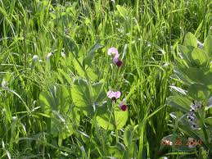
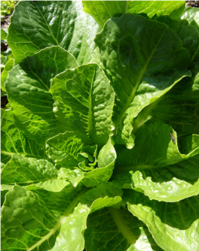
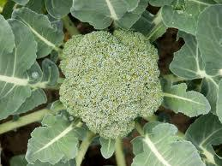
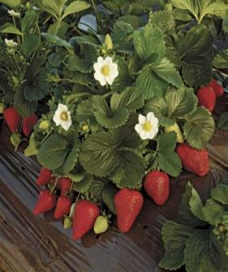
Cal CORE
Network
2011-2015

Slide 50
Project Goals
Expand and strengthen a research-extension-farmer network for organic production on central coastal California and beyond:
  Build our research-extension-farmer network
  Implement integrated on-farm experiments in Santa Cruz, Monterey and Santa Barbara Counties;
  Enable Spanish-speaking growers to participate in network meetings, management of on-farm trials, and workshops
  Organize workshops and field days
  Develop printed educational tools, webinars and online educational resources for nationwide outreach using eOrganic.info.

Slide 51
Project Goals
Evaluate performance of crop rotations and management strategies designed to meet the combined goals of high yields, reduced disease levels, provision of adequate N with minimal environmental impacts and improved C- sequestration

Slide 52
  Participants
    Project leaders: 4
    Carol Shennan (Project Director, UCSC), Joji Muramoto (UCSC), Alexander Gershenson (San Jose State Univ.), and Karen Klonsky (UC Davis)
    Project staff: 5 (UCSC)
    Collaborators – research and extension: 11 (UCCE, CSUMB, USDA-ARS, CDFA, Univ. of New Hampshire, Oregon State Univ.)
    Farmer collaborators: 16
    NGO collaborators: 3
    Industry collaborators: 3 Total: 42 members

Slide 53
  Santa Cruz and Monterey Counties
  Mother – baby trials
    Compare 4 versus 2 year vegetable/strawberry rotations on:
      yield, weed and disease suppression
      soil N, nitrate leaching, denitrification
      C sequestration, methane and carbon dioxide emissions
      economics of production
    Test effectiveness of mustard seed meal for N fertility supply and weed and disease suppression
    Compare Anaerobic Soil Disinfestation (ASD) mustard seed meal and non-host crop rotations on Verticillium wilt and other diseases in strawberries.

Slide 54
 | Year 1 |  |  | Year 2 |  |  | Year 3 |  |  | Year 4
Treatment | Fall 2011 | Winter | Summer 2012 | Fall 2012 | Winter | Summer 2013 | Fall 2013 | Winter | Summer 2014 | Fall 2014 | Winter | Summer 2015
1a | cc | cc | V-B | cc | cc | V – L+C | cc | cc | V-B | asd | S + | S +
2a | cc | cc+c+f† | V-B | cc | cc+c+f | V – L+C | cc | cc+c+f | V-B | asd + c | S + | S +
3a | cc* | cc+mc† | V-B | cc | cc+mc | V – L+C | cc* | cc+mc | V-B | mc | S + | S +
4a | bf | bf | V-B | bf | bf | V – L+C | bf | bf | V-B |  | S | S
5 | Grower’s standard |  | V-B | Grower’s standard |  | V – L+C | Grower’s standard |  | V-B | Grower’s standard | S | S
Baby trial treatments – Experimental Design
Fertility/disease control treatments:
    Cover crop + ASD ----- moderate fertility
    Cover crop + compost/feathermeal +ASD -----high fertility
    Cover crop + mustard seed meal -------- high fertility
    Untreated control -------- low fertility
    Grower’s standard
Vegetable crops: V–B= broccoli; V– L+C =Lettuce + Cauliflower
Strawberry crops: S = strawberry; S + = strawberry + liquid fertilizer

Slide 55
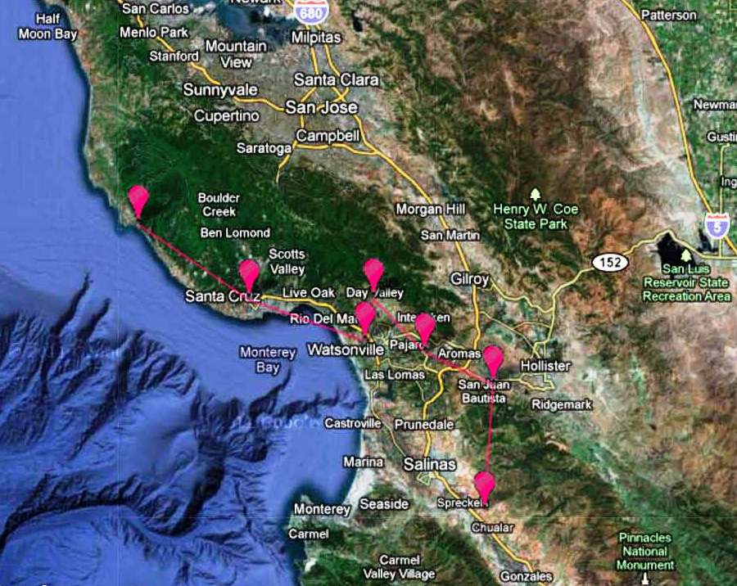
Mother-Baby Trials
70 linear miles in 4 counties

Slide 56
Mother-Baby Trials
Baby 1
SBF
Mother
UCSC
Baby 3
LEF
Baby 4
CAS
Baby 2
HGO
Baby 5
COKE
Baby 6
ALBA
70 linear miles in 4 counties

Slide 57
Mother/Baby Trial Sites (Total: 3.91 acre)
Trial (acre) | Farm | Location | Manager /Contact | Soil type | Soil order | Organic since (yrs as of 2011)
Mother (0.40A) | CASFS-UCSC | Santa Cruz | Darryl Wong | Elkhorn sandy loam | Mollisols | 19 (40+)
Baby-1 (0.65A) | Swanton Berry Farm | Davenport | Tim Campion | Colma sandy loam/Tierra loam | Mollisols /Alfisols | 2003 (8 years)
Baby-2 (0.59A) | High Ground Organics | Watsonville | Steve Pedersen | Tierra/Watsonville complex | Alfisols /Mollisols | 1996 (15 years)
Baby-3 (0.58A) | Live Earth Farm | Watsonville | Tom Broz | Elder sandy loam /Soquel loam | Mollisols | 1998 (13 years)
Baby-4 (0.65A) | Cassidy Ranch | Watsonville | Dan Balbas /Dick Peixoto | Salinas clay loam | Mollisols | 2004 (7 years)
Baby-5 (0.51A) | Coke Farm | San Juan Bautista | Dale Coke | Hanford coarse sandy loam | Entisols | 1996 (15 years)
Baby-6 (0.54A) | ALBA | Salinas | Nathan Harkleroad | Hanford gravelly sandy loam | Entisols | 1991 (20 years)

Slide 58
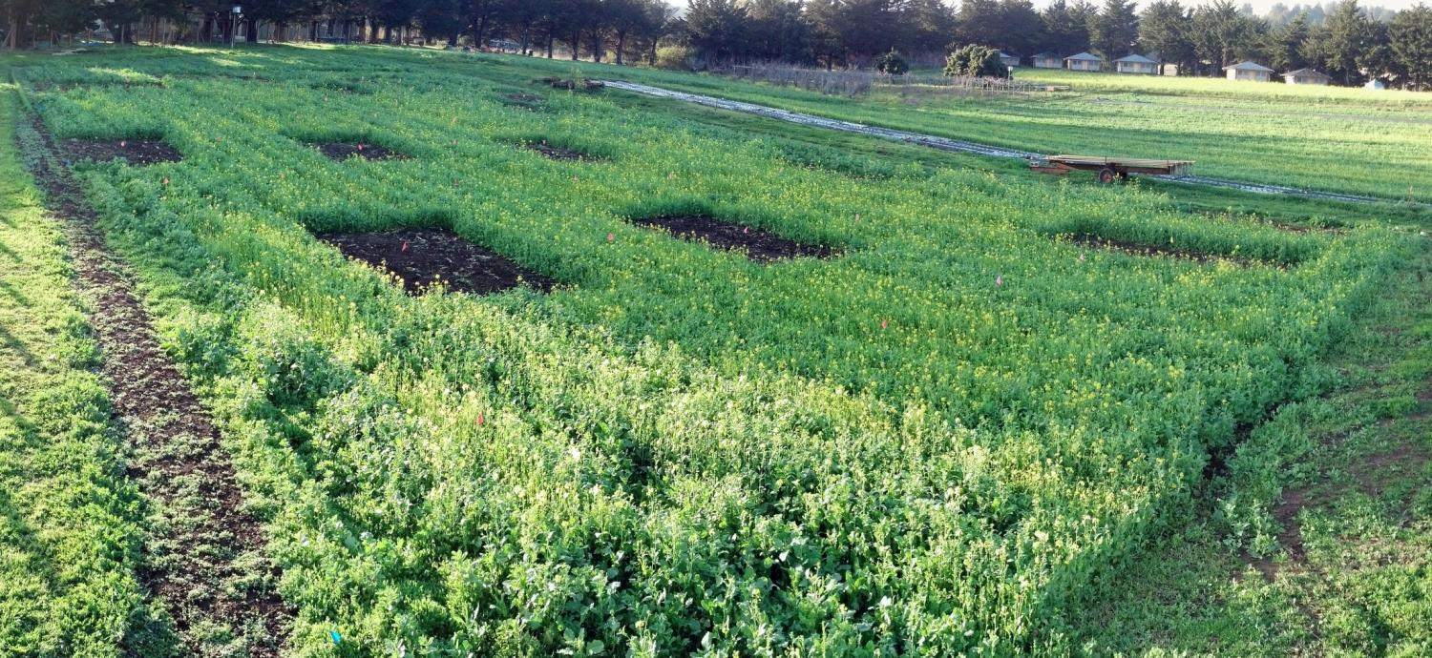
Mother trial - CASFS UCSC

Slide 59
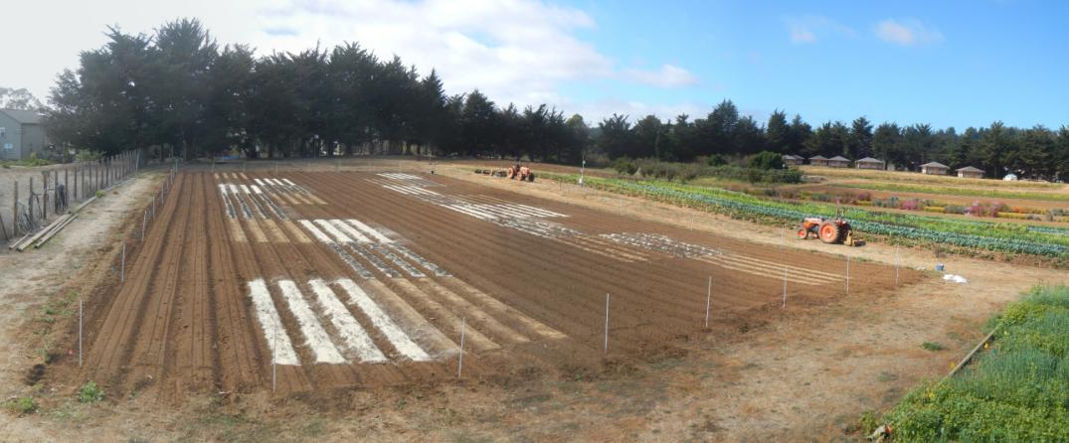
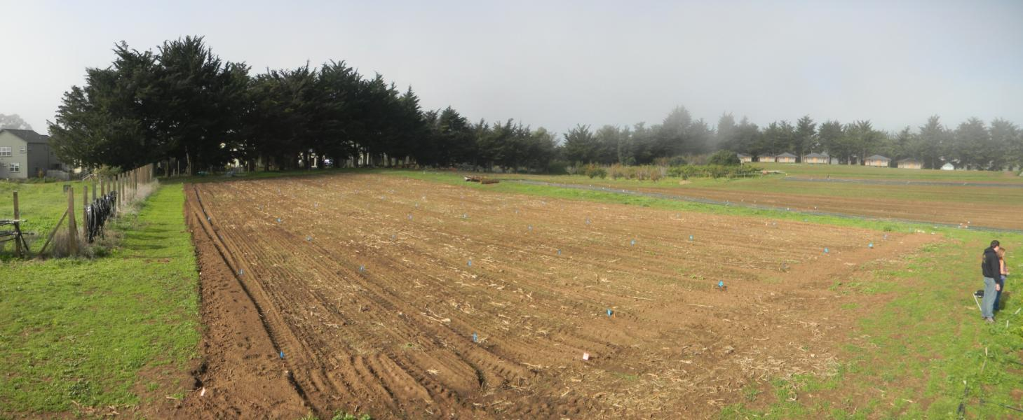
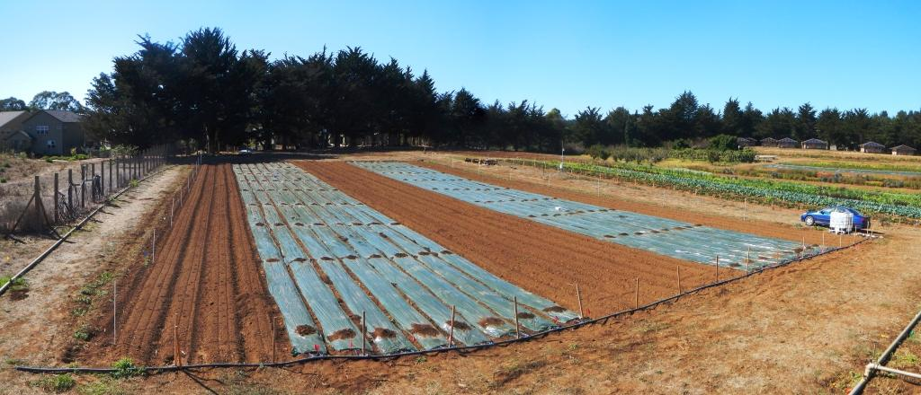
Mother Trial (UCSC Farm. 37 years of organic management
64 plots)

Slide 60
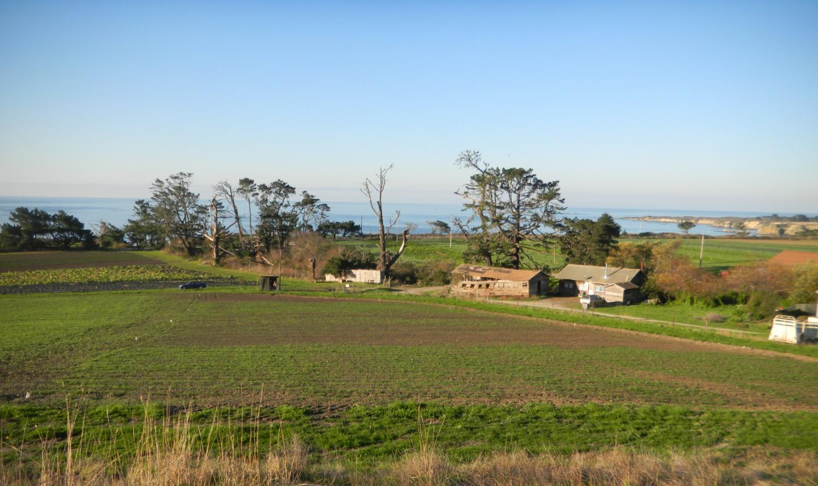
Baby-1 (Swanton Berry Farm. 8 yrs of organic mgmt)

Slide 61
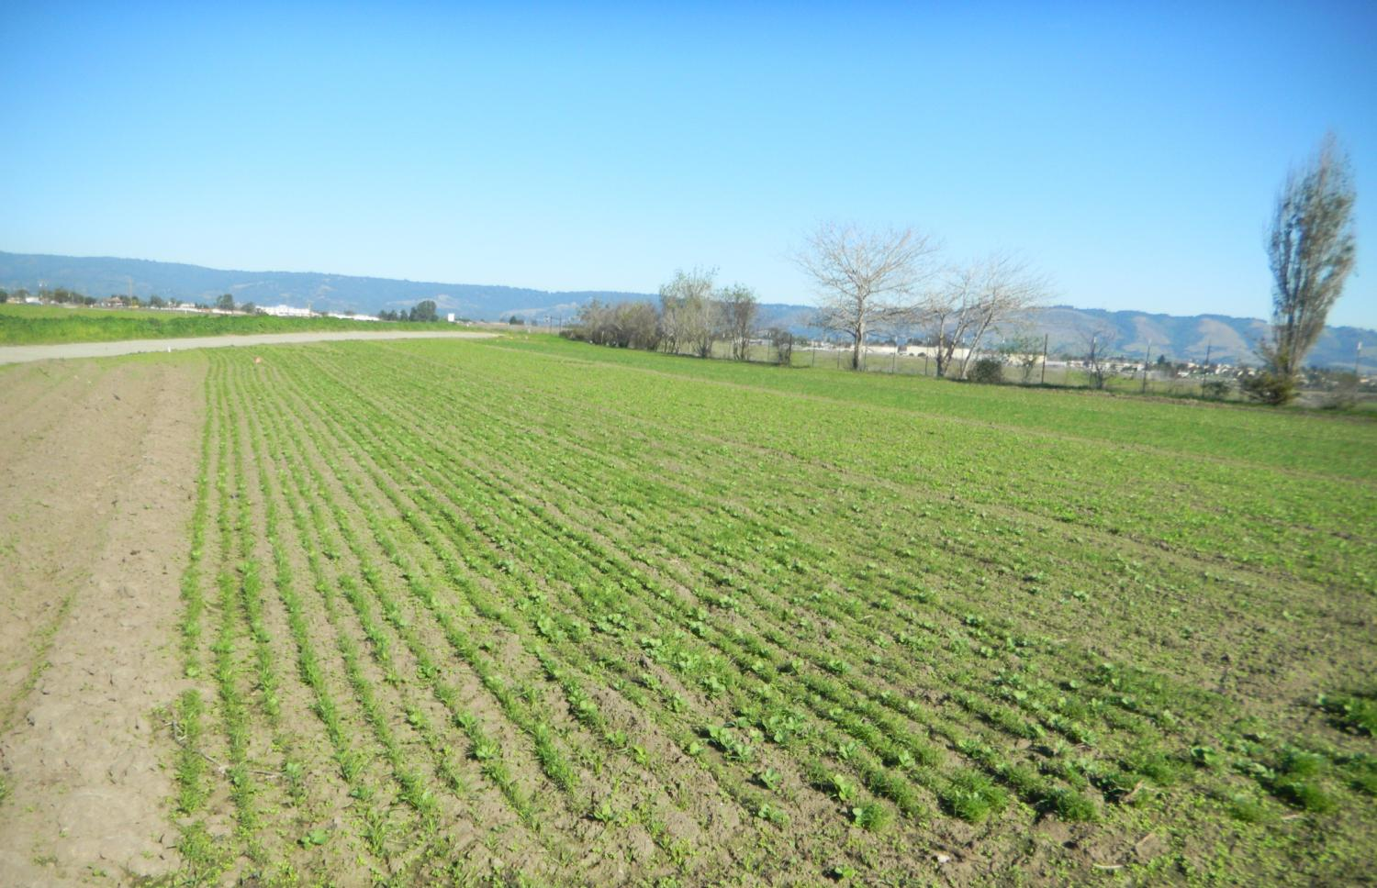
Baby-2 (High Ground Organics. 15 yrs of organic mgmt)

Slide 62
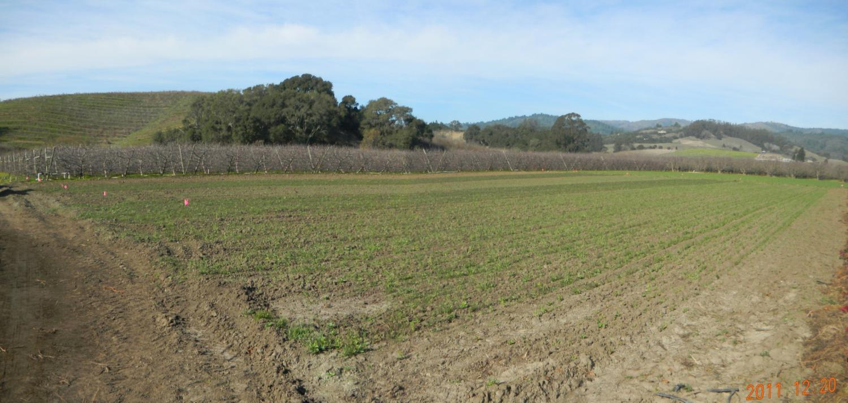
Baby-3 (Live Earth Farm. 13 yrs of organic mgmt)

Slide 63
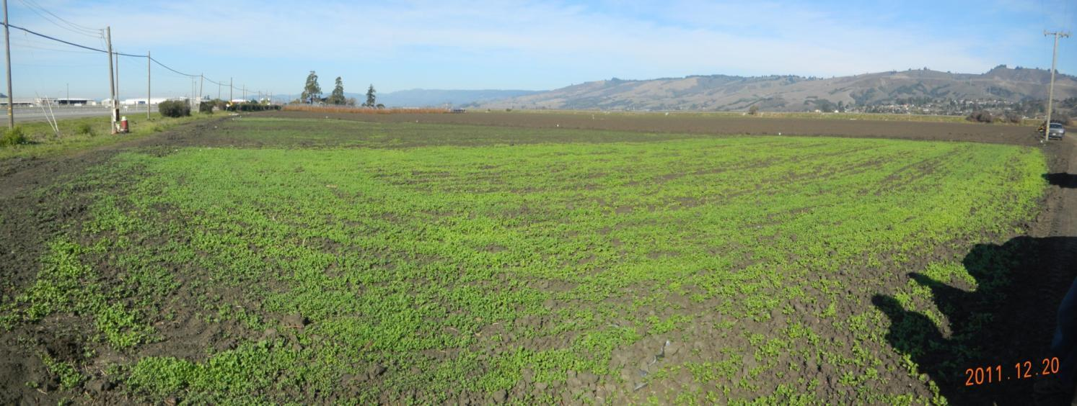
Baby-4 (Cassidy Ranch. 7 yrs of organic mgmt)

Slide 64
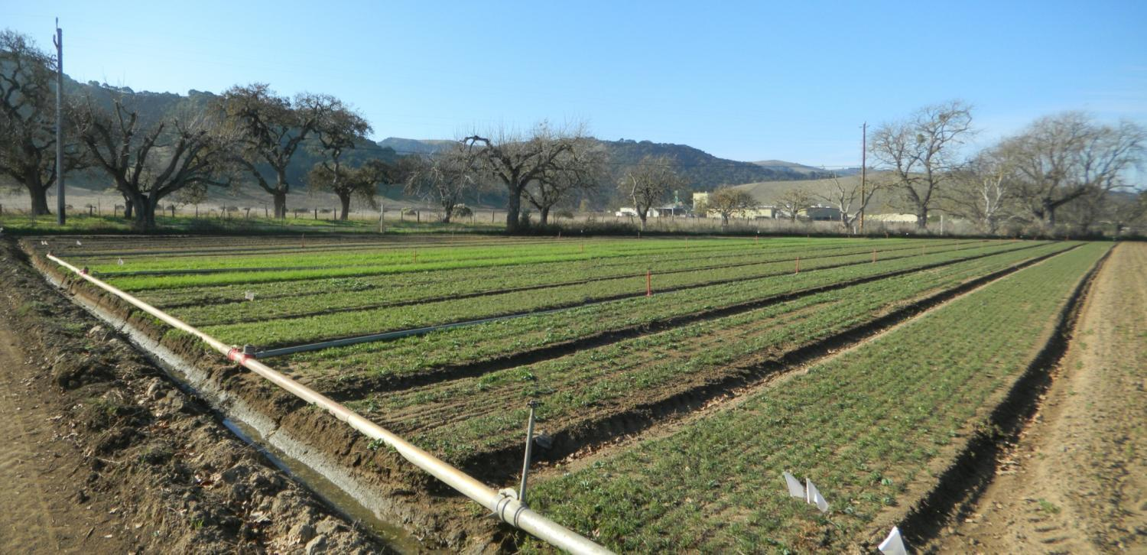
Baby-5 (Coke Farm. 15 yrs of organic mgmt)

Slide 65
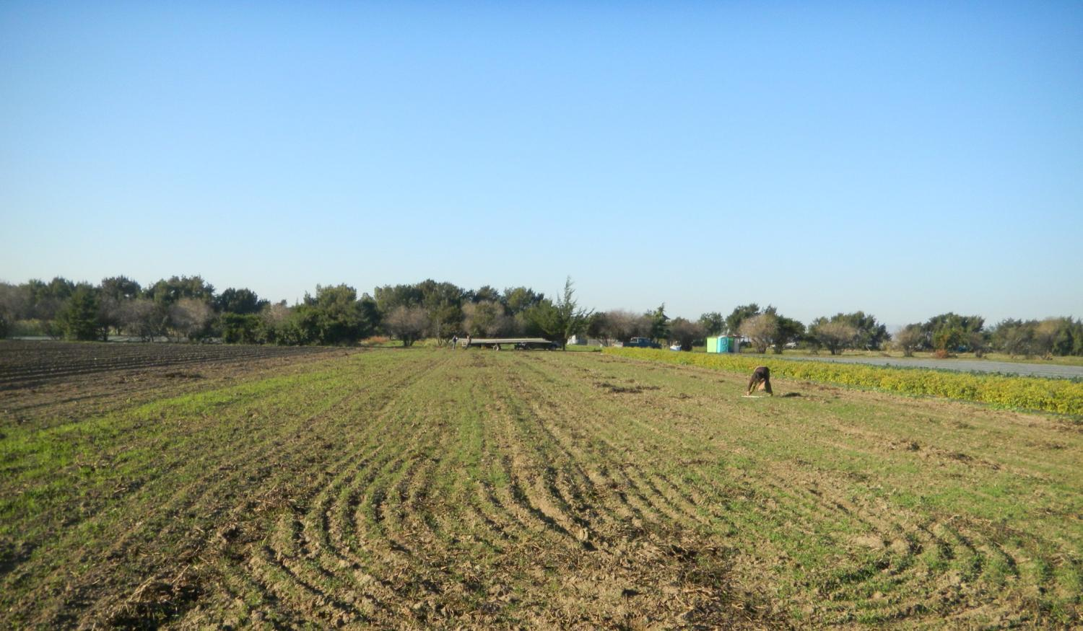
Baby-6 (ALBA. 20 yrs of organic mgmt)

Slide 66
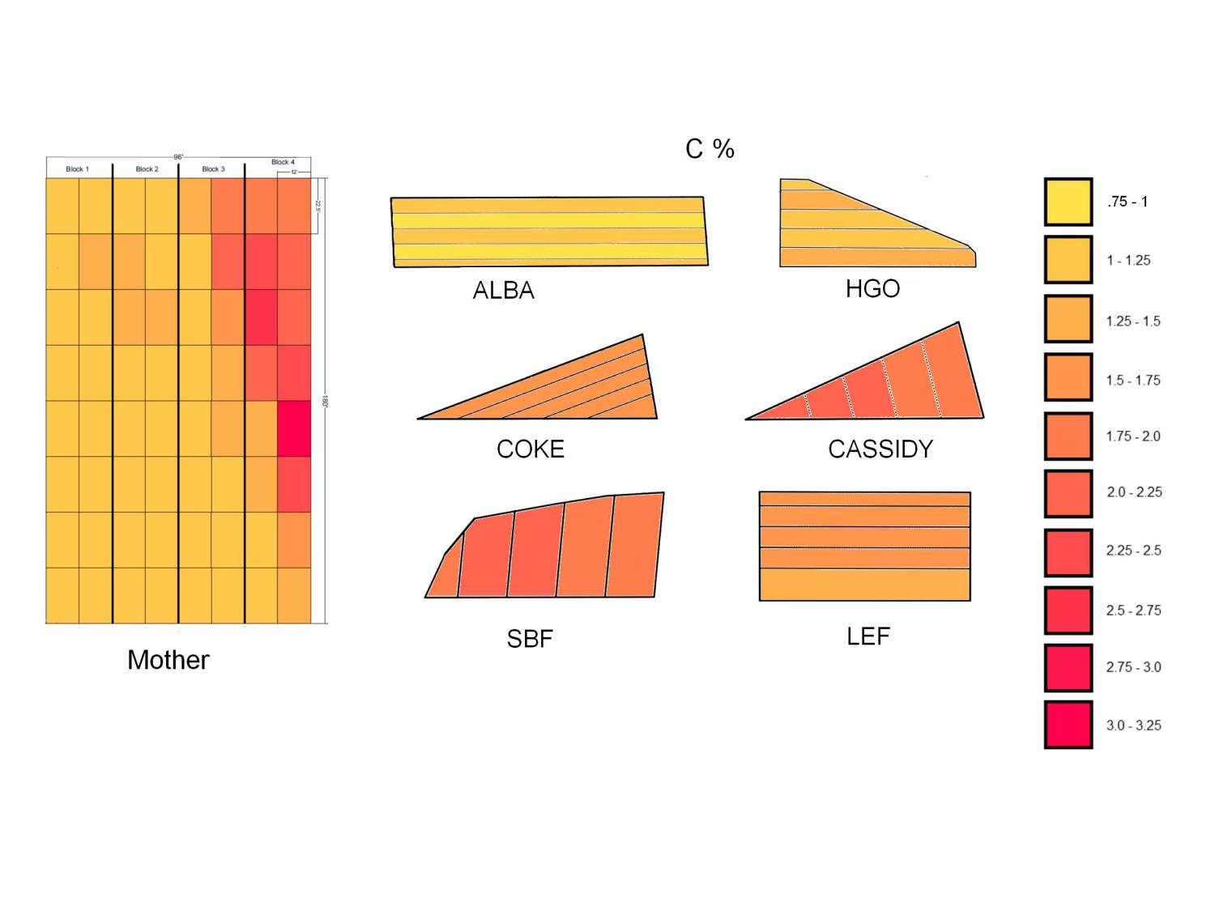

Slide 67
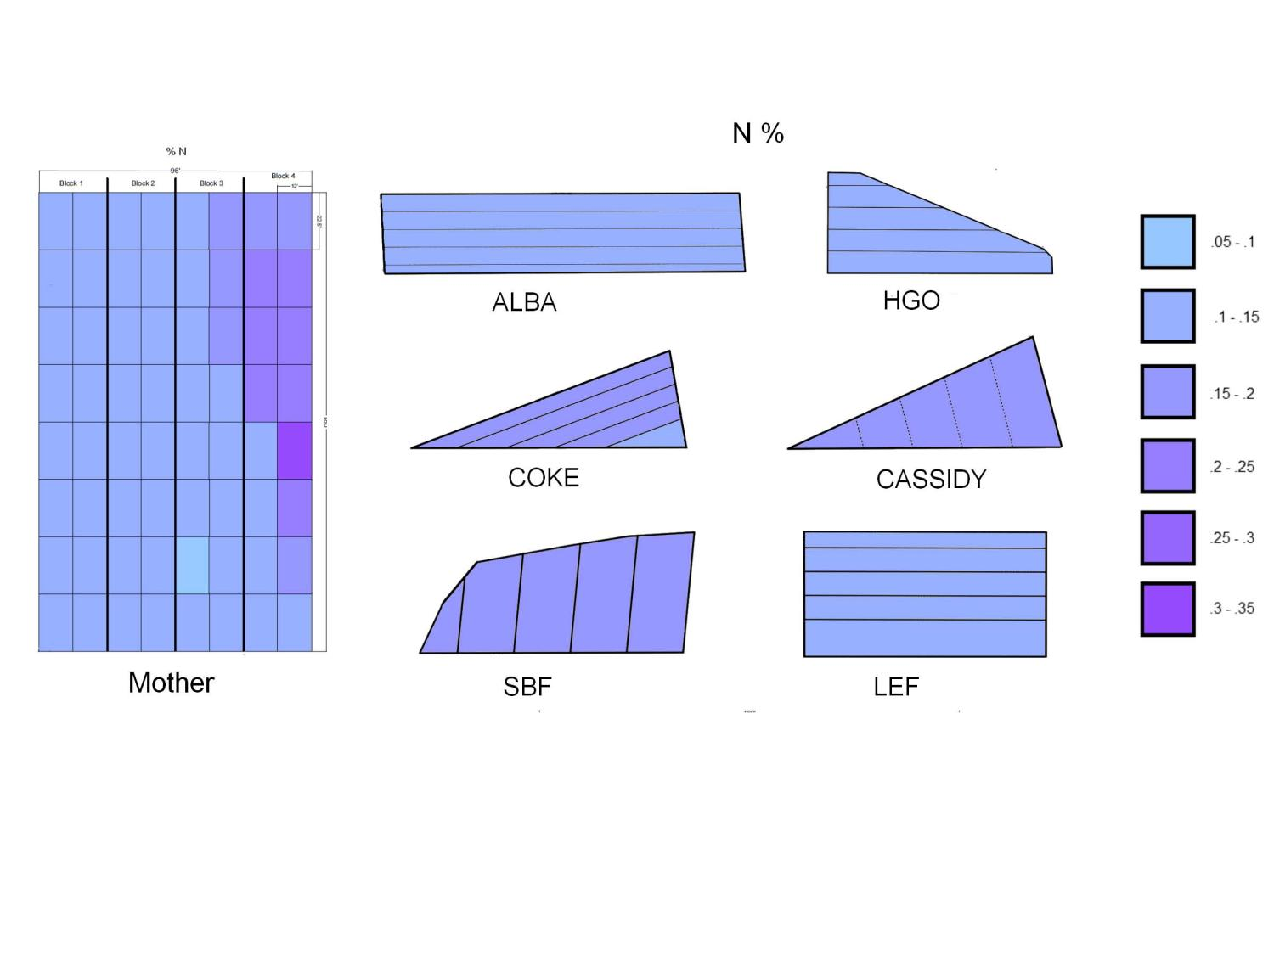

Slide 68
Acknowledgements
We gratefully acknowledge funding for this work from the following:
USDA NIFA OREI Award # 2011-51300-30677
USDA NIFA MBTP Award # 2012-51102-20294
USDA WSARE Award # SW11-116
Organic Farming Research Foundation
And the many growers, extension and industry people who have made this work possible
Gary Tanimura, Glenn Noma, Tanimura and Antle Fresh Foods Inc.
Liz Mirazzo, Andy Webster of CASFS, UCSC
Luis Rodriguez, Patti Wallace, Mike nelson, Plant Science inc.
K. Kammeijer, L. Murphy, P. Ayala, UCCE
Lab assistants, interns, and volunteers of the Shennan lab, UCSC

Slide 69
Questions?
Joji Muramoto
joji@ucsc.edu

