Slide 1
Utilization of Anaerobic Soil Disinfestation (ASD) for Weed Control in Tomato and Bell Pepper Plasticulture Production System
Gursewak Singh
Advisor : Dr. Matthew Cutulle

Slide 2
ASD Mustard meal/molasses field study
Objective
a) To evaluate mustard meal/molasses combinations (best chosen from greenhouse trials) in field trials for two years for weed control in tomato, and pepper crop.
Experiment design and treatments
Design- RCBD with 3 replications.
Plot dimensions – 15 ft x 2 ft
The treatment design consists of a factorial with 4 carbon sources treatments a) Mustard meal, b) Molasses, c) Mustard meal+molasses, none) by 2 ASD treatments (plastic sealed and unsealed).
The experiment consisted of 8 treatments replicated 3 times in a total of 24 plots.
Credits- Zachary Williamson

Slide 3
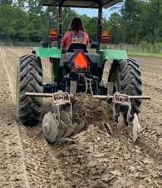
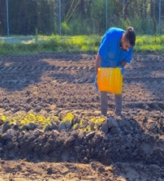
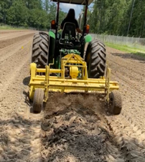
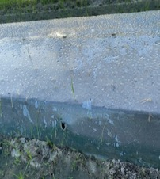
Methods- Field preparation and ASD set up
1
1
2
3
4
5
4
1. Raised beds were prepared using tractor-mounted bed maker.
2. Amendments added to the plots manually. (Mustard meal-2.1 Mg ha⁻¹, Molasses- 14 m³ha⁻¹)
3. Soil carbon treatments mixed with tractor-mounted peanut hoe.
4. Tractor mounted plastic bedder and drip-tape implement was used to re-bed the field and seal it with totally
impermeable film (TIF) clear mulch and single drip line.
5. Assigned sealed plots were completely air-tight by TIF clear mulch, while unsealed plots were poked holes on
the top and sides of beds.
.

Slide 4
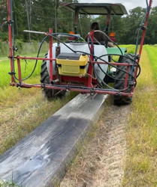
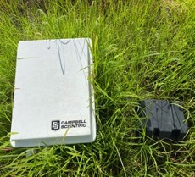
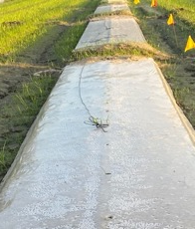
6
7
8
6. ORP probes were installed in plots.
7. ASD performed for 4 weeks and terminated by poking holes in sealed beds (similarly as poked in unsealed beds)
and left undisturbed for 1 week to regain aerobic conditions.
8. The clear plastic beds were painted with black spray at a 1/7 paint to water dilution to avoid the high solar heat
effects on crop.

Slide 5
Crop transplantation and management
Tomato and Pepper transplantation
After one week of ASD termination, tomato and peppers plants were transplanted into the plots by splitting each plot into two halves.
Cultivars transplanted were Mountain Magic for Tomato (indeterminate) and Vanguard f1 for Pepper (Bell shaped), selected on basis of southeast US environmental conditions.
The transplants were irrigated and fertilized daily through the drip tape connected to the centrally controlled irrigation system.
Stacking and Pruning
After 2 weeks of crops transplantation, staking was done by installing 6 feet wooden stakes and tying the plants with strings adopting Florida weave stacking method. Plants were checked daily during active growth and tied to the stakes depending on the growth.
Tomato plants were also pruned (suckered) once a week in the growth period to reduce the number of branches, by removing the shoot grows between the main stem and leafy branch of tomatoes.

Slide 6
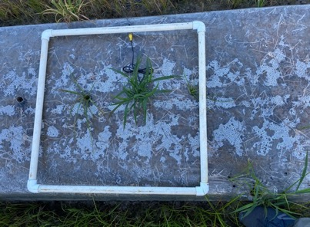
Data collection and analysis
Weed control
ASD effects on weed control was estimated by collecting weed counts. Weed counts were estimated using 2 feet square quadrat by randomly throwing 5 times on plots and then the data was averaged for final counts.
Crop response
To check crop response to ASD, data was collected periodically including crop stand counts, injury ratings, and vigor ratings.
Crop Yield
The plots were harvested weekly/biweekly based on the crop harvest conditions and the crop yield was graded and sorted following USDA guidelines.
Statistical Analysis
All data was subjected to analysis of variance using mixed model methodology (JMP v. 14). Carbon source and plastic cover seal and their interactions effects were considered fixed while replication was considered random.

Slide 7
Effects of treatments soil redox potential(Eh) during four-week of ASD
Average redox potential during ASD process.
Treatment | mVª (redox potential)
Mustard meal sealed | -12 ab
Molasses sealed | -39 ab
Molasses + mustard meal sealed | -146 b
No carbon source sealed | 100 a
Mustard meal unsealed | 1 ab
Molasses unsealed | 7 ab
Molasses + mustard meal unsealed | 8 ab
No carbon source unsealed | 128 a
Higher anaerobic soil conditions were achieved in mustard meal+molasses sealed treatments.
Accumulated anaerobic conditions are reported as a key indicator for successful pest control in ASD (Guo et al. 2017).
LS Means Contrast | Prob > F
Molasses+mustard meal sealed vs no carbon source sealed | 0.0125*
ª Means followed by same letter within a column are not statistically different according to
LSD test (P ≤ 0.05).

Slide 8
Yellow nutsedge control
Weed counts taken after 0, 30, 60 and 90 days after ASD.
 | Yellow nutsedgeª
 | 0 DAT^{b} | 30 DAT | 60 DAT | 90 DAT
Treatment | ---------------No. of plants (2'x2' quadrat)^{c}--------------
Mustard meal sealed | 0 C | 0 C | 3 C | 4 C
Molasses sealed | 1 C | 0 C | 3 C | 8 C
Molasses + mustard meal sealed | 0 C | 1 C | 1 C | 4 C
No carbon source sealed | 11 B | 18 B | 23 B | 28 B
Mustard meal unsealed | 24 A | 33 A | 37 A | 42 A
Molasses unsealed | 21 A | 30 AB | 34 AB | 39 AB
Molasses + mustard meal unsealed | 21 A | 26 AB | 30 AB | 35 AB
No carbon source unsealed | 28 A | 37 A | 41 A | 45 A
Yellow nutsedge was the dominant weed that emerged in the experimental plots.
Carbon source and plastic mulch seal had a significant inhibitory effect on yellow nutsedge emergence (P<0.0001).
Factor | Prob > F | Prob > F | Prob > F | Prob > F
Carbon source | 0.0002* | 0.0001 | <0.0001* | <0.0001*
Plastic cover sealing | <0.0001* | <0.0001* | <0.0001* | <0.0001*
Carbon source x Plastic cover sealing | 0.2327 | 0.618 | 0.0274 | 0.0094

Slide 9
Grass weed control
Weed counts taken after 0, 30, 60 and 90 days after ASD.
Barnyard-grass, goosegrass and large crabgrass were the two most prevalent grass weeds in the experimental plots.
Carbon source and plastic sealing had significant effects on grass weeds control (P<0.0001).
 | Grass weedsª
 | 0 DAT^{b} | 30 DAT | 30 DAT | 60 DAT |  | 90 DAT
Treatment | ----------------No. of plants (2'x2' quadrat)^{c}--------
Mustard meal sealed | 0 C |  | 0 B | 2 B | 2 B | 3 B
Molasses sealed | 1 C |  | 0 B | 3 B | 3 B | 6 B
Molasses + mustard meal sealed | 0 C |  | 0 B | 1 B | 1 B | 3 B
No carbon source sealed | 3 AB |  | 5 A | 8 A | 8 A | 14 A
Mustard meal unsealed | 4 A |  | 6 A | 8 A | 9 A | 12 A
Molasses unsealed | 5 A |  | 5 A | 8 A | 10 A | 11 A
Molasses + mustard meal unsealed | 4 A |  | 5 A | 8 A | 8 A | 13 A
No carbon source unsealed | 6 A |  | 7 A | 10 A | 10 A | 15 A
Contrast | Prob > F
Sealed vs unsealed | 0.0001*

Slide 10
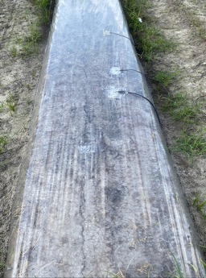
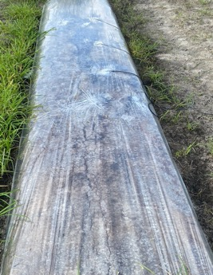
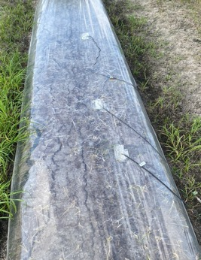
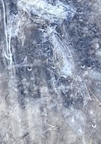
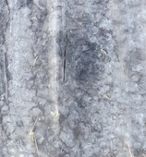
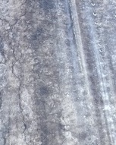
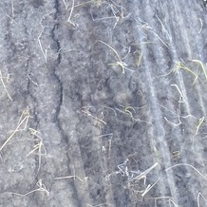
Molasses sealed
Mustard meal sealed
Molasses + mustard meal sealed
Solarization/none sealed

Slide 11
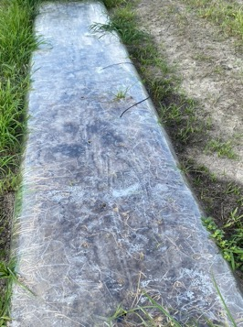
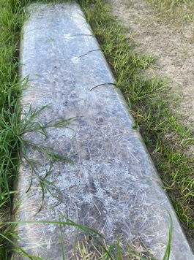
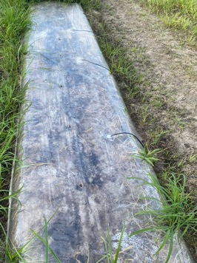
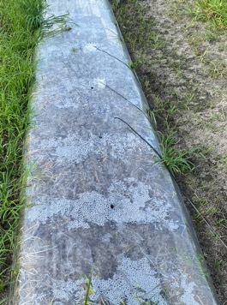
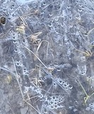
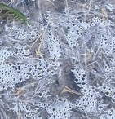
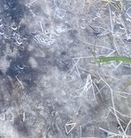
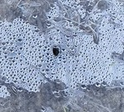
Molasses unsealed
Mustard meal unsealed
Molasses + mustard meal unsealed
Solarization/none sealed

Slide 12
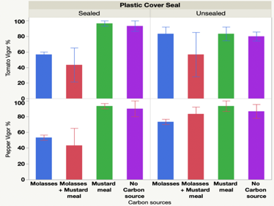
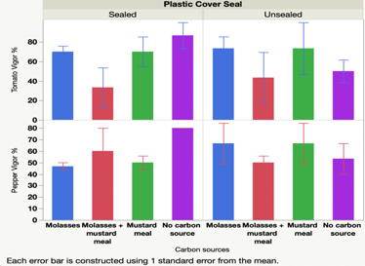
Response of Tomato and Bell Pepper plants to ASD plots
Graph 1. Crop Vigor response 14 DAT.
a
ab
ab
ab
bc
abc
bc
c
Observed some phytotoxic effects in term of slow initial growth and leaf falls.
In plastic sealed plots, plant were more vigorous in mustard meal treated plots followed by molasses treated plots.
a
a
ab
a
a
abc
bc
c
Graph 2. Crop Vigor response 28 DAT
ab
a
ab
ab
ab
ab
b
ab
b
a
ab
ab
ab
ab
ab
ab
LSD test (P ≤ 0.05)

Slide 13
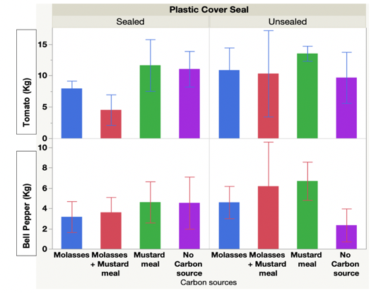
Marketable crop yield
Graph showing total marketable yield of Tomato and Bell Pepper.
There were some numerical trends showing higher crop yield in unsealed treatments.
No significant differences observed in tomato and bell pepper yields between sealed and unsealed treatments.
a
a
a
a
a
a
a
a
a
a
a
a
a
a
a
b
LSD test (P ≤ 0.05)

Slide 14
Conclusions
All ASD incorporated carbon sources treatments generated high anaerobic conditions.
Acceptable level of weed control observed in ASD carbon sources treatments.
Molasses + mustard meal, reported best in relation to weed management perspective.
ASD can be utilized as a potential biological pest management technique.

Slide 15
Future research directions
Additional research is needed to examine the potential phytotoxic effects of these treatments on crop plants.
More research is needed to determine whether ASD kills weed seeds/tubers permanently or induces weed seed dormant conditions in the soil.
Future studies will focus on implementing more detailed investigations of carbon treatments in the field at different locations with multiple soil types.

Slide 16
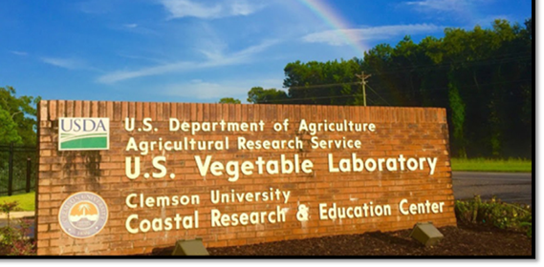
Acknowledgments
Major Advisor – Dr. Matthew Cutulle
USDA faculty- Dr. W. P. Wechter, Melanie Katawczik
CREC faculty - (Tyler Campbell, Giovanni Caputo, Matt Horry, Taylor Snipes, Glen Carter and all summer interns)
Funding- Southern SARE
Photo Credit: USDA ARS

