Slide 1
ASD On farm trial, 2021
Grower- Harleston Towles
Graduate Student- Gursewak Singh
Advisor- Dr. Matthew Cutulle

Slide 2
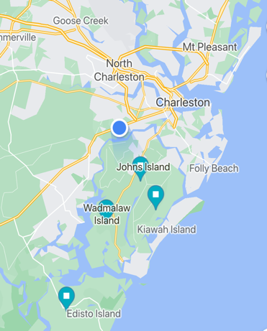
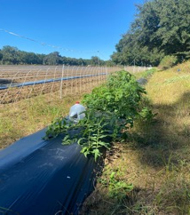
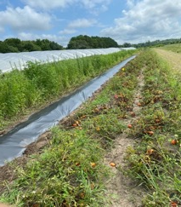
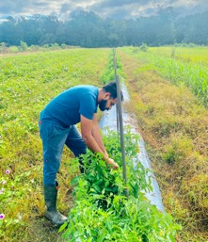
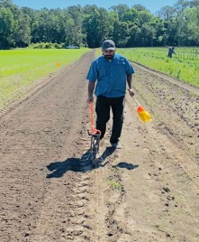
On farm grower trials 2021

Slide 3

Edisto Island Grower Trial 2021
Table 1. List of carbon sources tested from agro-industrial waste streams
 | Carbon source | Rate
1 | Molasses | 1452 gal/acre
2 | Mustard meal | 2000 lbs./acre
3 | Chicken manure | 18150 lbs./acre
4 | Sweet potatoes | 2000 lbs./acre
5 | Cotton seed meal | 16616 lbs./acre
6 | Rice bran | 10000 lbs./acre
7 | Baby food industrial waste | 16616 lbs./acre
8 | Molasses + Molasses | 1452 gal/acre + 1452 g/acre
9 | Molasses + mustard meal | 1452 gal/acre + 2000 lbs./acre
10 | Molasses + chicken manure | 1452 gal/acre + 18150 lbs./acre
11 | Molasses + sweet potatoes | 1452 gal/acre + 2000 lbs./acre
12 | Molasses + cotton seed meal | 1452 gal/acre + 16616 lbs./acre
13 | Molasses + rice bran | 1452 gal/acre + 10000 lbs./acre
14 | Molasses + baby food industrial waste | 1452 gal/acre + 16616 lbs./acre
15 | Control
Fig a. Gursewak Singh (Graduate Student) and Harleston Towles (Vegetable Grower)

Slide 4
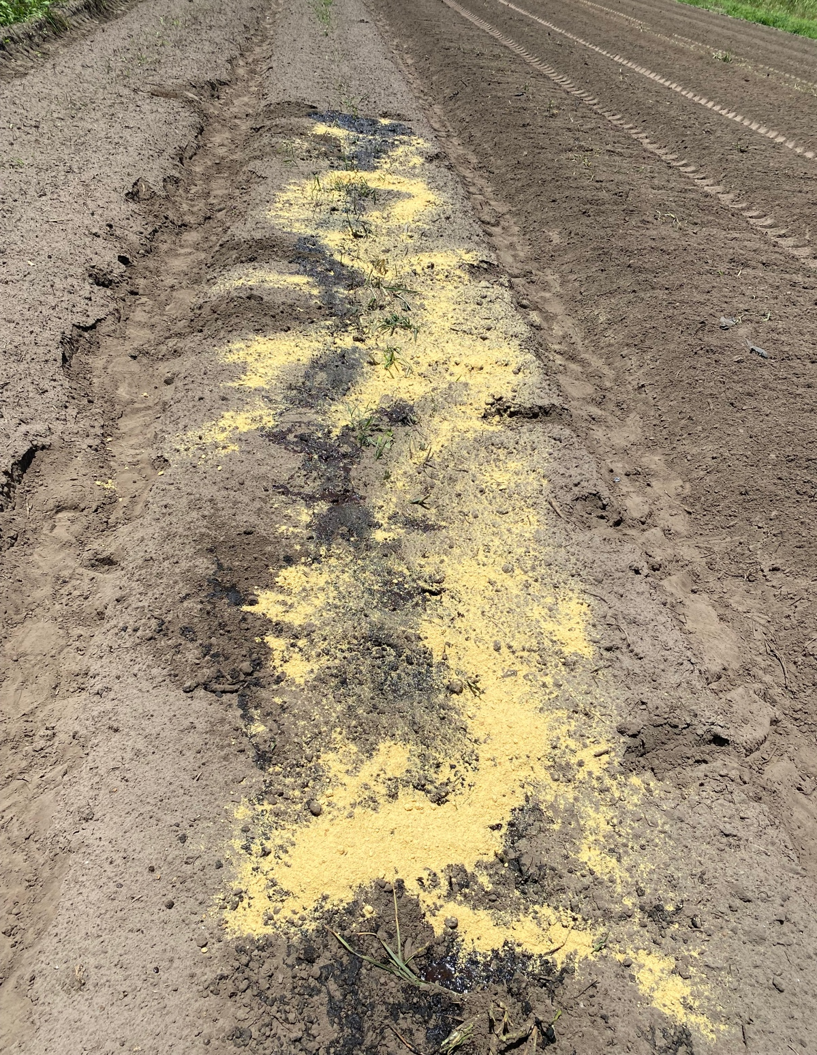
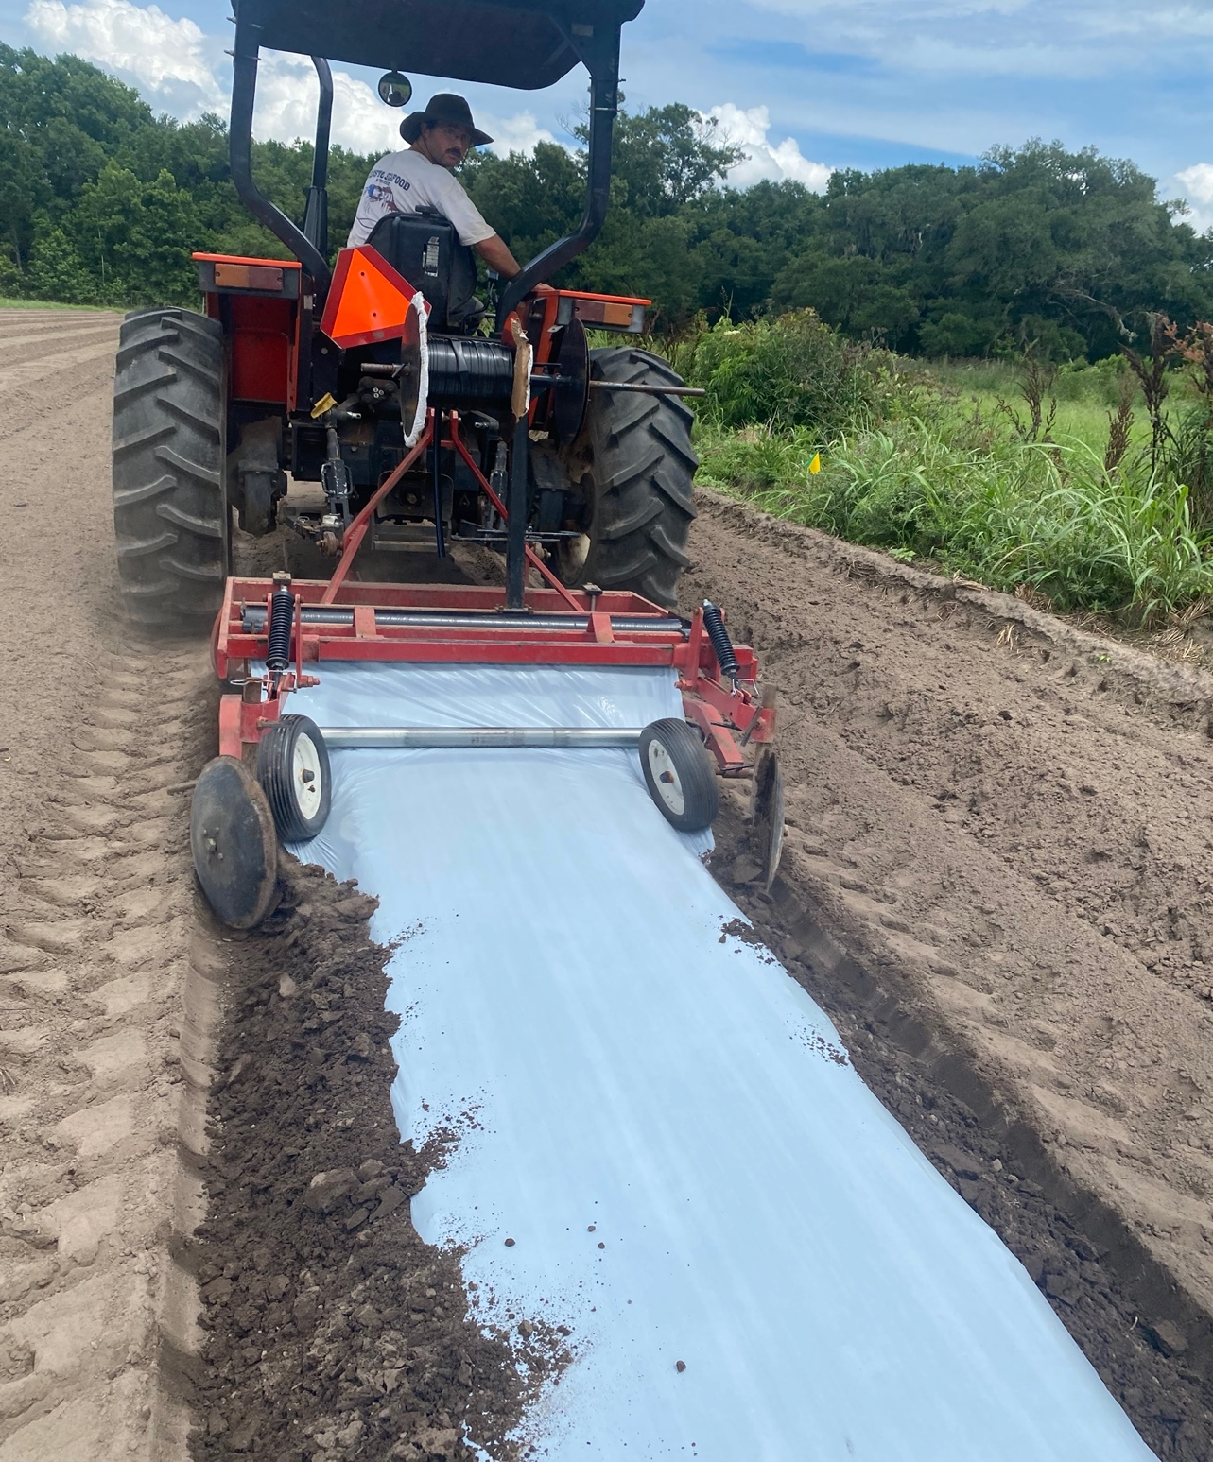
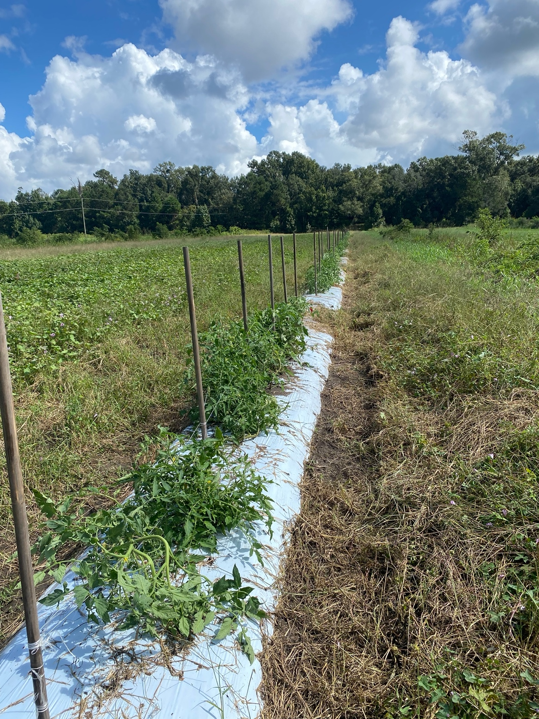
ASD Set Up
ASD set up- June 21, 2021
ASD end – July 22, 2021
Tomato transplant - Aug 3, 2021
Harvesting- Nov 10-Nov 30

Slide 5
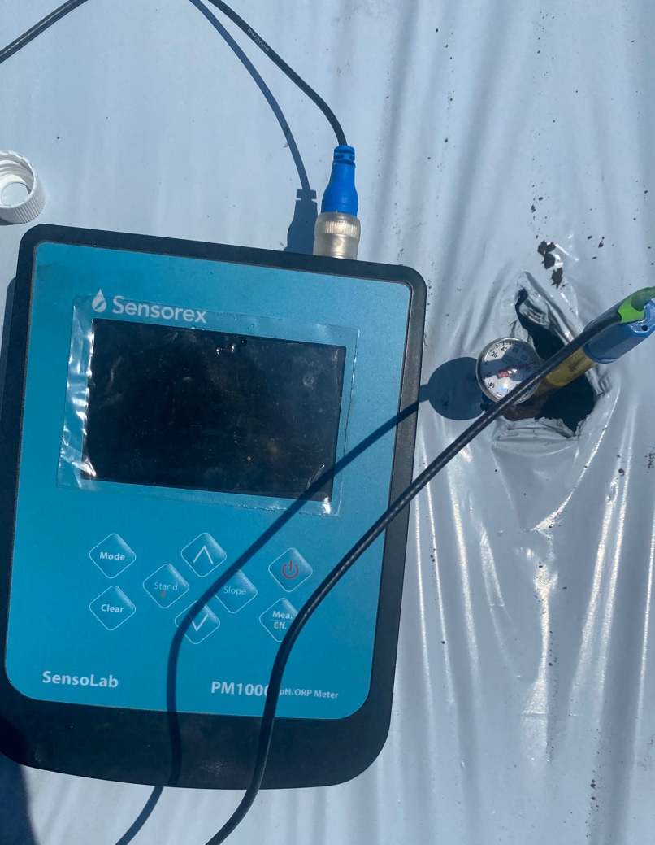
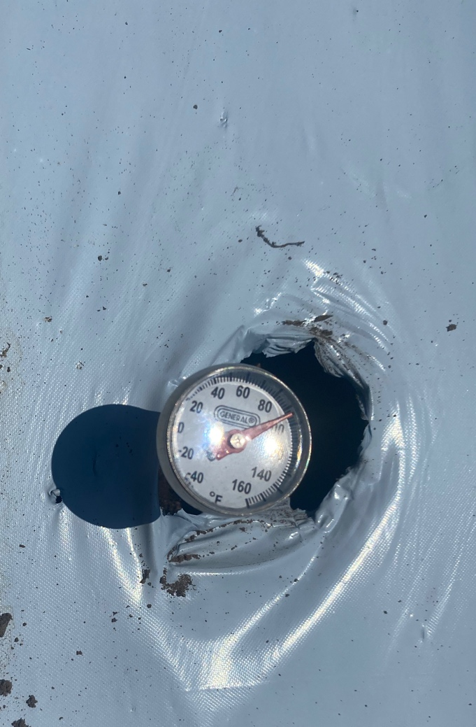
Portable Sensors for Data Collection
Fig a. Temp Sensor
Fig b. pH and ORP sensor
Fig c. Average ORP, pH and Temperature during 4 wk ASD period

Slide 6
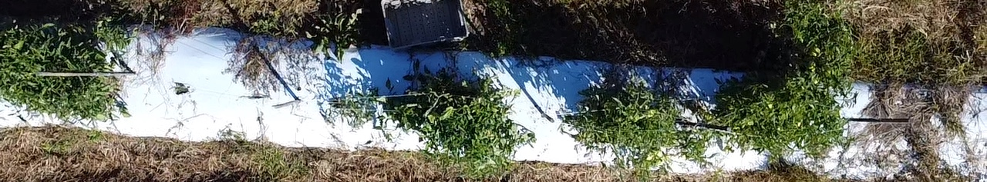
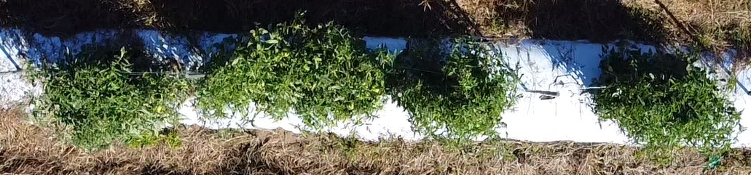
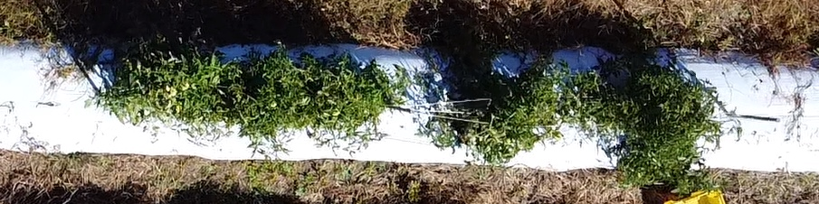
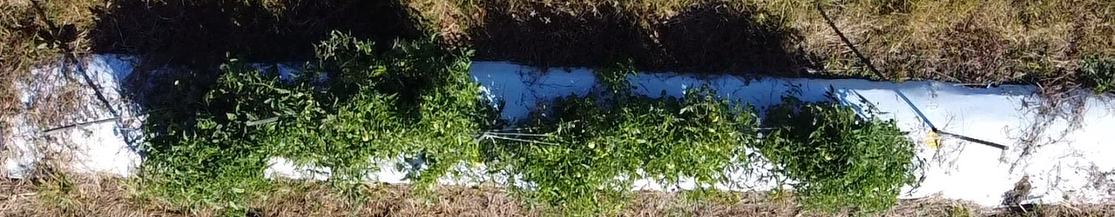
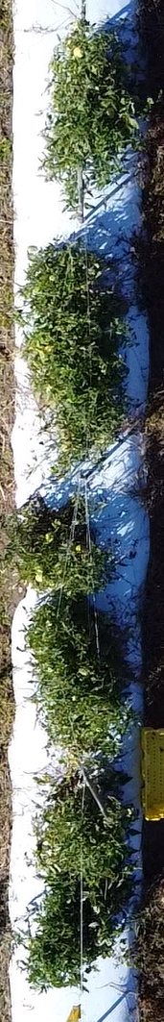
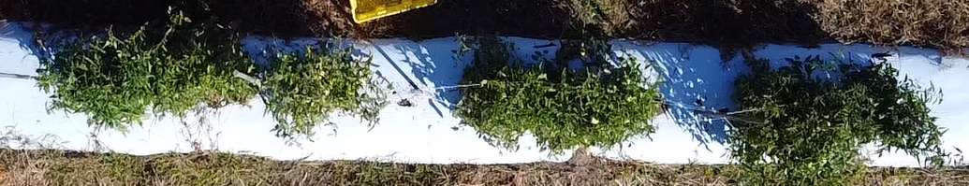
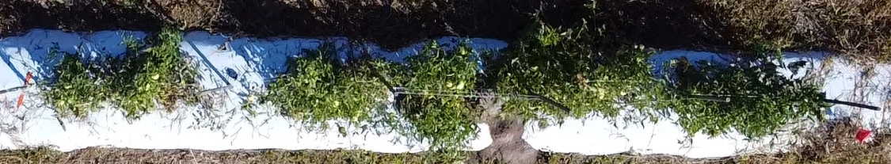
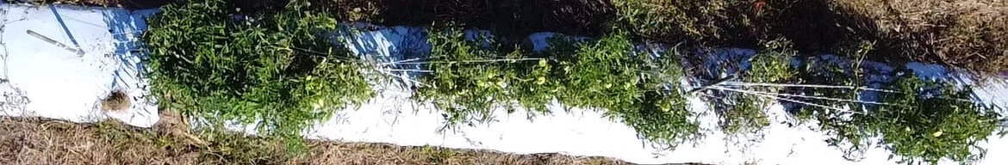
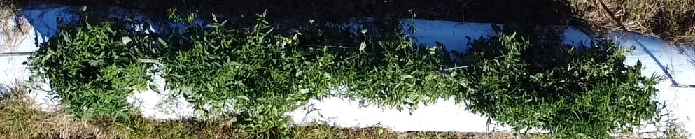
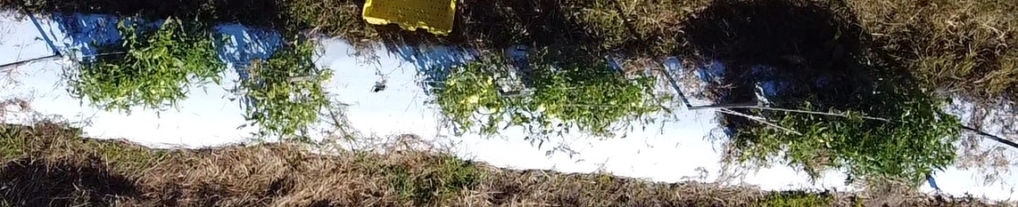
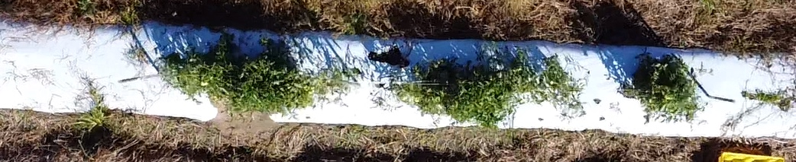
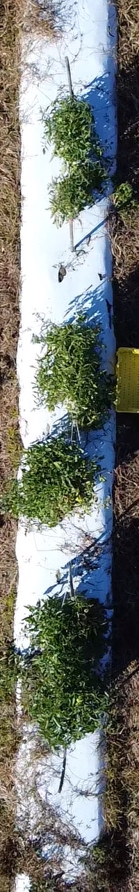

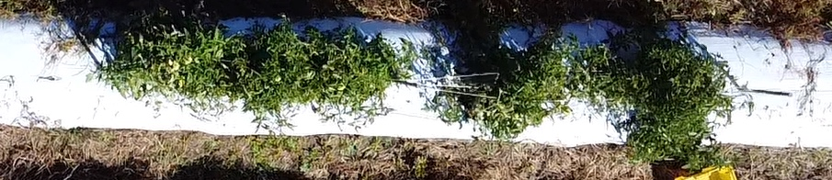
Aerial Shots of Field Plots
M
MM
CM
SP
CS
RB
BFW
M+MM
M+CM
M+SP
M+CS
M+RB
M+BF
Control
M- Molasses
MM- Mustard meal
CM- Chicken manure
SP- Sweet potatoes
CS- Cottonseed meal
RB- Rice bran
BFW- Baby food waste

Slide 7
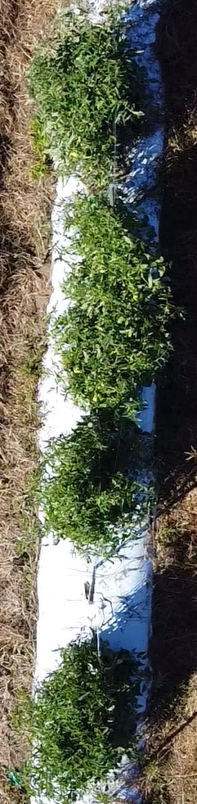
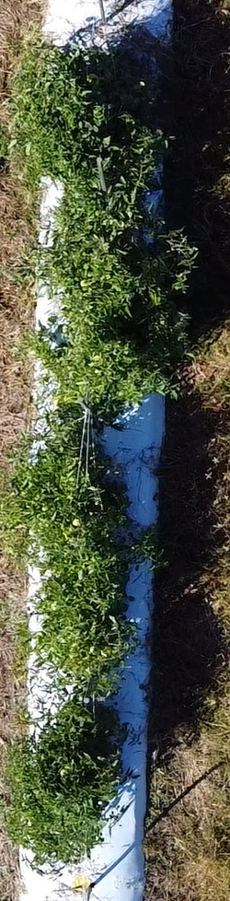
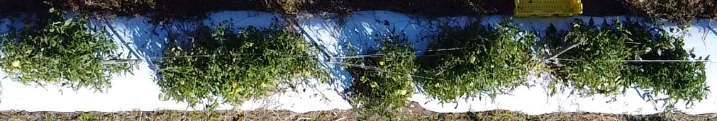
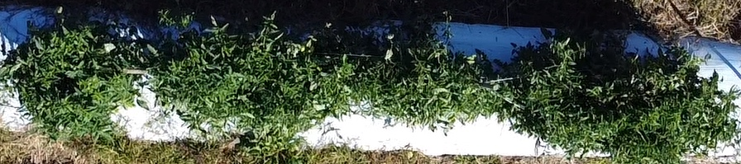
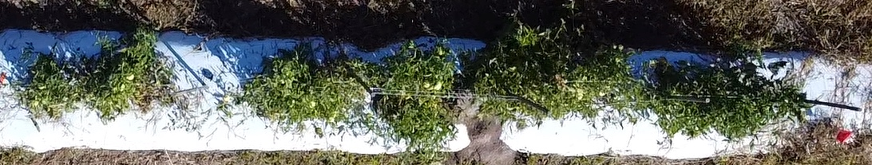
Control vs Most Vigrous Plots
Control
CSM
RB
MCM
MCS
MRB

Slide 8
Plant Vigor, Weed Counts and Tomato Yield

Slide 9
