Slide 1
Pete Ambrose Farm, 2021
Gursewak Singh

Slide 2
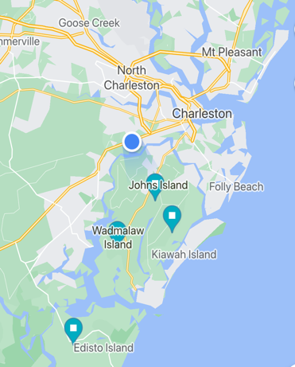
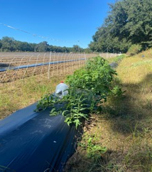
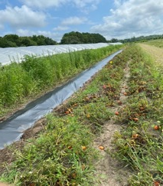
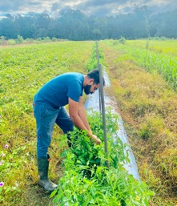
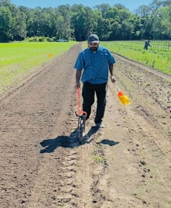
On farm grower trials 2021

Slide 3
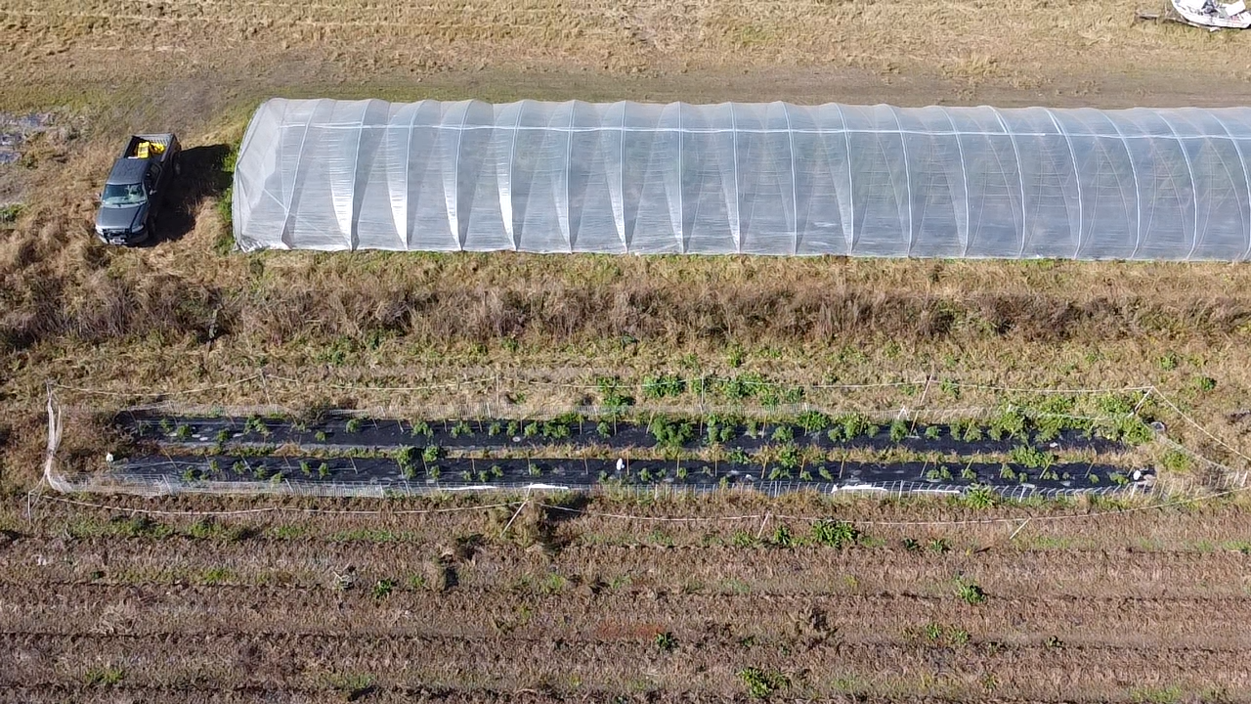
Wadmalaw Island Grower Trial 2021
Fig. Pete Ambrose Farm

Slide 4
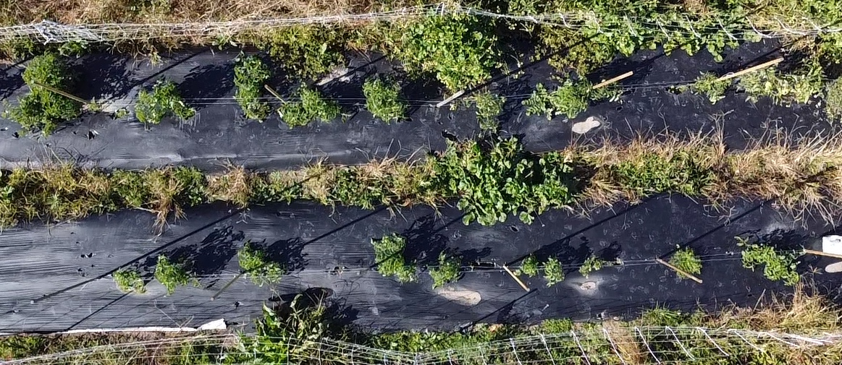
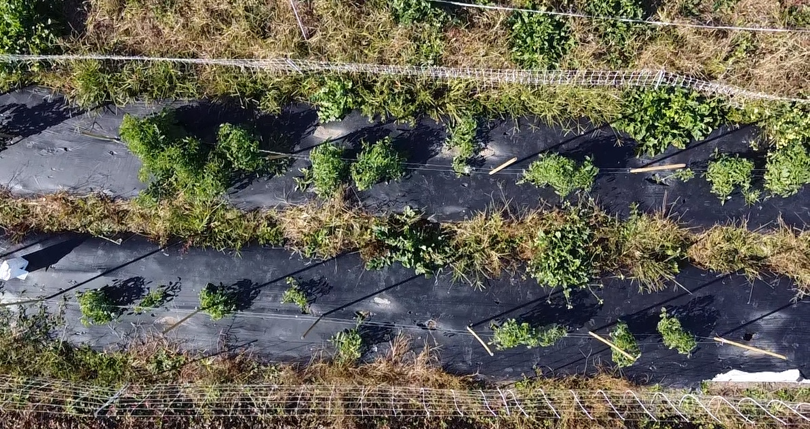
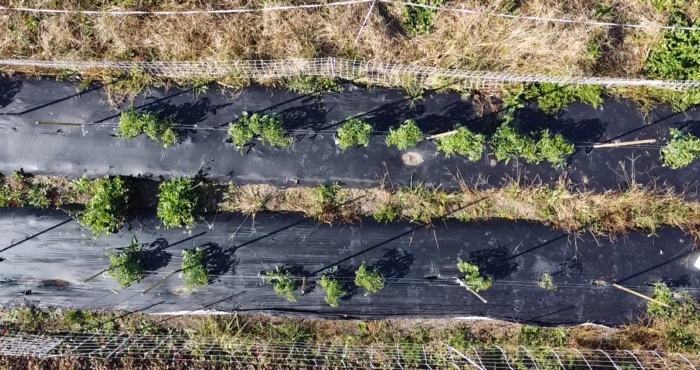
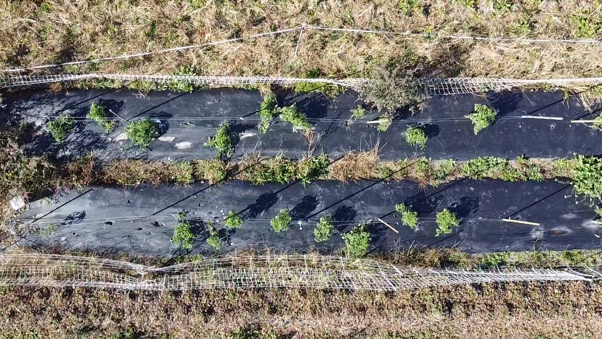
Aerial Shots of Field Plots
1
2
3
4
5
6
7
8
Sorghum-sudangrass
Mustard meal + Molasses
3. Sunn hemp
4. Chicken manure + Molasses
5. Sorghum-sudangrass + Sunn hemp
6. Cotton seed meal + Molasses
7. Control
8. Mustard meal

Slide 5
 | Carbon sources | ORP (mv)ª | Temp (F) | pH | Weed Control^{b} | Plant Response^{b}
1 | Sorghum-sudangrass | 201 | 99 | 6.9 | B | C
2 | Mustard meal + Molasses | -86 | 102 | 5.9 | A+ | B+
3 | Sunn hemp | 202 | 101 | 6.8 | B | C-
4 | Chicken manure + Molasses | 45 | 100 | 6.9 | B+ | A+
5 | Sorghum-sudangrass + Sunn hemp | 223 | 99 | 6.1 | B | C
6 | Cottonseed meal + Molasses | -10 | 101 | 6.2 | A | B
7 | Control | 360 | 99 | 6.9 | C | C
8 | Mustard meal | 189 | 99 | 6.8 | A | B
ªSoil conditions typically considered aerobic when redox potential is >200 mV and anaerobic when <200 mV.
^{b}Weed control and plant health rates are based on scale of A+, A, A−, B+, B, B−, C+, C, C−, A+ being the highest and C- being lowest

Slide 7
Adair McCoy Farm, 2021
Gursewak Singh

Slide 8
On farm grower trials 2021

Slide 9
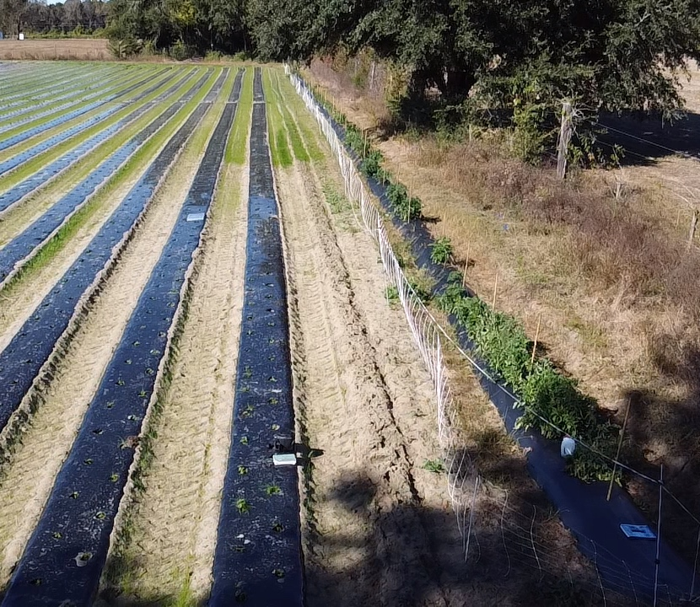
Adair McCoy farm trial 2021

Slide 10
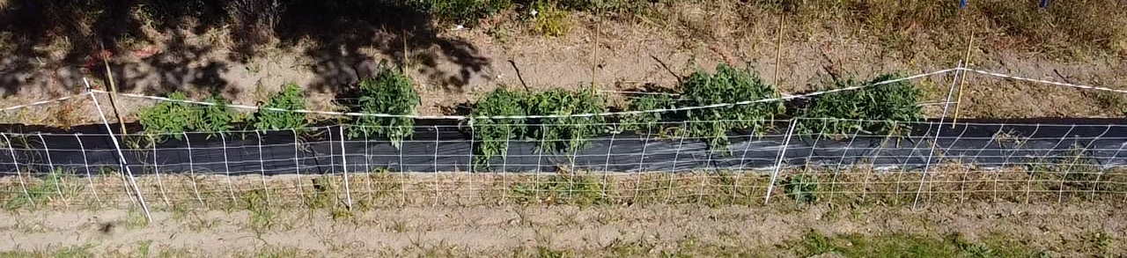
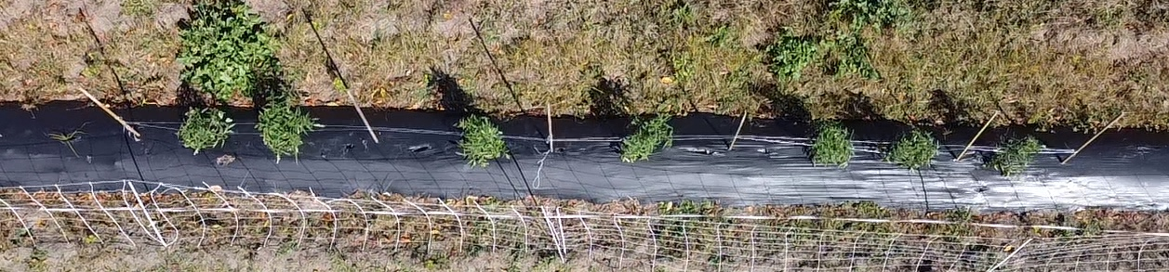
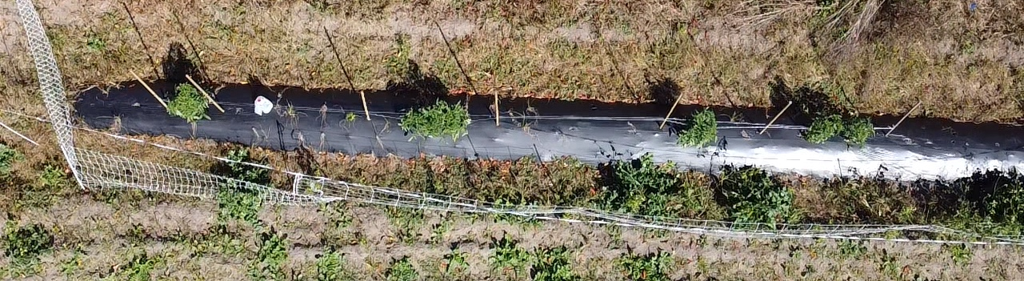
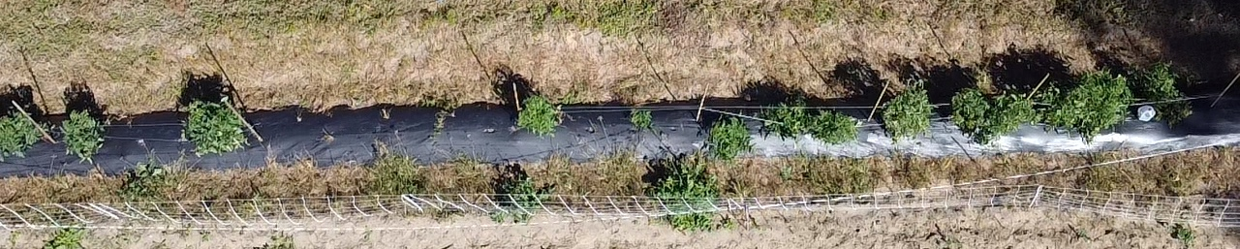
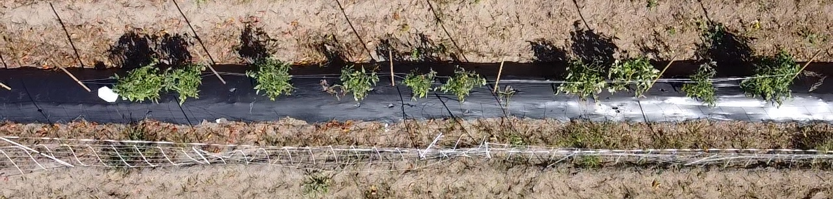
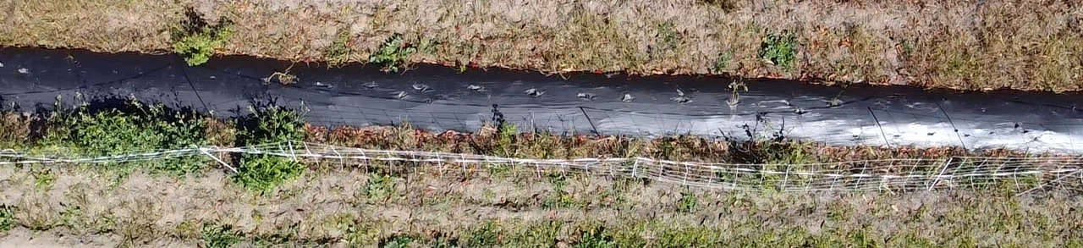
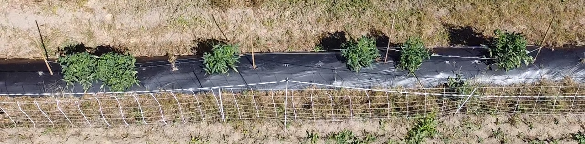
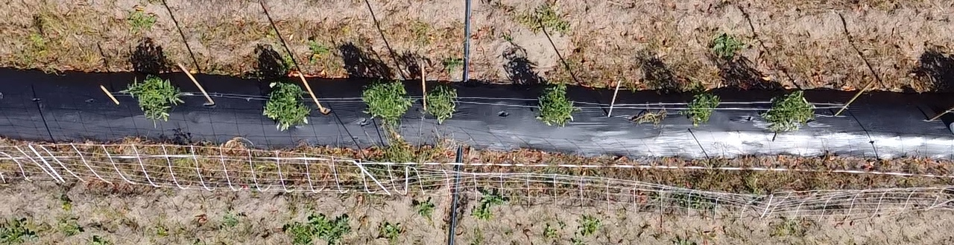
Aerial Shots of Field Plots
1
2
3
4
5
6
7
8
1 | Mustard meal + Molasses
2 | Chicken manure + Molasses
3 | Cottonseed meal + Molasses
4 | Molasses
5 | Control
6 | Sorghum sudangrass
7 | Sunn hemp
8 | Sorghum sudangrass + Sunn hemp

Slide 11
John Island Trial Outcomes
 | Carbon sources | ORP (mv)ª | Temp (F) | pH | Weed Control^{b} | Plant Response^{b}
1 | Mustard meal + Molasses | 59 | 101 | 6.3 | A+ | A-
2 | Chicken manure + Molasses | 78 | 100 | 6.1 | A | A+
3 | Cottonseed meal + Molasses | 80 | 101 | 6.5 | A | A
4 | Molasses | 101 | 100 | 6.6 | B | B
5 | Control | 323 | 99 | 6.8 | C | C
6 | Sorghum sudangrass | 210 | 101 | 6.9 | B | C
7 | Sunn hemp | 233 | 99 | 6.9 | B | C-
8 | Sorghum sudangrass + Sunn hemp | 199 | 99 | 6.8 | B | B
ªSoil conditions typically considered aerobic when redox potential is >200 mV and anaerobic when <200 mV.
^{b}Weed control and plant health rates are based on scale of A+, A, A−, B+, B, B−, C+, C, C−, A+ being the highest and C- being lowest

