Slide 1
Beginning Farmer Network of Massachusetts
ASGAP Research Project Update
July 25, 2016

Slide 2
Review: Purpose
There has not been a comprehensive assessment done of this kind, at this level, to assess and evaluate how well Massachusetts is meeting the needs of its beginning farmers.
This is coming on the heels of the MA Food System Planning Process – which has already gone far in creating an inventory of training/resources; we want to expand on their work and hone it to focus on the beginning farmer population.
We hope that the end result will help make an evidence-based, ground-truthed case for targeting specific needs of beginning farmers, especially amongst policy makers and service providers.

Slide 3
Review: Guiding Questions
What resources (programs, training, technical assistance, educational workshops, support services) are available for beginning farmers in Massachusetts?
How effective are these resources at meeting the needs of beginning farmers?
What needs do beginning farmers have that aren’t currently being met? What are the major gaps that exist in available resources?
What kinds of programs and policies are needed to meet the needs of beginning farmers on their most pressing topics, skills, and resources?

Slide 4
Review: Data Collection Methods
Matrix
Survey
Quantitative
Open Ended
Focus Groups →Beginning Farmer Interviews

Slide 5
Summary of Survey Respondents
166 responses, but only 63 completed through farmer resources table and 101 fully completed farmer background questions
Over half were 25-40 years old
Most had been farming 1-7 years
Most are farming less than 5 acres
Biggest response from Pioneer Valley and Central Mass followed by Northeast and Southeast parts of the state
Hardly any response from Cape & Islands, Berkshires
Majority of respondents are growing vegetables, fruit, berries, flowers and herbs

Slide 6
Survey Respondents: Age and Years Farming
Age
Years Farming

Slide 7
Survey Respondents: Acres Farming & Region Accessing Resources
Acres Farming
Region Accessing Resources

Slide 8
Survey Respondents: Agricultural Enterprise

Slide 9
Respondents by Zip: 101 Respondents

Slide 10
Respondents by Zip: 63 Respondents

Slide 11
Survey: Farmer Resource Questions

Slide 12
Survey: Farmer Resource Questions

Slide 13
Survey: Farmer Resource Questions

Slide 14
Survey: Farmer Resource Questions

Slide 15
Survey: Farmer Resource Questions

Slide 16
Survey: Farmer Resource Questions

Slide 17
Survey: Farmer Resource Questions

Slide 18
Survey: Farmer Resource Questions

Slide 19
By Region: NORTHEAST
Very little response regarding livestock
Largest gap in resources available were in family & community relations and review & re-plan whole farm
Most people feel comfortable with the resources available for raising crops, setting up and starting a business
Marketing is an area that could be improved

Slide 20
By Region: METRO BOSTON
Sample size is only 3 respondents
Good: raising crops, education and professional development, set up and start up a business
Needs improvement: marketing, family & community relations, review and re-plan whole fam

Slide 21
By Region: SOUTHEAST
Good: managing a farm business, education and professional development, setting up and starting a farm business
Needs improvement: nourishing family & community relations, managing farm labor resources, review and re-plan whole farm

Slide 22
By Region: CAPE & ISLANDS
Only 1 respondent from Cape & Islands
Felt they couldn’t find resources on whole farm planning, setting up and starting a business, managing a farm business, education and professional development; hadn’t looked for resources on the rest
Not a large enough sample

Slide 23
By Region: CENTRAL
Good: raising crops, setting up and starting a farm business
Needs improvement: management of tools, equipment, supplies, management of farm infrastructure, management of production and natural resources

Slide 24
By Region: BERKSHIRES
Small sample size
Good: management of production and natural resources, whole farm planning, setup and start up of business
Needs improvement: marketing of farm products and services, education and professional development
Very disparate answers between 4 respondents

Slide 25
By Region: PIONEER VALLEY
Good: Management of the farm business, management of tools, equipment and supplies, whole farm planning, education and professional development
Needs improvement: review and re-plan whole farm, nourish family and community relations, marketing of farm products and services, managing farm labor resources
Some topics had really disparate responses (red & green)

Slide 26
Regional Data Discussion
Overall, good resources across the state for starting and setting up a farm business, for raising crops, and opportunities for professional development and education
Overall, more is needed on nourishing family & community relations, managing farm labor, marketing, reviewing and re-planning whole farm
Need to delve deeper into regional issues, why they exist

Slide 27
Open-Ended Question #1: Top three most helpful resources
Top three resources:
UMass (including Extension and Stockbridge School)
NOFA
New Entry
“Multi-service farm support organizations” seem to be the most helpful resource for beginning farmers
Lots of other resources are mentioned once or twice; beginning farmers are finding information in a wide variety of places
Resources such as technical assistance and mentorship are hardly mentioned while more conventional “educational” resources are mentioned often (workshops, conferences, etc.)

Slide 28
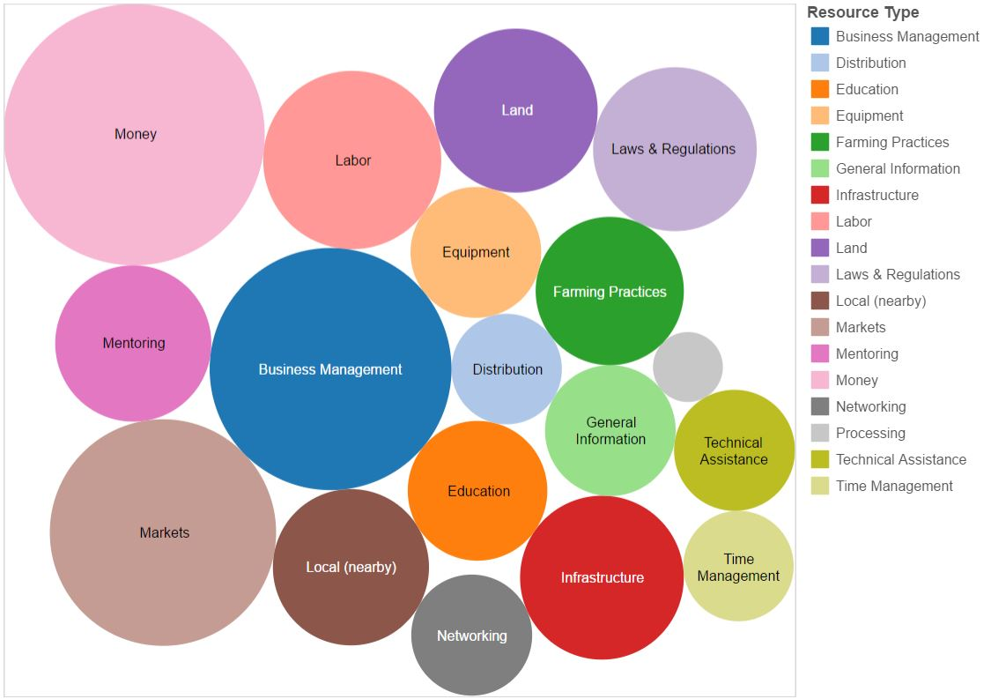
Open-Ended Question #2: Top three current needs for success in farming

Slide 29
Open-Ended Question #2: Top three current needs for success in farming
Business management, money and markets come to the top of the list
This indicated that while there is a wide variety of needs for beginning farmers, the clear need that rises above the rest is to be profitable
Labor, land, laws & regulations, and infrastructure come in all around the same level of importance
“Business management” response seems to conflict with earlier results showing that there were enough resources to help with business start-up; perhaps need is help with sustained management or scaling up?

Slide 30
Open Ended Question #3: Comments or advice about resources/resource gaps for beginning farmers in MA
#of Comments

Slide 31
Open Ended Question #3: Comments or advice about resources/resource gaps for beginning farmers in MA
Responses to this question are varied, but a few trends emerge:
Resources generally available in the eastern part of the state while a majority of farmers are located in the west. Especially during the growing season, travel to workshops is prohibitive for most growers in the western part of the state.
Many farmers indicated an awareness that resources are available, but they lack time to find them and would benefit from more of a “one stop shopping” type of situation.
Very distinctive desire expressed for sharing resources with other farmers, regionally, such as tools and equipment.

Slide 32
Farmer Interviews: Participants
Northeast
Three Sisters Garden Project, Ipswich, MA
Barrett’s Mill Farm, Concord, MA
Alprilla Farm, Essex, MA*
Southeast
White Barn Farm, Wrentham, MA
Heart Beets Farm, Berkley, MA
Western
Grace Hill Farm, Cummington, MA
Red Shirt Farm, Lanesborough, MA
Central
Enterprise Farm, S. Deerfield, MA*
The Kitchen Garden, Sunderland, MA
Urban
Urban Farming Institute, Roxbury, MA

Slide 33
Farmer Interviews: Questions
Background Information:
How many years have you been farming total?
How did you get into farming?
When did you start your farm business?
What do you produce?
How large is your farm?
What are your primary markets?
How did you find your land?
Do you have a business partner?
Resource Questions:
Where do you go for information about farming?
What types of resources do you like the best?
For your region, where do you perceive the gaps are in resources available?
For your enterprise, where do you perceive the gaps are in resources available?
Going forward, what’s your biggest resource challenge?

Slide 34
Interviews: Where do beginning farmers get their information?
Other farmers: developing a network of local and/or trusted farmers you can call is absolutely vital in the farming business.
Apprenticeships: the foundation for most beginning farmers and important in developing your “farmer to farmer network.” Especially important for farmers doing more niche agricultural enterprizes (i.e. raw milk cheese).
Active Listserves: helpful for farmers especially beyond the initial years for all kinds of questions, serves as a virtual farmer to farmer network - CRAFT, Google Groups.
Instagram/YouTube: Especially useful for video sharing of new techniques, equipment.
UMass Extension: farmers turn to their Plant Diagnostics Lab, NE Vegetable Management Guide, Soil Testing but discussed the gap in people help (no extension agents).
Books: Lean Farmer, Market Gardener, The New Organic Grower, The Organic Grower’s Business Handbook
“Local Leaders”: Chris Yoder of Vanguarden Farm, Dan Kaplan of Brookfield Farm, Greg Maslowe at Newton Community Farm, Roxbury Farm
Case Studies: how one farm scaled up from year to year, in terms of labor, equipment, etc.

Slide 35
Interviews: Where are the gaps?
Land: active regional inventories based off on-the-ground knowledge; APR issues
Labor /Employment Guidance: laws and regulations but also how to manage people for a positive, education experience
Local Regulation Guides: on a wide range of issues, including conservation, construction, water, etc.
Money: not just what’s available but also a timeline of when and how you can prepare to apply for it
Markets: Growing markets for local growers especially with restaurants and small grocers, cooperatives
Supply Directories: up-to-date regional guides of where to purchase things that are needed for farms
“Start Up Packet”: checklists of things to think about for each year, skills to be acquired, training to think ahead
Internship Help: a way to make sure that folks are getting paid a bit more, and to make sure that farms don’t become too dependent on that labor
Mentoring/Experienced Farmer Consulting: would pay farmers to visit farm 2-3 times per season to give feedback on what they could do better
Taxes/Payroll/Bookeeping Guidance: help finding companies or individuals; what to pay for and what not to pay for
Case Studies: Step-by-step guides of how a successful farm made strides toward scaling up, year to year

Slide 36
Interviews: General Observations
Wealth of resources in the eastern part of the state
Workshops offered during growing season mean taking at least a half or full day; Saturdays are hard because of markets, Sundays would be best
Beginning farmers tend to “age out” of workshops – no longer helpful, geared toward younger folks
Time is one of most difficult things in season – for this reason, video was cited as a preferred format
Businesses that source directly from local farmers are really helping farmers distribute and scale up (Lettuce Be Local, Farm Fresh RI, Boston Organics)
All farmers felt strongly that production experience comes from farmer to farmer and apprenticeships, business side of things is more difficult
Many farmers expressed sadness at not being able to pay interns and apprentices more money

Slide 37
Thank you!

