Slide 1
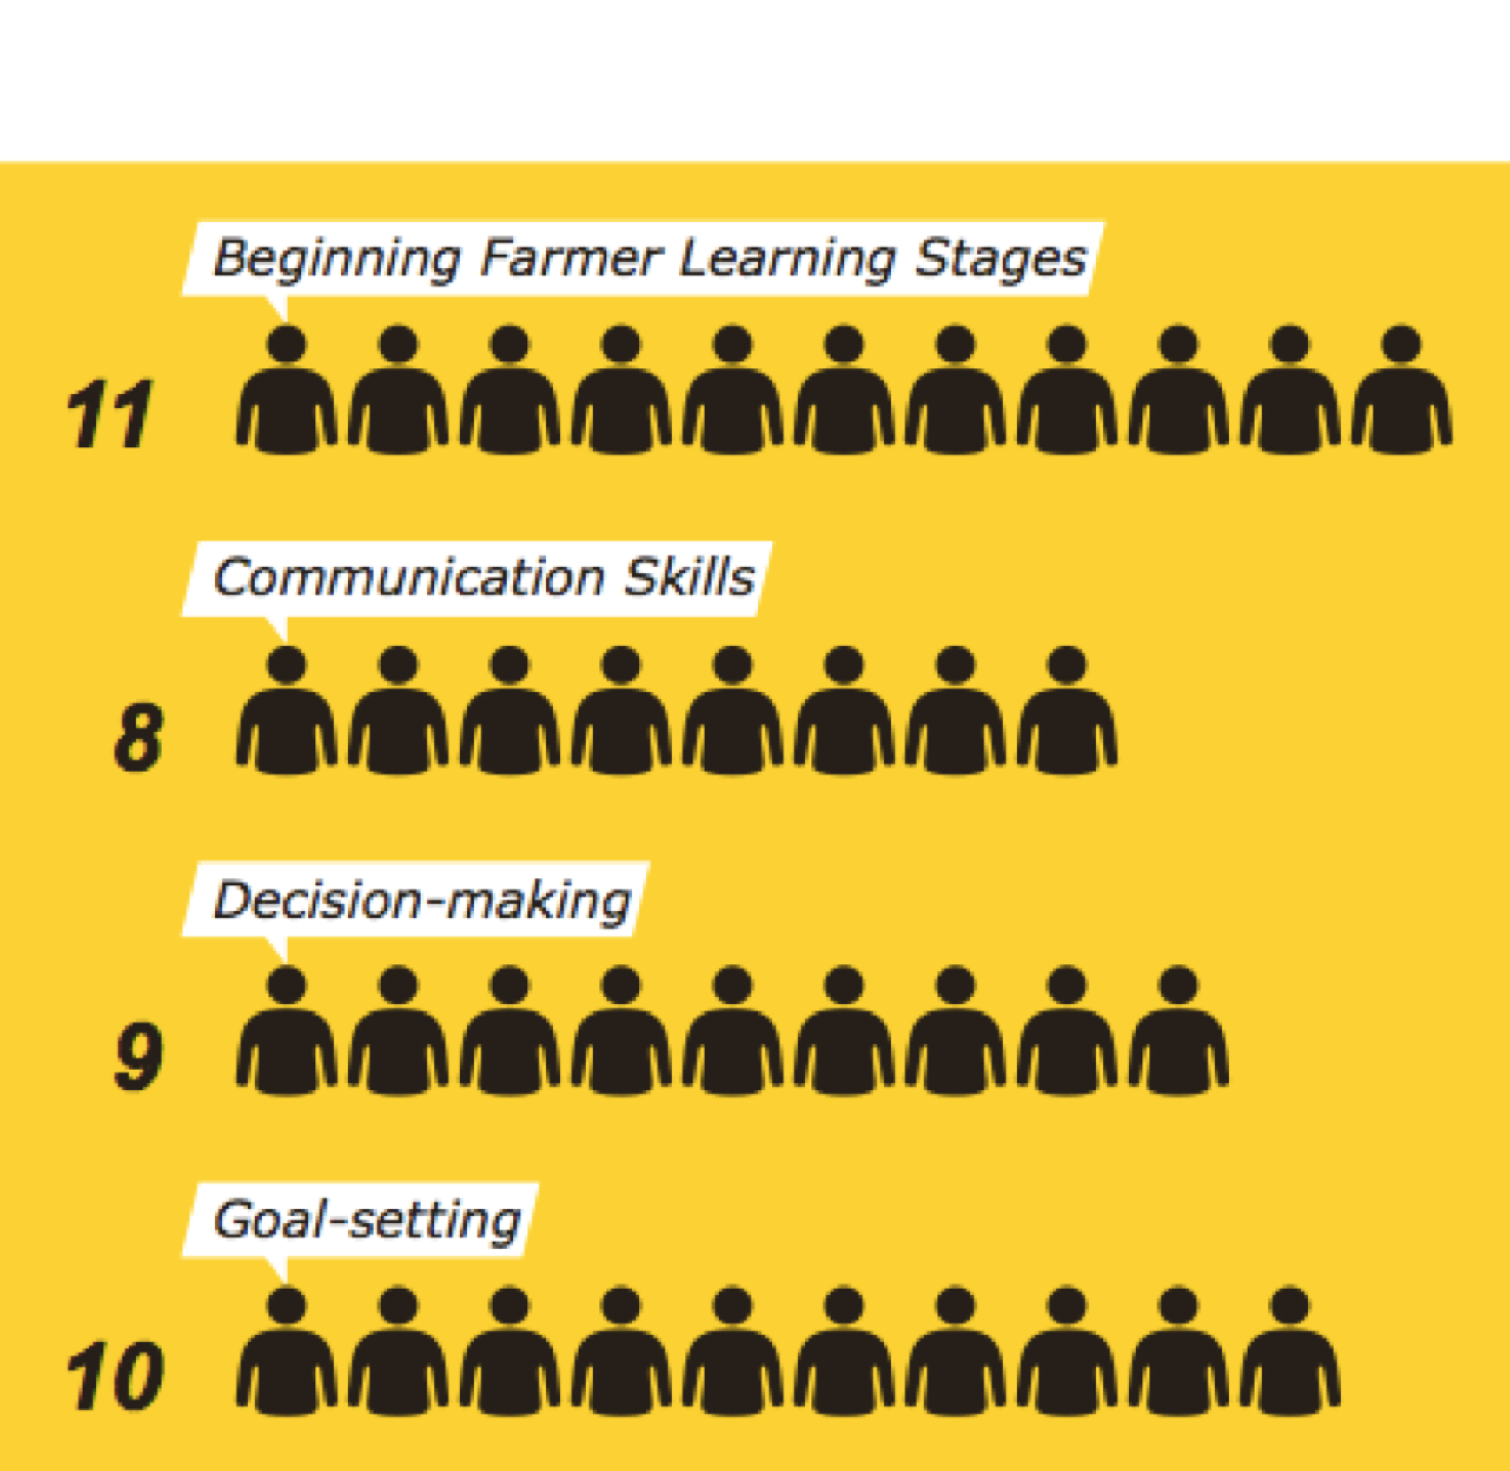
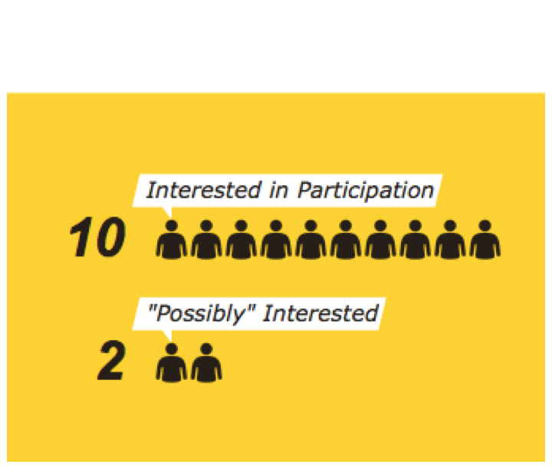
Level of Interest Survey (n=12)
Interest by Topic Area
Interest in Participation

Slide 2
Agricultural Service Provider Places of Work (n = 53)
Notes:
Leslie

Slide 3
What Percentage of New Farmers Have you Worked with in the Last Three Years? (n = 53)
Notes:
Leslie less than 10% 3ppl, 10-24% 6ppl, 25-49% 14ppl, 50-74% 19ppl, all 4ppl

Slide 4
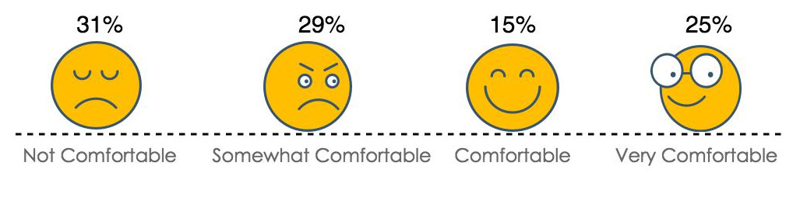
How comfortable are you in addressing interpersonal skills in 1-on-1 consultations with farmers? (n = 52)
Notes:
Leslie

Slide 5
How Frequently Do You See Problems of Interpersonal Skills on Farms You Work With? (n = 53)
Notes:
Rarely 12ppl, somewhat infrequently 10ppl, somewhat frequently 18ppl, frequently 10ppl

Slide 6
Frequency of Seeing Problems with Farmers Among ASPs Not Comfortable with Addressing Interpersonal Issues (n = 16)
Notes:
Rarely, 27 people- 10% Somewhat Infrequently, 33 people- 11-40% ; 13 people- Somewhat Frequently, 0 people -41-74% Frequently/Very often 75%+ 27 27 33 13

Slide 7
Familiarity with New Farmer Learning Stages
(n = 53)
Notes:
47% somewhat unfamiliar or not familiar at all

