Slide 1
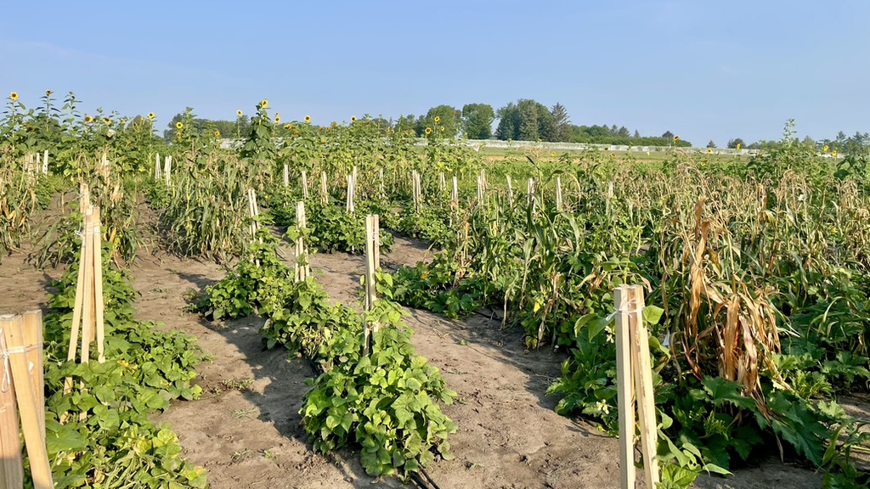
2021 Season Overview and Looking Forward
ISU Horticultural Research Station

Slide 2
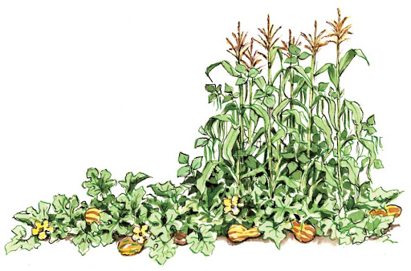
Recap of Varieties Grown
Corn - Turtle Mountain White
Bean - Hidatsa Red
Squash – Algonquin Long Pie Pumpkin
Sunflower – Arikara Sunflower
Notes:
Interested in new varieties due to disease issue and we want to make sure we’re contributing the most to rematriation efforts

Slide 3
Observational Smut Trial
South Dakota Rainbow
Winnebago Spotted
Ames 1056
Dakota White
Oklahoma Bronze
Ames 1056; Dakota White; Oklahoma Bronze; South Dakota Rainbow; Winnebago Spotted
Notes:
Mention didn’t see much smut in general – Dakota white did have some
Ames 1056 - this could be what the whites called Ivory King. Grown by the Yankton Sioux Indian Tribe. An original Indian corn that has possessed superior adaptability to the Wagner, South Dakota area in competition with hybrids. Obtained by Joe Curtis from Mrs. Victor Ktena, Sioux Indian woman. It was passed to her from the maternal side for many generations.

Slide 4
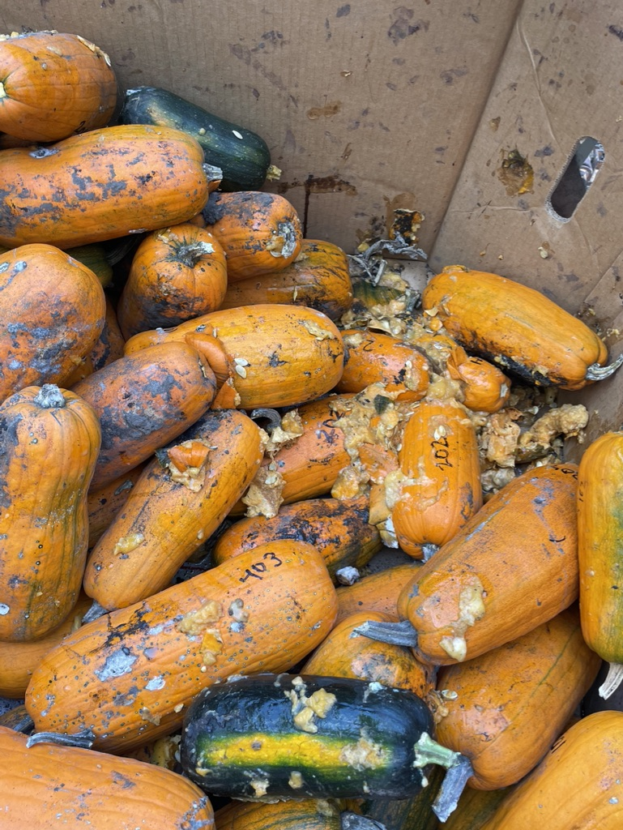
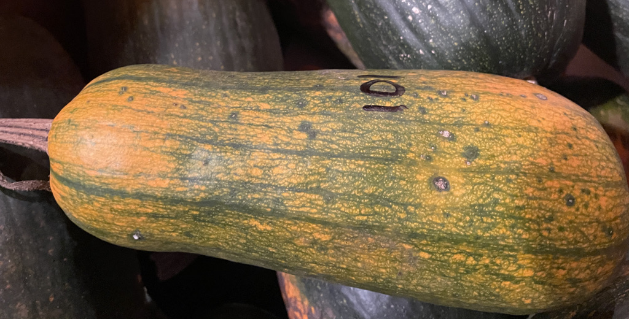
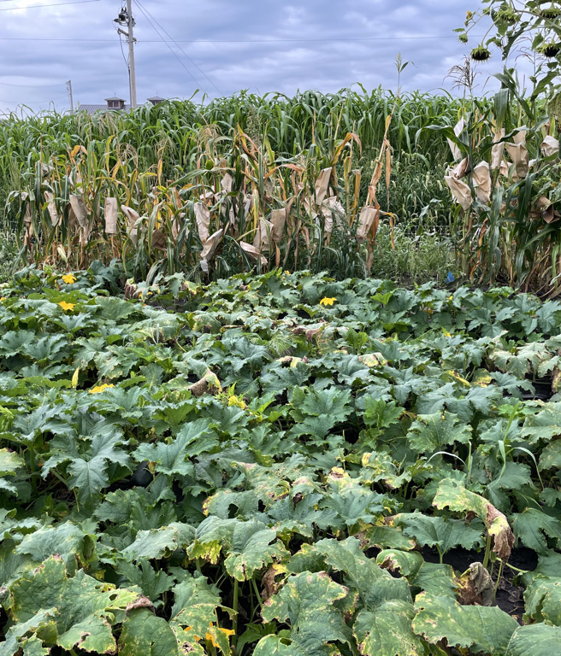
Bacterial Spot of Cucurbit Xanthomonas cucurbitae

Slide 5
Options moving forward
Use same variety – I have seed, so we wouldn’t be jeopardizing new seed stock
OR – we select a new variety, with hopefully more resistance to the disease

Slide 6
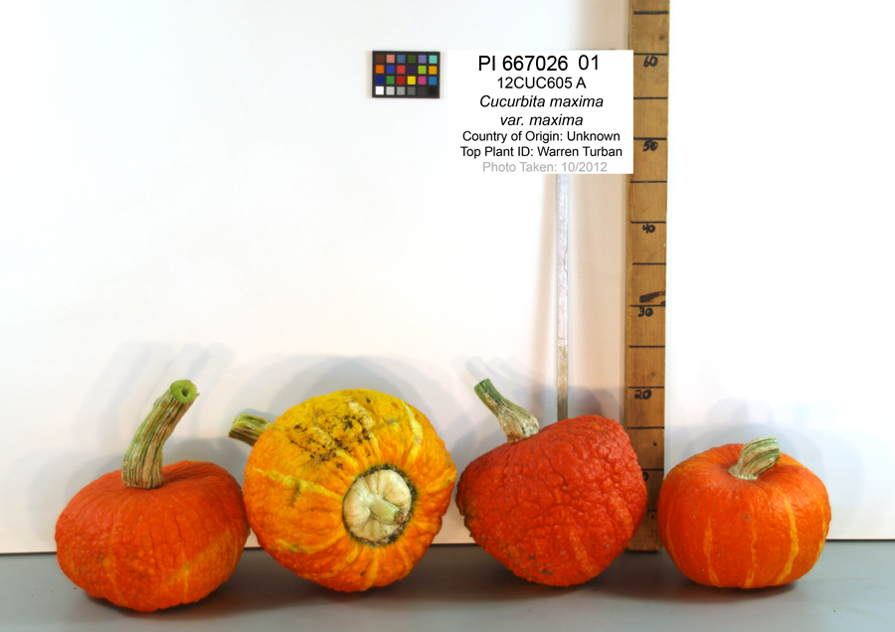
Potential option 1 – Warren Turban
From Seed Savers Exchange
Information from Vaughan's '61 catalogue: A winter variety squash. 80 days. Fruits are large, heavily warted, bright orange, red with a definite button.

Slide 7
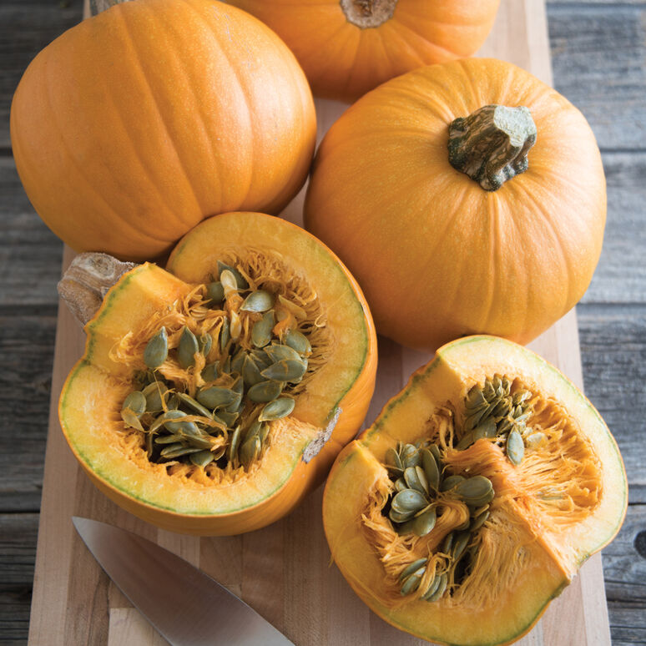
Option 2 – Naked Bear hybrid
Could get seed from Johnny’s
Specialty pumpkin. 105 days. The semi-hulless seeds are excellent for roasting and snacking, and can be pressed for oil. Will yield a crop even under strong disease pressure

Slide 8
Thoughts on corn and squash varieties for next year? Are there other seeds who need to return home? Open to input, recommendations, and discussion for all crops grown.
Notes:
Bean too?

Slide 9
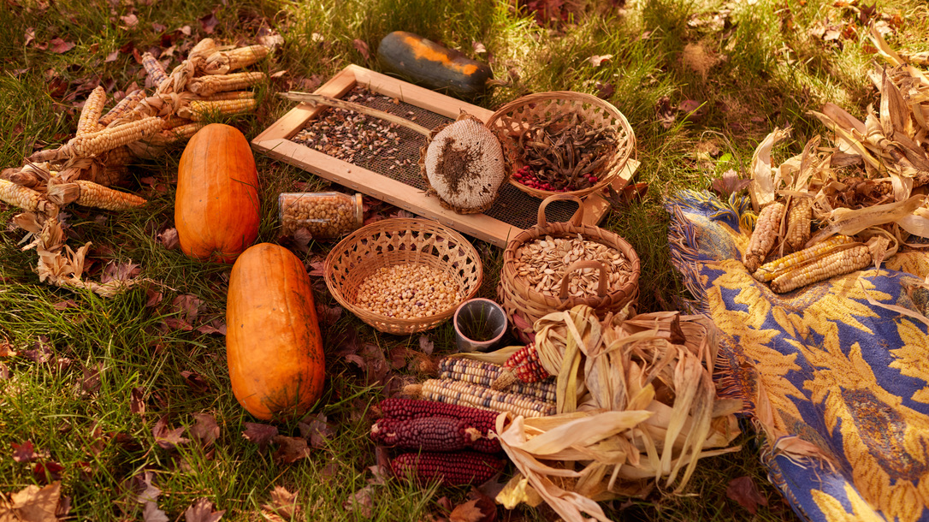
Many thanks to you all!

