Slide 1
Reuniting the Three Sisters: Native American Intercropping and Soil Health
Extension and Outreach
Soil health
3- Sisters Project
Community
Biodiversity
Pest and Diseases
Crop rotation
Food quality

Slide 2
Outreach/Workshop input
Multi-disciplinary team (soil science, Horticulture, Food Science, Social science)
Input from advisory board and community members
Iowa-Nebraska-Minnesota- Wisconsin

Slide 3
Topics covered
Soil fertility and health in home gardens
How to set up drip irrigation
Seed saving for home gardeners
DIY Soil health tests
Key insect pests of squash, beans, and corn
Composting basics and troubleshooting

Slide 4
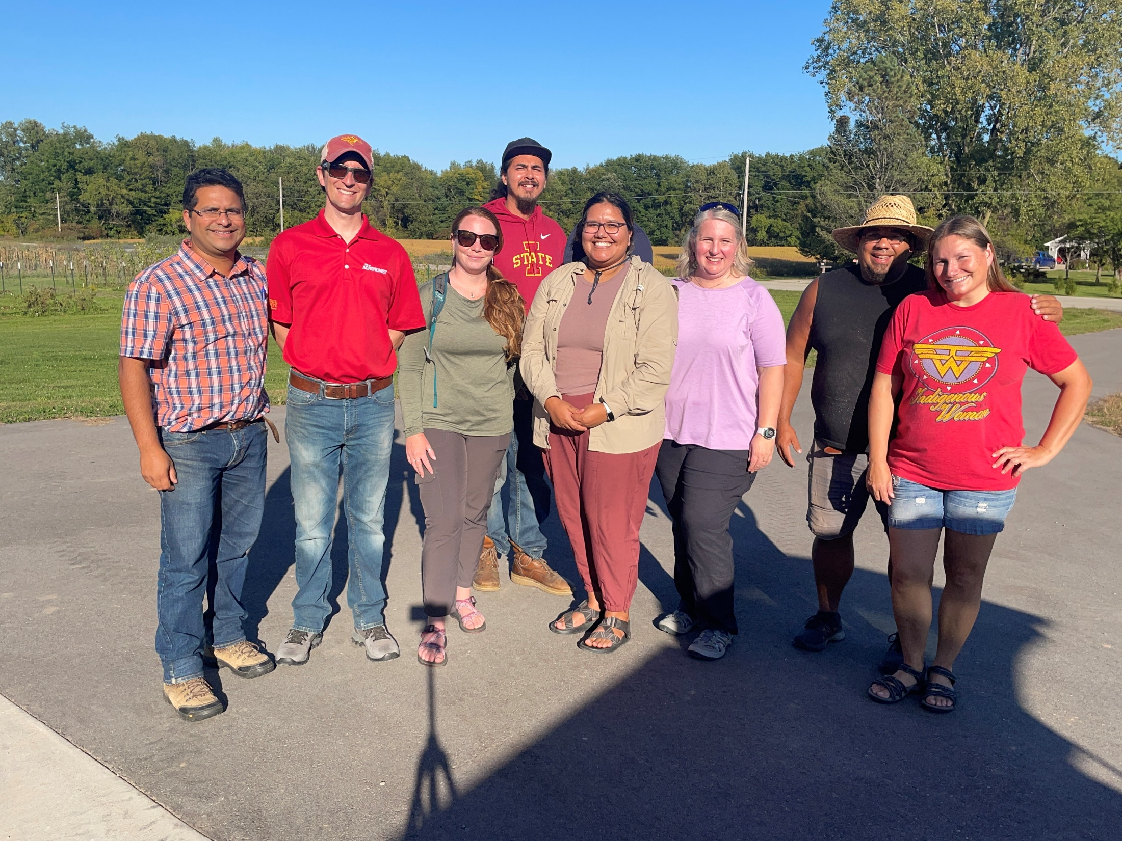
Soil health and pest management workshop

Slide 5
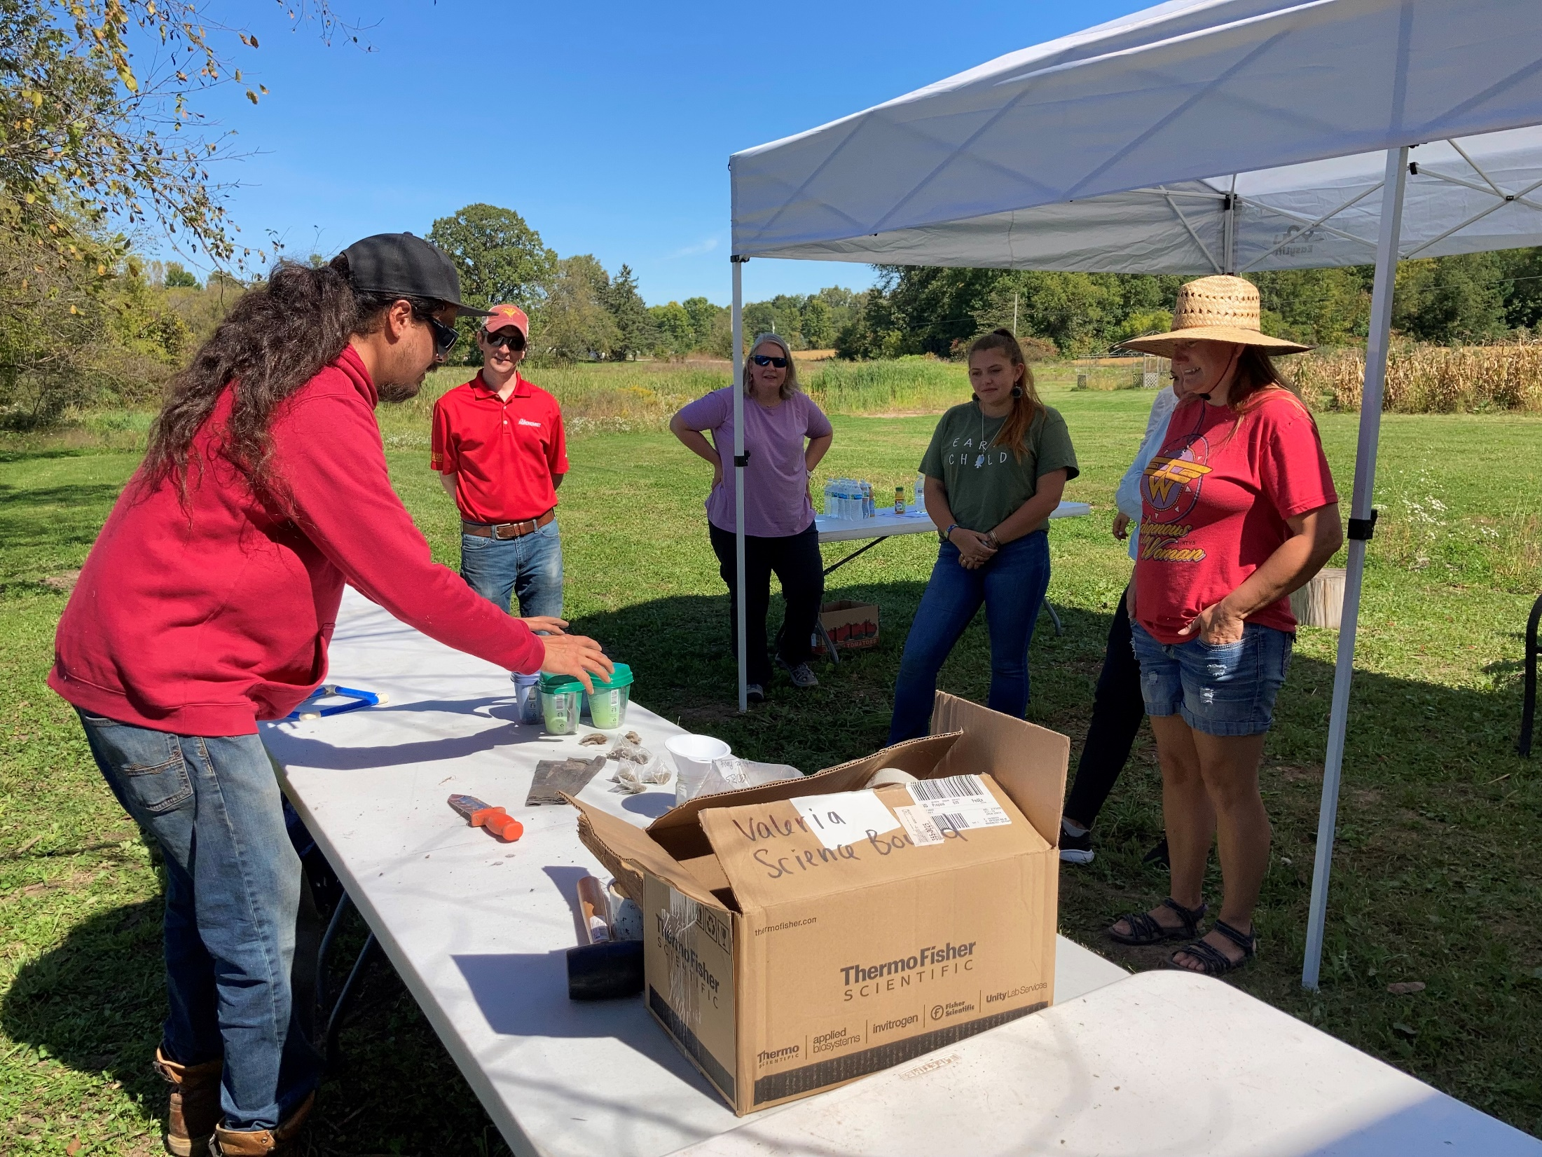
Hands-on activity

Slide 6
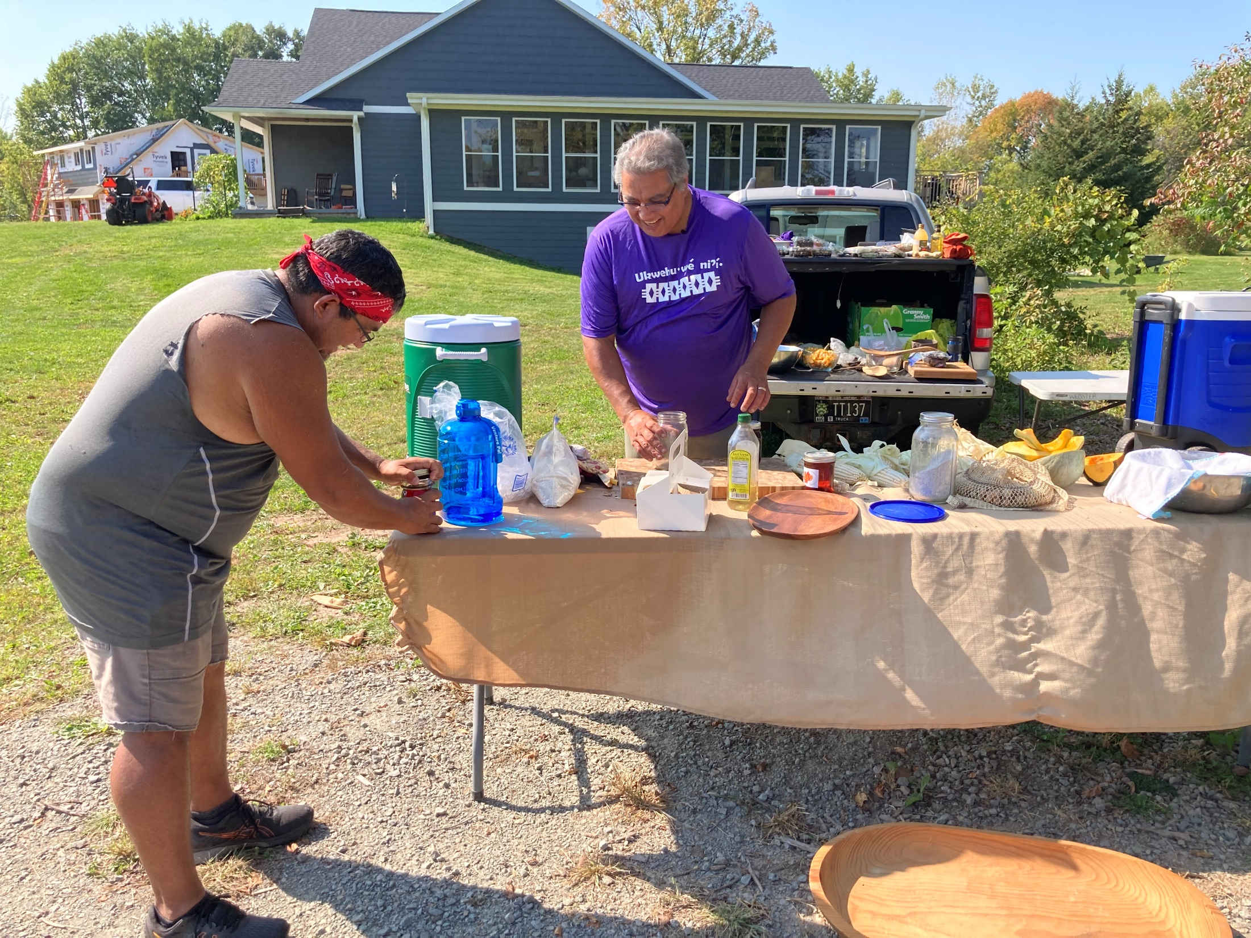
Food and culture

Slide 7
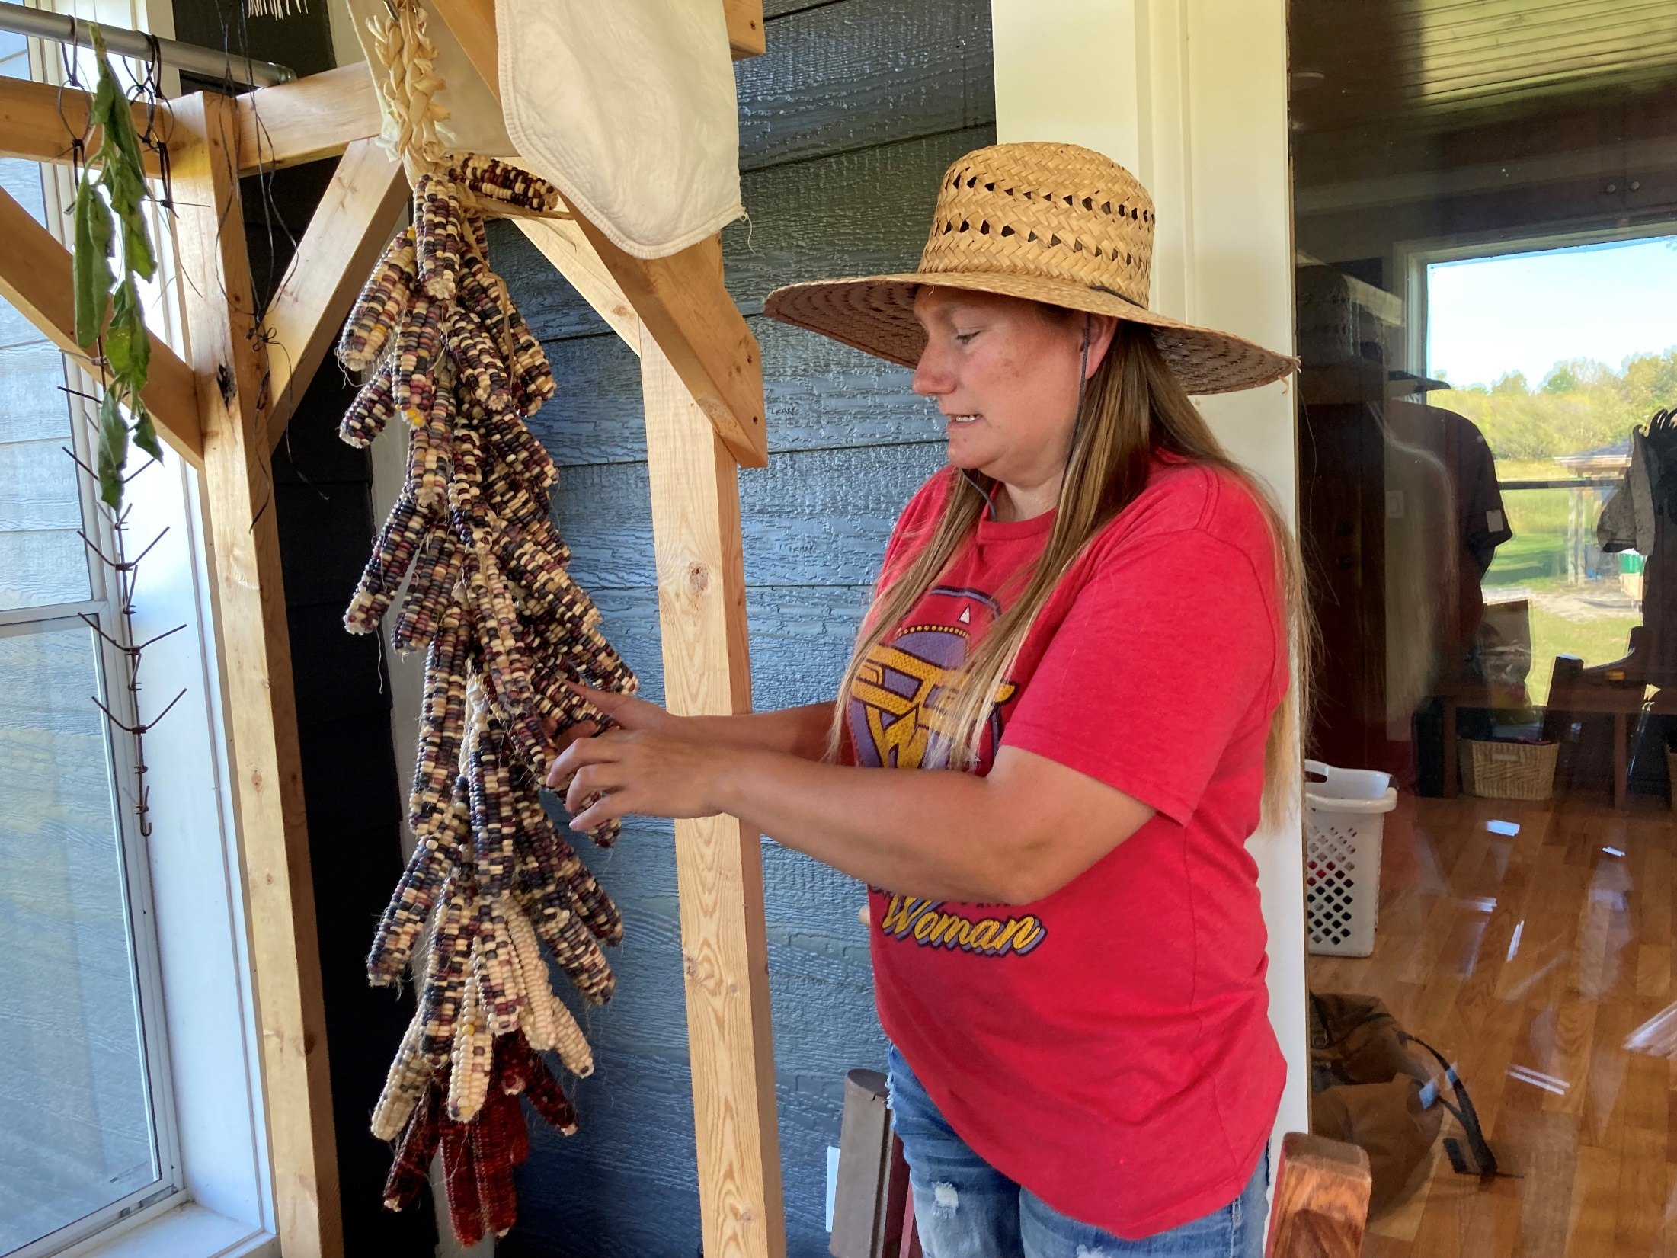

Slide 8
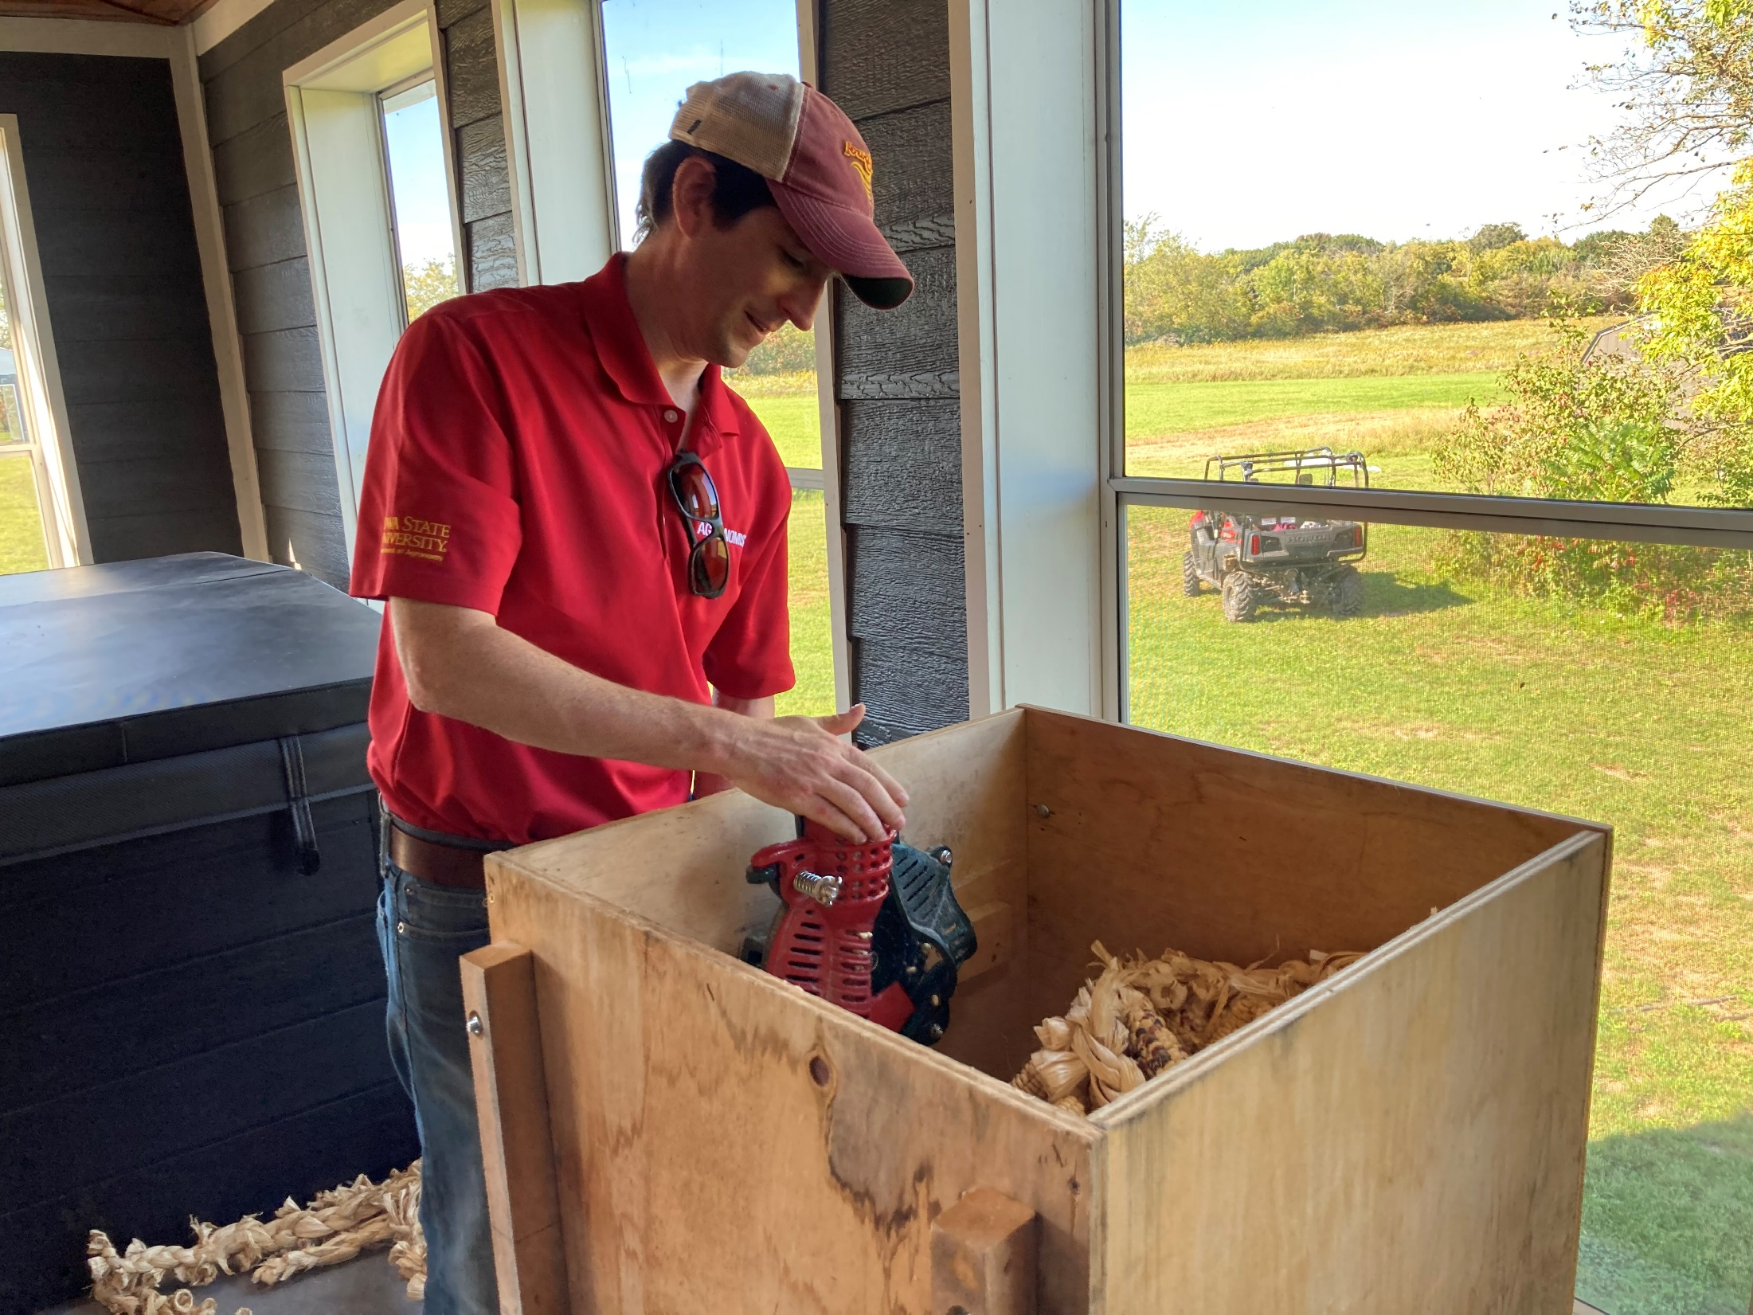
Hands-on…bring it on……

Slide 9
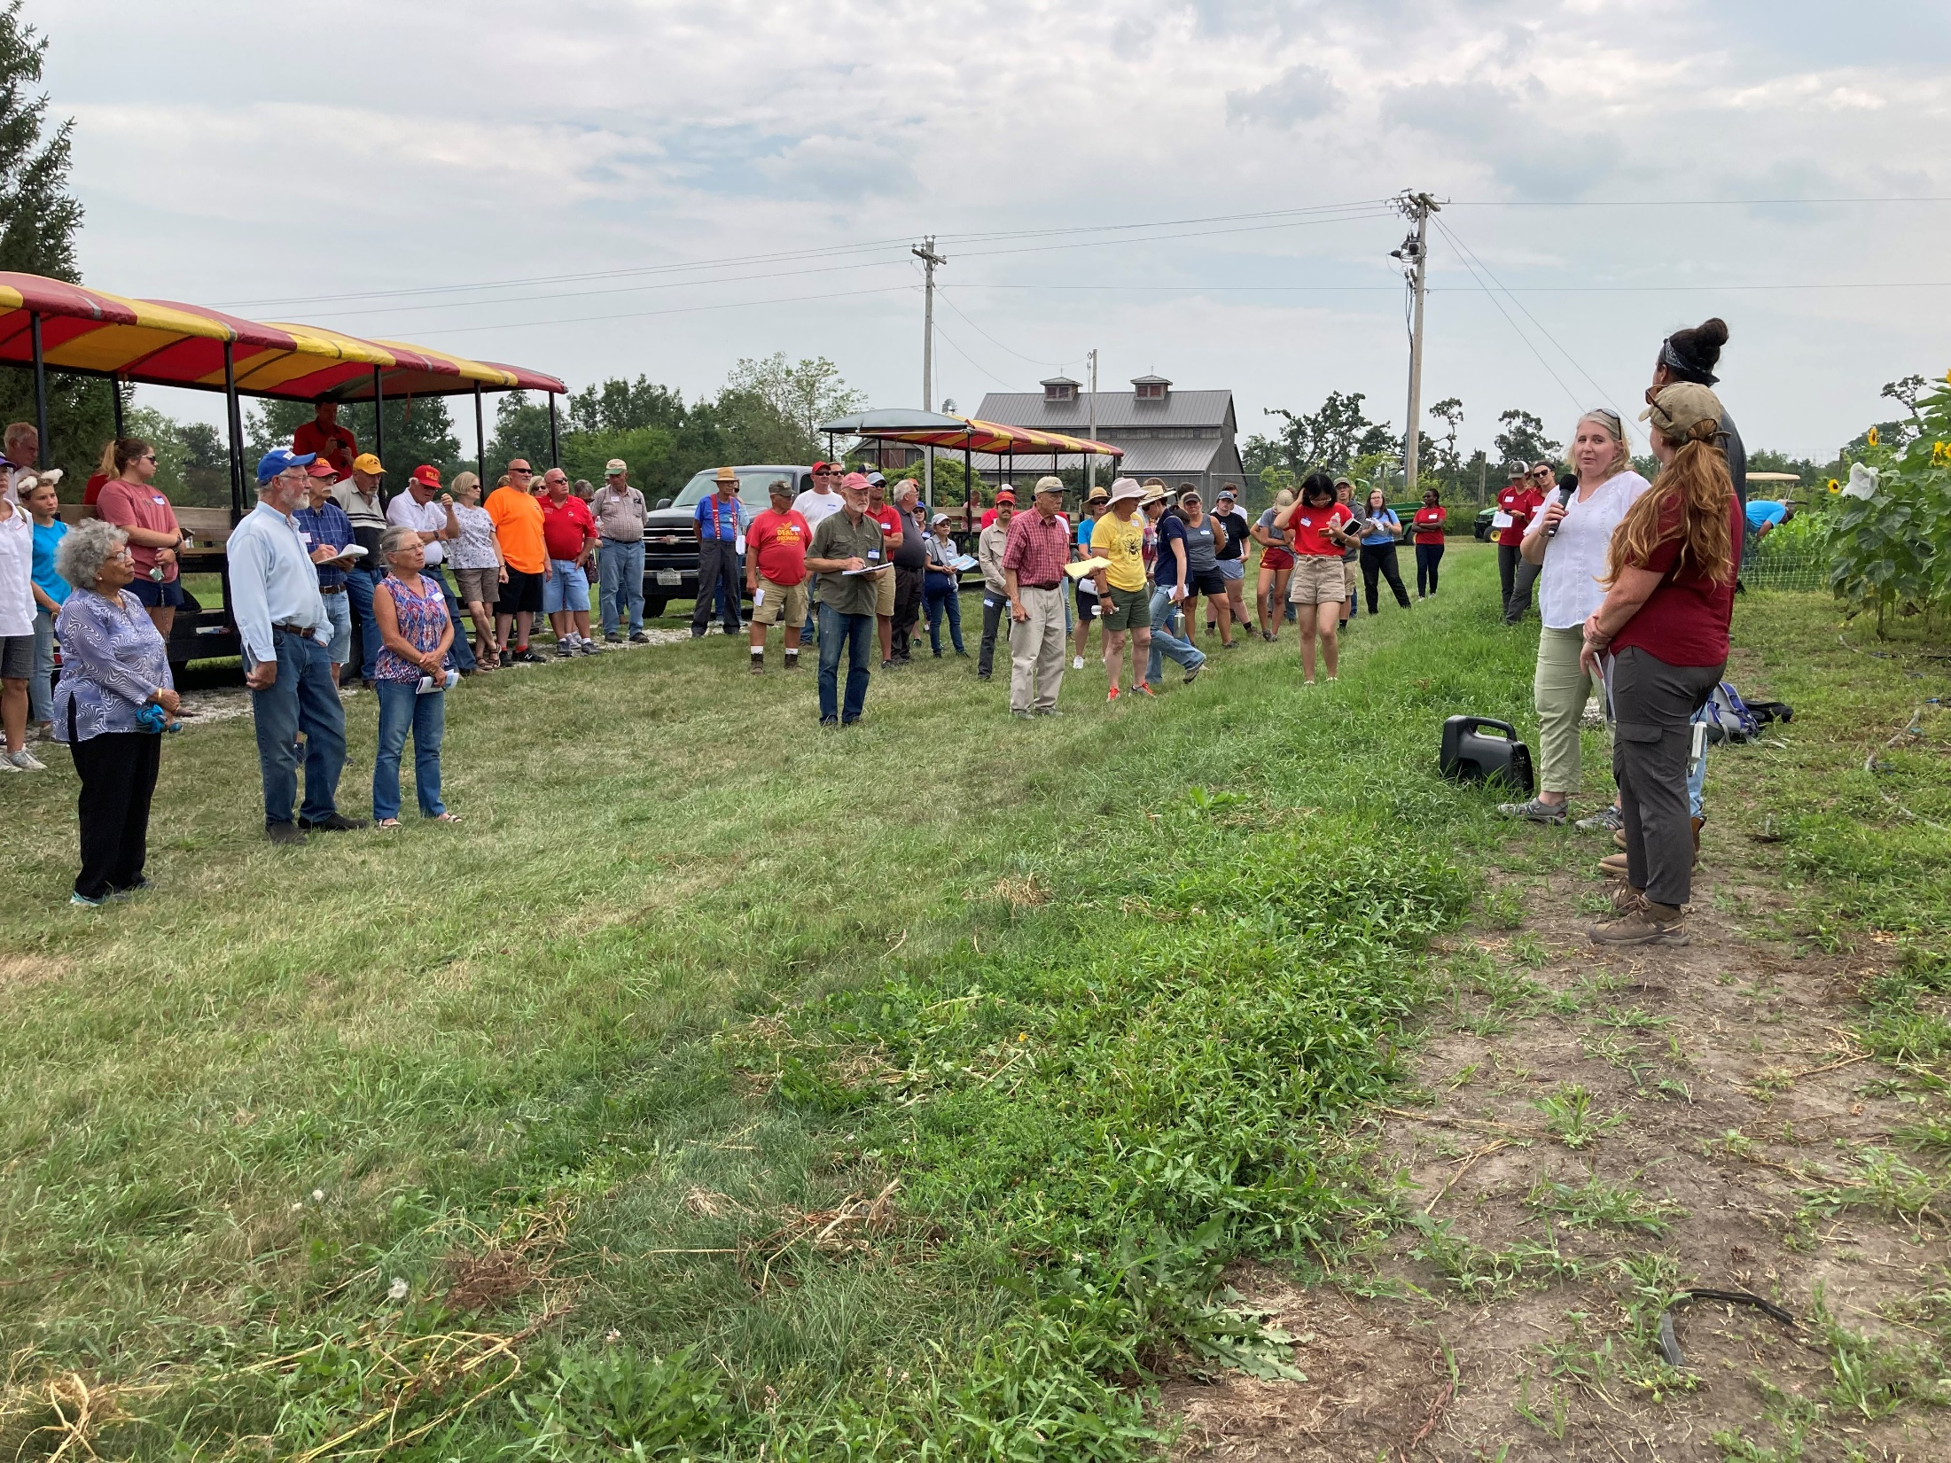
Field Day at the Horticulture Research Station, Ames, IA

Slide 10
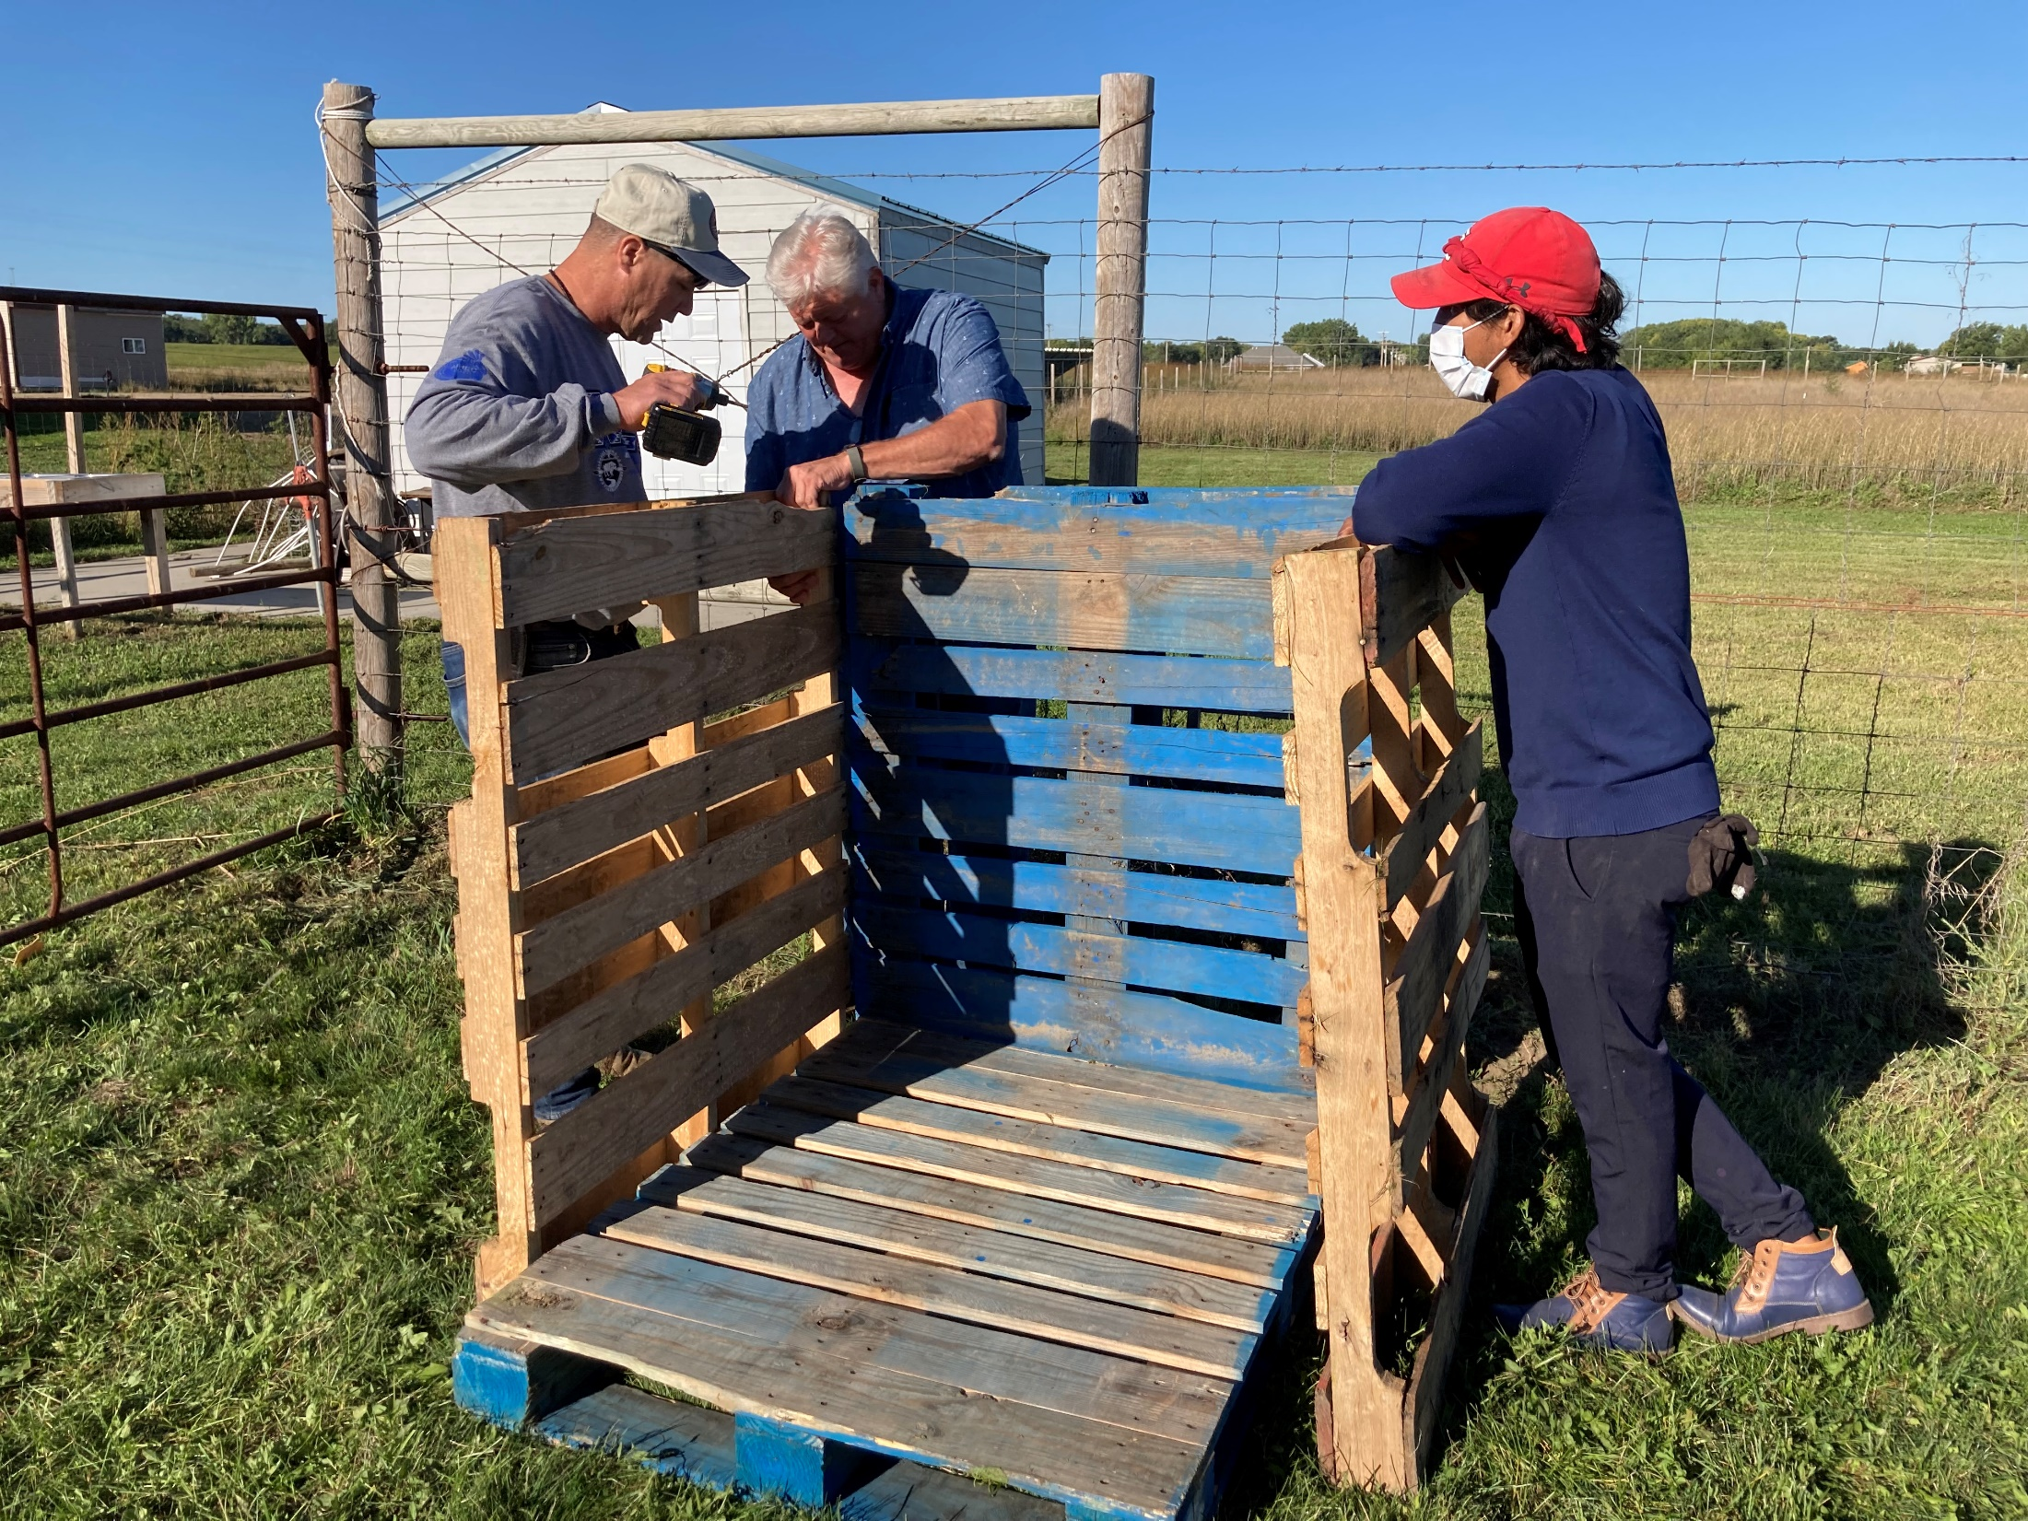
Hands-on compost making @ NICC

Slide 11
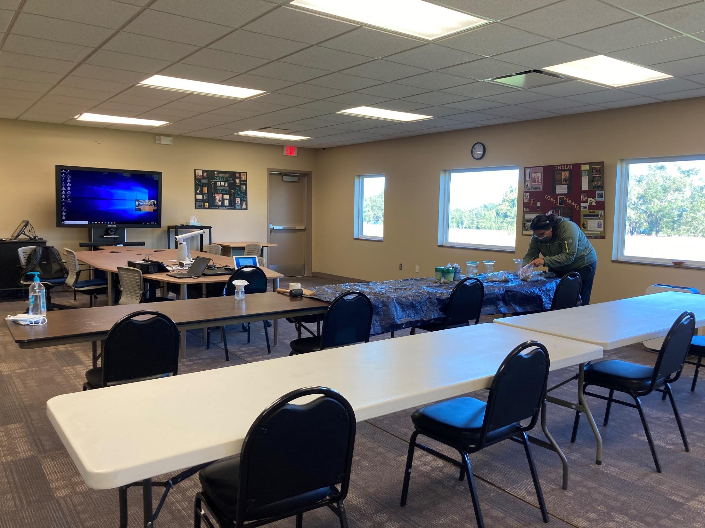
Classroom learning

Slide 12
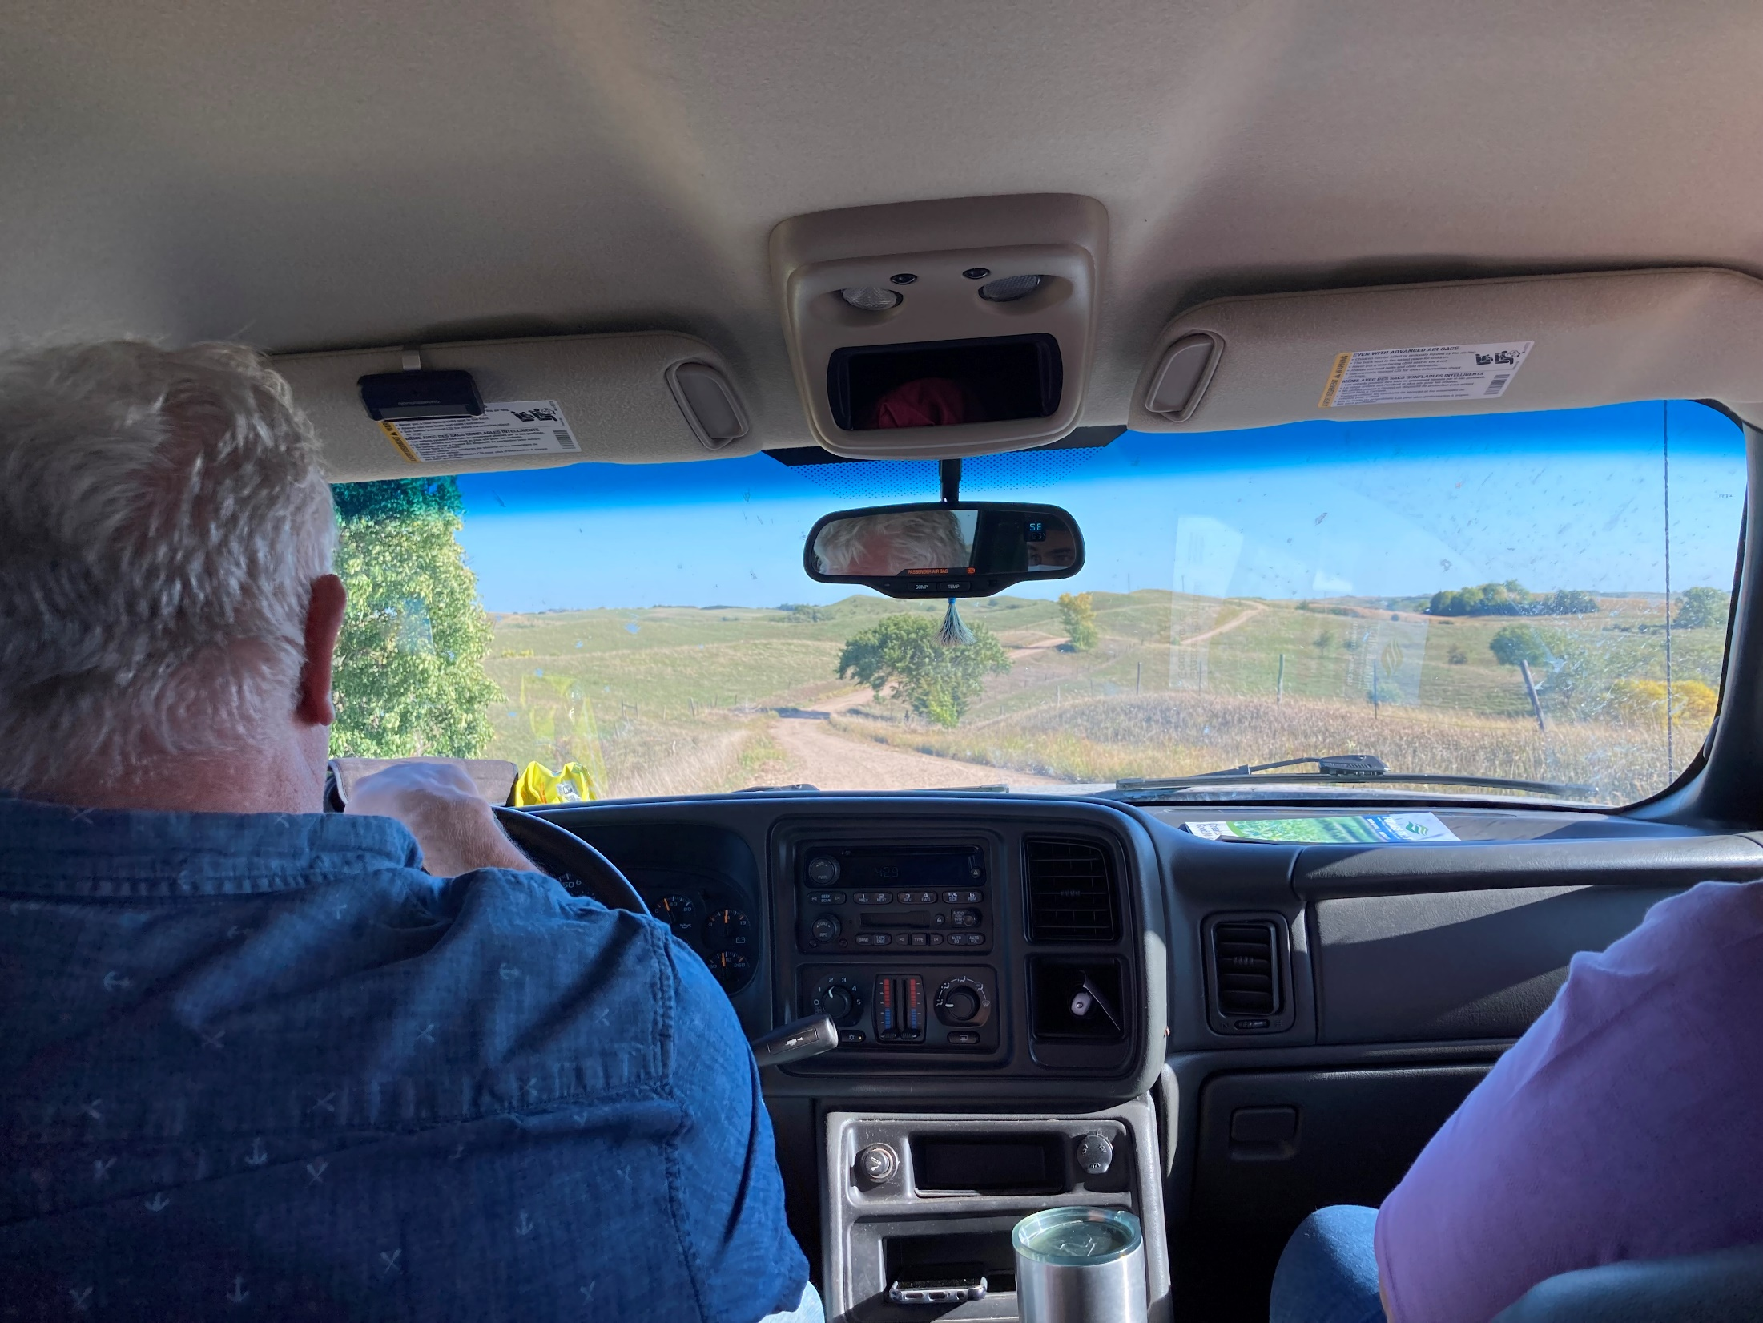
Hank’s VIEWpoint

Slide 13
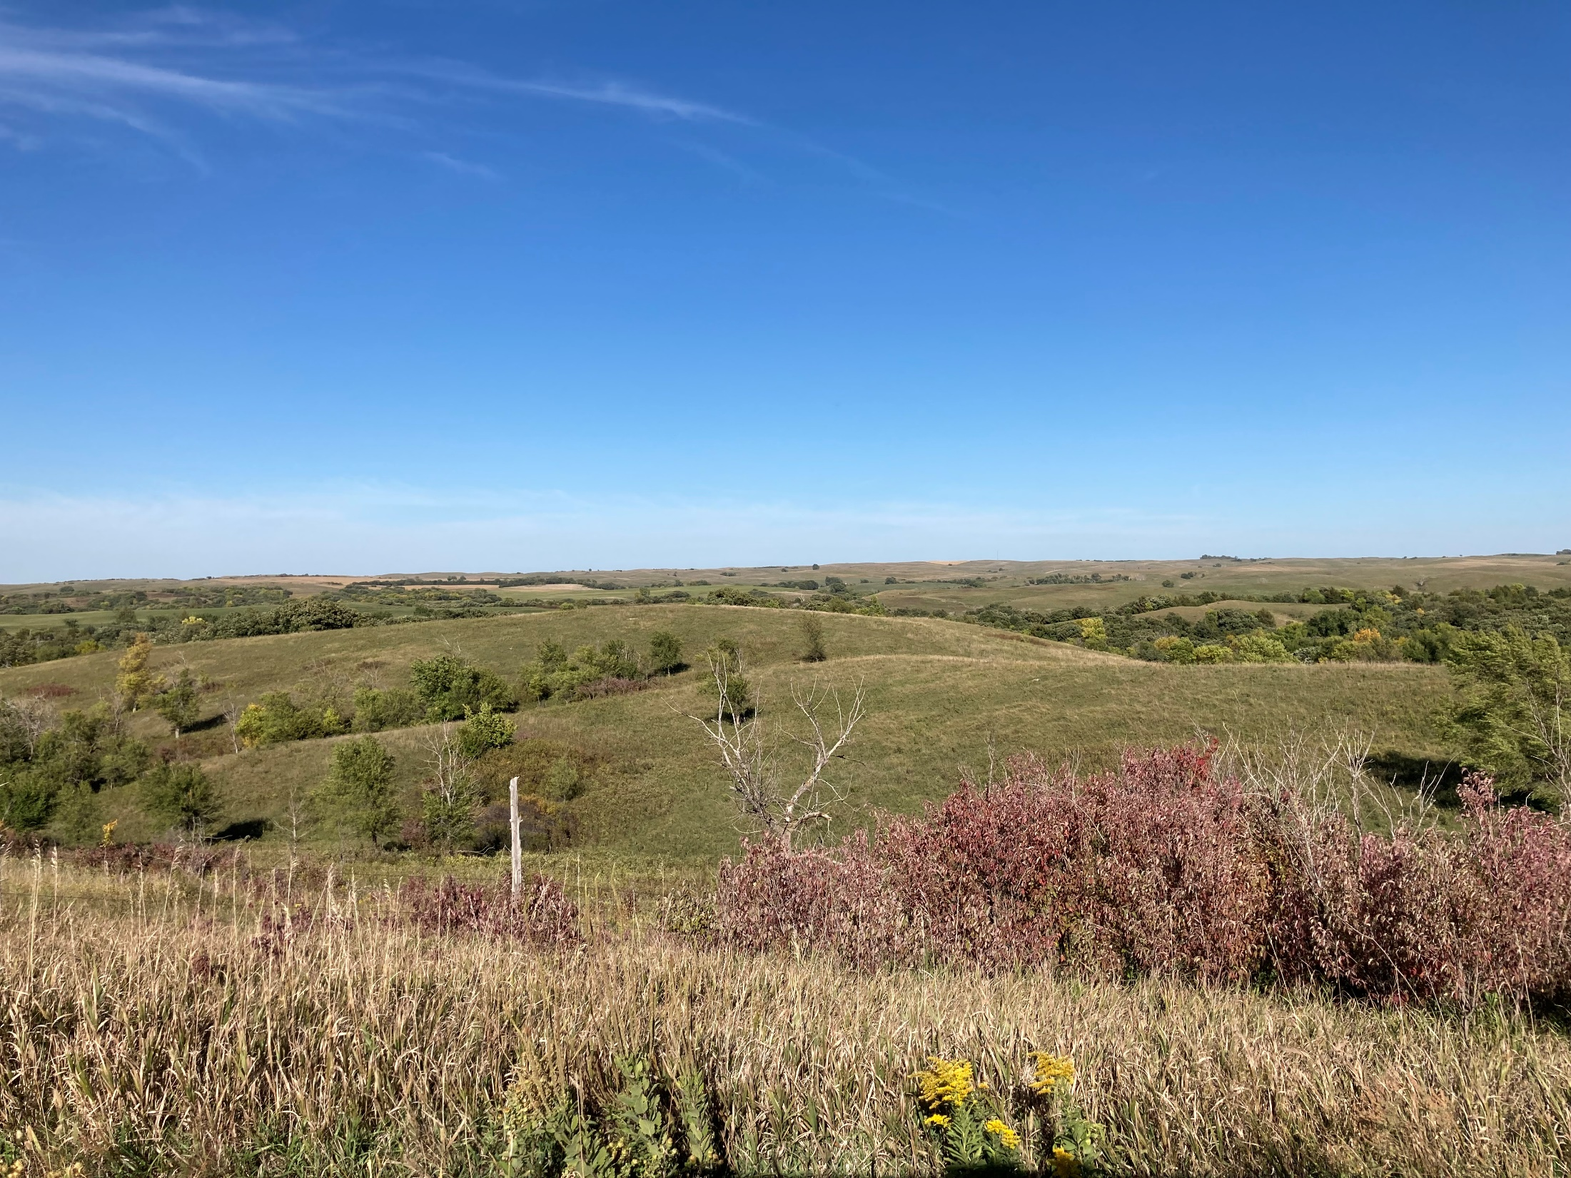
Niobrara region

Slide 14
Proposed activities
Connect with native gardeners, organizations, and community members through in-person visits.
Opportunities for needs assessment and collect feedback on current practices and methods.
Hands-on workshops topics.
Support deployment of DIY soil health kits and work with collaborators to collect, analyze, and interpret data.
Connect stakeholders to information resources through websites, YouTube videos, webinars

Slide 15
Workshop topics
Link to propose topics of your interest
https://docs.google.com/document/d/1gm4Ngx1qyBQfO0A1I4X2WT8vm9rsFy0G46v11gManCk/edit?usp=sharing

Slide 16
Many Thanks
Many THANKS
3-Sisters project team and advisory board members

