Slide 1
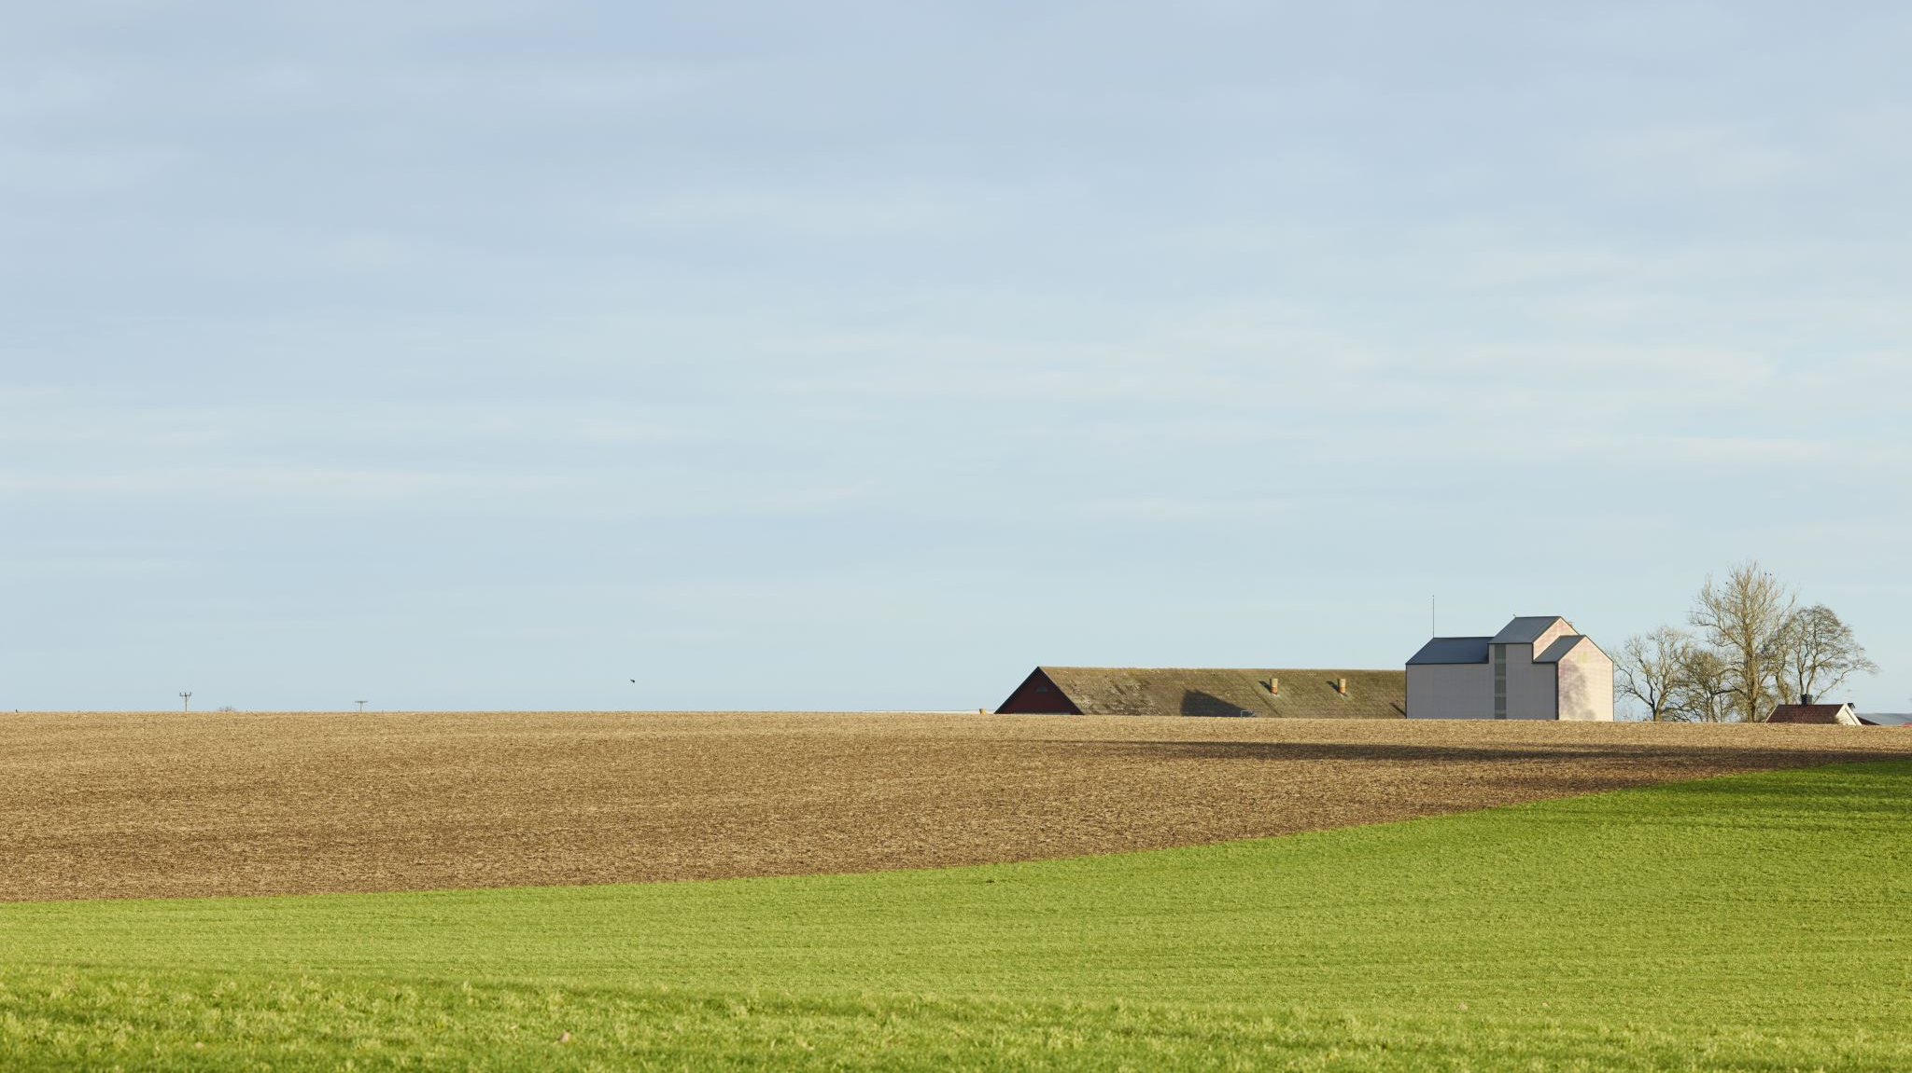
Who can innovate? Assessing growers’ capacities to introduce culturally meaningful seed into the US seed system
Sally Burke & Dr. Daniel Tobin
The University of Vermont
AFHVS-ASFS Conference
June 6, 2024
Syracuse, NY
This material is based upon work supported by the National Institute of Food and Agriculture, U.S. Department of Agriculture, through the Northeast Sustainable Agriculture Research and Education program under subaward number LNE22-456R. Any opinions, findings, conclusions, or recommendations expressed in this publication are those of the author(s) and do not necessarily reflect the view of the U.S. Department of Agriculture.

Slide 2
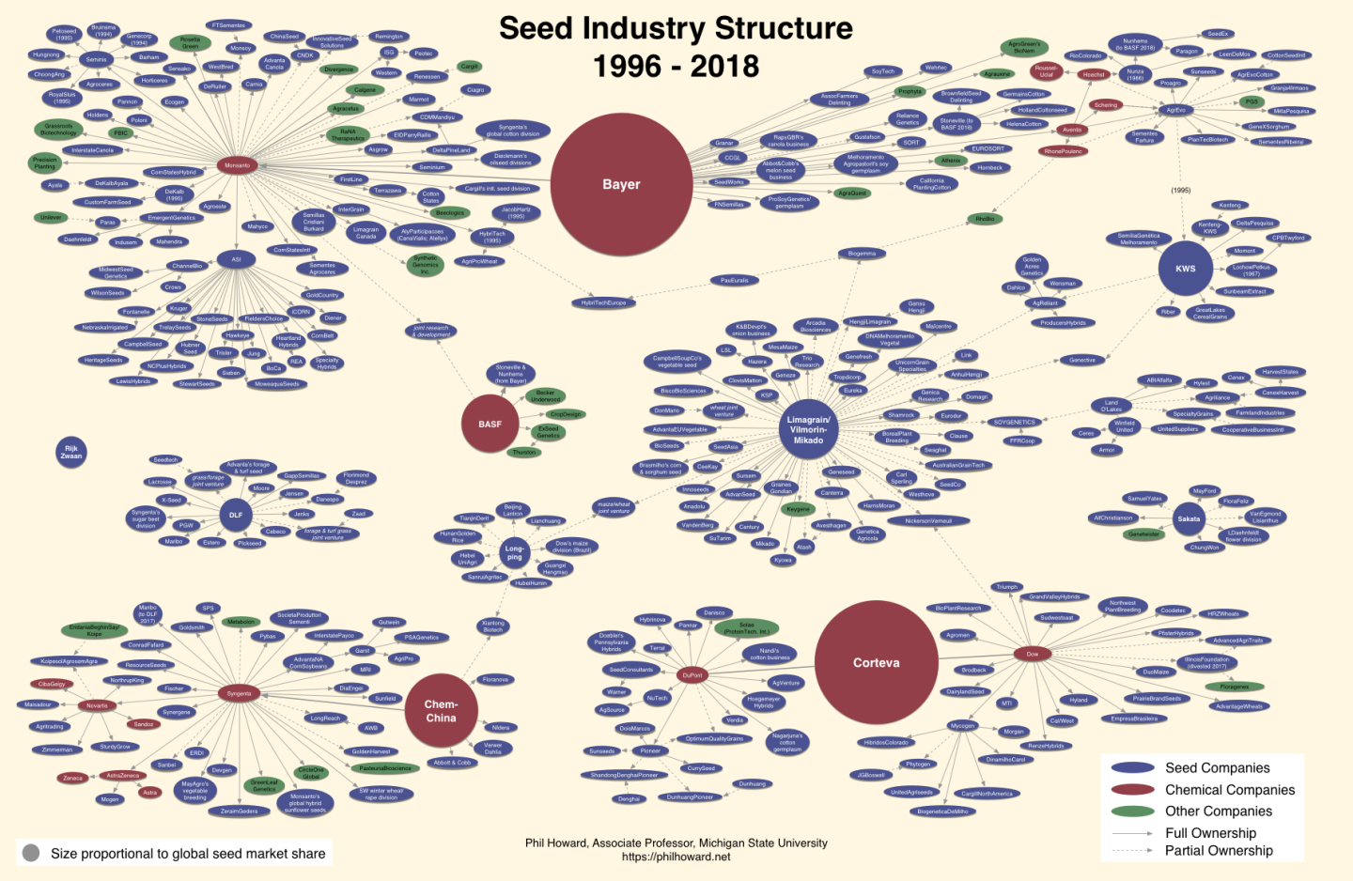
The dominant US food system
Corporate consolidation of the seed industry
Monoculture farming system
Issues surrounding food justice
These and other issues lead to a dearth of culturally acceptable (CA) seed and food in the US.
Notes:
Corporate consolidation of the seed industry: four companies control 51% of global seed sales (Howard, 2023).
Monoculture farming system: corn and soybean cover 57% of total field area in the US (Spangler, 2020).
Food justice literature notes the extreme difficulty BIPOC individuals face in producing and purchasing culturally acceptable (CA) food in the US (Alkon & Norgaard, 2009).

Slide 3
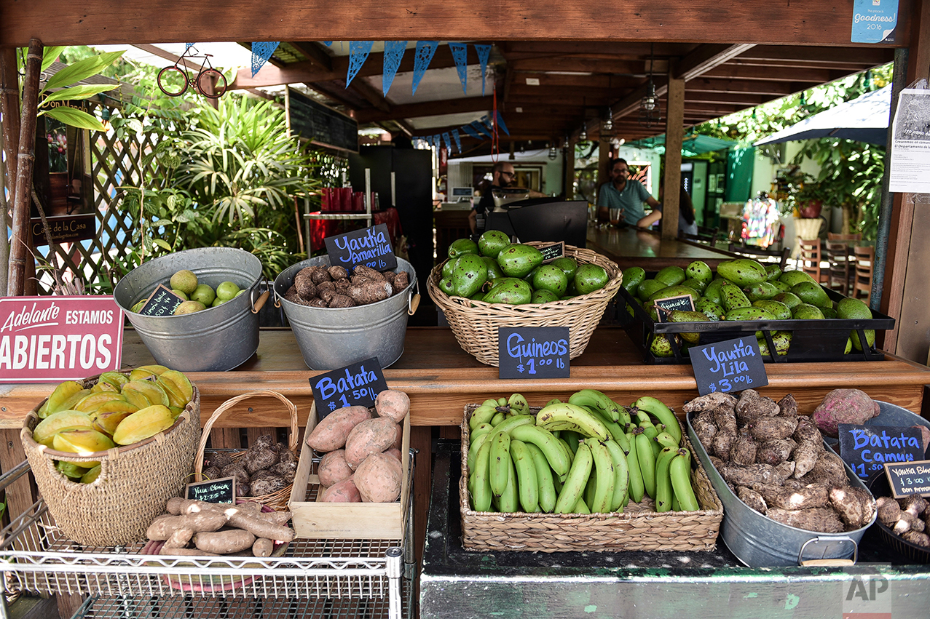
Culturally acceptable food
Food security exists when all people, at all times, have regular and reliable physical, social and economic access to sufficient safe, nutritious and culturally relevant food that meets their dietary needs and food preferences (FAO, 1996).
Food that provides connections between food and livelihoods, relationships, and human dignity (Hammelman and Hayes-Conroy, 2015).
Photo source: AP Photo/Carlos Giusti
Notes:
Proper access to culturally acceptable food enhances the likelihood of better health outcomes and is an integral component of food justice (Alkon and Norgaard, 2009; Moffat et al., 2017; Vallianatos and Raine, 2008).
The cultural acceptability of food is inextricably linked to how food is produced and who can benefit from its production and consumption (Hammelman and Hayes-Conroy, 2015).
Ways to support growers in creating a more CA food system in the US should be explored.

Slide 4
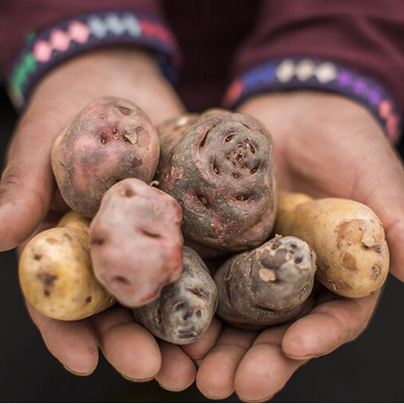
Pro-poor value chain development & agriculture innovation
Pro-poor value chain development: Links growers who have been historically excluded from market opportunities to higher value markets (Meinzen-Dick et al., 2009).
Agriculture innovation: “The processes of change in the production and marketing of [agricultural] goods and services” with the intent of addressing societal problems (Devaux et al., 2018, p. 100; Yongabo and Göktepe-Hultén, 2021).
Photo source: Peru Country Brand
Notes:
Has been employed in the Global South to support marginalized farmers in creating more CA food systems (Thiele & Devaux, 2002).
Pro-poor value chain development: Links growers who have been historically excluded from market opportunities to higher value markets (Meinzen-Dick et al., 2009).
Seeks to improve “the competitiveness of market chains [to benefit] small farmers as well as other market chain actors” (Horton, 2008).
Agricultural innovation: Aim is to create a social surplus of goods which make agricultural products more affordable and available for consumers (Wright, 2012).
Often requires financial resources, access to information and infrastructure, collaborative networks and partnerships, training, and policy support (Cofré-Bravo et al., 2019).

Slide 5
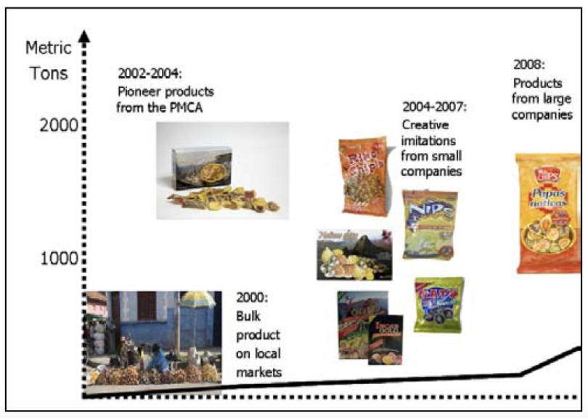
Pro-poor value chain development & agriculture innovation: The Papa Andina Project
Project worked to improve the lives of small-scale farmers by developing market opportunities for native potatoes (Horton et al., 2009).
Project innovations (Devaux et al., 2010):
Native potato chips introduced into large urban markets
Introduced “gourmet” native potatoes into high-value markets
Began to export processed potato products to international supermarkets
Source: Devaux et al., 2010
Notes:
– more secure market linkages in established national markets made for biodiverse and CA native potato varieties (Devaux et al, 2009).

Slide 6
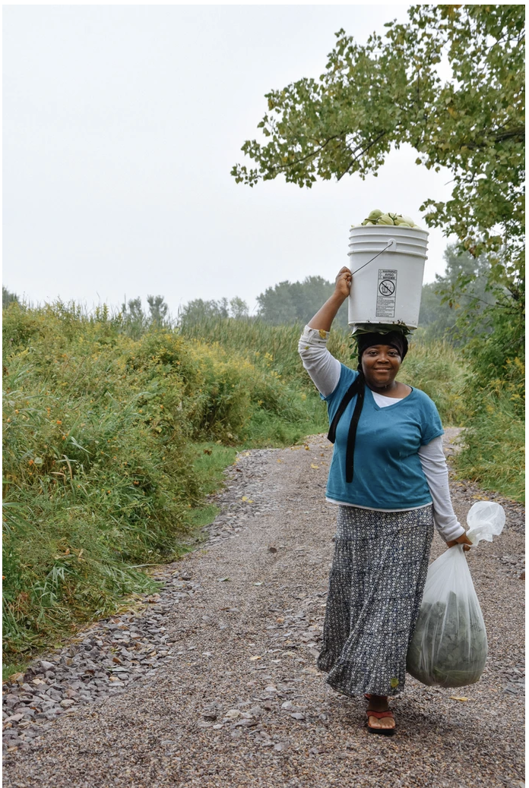
Pro-poor value chain development & agriculture innovation: Culturally acceptable seed and food
Pro-poor value chain development approach:
Support growers (particularly marginalized growers) to secure enhanced market linkages in established US markets for CA crops.
Agriculture innovation:
Introducing new/more CA crops into established US markets
Photo source: New Farms for New Americans

Slide 7
What is needed for enhanced CA food access and who can innovate?
Precursors to agricultural innovation:
Resource access: financial resources, farmland, access to markets, infrastructure, information, labor (Devaux et al., 2017; Diederen et al., 2003; Läpple et al., 2015)
Social connectivity (Audouin et al., 2018)
Access to CA seeds
Some of the most marginalized identities are associated with a lack of access to the resources necessary for agricultural innovation (Horst & Marion, 2019; McGuire et al., 2022).
Study interrogates who is well-positioned to enhance the seed value chain so CA crops are more available and accessible.

Slide 8
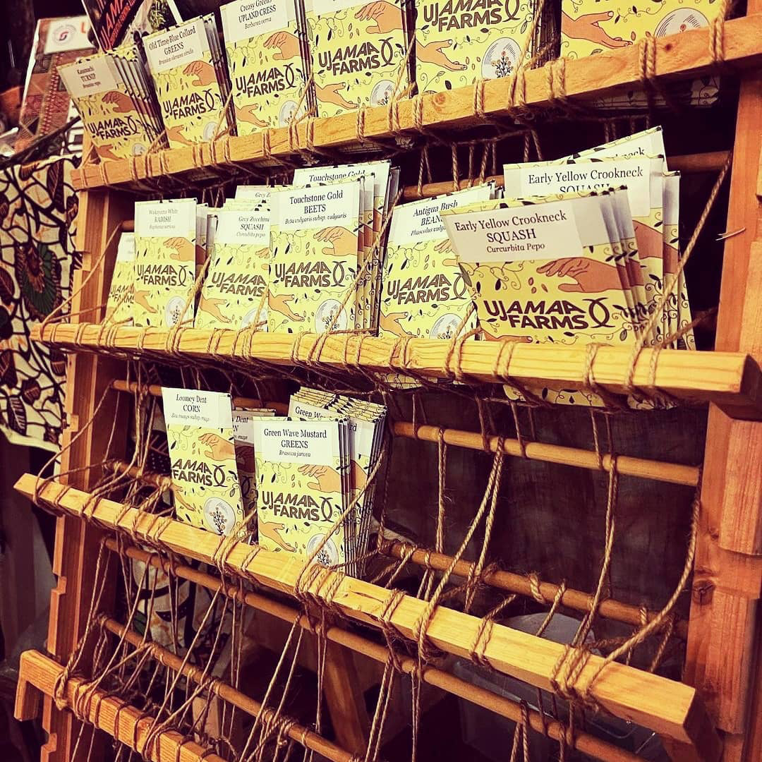
Research questions
RQ1: How do social connections between farmers and gardeners and other seed value chain actors vary according to the demographics of the grower?
RQ2: How does access to resources for farmers and gardeners vary according to the demographics of the grower?
RQ3: How do barriers to growing CA crops, experienced by farmers and gardeners vary according to their demographics?
Photo source: Ujamaa Cooperative Farming Alliance

Slide 9
Methods
National online survey using Qualtrics sent to seed value chain stakeholders between October 2023-January 2024.
Convenience sampling using the research team’s personal and professional contact lists and via publicly listed contact information.
Data analyses conducted using SPSS Version 28.0 through running a series of multivariate regressions.
Notes:
Measured the attitudes, and perceptions of opportunities, challenges, and bottlenecks towards marketing and selling CA seeds.
Collaborated with the Ujamaa Cooperative Farming Alliance to recruit racially and ethnically diverse respondents.
Respondents recruited through Northeastern Organic Farmer’s Associations (NOFAs) and university master gardener lists.
Sampling frame further developed through Google, Yelp, etc. internet searches.

Slide 10
Respondent demographics
*This study draws on results from 1,585 farmers and gardeners.
Variable | Frequency | Percent
Race BIPOC Non-BIPOC | 231 1044 | 0.181 0.819
Gender Female Male Other | 877 353 71 | 0.674 0.272 0.054
Income Less than $50,000 $50,000 - $99,999 $100,000 + | 332 393 316 | 0.319 0.378 0.303
Variable | Frequency | Percent
Grower type Gardener Farmer | 1160 425 | 0.732 0.268
Age Mean age = 57 Standard deviation = 14.504
Education High school – Associate’s Bachelor’s degree Post-graduate degree | 264 492 524 | 0.206 0.385 0.409

Slide 11
Results
Y: Farmer or gardener= 1 | Model 1: Connectivity | Model 2: Barriers | Model 3: Barriers to CA seed access
Gender (1=non-male) | 0.467 | -0.383 | 1.049**
Race (1=BIPOC) Grower type (1=farmer) | -0.606 4.509*** | 1.988** 5.371*** | 0.404 1.043*
Income Employment status | -0.049 1.137 | -0.632*** 2.377*** | -0.370*** 0.910
Education | 0.505 | -0.230 | -0.117
Year born | -0.025 | 0.144*** | 0.016
Land access | 0.502 | -0.158 | -0.181
Connectivity Grows CA crops (1=yes) Profit as important (1=yes) | 1.219 -0.267 | 0.026 0.757 5.813*** | 0.001 -1.054** 1.180**
Constant N F-Value | 68.681 364 3.086*** | -268.106 354 31.299*** | -20.975 331 3.946***
R² | 0.080 | 0.501 | 0.119
*** p < 0.01, ** p < 0.05, *p < 0.1.
Notes:
BIPOC, lower income growers, and farmers encounter the most barriers related their ability to grow and sell increased amounts of CA crops.
BIPOC and lower income growers experience barriers to accessing resources across almost all individual barrier categories.
Non-males, lower income growers, and farmers encounter the most barriers related their ability to access CA seeds.
The cost of culturally acceptable seed was a barrier for all three groups.
One thing you'll want to add or at least explain is how the dependent variables were measured. How did you measure connectivity, barriers, access to CA seed

Slide 12
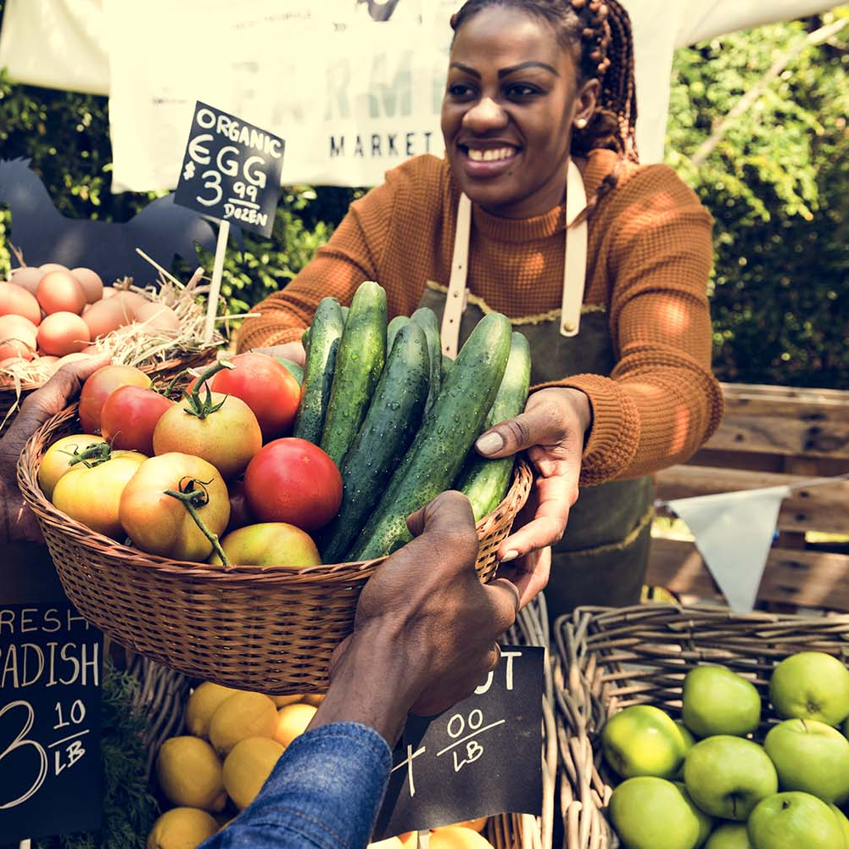
Discussion: How do social connections between farmers and gardeners and other seed value chain actors vary according to the demographics of the grower?
Farmers are more likely to have connections to others along the value chain compared to gardeners.
Connections to value chain stakeholders are key for agricultural innovation (Devaux et al., 2009).
Gardeners are critical actors to maintaining crop diversity in the US (Isbell et al., 2021) and thus must be better integrated into the value chain.
Photo source: Visit Montgomery
Notes:
) – in this case that innovation is expanding CA food access.

Slide 13
Discussion: How does access to resources for farmers and gardeners vary according to the demographics of the grower?
BIPOC, lower income, and professional farmers encounter the most barriers in accessing resources required for agricultural innovation.
A lack of support for farmers (typically smaller-scale) and historical discrimination towards BIPOC and low-income growers in the US are likely the major causes (American Farm Bureau Federation, 2024; Covey et al., 2006; Wright, 2013).
BIPOC growers are among the most likely CA crop stewards (Brush, 2011; Minkoff-Zern et al., 2020).
Diverse crop cultivation typically occurs on smaller scales (Nicholls et al., 2020).
Agricultural innovation requires access to financial capital (Devaux et al., 2017).
Notes:
Farmers seeking to profit from the sale of CA crops often face challenges scaling their business operations (i.e., accessing resources) to meet consumer demand (Thiele & Devaux, 2002).
Without access to necessary farming resources, growers will experience difficulty accessing markets for their products (Donovan & Poole, 2014).

Slide 14
Discussion: How do barriers to growing CA crops, experienced by farmers and gardeners vary according to their demographics?
Lower income growers and professional farmers also face more barriers to accessing CA seeds compared to their counterparts.
The cost and the ability to access enough CA seed are what these groups struggled the most with.
Efforts to lower the costs of CA seed and increase their quantities should be taken to increase their likelihood of uptake.
Affordability has been found to be a barrier to farmers related to the uptake of new seed varieties (Mastenbroek et al., 2020).
Farmers tend to prefer low input costs and like to find ways to scale their business (Tey and Brindal, 2014); this is at odds with the prohibitive pricing and lack of sufficient quantities of CA seed available.
Notes:
If women and professional farmers cannot access CA seeds, it will be very difficult to enhance the cultural acceptability of US food systems.

Slide 15
Conclusion
A more culturally acceptable food system cannot be built while some of the most diverse farmers face barriers to agricultural innovation.
Growers who have an interest in culturally acceptable food must be given increased support.
Multistakeholder partnerships along the seed value chain (Läpple et al., 2016).
Measures to increase the inclusivity of value chains (Devaux et al., 2009).
Tailer outreach efforts to the needs of specific groups along the value chain (Devaux et al., 2017).
Notes:
Pro-poor value chain development can offer insights on how to provide support to achieve agricultural innovation:
in accessing resources and forging connections to others along the value chain.

Slide 16
References
Alkon, A. H., & Norgaard, K. M. (2009). Breaking the food Chains: An investigation of food justice activism. Sociological Inquiry, 79(3), 289–305. https://doi.org/10.1111/j.1475-682X.2009.00291.x
Cofré-Bravo, G., Klerkx, L., & Engler, A. (2019). Combinations of bonding, bridging, and linking social capital for farm innovation: How farmers configure different support networks. Journal of Rural Studies, 69, 53–64. https://doi.org/10.1016/j.jrurstud.2019.04.004
Covey, T., Green, R., Johnson, J., Jones, C., Morehart, M., Strickland, R., ... & Bagi, F. (2006). Agricultural Income and Finance Outlook.
Devaux, A., Horton, D., Velasco, C., Thiele, G., López, G., Bernet, T., Reinoso, I., Ordinola, M., 2009a. Collective action for market chain innovation in the Andes. Food Policy 34, 31-38.
Devaux, A., Torero, M., Donovan, J., & Horton, D. (2018). Agricultural innovation and inclusive value-chain development: A review. Journal of Agribusiness in Developing and Emerging Economies, 8(1), 99–123. https://doi.org/10.1108/JADEE-06-2017-0065
Donovan, J. and Poole, N. (2014), “Changing asset endowments and smallholder participation in higher value markets: evidence from certified coffee producers in Nicaragua”, Food Policy,Vol.44,pp.1-13.
Hammelman, C., & Hayes-Conroy, A. (2015). Understanding cultural acceptability for urban food policy. Journal of Planning Literature, 30(1), 37-48.
Horst, M., & Marion, A. (2019). Racial, ethnic and gender inequities in farmland ownership and farming in the U.S. Agriculture and Human Values, 36(1), 1–16. https://doi.org/10.1007/s10460-018-9883-3
Horton, D. (2008). Facilitating pro-poor market chain innovation. Lima: Papa Andina.
Howard, P. (2023, January 12). Recent changes in the global seed industry and Digital Agriculture Industries. Recent Changes in the Global Seed Industry and Digital Agriculture Industries. https://philhoward.net/2023/01/04/seed-digital/
Howard, P. (2003). The major importance of ’minor’ resources: women and plant biodiversity. London, UK: International Institute for Environment and Development (IIED).
Isbell, C., Tobin, D., & Reynolds, T. (2021). Motivations for maintaining crop diversity: Evidence from Vermont's seed systems. Ecological Economics, 189, 107138.
Läpple, D., Renwick, A., Cullinan, J., & Thorne, F. (2016). What drives innovation in the agricultural sector? A spatial analysis of knowledge spillovers. Land use policy, 56, 238-250.
Lyon, A., Friedmann, H., & Wittman, H. (2021). Can public universities play a role in fostering seed sovereignty? Elementa: Science of the Anthropocene, 9(1), 00089. https://doi.org/10.1525/elementa.2021.00089
Meinzen-Dick, R. S., Devaux, A., & Antezana, I. (2009). Underground assets: Potato biodiversity to improve the livelihoods of the poor. International Journal of Agricultural Sustainability, 7(4), 235–248.
Moffat, T., Mohammed, C., & Newbold, K. B. (2017). Cultural dimensions of food insecurity among immigrants and refugees. Human Organization, 76(1), 15-27.
Spangler, K., Burchfield, E. K., & Schumacher, B. (2020). Past and Current Dynamics of U.S. Agricultural Land Use and Policy. Frontiers in Sustainable Food Systems, 4. https://www.frontiersin.org/articles/10.3389/fsufs.2020.00098
Thiele, G., Devaux, A., 2002. Adding value to local knowledge and biodiversity of Andean potato farmers. The Papa Andina Project. Info Agrar News, 12, 2-3.
Vallianatos, H., & Raine, K. (2008). Consuming food and constructing identities among Arabic and South Asian immigrant women. Food, Culture & Society, 11(3), 355-373.
Wright, B. D. (2012). Grand missions of agricultural innovation. Research Policy, 41(10), 1716–1728. https://doi.org/10.1016/j.respol.2012.04.021
Yongabo, P., & Göktepe-Hultén, D. (2021). Emergence of an agriculture innovation system in Rwanda: Stakeholders and policies as points of departure. Industry and Higher Education, 35(5), 581–597. https://doi.org/10.1177/0950422221998610

