Slide 1
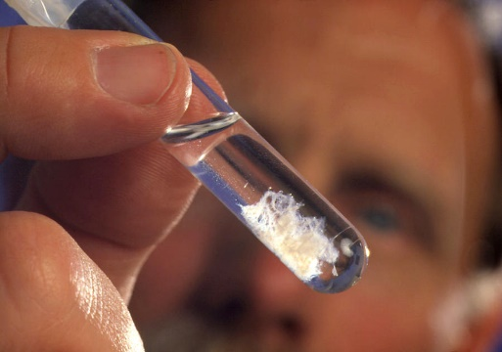
A Review of Genetics and Genomics
Holly Neibergs
Neibergs@wsu.edu
Funding provided by WSARE Project # SW21-925
April 12, 2017

Slide 2
Selection
Selection - Deciding which animals will be in the breeding herd
How do we decide?
Visually (phenotypic)
Relative’s performance
Predicted Transmitting Ability (PTA)

Slide 3
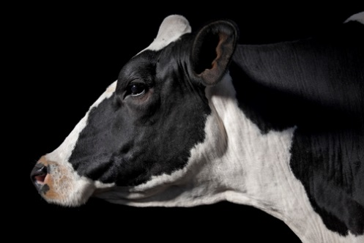
Traditional selection

Slide 4
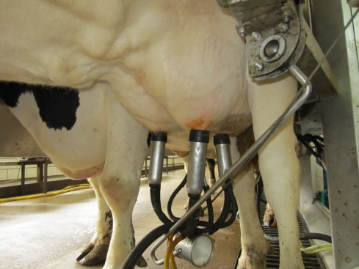
Predicted transmitting abilities (PTA)
Predicted Transmitting Abilities (PTA) are an estimate of the genetic superiority (or lack thereof) that will be transmitted to their offspring for a given trait. The PTA measures the expected difference between the animal’s offspring and the mean of all offspring for that trait.
mean of the herd’s offspring = 25,000 pounds
mean of the cow’s offspring = 27,000 pounds
PTA = +2000 lbs.

Slide 5
Selection indexes
Predicted transmitting abilities (PTA) of dairy cattle are often summed into a selection index.
Selection indexes combine PTAs of various traits, weights them and gives you a single value to select by. Weights can be based on economic value or the prioritization of what is the most important traits.
Examples: Total performance index (TPI), Net merit$ (NM$)

Slide 6
Genomic selection

Slide 7
Genomic selection
Some traits (those with low heritability, that are expensive to measure or that occur late in life) especially benefit from genomic selection.
Genomic Selection is when we predict an animal’s performance based on their DNA.
Genotype is the DNA on 2 chromosomes (Chromosome pair) given by both the sire and dam
Certain genotypes are associated with performance traits
A
A
G
G

Slide 8
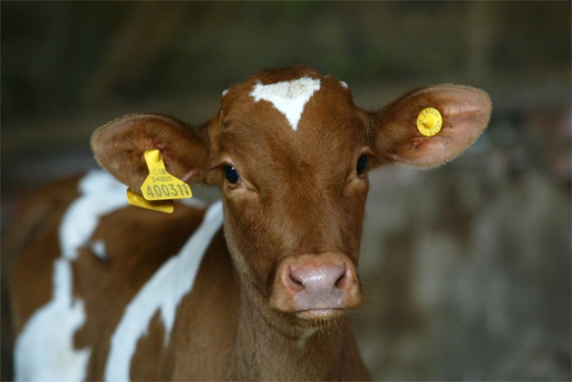
Why genomic selection?
Improves our reliability or accuracy to make good selection decisions
Increases our genetic progress
Excellent return on investment

Slide 9
Trait | Reliability %
 | Genomic Average | Traditional Parent Average | Difference Young Holstein Bulls¹ | 2013 Difference Holstein Heifers² | Genomic Daughter Equivalents²
Net Merit ($) | 75 | 33 | + 42 | +42 | 33.1
Milk (pounds) | 78 | 35 | + 43 | +44 | 26.6
Fat (pounds) | 78 | 35 | + 43 | +44 | 26.6
Protein (pounds) | 78 | 36 | + 42 | +44 | 26.6
Productive Life (months) | 73 | 29 | + 44 | +43 | 77.6
Somatic Cell Score | 75 | 31 | + 44 | +43 | 58.5
Daughter Pregnancy Rate (%) | 71 | 27 | + 43 | +42 | 146.3
Final Score | 76 | 32 | + 44 | +46 | 26.8
Sire Calving Ease | 73 | 54 | + 18 | +28 | 39.5
Daughter Calving Ease | 61 | 36 | + 25 | +28 | 45.1
¹ Genomic minus traditional for 1909 young bulls (CDCB, 2016). ² Genomic minus traditional for = 240,618 Holstein heifers (AIPL-USDA, 2013)

Slide 10
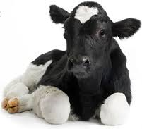
summary
Selection decides who will remain in the breeding herd
Traditional selection uses visual information and records from relatives
Genomic selection uses genotypes to choose who to keep in the breeding herd along with visual information and records from relatives

