Slide 1
Agricultural Conservation Leasing
Add Your Name/Title
Title of the Event/Workshop
This work is supported by the National Institute of Food and Agriculture, U.S. Department of Agriculture, through the Northeast Sustainable Agriculture Research and Education program under subaward number ENE18-151.

Slide 2
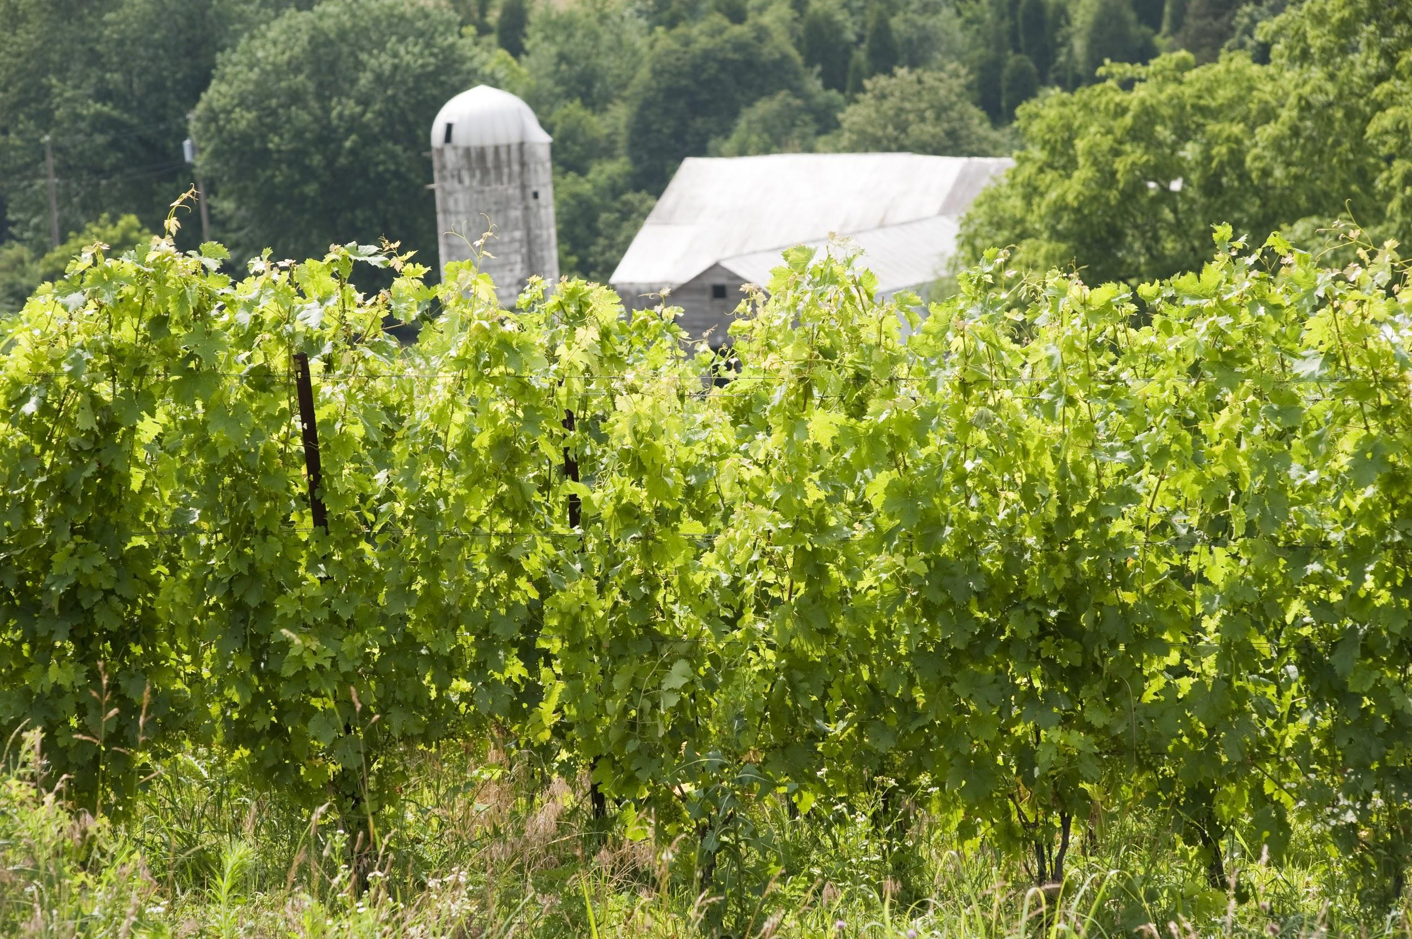
Agricultural Conservation Leasing
In Maryland, 43% of agricultural acres are in a formal or informal lease arrangement
Conservation practices are less prevalent on leased acres
Why do you think this is?
Notes:
Why?
Poor communications between landowners/farmers
Lack of understanding of the cost-share funding
Concern about losing the lease
Complicated beaurocracy for federal programs that require landowner participation

Slide 3
Agricultural Conservation Leasing
Farmer’s Perspective:
Communication barriers with landowner
Concerns about return on investment with leases that are not guaranteed in the future
Landowners Perspective:
Lack of understanding of agriculture and/or conservation practices
Hesitancy about federal programs that require landowner participation
Notes:
Pg. 1 Agricultural Conservation Leasing Guide

Slide 4
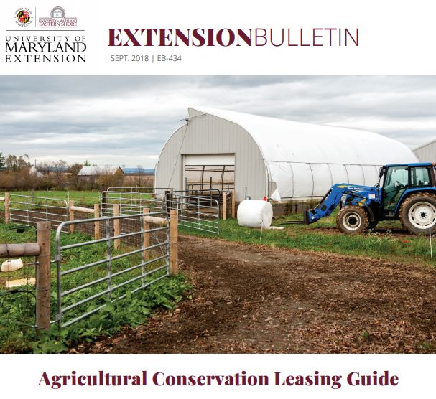
Agricultural Conservation Leasing Guide
The Guide helps landowners and farmers with the Who, What and How of conservation on leased farmland.
-Who- the roles of the state and federal players and contact info(UME, NRCS, SCD, NGOs)
-What- leasing and communication strategies for each party to consider
-How- sample lease language to support specific practices
Download at umaglaw.org
Notes:
Contact information for groups- Appendix A, Agricultural Conservation Leasing Guide

Slide 5
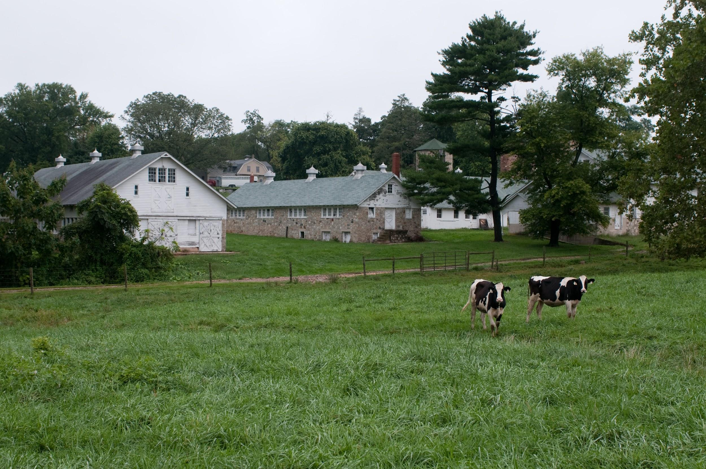
How Can a Lease Help You?
By communicating and using simple lease language, landowners and farmers can establish the necessary foundation to implement conservation practices on leased land in a mutually beneficial way.

Slide 6
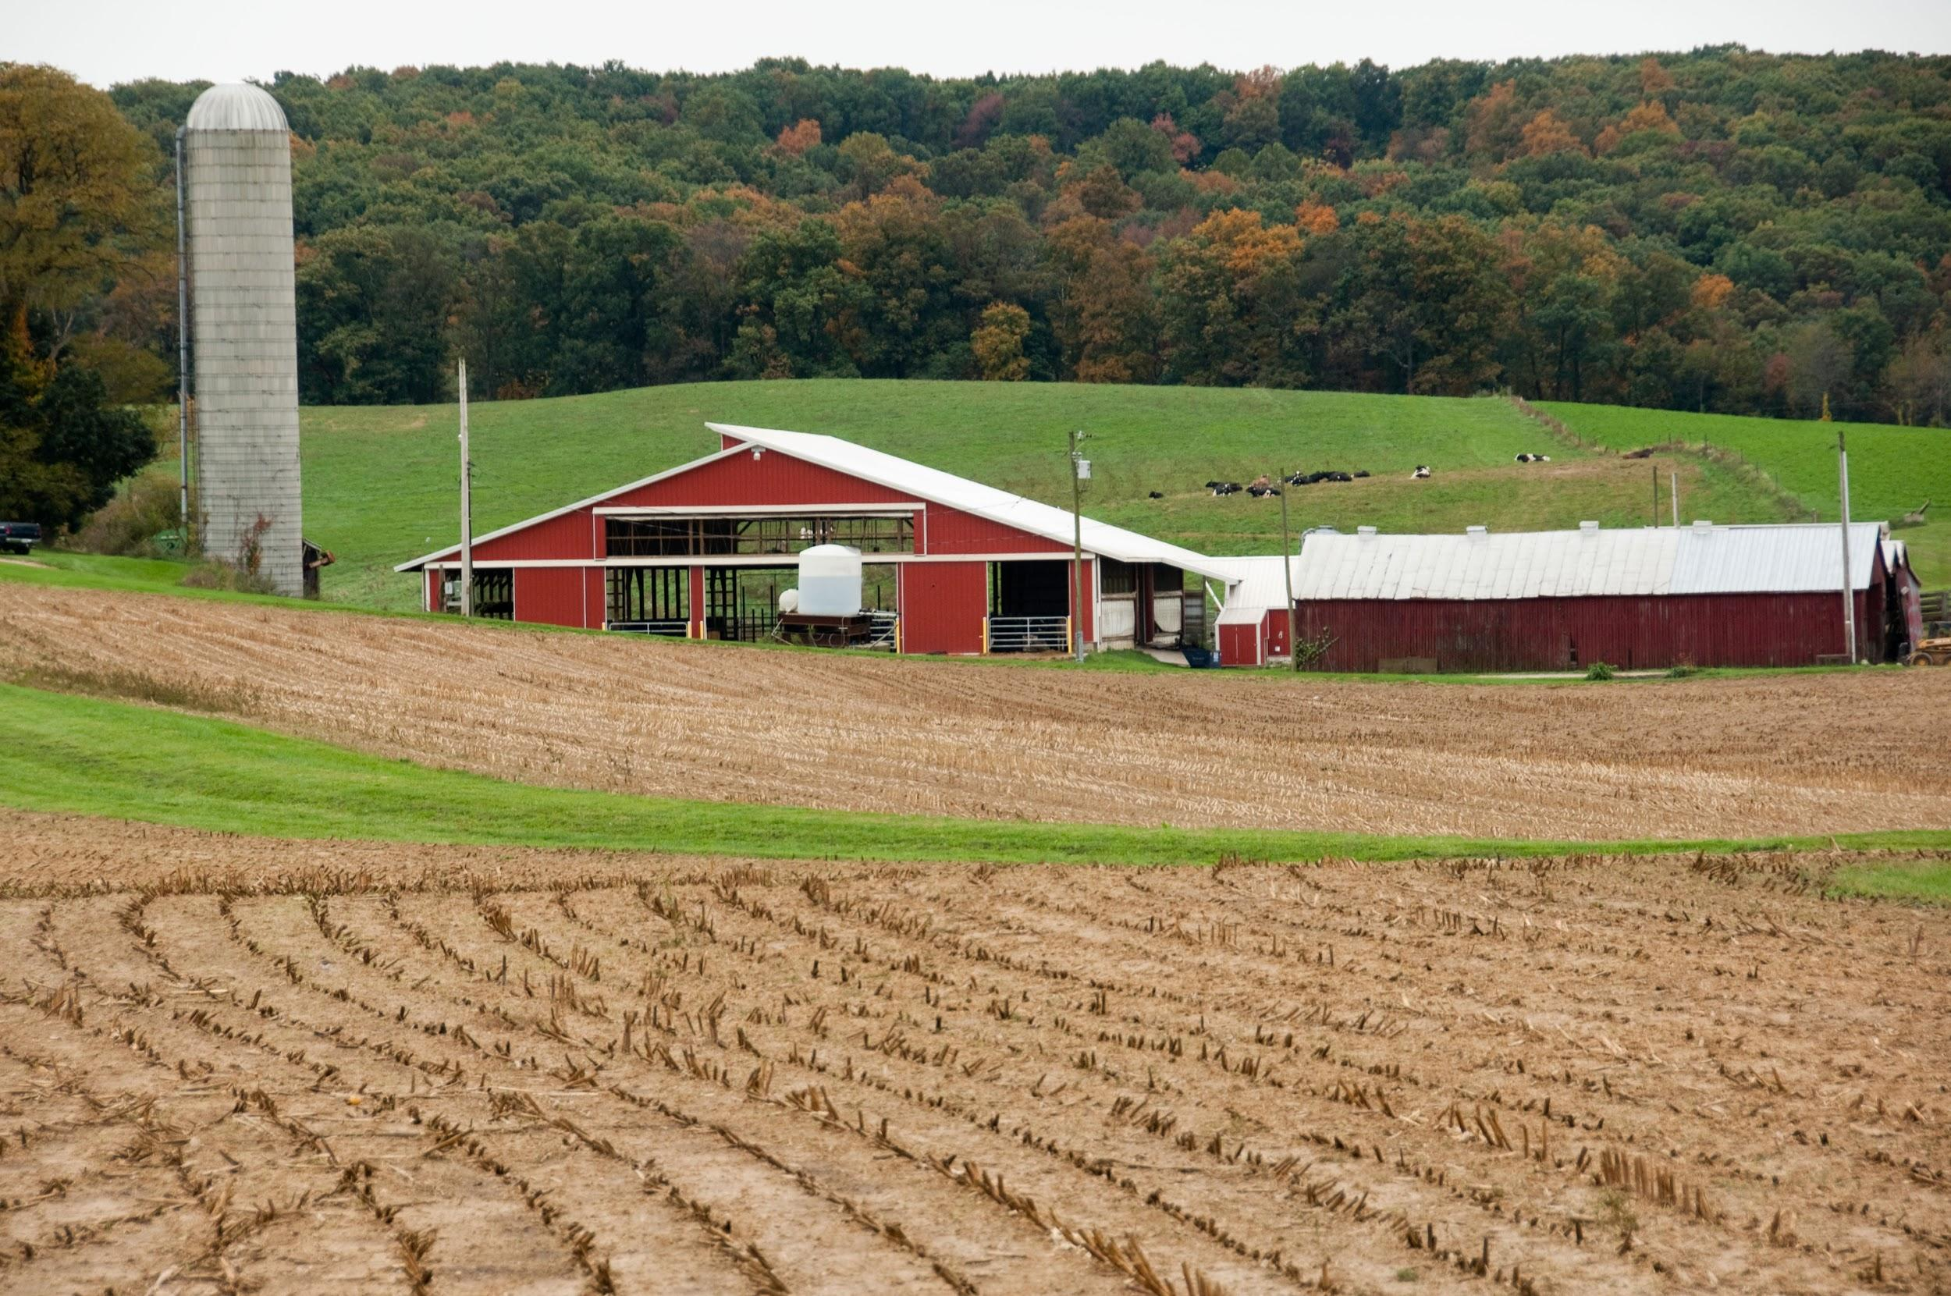
Benefits of Written Lease
Protects both parties
Avoids misunderstandings
According to law, leases for a term longer than one year should be in writing.
Often needed for Federal and State conservation programs

Slide 7
Leasing 101
There is very little Maryland law pertaining to ag leases.
This means parties have to communicate about priorities and work together to form leases
Leases don’t have to be and should not be complicated
Notes:
Maryland Code, Real Property Article, Section 8-402(b)(3)(i) for farm tenancies, unless otherwise provided in writing, the notice shall be given six months before the expiration of the current year of the tenancy.

Slide 8
Leasing 101
To be valid a lease needs to be/have:
Valid contract (legal names of parties, an offer, and acceptance of the offer for consideration($))
Description of the extent of the property to be leased
Definite lease term
Definite rental rate
Notes:
Nicknames are commonly used in informal agreements, but legal names must be used for a valid lease
A lease does not need to be complicated

Slide 9
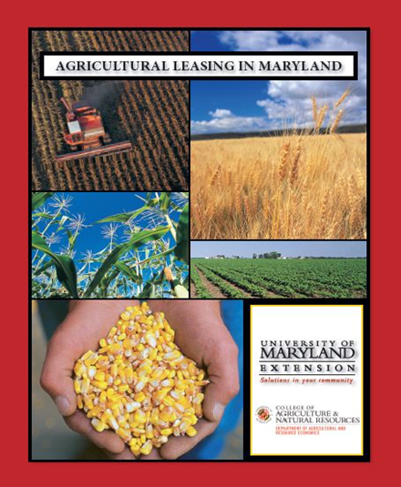
Leasing Resources
General leasing law and examples of leases: Agricultural Leasing in Maryland, available at umaglaw.org
Fillable versions of the leases also available at umaglaw.org

Slide 10
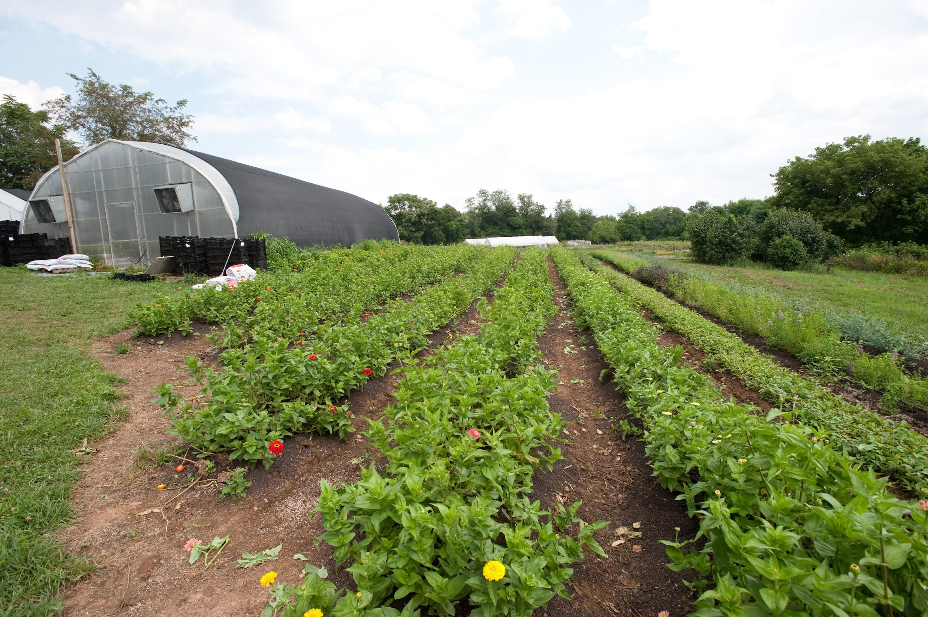
Leasing 101
Don’t sign a lease you don’t understand
Do have an attorney review the lease
If it matters, do put it in the lease - oral agreements and side arrangements (mowing, noxious weed control, etc.) not in the lease will not be allowed in court.

Slide 11
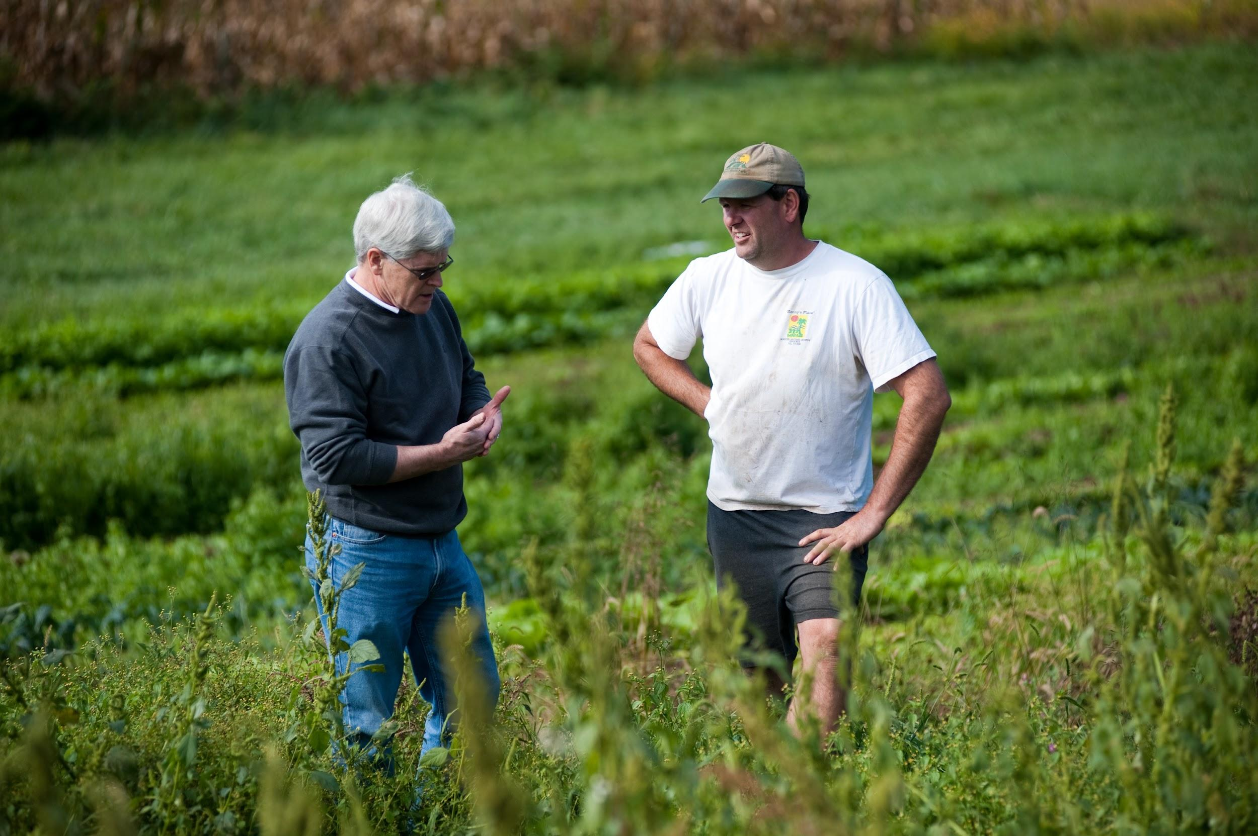
Value of Communication in Leasing
Most lease disputes arise out of a misunderstanding
Open communication:
Sets expectations
Delineates responsibilities
Reduces the likelihood of conflict.
Notes:
Pg. 1 in the Agricultural Conservation Leasing Guide

Slide 12
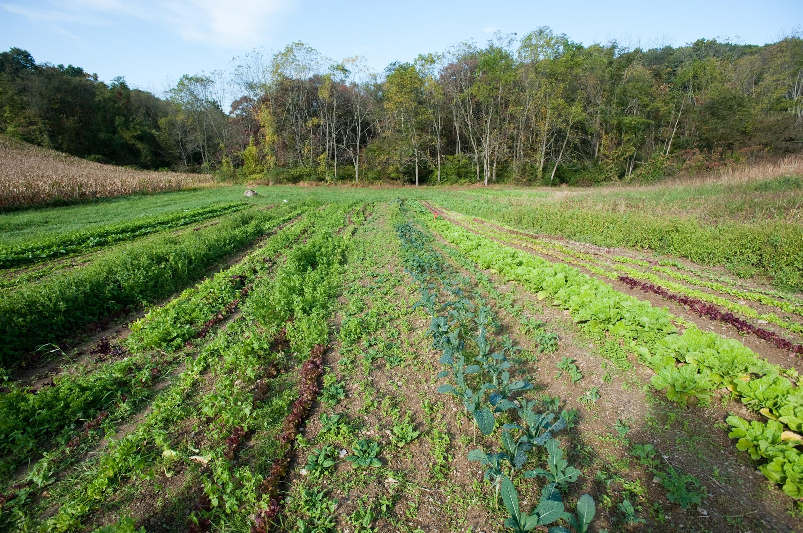
Communicating Leasing Priorities
Landowners and farmers should
Identify parts of the farm that could benefit from practices
assess their own priorities and
recognize where interests align and differ
Notes:
Pg. 2 in the Agricultural Conservation Leasing Guide & Appendix B
Appendix B in the guide has a list of questions that can inform these discussions
Both parties may have something to gain from using agricultural conservation practices that safeguard the future health and profitability of farmland

Slide 13
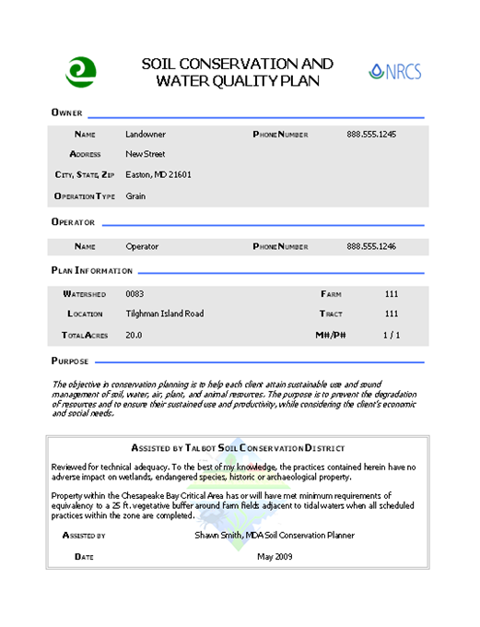
Use a Conservation Plan as a tool
Reviewing, updating, or creating conservation plan can help to initiate a conversation about recommended conservation practices
Notes:
Pg 4. in the Agricultural Conservation Leasing Guide
More formally conservation plans are called Soil Conservation and Water Quality Plans
Some farmers are required to have conservation plans but most are voluntary
Conservation plans are developed free of charge by technical staff working in Maryland’s Soil Conservation Districts.
Agreeing in a lease to meet annually or biannually to review a farm conservation plan is a way to ensure conservation goals are met and to assess whether or not farming methods need to be adjusted
Landowners with preferred farming practices, such as particular conservation methods, should include that information in the lease

Slide 14
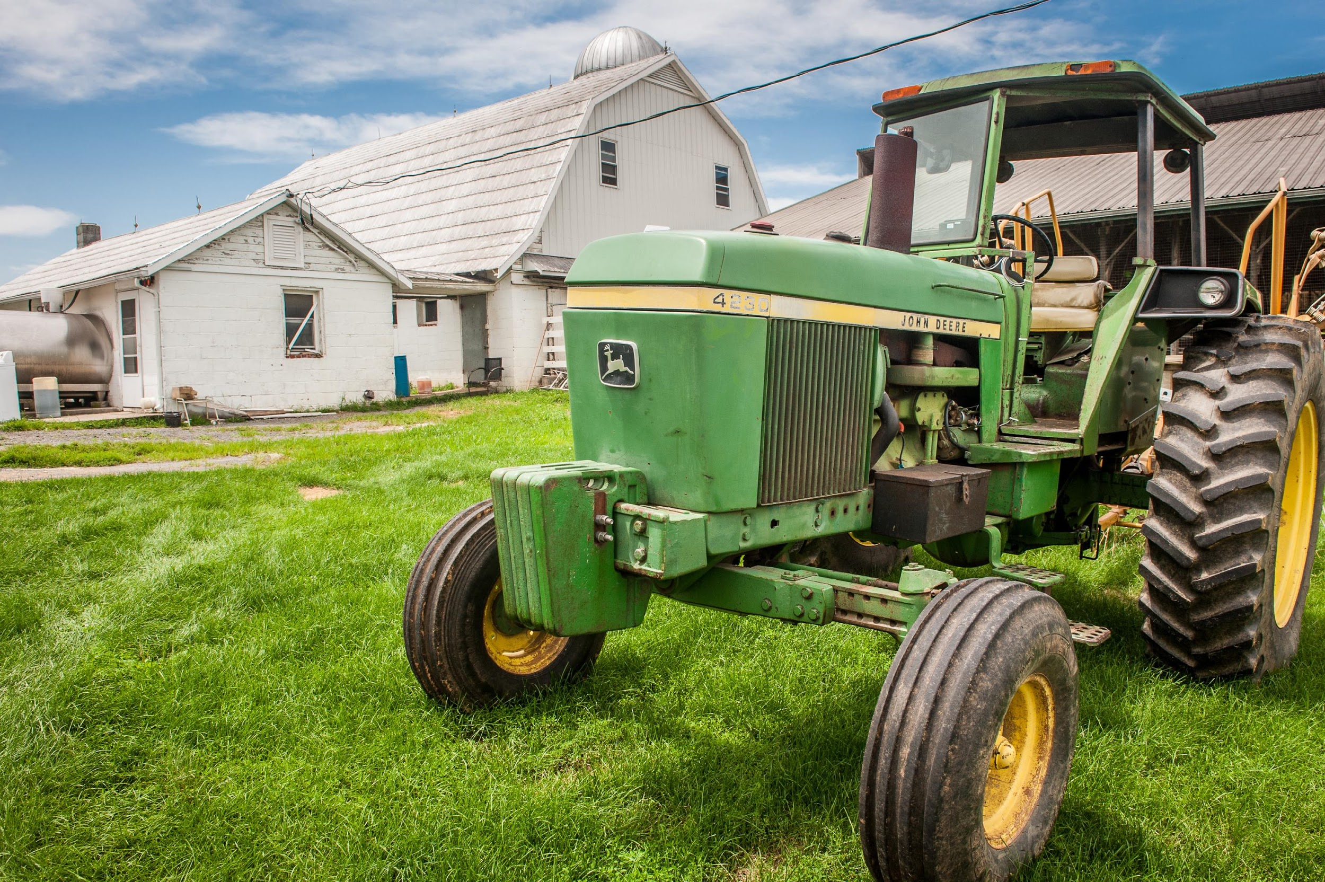
Communication Tools
-Check out the Landowner/Farmer Communication Worksheet (App. B to the Guide)
-Questions to ask yourself and the other party to the lease about conservation goals and how practices can be put into place equitably.

Slide 15
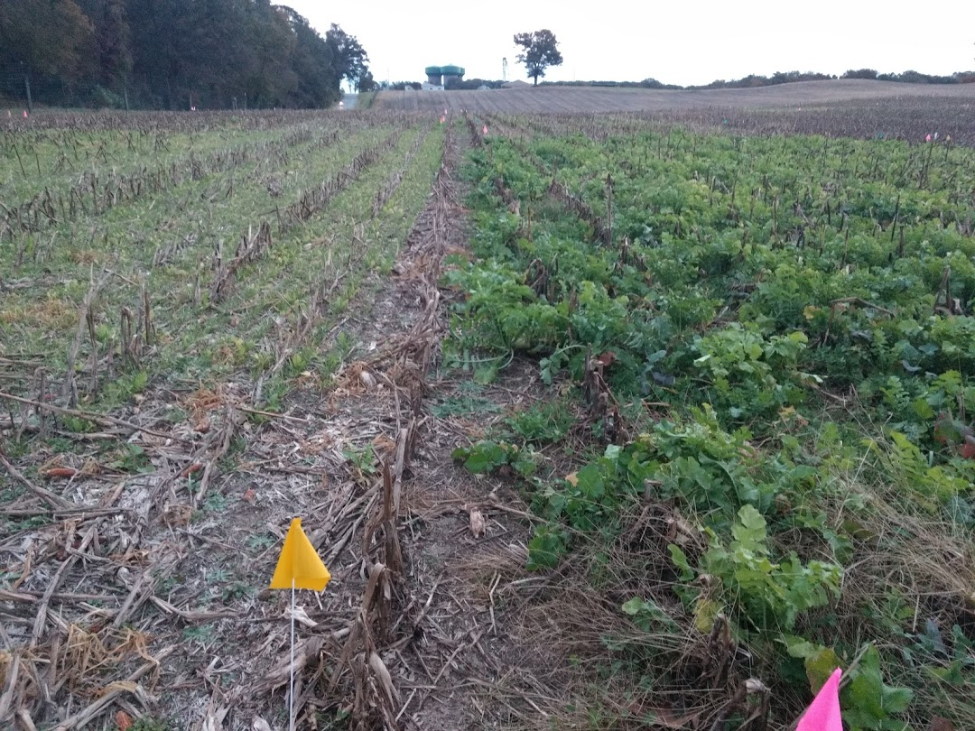
Landowners- Questions to Ask Yourself
How will conservation practices benefit your land?
Should you make agricultural conservation choices:
independently or
collaboratively with the farmer?
Will conservation practices reduce tillable acres/production area?
Notes:
Pg. 16 in the Agricultural Conservation Leasing Guide

Slide 16
Landowners- Questions to Ask Your Farmer
What impact will new practice or structure have on the farmer’s bottom line?
increased labor/time?
increased input costs?
reduced yields?
How can we collaborate to make the implementation and maintenance of conservation practices equitable?
Notes:
Pg. 17 in the Agricultural Conservation Leasing Guide
Thinking about farm practice profitability before your conversation especially from the landowners perspective will yield a more productive conversation.

Slide 17
Farmers- Questions to Ask Yourself
What conservation practices would improve the leased farm?
reduced erosion
slow surface water runoff
increase soil fertility
reduce nutrient leaching
Notes:
Pg. 16 in the Agricultural Conservation Leasing Guide

Slide 18
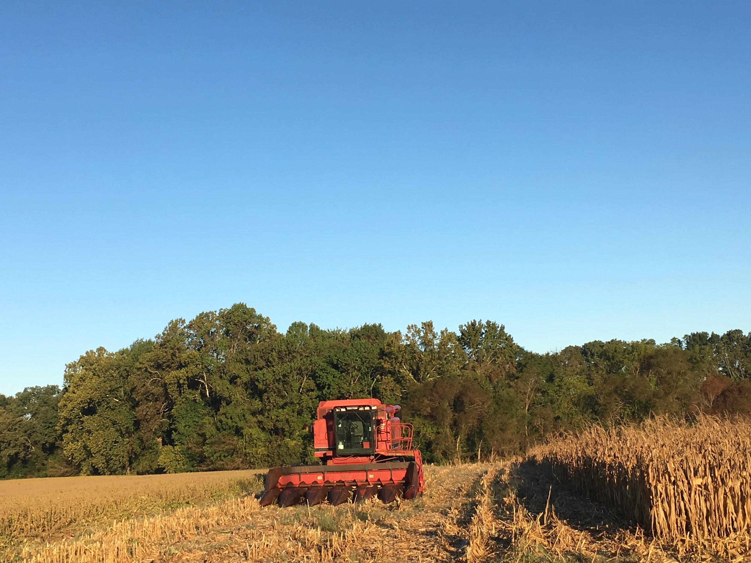
Farmers- Questions to Ask the Landowner
Is the landowner planning to contribute financially to the construction of or maintenance of a conservation practice?
Notes:
Pg. 17 in the Agricultural Conservation Leasing Guide
After estimating the costs of a conservation practice, it can be difficult for the farmer and landowner to decide how to share the costs.
Should the landowner or the farmer pay for the costs of a farm conservation practice?
What if the costs are divided and the lease is later terminated?
Should the costs be prorated over time?
Both parties should consider such questions and address them in the lease.

Slide 19
Farmers- Questions to Ask the Landowner
If the landowner is not going to contribute financially, would they consider some of these non-monetary approaches?
Graduated rent to compensate for decreased yields?
Extend Lease term
Right of first offer for land sale
Notes:
Pg. 6 in the Agricultural Conservation Leasing Guide
Decreased yields may be a fear when a conservation practice is installed
Graduated rent can be an alternative to using a different form of lease
When reducing rent for an investment, be sure to state the reason why in the lease

Slide 20
Maintaining Communication is the key
A good lease reflects the parties’ understanding and circumstances are bound to change over time.
Maintaining landowner/farmer communication ensures leasing arrangement remains mutually beneficial.
Notes:
Pg. 1 in the Agricultural Conservation Leasing Guide

Slide 21
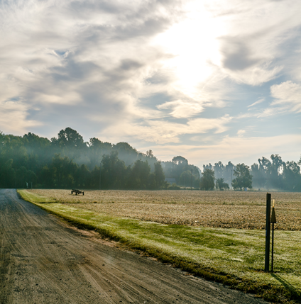
Structuring a Lease for Conservation
Lease Options:
–Think beyond cash rent
–Term matters
–Rent should reflect investment and impact on yield
–Consider sharing program payments

Slide 22
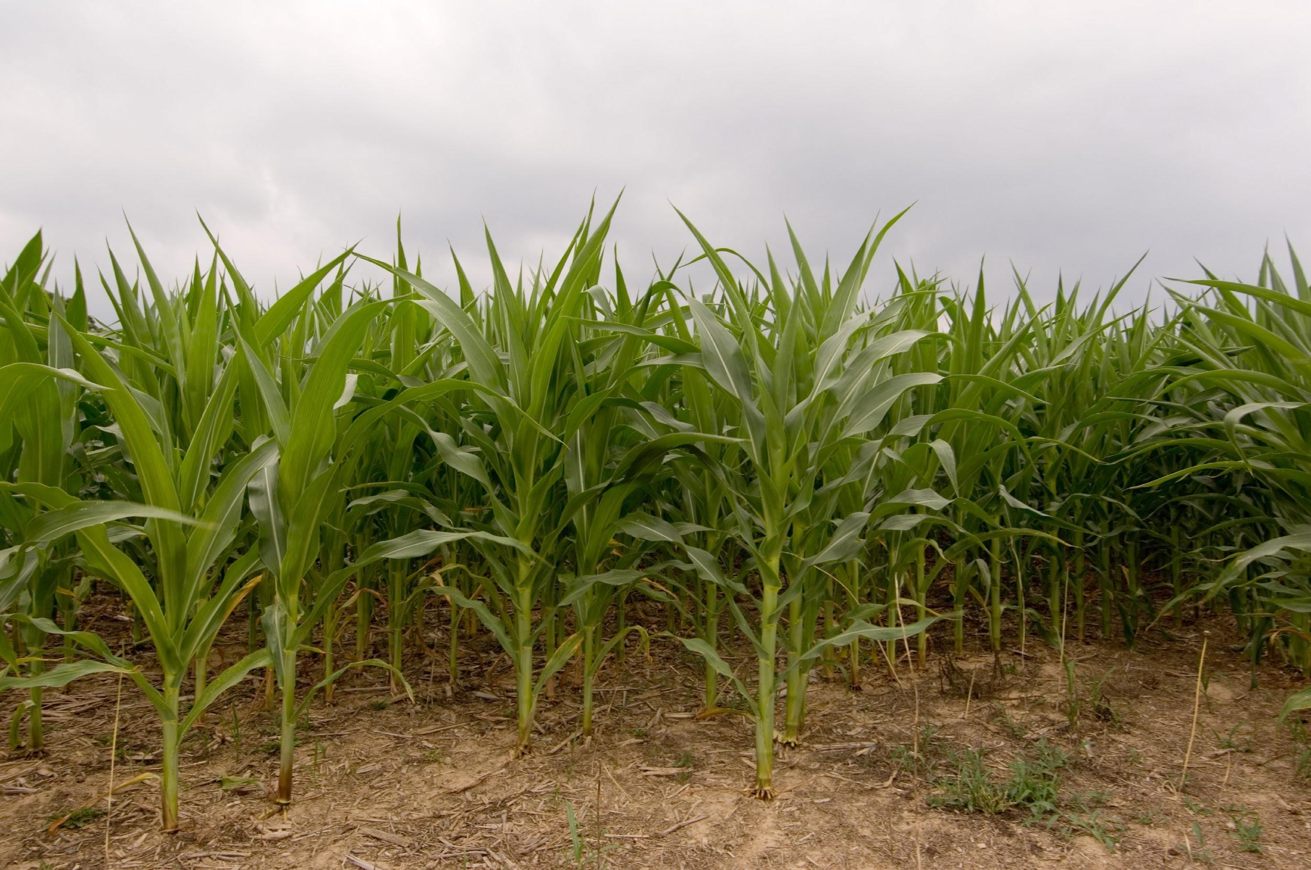
Using Key Lease Terms:
Type of Lease
If a conservation practice will pose risk.
A flexible cash lease or a crop share lease may be appropriate to share the risk.
Notes:
Pg. 6 in the Agricultural Conservation Leasing Guide
A flexible cash lease allows the landowner to receive a rate based on acreage, but the rate may fluctuate based on crop yields or market prices.
A crop share lease provides the landowner with a percentage of harvested crop profits for land use, though the farmer must also share the cost of inputs
the landowner may be classified as self-employed for tax purposes, which could lead to higher taxes.
An alternative to choosing a different form of lease is to reduce rent by the amount the farmer initially spent on the conservation practice.

Slide 23
Using Lease Terms to Support Conservation
Term of Lease
The longer the term- the more invested the farmer will be.
A renewal provision allows for the parties to agree to extend the original term.
You can agree to use a set formula or rental adjustment index to reach future rental rates.
Notes:
Pg. 6 in the Agricultural Conservation Leasing Guide
A longer-term lease gives a farmer more security to make a return on his/her investment in the property
A lease term can also be extended to match the life of a conservation practice, or for how long a conservation practice continues to provide the intended benefits

Slide 24
Using Key Lease Terms:
Term of Lease
In some cases longer terms are unattractive options because of fear they will chill a sale.
A possible solution is to include a right to termination, within a certain amount of time, if the property is listed for sale.
Notes:
Pg. 6 in the Agricultural Conservation Leasing Guide

Slide 25
Using Key Lease Terms:
Right of First Offer/Refusal
Alternatives to longer term:
Right of first offer gives the farmer the first opportunity to purchase the property before the landlord offers it to third parties
Right of first refusal gives the farmer the opportunity to match an offer made to purchase the farm
Notes:
Pg. 7 in the Agricultural Conservation Leasing Guide
Rights of first offer and refusal encourage good stewardship because a farmer works the land which he/she might one day own
Providing a farmer with first rights of offer and refusal can also help maintain the leasing relationship

Slide 26
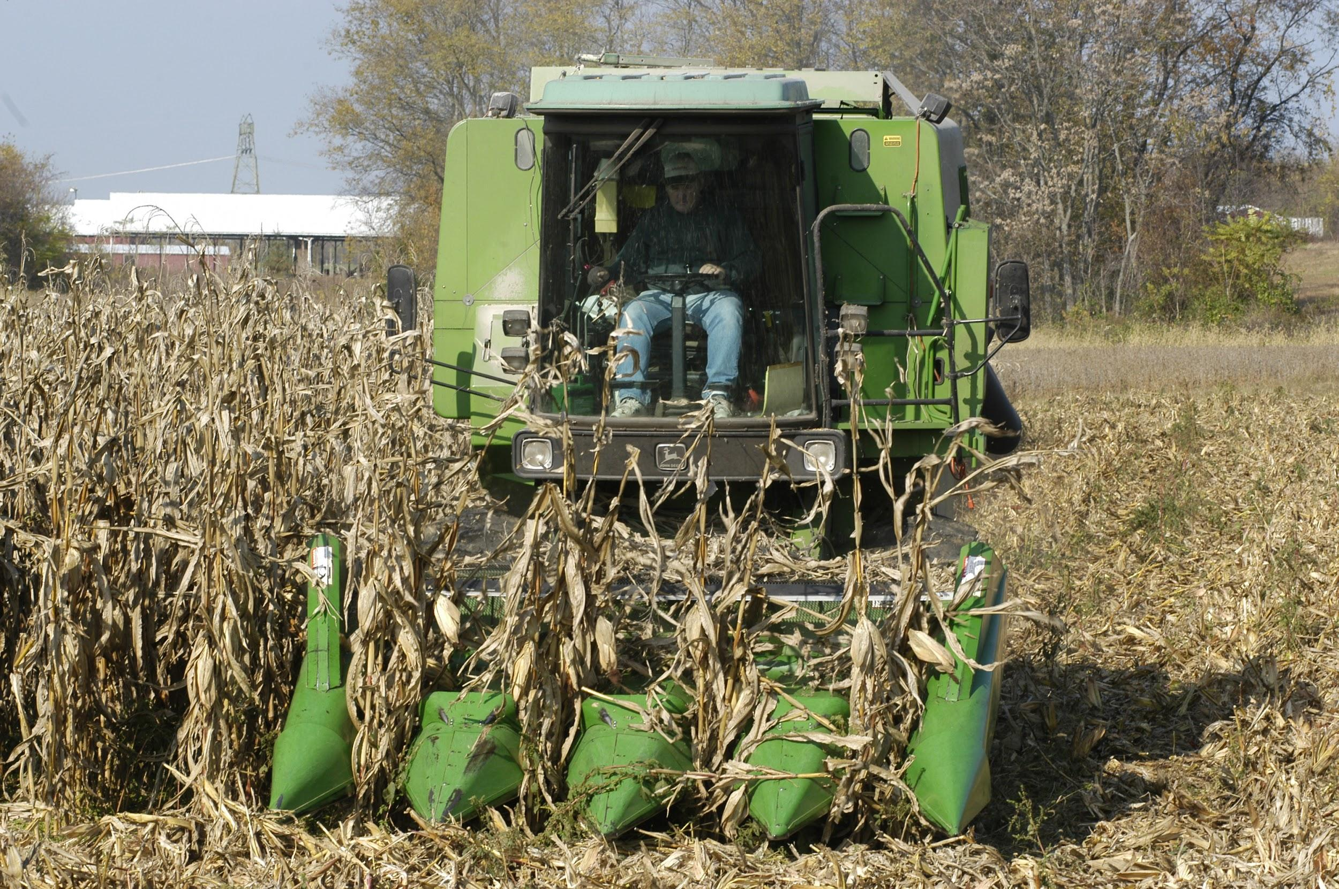
Using Key Lease Terms:
Proration of Costs
Proration of Costs
Use the lease to allocate costs of initial implementation and ongoing maintenance of the conservation practice
Notes:
Pg. 6 in the Agricultural Conservation Leasing Guide

Slide 27
Using Key Lease Terms:
Depreciation Schedule
Helps safeguard a farmer’s initial investment in case the lease ends before the practice is developed
A depreciation calculation allows farmer to be reimbursed by the landlord if the lease is terminated
Conservation Practice | Tenant’s Net Cost of Installation | Annual Rate of Depreciation | Date Depreciation Begins
Grassed waterway | $1,250 | 10% | 8/1/2017
Notes:
Pg. 7 in the Agricultural Conservation Leasing Guide

Slide 28
Sample Lease Provisions To Compensate Farmer for Maintenance:
Sample lease provision: To compensate Tenant for the time and expenses contributed towards the creation of a __________, rent in year one of the lease shall be reduced by $______ or %_____.
Alternative: The rent for the first year of the term will be reduced by 15% and the reduction shall diminish by 5% each year until the full rental amount is due and owing.
Notes:
Pg. 6 in the Agricultural Conservation Leasing Guide

Slide 29
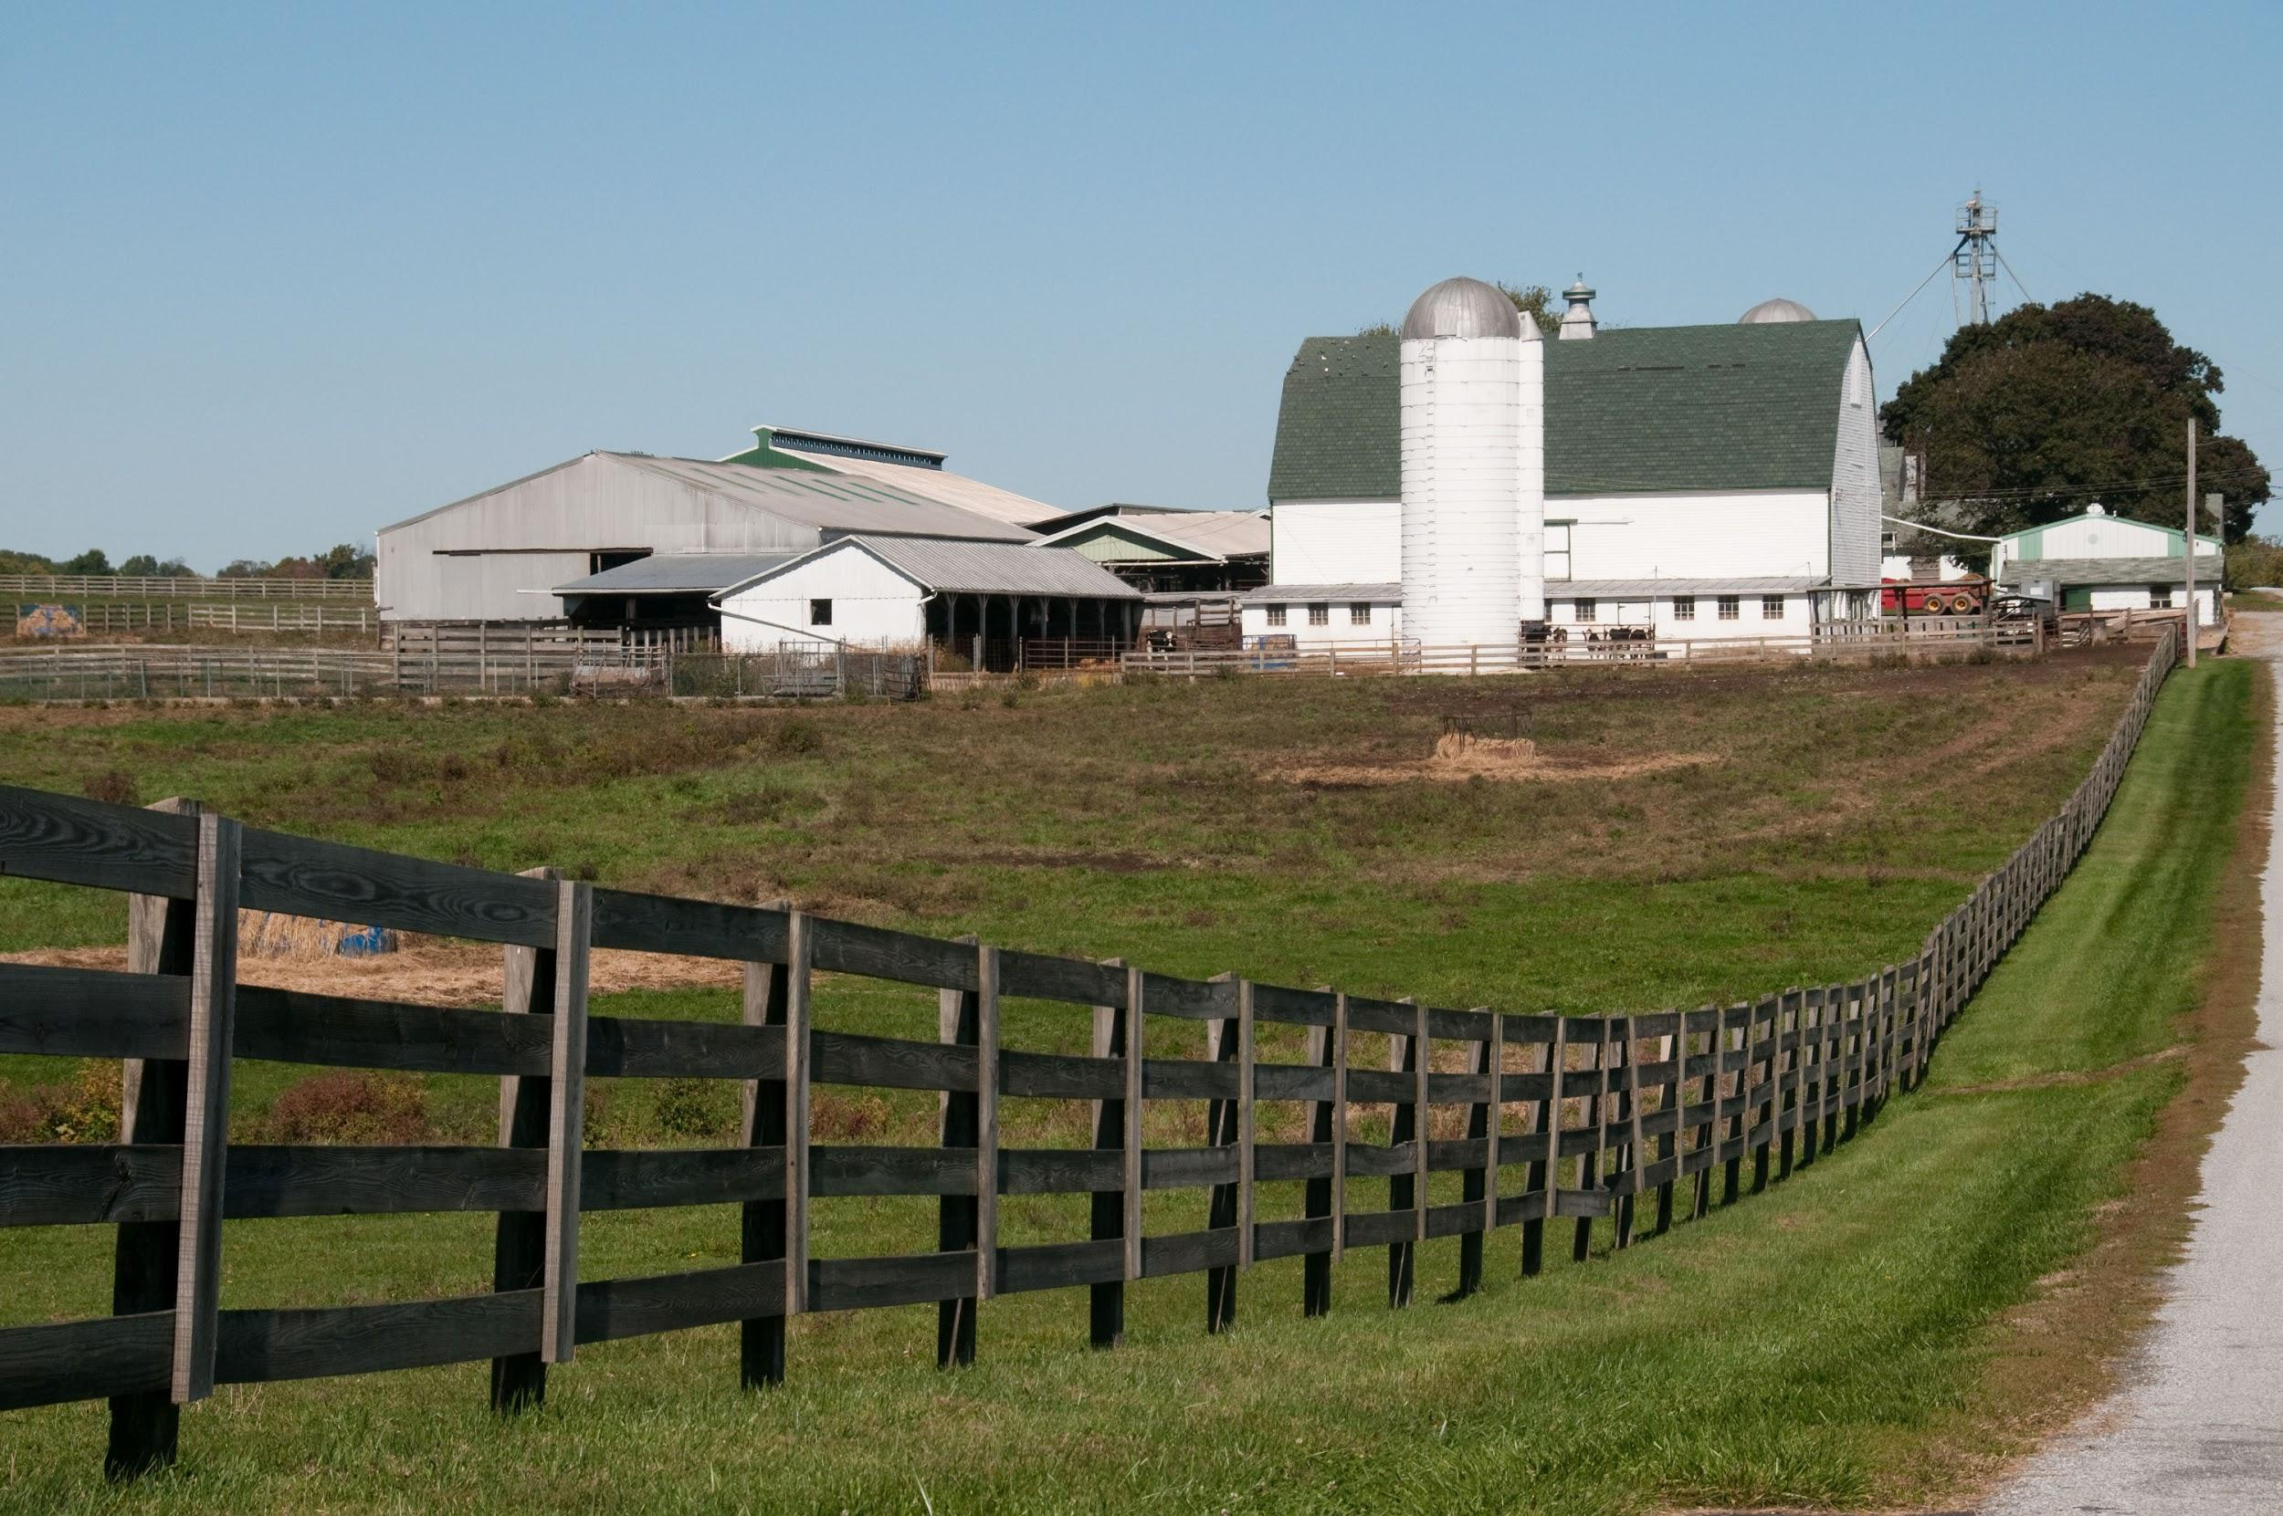
Establish Conservation Standards
Define standards of good husbandry
What does good farming mean to you?
What does good farming mean to the other leasing party?
e
Notes:
Pg. 2 in the Agricultural Conservation Leasing Guide
Landowners and farmers should never assume they share farming values
The best way for landowners and farmers to ensure they agree on what good husbandry means is to first discuss preferred farming methods and then make certain that their lease agreement reflects those preferences
Although some sources of American common law reference an implied legal covenant of good husbandry, Maryland courts have not recognized it

Slide 30
Sample Conservation Standards
-Tenant shall follow good agricultural practices in farming of the Premises.
-Specifically, Tenant shall follow the farming recommendations of the Maryland Department of Agriculture and the Soil Conservation District for the County in which the Farm is located.
Notes:
Pg. 4 in the Agricultural Conservation Leasing Guide

Slide 31
Establish Standards by Referencing a Conservation Plan
-Tenant shall, to the maximum extent possible, implement the best management practices and natural resource strategies outlined in the farm’s conservation plan dated _________ and as amended from time to time.
-Tenant further agrees to amend the farm’s conservation plan either [insert a time interval]or as recommended by the Soil Conservation District, whichever is sooner.
Notes:
Pg. 4 in the Agricultural Conservation Leasing Guide

Slide 32
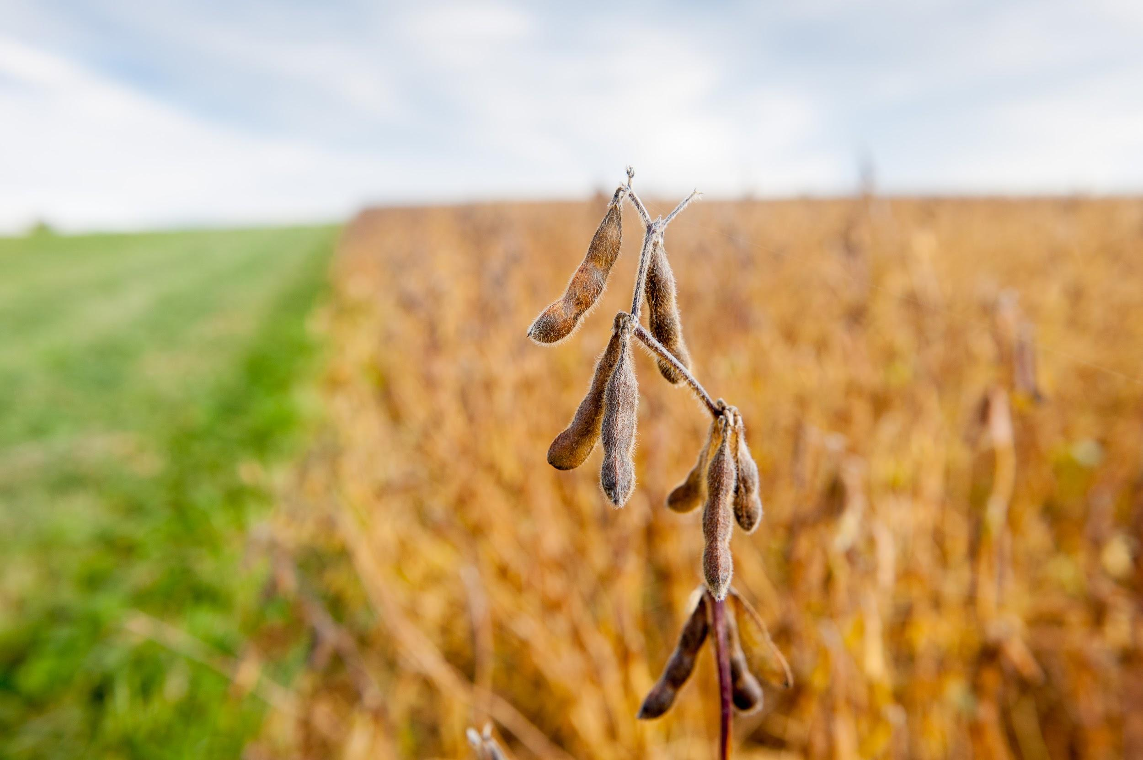
Conservation Practice Lease Language
The Agricultural Conservation Leasing Guide contains considerations and sample lease language for common practices.
For example, the use of conservation tillage

Slide 33
Conservation Tillage
What are some considerations for conservation tillage?
Is the farmer willing to consider adopting reduced-till or no-till management?
If so, does the farmer have the necessary equipment?
Is the field more suitable for reduced-till or no-till?
Would starting as reduced-till while phasing to no-till be beneficial?
Notes:
Pgs. 12-13 Agricultural Conservation Leasing Guide
Conservation tillage is used to manage the components of crop and other plant residue on the soil surface
Limiting soil-disturbing activities, like tilling, increases organic matter, allowing the soil to hold more moisture, maintain better microbial life, and provide more nutrients to crops

Slide 34
Conservation Tillage
Will it be necessary to change other practices to reduce weed growth?
What are the disease and weed management challenges and implications in a reduced-till and no-till system?
Notes:
Pgs. 12-13 Agricultural Conservation Leasing Guide

Slide 35
Conservation Tillage
Tenant, in consultation with SCD, NRCS, and/or MDA, shall reduce tillage as much as possible in accordance with the farm conservation plan. Tenant shall maintain at least [insert percentage such 30] % residue cover on the ground surface at planting.
Notes:
Pgs. 12-13 Agricultural Conservation Leasing Guide

Slide 36
Troubleshooting
Trust but verify
A landowner may want to reserve the right to either receive or inspect the farm and take soil samples
These rights must be in the lease
Notes:
Pg. 13 in the Agricultural Conservation Leasing Guide

Slide 37
Sample Troubleshooting Language
-Tenant shall provide to Landlord copies of soil tests to confirm continued fertility of the soil.
-Landlord may also collect soil samples for testing from the Premises at all reasonable times.
Notes:
Pg. 13 in the Agricultural Conservation Leasing Guide

Slide 38
Troubleshooting
Include conservation maintenance provisions
Responsibilities for maintenance should be written into the lease
Farmer and landowner should be aware of what practices may damage or interfere with the conservation practices
Notes:
Pg. 13 in the Agricultural Conservation Leasing Guide

Slide 39
Example of Maintenance Lease Language
Sample riparian buffer provision:
-Tenant shall not plant, harvest, plow, disc or use fertilizers or pesticides within the vegetative buffer area(s).
-Tenant shall maintain the vegetative buffer, in accordance with SCD and NRCS standards, by mowing and/ or applying recommended herbicides to control noxious weeds and/or invasive species.
-To compensate Tenant for the buffer maintenance, Tenant shall receive ___ % of the annual CRP rental payment received by Landlord.
Notes:
Pg. 8&9 in the Agricultural Conservation Leasing Guide

Slide 40
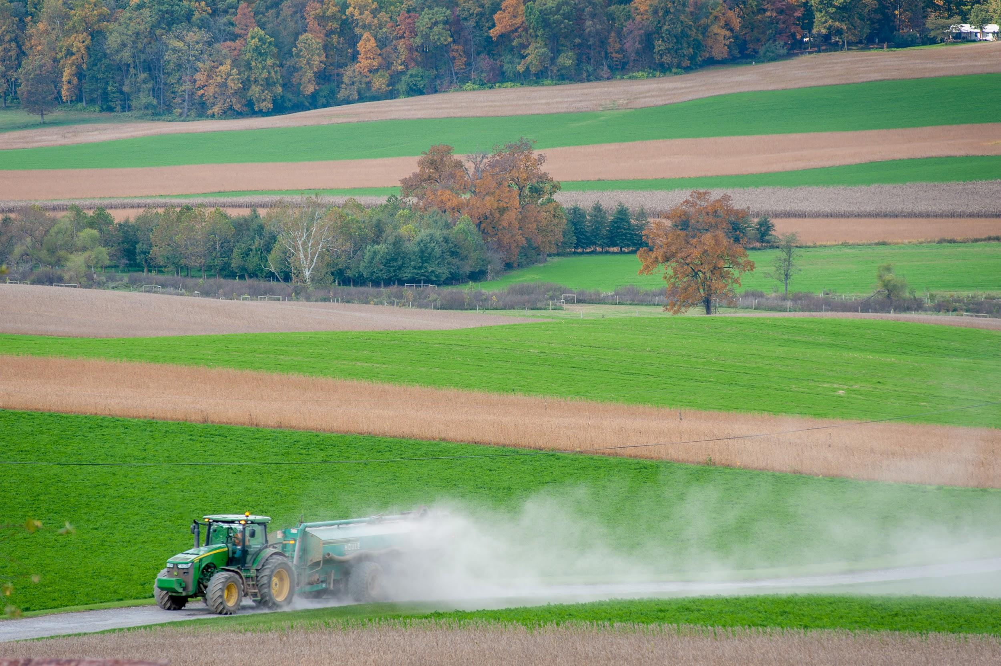
Troubleshooting
Maintain Landowner/Farmer Communication
Establish a requirement to meet and walk the farm annually
Consider including a conflict resolution provision
Do you want to require mediation before litigation?
MDA offers low-cost mediation for agricultural disputes
Notes:
Pg. 14 in the Agricultural Conservation Leasing Guide
Leases should be mended as the agreements between landowners and farmers change. These leases are meant to be beneficial to both parties
A landowner may also use other tools to stay informed, such as the farm’s nutrient management plan, soil test results, and/or conservation plan.
Mediation is a confidential and non-adversarial
Both parties can benefit from having a neutral third-party involved in dispute resolution.
A section on pursuing mediation before litigation can be written into a lease so, in the case of a conflict, the parties must first try to settle any dispute through mediation before initiating litigation.

Slide 41
Next Steps
You will be contacted in the months following this presentation by the Hughes Center/ALEI and asked whether you have taken any steps towards:
Initiating communication about conservation leasing goals and/or
Efforts to use conservation practices on leased acres.

Slide 42
Next Steps
Examples of efforts to use conservation practices on leased acres include
Agreeing to follow the terms of a conservation plan
Applying for cost-share funding or technical assistance for a practice
Entering into a new lease with conservation practice provisions
Amending an existing lease to include conservation practices
If you take any of these steps, please let us or your presenter know!

Slide 43
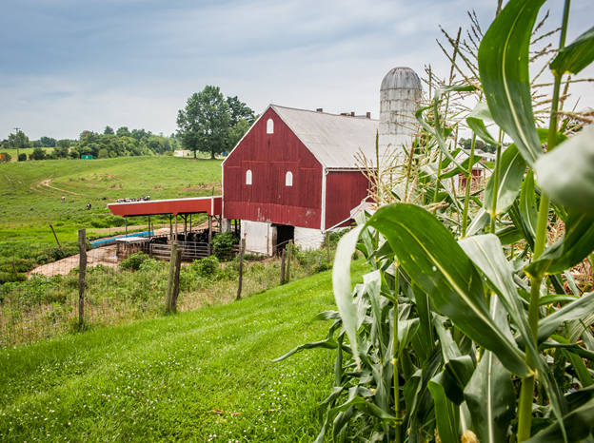
Thanks
Questions?
For further
information contact:
Sarah Everhart
ALEI
severhart@law.umaryland.edu/ 410-458-2475

