Slide 1
Agricultural Leasing Principles
Sarah Everhart
Managing Director
ALEI
This work is supported by the National Institute of Food and Agriculture, U.S. Department of Agriculture, through the Northeast Sustainable Agriculture Research and Education program under subaward number ENE18-151.

Slide 2
ALEI
The Agriculture Law Education Initiative (ALEI) is a partnership of the Francis King Carey School of Law at the University of Maryland, Baltimore (UMB); the College of Agriculture & Natural Resources at the University of Maryland (UMCP); and the School of Agriculture and Natural Sciences at the University of Maryland Eastern Shore (UMES).
ALEI is an initiative of the University of Maryland: MPowering the State, a strategic alliance between UMB and UMCP created in 2012 to significantly expand research collaboration, business development, and student opportunities at both universities.
Website: www.umaglaw.org Email: umaglaw@umd.edu

Slide 3
Disclaimer
This presentation is intended to provide general information and should not be construed as providing legal advice. It should not be cited or relied upon as legal authority. For advice about how these issues might apply to your individual situation, consult an attorney.

Slide 4
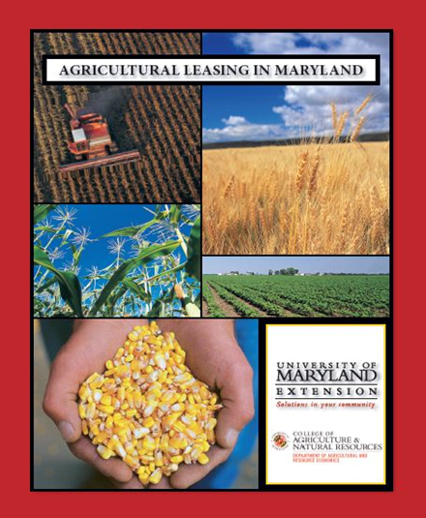
Leasing Resources
Agricultural Leasing in Maryland, Paul Goeringer
(in your materials)
Fillable versions of the leases available at umaglaw.org
Subscribe to the Maryland Risk Management Education Blog

Slide 5
Leasing 101
•There is very little Maryland law pertaining to ag leases.
•This means parties have to communicate about priorities and work together to form leases.
•Leases don’t have to be and should not be complicated.

Slide 6
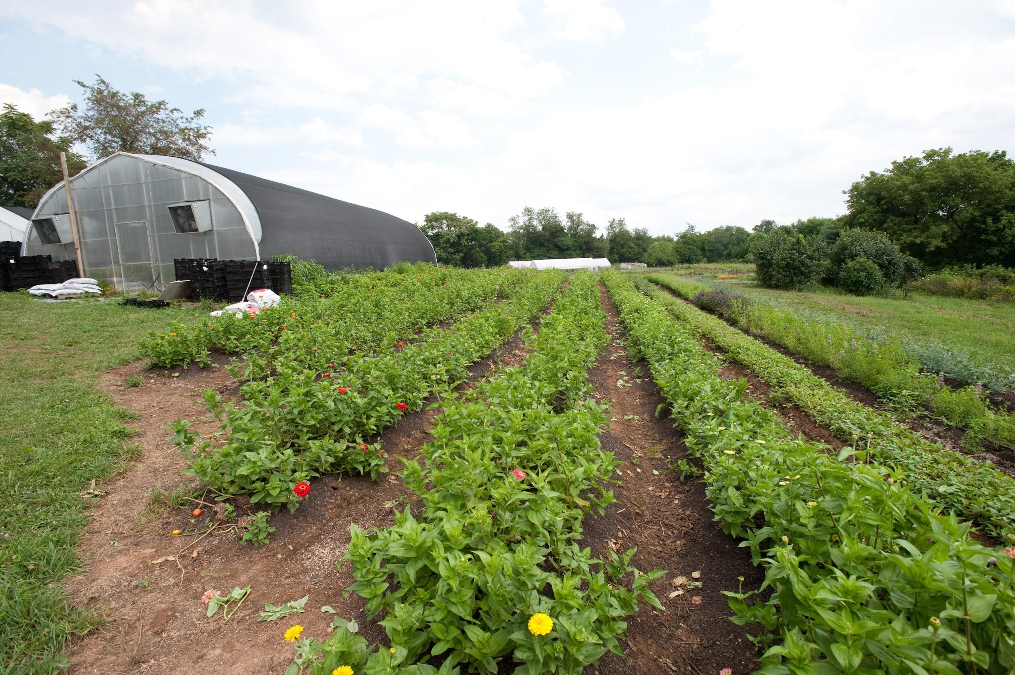
Leasing 101
•Don’t sign a lease you don’t understand.
•Do have an attorney review the lease.
•If it matters do put it in the lease- oral agreements and side arrangements not in the lease will not be allowed in court.

Slide 7
Leasing 101
To be valid a lease needs to be/have:
1.Valid contract (legal parties, offer & acceptance for consideration)
2.Description of the extent of the property to be leased
3.Definite lease term
4.Definite rental rate
•A good lease is specific, delineates responsibilities fairly and prevents conflict.

Slide 8
Types of Leases:
Cash Lease
Tenant pays the landlord a cash sum per acre or lump sum for the rights to use the land and other farm resources
Landlord receives a fixed income per year with little involvement
Tenant makes all management decisions and retains windfall profits
Challenge: Finding the appropriate cash rental rate per acre

Slide 9
Setting the rate
•A good resource to consult when choosing the right rental rate is the University of Maryland Extension’s Grain Marketing website: https://extension.umd.edu/grainmarketing
•The Grain Marketing site has:
–custom rates
–crop budgets
–crop insurance and
–farm lease agreements

Slide 10
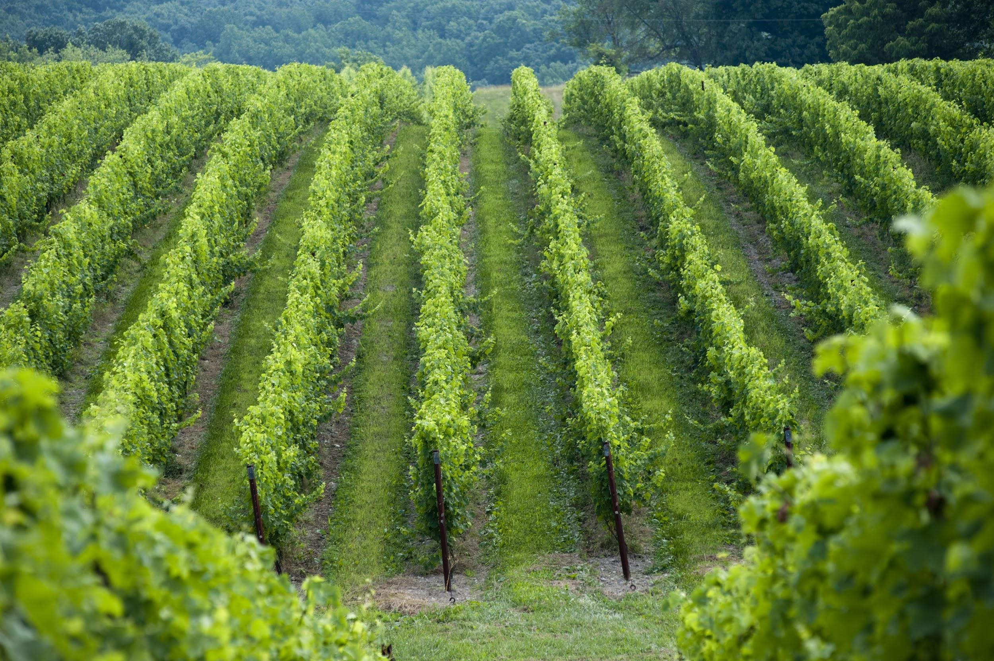
Types of Lease:
Flex Lease
Landlord charges the tenant an amount per acre that can fluctuate up or down per crop yield or market price
Landlord gains when crop yields are high
Tenant benefits from low rent when yields are low

Slide 11
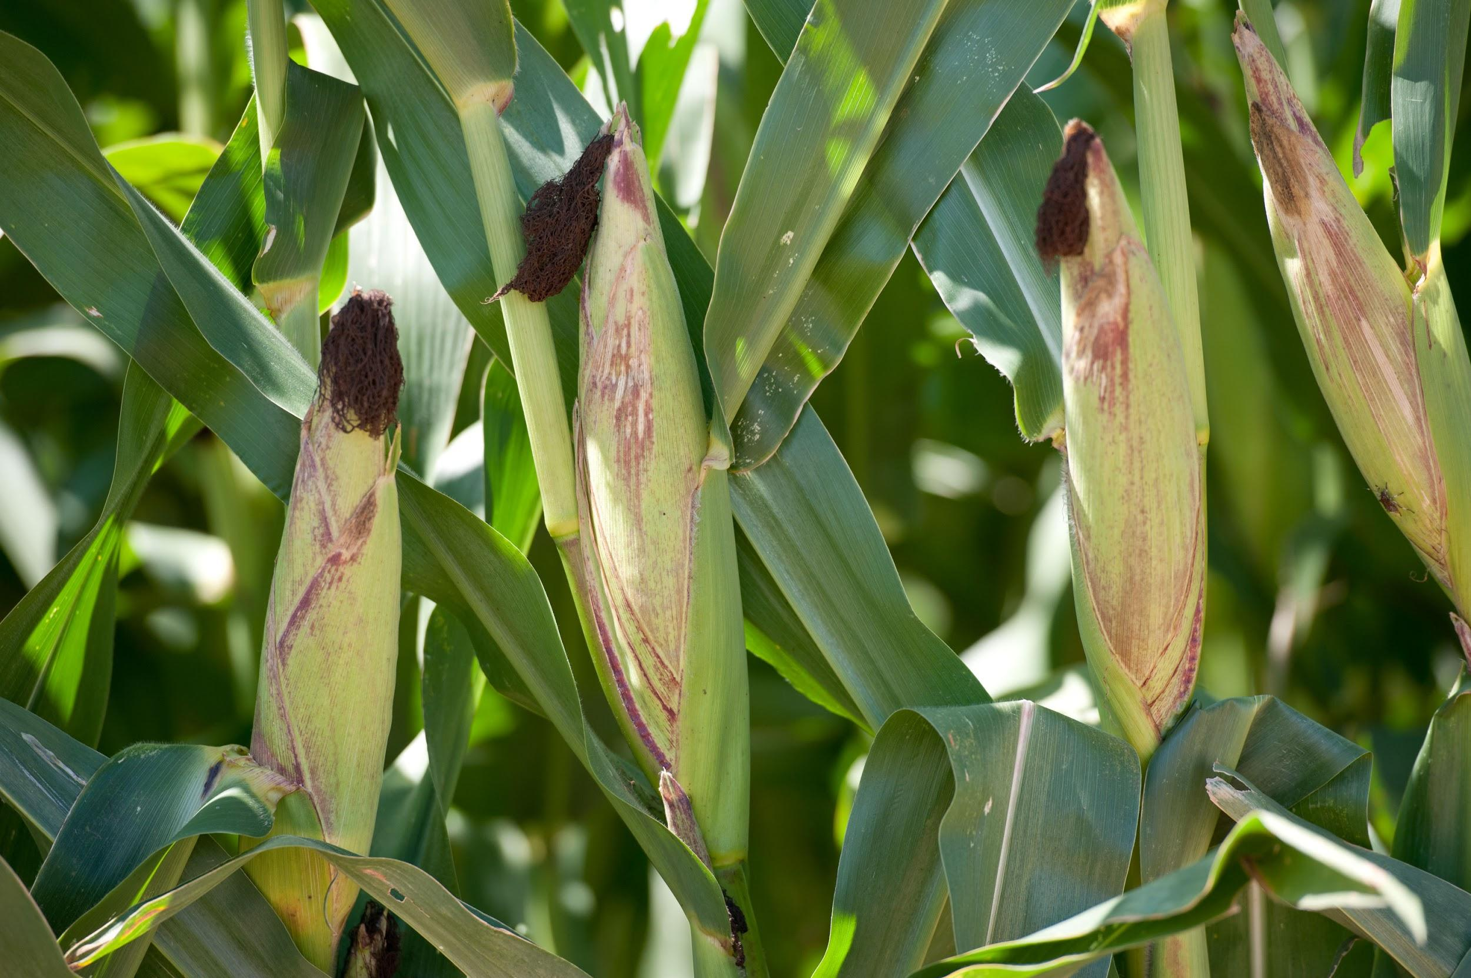
Types of Leases:
Crop Share Lease
Landlord allows the tenant to use the land and typically pays a percentage of input costs
Tenant pays the landowner a certain percentage of harvested crops
Crop insurance and Federal farm programs can be divided based on crop ownership

Slide 12
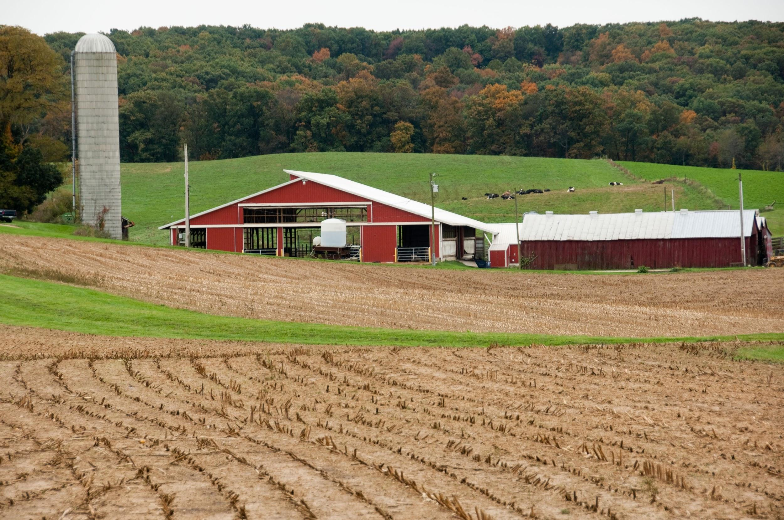
Benefits of Written Lease
Protects both parties
Avoids misunderstandings
Statute of Frauds-requires a written lease for a term longer than one year
Needed for Federal and State conservation programs

Slide 13
Right of Reentry
What rights does a landowner have to reentry?
Landlord must reserve the right of reentry in the lease to be allowed onto the leased property (recreational uses/soil samples, etc.)

Slide 14
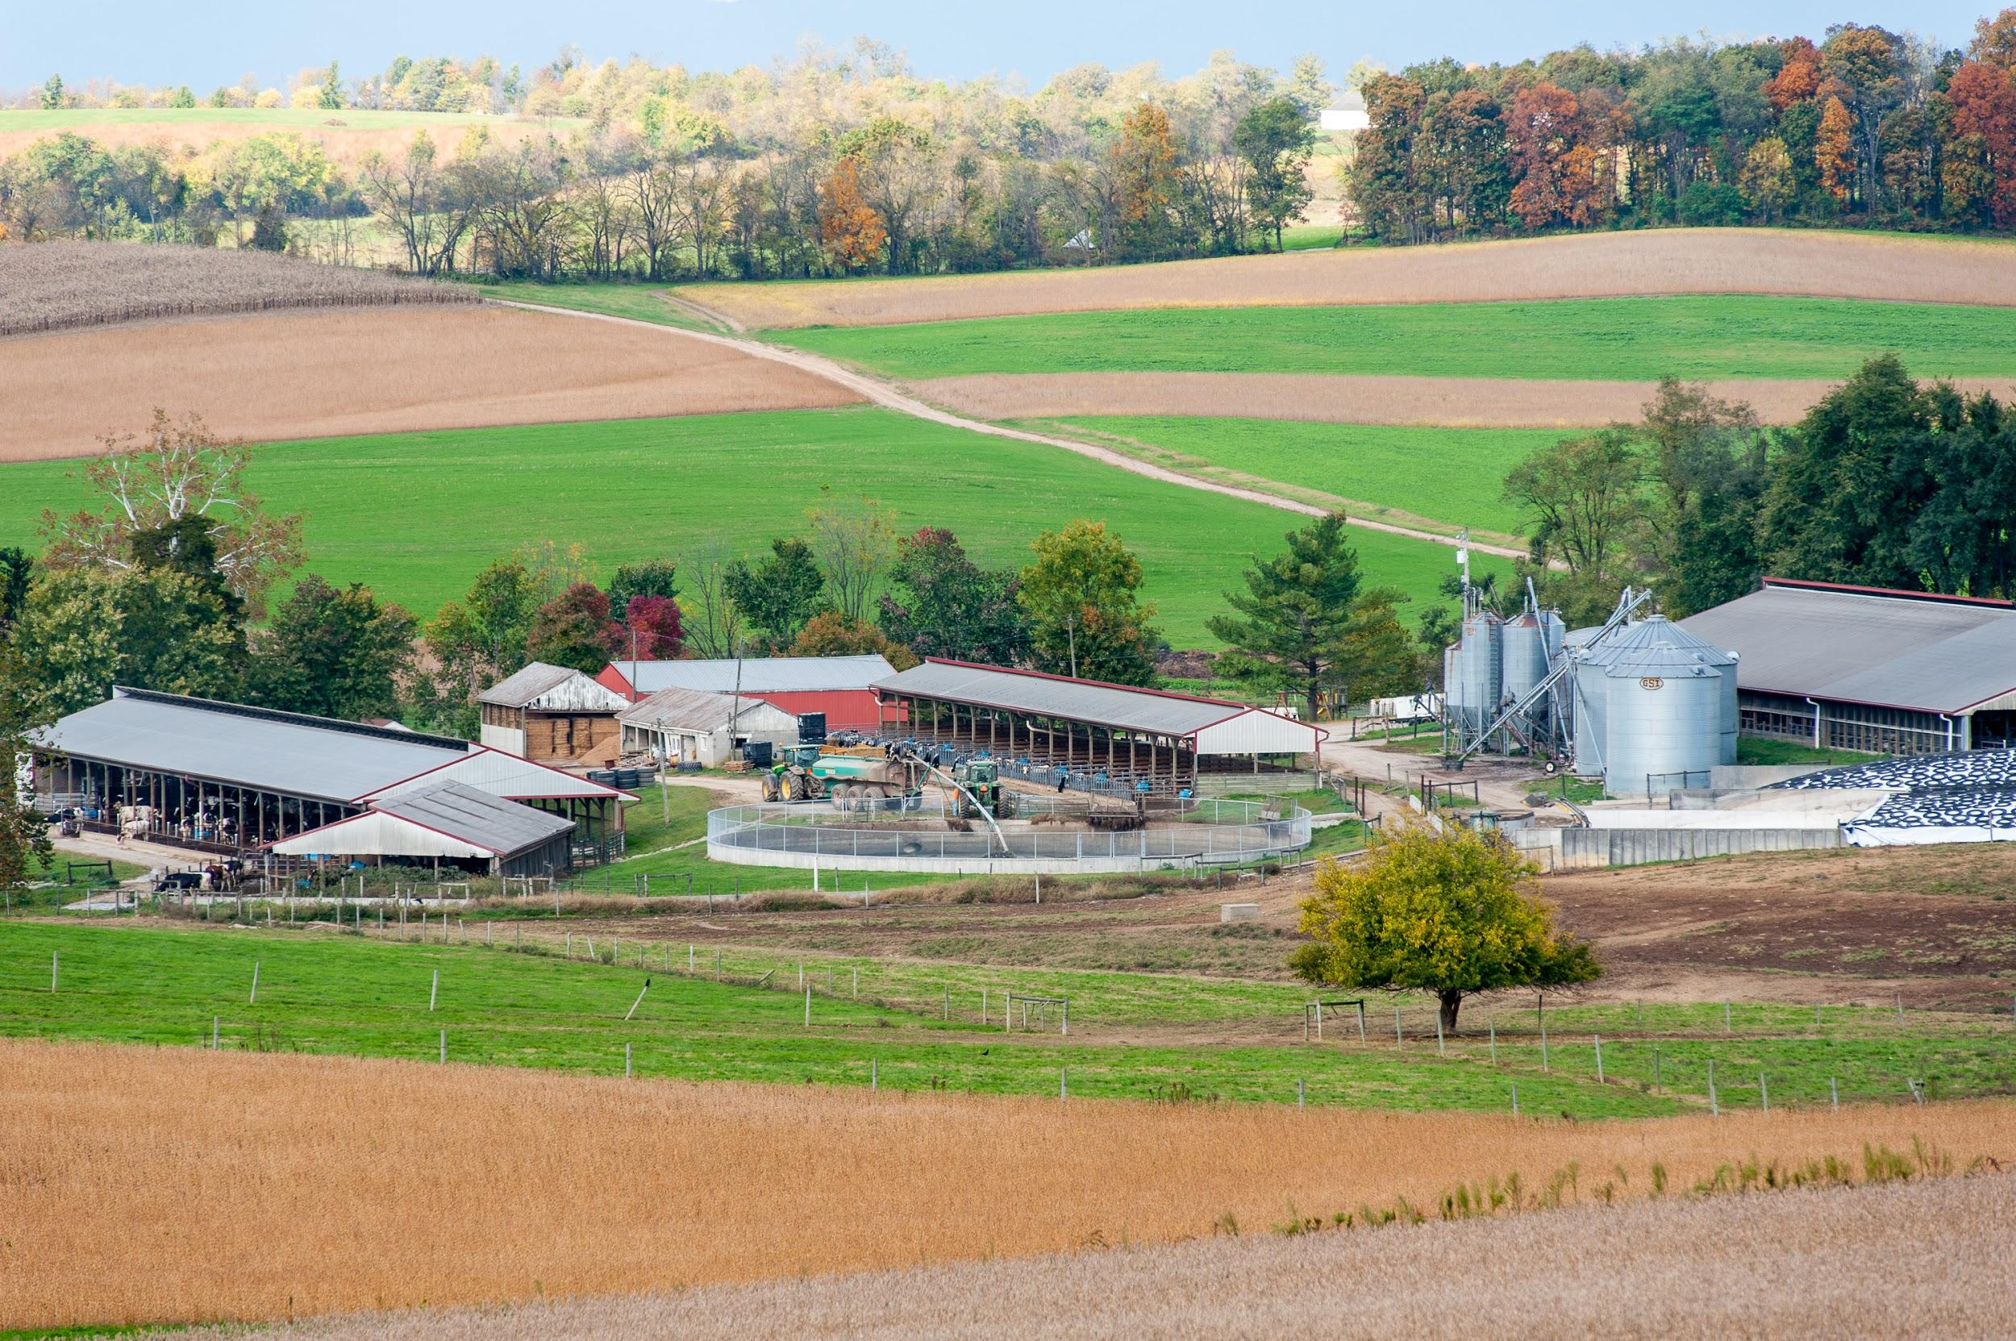
Rights in a Growing Crop
–What is a farmer’s right to a growing crop?
-When the lease is for an uncertain term, the tenant has the right to harvest the growing crop in a reasonable amount of time, absent an agreement to the contrary.

Slide 15
Rights in a Growing Crop
When a lease is for a term of years and the tenant knows the date the lease will expire, a tenant will not be able to harvest crops maturing after the lease expires.
-Specify the tenant’s right to a growing crop in the lease.

Slide 16
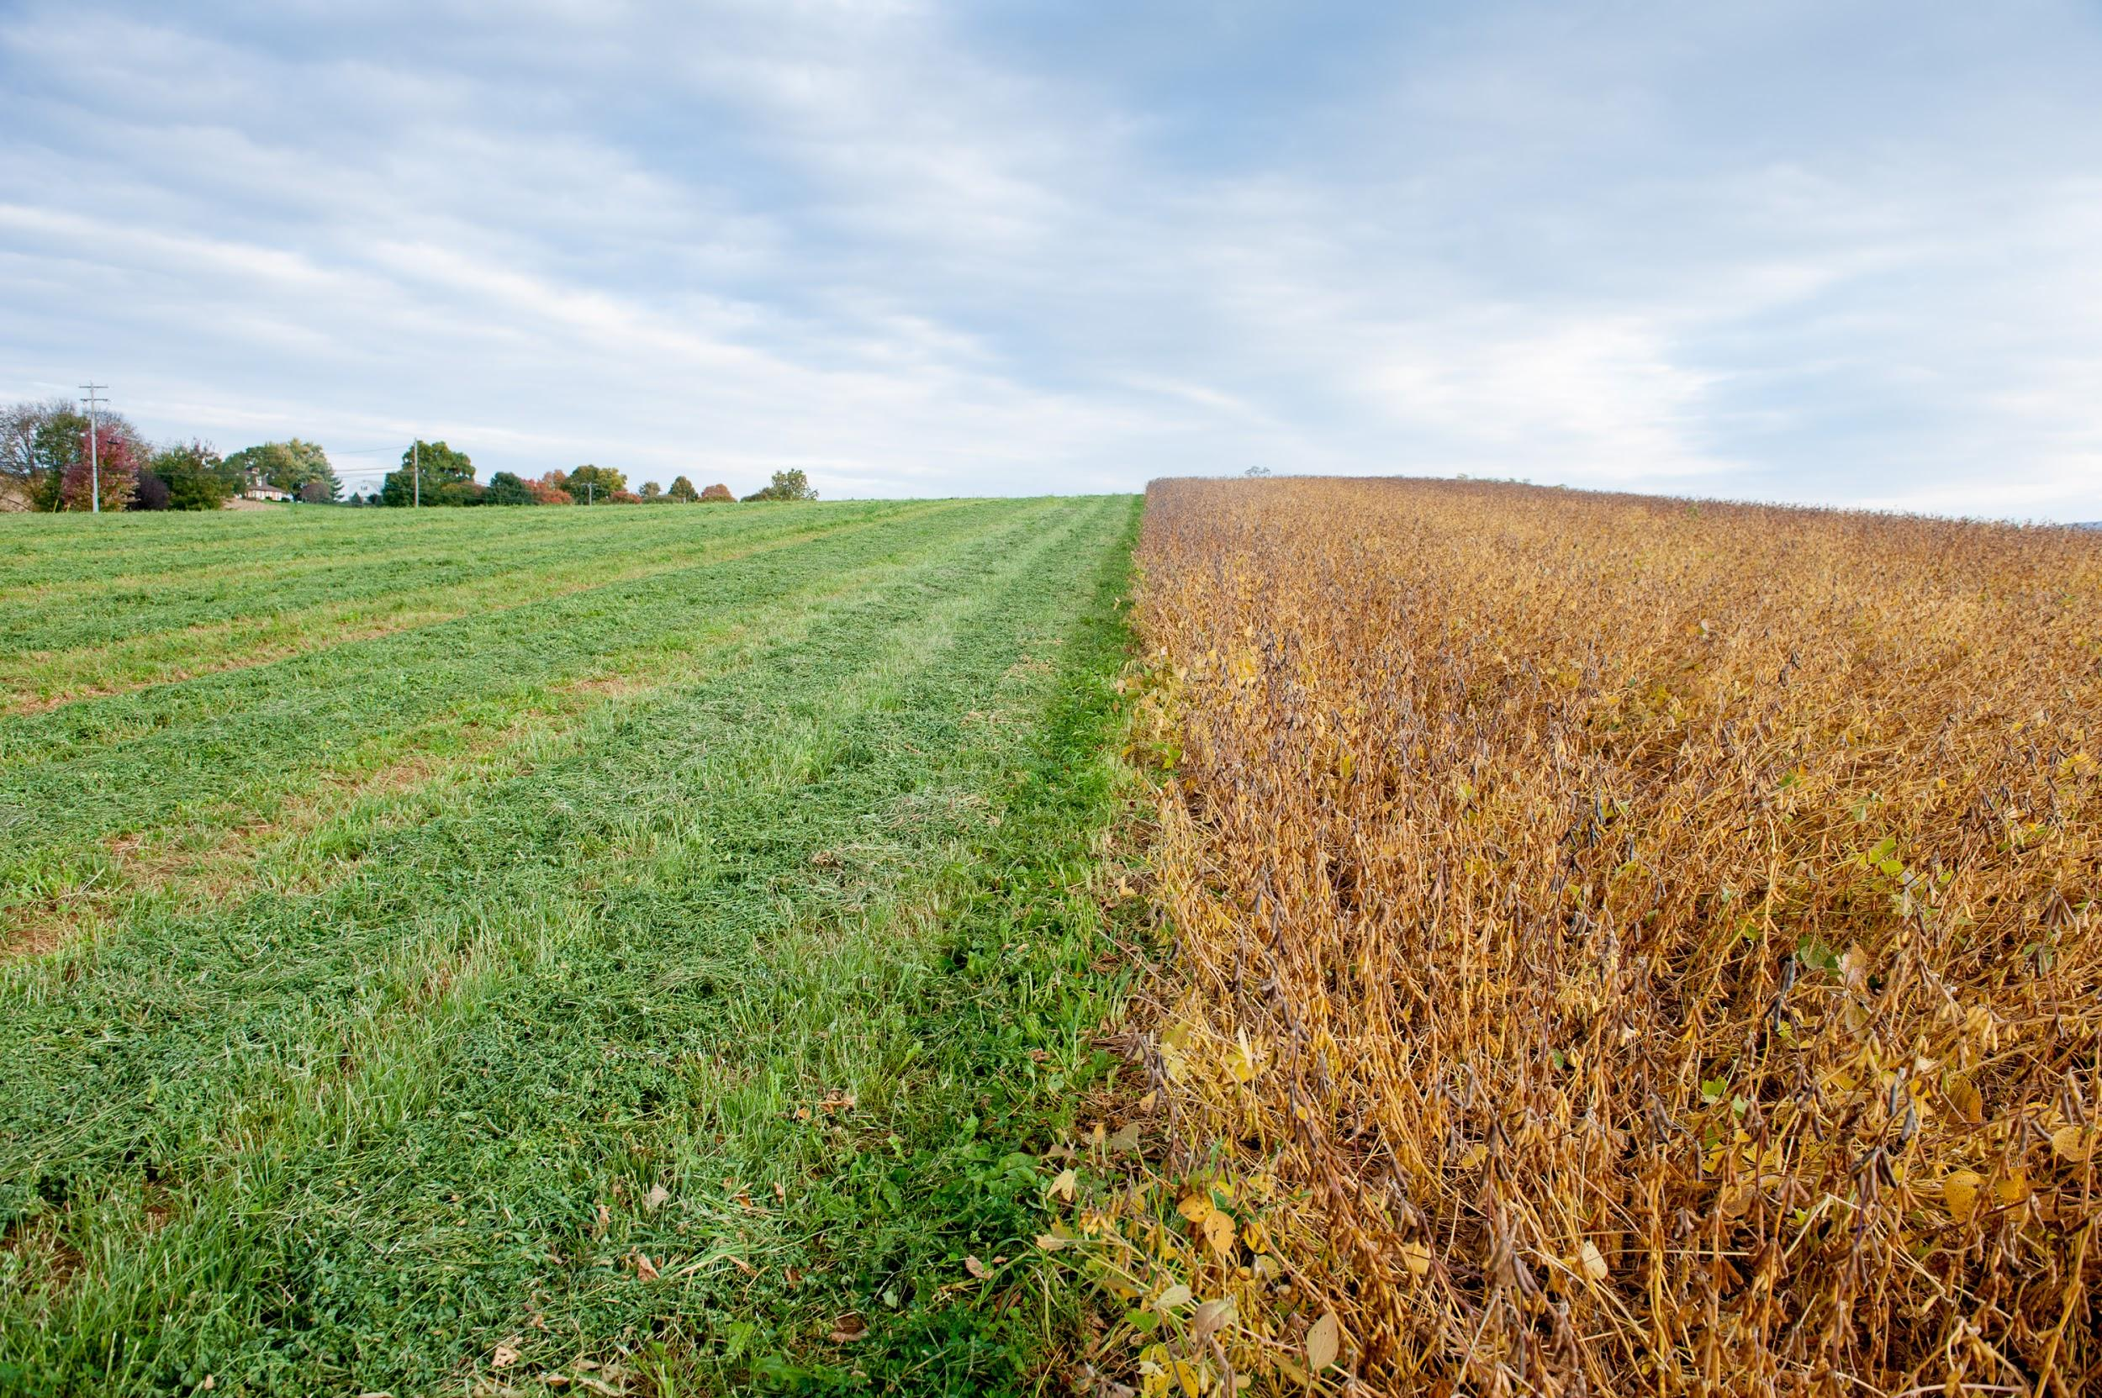
Noxious Weed Control
Noxious weed control
Landlords and tenants can be held liable for noxious weed control
Lease terms should clearly identify which party is responsible for noxious weed control
Include any other species of concern- ex- Palmer Amaranth

Slide 17
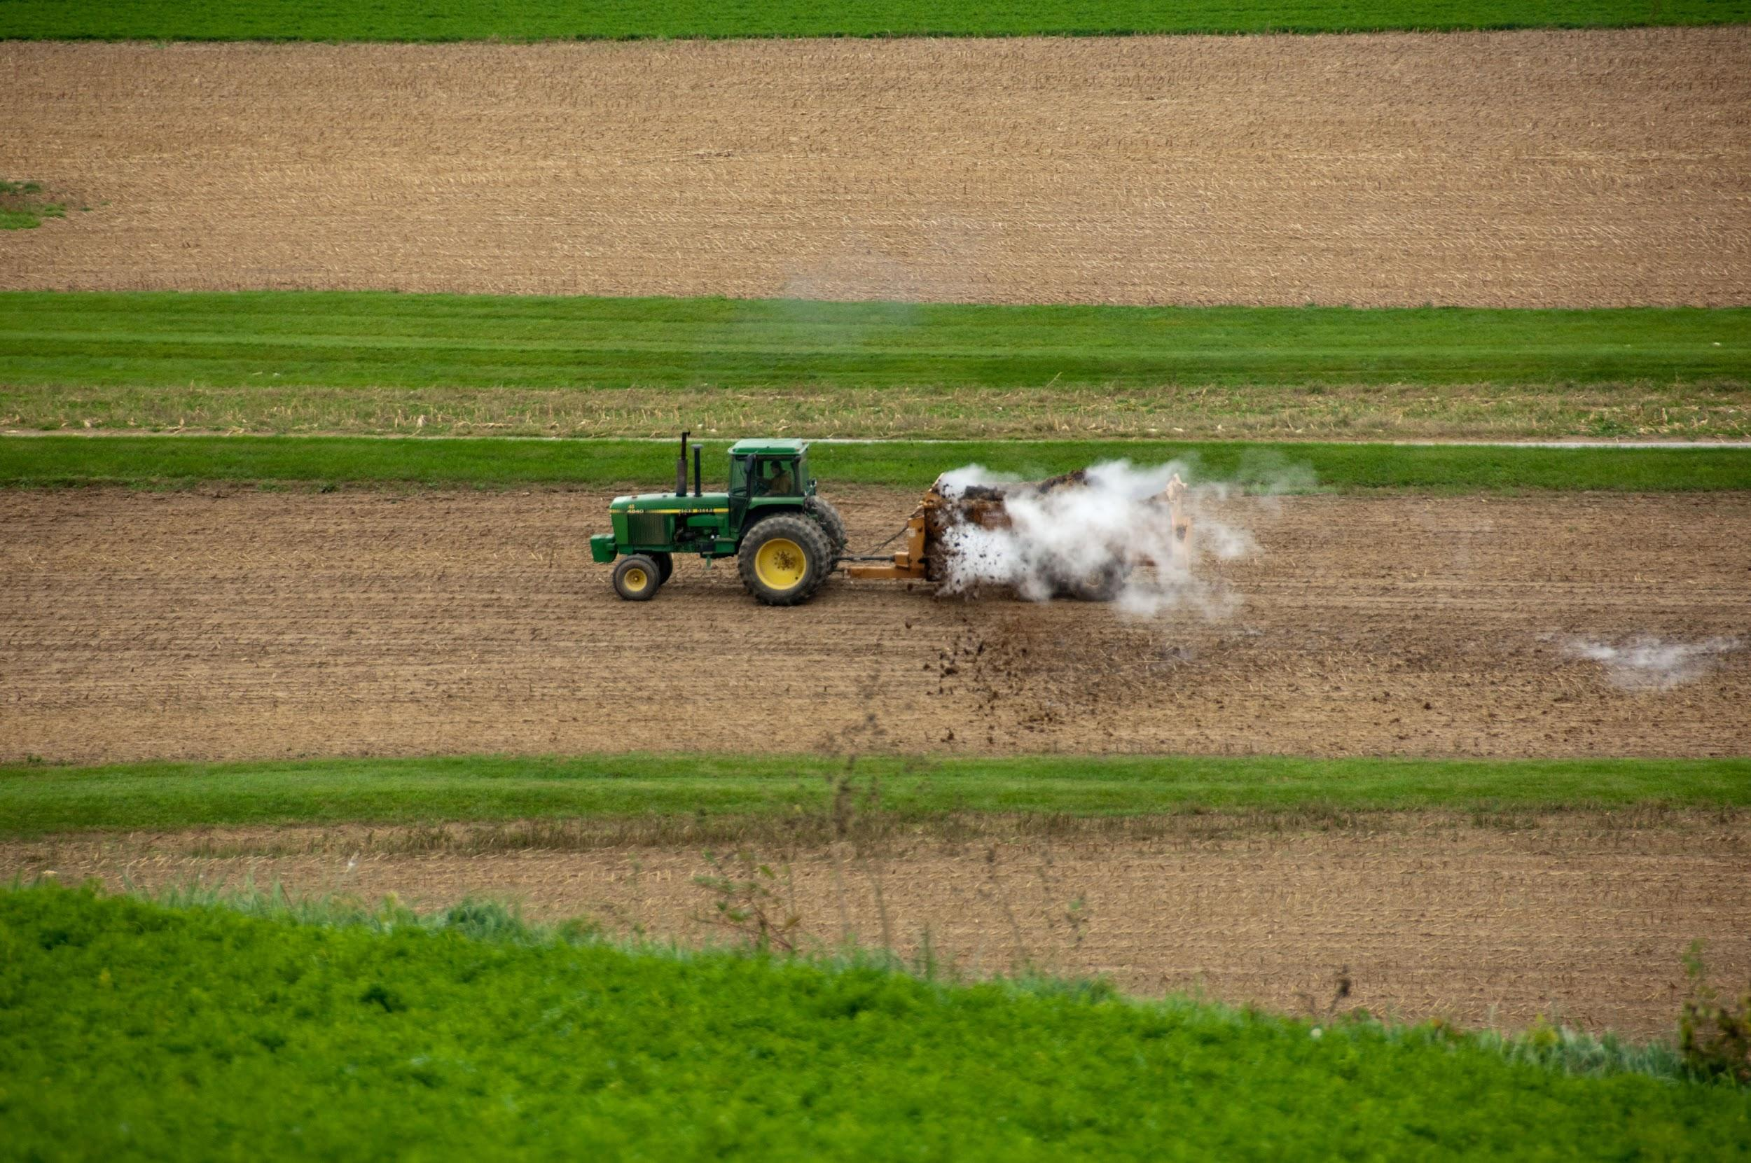
Repairs
Repairs
Landlord has no legal duty to make repairs to rented property
Tenant is only required to make ordinary repairs to the property
A written Lease allows the parties to determine who should be responsible for repairs

Slide 18
Insurance
Who is insuring what?
–A Landlord should maintain insurance over buildings and permanent features.
–A tenant should carry insurance to cover loss to equipment and other personal property on farm.

Slide 19
Lease Renewal
If there is no renewal section, unless proper notice to terminate is given, a periodic tenancy will automatically renew at the end of the term.
The terms of the original lease will continue to apply until the parties agree to terminate the original terms or agree to a new lease.

Slide 20
Lease Termination
•How do you terminate an agricultural lease?
•Unless stated otherwise in the lease, year to year ag leases require 6 months’ notice before end of lease to terminate.
–That means by June 30 if your lease ends on December 31.

Slide 21
Lease Termination
•Notice to terminate should be given in writing with a copy retained by the sender.
•In Ag Leasing in Maryland there is a form termination letter that you can use to develop your own.

Slide 22
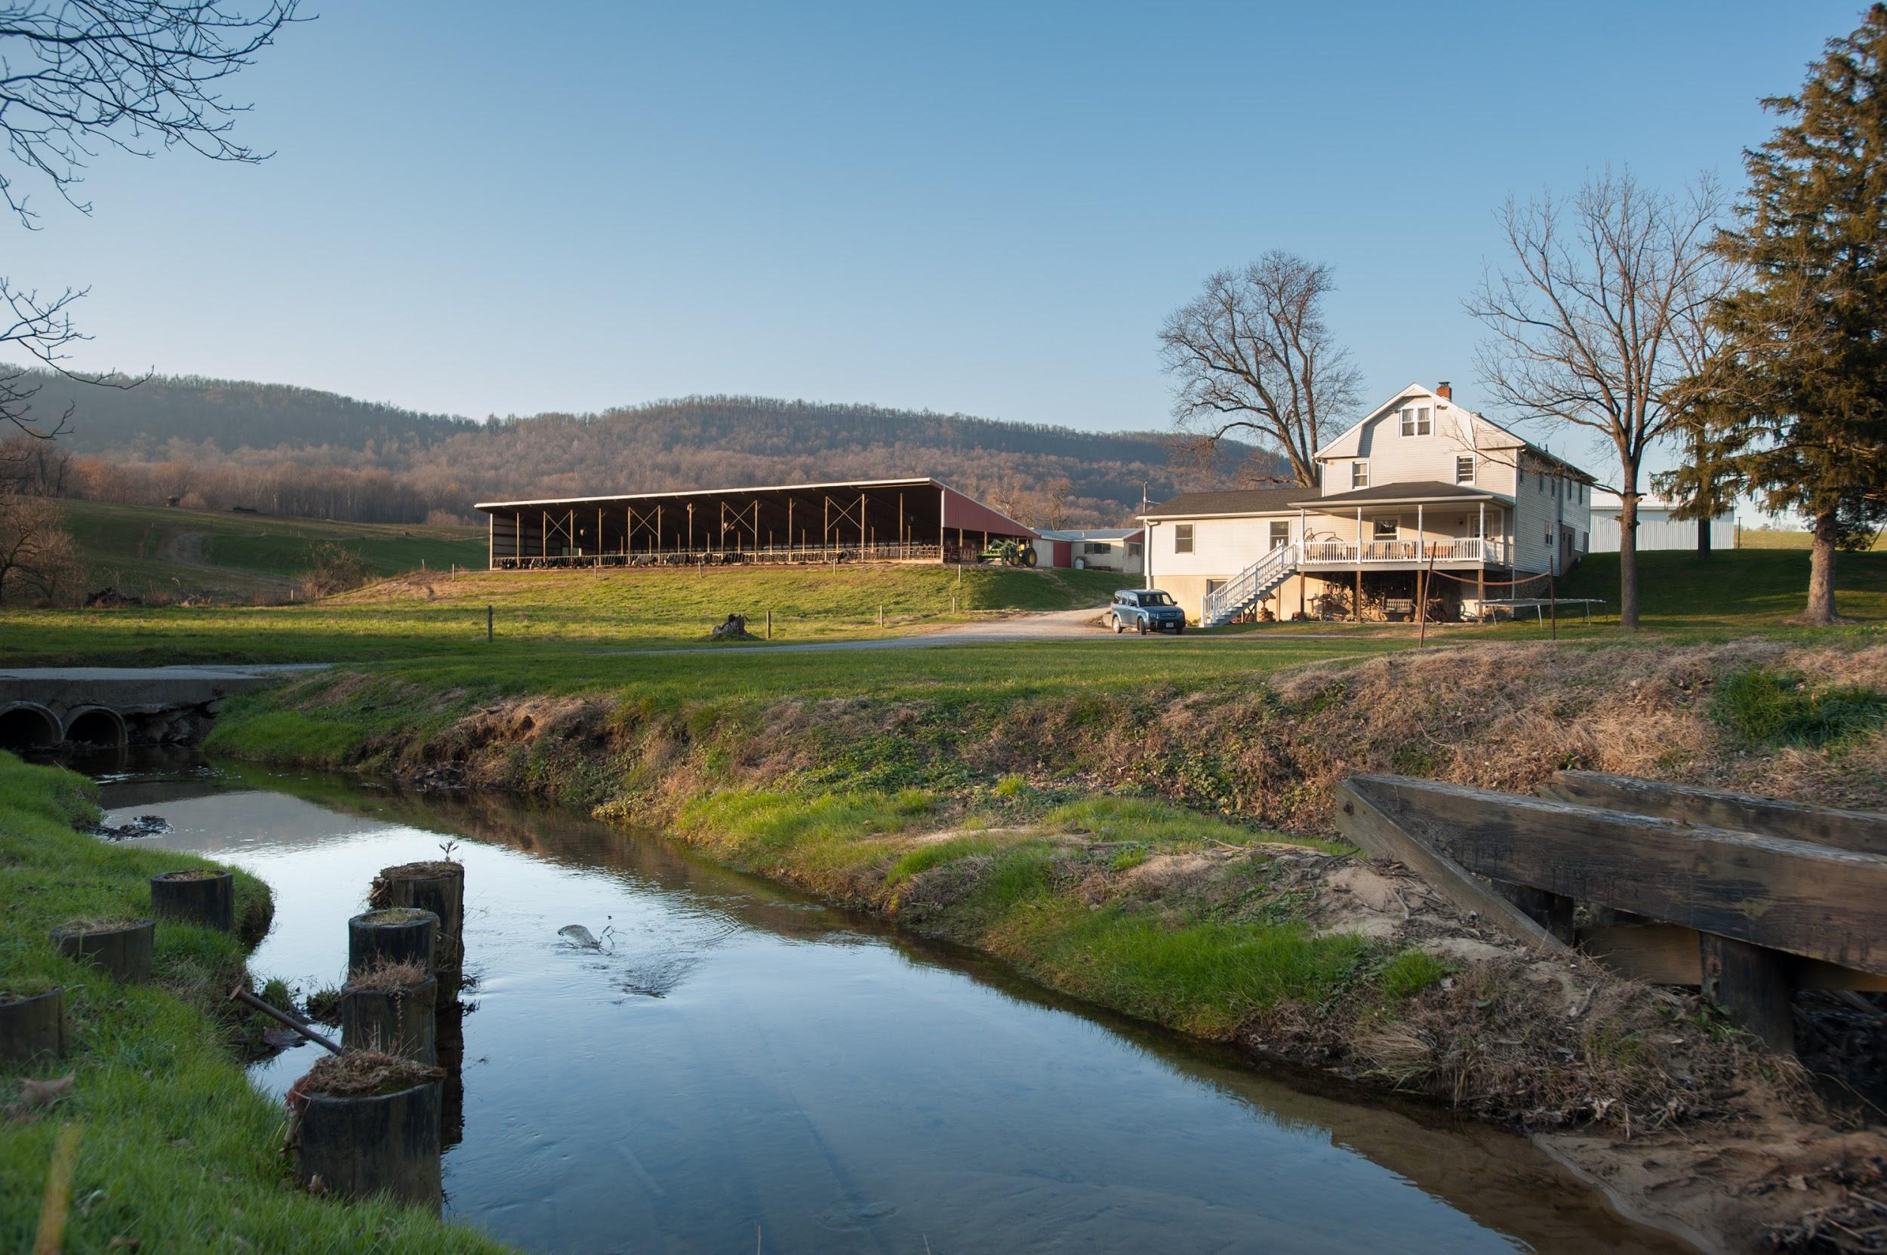
Amending the lease
Amending the lease
At any time the parties can agree to amend the lease
Both parties must agree and it should be in writing

Slide 23
The “what ifs”
A good lease considers the “what ifs”.
What happens if the rent is late?
–Is there a penalty?
–Is there a grace period?
–Is being late with the rent one time a breach or will it take a few late payments before the landlord can terminate the lease?

Slide 24
The “what ifs”
•What happens upon a breach?
–Do the parties give notice and have time to resolve the issue?
•If there is a breach do you rush to court?
–Do you want to require mediation before litigation?
–Does the prevailing party get their attorney’s fees paid by the breaching party?

Slide 25
Conclusion
•The terms of a lease can make or break an operation on rented land.
•Take the time to talk it out and put your understanding in writing.
•Don’t expect the law to resolve issues.
•Protect yourself and use a lease to safeguard your business.
Seek Legal Advice!

Slide 26
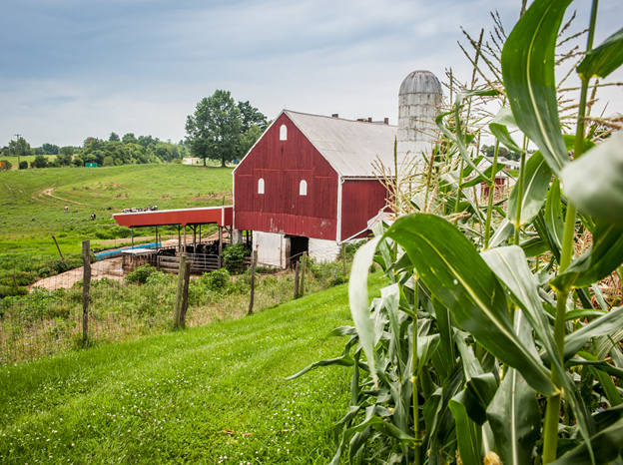
Thanks
Questions?
Sarah Everhart
severhart@law.umaryland.edu/ 410-458-2475

