Slide 1
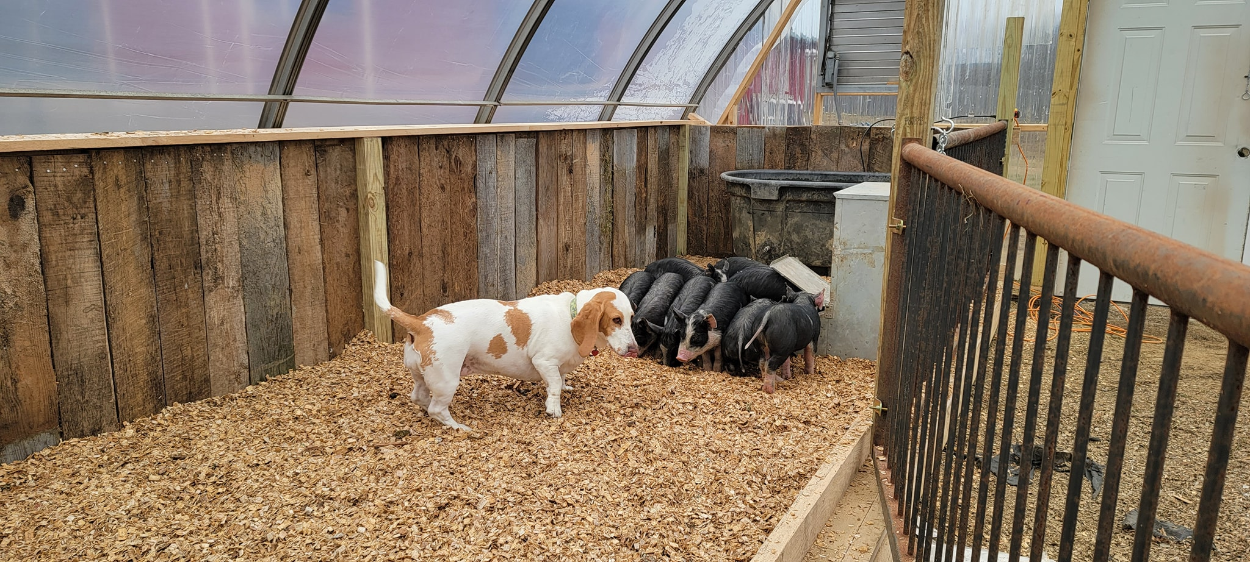
Alternative Swine Feeds
Colt W. Knight, PhD
Associate Extension Professor & State Livestock Specialist

Slide 2
Swine Nutrition

Slide 3
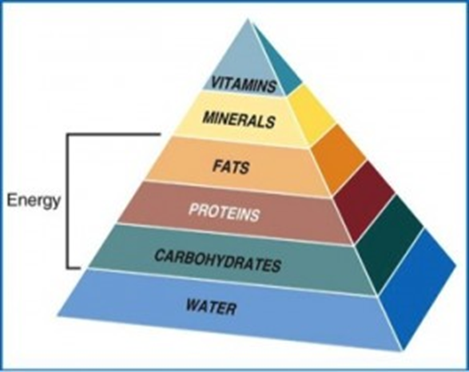
Six Basic Nutrients
Water
Protein
Carbohydrate(CHO)
Lipid(fat)
Vitamin
Mineral

Slide 4
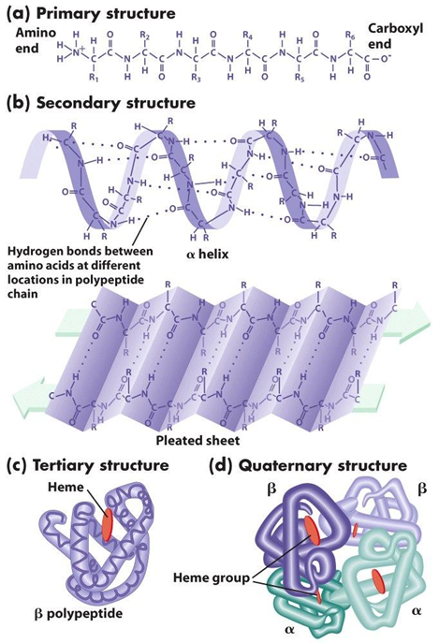
Protein
Animal age↑, protein requirement↓
Excess protein creates
Muscle
Fat
Made up of Amino Acids(AA)
Basic structural unit
Metabolism
Hormone
Antibody
DNA production

Slide 5
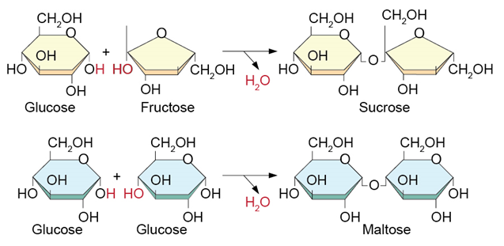
Carbohydrate(CHO)
Energy Source
Building block of other nutrients
Crude Fiber
Cellulose
Nitrogen free extract
Starch and Soluble Sugar
Excess stored as FAT

Slide 6
Lipid(fat)
Energy
Stored in higher concentrations than CHO
Heat
Insulation
Body Protection
Source
Oils (soybean oil)
Animal byproducts (tallow)

Slide 7
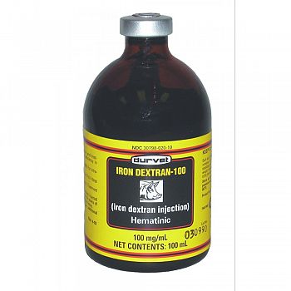
Minerals
Major minerals
Ca, P, Na, CL
Minor (Trace minerals)
Fe, Cu, Zn, Mg, Si, Se
Function
skeleton,
protein synthesis,
oxygen transport,
fluid and acid-base balance in body,
enzyme reactions

Slide 8
Vitamins
Water soluble
B & C
Fat soluble
A, D, E, K
Function
Metabolism
Enzyme reactions

Slide 9
What is a ruminant?

Slide 10
Four chambers of ruminant stomach
Rumen – Fermentation and VFA absorption
Bacteria
Protozoa
Fungii
Reticulum – Pouch
Rock, nails, wire
Omasum – Water and some nutrient absorption
Abomasum – True stomach
HCL

Slide 11
Hind Gut Fermenters
Rabbits
Horses
Elephants
Not a ruminant, but cecum acts as a much less efficient rumen. These animals eat more, as a percentage of their body weight, than ruminants.

Slide 12
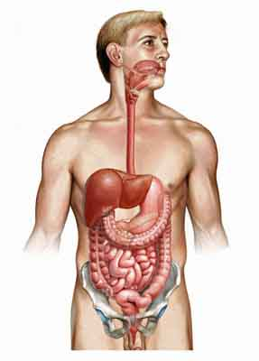
Monogastrics
Animals like people, pigs, carnivores.

Slide 13
How much feed does a pig eat?
A lactating sow can eat up to 20 lbs a day.

Slide 16
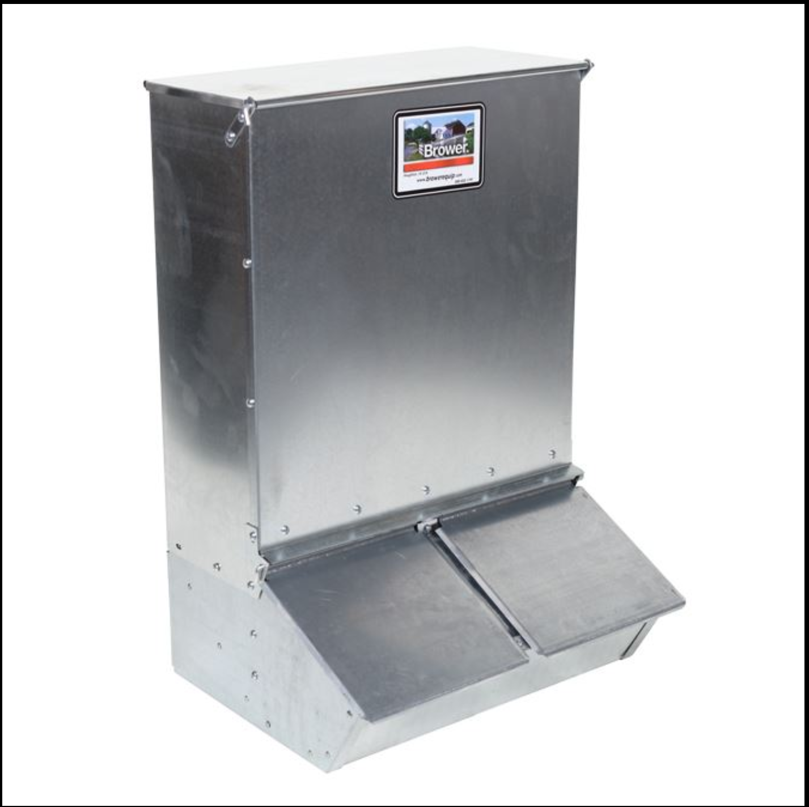
Complete feed

Slide 17
Slopping Hogs
1980 Swine Heath Protection Act
Illegal to feed slop unless its heated to 212 degrees for 30 minutes
Certain licenses needed
2200 licenses garbage feeders in the USA, ~ 3000 in PR.
Decline in slopping hogs due to regulations

Slide 18
Milk Waste

Slide 19
Common things I get asked about

Slide 20
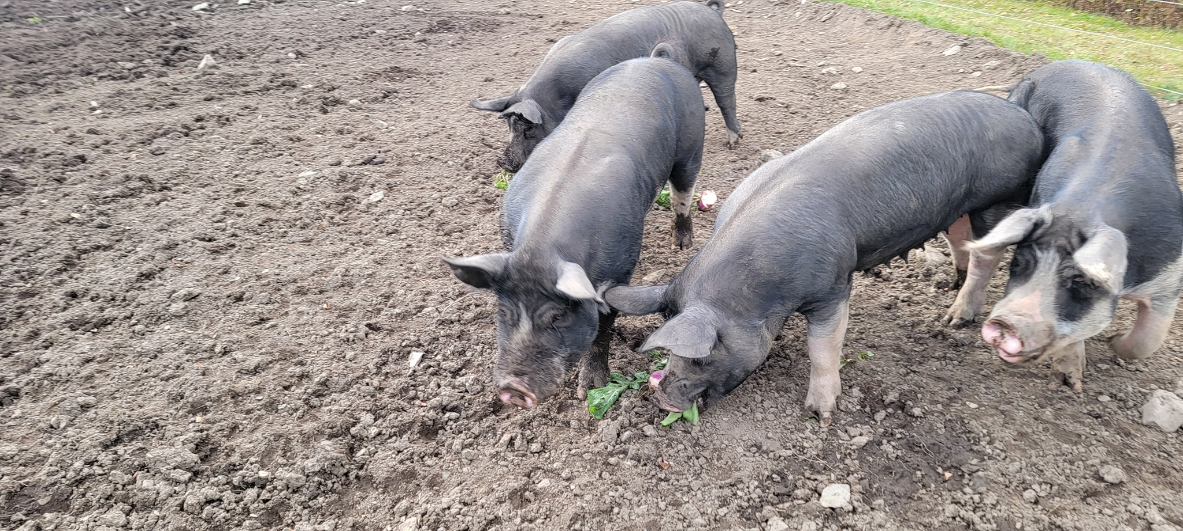
Notes:
Turnips and beets – Mangels (livestock beets) – research is mixed on meat quality decreasing, same, or slightly lower. Need to feed with protein supplement to promote growth. ~6-7% CP, 75-815 TDN
1 acre turnips – feed for enough 5 sows 56 days. 40 pigs consumed in 7 days 14-22 % CP 70-80% TDN – used historically as winter fodder and pasture crop.

Slide 21
Forages
Pasture
Great supplement for vitamins and minerals
Hay
Legume hay higher in nutrition
Haylage/silage
High in moisture
Can contain dangerous mycotoxins
Dilutes complete feed nutrient density

Slide 22
Barley
Lower in energy than corn
Growing pigs can compensate by eating more
Doesn’t work well in a limit fed ration
Typically used to dilute high energy feed rations in commercial operations

Slide 23
Brewers Grain
Grain left over from brewing and fermenting beer
Good source of nutrition – High in Protein
Severe storage and handling issues
Spoilage
Freezes

Slide 24
Apples

Slide 25
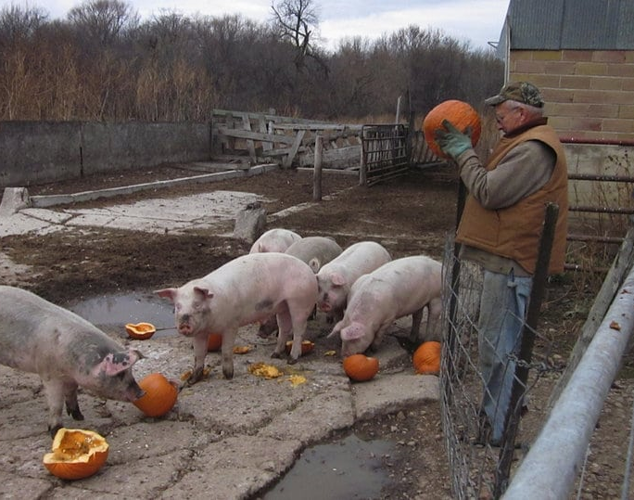
Pumpkins
Mostly Water
Contain 10-14% CP on average
Not a dewormer

Slide 26
Potatoes

Slide 27
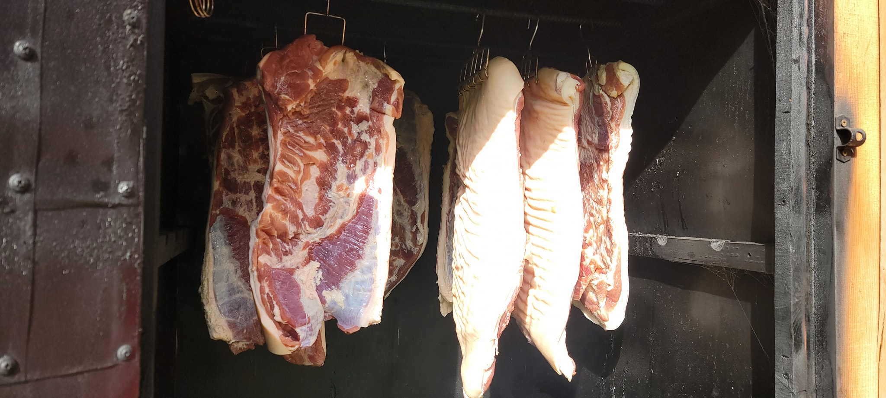
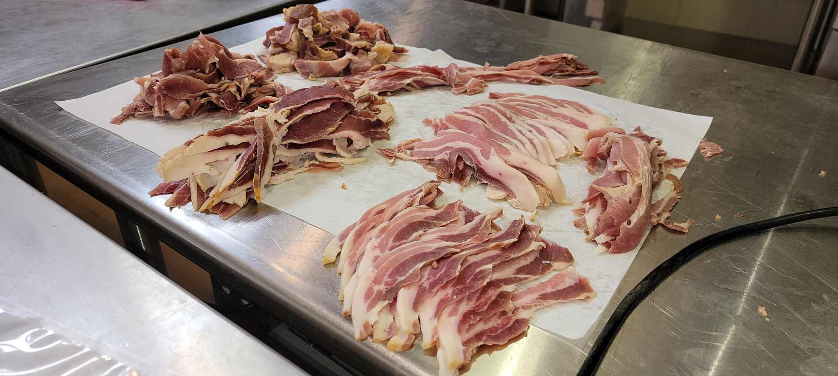
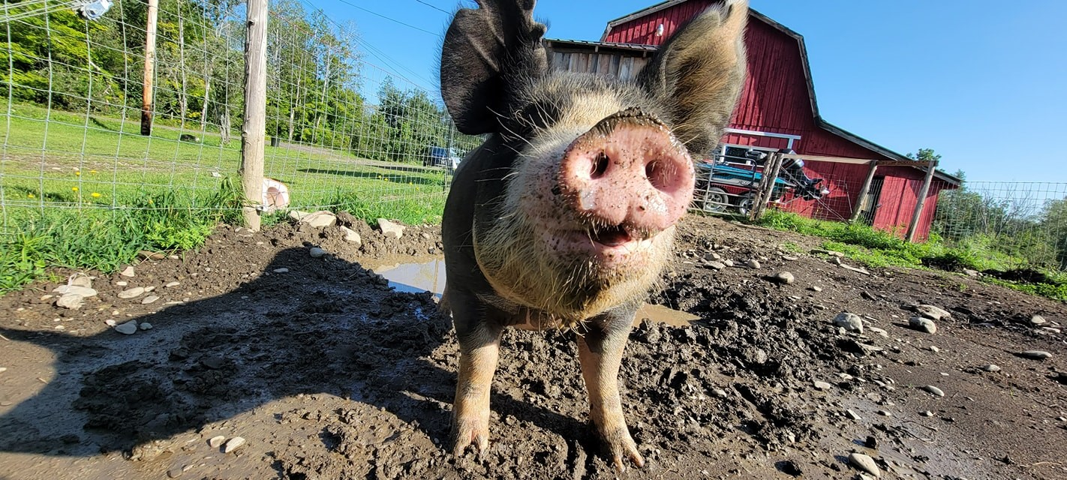
THANK YOU
Colt W. Knight, PhD
University of Maine Cooperative Extension
colt.knight@maine.edu
207 581 2953

