Slide 1
Backyard Nursery Production
Frank Cruz, L. Robert Barber, Mark Acosta, Roland Quitugua
University of Guam Cooperative Extension Service
For More Information Contact: 735-2080

Slide 2
Why we need a Nursery
To produce high quality plants on a timely basis
A fruit based farm will require a large amount of plant materials, a nursery is the most economical and secure way of obtaining these materials
Potential to generate income from sale of excess plant materials

Slide 3
Requirements for Nursery Production
Good water source – quantity & quality
Protected open area to grow plants
Protected area for propagation, potting & seedling production
Good growing media
Containers or production beds
Good plant material
Notes:
What they want? How they want it! When they want it! And what price they want it for
Consumers are willing to pay premium price for good quality produce!
Make up your mind are you going to treat this as a hobby or a business? The rules are different for each You cannot go back and forth!
If you are the end user then what you want dictates production.

Slide 4
Good growing media
Air ⬅ ➔ Water
– Held in spaces between soil particles
– Containers restrict air and water movement
– Total air and water space ~ 50%
Solids
– Provide or holds nutrients
– Holds roots which support the plant
– Weight is important
Notes:
If you lack any of these… find it!

Slide 5
Good Growing Media
Disease free
Weed seed free
Organic Materials & Inert Materials
Can use soil
Soil sterilization or composting
Commercial mixes
Not all created equal

Slide 6
Containers or Production Beds
Production beds can be efficient and inexpensive
– Requires good soils
Containers are easy to handle
– Minimize transplant shock
– Provide better control of individual plants
– Too long in a container can result in root bound plants

Slide 7
Container Types
Pots
Bags
Tubes
Mesh bags
Recycled tins and cartons, even plastic cups with holes on the side bottom

Slide 8
Propagation
Sexual Reproduction vs Asexual Reproduction
Sexual – combination of egg and sperm to produce a new offspring
– Seeds are produced from the union
– Occurs naturally ~ collect seeds
Asexual - propagated from existing parent plant material
– Many methods, some quite easy

Slide 9
Sexual Reproduction
Seeds inexpensive (except hybrids)
Seeds are abundant
Many seeds are clean and disease free, easily moved between countries
– Some seeds can carry disease (mango, betelnut)
Seedlings have strong tap roots
Some seedlings go through vegetative phase
Low labor cost

Slide 10
Sexual Reproduction
Some plants do not produce seeds (breadfruit, banana)
Some not “true to type”
Some seeds carry disease
Seed dormancy must be broken (scarification, hot water treatment, etc.)
Seed orientation when planting is important (avocado, mango)

Slide 11
Asexual or Vegetative Propagation
Division (banana, taro, lemongrass, ginger)
Cuttings (fig, citrus, mulberry, glyricidia)
Air-layering (fig, citrus, breadfruit, avocado, mango)
Grafting & budding (Art as much as a science)
– Practice is critical.
Micropropagation/tissue culture - DoAg and UOG have labs

Slide 12
Asexual or Vegetative Propagation
Divisions
– Plantlets or suckers removed from the mother plant
Banana, taro
Cuttings
– Leaf – mother-in-law-tongue, kalanchoe
– Root cutting and shoot – breadfruit, guava, citrus, pomegranate
– Stem cutting – softwood, semi-hardwood, hardwood

Slide 13
Asexual or Vegetative Propagation
Hardwood cuttings - easiest
– Plumeria
– Fig
– Glyricidia
– Siniguelas
Semi-Hardwood
– Citrus

Slide 14
Asexual or Vegetative Propagation: Softwood Cuttings
Most delicate
Desiccation – most serious problem
Prevent or minimize desiccation by reducing leaf area
– Remove whole leaves
– Cut leaves to reduce area
Prevent or minimize desiccation by increasing humidity
– High humidity chamber
– Mist propagation system

Slide 15
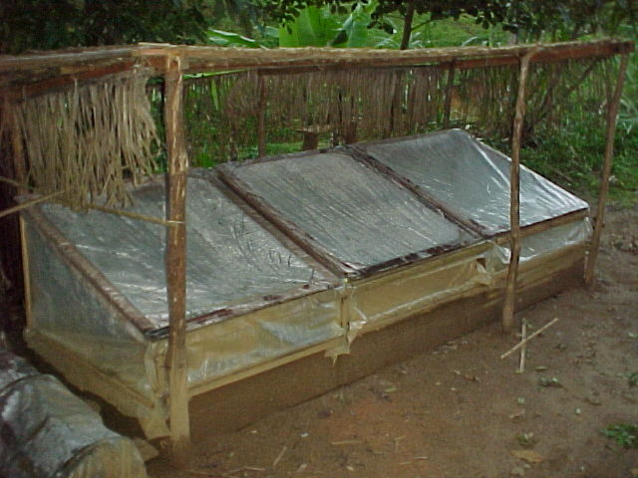
Non-mist

Slide 16
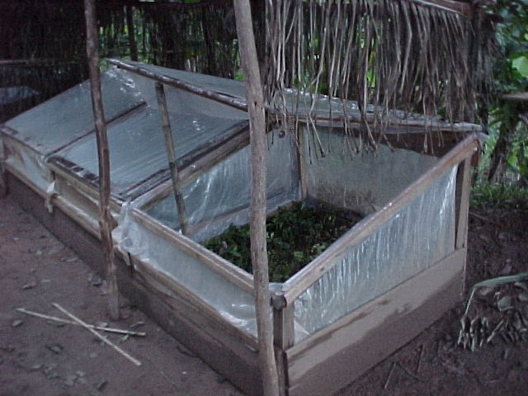
Non-mist

Slide 17
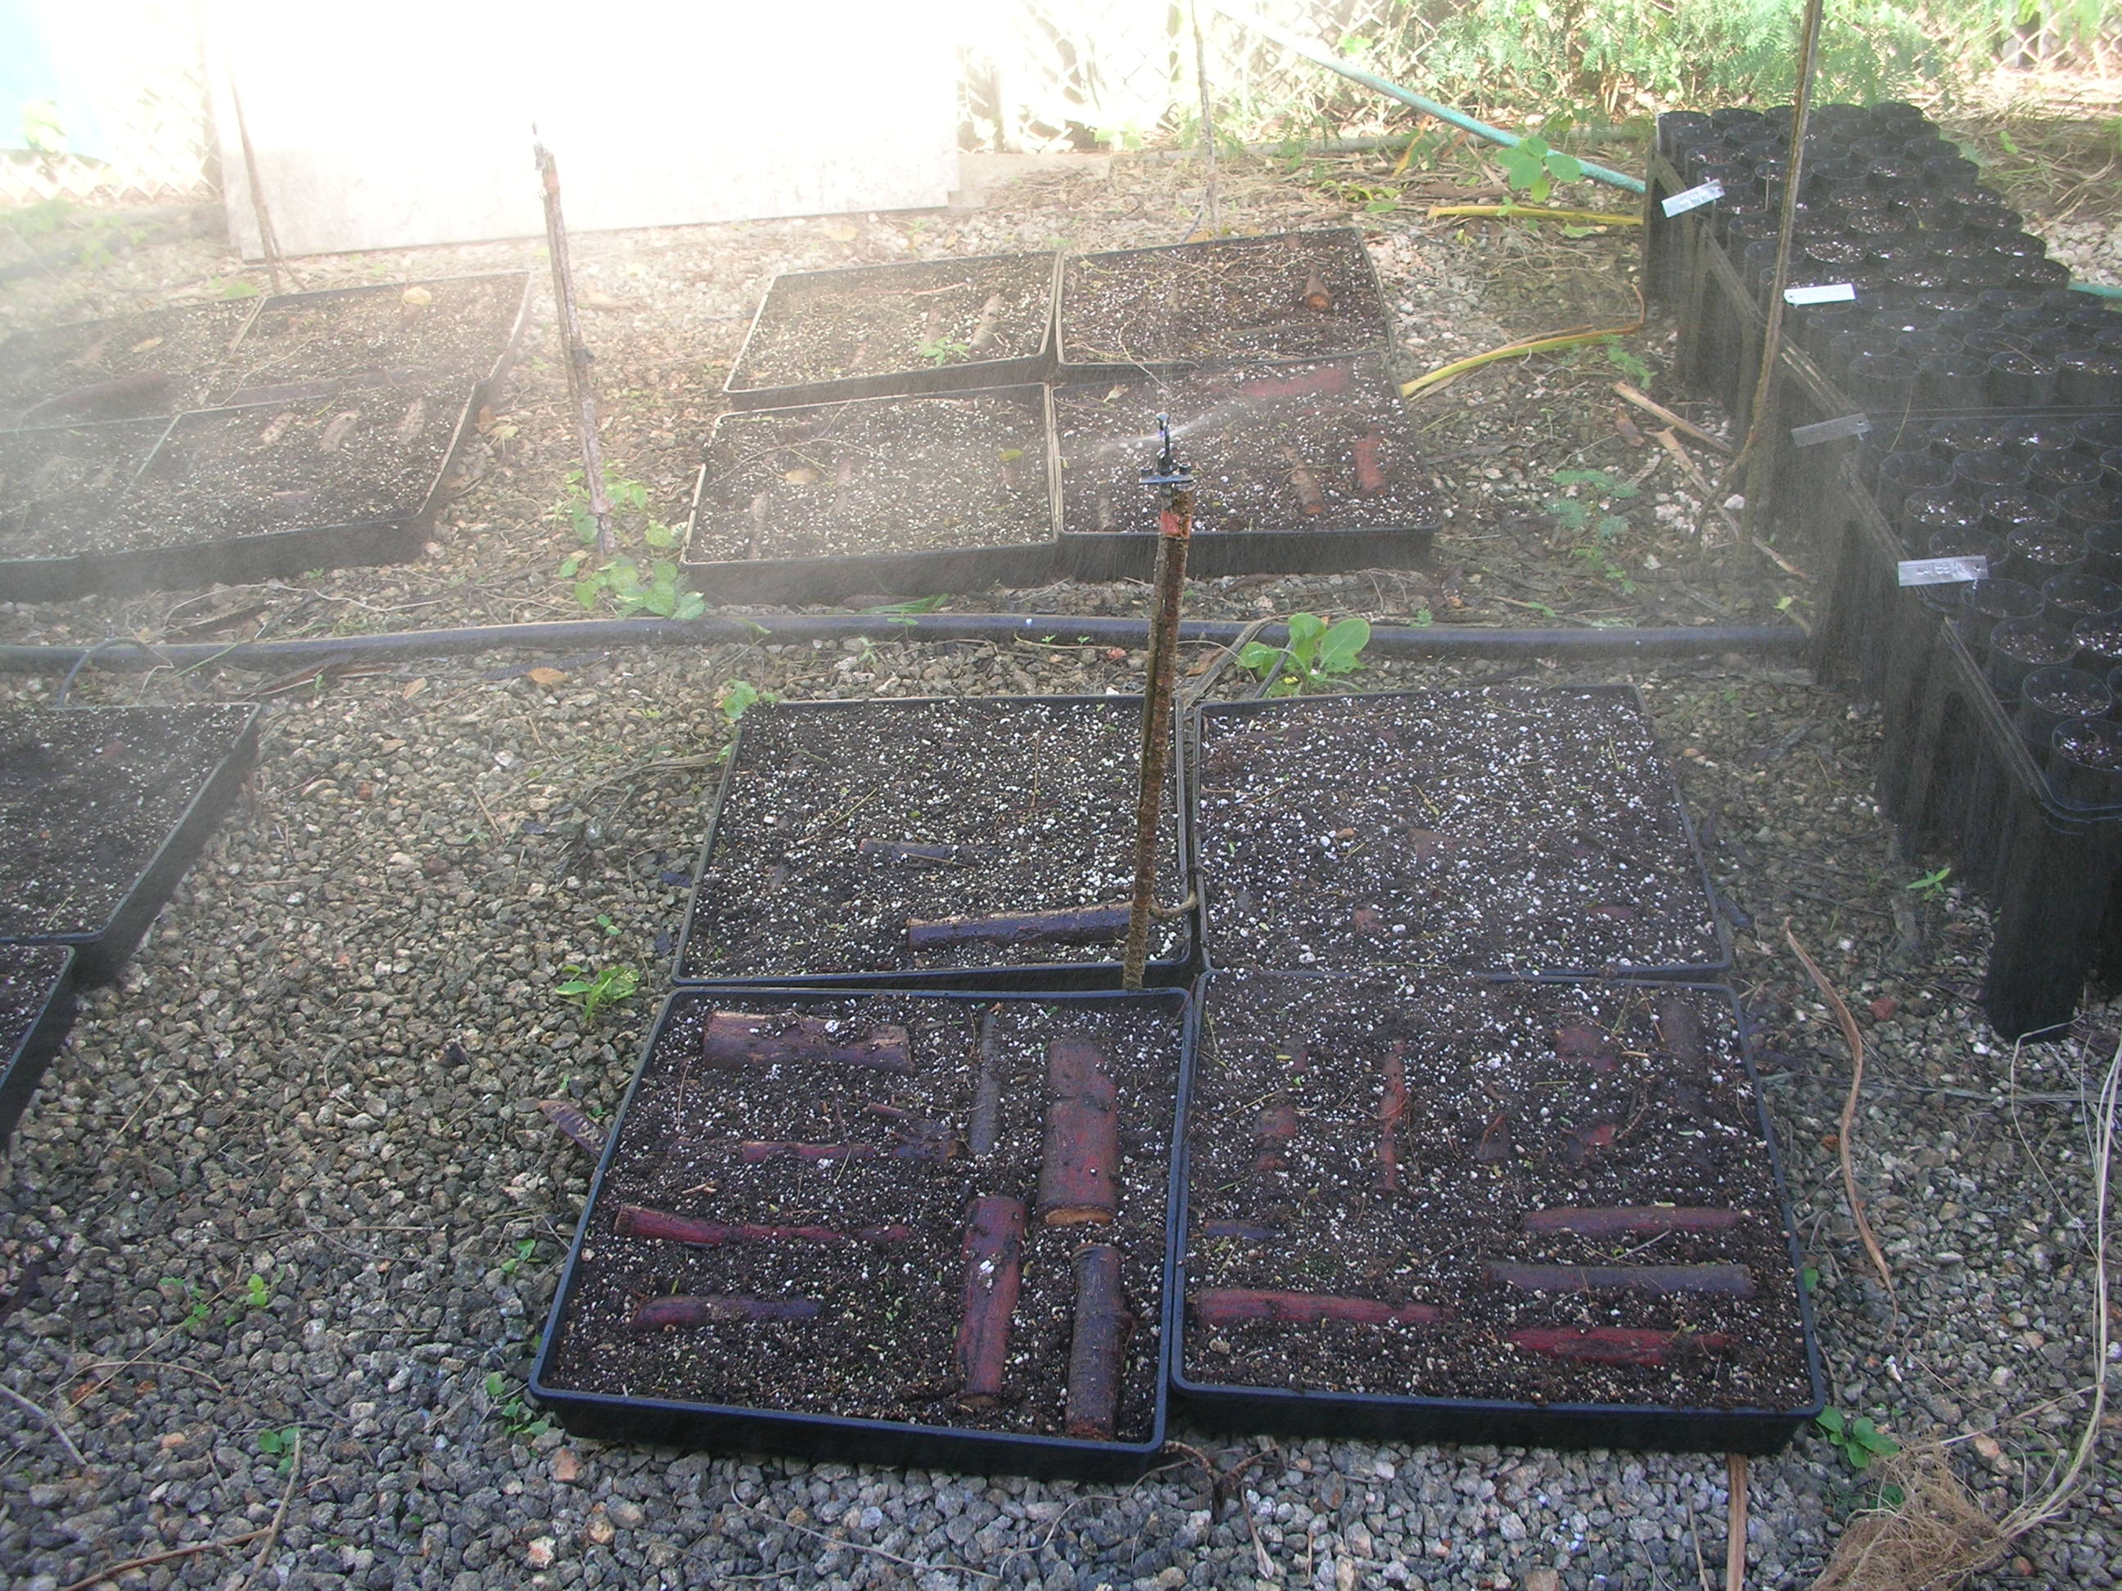
Mist System

Slide 18
Asexual or Vegetative Propagation
Air-layering – make a branch root
Grafting & budding
– Combine parts from two plants to make one
– Rootstock & Scion
– Top working
Micro-propagation
– Aseptic culture
Seedlings (orchids)
Tissue culture (bananas, taro)

Slide 19
Things to watch out for!
Tall lanky seedlings
Timing for use
Pot bound plants
“J” rooted plants
Mislabeled plants
Sanitation

