Slide 1
Bale Grazing to Build Soil Health
Erin & Drew Gaugler, FNC18-1123
NCR-SARE’s Farmers Forum, 2020

Slide 2
North Dakota
Notes:
Location of operation.

Slide 3
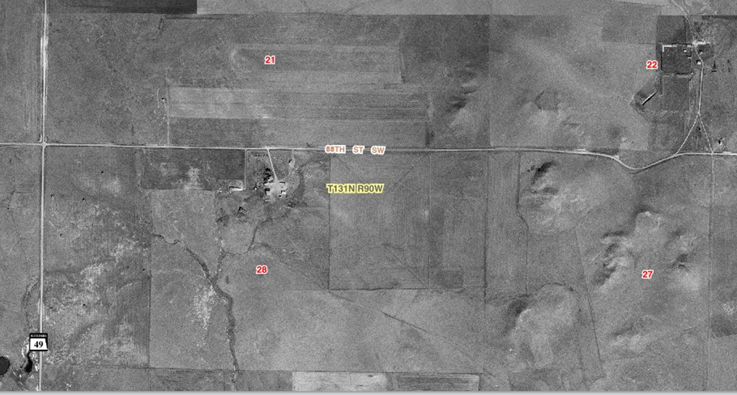
1957
Notes:
1957, approximately the point that they quit farming to the west.
Historically farmed with no inputs and depleted to a point of no longer being productive.

Slide 4
1995
Notes:
Project area = 84 acres
Historically farmed with no inputs and depleted to a point of no longer being productive.

Slide 5
2004

Slide 6
2010

Slide 7
2017 (project area)
Notes:
Project area = 84 acres

Slide 8
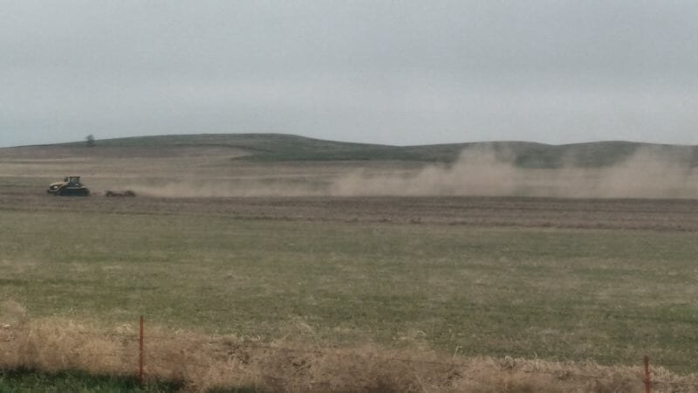
Resource Concerns
Soil loss
Water management
Reduced forage production & quality
Notes:
Add in clay pan photos, dirt blowing

Slide 11
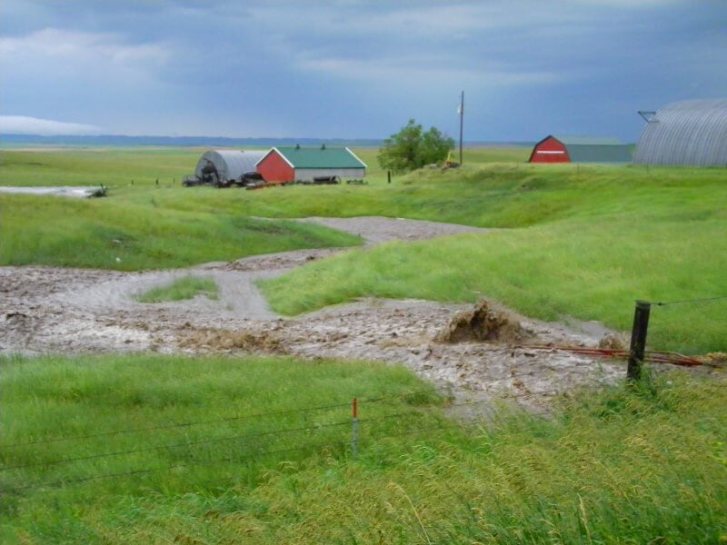

Slide 12
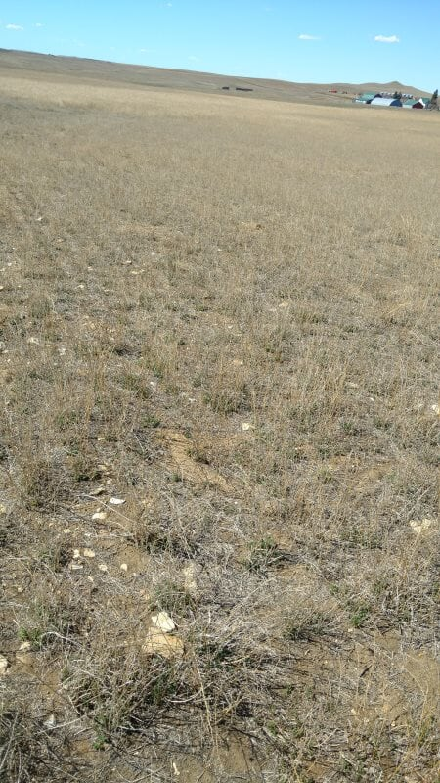

Slide 13
Project Objectives
Improve soil health & fertility
Increase nutrient cycling & reduce nutrient runoff
Improve forage production & quality
Reduce feed & labor costs
Share findings through various outreach efforts

Slide 14
Bale Grazing & Management

Slide 15
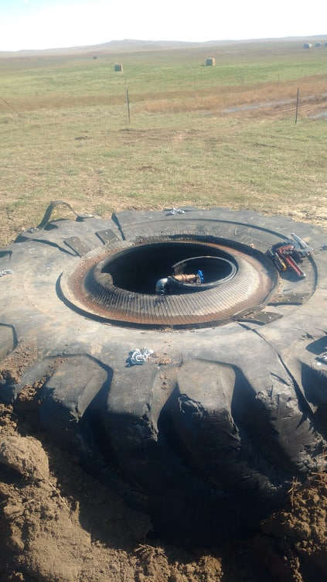
Water

Slide 16
Wind Protection

Slide 17
Fencing

Slide 18
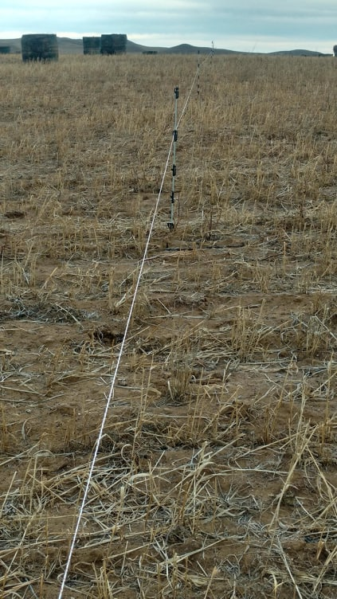

Slide 19
Bale Grazing

Slide 20
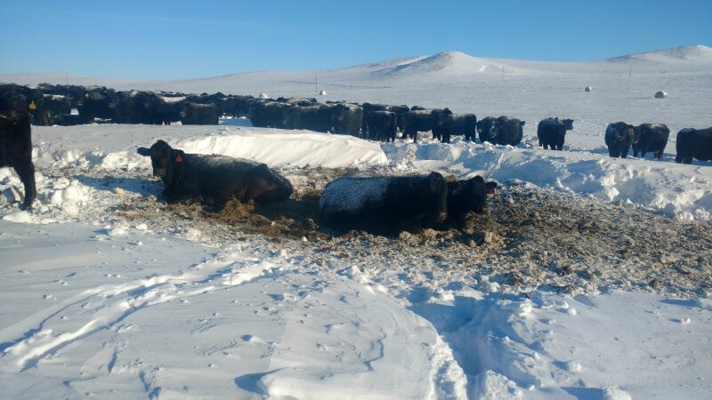

Slide 22
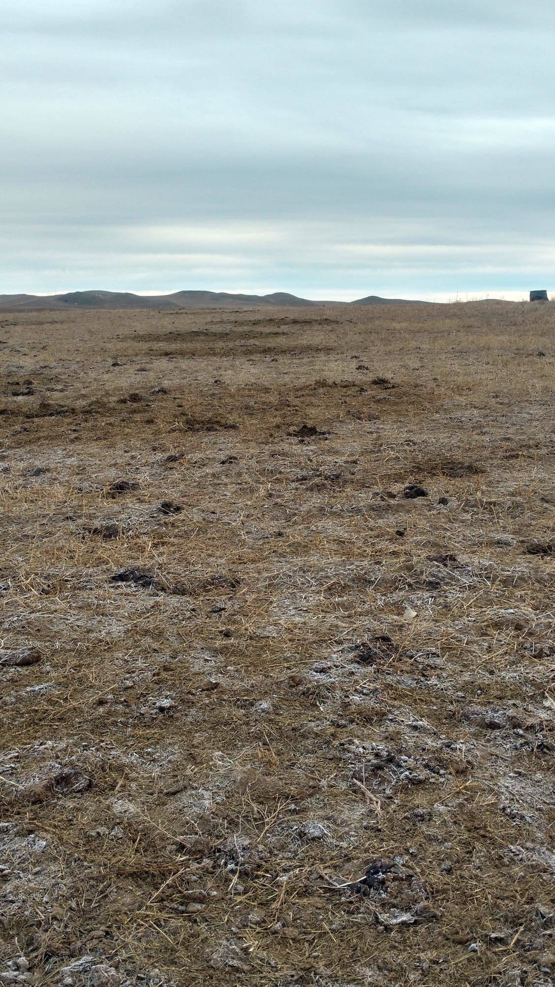

Slide 23
Nutrient Response of Soil
0-6” | Cover Crop Only | Bale Graze & Cover Crop (Direct Impact) | Bale Graze & Cover Crop (Indirect Impact)
pH | 7.6 | 6.7 | 6.2
NO3-N (lb/ac) | 4 | 74 | 4
OM (%) | 2.9 | 2.9 | 2.9
P (ppm) | 4 | 13 | 4
K (ppm) | 201 | 790 | 280
Soluble Salts (mmhos/cm) | 0.27 | 0.36 | 0.13
Zn (ppm) | 0.5 | 1.8 | 0.8
Mn (ppm) | 25.3 | 67.2 | 19.4
Cu (ppm) | 0.4 | 1.0 | 0.5
SO4-S (lb/ac) | 8 | 26 | 3
Cl (lb/ac) | 10.4 | 18.3 | 14.3

Slide 24
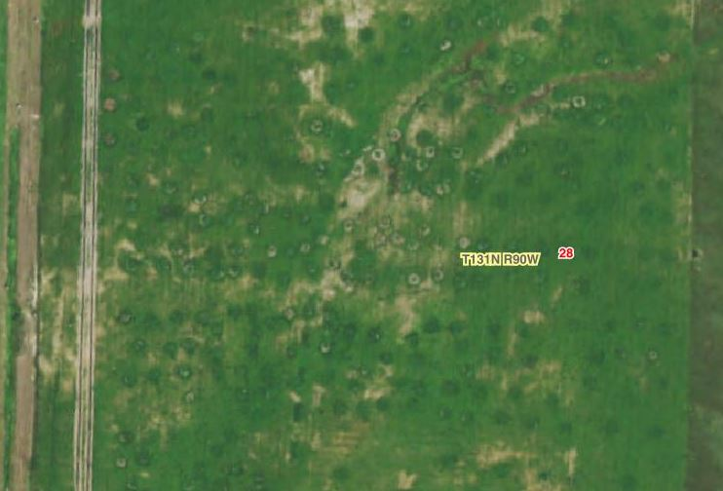
2019

Slide 26
Outreach Efforts
Focused on a mix of traditional & non-traditional producers
Emphasis of on-farm demonstrations, located near highway
A need persists to reach producers that do not participate in traditional outreach efforts

Slide 27
Moving Forward
Expand bale grazing to renovate more acres (ie. pasture)
Continue to improve management to reduce labor & costs
Residue management
Consider multi-species grazing
Incorporation of bi-products?
Straw windbreaks?

Slide 28
Questions?
Erin & Drew Gaugler, FNC18-1123
NCR-SARE’s Farmers Forum, 2020

