Slide 1
Bat Researcher for a Day!

Slide 2
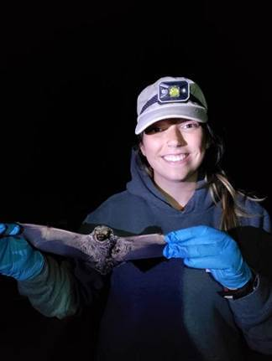
Lead Bat Researcher Hanna Karevold Edens Assistants [Insert Names]

Slide 3
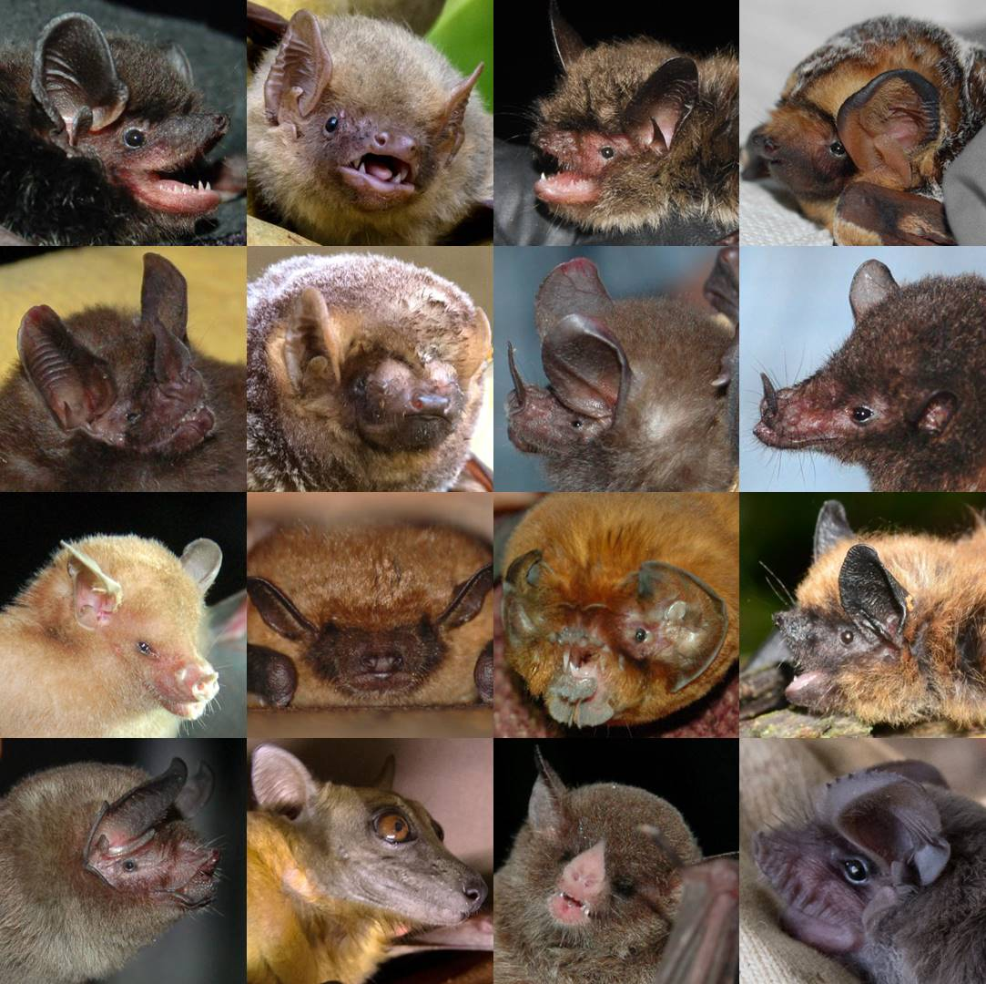
TEST YOUR BAT KNOWLEDGE???
ARE BATS….
A) Birds
B) Reptiles
C) Mammals
D) Rodents
TRUE or FALSE
ALL bats use echolocation?
How many different bat species are found in North Dakota?

Slide 4
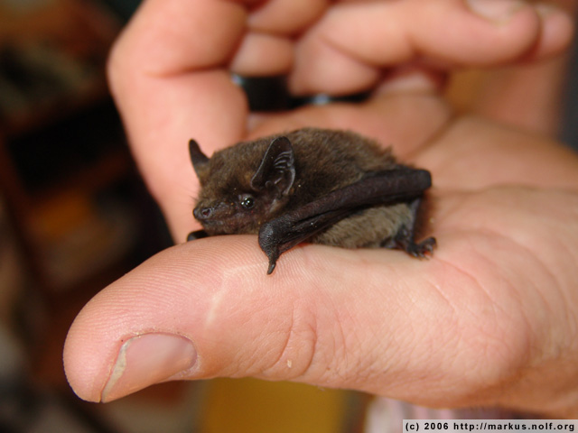
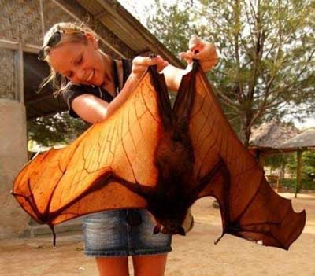
One of Most Diverse Mammalian Groups
Second only to rodents for number of known species
There are approximately 1,400 species of living bats, making up ~20% of all known living mammal species
Bumblebee Bat
Craseonycteris thonglongyai
2g
Giant Golden-Crowned Flying Fox
Acerodon jubatus
1090g (2.5 lbs)

Slide 5
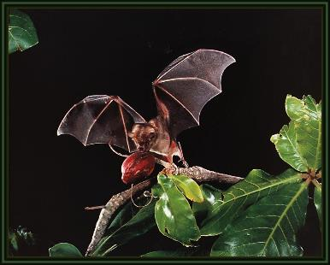
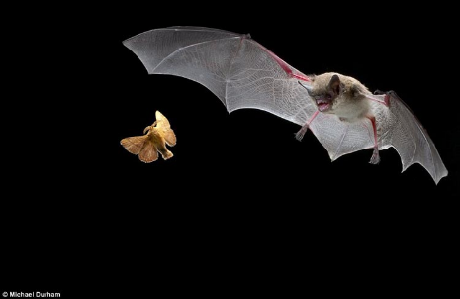
Do all bats Echolocate?
Megachiroptera (Old World Fruit Bats)
Roughly 200 species
Feed primarily on plant material
Unable to ecolocate
Found only in the tropical and subtropical areas.
Microchiroptera (echolocating bats)
Roughly 1200 species
Great variety of diets including insects, frogs, fish, blood, other bats
Use ecolocation
Broad geographic distribution (Nearly everywhere except Arctic/polar regions and some isolated oceanic islands)

Slide 6
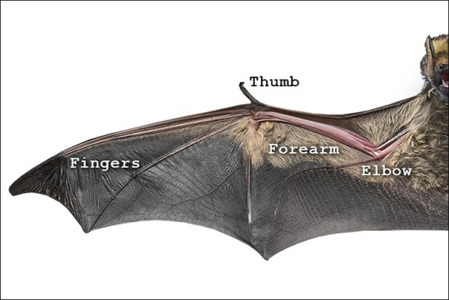
Only Mammal With True Wings And Flight
Wings are a modification of a forelimb

Slide 7
Bat Anatomy

Slide 9
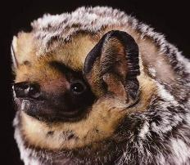
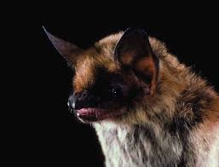
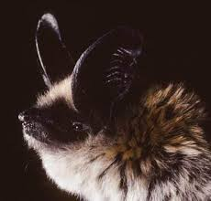
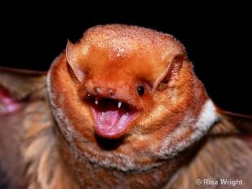
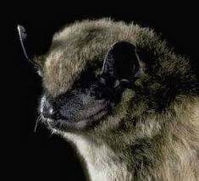
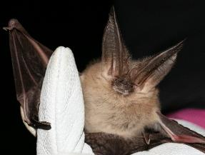
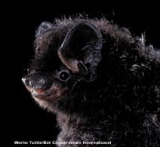
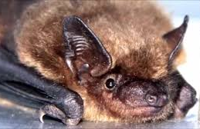
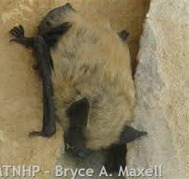
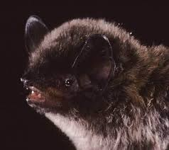
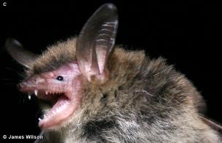
Bats of
North Dakota
There are 11 different species!

Slide 10
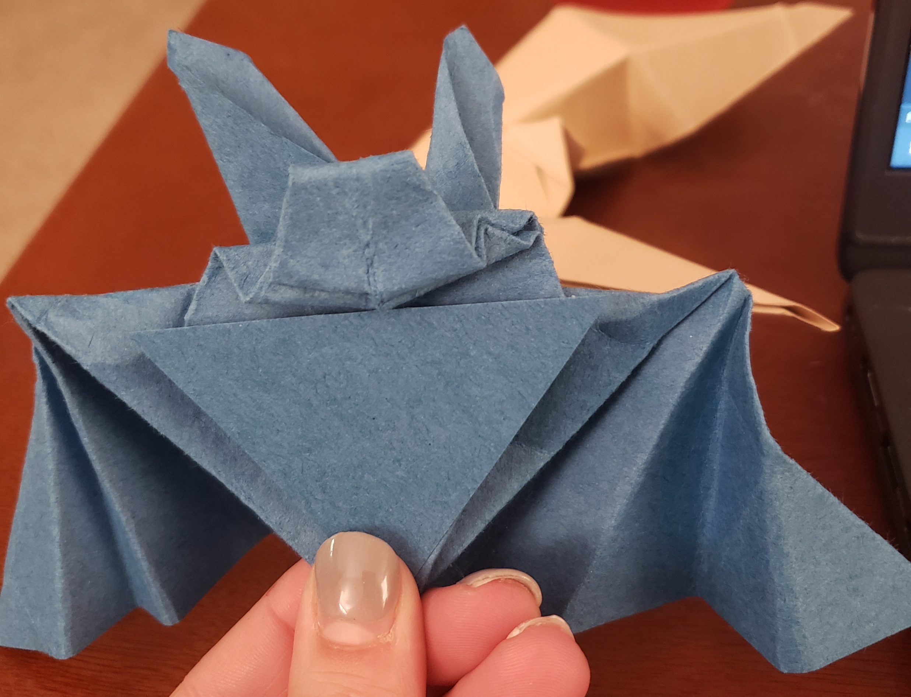
ORIGAMI BATS!!!

Slide 11
TO THE FIELD! But First….

Slide 12
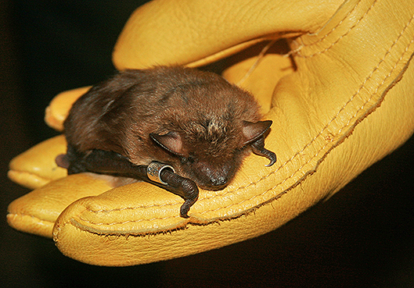
Researcher Safety While Handling Bats
Safety of the researchers is extremely important!
Never handle bats or other wild animals…
*Leave it to the Professionals*
Rabies shots and boosters
Leather gloves
Coveralls or Tyvek suits
N95 masks

Slide 13
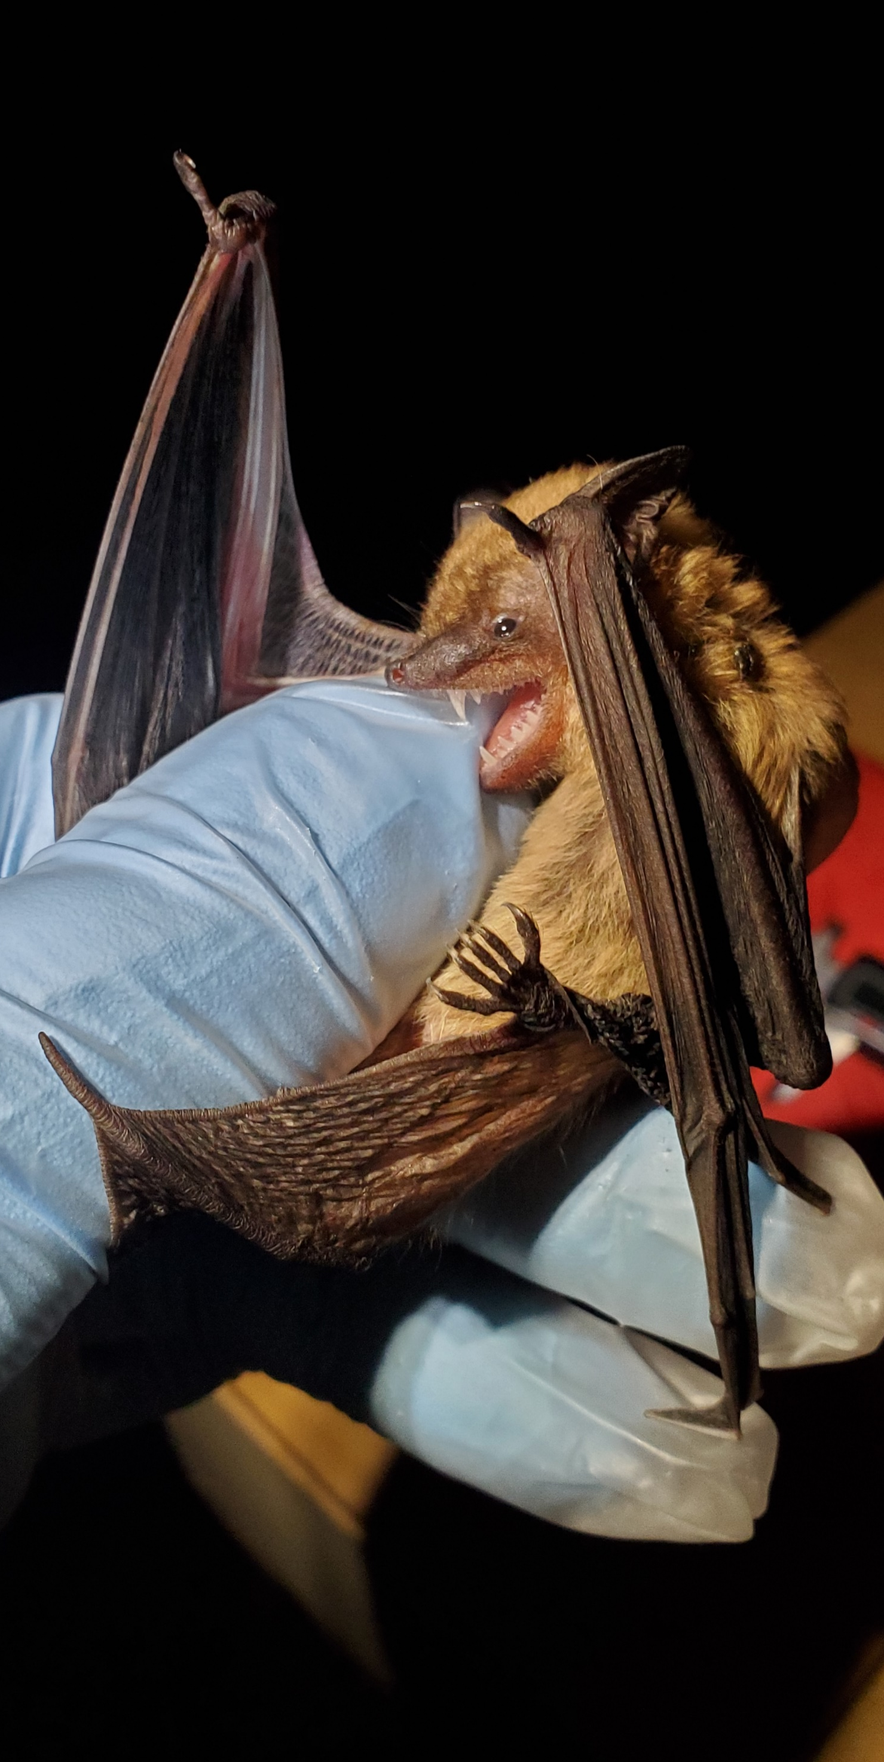
Bat Safety During Research
The health and safety of the bats is equally important!
Holding bags – clean, breathable cotton
Health checks, food, and water
Disinfecting tools and work surfaces
Nitrile gloves over leather gloves

Slide 14
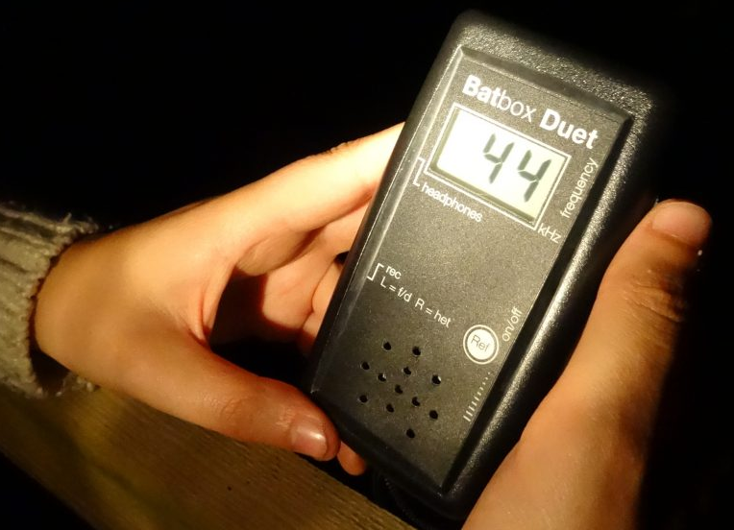
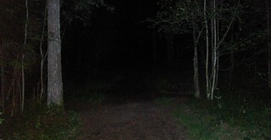
How Do Scientists Catch Bats In The Field?
Find good sites
→ bats need places to live and access to water
Bat detectors
→ allow the user to hear bat calls

Slide 15
You Found a Site… Now What? Start by taking general Field Notes in your Research Notebook E.g., Date, Time, Location, Weather

Slide 16
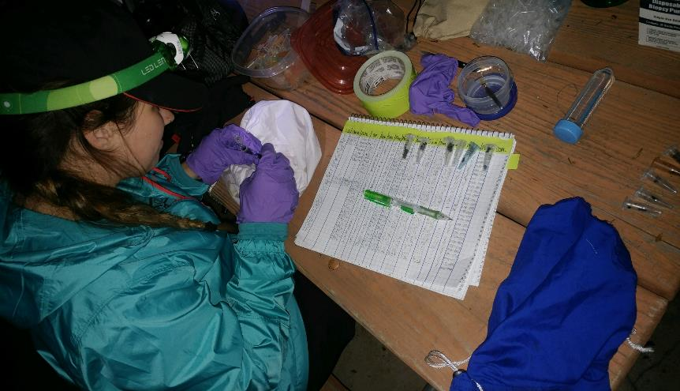
Data Is Recorded in a Field Notebook!!

Slide 17
Handwritten Data is Later Typed into Spreadsheets

Slide 18
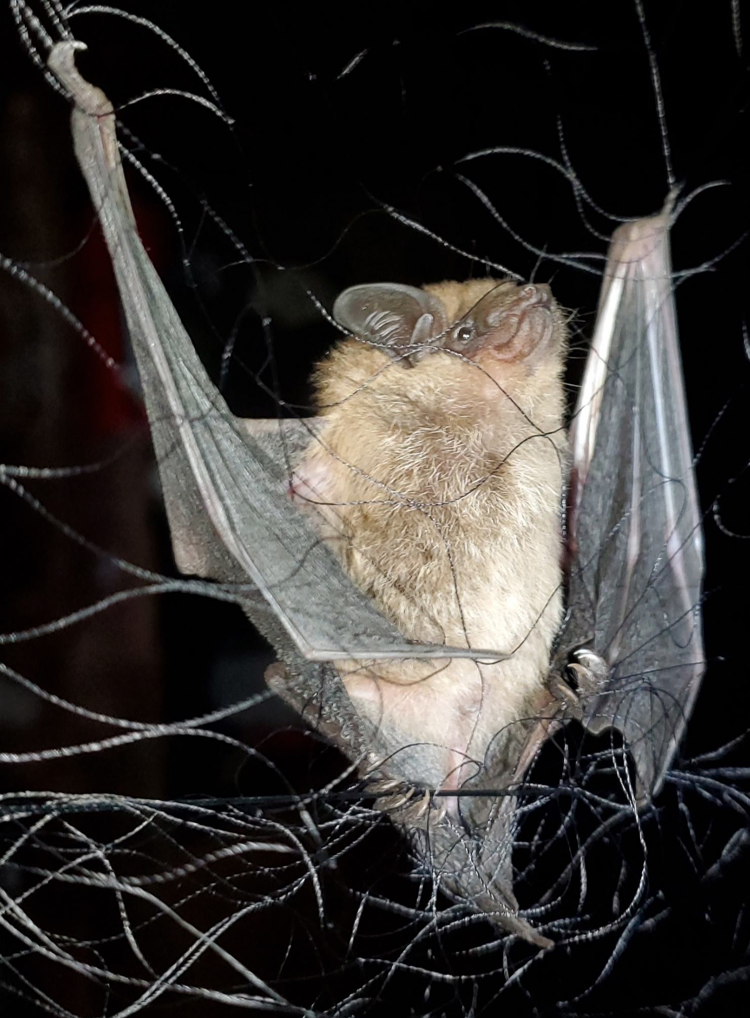
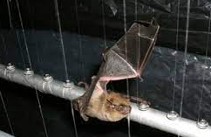
How Do Scientists Catch Bats In The Field?
. Use nets or traps to catch bats
Mist nets
Harp traps
Hand nets

Slide 19
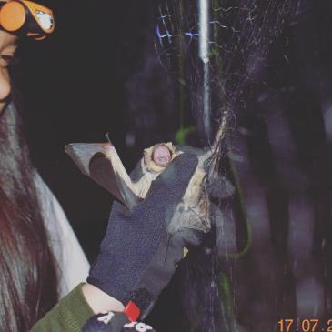
Let’s Catch Some Bats!!!!

Slide 20
How Do Scientists Collect Data?
Spring scale
Mass → Grams (g)

Slide 21
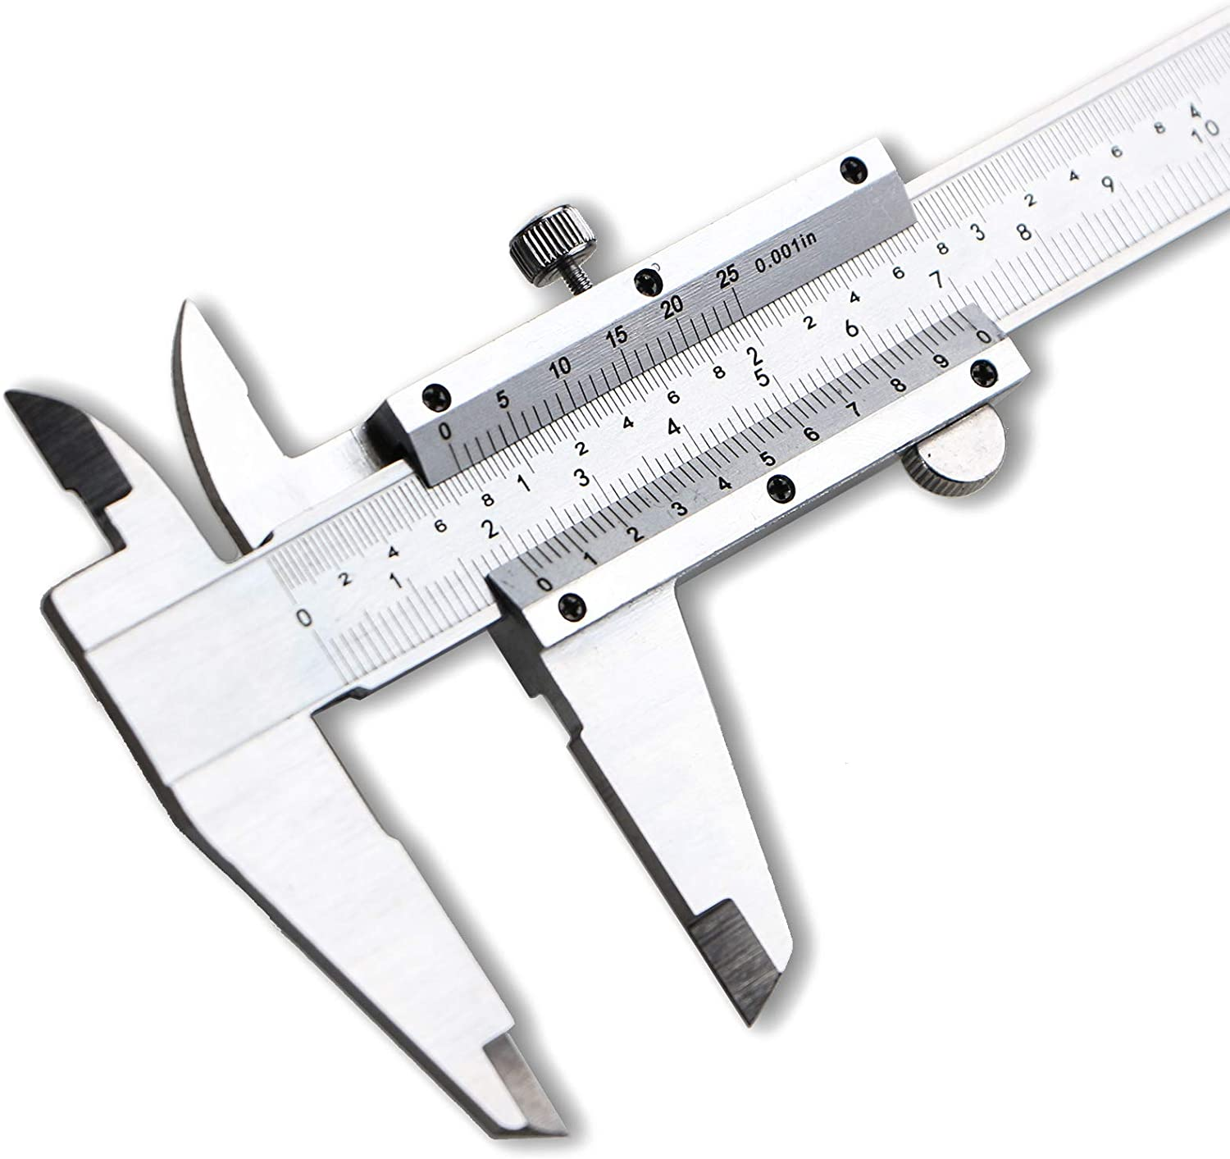
How Do Scientists Collect Data?
Calipers (or a Ruler)
Length
Millimeters

Slide 22
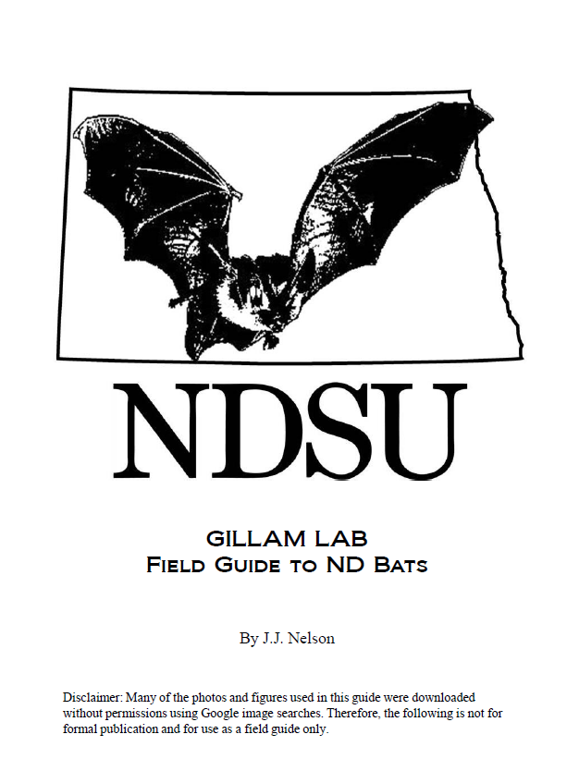
Identifying Bat Species and Age
5-bonus points to anyone who can identify an issue with this photo…

Slide 23
DATA COLLECTION
ID | Bat Species | Age (Adult (A) or Juvenile (J)) | Mass (g) | Forearm Length (mm)
A | MYLU | A | 7.5 | 36

Slide 24
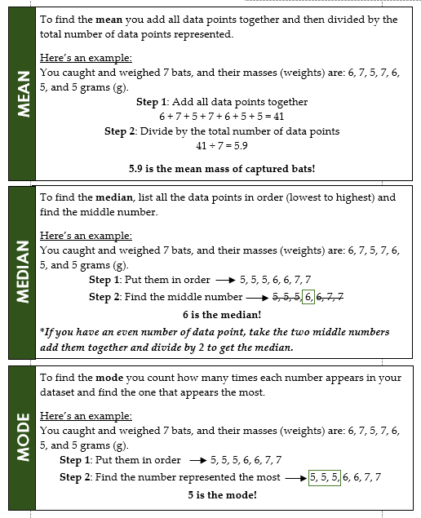
Statistical Analysis
Determine the MEAN, MEDIAN, & MODE of our dataset!

Slide 25
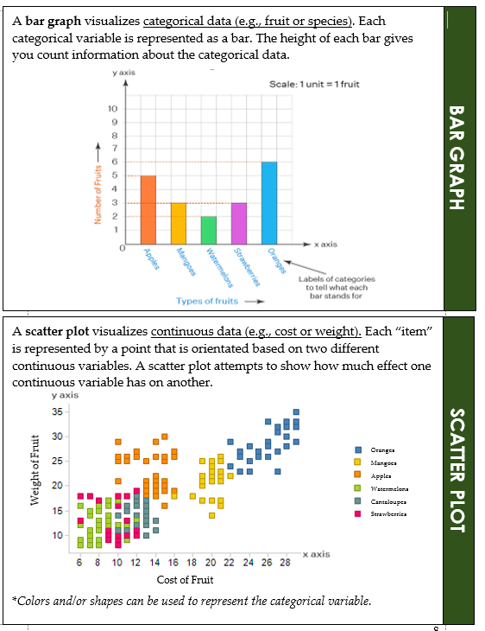
Data Visualization
Can you visually represent the dataset?

