Slide 1
WEST VIRGINIA BEGINNING FARMER ON-FARM MENTORSHIP PROGRAM This material is based upon work supported by the National Institute of Food and Agriculture, U.S. Department of Agriculture, through the Northeast Sustainable Agriculture Research and Education program under subaward number SNE20-014-WV Dee Singh-Knights, Ph.D. Associate Professor and Extension Specialist, and NESARE State Coordinator Agribusiness Economics and Management, West Virginia University dosingh-knights@mail.wvu.edu 304-293-7606
Notes:
Welcome to the 2020 West Virginia Annie’s Project; Agribusiness Business Planning and Risk Management Training for Women.
All materials in this course are for the expressed purpose of the WV Annie’s Project.
Any unauthorized use or dissemination of these materials is a violation of the WVU Extension Services copyright laws. Please contact Dee Singh-Knights using the information above for more information

Slide 2
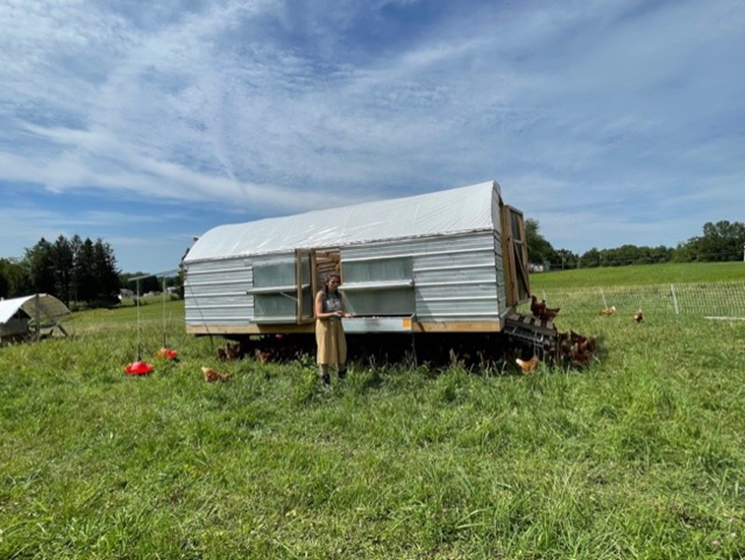
WEST VIRGINIA BEGINNING FARMER ON-FARM MENTORSHIP PROGRAM
Pike Mountain Farm, Preston County, WV
A CURRICULUM GUIDE TO DEVELOPING OR IMPROVING ON-FARM MENTORSHIP PROGRAMS

Slide 3
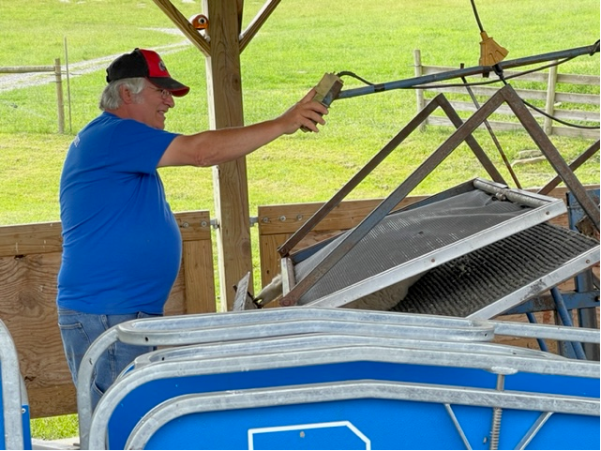
WEST VIRGINIA BEGINNING FARMER ON-FARM MENTORSHIP PROGRAM Introductory Presentation to Accompany WV Beginning Farmer On-Farm Mentorship Program
Mark Teets, Owner, Snowy Creek Dorsets, Preston County, WV
Notes:
Welcome to the 2020 West Virginia Annie’s Project; Agribusiness Business Planning and Risk Management Training for Women.
All materials in this course are for the expressed purpose of the WV Annie’s Project.
Any unauthorized use or dissemination of these materials is a violation of the WVU Extension Services copyright laws. Please contact Dee Singh-Knights using the information above for more information

Slide 4
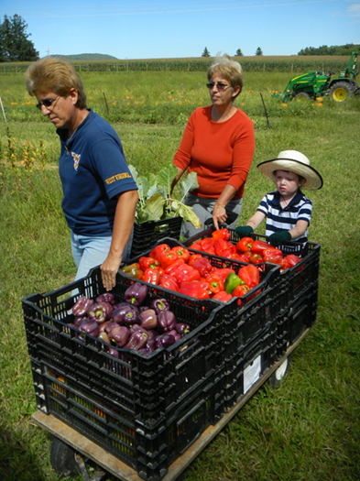
BEGINNING FARMER AND ON-FARM MENTORSHIP PROGRAM WHY a Beginning Farmer and Mentorship Program in WV?
Over the last decade, WV farmland has declined by 72% and agriculture’s contribution to GDP fell by 25%, with WV experiencing high levels of unemployment (7.3%).
Beginning farmers can play a catalytic role in strengthening WV’s agribusinesses.
WV has experienced a significant decline in the number of producers (10% between 2012 and 2017)
Currently, for each principal operator under 35 years old, there are 7 over 65 (USDA, 2017).
With almost half of WV farmers projected to retire in the next 10 years, WV urgently needs to grow new farmers.
Vested Heirs Farm, Terra Alta, WV
Notes:
My contributions to this project is to help you to understand the business side of farming.
I know you have all hear the usual farm jokes – ‘I farm so that is why I have a fulltime day job’, or ‘that’s the nature of farming, sometimes you, win sometimes you lose’. And because of this way of thinking, managing the farm as a business is not at the top of the ‘to-do’ list for the majority of farm managers.
Most people would agree that ‘farming is a risky business, and yet, farm managers are among the least prepared to manage risks.
So my purpose in this project is to help you to understand why you need to approach farming differently, and how to do that.

Slide 5
BEGINNING FARMER AND ON-FARM MENTORSHIP PROGRAM
Overall Beginning Farmer Program Goals: Enhancing agribusiness sustainability through business planning and risk management.
Core Values:
The business side of agribusinesses
The big picture - holistic or whole-farm perspective
Sustainability in agribusinesses:
Profits, People, Planet
Experiential Learning – Active and applied hands-on education in real farm/business settings.
Small and Medium-Sized Operations – Geared towards smaller operations that produce high value specialty crops and/or livestock for retail and direct market.
Beginning with the End in Mind!
Dwight Eisenhower: “In preparing for battle I have always found that plans are useless, but planning is indispensable.”
Notes:
This mentorship guide assumes the following core values of the mentorship program and the wider beginning farmer program, which it supplements:
Mentorship – Providing support to mentors able and willing to share their experience and expertise through on farm education to beginning farmers.
Community – Focused on building place-based knowledge and forming community connections.
Experiential Learning – Active and applied hands-on education in real farm and business settings.
Whole Farm Systems – Framing all decision making for personal, farm, and business management through a whole systems lens (business planning and risk management).
Small and Medium-Sized Operations – Geared towards smaller operations that produce high value specialty crops and/or livestock for retail and direct market.

Slide 6
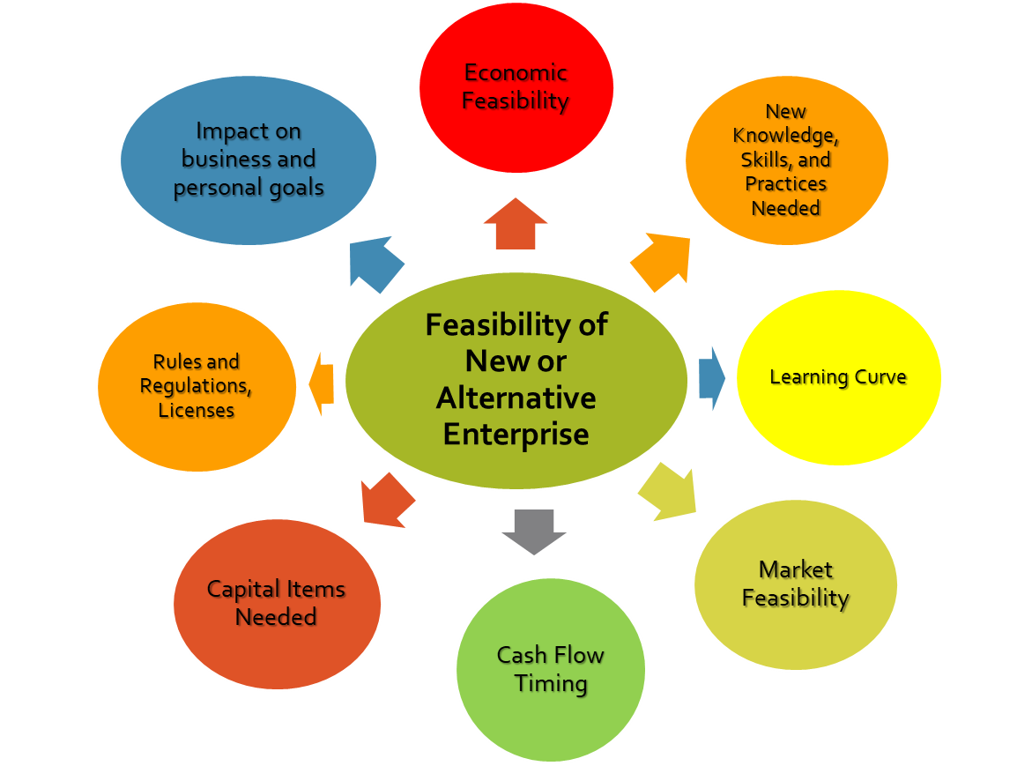
BEGINNING FARMER AND ON-FARM MENTORSHIP PROGRAM
Risk Management
Look before you leap!!
Notes:
As I said before, farming is RISKY business. All businesses are in fact; they all face risks.
Risk management is focused on thinking strategically and proactively about risks that the business will likely face, and applying appropriate strategies or action by which negative outcomes can be reduced.
And while we want producers to consider expanding, modifying or adding new enterprises to their current operations, we want you to consider all the risks, good and bad, that come with those changes.
So what are the things that can make or break a new enterprise? You have to be aware of these, and plan for them in advance. Such as……

Slide 7
BEGINNING FARMER AND ON-FARM MENTORSHIP PROGRAM Business Goals and Risk Management
Risk
Management for Profitability
Market Risk - Market Analysis and Feasibility
Financial Risk - Financial Analysis and Feasibility
Production Risk - Production and Management Changes
Legal Risk - Managing Legal Risks
Human Resource Risk - Human Resource Management
Notes:
Business Success and Risk Management go hand in hand. Thinking through the risks affecting your business will help you avoid skimming the surface, and look deeper into the actual risks facing your business.
But when we think of the myriad of risks that we face in our operations, it can be daunting and overwhelming. To make it make palatable for you, we focus on the five FUNCTIONAL AREAS of your business, and the risks that come along with each area. It is important to consider all the risks in your business – this ensures you are taking the ‘big-picture’ or ‘whole-farm’ or ‘holistic’ approach to managing your business. The ‘big-picture’ approach ensures you are considering everything that the business needs to be successful (Remember: the success of your business depends on more than just a good product).
And this process can be applied to any business - (agriculture or not; primary production or value-added; monoculture or diversified operations).
Managers should take a holistic approach to risk management, and avoid focusing on a single source of risk.
Holistic Farm Planning or Whole Farm Planning can be used by the farm family to balance their business goals and their family goals and quality of life; balancing production, profitability, and satisfying your consumers; and managing long-­term stewardship of your farm resources.
This course recognizes that Holistic Farm Planning and Risk Management in the five risk areas above is essential to improving the viability and profitability of the farming enterprise.

Slide 8
BEGINNING FARMER AND ON-FARM MENTORSHIP PROGRAM Agribusiness Performance Drivers - Understanding the BIG PICTURE
Assessing Potential
Resources and Inventory
Partners, Regulations, Licenses
Market Feasibility
Financial Feasibility
Target Market
Financial Plan
Marketing Plan
Human Resources Plan
Business Ideas
Farm/Food Safety and Liability
Vision, Mission and Goals
Notes:
As I said before, farming is RISKY business. All businesses are in fact; they all face risks.
Risk management is focused on thinking strategically and proactively about risks that the business will likely face, and applying appropriate strategies or action by which negative outcomes can be reduced.
And while we want producers to consider expanding, modifying or adding new enterprises to their current operations, we want you to consider all the risks, good and bad, that come with those changes.
So what are the things that can make or break a new enterprise? You have to be aware of these, and plan for them in advance. Such as……

Slide 9
BEGINNING FARMER AND ON-FARM MENTORSHIP PROGRAM Training, Coaching, Mentoring – What’s the Difference?
METHOD | Emphasis / Focus | Relationship | Approaches | Outcomes
Training | Development of new skills Short term focus and input Refreshing old skills Technical or ‘soft’ focus | Highly transactional Short term few days ‘Teacher and pupils’ scenario Ownership is with trainer to impart skills | Trainer as expert Expert knowledge Trainer led Activities, discussions, role play, exercises Support primarily at time Goals identified as start of session and coaching intervention | Increased skill set Increased confidence in using skills Not always a plan of how to apply skills
Coaching | Develops existing skills Develop confidence Longer term focus and input Considers ‘how’ to achieve something Developing person not skill | Longer term, more transformational 4-6 sessions for 1-2 hours Ownership of actions is with learner | Learner as expert Learner with expert knowledge Questions and exploration by coach Experience, scenario, options and metaphor based | Increased application of skills Increased awareness of behaviors and impact Increased options of approaches Plan of approach often present Increased confidence
Mentoring | Mentor sharing their experience with learner Longer term development focus | Long term relationship Can be lifetime relationship Transformational Ownership with learner | Mentor as expert Mentor led Questions and exploration by mentor Experience based Evolving agenda over time | Increased clarity on direction, career, role or life Increased awareness Mentee led plan Increased confidence

Slide 10
CHALLENGES TO IMPLEMENTING EFFECTIVE MENTORING STRATEGIES
Making a match between mentors and mentees result in a productive exchange.
Geographic distance between mentors and mentees limits in-person time and can impact the ability to start or continue relationships
However when producers are not competing in the same market the mentor may be more likely to share more proprietary information.
Mentor farmers need support and to have a manageable number of engagements and level of commitments in order to make it sustainable for them, their family and their farms.
Mentor farmers have on-going needs for peer-to-peer learning.
Beginning farmers that are a few years into farming need to be connected with technical assistance that can help them address issues specific to their farm, markets and families.

Slide 11
BEST PRACTICES TO CONSIDER WHEN DESIGNING MENTORING PROGRAMS
Small groups of farmers forming mentoring pools
Asking established farmers to identify other farmers they think would be good mentors
Clarifying for others about mentoring strategies that your program uses
Farmers have a unique ability to share from their genuine experiences and this is important in building a relationship with beginning farmers
Create an identity for farmer networks
Mentors should be prepared to share their numbers with beginning farmers
Networking is a key element for a beginning farmer program

Slide 12
BEST PRACTICES TO CONSIDER WHEN DESIGNING MENTORING PROGRAMS (Continued)
Package mentoring with beginning farmer educational pathways (like farm planning training)
Develop diverse pools of mentors including food entrepreneurs.
Paying mentors for their time.
Put responsibility for initiating mentoring relationship on mentee (require them to call mentor every week and hold them accountable).
Tours of mentor and mentee farms for those participating each year.
Mentee applications are reviewed by potential mentors and includes a professional development plan. Mentors decide which mentor can best meet the mentees PD goals.

Slide 13
CONSIDERATIONS FOR DESIGNING THE OVERALL ON-FARM MENTORSHIP PROGRAM
It is important for the lead organization/agency to have a formal process to invite mentors and mentees to participate in the mentorship program, and for selecting the ‘best fit’ to ensure mentors and mentees are suitably matched.
A written application
A formal interview (see list of sample interview questions on page ---)
Conversations by e-mail, in person, or on the phone
Checking references
An on-site visit, a working visit, and a trial-period
List of participating farm and farm mentors
The role of the organization/agency facilitating the mentorship program
Benefits for farm mentors/host farms and mentees/aspiring or beginning farmer
Supports to be provide to all participants

Slide 14
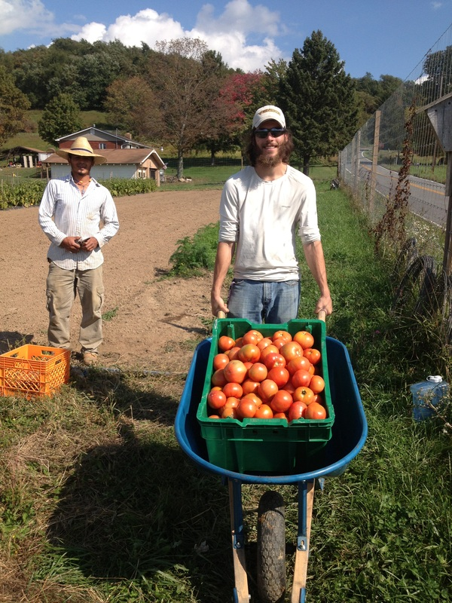
ON-FARM MENTORSHIP PROGRAM Hallmarks of a Successful On-Farm Mentorship Program
Communication
Managing Curiosity, Patience, and Consistency
Whole-Farm Outlook
Context – one farm
Anticipated Needs
Principles of Adult Education
Mountain Harvest Farm, LLC, Grafton, WV

Slide 15
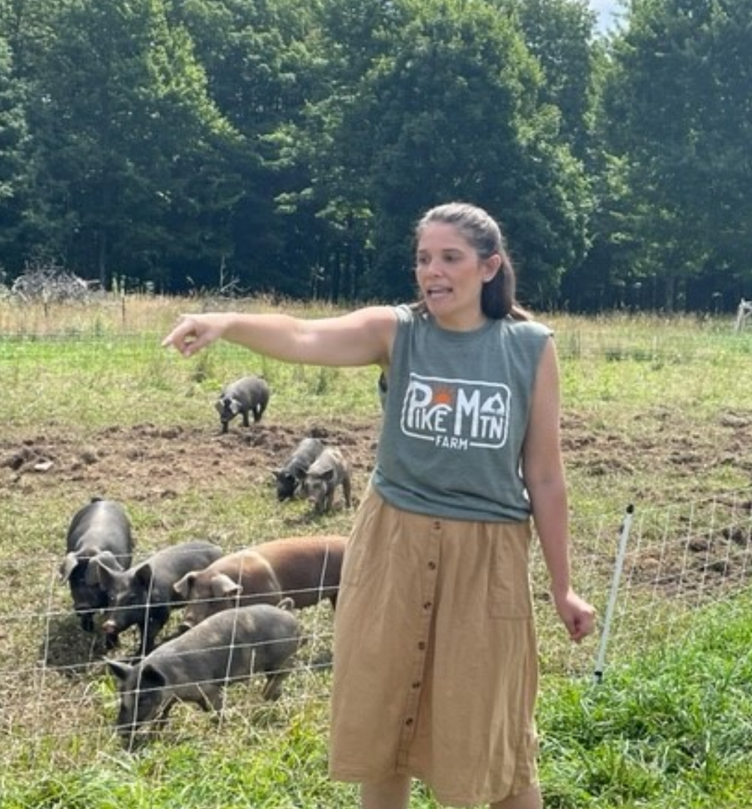
ON-FARM MENTORSHIP PROGRAM Principles of Adult Education
Make Content Relatable
Engage Positive Emotions
Autonomous and Self-Directed
Identify Mental Models
Provide Opportunities for Practice and Application
Respect
Goal-Oriented
Pike Mountain Farm, Terra Alta, WV

Slide 16
ON-FARM MENTORSHIP PROGRAM - (MENTEES) Benefits of Participation
Mentorship curriculum guide to better understand the expectations and requirements of the program
Beginning Farmer Training Program to complement the mentorship program and on-farm learning
Provide on-farm orientations for mentees with the host farm
Facilitate a group orientation between mentees and on-farm mentors to encourage ‘match-making’
Facilitate networking with other local producers, where appropriate
Facilitate on-farm evaluation sessions to help ensure successful experience for participants
Provide ongoing check-ins and support during the program season
Provide certification to participants upon program completion
Provide opportunities for college credits for program participants, where appropriate
Coordinate an alumni network of beginning farmers (Beginning Farmer Success Academy)
Notes:
Access to mentorship curriculum guide, program objectives, checklists, task analysis sheets and related assessment/evaluation forms, to better understand the expectations and requirements of the program
Access to the overall Beginning Farmer Training Program to complement the mentorship program and on-farm learning
Provide on-farm orientations for mentees with the host farm
Facilitate a group orientation between mentees and on-farm mentors to encourage ‘match-making’
Facilitate networking with other local producers, where appropriate
Facilitate on-farm evaluation sessions to help ensure successful experience for participants
Provide ongoing check-ins and support during the program season
Provide certification to participants upon program completion
Provide opportunities for college credits for program participants, where appropriate
Coordinate an alumni network of beginning farmers (Beginning Farmer Success Academy)

Slide 17
ON-FARM MENTORSHIP PROGRAM - (MENTEES) Are you a Good Fit?
How familiar are you with on-farm work (planning, management, physical labor, etc.)?
Describe your working style – some options may include:
Do you prefer to work alone or on a team?
Do you like a lot of instruction and guidance, or do you prefer to observe and try things on your own?
Do you prefer to start and end early or take frequent breaks?
What have been your favorite jobs?
How do you prefer to give and receive feedback?
How do you handle challenging situations? How do you learn from these experiences?
Are you able to commit to the time requirements of the program and the expectation of the host farm? What challenges do you see in this area? Are there any limitations we should be aware of?
What are you short, medium and long-term agriculture business goals?
What type of interaction are you expecting with the host farmer prior to the program?
Notes:
Access to mentorship curriculum guide, program objectives, checklists, task analysis sheets and related assessment/evaluation forms, to better understand the expectations and requirements of the program
Access to the overall Beginning Farmer Training Program to complement the mentorship program and on-farm learning
Provide on-farm orientations for mentees with the host farm
Facilitate a group orientation between mentees and on-farm mentors to encourage ‘match-making’
Facilitate networking with other local producers, where appropriate
Facilitate on-farm evaluation sessions to help ensure successful experience for participants
Provide ongoing check-ins and support during the program season
Provide certification to participants upon program completion
Provide opportunities for college credits for program participants, where appropriate
Coordinate an alumni network of beginning farmers (Beginning Farmer Success Academy)

Slide 18
ON-FARM MENTORSHIP PROGRAM - (MENTEES) Other Considerations for Both Mentors and Mentees
Time Management
Meals and Consumables
Schedule
Meetings
Questions and Feedback
Education
Dress Code – clothing, jewelry
Cell Phone Use, Photos, Videos
Visitors
Smoking, Vaping, Alcohol, Drug Policy
Privacy
Confidentiality
Farm Etiquette and Behavior
Independence vs Hand-Holding
Communication beyond Program
Other?
Other?
Notes:
Access to mentorship curriculum guide, program objectives, checklists, task analysis sheets and related assessment/evaluation forms, to better understand the expectations and requirements of the program
Access to the overall Beginning Farmer Training Program to complement the mentorship program and on-farm learning
Provide on-farm orientations for mentees with the host farm
Facilitate a group orientation between mentees and on-farm mentors to encourage ‘match-making’
Facilitate networking with other local producers, where appropriate
Facilitate on-farm evaluation sessions to help ensure successful experience for participants
Provide ongoing check-ins and support during the program season
Provide certification to participants upon program completion
Provide opportunities for college credits for program participants, where appropriate
Coordinate an alumni network of beginning farmers (Beginning Farmer Success Academy)

Slide 19
ON-FARM MENTORSHIP PROGRAM (MENTORS AND MENTEES)
To Be Provided as Part of Mentorship Program
Worksheet 1: To determine whether person is good candidate for BF Mentorship Program.
Worksheet 2: Questions for Mentor Interview Process
Worksheet 3: Questions for Mentee Interview Process
Worksheet 4: Developing a Farm Policy – A Checklist
Worksheet 5: DACUM Task Analysis Checklists – Entrepreneurship and Business Management Skills
Worksheets 6-15: DACUM Task Analysis Checklists – Specific Commodity Areas
Worksheet 16: Evaluations Form – Farm Mentor (In Progress)
Worksheet 17: Evaluation Form – Farm Mentee (In Progress)
Worksheet 18: Evaluation Form – Partner Agency/Organization and Host Organization (In Progress)
Notes:
Our team at WVU will be in touch with each mentor-mentee pair for the specific commodities to discuss the skill-sets and task analysis sheets.
Also to do evaluation – regular so any improvements can be made in time to benefit the experience for both parties.

Slide 20
ON-FARM MENTORSHIP PROGRAM - (MENTORS) Benefits of Participation
Access to highly motivated aspiring and beginning farmers, with or without experience
Willing mentees that will learn while contributing with farm tasks
Logistical and administrative support from lead organization/agency
Training for farm mentors in mentorship, communication, equity & inclusion
Access to mentorship curriculum guide, program objectives, checklists, task analysis sheets and related assessment/evaluation forms to use to enhance the effectiveness of the mentorship experience, for mentors and mentees.
A supportive network of peer farmer mentors to share experiences, best practices, and lessons learned.
Access to educational events that are part of the overall Beginning Farmer Training Program
Assistance with interpretation of applicable labor and employment laws
Notes:
Access to mentorship curriculum guide, program objectives, checklists, task analysis sheets and related assessment/evaluation forms, to better understand the expectations and requirements of the program
Access to the overall Beginning Farmer Training Program to complement the mentorship program and on-farm learning
Provide on-farm orientations for mentees with the host farm
Facilitate a group orientation between mentees and on-farm mentors to encourage ‘match-making’
Facilitate networking with other local producers, where appropriate
Facilitate on-farm evaluation sessions to help ensure successful experience for participants
Provide ongoing check-ins and support during the program season
Provide certification to participants upon program completion
Provide opportunities for college credits for program participants, where appropriate
Coordinate an alumni network of beginning farmers (Beginning Farmer Success Academy)

Slide 21
ON-FARM MENTORSHIP PROGRAM - (MENTORS) Qualities of Good Mentors
They encourage respect and realism for what it takes to make farming a career
They are upfront about the benefits and challenges of small-scale, “sustainable” farming/entrepreneurship as a vocation or career
They encourage respect for the three pillars of sustainability – profitability, environmental stewardship, and community connections and cooperation
They model and teach others to work efficiently and effectively
They work to develop mentoring relationships based on mutual trust and respect, with clearly defined boundaries
They nurture trainee self-development
They help create and maintain a positive, equitable, and healthy learning environment, setting a respectful tone, and addressing conflicts.
Notes:
Access to mentorship curriculum guide, program objectives, checklists, task analysis sheets and related assessment/evaluation forms, to better understand the expectations and requirements of the program
Access to the overall Beginning Farmer Training Program to complement the mentorship program and on-farm learning
Provide on-farm orientations for mentees with the host farm
Facilitate a group orientation between mentees and on-farm mentors to encourage ‘match-making’
Facilitate networking with other local producers, where appropriate
Facilitate on-farm evaluation sessions to help ensure successful experience for participants
Provide ongoing check-ins and support during the program season
Provide certification to participants upon program completion
Provide opportunities for college credits for program participants, where appropriate
Coordinate an alumni network of beginning farmers (Beginning Farmer Success Academy)

Slide 22
ON-FARM MENTORSHIP PROGRAM - (MENTORS) Are you a Good Fit – Questions for Self-Assessment?
Who were the mentors who helped you throughout your life? How and why were they mentors to you?
What prior experience do you have as an educator or mentor?
Why do you want to personally mentor a beginning rancher or farmer?
What skills and personal qualities will best serve as strengths in your role as a mentor?
What aspects of your personality will be challenged by the role of mentor?
Mentor/apprentice relationships provide mutual learning opportunities. What are you excited to learn from a mentee?
How comfortable will you be accepting critique, criticism, or suggestions from an apprentice?
How flexible are you in adapting your daily routine, work schedule, and operation to include a mentee?
How will you check in with the intern/apprentice to assess their learning?
Do you have the experience and expertise to provide a valuable education to an intern/apprentice?
Can you serve as an advisor/mediator as well as educator?
Notes:
Access to mentorship curriculum guide, program objectives, checklists, task analysis sheets and related assessment/evaluation forms, to better understand the expectations and requirements of the program
Access to the overall Beginning Farmer Training Program to complement the mentorship program and on-farm learning
Provide on-farm orientations for mentees with the host farm
Facilitate a group orientation between mentees and on-farm mentors to encourage ‘match-making’
Facilitate networking with other local producers, where appropriate
Facilitate on-farm evaluation sessions to help ensure successful experience for participants
Provide ongoing check-ins and support during the program season
Provide certification to participants upon program completion
Provide opportunities for college credits for program participants, where appropriate
Coordinate an alumni network of beginning farmers (Beginning Farmer Success Academy)

Slide 23
ON-FARM MENTORSHIP PROGRAM - (MENTORS) Other Considerations for Both Mentors and Mentees
Time Management
Meals and Consumables
Schedule
Meetings
Questions and Feedback
Education
Dress Code – clothing, jewelry
Cell Phone Use, Photos, Videos
Visitors
Smoking, Vaping, Alcohol, Drug Policy
Privacy
Confidentiality
Farm Etiquette and Behavior
Independence vs Hand-Holding
Communication beyond Program
Other?
Other?
Notes:
Access to mentorship curriculum guide, program objectives, checklists, task analysis sheets and related assessment/evaluation forms, to better understand the expectations and requirements of the program
Access to the overall Beginning Farmer Training Program to complement the mentorship program and on-farm learning
Provide on-farm orientations for mentees with the host farm
Facilitate a group orientation between mentees and on-farm mentors to encourage ‘match-making’
Facilitate networking with other local producers, where appropriate
Facilitate on-farm evaluation sessions to help ensure successful experience for participants
Provide ongoing check-ins and support during the program season
Provide certification to participants upon program completion
Provide opportunities for college credits for program participants, where appropriate
Coordinate an alumni network of beginning farmers (Beginning Farmer Success Academy)

Slide 24
ON-FARM MENTORSHIP PROGRAM (MENTORS AND MENTEES)
To Be Provided as Part of Mentorship Program
Worksheet 1: To determine whether person is good candidate for BF Mentorship Program.
Worksheet 2: Questions for Mentor Interview Process
Worksheet 3: Questions for Mentee Interview Process
Worksheet 4: Developing a Farm Policy – A Checklist
Worksheet 5: DACUM Task Analysis Checklists – Entrepreneurship and Business Management Skills
Worksheets 6-15: DACUM Task Analysis Checklists – Specific Commodity Areas
Worksheet 16: Evaluations Form – Farm Mentor (In Progress)
Worksheet 17: Evaluation Form – Farm Mentee (In Progress)
Worksheet 18: Evaluation Form – Partner Agency/Organization and Host Organization (In Progress)
Notes:
Our team at WVU will be in touch with each mentor-mentee pair for the specific commodities to discuss the skill-sets and task analysis sheets.
Also to do evaluation – regular so any improvements can be made in time to benefit the experience for both parties.

Slide 25
WEST VIRGINIA BEGINNING FARMER ON-FARM MENTORSHIP PROGRAM
Overall Beginning Farmer Program Goals: Enhancing agribusiness sustainability through business planning and risk management
Dee Singh-Knights, Ph.D.,
Associate Professor and Extension Specialist, and NESARE State Coordinator
Agribusiness Economics & Management,
West Virginia University
304-293-7606, Dosingh-knights@mail.wvu.edu

