Slide 1
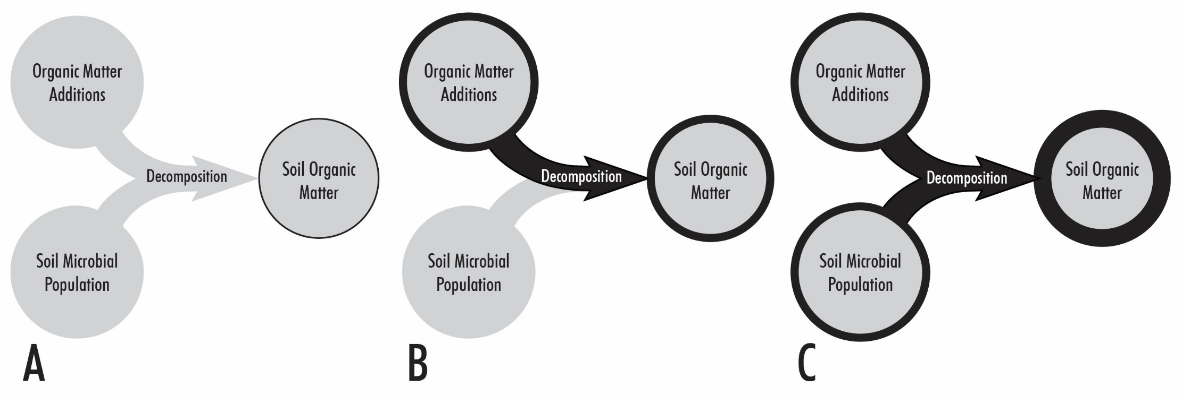
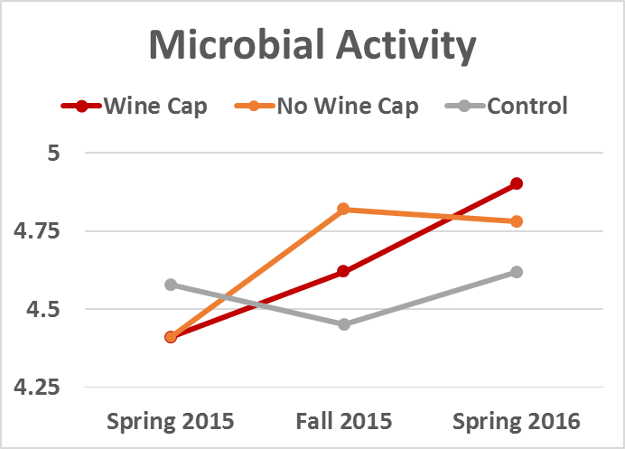
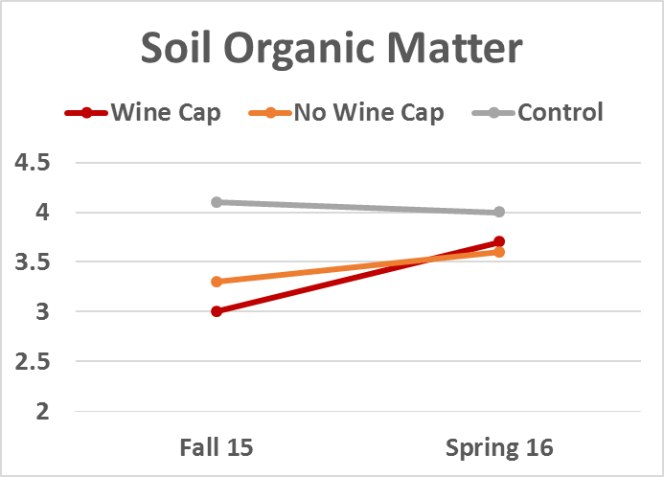
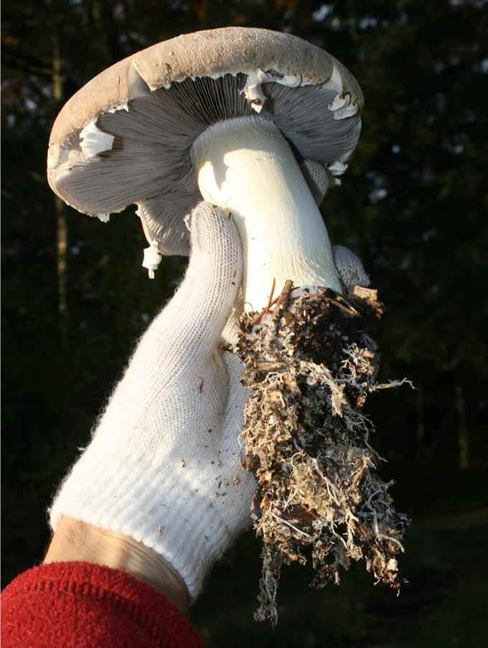
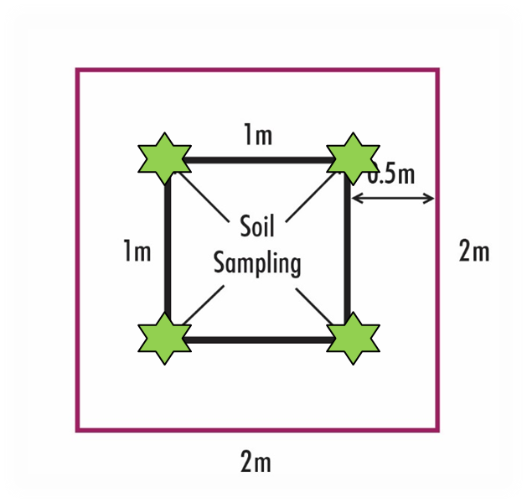
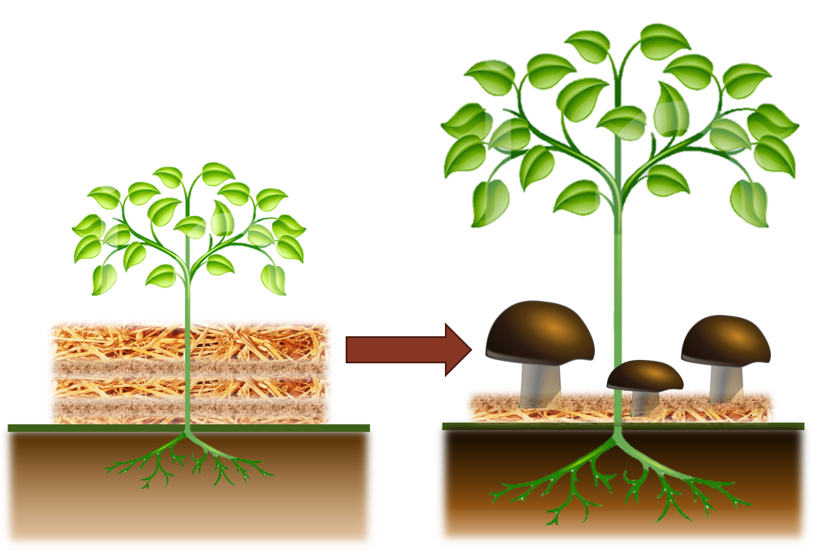
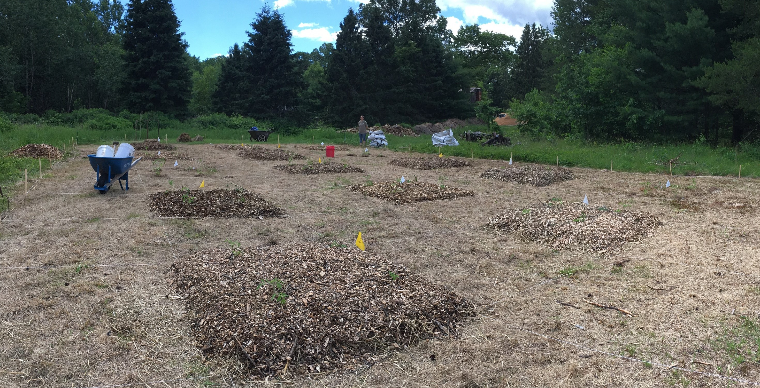
Cultivating the Wine Cap Mushroom while building soil health and suppressing plant disease – an innovative and economical approach to two common agricultural problems
Lindsey Bender
Field & Forest Products
Introduction:
Preliminary Results:
Plant productivity and growing success is highly dependable on soil health. Much of the North Central region is covered by sandy soils that have inherently low agricultural value due to both low organic matter and microbial activity. Options for amending soil organic matter include adding a variety of materials from finished compost to raw organic amendments, but these options can be costly, labor intensive, or slow to cause a measurable increase. Plant disease has a direct negative impact on grower economics and is especially problematic in low-quality sandy soils. Biological control of soil-borne plant pathogens is a potential alternative to the traditional use of sometimes unfavorable chemical pesticides, but criticisms of biopesticides include the organism’s speed of action, ecological fitness and persistence in the environment, and application (Butt and Copping 2000). The Wine Cap fungus, Stropharia rugoso-annulata (SRA), is an edible specialty mushroom that excels at rapid decomposition of straw and woodchips (Ukoima et al. 2009, Bruhn et al. 2010). It is also an ideal biopesticide candidate because it is nonpathogenic, conditioned for vigorous outdoor cultivation, and easy to grow. This research evaluates an innovative, accelerated strategy using Wine Cap mushroom beds to improve soil health, suppress plant disease, and supplement grower income by providing a unique mushroom cash crop (Figures 1 & 2).
Benefits of Wine Cap Mushroom:
This grant is still in progress through Fall 2018 so final results are not available. A pilot study carried out 2014-2016 yielded preliminary data which supports the hypothesis 1 of this study (Figure 5).
Figure 5. Data from a preliminary study in 2014-2016 demonstrated that the greatest increase in microbial activity and soil organic matter was measured in treatment plots planted with the Wine Cap fungus compared to control plots.
Figure 1. Background soil organic matter levels are due to native microorganisms decomposing existing organic material (A). Increasing soil organic matter is typically done by adding organic material to the soil for decomposition by native soil microorganisms (B). This long-term process can be expedited and amplified by adding a decomposition specialist fungus, Stropharia rugoso-annulata, to the organic material addition (C).
Discussion:
Hypotheses:
This research evaluates an innovative, accelerated strategy using Wine Cap mushroom beds to improve soil health, suppress plant disease, and supplement grower income by providing a unique mushroom cash crop.
Economically grown on readily available organic materials and agricultural byproducts
Easily companion planted in areas already being utilized or for preparing new beds
Enhancement of soil organic matter, water holding capacity, and microbial activity
Reduction of plant disease, need for watering, soil compaction and erosion
Weed suppression
Increased nutrient density in companion plant
1) There will be changes in soil health in response to organic additions and the addition of Wine Cap
2) The presence of Wine Cap will decrease disease prevalence in tomato plants
Methods:
Figure 4. Soil samples taken from inner 1m² to reduce edge effects.
The field was prepared and plots (2m x 2m, 7 treatments x 3 replicates, Figure 3) delineated with 2m buffers. Soil sampled from inner plot (Figure 4) seasonally and tested (Spectrum Analytic) for microbial activity (Solvita), SOM, nutrients and micronutrients. Treatment plots planted by spreading organic material (straw, wood chips, or combination of both based on treatment) onto the plot surface and planted with Wine Cap mushroom spawn. Control plots receive organic material only or no additions. Four tomato plants placed per plot. All yields and data collected.
Figure 6. The Wine Cap mushroom is a decomposition specialist that vigorously processes straw and woodchips into soil organic matter with it’s extensive network of root-like mycelium.
Acknowledgments:
This project is supported by the National Institute of Food and Agriculture, U.S. Department of Agriculture, under award number 2016-38640-25381 through the North Central Region Sustainable Agriculture Research and Education program under subaward number FNC17-1070. Any opinions, findings, conclusions, or recommendations expressed in this publication are those of the author(s) and do not necessarily reflect the view of the U.S. Department of Agriculture or SARE. USDA is an equal opportunity employer and service provider.
National Institute of Food and Agriculture
Figure 2. Companion planting Wine Cap mushrooms under vegetable plants has to potential to increase soil organic matter, water holding capacity, microbial activity, and plant nutrient concentration while reducing soil erosion, plant disease, and weeds.
United States Department of Agriculture
Figure 3. Experimental plot in spring 2016 examining the benefits of companion planting Wine Cap mushrooms with tomato plants.

