Slide 1
Nutrient Management in Hops: Research Results
Steve Culman, Brad Bergefurd,
Nicole Hoekstra, Thom Harker, Bethany Fortune
The Ohio State University

Slide 2
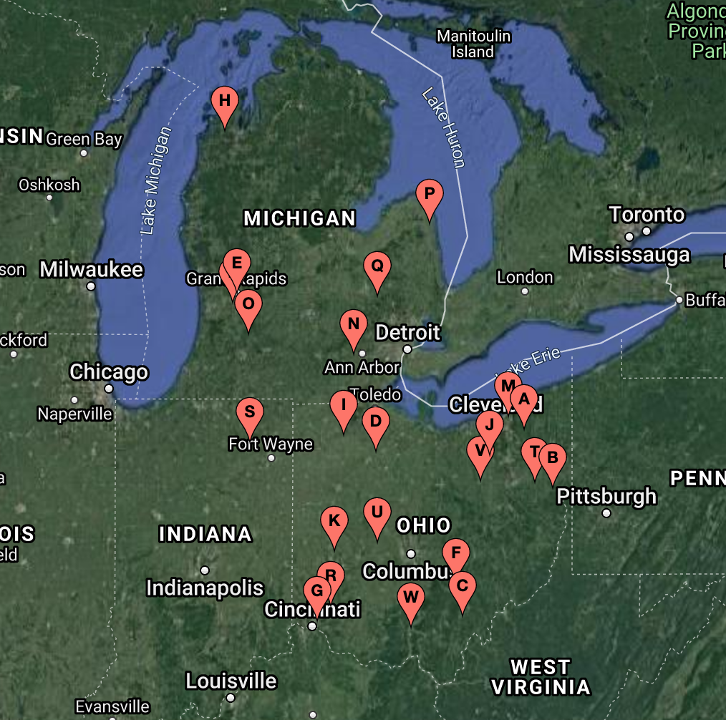
Thanks to you Hop Farmers for gathering data for this research
**THANKS to North Central Region SARE (NCR-SARE) Research and Education (R&E) Grant Program for Funding**

Slide 3
Hop Soil Fertility and Soil Health Objectives
Relationships between soil fertility and soil health with hop cone quality and yield
Develop sufficiency level values for leaf petiole nitrate for Midwest hops
Develop educational materials focused on soil health and nutrient management for Midwest hopyards

Slide 4
Experimental Design – Hopyards Classification
Variety:
  5 requests: Cascade, Chinook, Centennial, Columbus, Nugget
  Zeus, Mt Hood, Perle
Stand Age:
  0-3 years
  +4 years

Slide 5
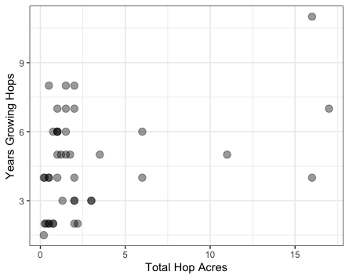
Farmer Cooperators
2019
  30 Farmers
  75 Hopyards
2021
  12 (of original 30) Farmers
  29 Hopyards
75% 2 acres or less
67% 5 years or less

Slide 6
Measurements Taken
Spring Soil Sample
  Routine soil test
  Soil Biological Health
Petiole Nitrate (~4 times, every 2 weeks)
Leaf Nutrient Analysis
Hop Yield
Hop Cone Quality

Slide 7
Soil Data

Slide 8
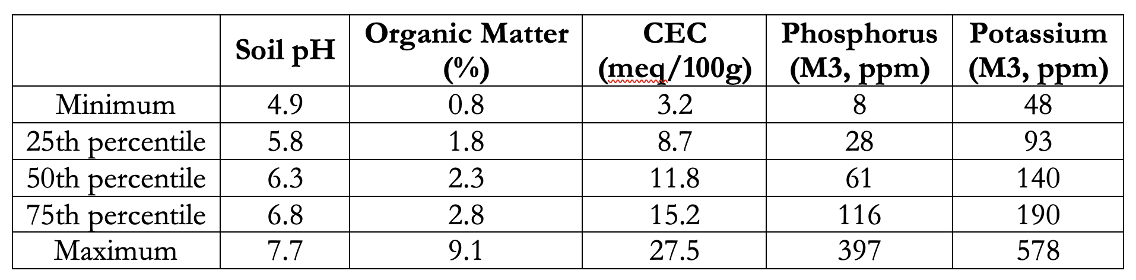
Soil Data – 87 hopyards
Optimal pH = 6.0 – 7.0. Many of the hopyards had low pH values
  Nitrogen fertilizers acidify soil, so soil testing in established hopyards is still necessary.
  Easiest to manage pH before hopyard establishment, but lime applications can still be made in established hopyards.
Most hopyard soils had sufficient P fertility (>25-40 ppm), but K fertility may be somewhat low (150-200 ppm)

Slide 9

Soil Data – Soil Health Measurements
Respiration
(Microbial Activity)
Active C
(Carbon Pool)
Soil Protein
(Nitrogen Pool)

Slide 10

Active C = Permanganate oxidizable C
2.5 g soil +
20 ml KMnO₄
0.5 ml of solution +
49.5 ml H₂O
Read color intensity
(on spectrophotometer)
Shake for 2 minutes
Settle for 10 minutes

Slide 11
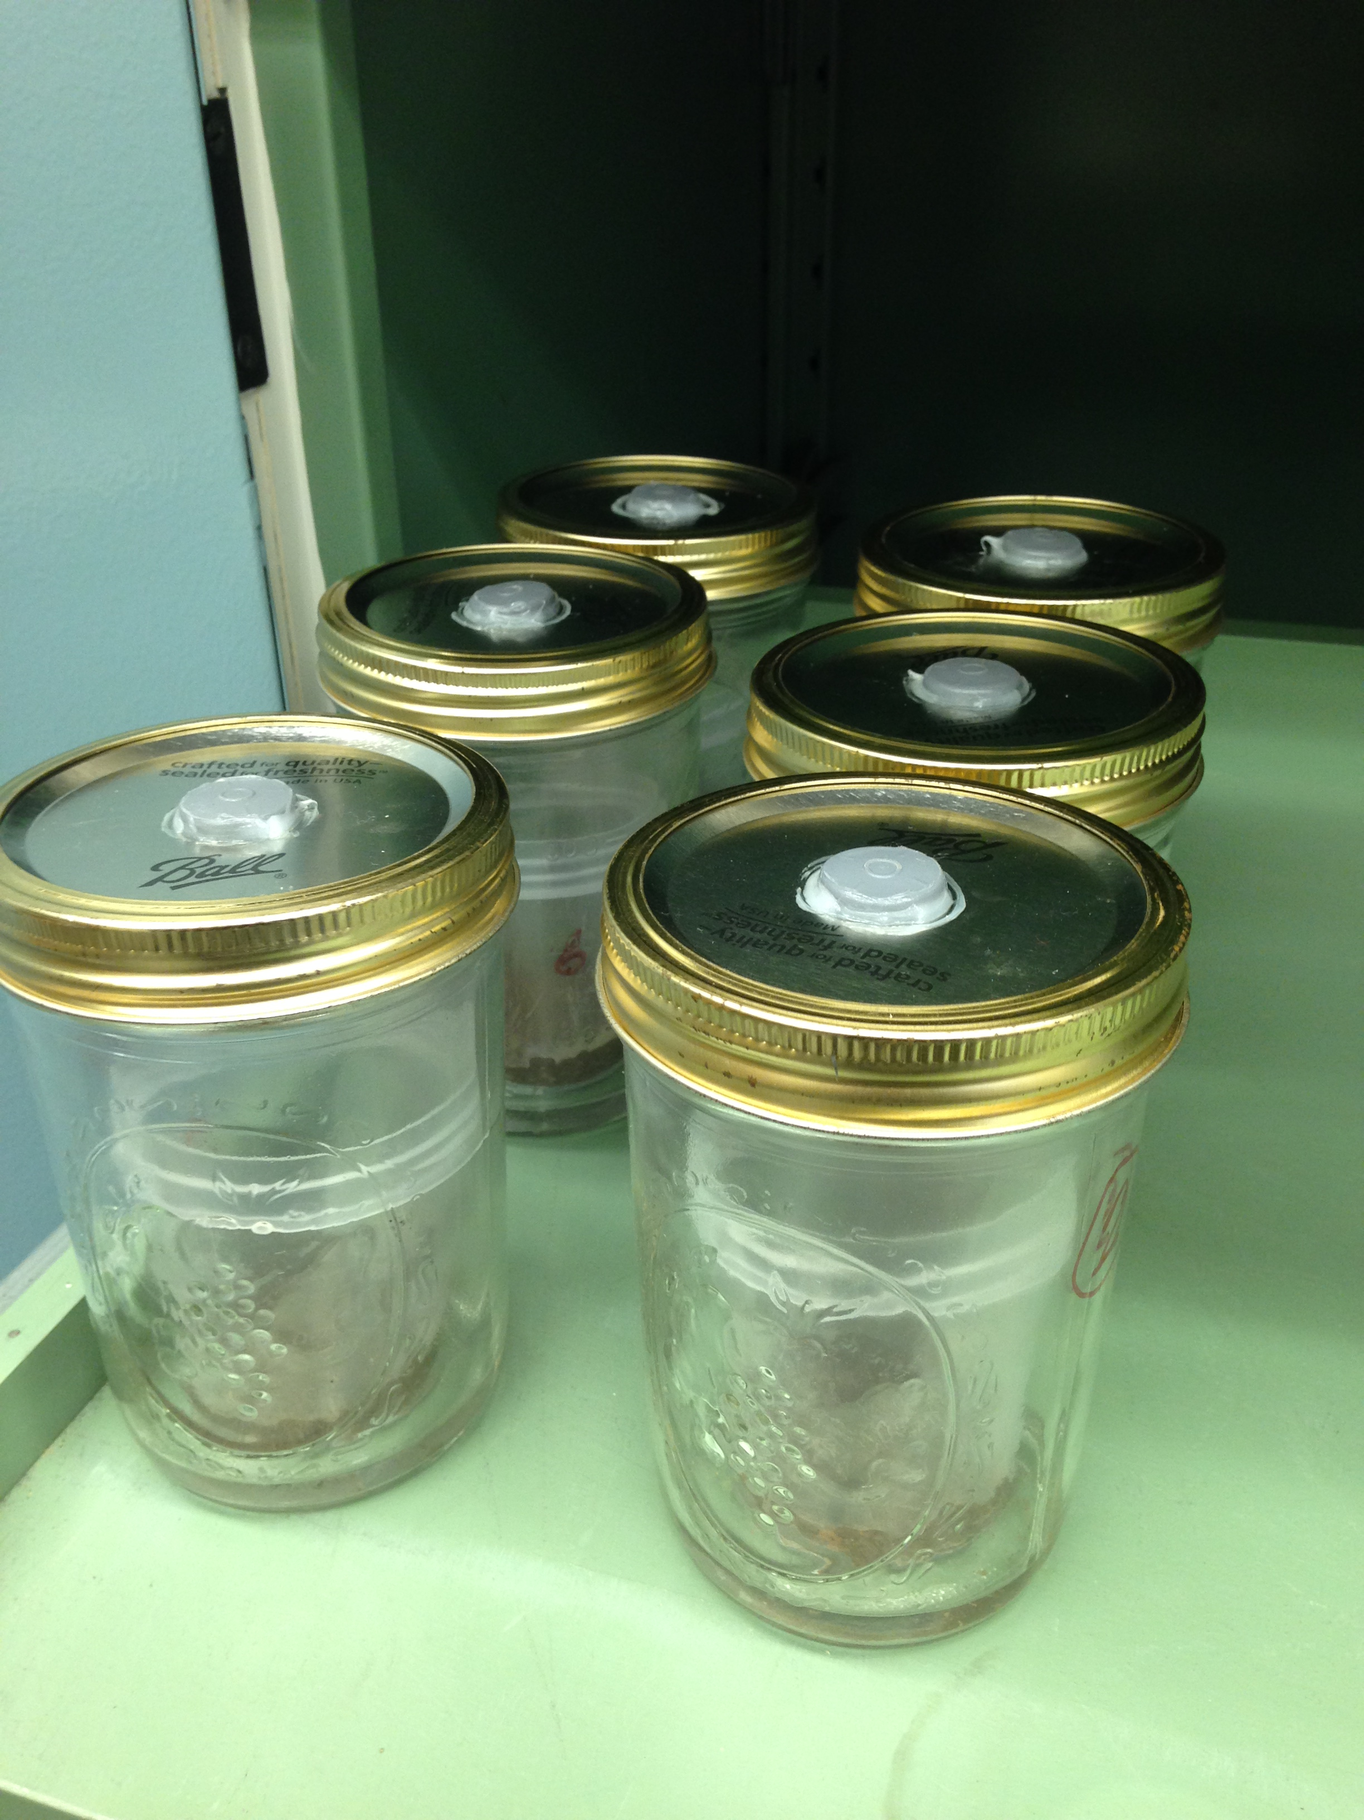
Soil Respiration
Dried soil +
water
Incubate for 24 hours
Measure concentration of CO₂ in jar
via GC or IRGA
Seal in jar
Measure color change in Solvita paddle

Slide 12
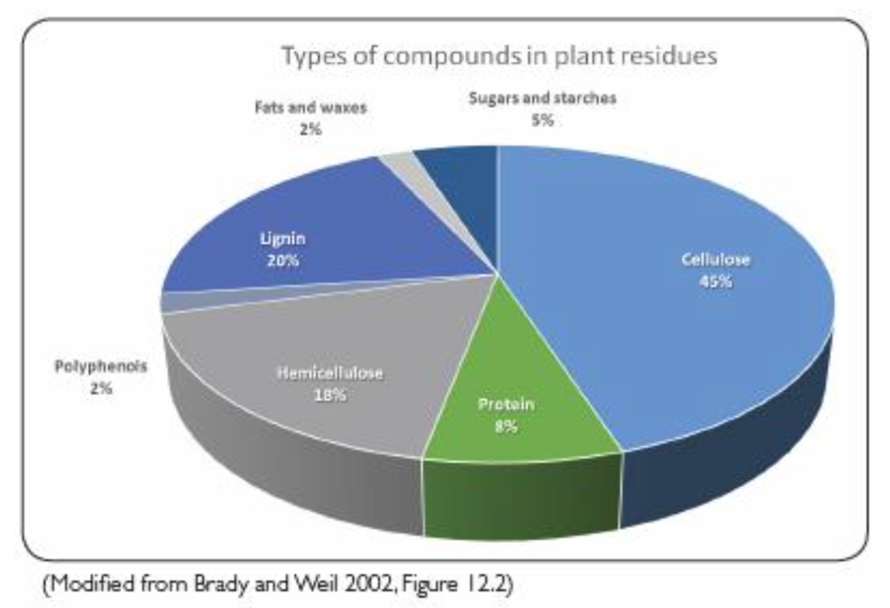
Soil Protein
Abundant in both plant- and microbial-derived biomass
Represents the largest pool of organic N in soil
Protein ➔ Amino Acids ➔ NH₄⁺
  Rate limiting step to soil N cycling

Slide 13
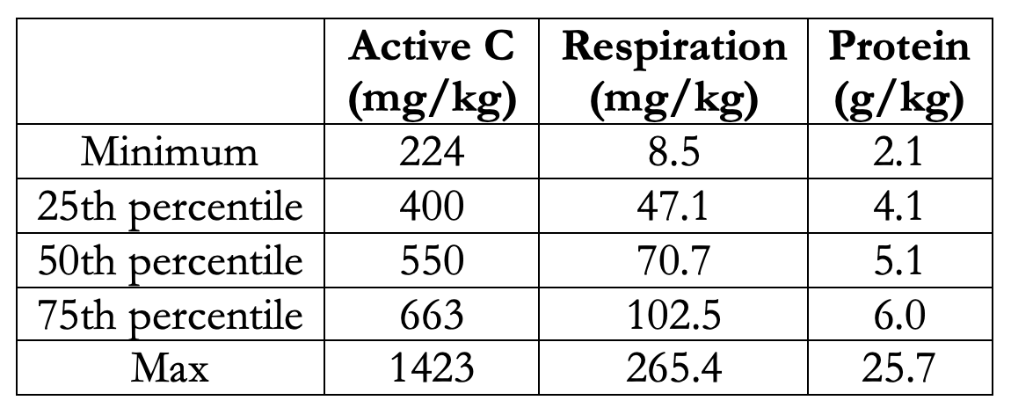
Soil Data – Soil Health Measurements
‘Average’ OH values | 490 | 41 | 4.8

Slide 14
Soil Findings
Many hopyards have low soil pH levels. Major limiting factor in nutrient availability.
P and K fertility for most hopyards looks good
Soil biological health indicators (Active C, Respiration, Protein) are above Ohio farmer averages

Slide 15
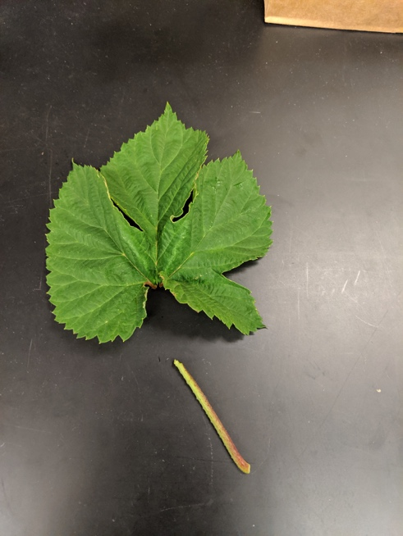
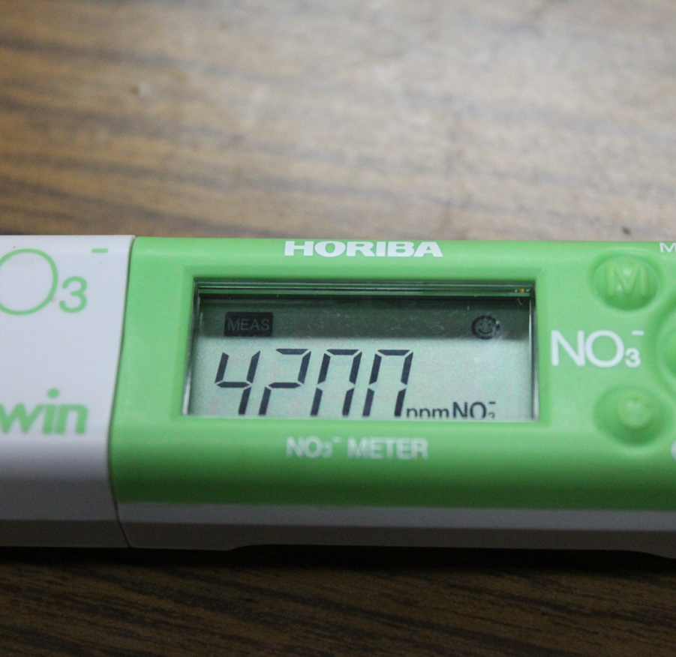
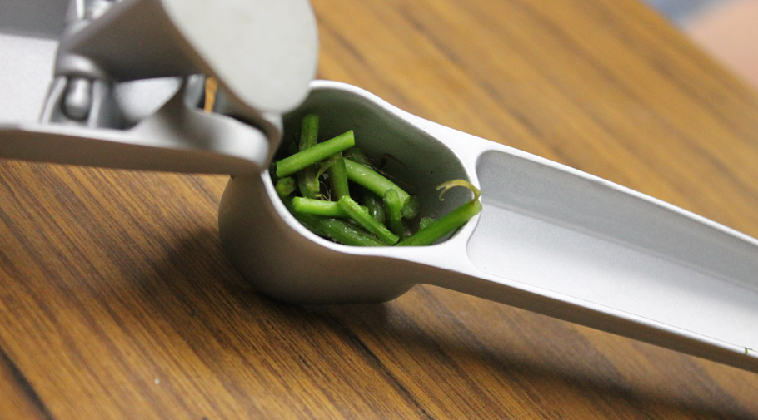
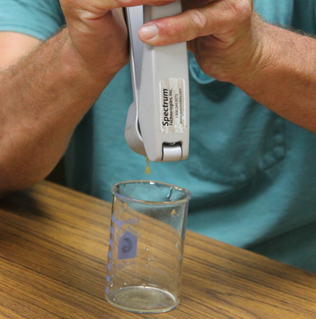
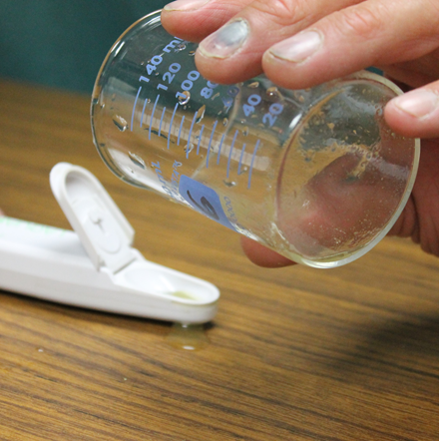
Petiole Sap Testing

Slide 16
Petiole Nitrate Readings (194 readings)
By Year:
  2019: 124 readings
  2021: 70 readings
By stand age
  0-3: 96
  4+: 98
By Variety
  Cascade: 69
  Centennial: 30
  Chinook: 62
  Columbus: 18
  Mt. Hood: 3
  Nugget: 4
  Zeus: 8

Slide 17
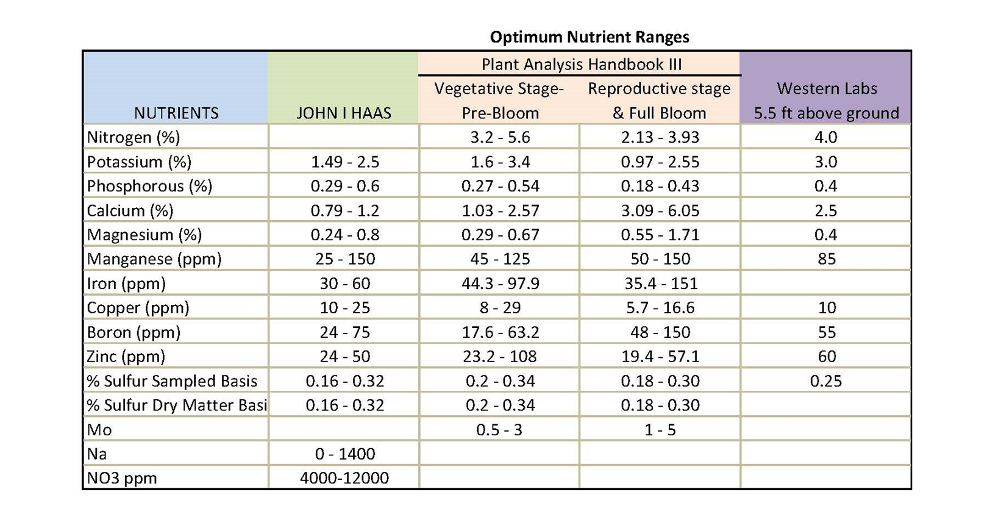
Petiole Sap Nitrate Levels
(compiled by Rob Sirrine, Michigan State University)

Slide 18
Petiole Sap Nitrate Levels
Rosalie Madden & Dr. Heather Darby, UVM Extension www.uvm.edu/extension/cropsoil/hops
Table 1. N fertility requirements for var. Nugget.
 | Nitrates | % N
low | 0-6,000 ppm | 0-2.66
normal | 6,000-10,000 ppm | 2.66-4.43
plenty | 10,000+ ppm | 4.43 +
Table 2. Fertility requirements for var. Cascade and var. Chinook.
 |  | Cascade | Chinook
Nitrate | Early June | > 10,000 ppm | 5 - 7000 ppm
 | Mid June | > 15,000 ppm | 7 - 9000 ppm
 | Late June | > 20,000 ppm | > 9000 ppm
% N | Early June | > 4.43% | 2.22 - 3.10%
 | Mid June | > 6.65% | 3.10 - 3.99%
 | Late June | > 8.86% | > 3.99%

Slide 19
Petiole Sap Nitrate Levels – 53 hopyards

Slide 20
Petiole Sap Nitrate Levels – 53 hopyards

Slide 21
Petiole Nitrate Findings
Petiole nitrate levels variable – need to strive for more uniform N management at critical times
Variety and stand age likely impacts crop N needs
Challenges and opportunities with meter

Slide 22
Leaf Nutrient Concentrations

Slide 23
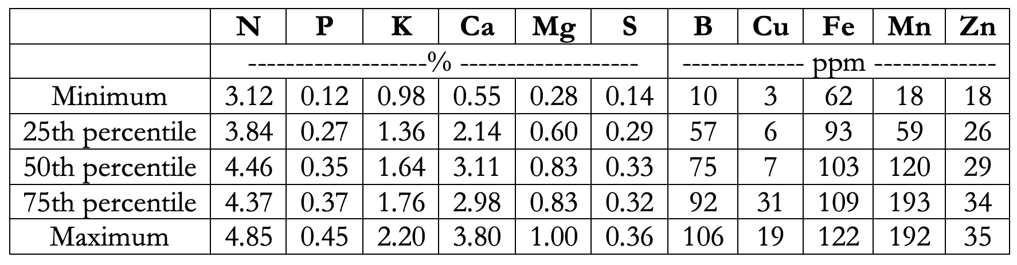
Hop Leaf Nutrient Concentrations

Slide 24
Petiole Sap Nitrate Levels
(compiled by Rob Sirrine, Michigan State University)

Slide 25
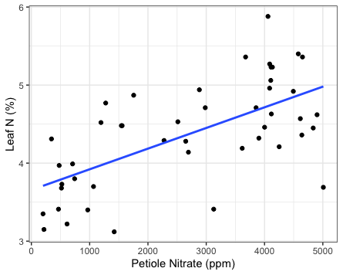
Hop Leaf N vs. Petiole Nitrate

Slide 26
Hop Cone Quality

Slide 27
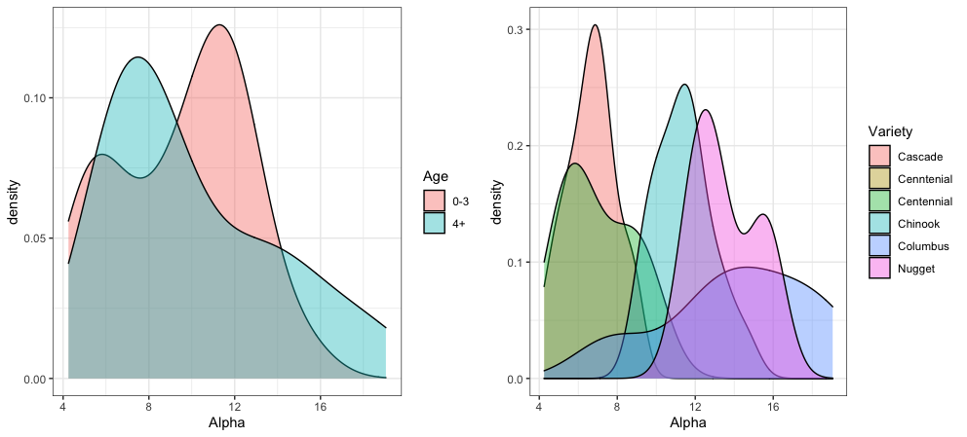
Alpha Acids – by Hopyard Age and Variety

Slide 28
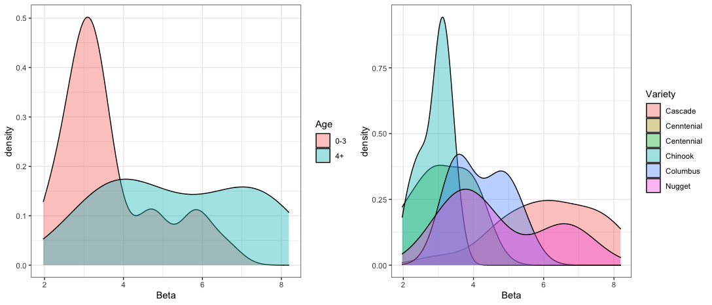
Beta Acids – by Hopyard Age and Variety

Slide 29
Envisioned Outcomes
Baseline understanding of nutrient management and soil fertility in hopyards
Factsheets on hop fertility management and soil health relationships
Farmer training information on utilizing and incorporating nitrate meters for hops
  Develop range of what ‘low’, ‘optimal’ and ‘high’ values are

Slide 30
Hop Nutrient Management

Slide 31
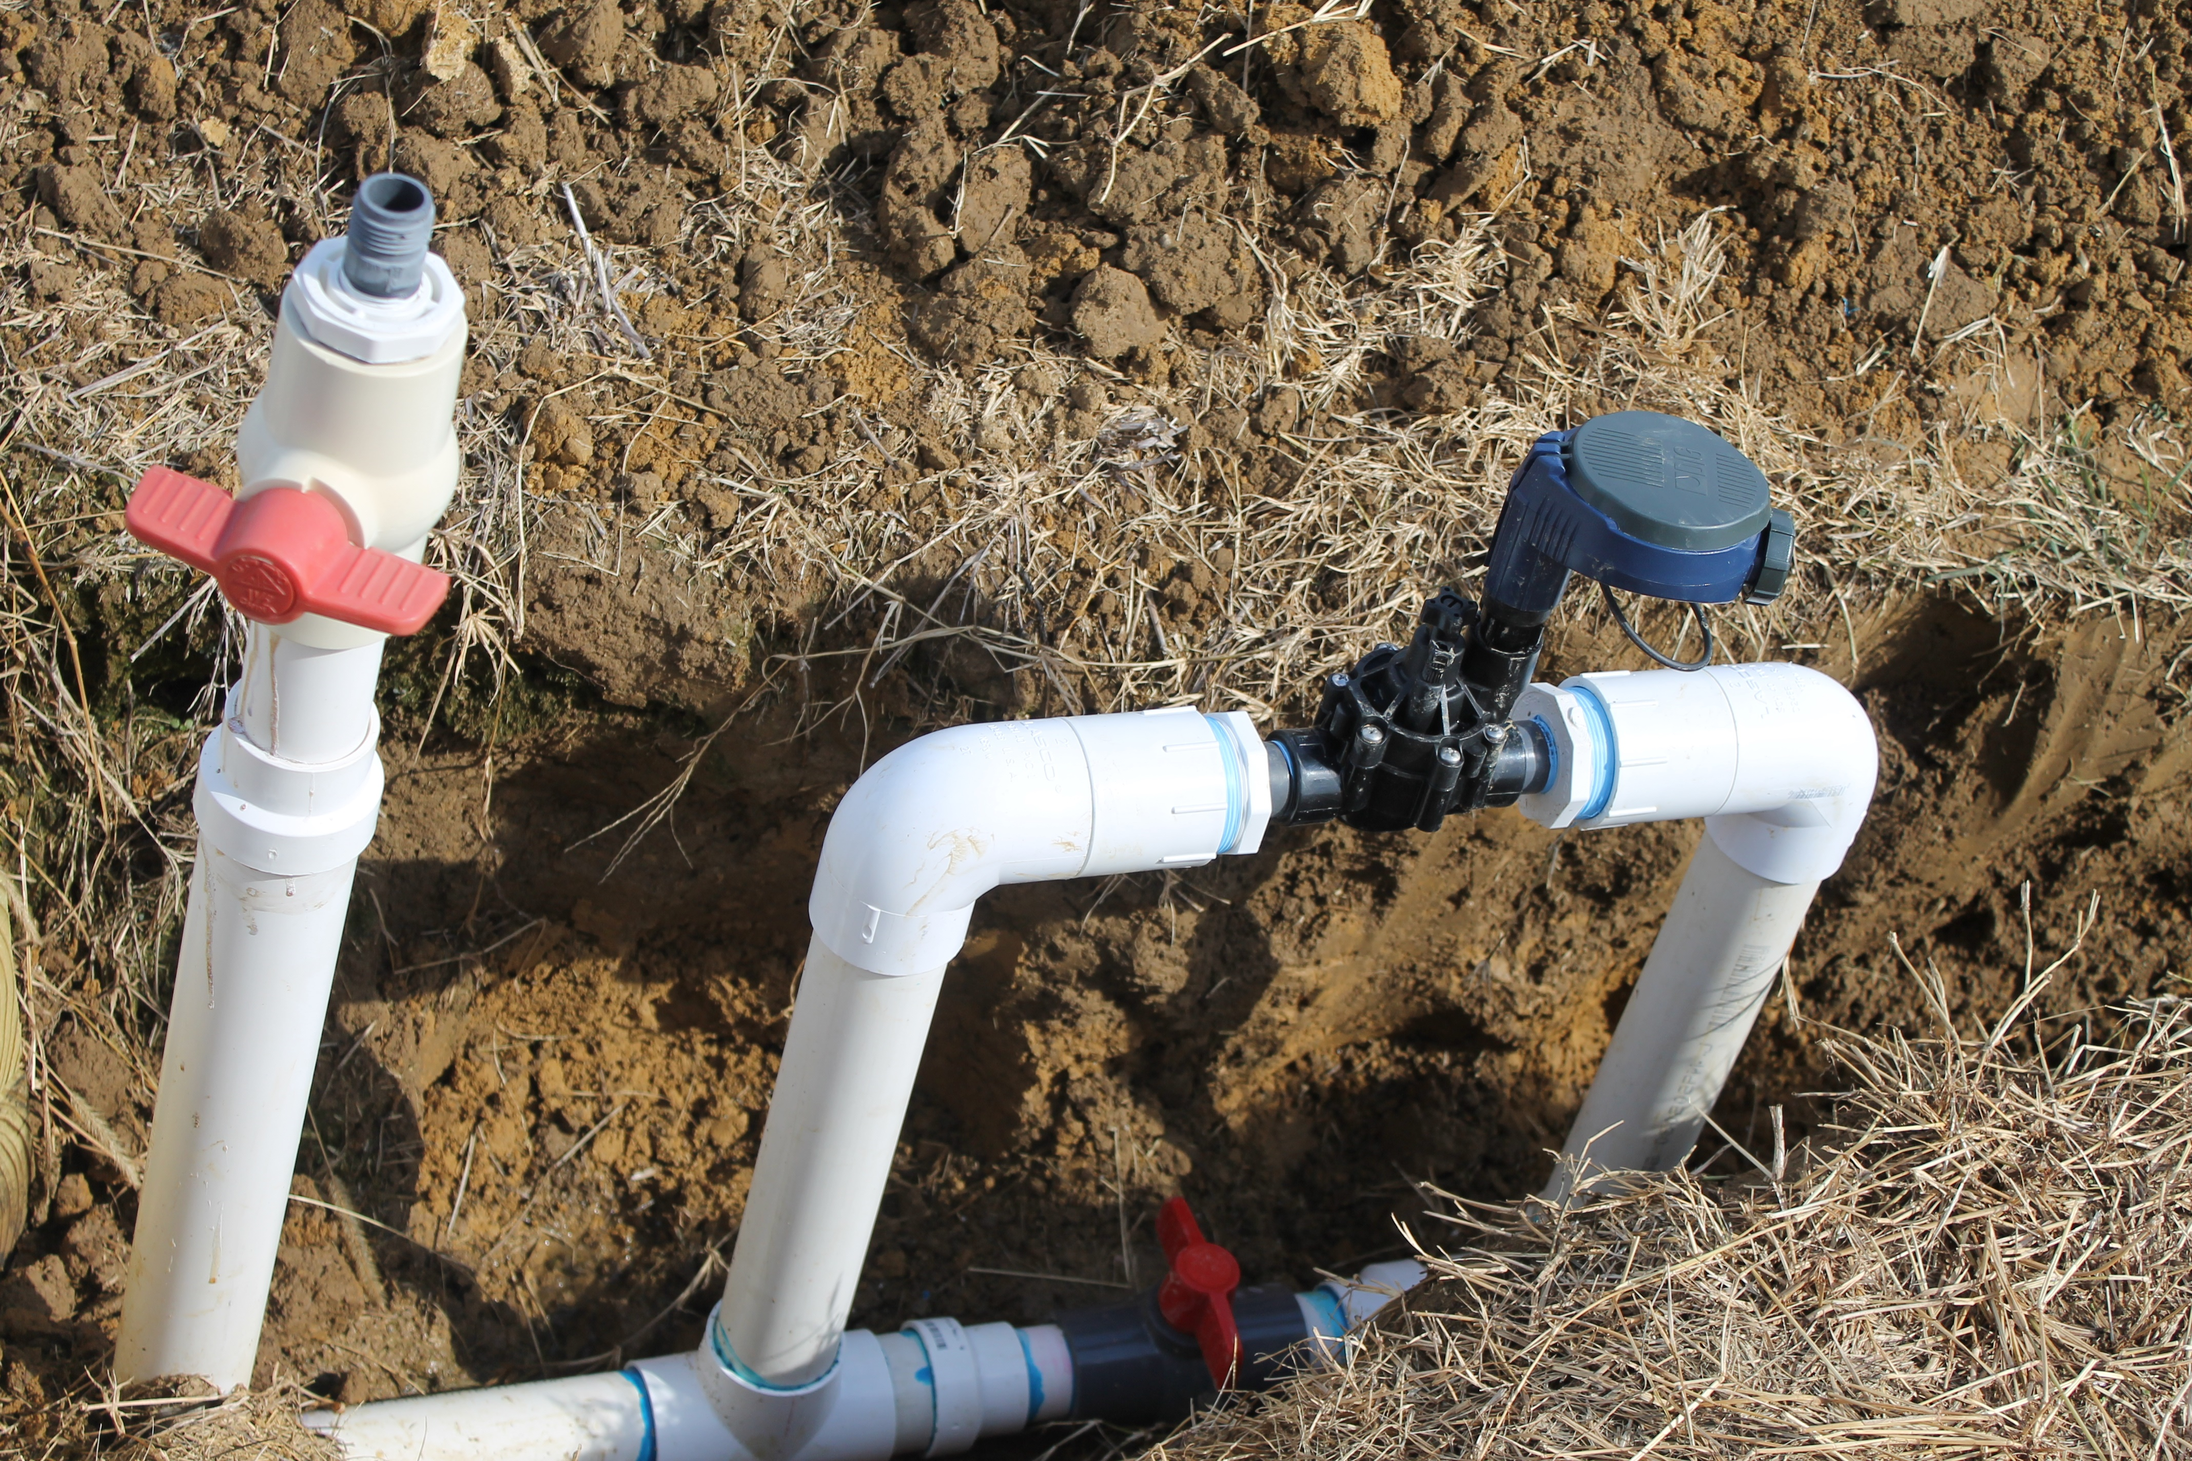
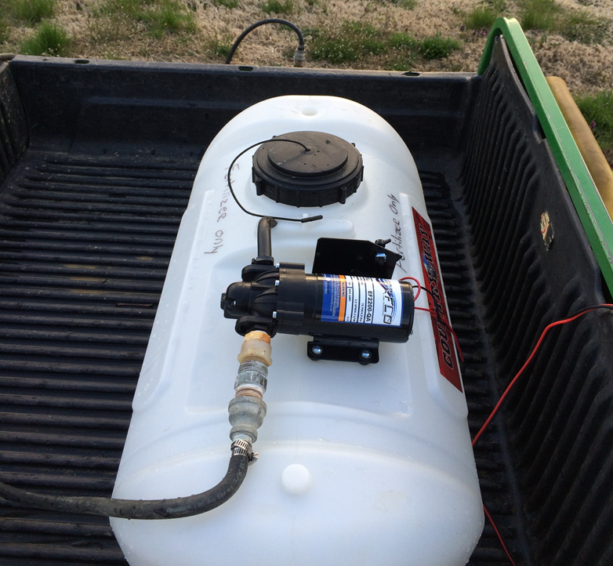
Nitrate Injection

Slide 32
Hop Fertility Research Study
Steve Culman: culman.2@osu.edu
Brad Bergefurd: bergefurd.1@osu.edu

Slide 33
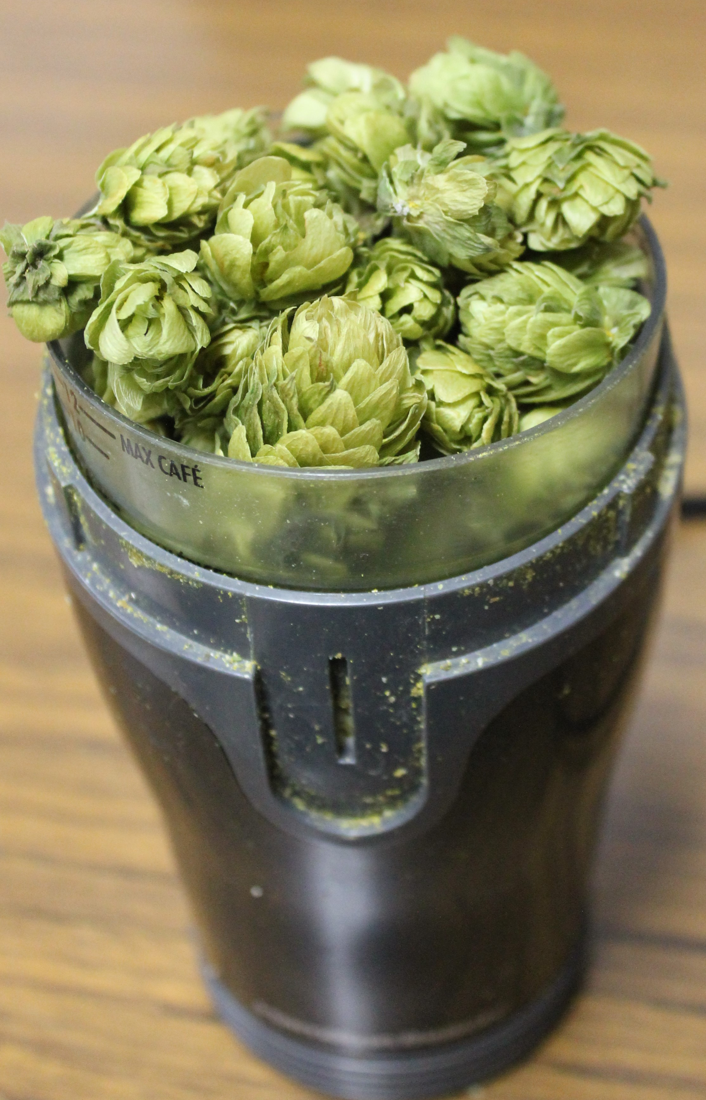
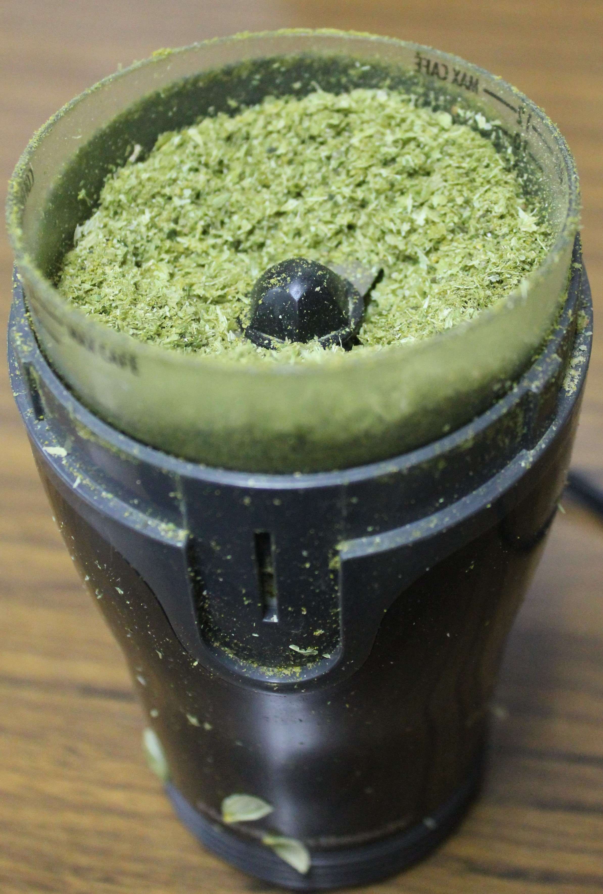
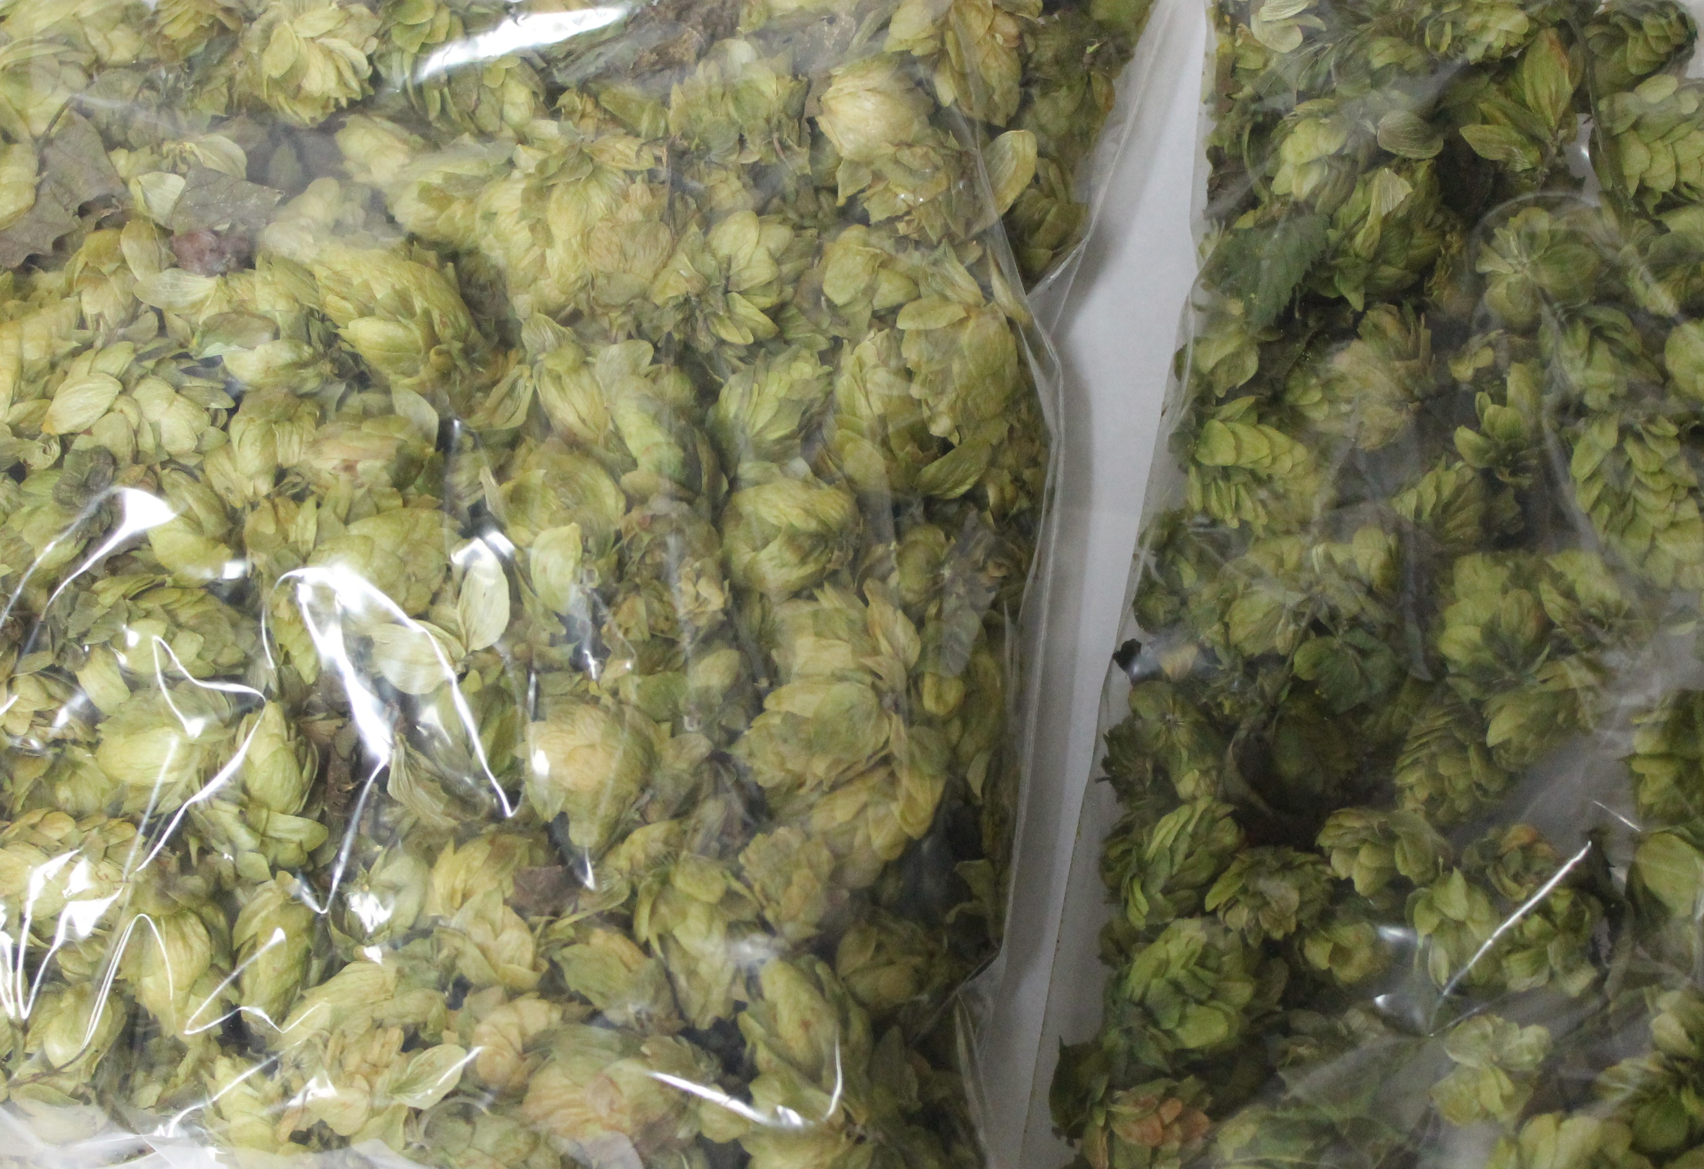
Hop Testing for Quality Analysis

Slide 34
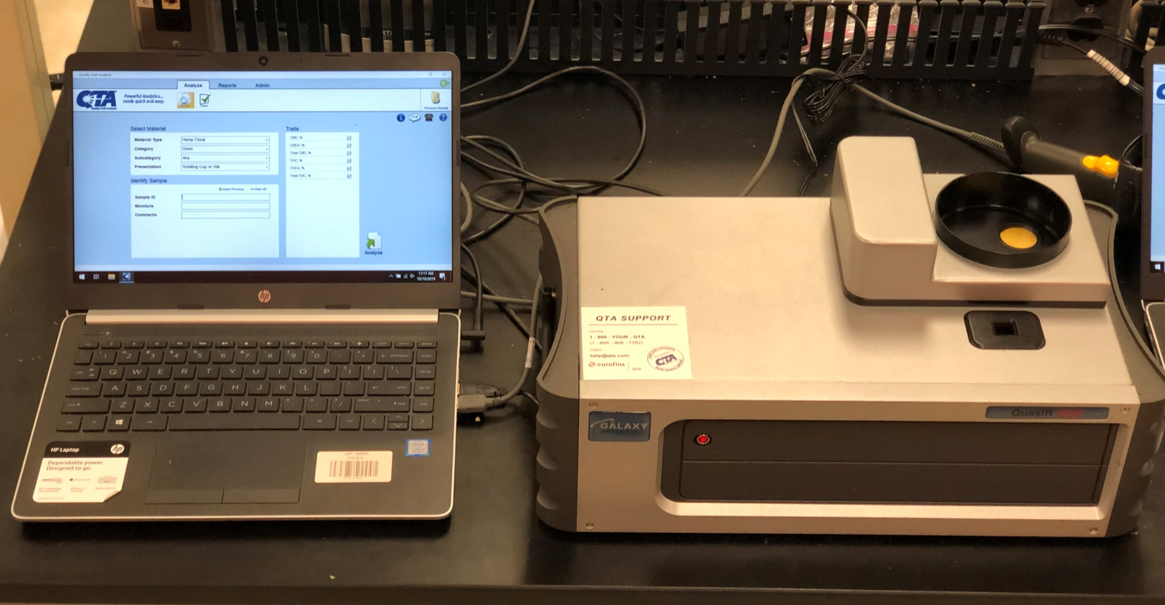
The System

Slide 35

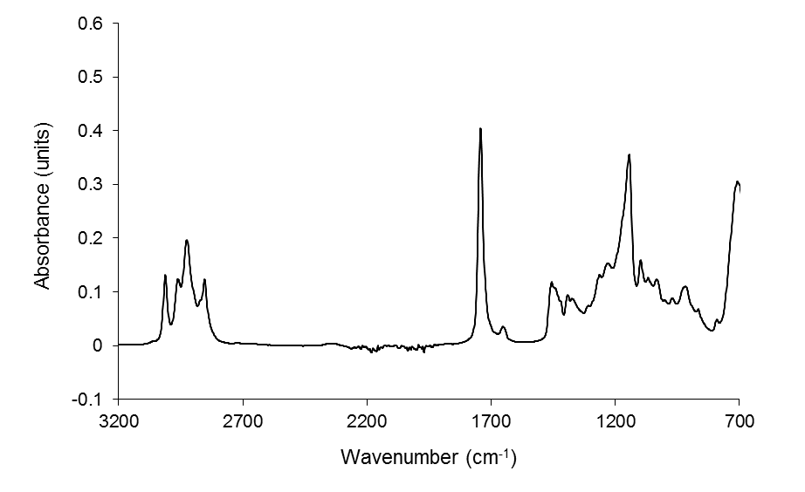
Infrared Method- Chemical Bonds
Sample
IR/NIR Light Source
Light before exposed to sample
Light after exposed to sample (specific wavelengths have been absorbed)
Infrared Spectrum
Measurement mechanism of an Infrared Spectrometer

Slide 36
Comparison of Lab Analysis (Alliance) vs. IR (Eurofins)
Blue line = best fit
Dotted line = 1:1

Slide 37
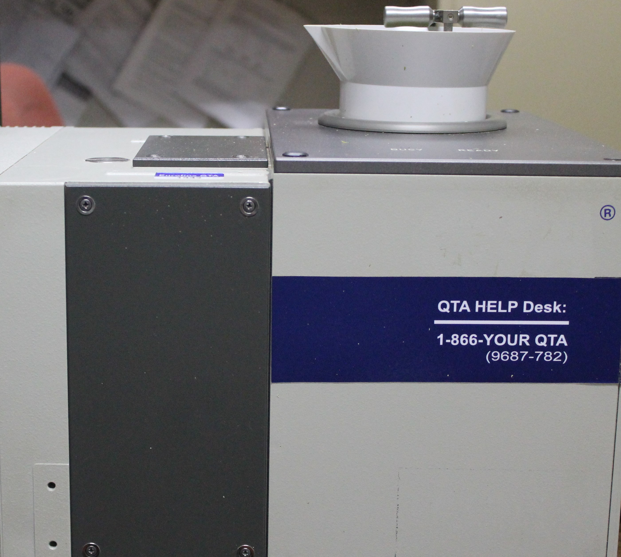
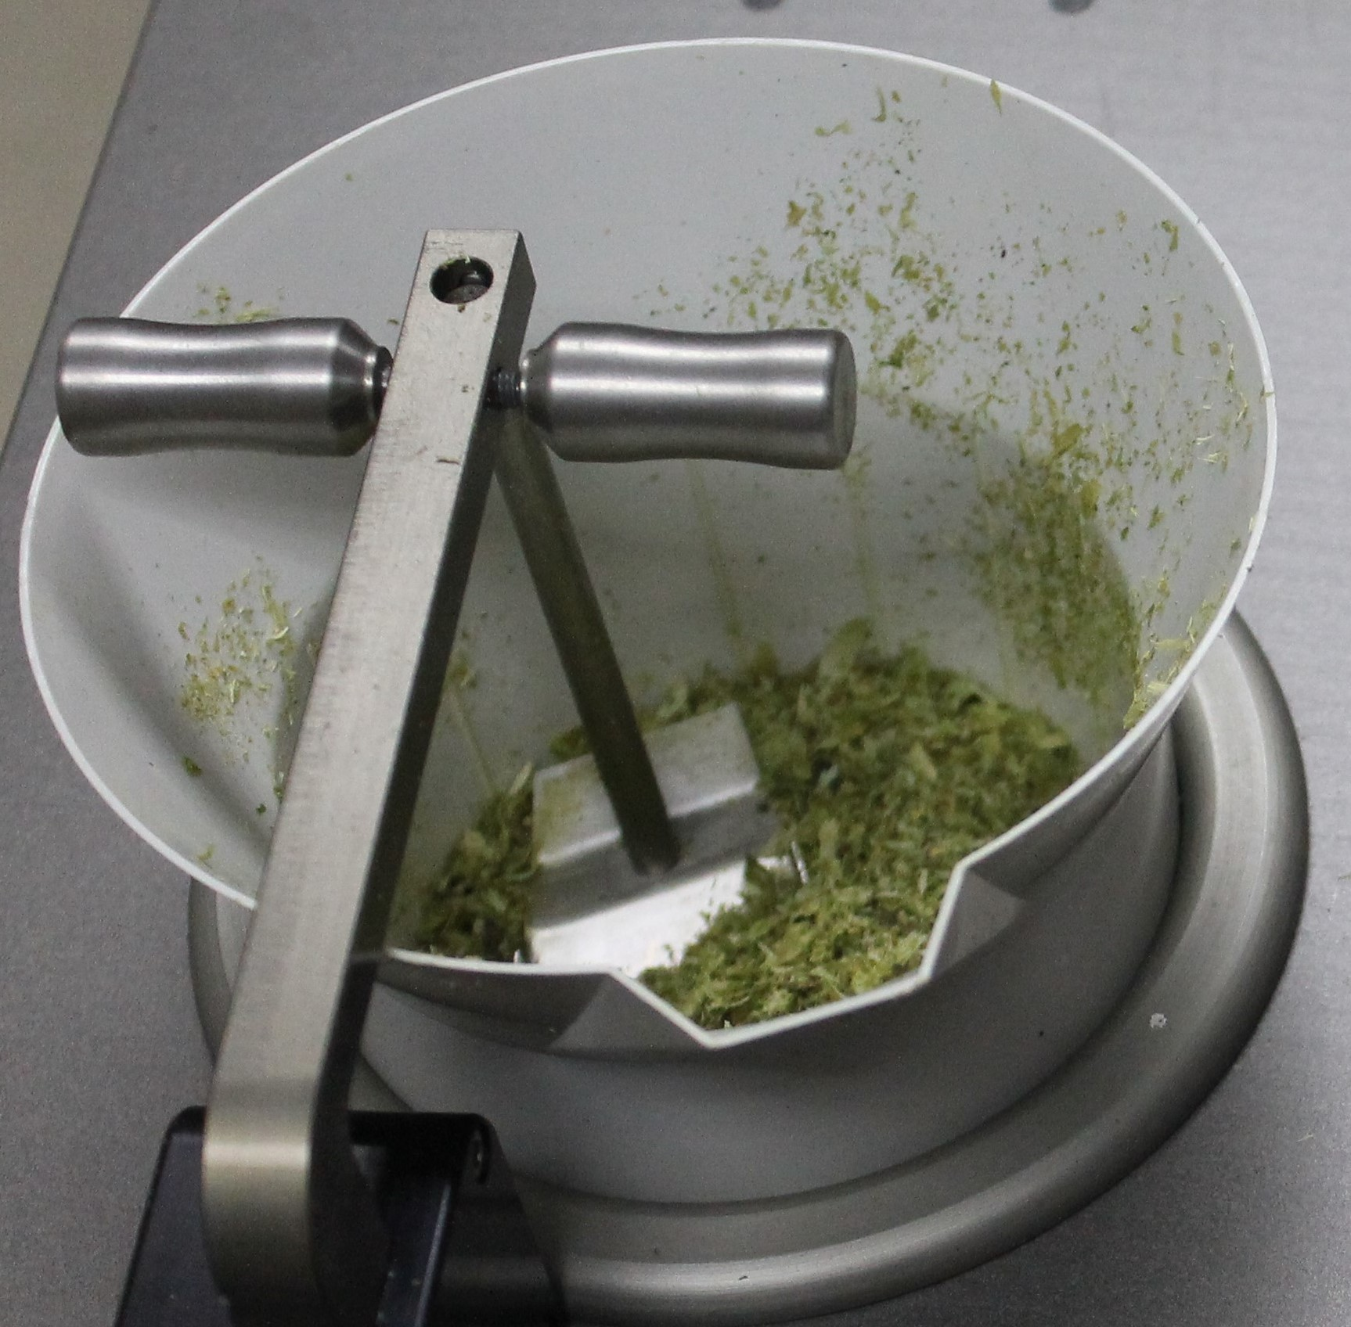
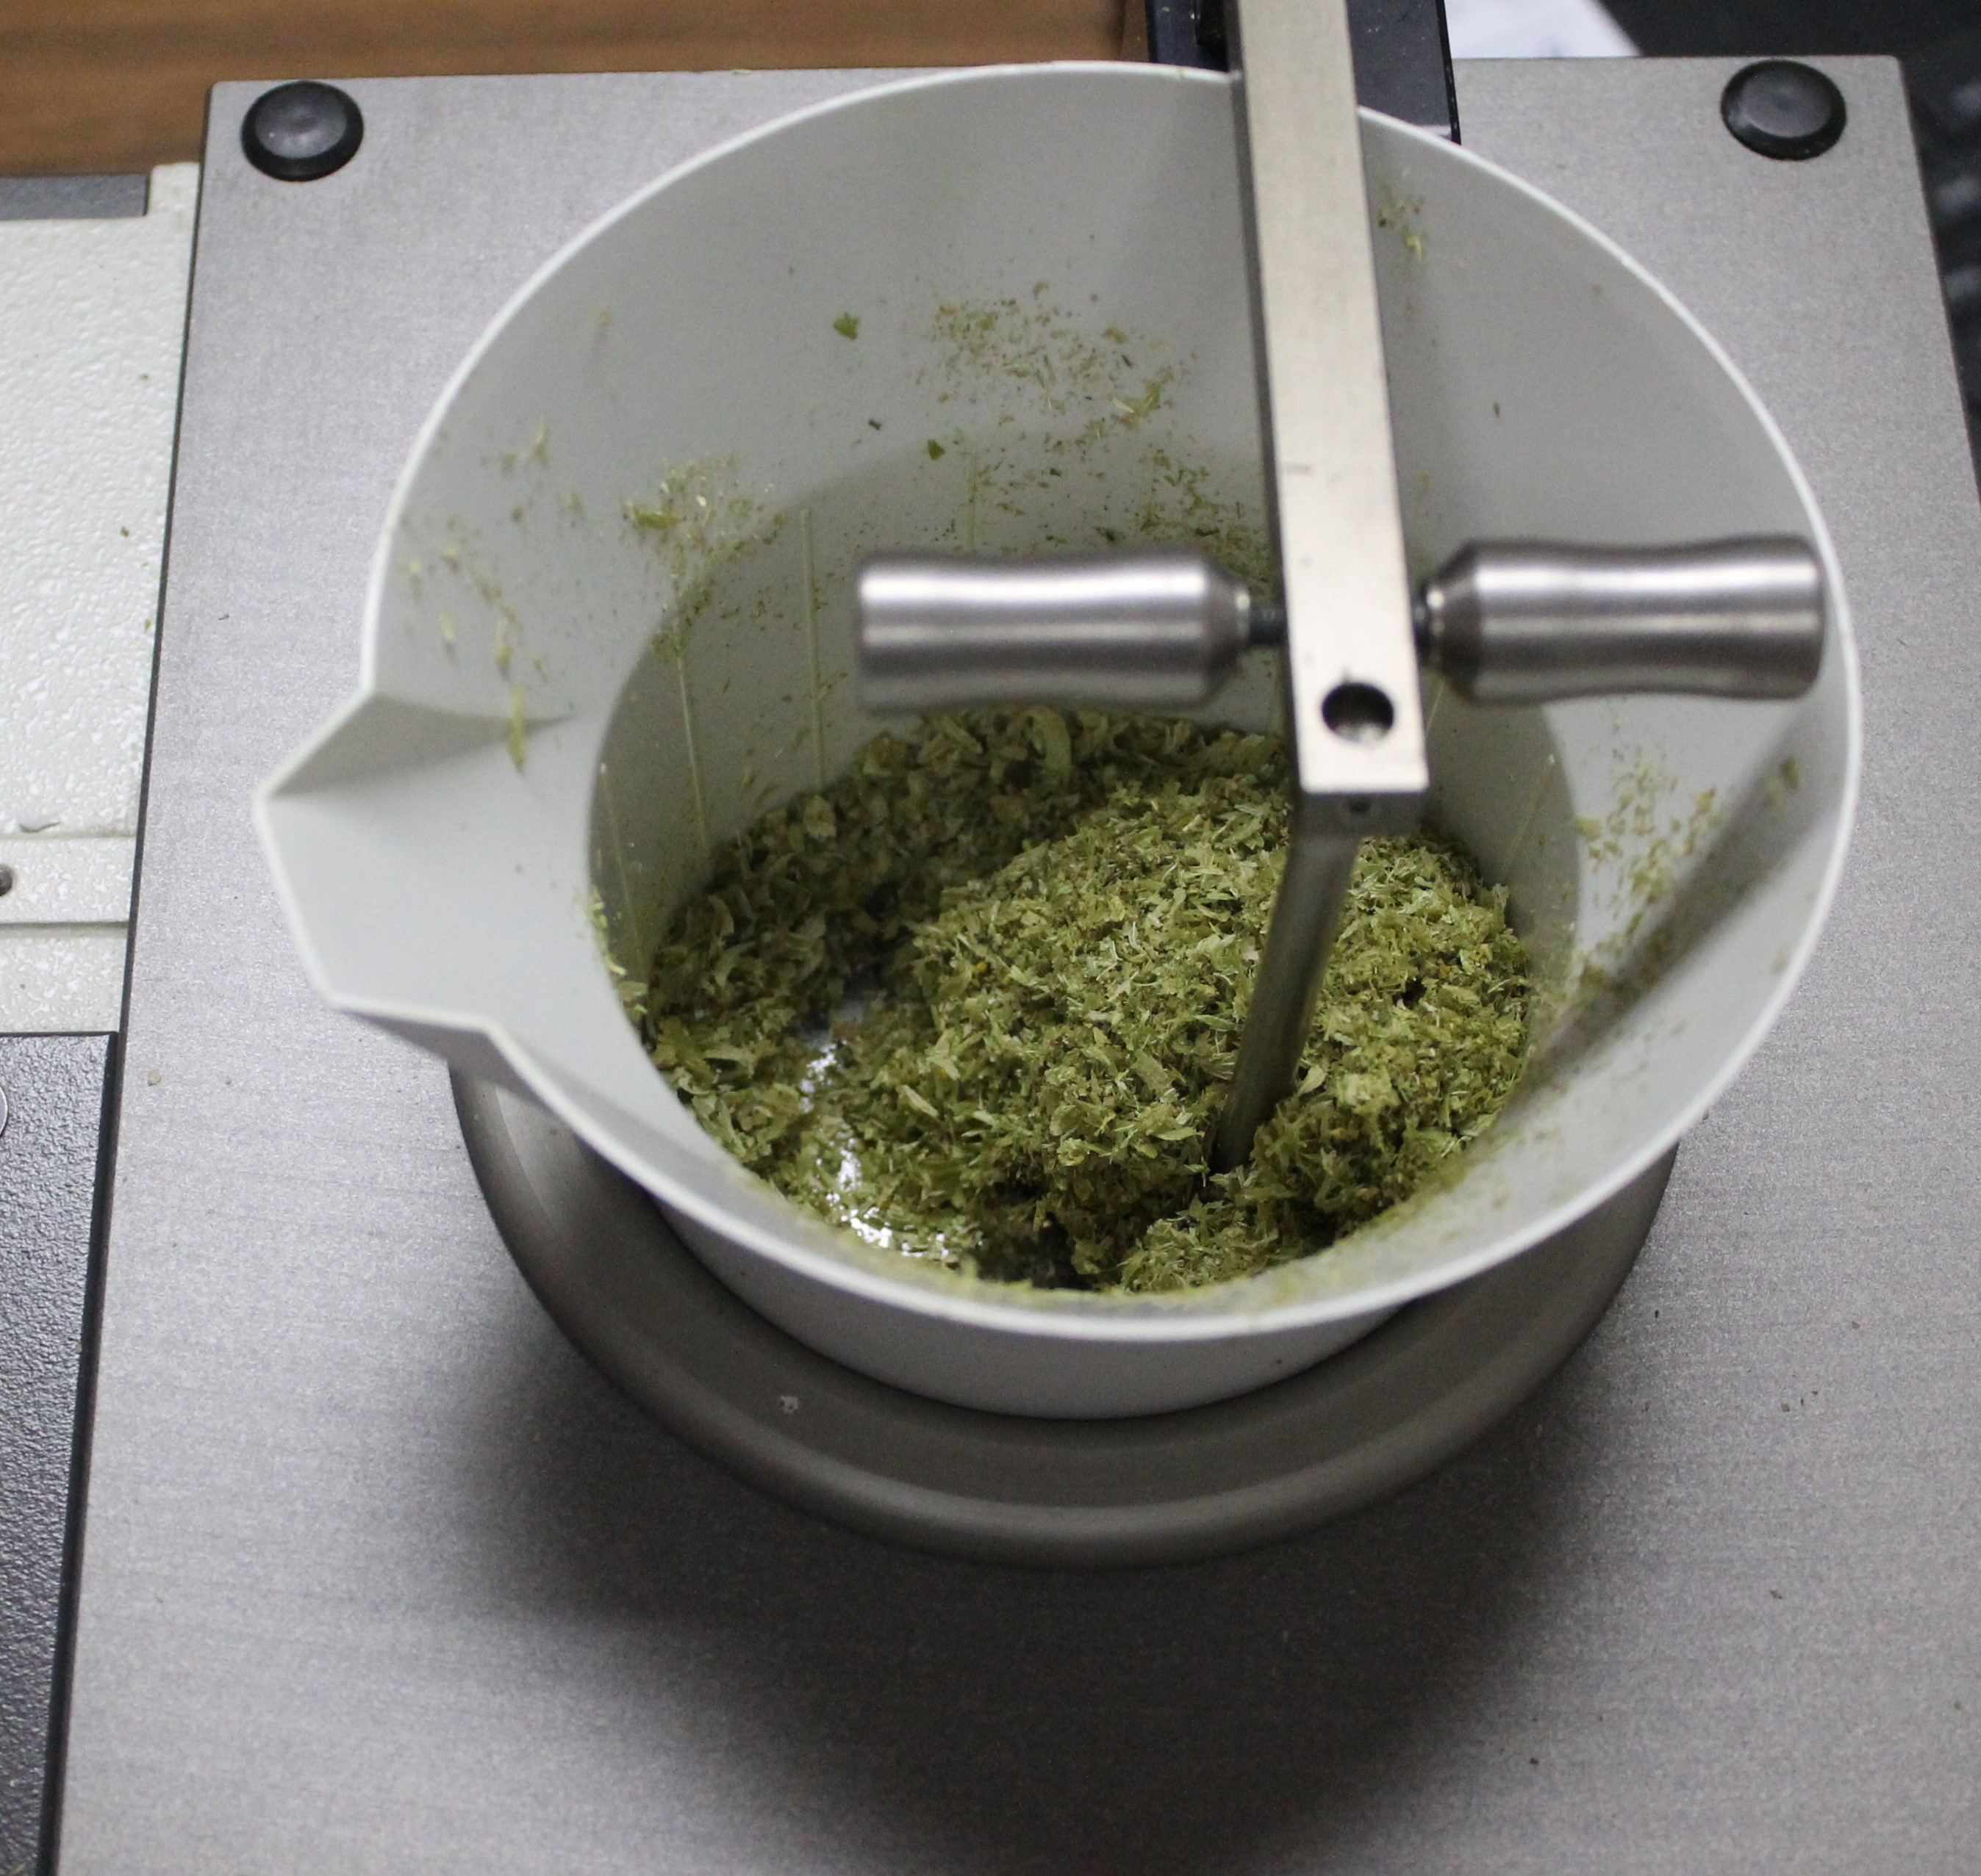

Slide 38
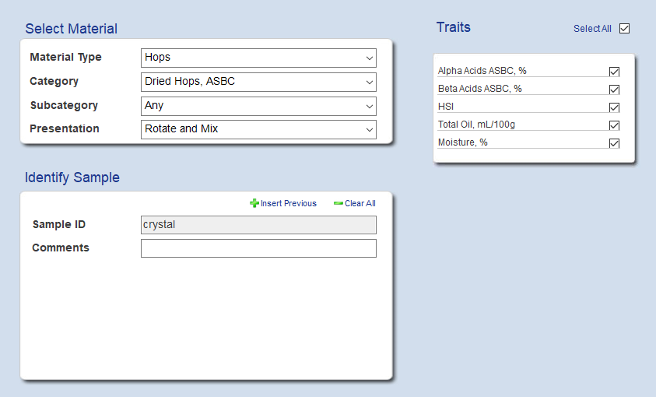
QTA Testing

Slide 39
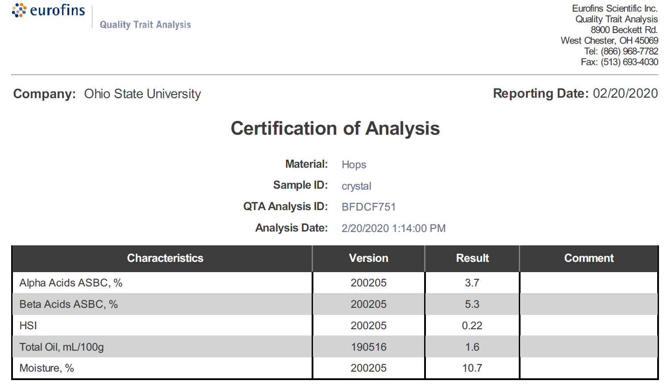
Analysis Results

Slide 40
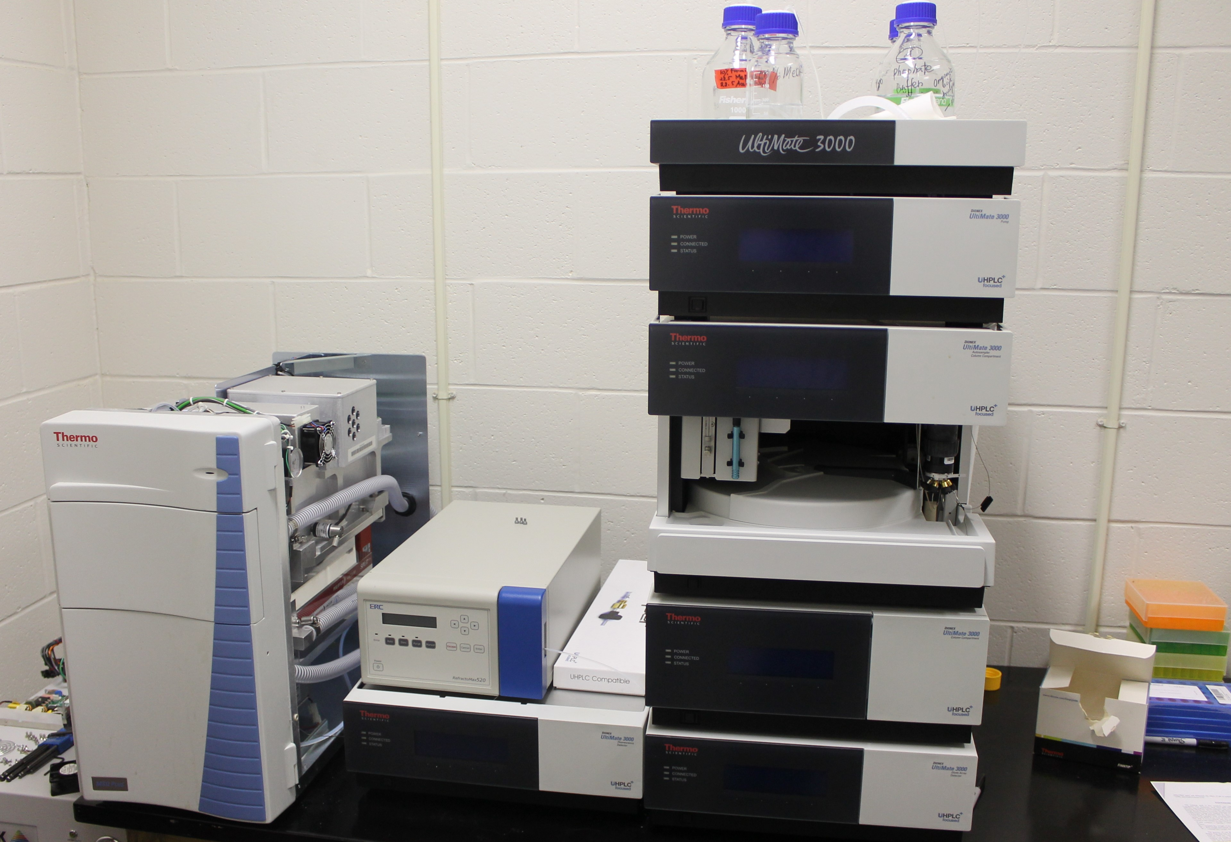
HPLC

Slide 41
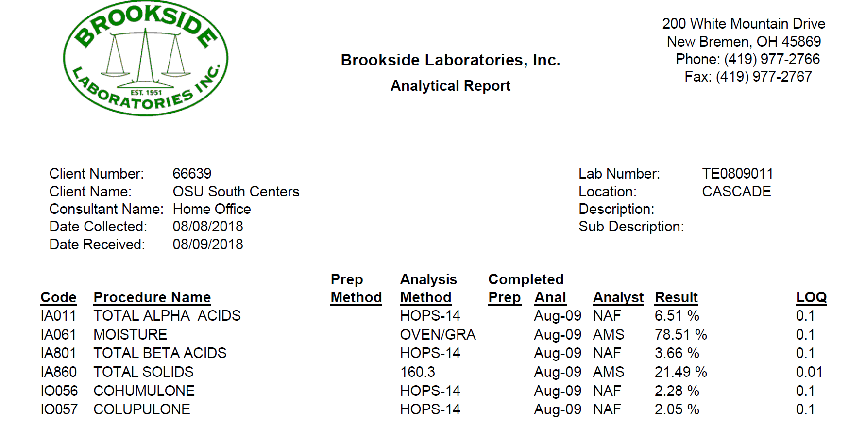
HPLC Analysis

