Slide 1
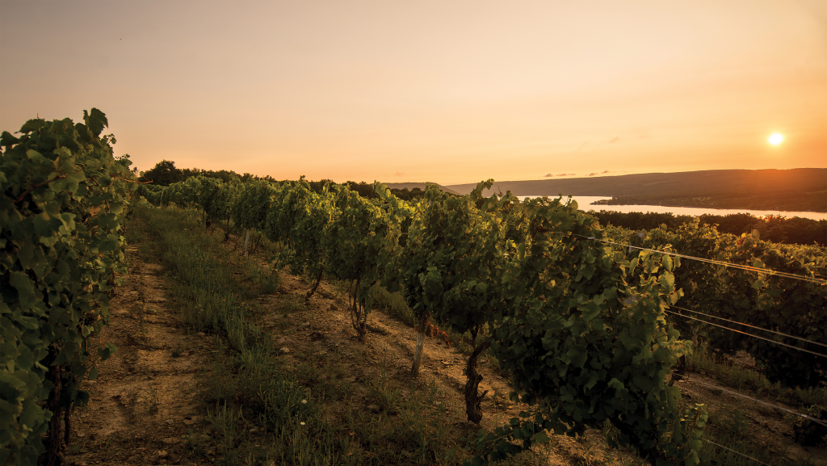


ASSESSING ROLE OF INSECTS IN SOUR ROT DISEASE ETIOLOGY IN VINEYARDS
Rekha Bhandari, Stephen Hesler, Katie Gold, Greg Loeb
Notes:
Sour rot …….disease ……

Slide 2
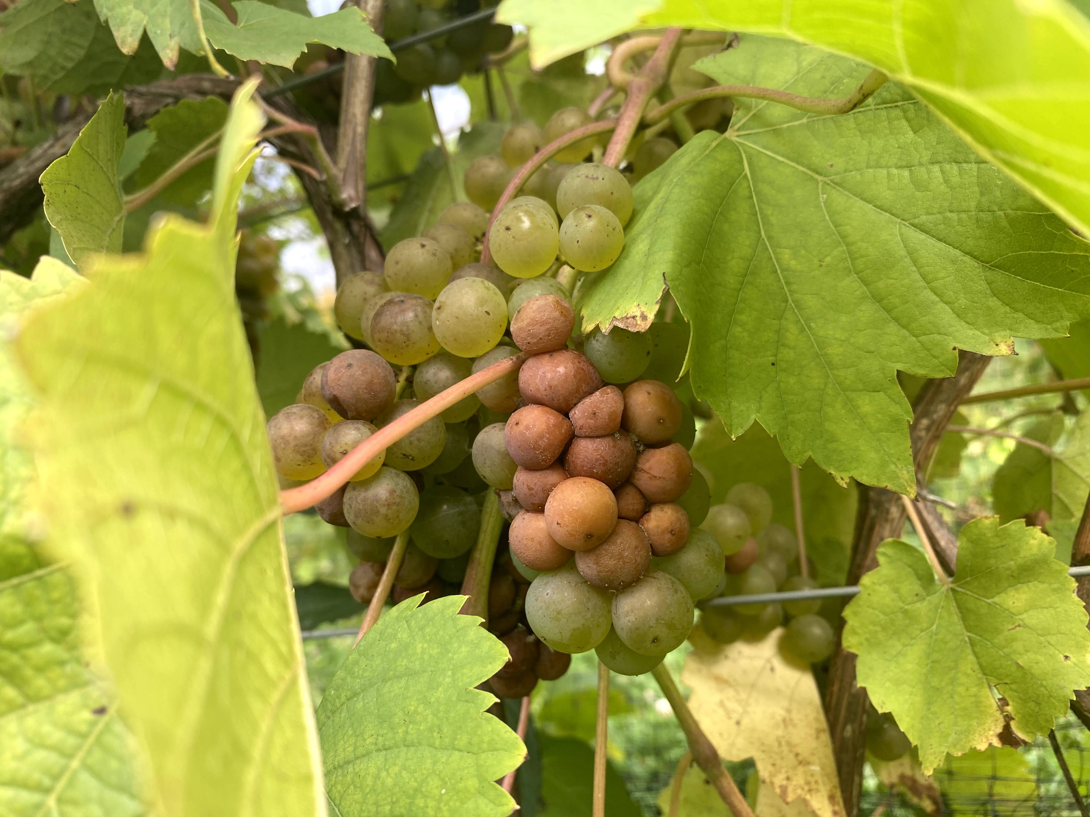
Background Method Result Discussion Conclusion
Sour rot disease
Economically important disease of grapes
Impacts grape production and wine industries
(McFadden-Smith and Gubler 2015)

Slide 3
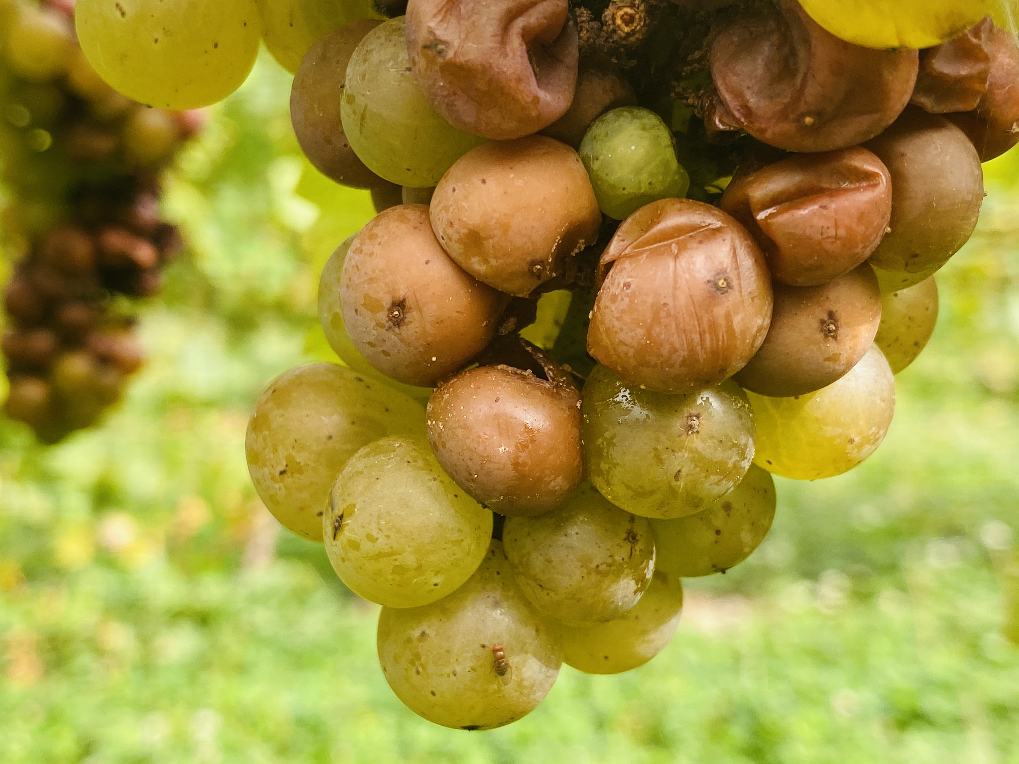
Background Hypothesis Method Result Discussion Conclusion
Host
Grape Cultivar
-Thin skinned
-Tight clustered
Pathogen
Yeast
Acetic acid bacteria
Environment
Warm (68 to 77-degree F) and wet condition
Injuries
Birds
Yellow jackets
Grape Berry Moth
Osmotic pressure
Drosophila fruit flies
D. melanogaster
D. suzukii
Sugar Yeast Ethanol
Ethanol Acetic acid bacteria Acetic acid
Pungent vinegar smell
Sour rot
(Barata et al. 2012; Hall et al. 2018; Ioriatti et al. 2018)
Notes:
Host :

Slide 4
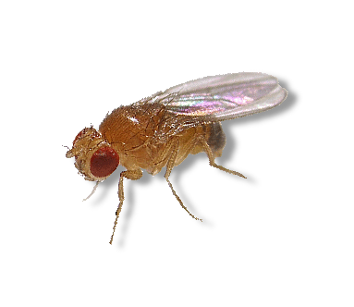

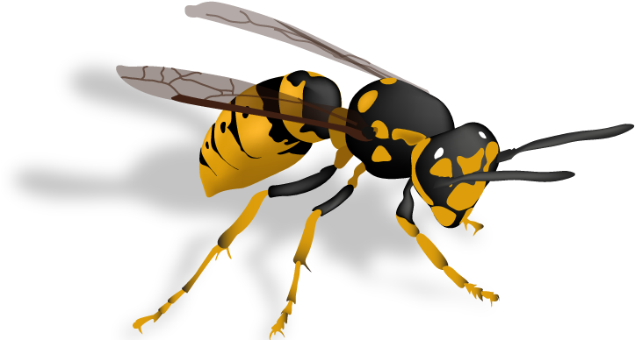
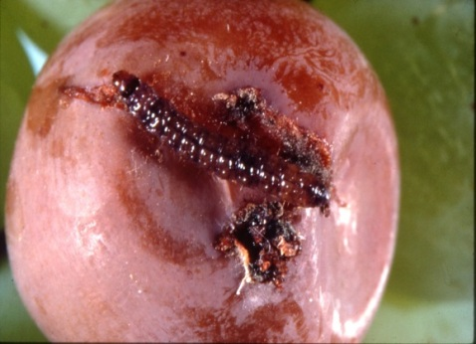
Background Hypothesis Method Result Discussion Conclusion
Injuries promote sour rot especially in the presence of Drosophila fruit flies.

Slide 5
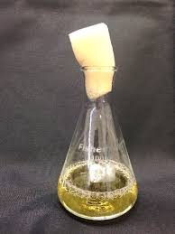
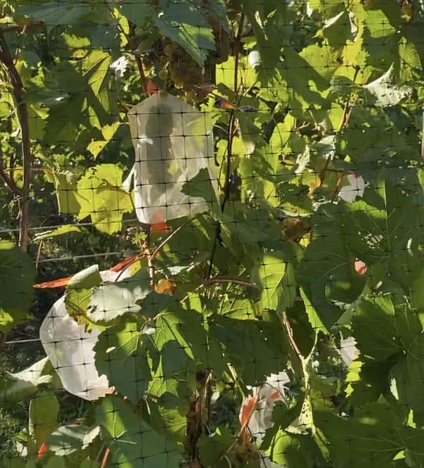
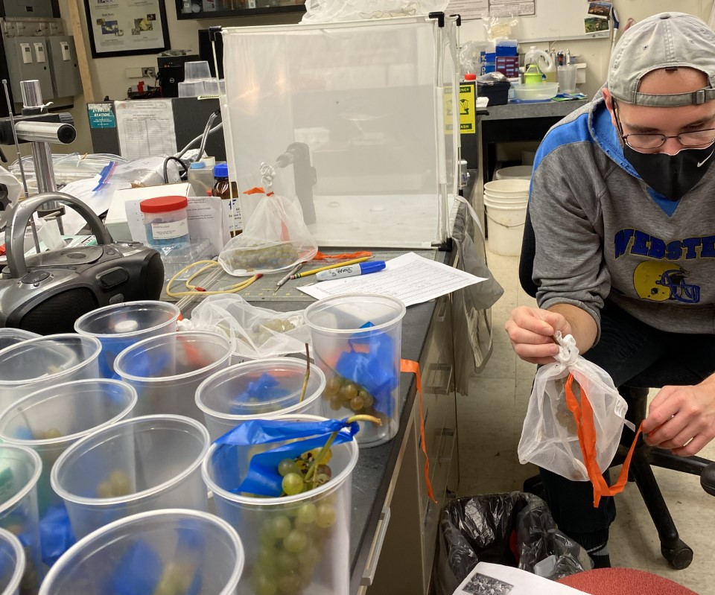
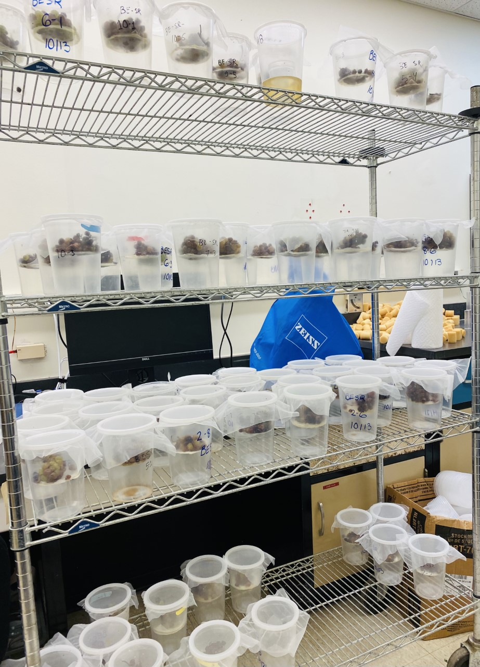
Background Hypothesis Method Result Discussion Conclusion
Semi field experiment
Source of injury
Presence or absence of D. melanogaster
Control
Present
Absent
GBM
Present
Absent
Mechanical Damage
Present
Absent
Yellow jacket
Present
Absent
Inoculation of clusters with acetic acid bacteria and yeast.
Clusters were enclosed using fine mesh bags.
Clusters were assessed for sour rot severity
Flies were reared from bagged cluster after assessing sour rot percentage

Slide 6
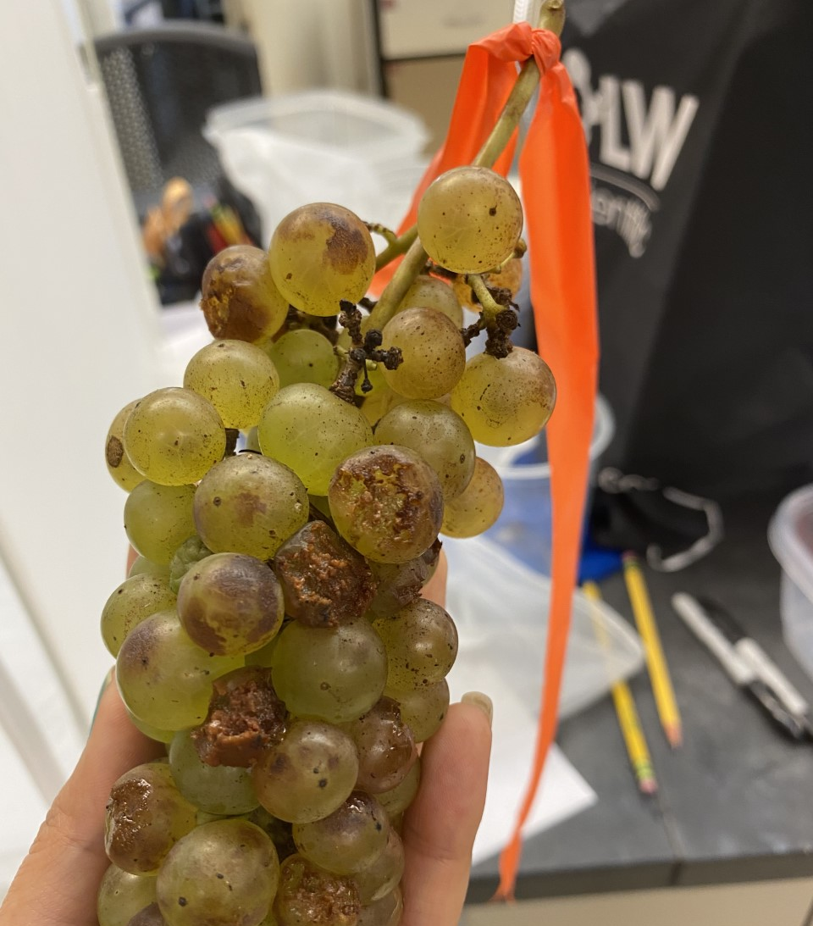
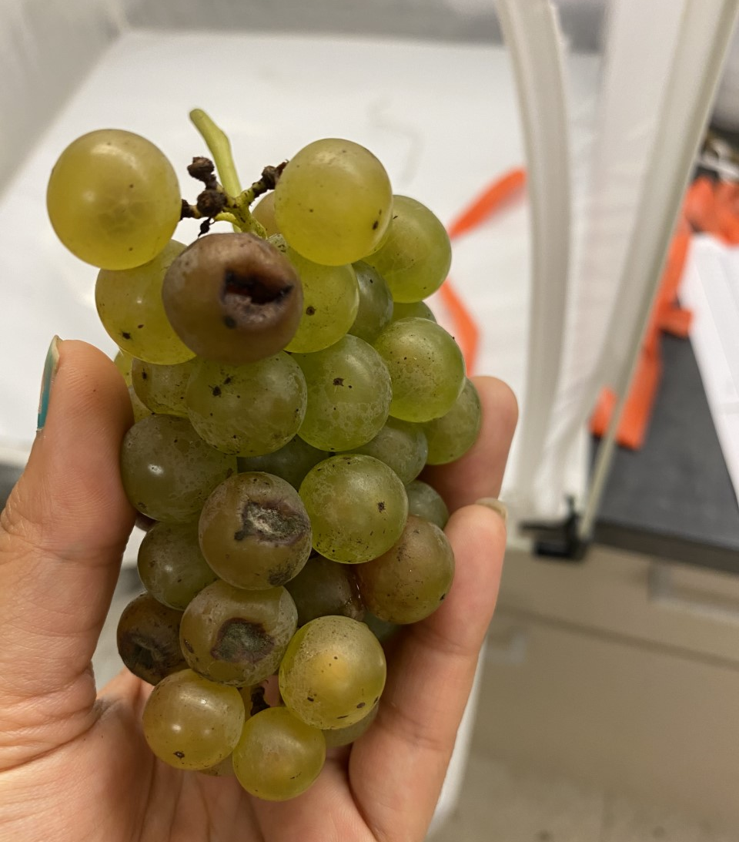
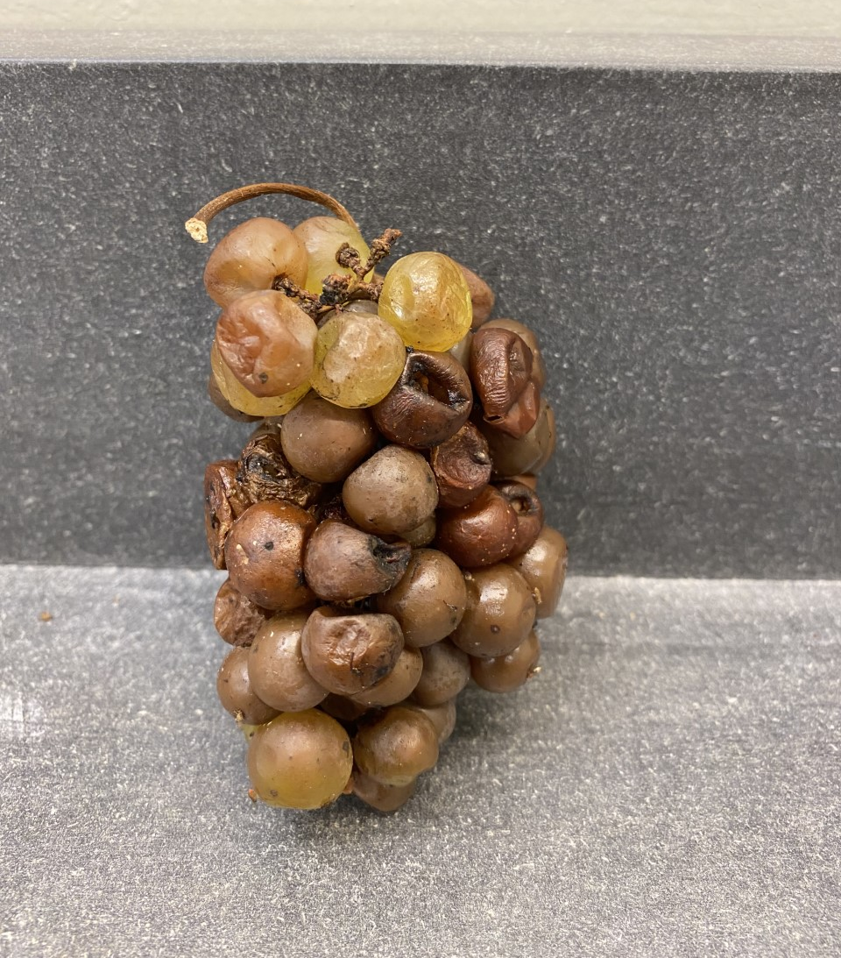
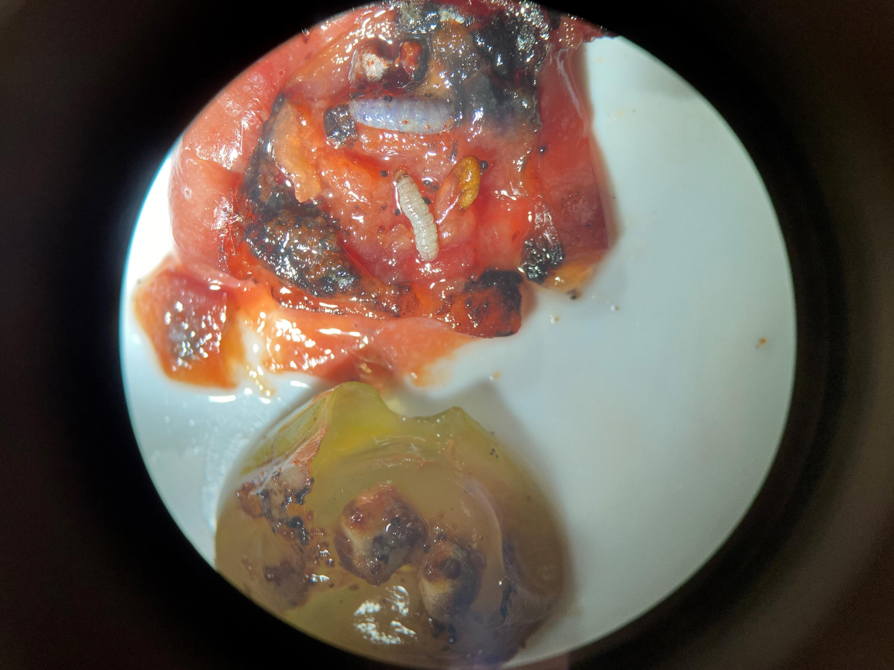
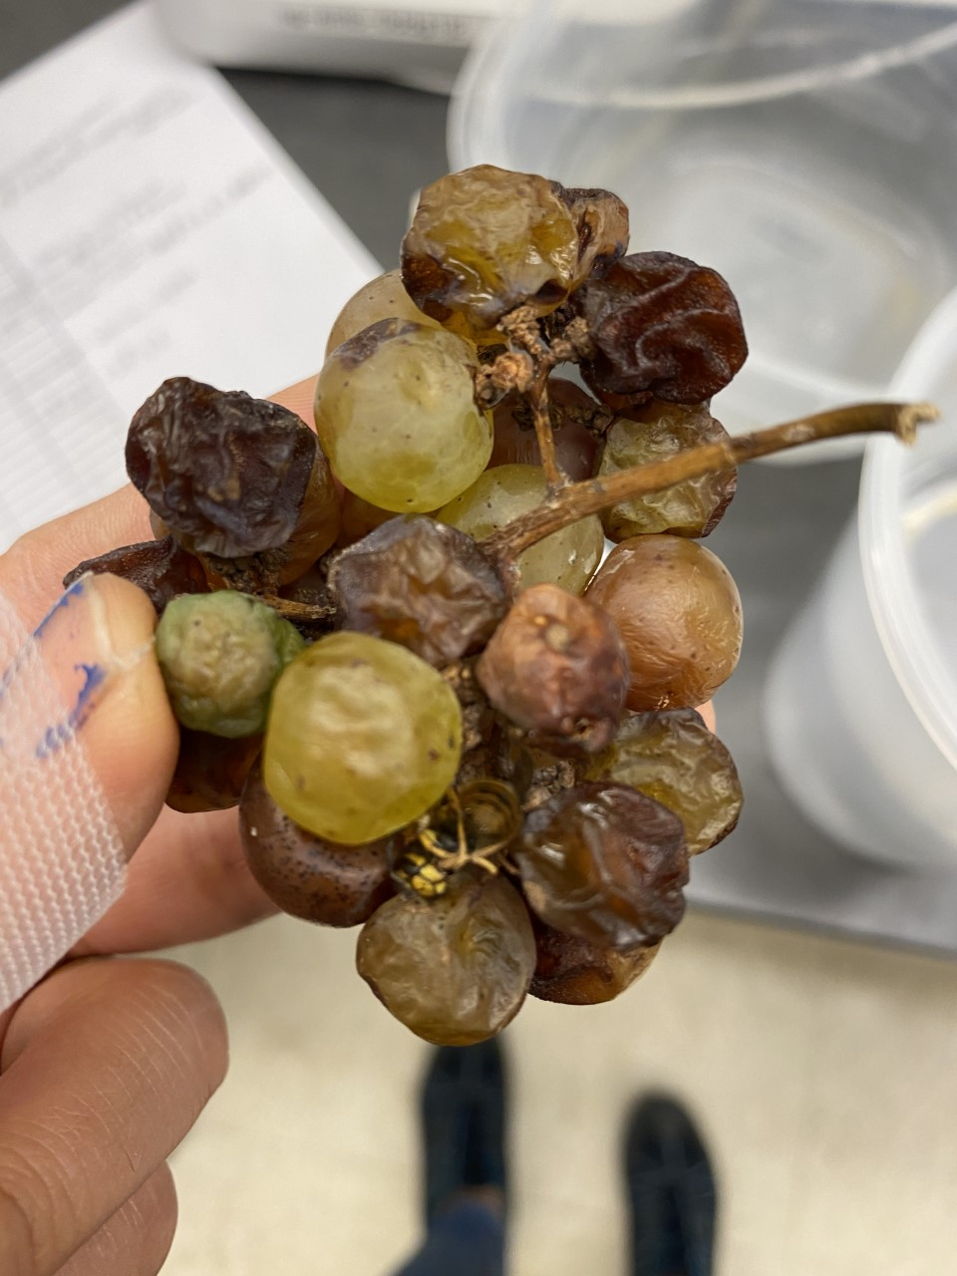
1
2
3
4
1. Mechanical damage
2. Mechanical damage with D.mel
3. GBM larvae
4. Damage from yellow jacket
5. Damage from yellow jackets and D. mel
5

Slide 7
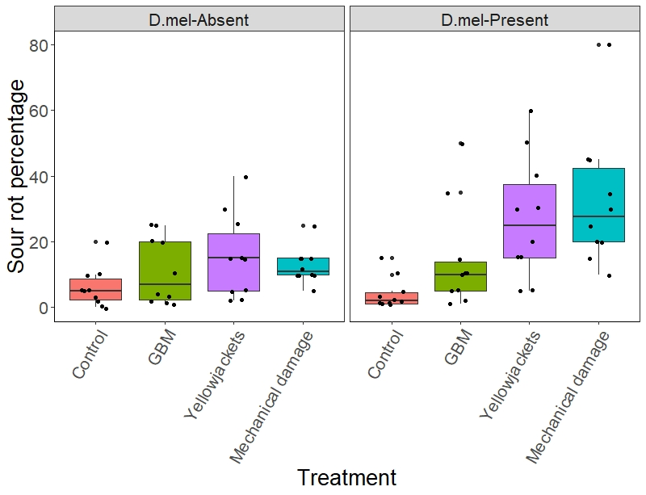
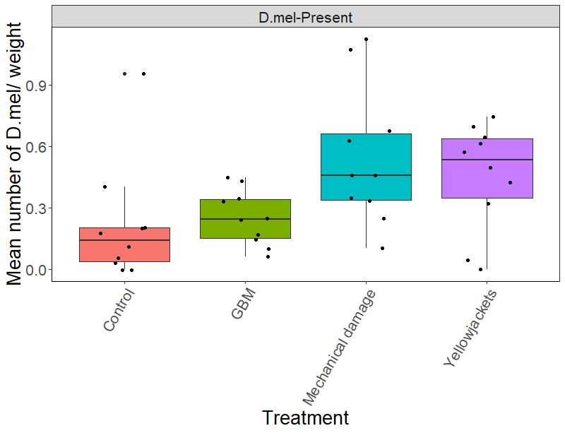
Background Hypothesis Method Result Discussion Conclusion
Figure showing mean percentage of sour rot in different treatments
Figure showing mean number of D. mel per cluster weight in different treatments

Slide 8
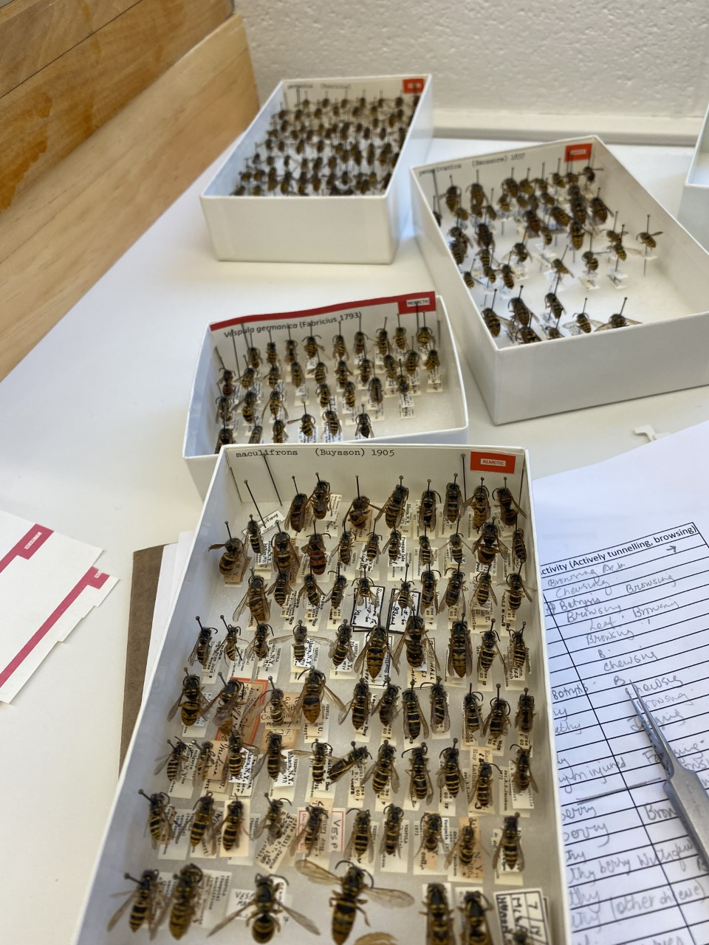
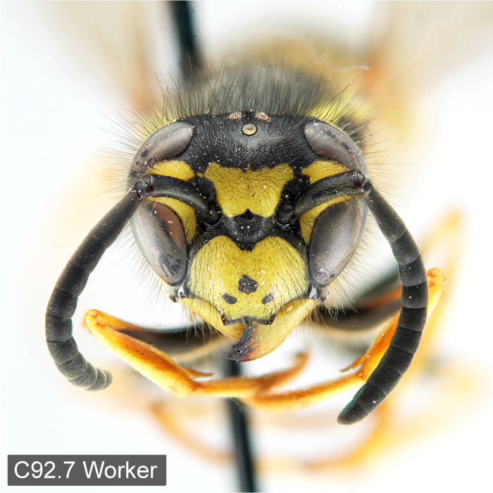
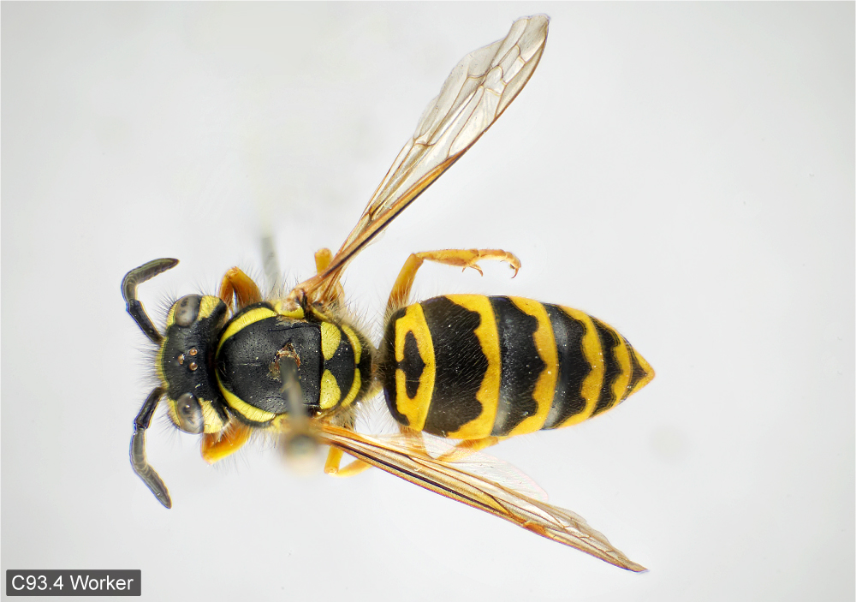
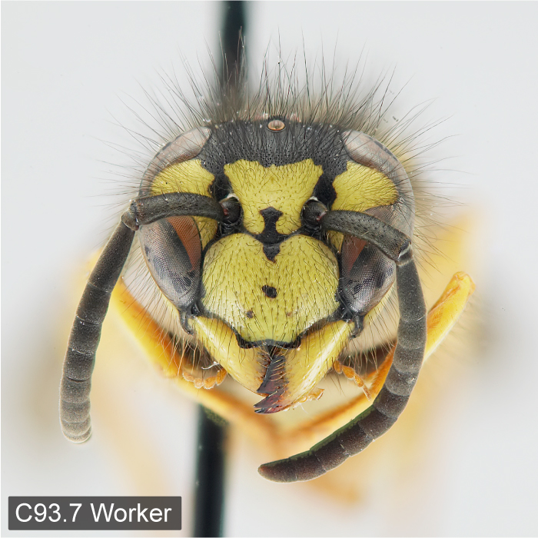
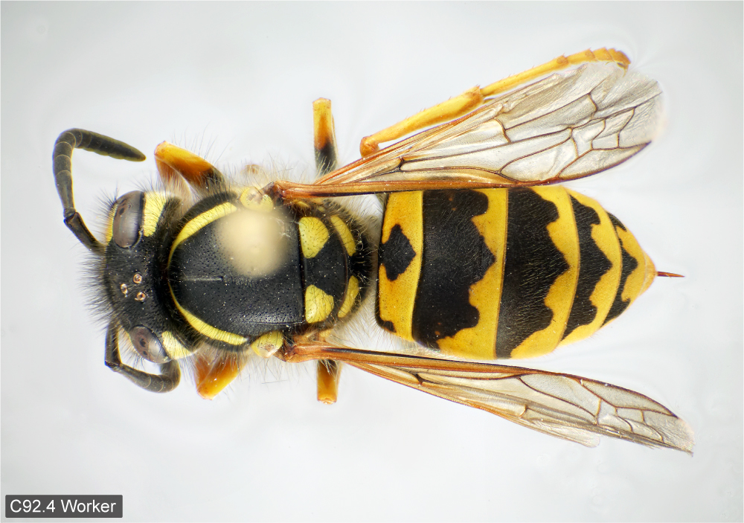
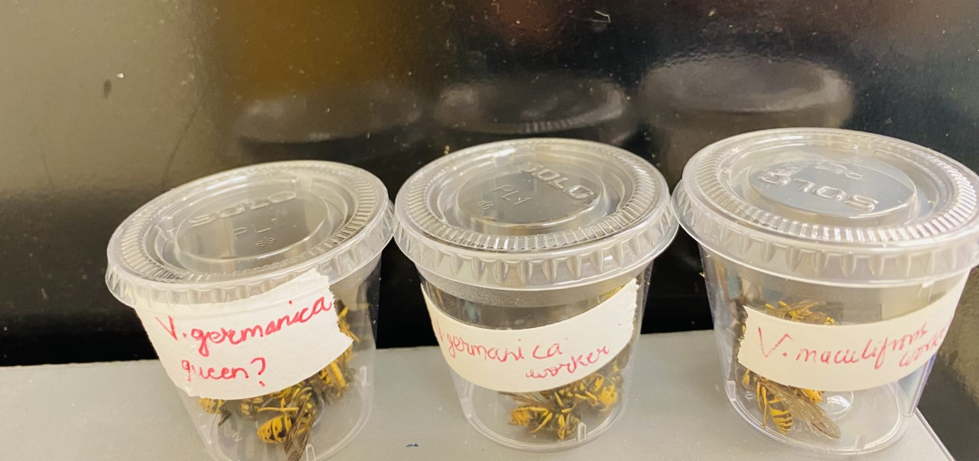
Background Hypothesis Method Result Discussion Conclusion
Yellow jacket Identification from bagged experiment
Vespula maculifrons
V. maculifrons
Cornell University Insect Collection
V. germanica
V. germanica
Identification Atlas of the Vespidae (Hymenoptera, Aculeata) of the northeastern Nearctic region
Buck et al. 2008

Slide 9
Background Hypothesis Method Result Discussion Conclusion
Mechanical damage drastically increases sour rot in the presence of D.mel
Yellowjackets cause injury and increase sour rot in the presence of D.mel
Role of GBM in sour rot was not understood well due to poor establishment of GBM in the tested cluster.

Slide 10
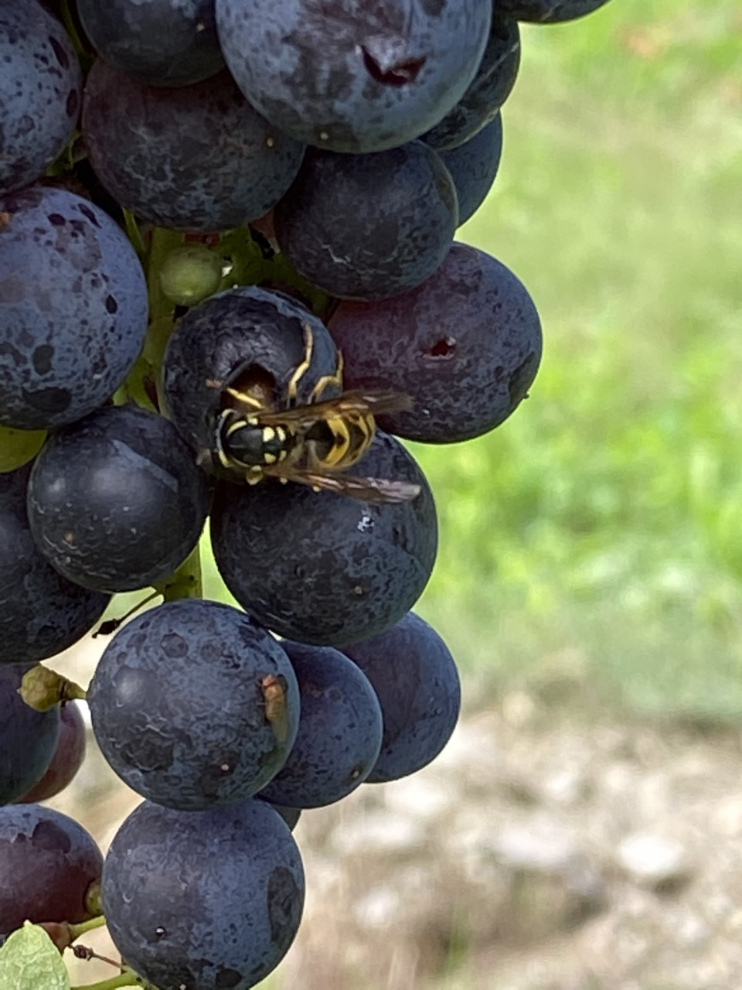
Future Directions
Assessing microbiota on and in body of yellowjackets
Evaluating ability to disperse microbes by yellowjackets
Assessing predominant species and species-specific injuries in grape clusters in vineyards

Slide 11


Acknowledgements:
Loeb Lab
Dr. Greg Loeb
Stephen Hesler
Yaroslav Grynyshyn
Emma Rosser
Gabrielle Brind’ Amour
Keren Wentworth
Samantha Wilden
Dr. Nicholas Aflitto
Dr. Linnea Ruth Meier
Cox lab
Cornell University Insect Museum

