Slide 1
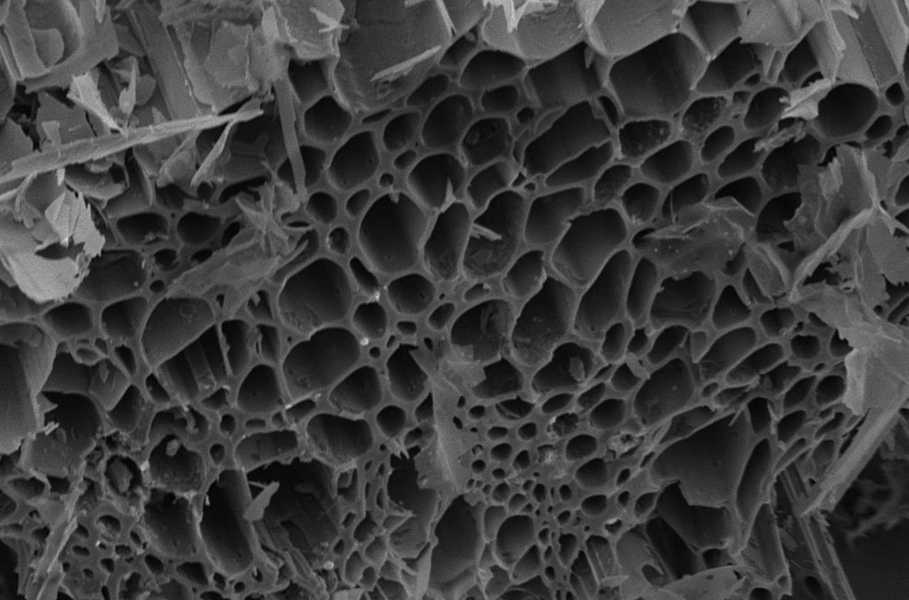


Biochar: A Win-Win for Agriculture, Forestry, and the Environment
Stephen Machado
Oregon State University
OSU – Columbia Basin Agricultural Research Center
stephen.machado@oregonstate.edu
541 278 4416
Resource Advisory Councils Meeting
The John Day/Snake RAC and the SE Oregon RAC, October 20, 2022
Notes:
The topic of my presentation is Biochar: A Win-Win for Agriculture, Forestry, and Environment
I have been working on biochar since 2012 and based on the results, I think biochar has a potential to increase agricultural productivity, reduce forest fires, and mitigate climate change effects

Slide 2
What is Biochar?
Biochar is charcoal produced from pyrolysis (combustion at low oxygen levels) biomass and carbonization
Pyrolysis and carbonization occur at temperatures from 200 to 1000° C
Resistant to decomposition (50% C, half-life 100-1000 years)
Notes:
What is Biochar?
Biochar is charcoal produced from pyrolysis (combustion at low oxygen levels) and carbonization of biomass
Pyrolysis and carbonization occur at temperatures from 200 to 1000° C
Biomass from crop and tree residues can be used as feedstock for biochar production
Resistant to decomposition (50% C, half-life 100-1000 years), that to say, if biochar is applied to the soil, it would take 100 to 1000 years before half of is decomposes

Slide 3
Major Constrains in Dryland Wheat Production in the PNW
Soil organic matter (carbon) decline
Increasing soil acidity
Notes:
Today I will present the work I am doing with biochar on Dryland Wheat Production
Major Constrains in Dryland Wheat Production in the PNW
Soil organic matter (carbon) decline
Increasing soil acidity

Slide 4
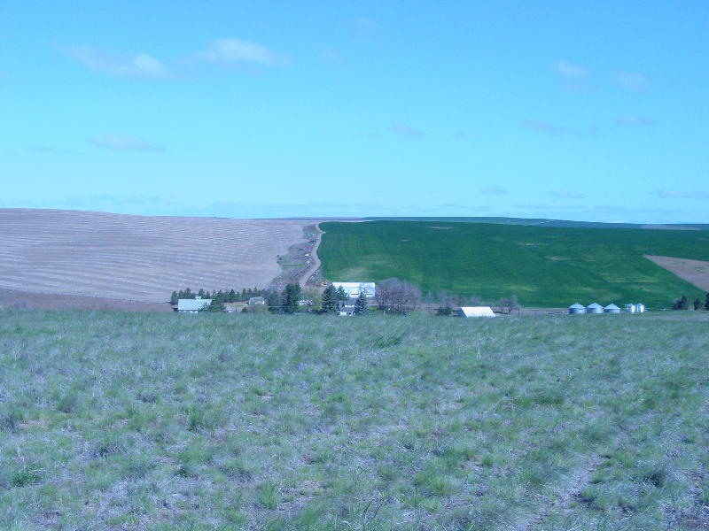
Winter Wheat-Summer Fallow
Fallow year
Crop year
Notes:
We have about 4.5 million acres of dryland wheat in the PNW
Most of the dryland regions do not receive enough precipitation to grow a crop every year (9-12 inches)
So fallowing one year to conserve soil moisture is practiced
Typically the fallow conserves about 30% of precipitation and this amount plus crop-year precipitation is enough to produce high and reliable yields
The downside is that by growing one crop in two years, there is not enough residue returns to maintain or build up SOC
As a result, the WW-SF system has been depleting SOC over the years and some systems have lost more than 50% of SOC present when cultivation began in the 1800s

Slide 5
Soil carbon in the 0-60 cm soil depth profile
Notes:
This is a graph of the Crop Residue Long-term Experiment at CBARC Pendleton showing soil organic carbon (SOC) trends under winter wheat – summer fallow (WW-SF) system starting in the 1930s to the present
Soil organic carbon is decreasing in all WW-SF practices except where cattle manure is being applied

Slide 6
Soil Organic Carbon and Nitrogen, Crop Residue, Winter Wheat-Summer fallow-LTE, Pendleton, 2010
Notes:
Compared to the Grass Pasture (represented as GP in this graph) , an area in proximity to the experiment, all WW-SF practices are losing SOC

Slide 7
Notes:
We observe similar trends in WW-SF fields in Sherman and Umatilla Counties where we sampled WW-SF and compared with the cemeteries that have not been cultivated since the start of settlements
We need 5000 to 6500 lbs of crop residues annually to maintain SOC; The WW-SF system produces half this amount

Slide 8
Notes:
In another LTE of W-P rotation, we see that SOC is maintained and even increased in this rotation.
This is because we are growing a crop each year and injecting and retaining enough biomass to maintain SOC

Slide 9
Soil Acidity
0-4 inches
4-8 inches
Soil pH
8-12 inches
12-24 inches
Lbs N per acre
Notes:
Another major problem we are running into is increasing soil acidity
Use of nitrogen (N) fertilizers containing ammonium-N is the primary reasons for increasing soil acidity
Examples of ammoniacal N fertilizers include Ammonium Nitrate, Anhydrous Ammonia, Urea, UAN Solutions, Diammonium Phosphate (DAP), Ammonium Sulfate, Monoammonium Phosphate (MAP)
Alternatively Potassium Nitrate and Calcium nitrate do not cause acidity but are very expensive
Process: As the ammonium-N in fertilizers undergoes nitrification (conversion of ammonium to nitrate in soils by bacteria), hydrogen (H+) is released, which can increase acidity. As the percentage of ammonium increases in a given fertilizer the acidifying potential will also be increased, thus reducing pH.

Slide 10
Notes:
We are observing increasing acidity in our dryland wheat systems in growers fields
Soil pH in soils sampled from growers’ fields in Umatilla is now around 5 in the top foot
Soils from cemeteries, where no N has been applied, have soil pH above 6

Slide 11
Notes:
Soil pH has reached below 5 in the top 4 inches in these fields

Slide 12
Notes:
We observed a similar situation in Sherman County fields
Most fields have pH below 5 in the top 4 inches
Soils from cemeteries, where no N has been applied, have soil pH above 6

Slide 13
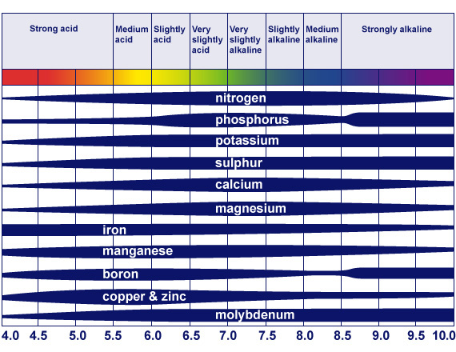
Notes:
When soil pH drops below 5, deficiencies of N, P, K, Ca, S, Mg occurs
The concentrations of Aluminum, Iron, and Manganese increase resulting in toxicity for the plant roots

Slide 14
Low pH Effects
Soil pH | % Fertilizer Efficiency |  |  | % Fertilizer Unavailable
 | N | P | K
5.0 | 53 | 34 | 52 | 54
5.5 | 77 | 48 | 77 | 33
6.0 | 89 | 52 | 100 | 20
7.0 | 100 | 100 | 100 | 0
Notes:
pH regulates nutrient availability with most nutrients available at pH values near neutral, i.e. 7
Nutrient availability decreases as the pH decreases or as soil acidity increases

Slide 15
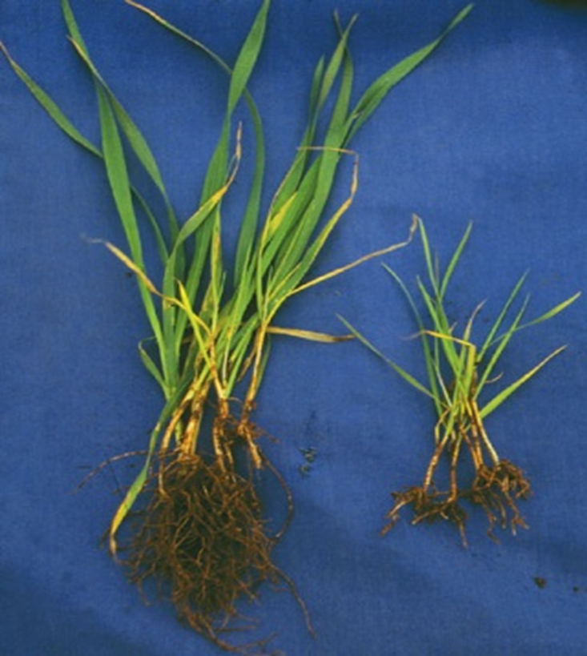
Low pH Effects
Plant Health
  Deficiencies (N, P, K, Ca, S, Mg)
  Toxicity (Aluminum, Iron, Manganese)
Microbial Community
  Rhizobia
Plant Diseases
  Cephalosporium
Herbicides
  Triazine
  Sulfonylurea
Notes:
Deficiencies (N, P, K, Ca, S, Mg) and Toxicity of Aluminum, Iron, and Manganese negatively affects soil and plant health
Soil acidity affects the microbial communities required for a health soil
Some plant diseases such Cephalosporium and weeds such as cheat grass increase as soil acidity increases
The efficacy of some herbicides may be affected

Slide 16
Tillage Fertility Long-term Experiment- initiated in 1940
Notes:
Overall, increasing soil acidity reduce soil and crop health and ultimately crop yields

Slide 17
Biochar Benefits-Soil Amendment
Biochar increases
  Soil organic carbon
  soil water holding capacity,
  cation exchange capacity,
  nutrient retention capacity
  fertilizer use efficiency
  soil microbial populations (mycorrhizae, rhizobia)
  Liming agent
  Enhanced sorption of organics (herbicides, pesticides, enzymes) (Good? Bad?)
  Some evidence for increased mycorrhizal populations, rhizobial infection rates
  Used as carrier for microbially-based environmental remediation
  Lowers bulk density
Notes:
Biochar increases
Soil organic carbon
soil water holding capacity,
cation exchange capacity,
nutrient retention capacity
fertilizer use efficiency
soil microbial populations (mycorrhizae, rhizobia)
Liming agent
Enhanced sorption of organics (herbicides, pesticides, enzymes) (Good? Bad?)
Some evidence for increased mycorrhizal populations, rhizobial infection rates
Used as carrier for microbially-based environmental remediation
Lowers bulk density

Slide 18
Biochar Studies
Greenhouse – Wheat Productivity
Field –Wheat and pea productivity
    Betts Farm
    Columbia basin Agricultural research Station (CBARC), Adams (Pendleton)
    Farms (Betts, Nelson, Hartley, Johns) WSARE Procject

Slide 19
Greenhouse Studies - Wallowa County Soils
Treatment† | Nitrogen rate |  |  | Biochar rate
 | lb ac⁻¹ | Kg ha⁻¹ |  | % | Mg ha⁻¹ | Ton ac⁻¹
1. N₀B₀ | 0 | 0 |  | 0 | 0 | 0
2. N₈₀B₀ | 80 | 90 |  | 0 | 0 | 0
3. N₈₀B_{0.5} | 80 | 90 |  | 0.5 | 10 | 4.5
3. N₈₀B_{1.0} | 80 | 90 |  | 1.0 | 20 | 9
3. N₈₀B_{2.0} | 80 | 90 |  | 2.0 | 40 | 18
Notes:
Working with Matt King an others in Wallowa County, we conducted greenhouse studies using soils from 5 growers
The treatments were as follows
We grew wheat in pots and assessed yields and other parameters

Slide 20
Table 1. Physical and chemical properties of soils and biochar used in the study
Wallowa County
Site | pH | Bulk Density | OM | EC | NO₃⁻-N | NH₄⁺-N | Bray-P | Extractable K | Total Bases | Estimated CEC
 |  | g cm⁻³ | g kg⁻¹ | dS/m | ----------------------mg kg⁻¹----------------------- |  |  |  | Cmol_{c} kg⁻¹
Butterfield | 5.46 | 1.16 | 3.4 | 0.68 | 22.2 | 3.2 | 24 | 77 | 16.2 | 21.6
Carman | 5.90 | 1.19 | 3.6 | 0.60 | 17.8 | 1.8 | 25 | 203 | 11.1 | 14.4
Dawson | 5.21 | 1.19 | 4.2 | 0.81 | 22.7 | 3.1 | 83 | 282 | 14.1 | 19.4
Melville | 5.50 | 0.90 | 11.4 | 1.40 | 45.7 | 5.8 | 115 | 440 | 25.8 | 33.5
Wolf Ranch | 5.42 | 1.13 | 6.2 | 1.69 | 79.7 | 3.7 | 35 | 289 | 16.4 | 22.0
Biochar | 9.94 | 0.12 | - | 1.58 | 2.8 | 11.0 | - | - | - | -
Notes:
Here is the soil analysis results of the farms
Melville had very high SOM and it appears that this negatively affected whet yields

Slide 27
Field Studies-Betts Field
This study evaluated the effects of biochar derived from forest wastes on wheat grown under chemical fallow starting in 2012.
Biochar rates were 0, 10, 20, and 40 tons/acre.
The biochar contained 90% C, 0.18% N, C/N of 500, and a pH of 10.6.
Winter wheat (Clearfield 102) was sown in the fall of 2012.
Grain yield, ears/m², and test weight were determined at maturity in 2013.
Soil pH of biochar amended soil was determined after wheat harvest.

Slide 28
Notes:
Increasing biochar increased soil pH by about 0.2 units from 5.8 to slightly above 6
And grain yield by almost a ton/ha

Slide 29
Notes:
Biochar was only applied in 2012 but we continued to monitor yields in the second year
This was a wheat – pea rotation, so we monitored the yields of peas after wheat and observed that pea yields were also increased in plots with biochar except for the highest rate
We wanted to continue the work at the farm by in the following year the grower harvested without informing us and so we lost the data
We then decided to start another experiment at the Pendleton Station where we have more control of the plots

Slide 30
Biochar Long-term Experiment – CBARC, Pendleton 2013
Wheat |  |  |  |  |  | Pea
 | Trt | Biochar (tons/a) |  | N (lbs/a) |  |  | Biochar (tons/a) |  | N (lbs/a)
 | 1 | 0 |  | 16 |  |  | 0 |  | 0
 | 2 | 0 |  | 84 |  |  | 0 |  | 16
 | 3 | 5 |  | 84 |  |  | 5 |  | 16
 | 4 | 10 |  | 84 |  |  | 10 |  | 16
 | 5 | 20 |  | 84 |  |  | 20 |  | 16
Notes:
We initiated another biochar experiment in 2013 at CBARC with the following rates

Slide 31
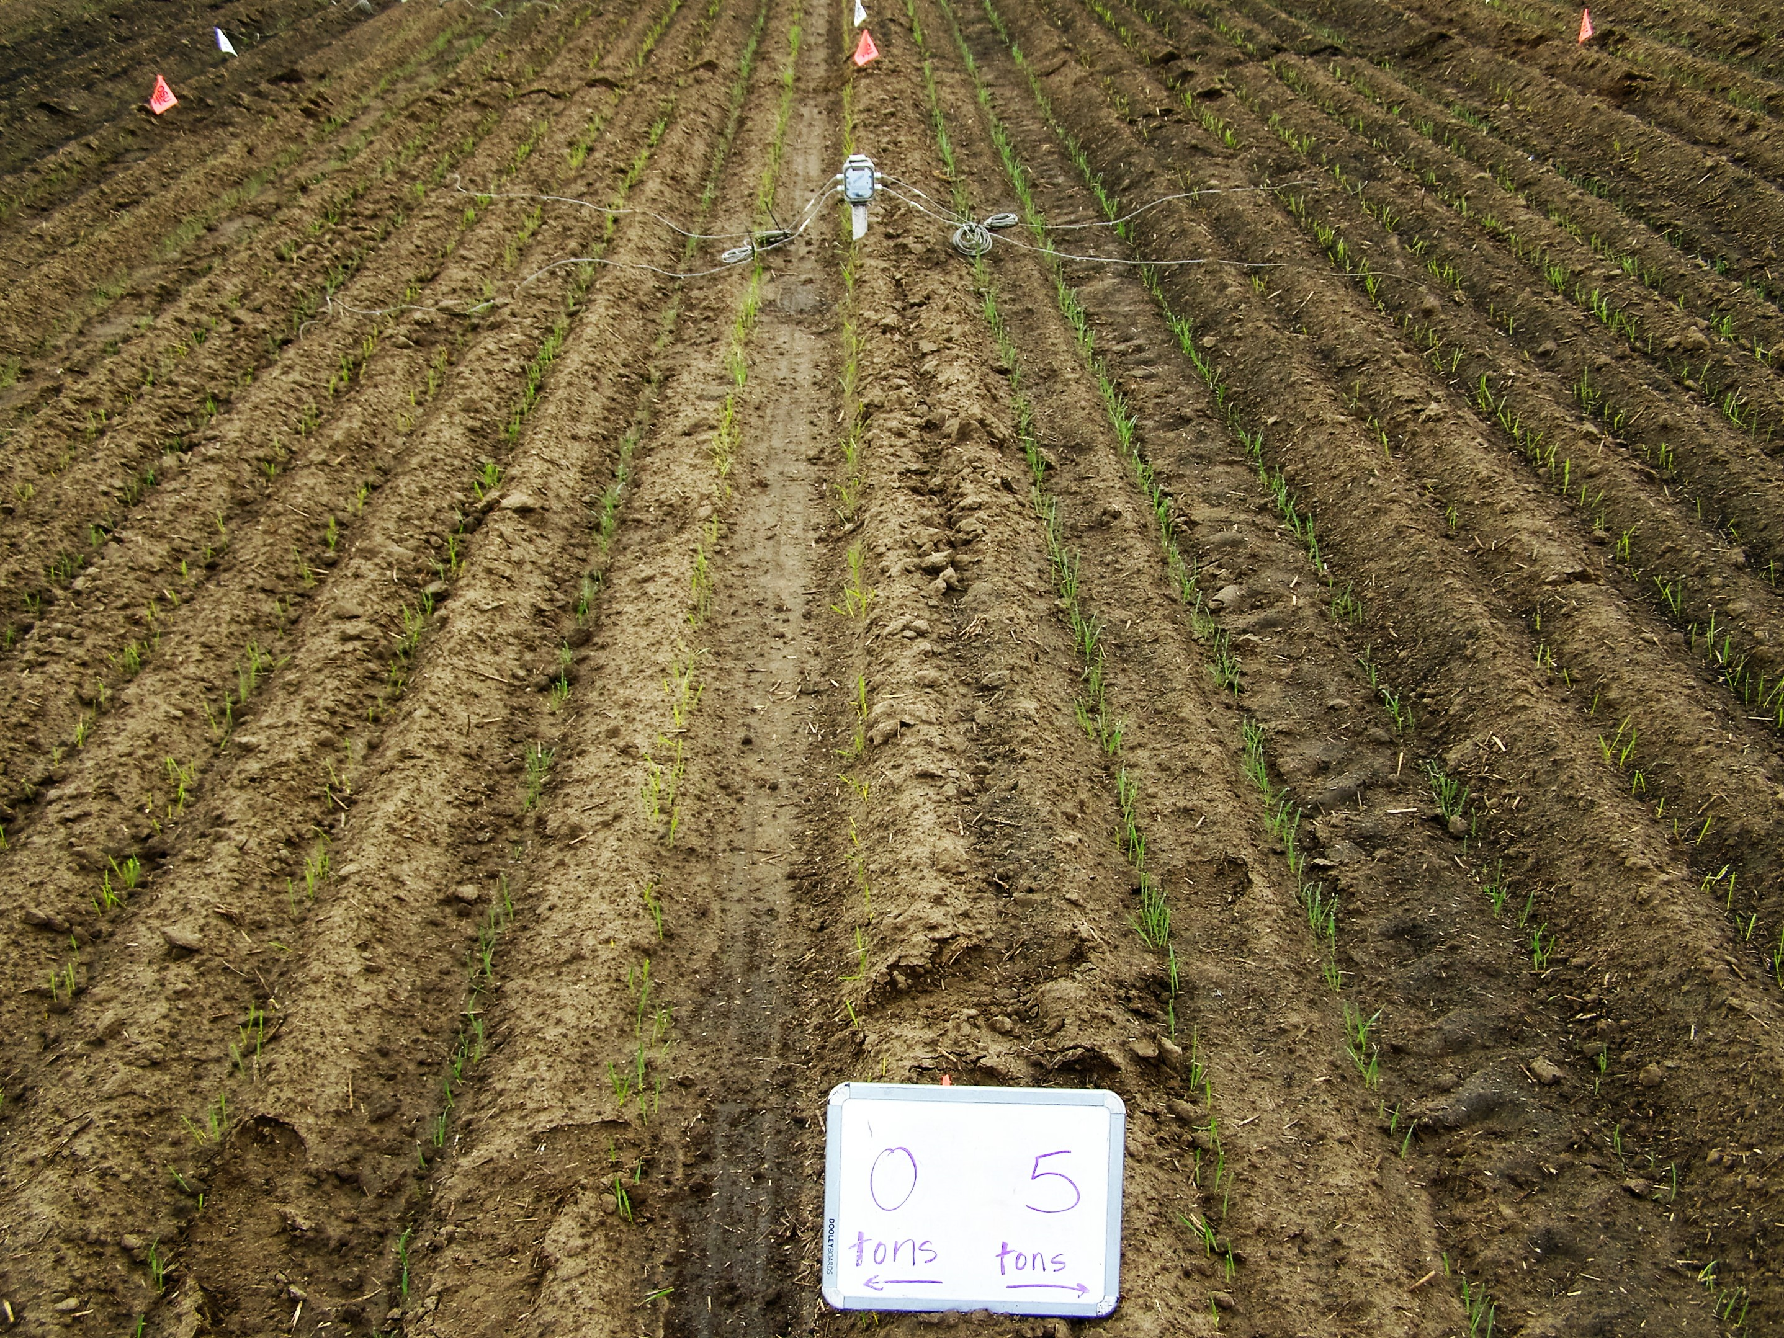
Notes:
This is the 5 ton /a rate

Slide 32
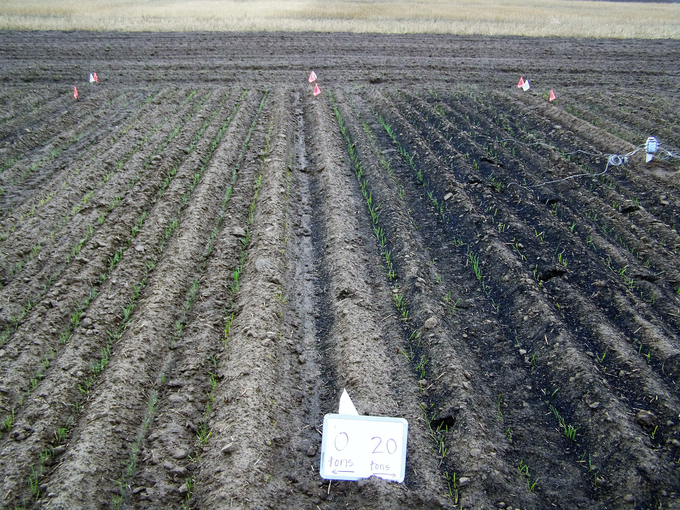
Notes:
20 ton/a rate
We disked it in but a lot remain visible
Biochar was applied only in 2013 and never applied again
This experiment is in its 10 year but the results I am showing are for 8 year. Didn’t get the time to add 2020 and 2021

Slide 33
Notes:
This graph shows the effect of biochar rates on wheat yields
Overall, increasing biochar increased wheat yields
5 tons per acre was optimum

Slide 34
Biochar and Wheat Yields
Notes:
This graph shows biochar effects on pH and wheat grain yield with 5 tons/a as the optimum rate (in blue)
Biochar increased soil pH
Biochar effects on pH and grain yield have persisted for 8 years. The experiment continues to see how long the effects will last

Slide 35
Notes:
This graph shows the effect of biochar rates on pea yields
Overall, increasing biochar increased pea yields
5 tons per acre was optimum

Slide 36
Biochar and Pea Yields
Notes:
We observed the same results in peas
In fact you can see the differences during in-season crop growth
Overall, the reduction of soil acidity and the increase SOC may have increased crop yields

Slide 37
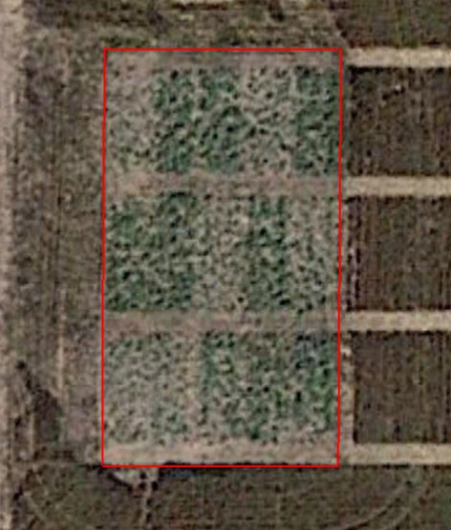
Google Earth picture showing spring pea growth under different biochar rates (2016)
1 3 5 2 4
Biochar (CBARC) Treatment code
 | Wheat |  | Pea
Trt | Bioch | Fert N | Bioch |  | Fert (N)
1 | 0 0 5 10 20 | 16 84 84 84 84 | 0 |  | 0
2 |  |  | 0 |  | 16
3 |  |  | 5 |  | 16
4 |  |  | 10 |  | 16
5 |  |  | 20 |  | 16
4 5 2 3 1
1 2 3 4 5
Biochar (tons/a)
Fert N (lbs/a)
Notes:
This figure shows Google Earth picture showing spring pea growth under different biochar rates
The differences in growth of spring peas is very evident from google earth photo
The more the biochar, the more the growth of the peas

Slide 38
Notes:
Here is another look at pH taking into account soil depth
pH increased with increase in biochar rates in the top 4 inch or 10 cm which is the layer we incorporated the biochar
That indicates alkaline biochar can be a great liming agent and one that is applied every 8 years for now. The experiment is still on going

Slide 39
Notes:
Obviously SOC increased with increase in biochar application rates
So in addition to reducing soil acidity, alkaline biochar reduces soil acidity; killing two birds with one stone so to say

Slide 40
Notes:
We did not expect ant N contribution from this biochar
The analysis showed that the biochar we used had only 0.18 %N

Slide 41
Notes:
Buk density decreases with increases with biochar rates
Very important given the compaction cause by heavy machinery

Slide 42
Notes:
CN ratio is higher with higher biochar application rates
This may tie up N and reduce yields at higher rates
This is the reason it maybe necessary to charge the biochar with nutrients before application

Slide 43
WSARE Project
Farm | Precipitation (in) | Biochar Treatment (tons/a)
Betts | 18-20 | 0 | 2.5
Johns | 17-22 | 0 | 2.5
Hartley | 17-22 | 0 | 2.5
Nelson | 11-12 | 0 | 2.5

Slide 44
Notes:
-Experiment on-going

Slide 45
Biochar Solution
Studies show that biochar can be the solution to both SOC depletion, soil acidification, climate change mitigation
However, there is need to “match” the biochar to the soil. Our soils are acidic and need alkaline biochar; the biochar we used had a pH of 10
Biochar source and cost remain prohibitive
Luckily our farms are in proximity to the forests
Biochar used in studies was produced by Biological Carbon using Douglas Fir feedstock
Notes:
Studies show that biochar can be the solution to both SOC depletion, soil acidification, climate change mitigation
However, there is need to “match” the biochar to the soil. Our soils are acidic and need alkaline biochar; the biochar we used had a pH of 10
Biochar source and cost remain prohibitive
Luckily our farms are in proximity to the forests
Biochar used in studies was produced by Biological Carbon using Douglas Fir feedstock

Slide 46

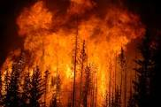

Forest Fires
Notes:
Producing biochar from forest waste helps reduce the fuel load responsible for the fires that are getting worse and worse use to climate change

Slide 47

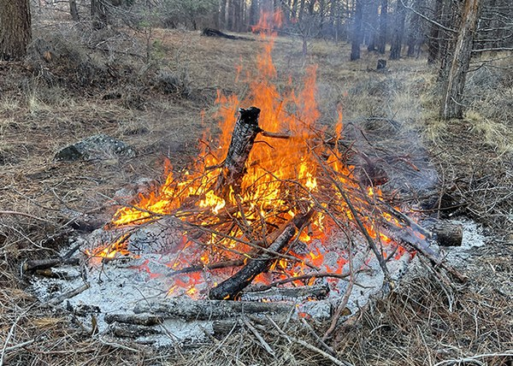
Notes:
It is reported that 1 Kg of wood contains about 450 to 500 gm of Carbon.
This means 1 Kg of wood is holding about 1.65 to 1.80 Kg of CO2.
This is how wood or forest act as carbon sink.
Similarly burning of 1 kg of wood will generate 1.65 to 1.80 Kg of CO2.

Slide 48
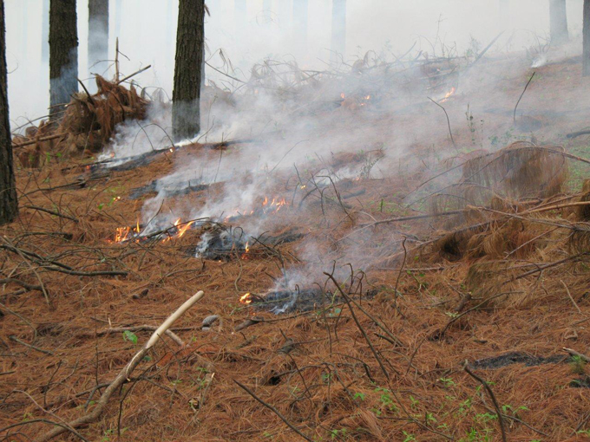
Notes:
If we produce biochar from forest waste instead of burning this biomass, we can reduce CO2 emissions and mitigate climate change effects

Slide 49
Climate Change Mitigation
Reduction in
  CO₂ : Biochar could offset a maximum of 12% of anthropogenic GHG emissions on an annual basis. Over the course of 100 years, this amounts to a total of roughly 130 petagrams (106 metric tons) of CO2-equivalents. (Woolf et al, 2010),
  A Win-Win for Agriculture, Forestry & Environment
Notes:
Reduction in
CO2 : Biochar could offset a maximum of 12% of anthropogenic GHG emissions on an annual basis. Over the course of 100 years, this amounts to a total of roughly 130 petagrams (106 metric tons) of CO2-equivalents. (Woolf et al, 2010),
A Win-Win for Agriculture, Forests, and Environment

Slide 50
?
Direct questions to:
stephen.machado@oregonstate.edu

Slide 55
Carbon input Requirements
Cropping System | Minimum Straw Required to maintain SOC (Mg ha⁻¹ yr⁻¹) | Straw Biomass Produced (Mg ha⁻¹ yr⁻¹)
Wheat – Fallow Crop Residue LTE (1976-2005) | 7.33 | 3.56
Wheat Fallow Tillage Fertility (1984-2005) | 5.90 | 4.33
Annual Cropping Wheat – Spring Pea LTE (1995-2005) | 5.14 | 5.15
Notes:
The WW-SF system losses SOC because of producing about half the biomass needed to maintain SOC while the annual cropping system produces enough residue to maintain SOC

Slide 56
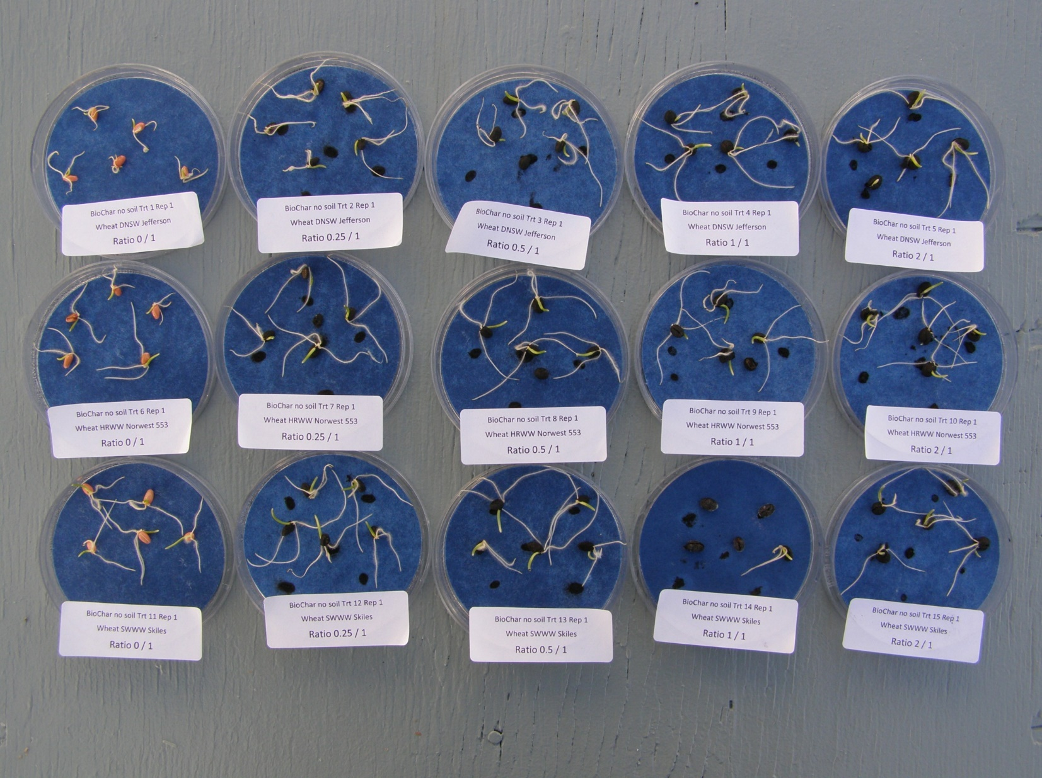
Notes:
Given the expense of biochar at that time, we were trying to use as little as we could but get some benefits
In this case we observed faster germination in seed coated with biochar, and that can make a difference in dryland agriculture
If seed remain in the soil for too long without germinating, they can be susceptible to fungal or bacterial infection and die

Slide 57
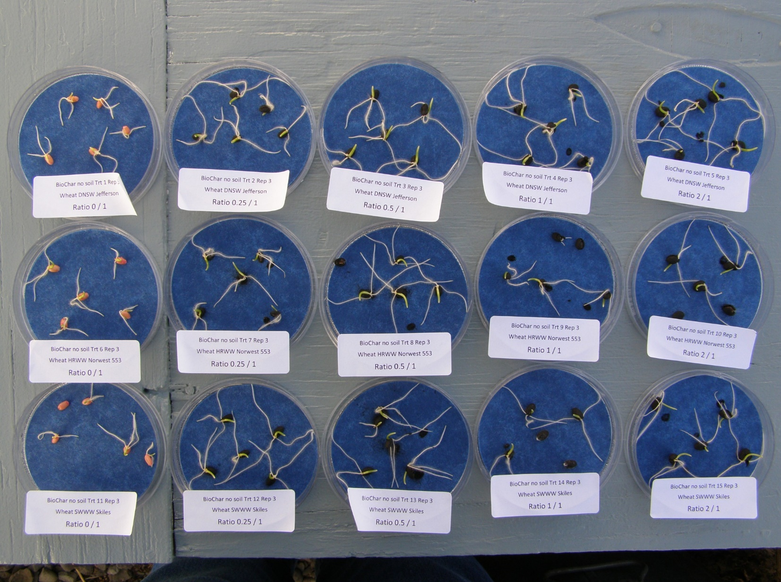

Slide 58
Table 3. Effect of biochar on wheat grain yield.
Treatments: 0 lb N ac⁻¹ (N₀) and 80 lb N ac⁻¹ (N₈₀) in combination with biochar rates of 0% (B₀), 0.5% (B_{0.5}), 1.0% (B_{1.0}), and 2.0% (B_{2.0}).
Soil Type | N₀B₀ (control) | N₈₀B₀ | N₈₀B_{0.5} | N₈₀B_{1.0} | N₈₀B_{2.0}
 | ------------------------Wheat grain yield (g pot⁻¹) ----------------------
Butterfield | 2.00 | 2.81 | 3.98 | 4.43 | 4.67
Carman | 0.98 | 1.74 | 1.44 | 1.56 | 2.24
Dawson | 2.09 | 2.95 | 3.57 | 3.65 | 6.22
Melville | 3.40 | 1.79 | 4.18 | 3.75 | 2.35
Wolf | 3.35 | 2.90 | 3.18 | 4.31 | 5.27
Notes:
Except for Melville soils, increasing biochar increased wheat biomass and grain yields
We think adding biochar to a soil already high in SOM negatively affected grain yields when biochar was applied above 5 tons/a

