Slide 1
Body Condition Scoring Beef Cattle
Kim Mullenix, Ph.D.
Extension Specialist/Assistant Professor
Auburn University

Slide 2
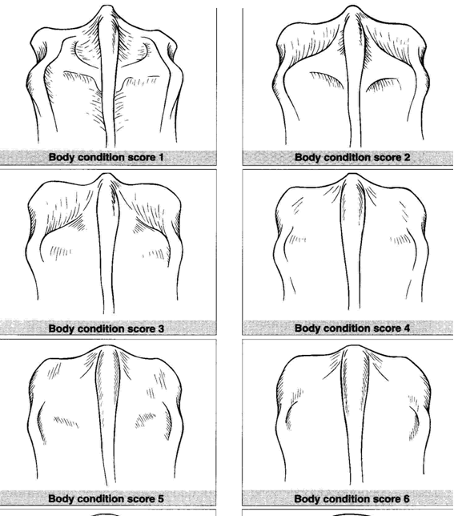
Numeric scoring system
1-9
Field estimation of body energy reserves
Also affects: reproduction, feed efficiency, $$$$
Body condition score 1
Body condition score 2
Body condition score 3
Body condition score 4
Body condition score 5
Body condition score 6

Slide 3
Goals and Considerations for BCS in the Cow Herd
Mature cows – Minimum BCS 5 is recommended at calving
Heifers are still growing and have slightly higher nutrient requirements
Calve at BCS 6
Realistically – cattle will lose one BCS after calving during peak lactation

Slide 4
Why is BCS Important After Calving?
Energy Reserves
Recovery from calving
Lactation
Daily maintenance
Breeding occurs in the months shortly after calving
Table 1. Relationship of body condition score to beef cow performance.
BCS | Preg. Rate (%) | Calving Interval (days)
3 | 43 | 414
4 | 61 | 381
5 | 86 | 364
6 | 93 | 364
Source: Kunkle et al., 1998

Slide 5
Thin cows become pregnant later in the breeding season
*Time from calving to estrus
80 d
55 d
Source: Houghton et al., 1990

Slide 6
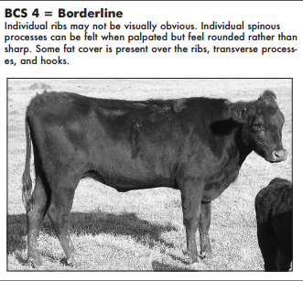
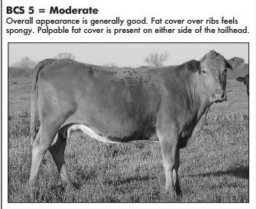
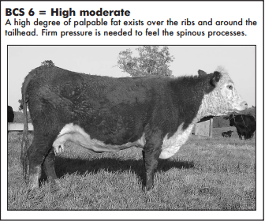
Body Condition Score
Image Source: MSUES Publ. 2508 – Parish and Rhinehart, 2008

Slide 7
Description of body condition scores
BCS | % Body Fat
1 | 3.7
2 | 7.5
3 | 11.3
4 | 15.1
5 | 18.9
6 | 22.6
7 | 26.4
8 | 30.2
9 | 33.9
Adapted from NRC, 2016; Herd and Sprott, 1986

Slide 8
Steps to Evaluating Body Condition Score
Evaluate from the front, side and rear
Ask – is skeletal structure visible or does the animal have a smooth appearance?
Look for fat deposition from front to rear

Slide 9
Steps to Evaluating Body Condition Score
Visually appraise the brisket for fat
Move over shoulder and ribs looking for bone structure
Back – spinous process and vertebrae leading to tailhead
Hooks and pins

Slide 10
Best Practices – Body Condition
When to Score
Weaning
45 days after weaning
90 days before calving
Calving
Breeding
What to Expect
5+ for cows
6+ for heifers

Slide 11
BCS – Keys to Success
Remember - Better to maintain than gain
Table A. Pounds of additional TDN required per day for 60 days to increase cow body condition score by 1 unit.
 | Cow Weight at BCS 5
BCS | 1,000 | 1,200 | 1,400
3 | 1.9 | 2.2 | 2.4
4 | 2.1 | 2.4 | 2.6
5 | 2.3 | 2.6 | 2.8
Equivalent to:
15 pounds of annual ryegrass pasture
6 pounds of mid-quality bermudagrass hay
4 pounds soyhulls
Source: NRC, 2016

Slide 12
Meeting Cow Herd Nutrient Needs

Slide 13
Pre-Partum Nutrition
Based on cattle BCS and forage quality:
Mid gestation – shortly after weaning, a time where nutrient requirements are fairly low
Additional TDN and CP may be needed entering into late gestation
Reducing energy pre-partum is not a good idea – majority of studies indicate calf BW and dystocia not impacted by energy supplementation
Funston, 2010

Slide 14
Pre-Partum Nutrition
Provide high-quality hay, digestible energy and protein supplement
Provide high-quality hay, digestible energy and protein supplement
Begin stockpiling perennials, planting cool-season annuals
Utilize stockpiled forage – supplement
warm-seasons
Warm-season forage quality/quantity declining
Limit-grazing winter annuals
Use cool-season forages in active growth
Fall Calving
(Sept – Nov)
Winter Calving
(Dec - Feb)
Spring Calving
(Mar - May)

Slide 15
Nutrient Needs – Key Times
Late Gestation
Oct Nov Dec Jan Feb Mar Apr May Jun Jul Aug Sept
Months Since Calving

Slide 16
Post-Partum Nutrition
From calving up to 80 - 90 days after
Increasing nutrition following calving can increase pregnancy rates and conception in beef cows
Dietary energy (additional TDN) is important*
Increases weight
Increasing body condition

Slide 17
Breeding Season
Provide quality forage and supplement as needed
Now isn’t the time to make up losses
Excessive protein and energy supplementation can negatively impact reproduction

Slide 18
Take Home Points
Production Goals
A live calf every year and cows to rebreed
Management Tools for Reproduction
Body condition scoring
Resources available – when to provide them
Nutrition is a moving target – adjust pre- and post-partum nutrition to maintain body condition

Slide 19
Questions?
Visit www.aces.edu/beefsystems

