Slide 1

Effectiveness of a Plant-Derived Product to Improve Udder Health in Organic Dairy Cows
Bhuwan Shrestha, Rajesh Neupane, Bob Whitney, Narayanan Paul, Sushil Paudyal

Slide 2
Thank you
This material is based upon work that is supported by the National Institute of Food and Agriculture, U.S. Department of Agriculture, through the Southern Sustainable Agriculture Research and Education program under subaward number OS24-178. USDA is an equal opportunity employer and service provider.
Any opinions, findings, conclusions, or recommendations expressed in this publication are those of the author(s) and should not be construed to represent any official USDA or U.S. Government determination or policy.

Slide 3
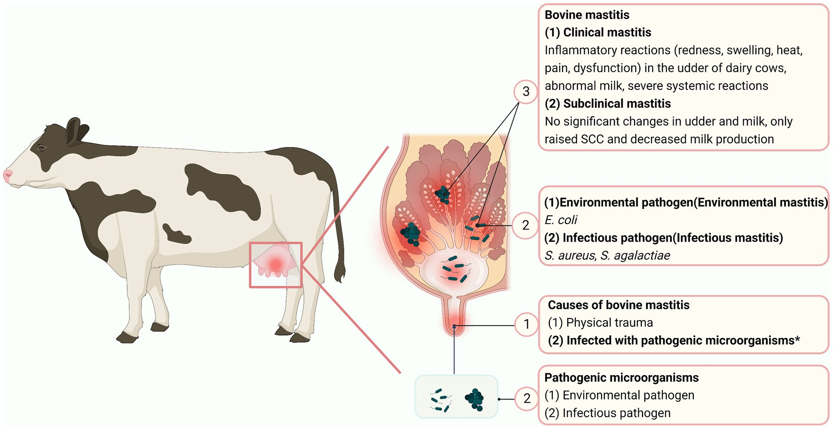
Mastitis:
  Disease affecting 30% of dairy cows globally¹
    Economic losses:
      Reducing yield and quality of milk
      Increasing culling rate
    Animal welfare and
    Sustainability of farms
  Cost the global dairy industry $20B-32B (USD) annually²
Fig: Mastitis in dairy cow (Li et al., 2023)

Slide 4
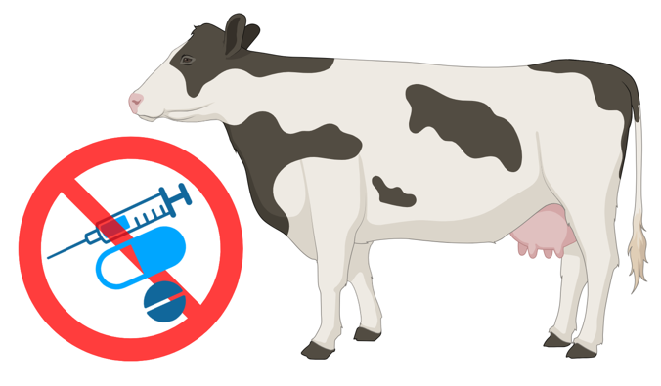
Treatment:
  Conventional dairy: Use antibiotics and non-steroidal anti-inflammatory drugs
  Organic dairy: Restrictions on antibiotics usage, limited options of treatment
    Need of viable treatment options
Source: BioRender

Slide 5
  Antimicrobial resistance
  Biofilm formation
  Quorum sensing
  Quorum quenching
    Ethanol extracts of Searsia lancea prevented biofilm formation and disrupted preformed biofilm against Streptococccus agalactiae, S. dysgalactiae, S. uberis, and Eschericia coli (Akinboye et al., 2024)
    Extracts of Liriodendron tulipifera, Quercus alba inhibited biofilm formation in Staphylococcus aureus (Detweiler et al., 2019)
Notes:
BF is one of the method of developing resistance by microorganisms against the antibiotics.
Production of biofilm is influenced by communication system between the cells by releasing chemical autoinducer or signaling molecules.

Slide 6
Objective:
  To evaluate the effectiveness of quorum sensing-based plant products in improving udder health in organic dairy cattle

Slide 7
Methods

Slide 8
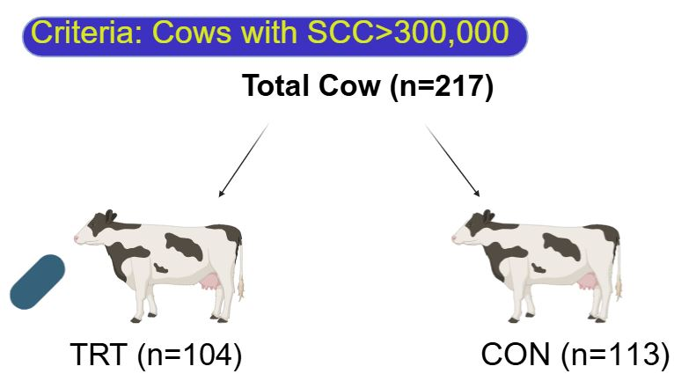
Methods
  Animals:
  Study site:
  Commercial dairy farm under certified organic management
  Central Texas
  Free stall barns with sand bedding
  Rotary milking parlor
Study period:
  Dec 2023 to Mar 2024

Slide 9
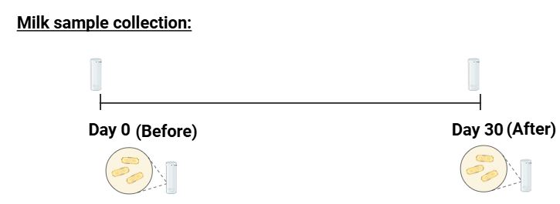
Methods..
DHIA: SCC
Culture: identification and counts (cfu)

Slide 10
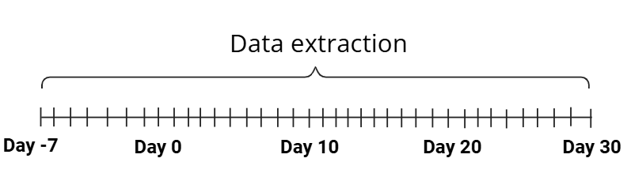
Methods..
Milk yield
Rumination time and Water intake

Slide 11
Methods..
Bacteriological cure analysis
Survival analysis
Statistical analysis: SAS 9.4
  Linear score of SCC (LSSCC) = log₂(SCC/100)+3 (Schukken et al., 2003)
  LogCFU= log₁₀ (cfu+1)
  Samples with ≥ 3 isolates (contaminated) were not included
  Pre-treatment data used as covariate
  Mixed procedure: Continuous outcome variable

Slide 12
Methods..
  PROC GLIMMIX: Bacteriological cure and its odds
  Survival analysis:
    Cox’s proportional hazard using PHREG procedure
    Kaplan-Meier curves using LIFETEST procedure
  Significance was set at P < 0.05 and tendencies at P < 0.1

Slide 13
Results

Slide 14
Results
Bacteria | Overall |  |  | Control |  |  | Treatment
 | No. | Before | After | No. | Before | After | No. | Before | After
Gram positive | 119 (27%) | 74 | 45 | 70 | 45 | 25 | 49 | 29 | 20
Staphylococcus aureus | 55 | 32 | 23 | 38 | 23 | 15 | 17 | 9 | 8
Staphylococcus chromogenes | 21 | 12 | 9 | 10 | 6 | 4 | 11 | 6 | 5
Streptococcus dysgalactiae | 11 | 6 | 5 | 8 | 5 | 3 | 3 | 1 | 2
Corynebacterium spp | 6 | 6 | 0 | 2 | 2 | 0 | 4 | 4 | 0
Streptococcus uberis | 6 | 2 | 4 | 2 | 1 | 1 | 4 | 1 | 3
Other | 20 | 16 | 4 | 8 | 5 | 3 | 9 | 7 | 2
Gram negative | 2 (0.4%) | 1 | 1 | 0 | 0 | 0 | 2 | 1 | 1
Klebsiella pneumoniae | 2 | 1 | 1 | 0 | 0 | 0 | 2 | 1 | 1
No growth | 26 | 16 | 10 | 11 | 6 | 5 | 15 | 10 | 5
Mixed | 172 | 78 | 94 | 83 | 37 | 46 | 89 | 41 | 48
Contaminated | 115 | 48 | 67 | 62 | 25 | 37 | 53 | 23 | 30
Overall | 434 | 217 | 217 | 226 | 113 | 113 | 208 | 104 | 104
Contagious | 308 (71%) | 147 | 161 | 164 | 79 | 85 | 144 | 68 | 76
Environmental | 95 (22%) | 52 | 43 | 50 | 27 | 23 | 45 | 25 | 20

Slide 15
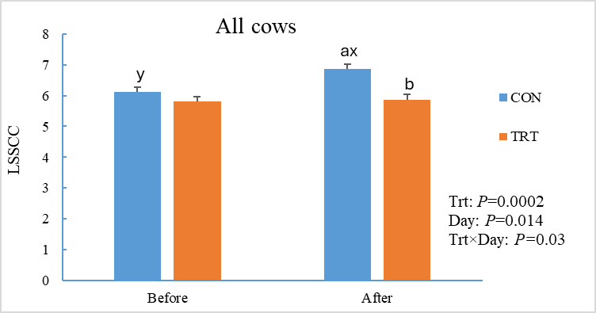
Results..
TRT had lower LSSCC vs CON

Slide 16
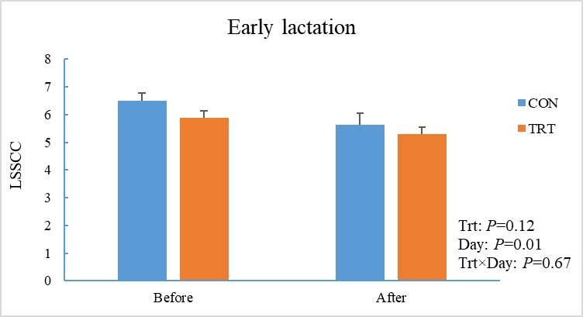
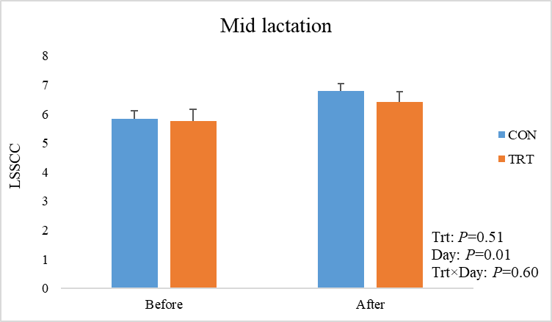
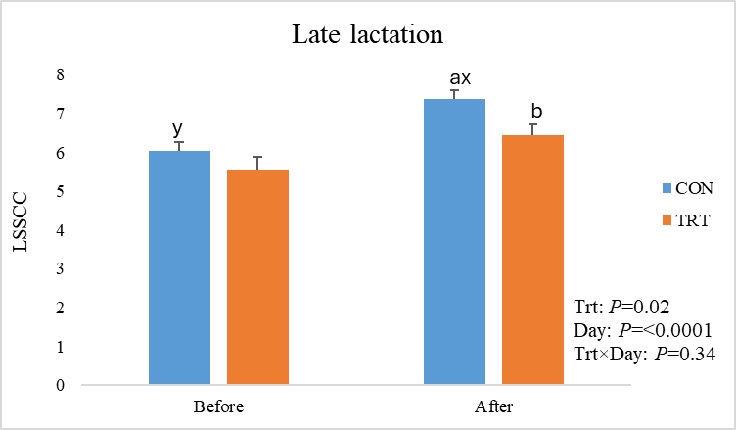
Results..
Effects in late
lactation

Slide 17
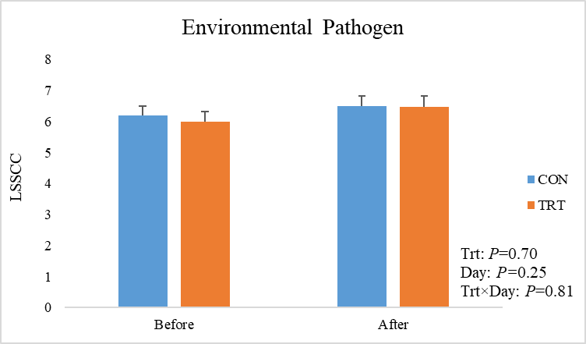
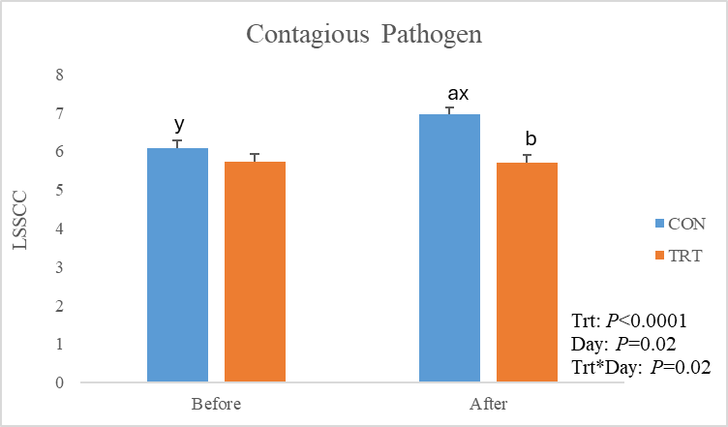
Results..
TRT had lower LSSCC vs CON in contagious mastitis events

Slide 18
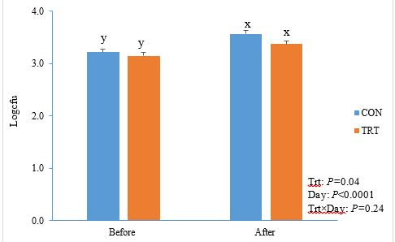
Results..
TRT had lower logcfu vs CON

Slide 19
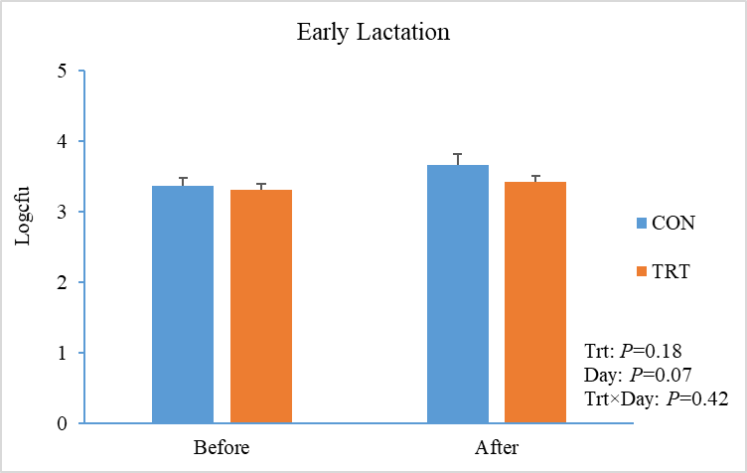
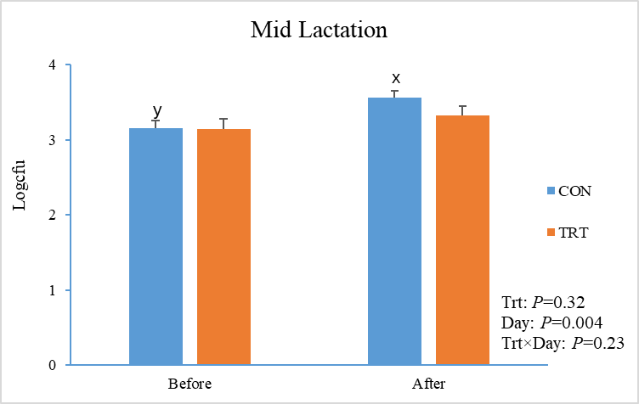
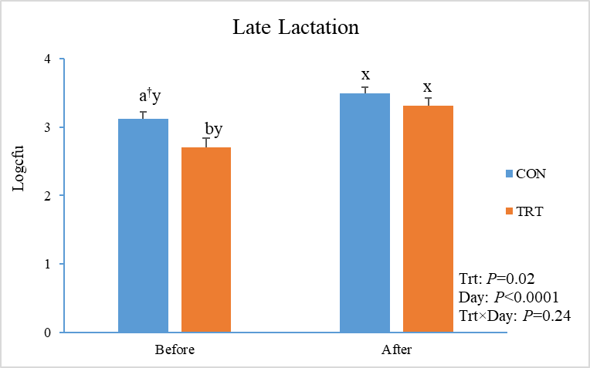
Results..

Slide 20
Results..
No effect of treatment on bacteriological cure
Effect | LSM | SEM | OR (95% CI) | P-value
Overall
TRT | 0.40 | 0.03 | 1.44 (0.68-3.04) | 0.33
CON | 0.34 | 0.03 | Referent

Slide 21
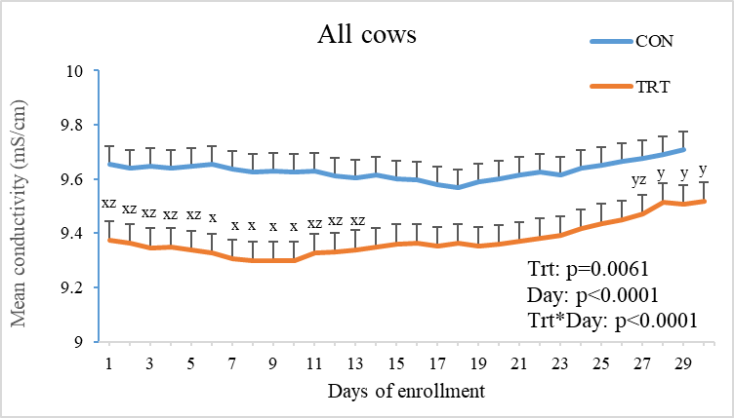
Results..
EC was lower in TRT vs CON

Slide 22
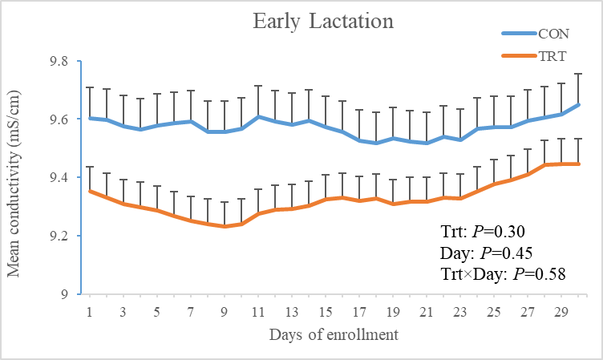
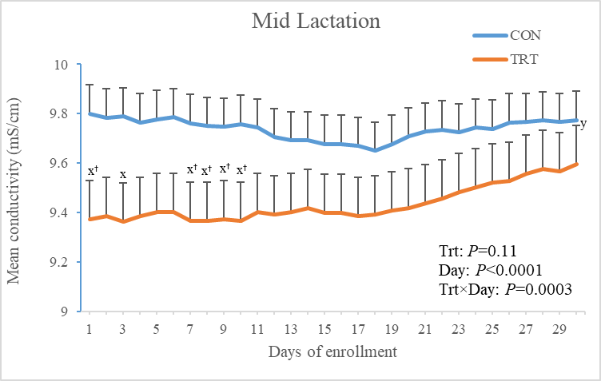
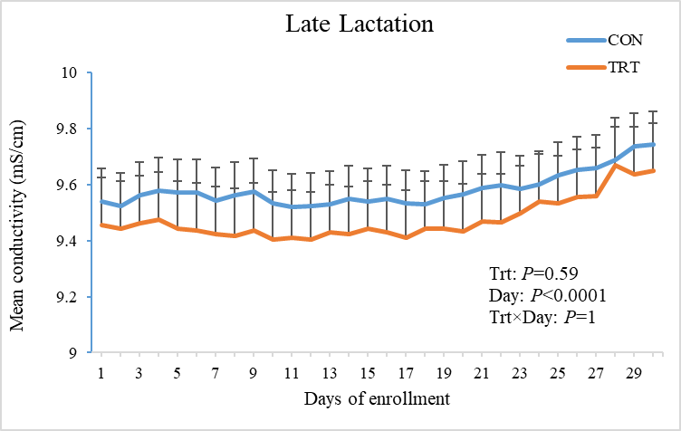
Results..

Slide 23
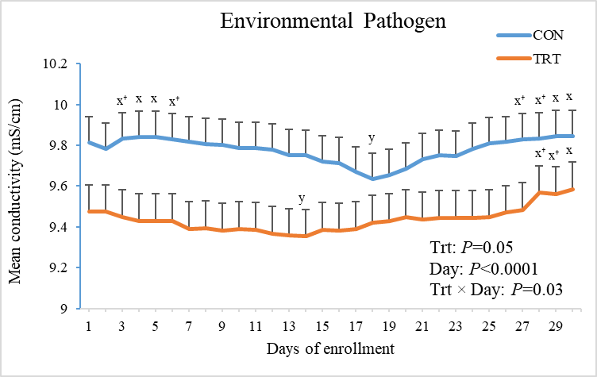
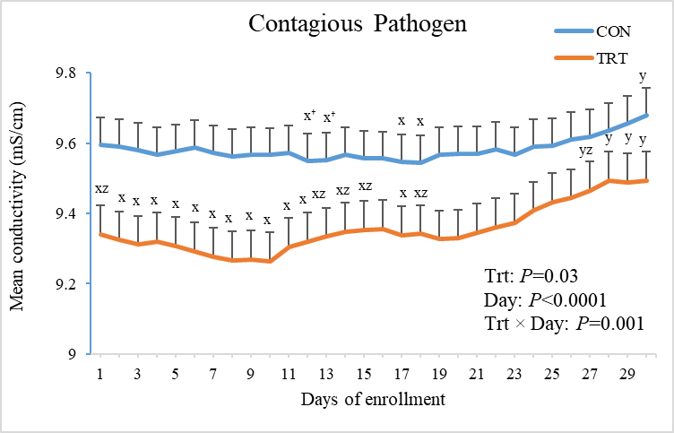
Results..

Slide 24
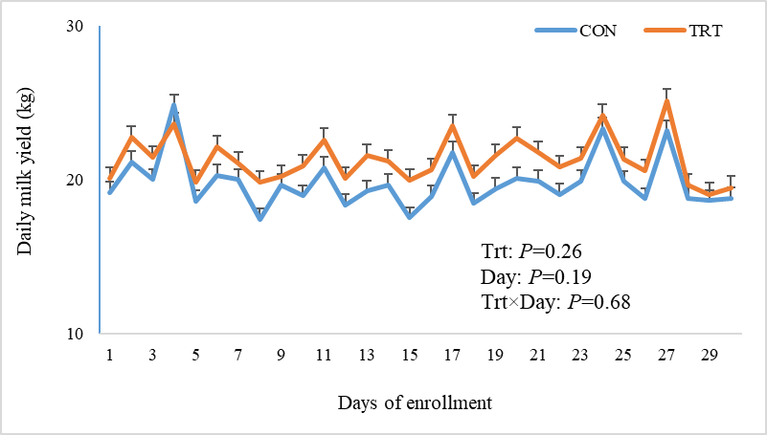
Results..
No treatment effects on milk yield

Slide 25
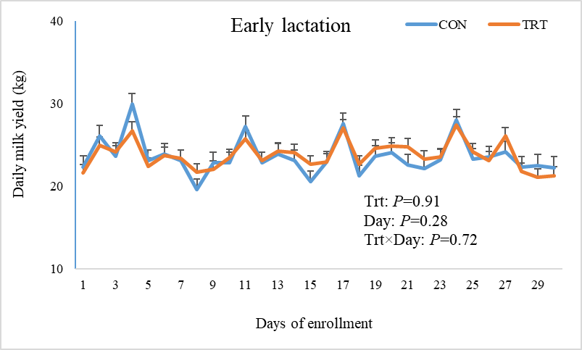
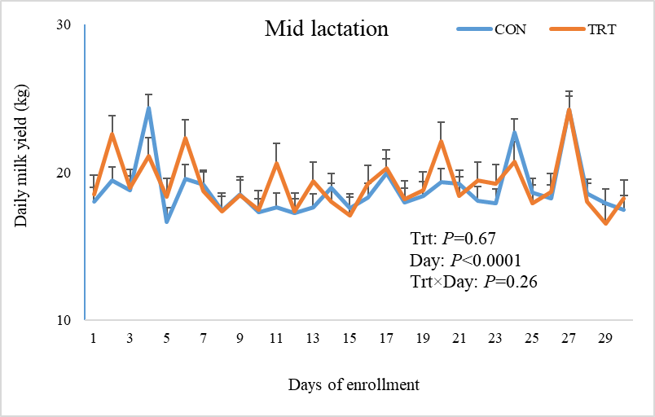
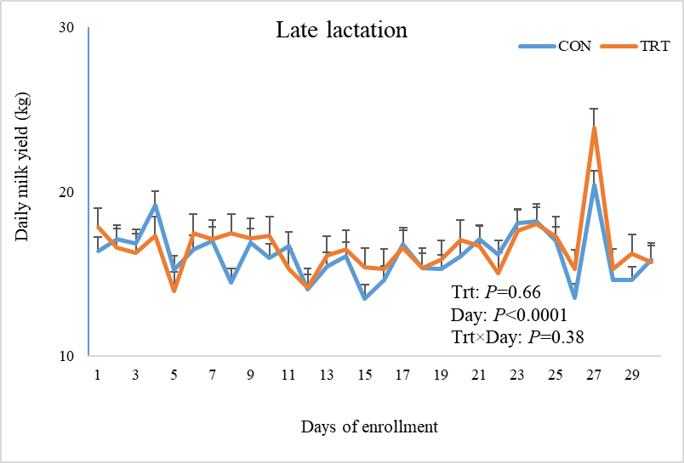
Results..

Slide 26
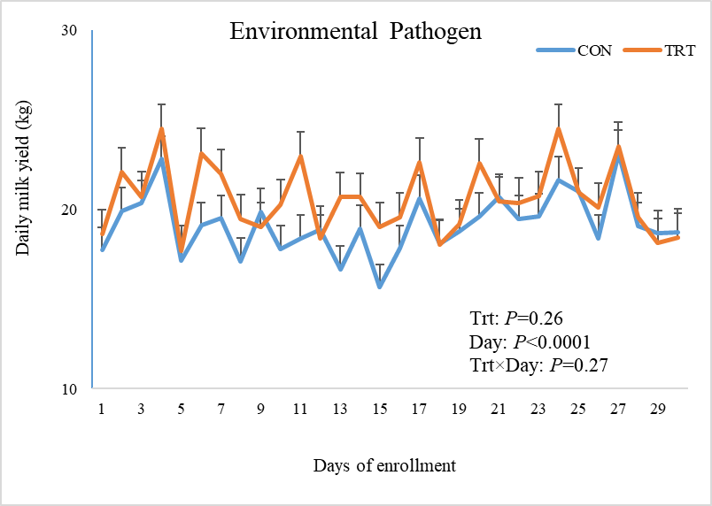
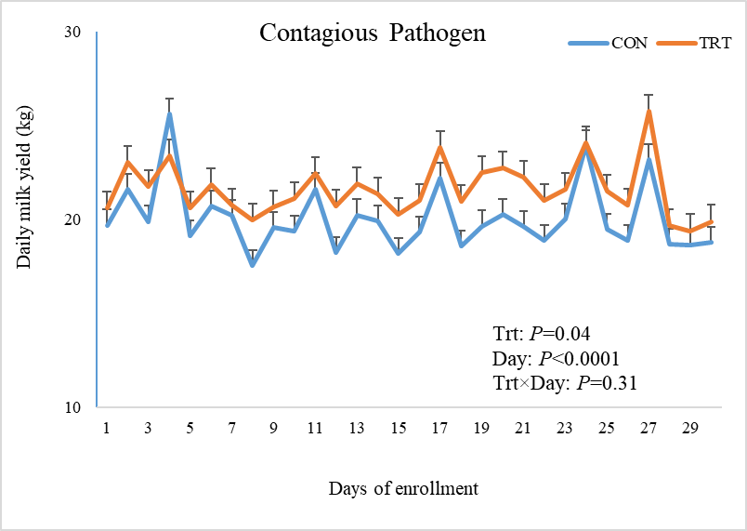
Results..
Higher milk yield in TRT vs CON in contagious mastitis events

Slide 27
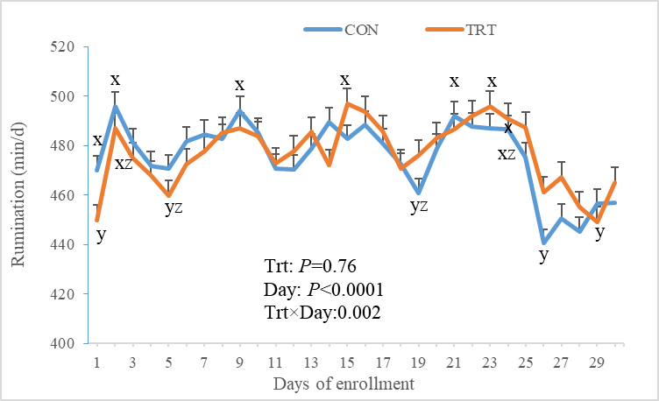
Results..
Treatment × Day interaction effect on rumination time

Slide 28
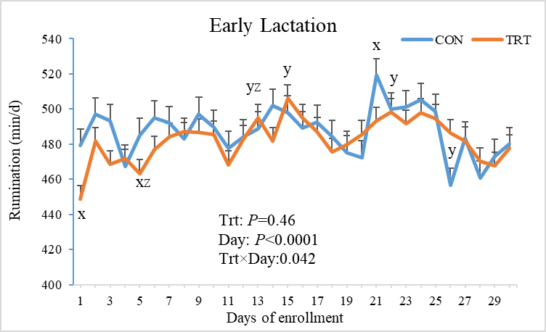
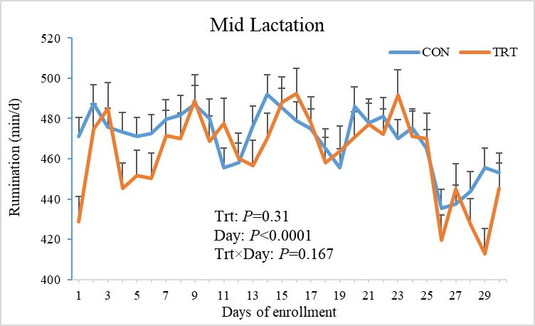
Results..

Slide 29
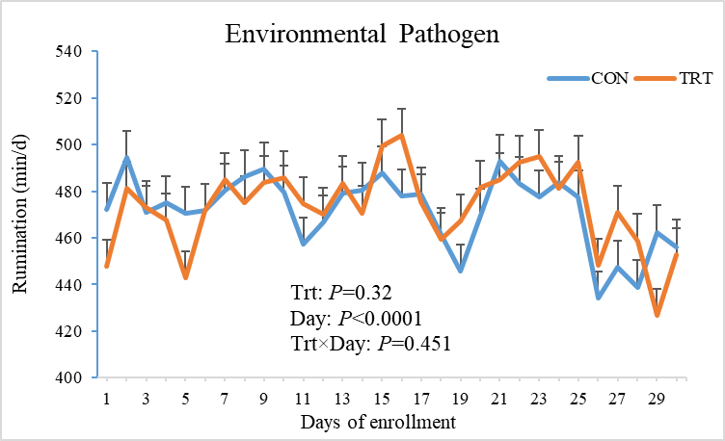
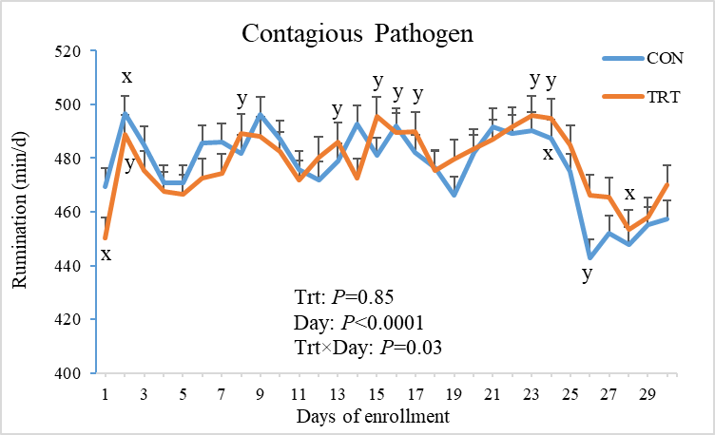
Results..

Slide 30
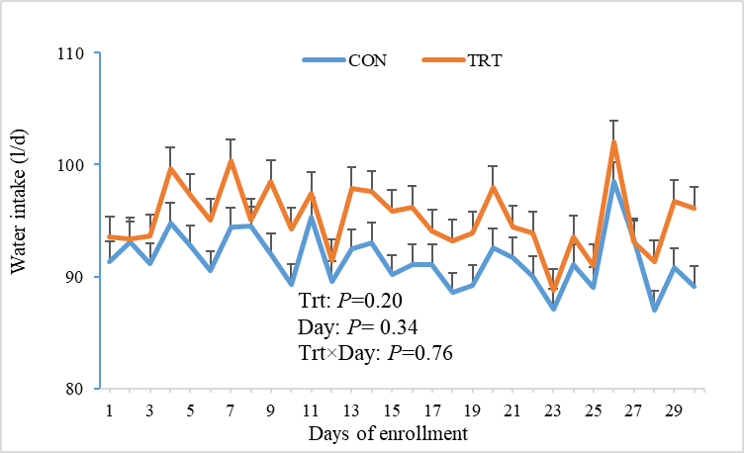
Results..
No treatment effects on water intake

Slide 31
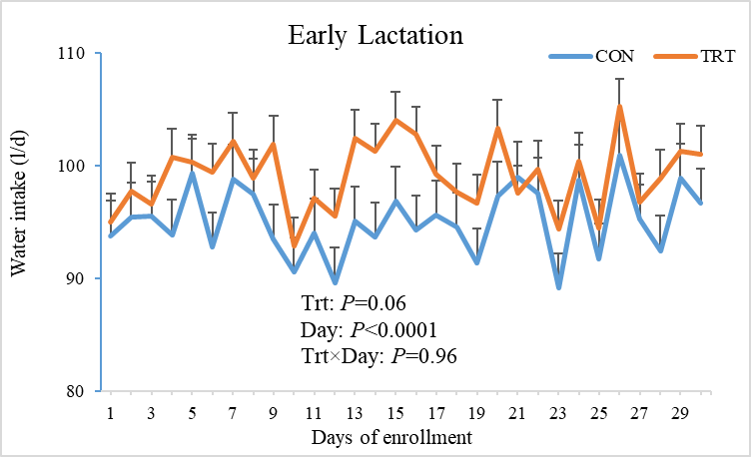
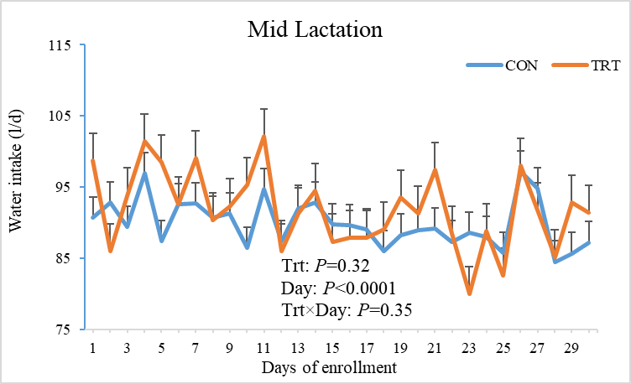
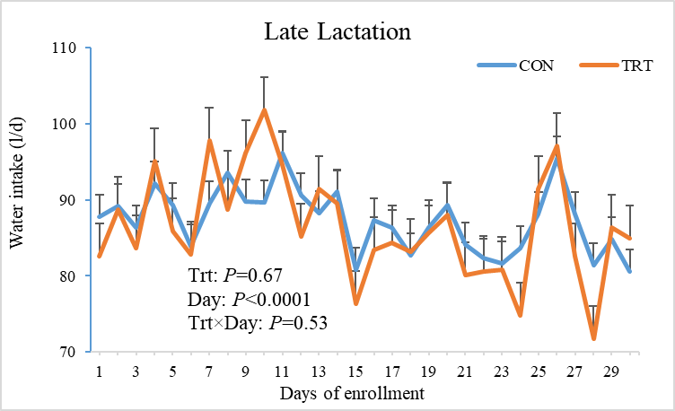
Results..

Slide 32
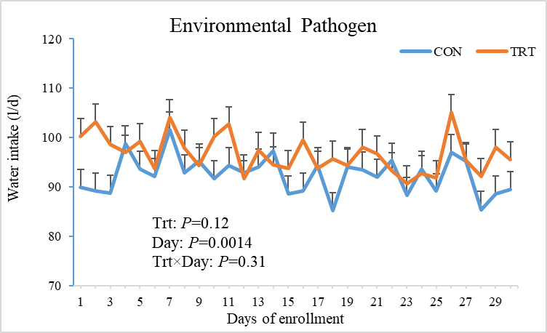
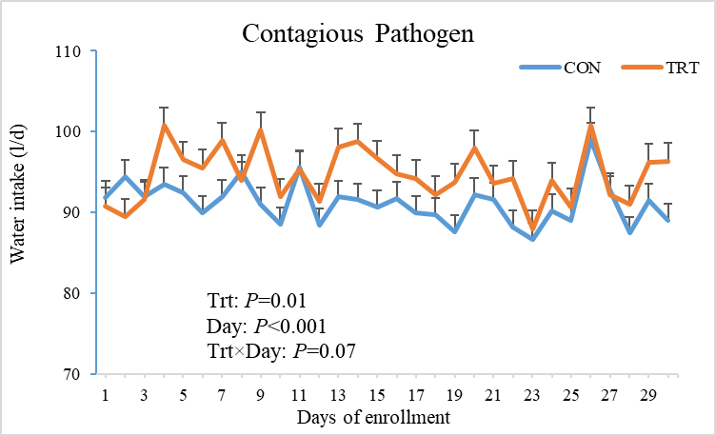
Results..

Slide 33
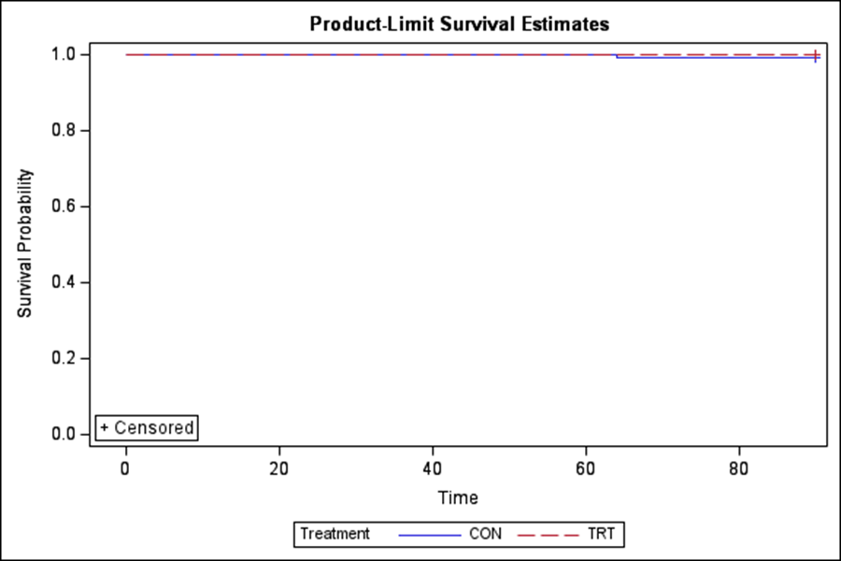
Results..
No difference in the survival rate between groups
P=0.99

Slide 34
Conclusions
  Demonstrated effectiveness in reducing SCC
  Increased milk yield and water intake of cows infected with contagious pathogens
  Did not impair rumination time
  These suggests plant-based antibiofilm bolus has the potential to support cows with subclinical mastitis and is particularly effective against contagious bacteria.

Slide 35
“Thank you”
Questions???

