Slide 1
An Overview of Montana Agritourism
Shannon Arnold

Slide 2
Defining Agritourism
What is agritourism? What words do you think of?
Agritourism, defined as “the business of establishing farms as travel destinations for educational and recreational purposes,” offers a viable option to help reconnect the public to the food system and bridge the growing gap of knowledge between consumer and producer (Schilling et al., 2006, p. 200).
Why should anyone consider agritourism?
Additional income stream
The ability to diversify operations
Education of urban and suburban audiences

Slide 3
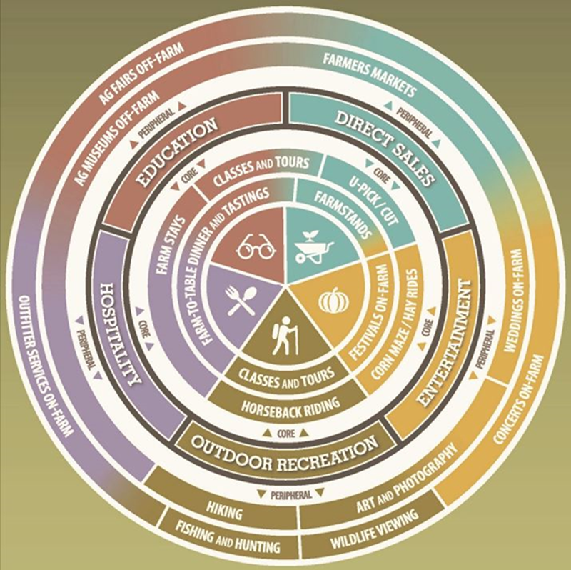
Agritourism Framework (Chase et al., 2018)
Core Activities:
  Classical Agritourism activities on-the-farm connected to agricultural production and marketing
Peripheral Activities:
  Non-Traditional activities on-farm but lack connection to ag
Notes:
An activity could be in either the core or peripheral category based on location, i.e., on-farm vs. off-farm, or how that activity is connected to traditional agriculture. Chase et al. (2018) defined core activities as “those that take place on a working farm or ranch and have deep connection to agricultural production and the marketing of a farm’s products”
Peripheral activities are defined as those that “may take place on a working farm, but they may lack deep connection to the actual farm or ranch, so they may be considered as peripheral activities and are located on the outer ring of the chart” (p. 17).

Slide 4
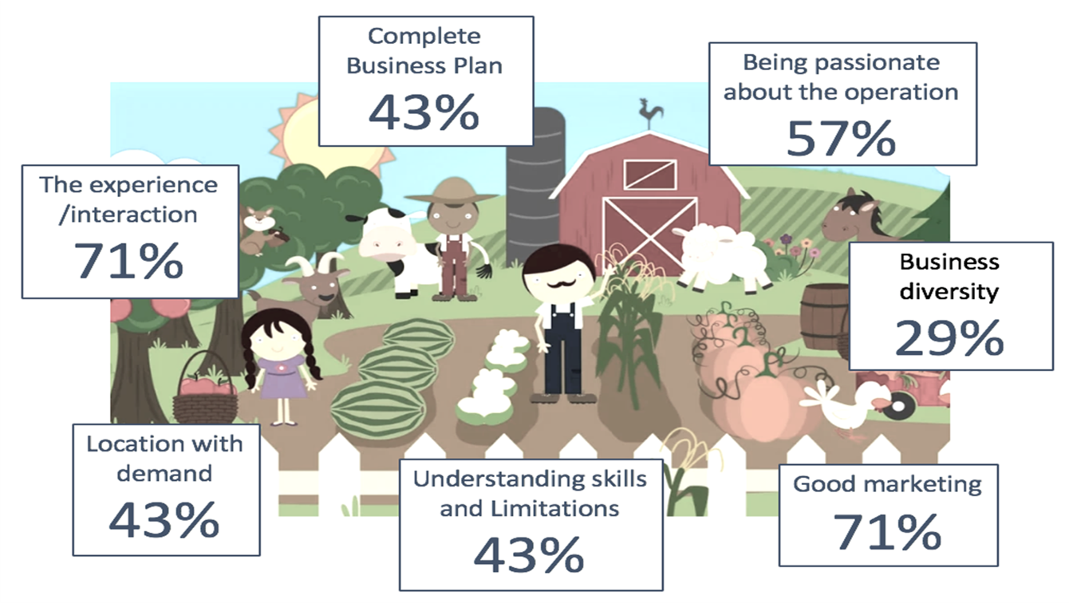

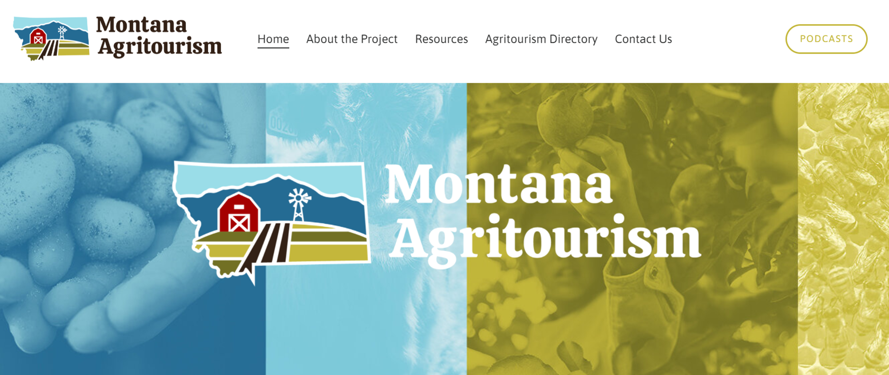
Characteristics of an Effective
Agritourism Operation
Notes:
For each episode, the project directors will invite current and prospective agritourism operators in Montana to discuss their challenges and questions. Then, industry experts, researchers and Extension professionals, and experienced agritourism operators from nearby states will be invited to respond to the questions and provide insights about overcoming specific challenges to be successful. A complementary website to host the podcast series and informational resources will significantly aid in expediting the development of a successful agritourism industry in Montana. The innovative podcast delivery mechanism is intended to engage groups of younger, potentially economically disadvantaged producers who are most likely to begin an agritourism business but are also more challenging to reach with more traditional educational efforts. This project will use a portfolio of marketing strategies—ranging from traditional press releases to targeted social media strategies—to maximize reach across varying demographic and socioeconomic groups. By tracking analytics, the project will provide insights about which communications and marketing strategies are most effective.
This communication approach seeks to engage varying demographic and socioeconomic groups
Recording is the easy part! Now what?
Post-Editing, Transcribing, and Text Analysis
Descript
Machine learning transcription service: 1 hour podcast = 5 minutes to transcribe = 95% accuracy
$199 year
Text Analysis
Nvivo- Qualitative Analysis Software
Post-Editing
Hired a Marketing and Consulting Company

Slide 5
Montana Agritourism Steering Committee
Our Vision
Combining the essential elements of tourism and agriculture industries will attract the public, increase agricultural income, and provide recreation and/or educational experiences for visitors.
Our Mission
Dedicated to promoting the Agritourism industry in Montana by working collaboratively with state and industry partners, providing resources, research, and education, and connecting our producers and community stakeholders with local, state, and global agritourism markets.
Core Values and Goals
Targeted marketing and branding.
Effective industry-driven networks.
Amended policies.
Regulatory Issues.
Meaningful standards.
Strengthen economic diversification.
Notes:
Our Mission
Dedicated to promoting the Agritourism industry in Montana by working collaboratively with state and industry partners, providing resources, research, and education, and connecting our producers and community stakeholders with local, state, and global agritourism markets.
Montana’s strategic agritourism marketing plan combined with culinary tourism marketing and value-added products will put the spotlight on Montana as a world-class destination for interesting, fun and life-changing agriculture-based experiences.
. The goal is to develop and sustain an agritourism affiliation for the purposes of creating relationships, assisting operators with marketing, and learning best practices with an emphasis on stewardship.
To clarify and improve the state and local regulatory framework so agritourism businesses are compatible with the intent of land-use law and public health regulations and operating smoothly.
To lessen the barriers to entry by addressing inherent risks, limited liability laws, and insurance coverage needed to operate.
To collaborate with industry partners advocating for a bill that would provide Limited Liability for Agritourism Providers so that Montanans can afford to provide agritourism opportunities and do so with some peace of mind.
To pave the way for locals and visitors to discover agritourism products and services vetted for authenticity and quality.
We are committed to making resources readily available and providing advice and support for producers interested in growth and value-added opportunities in agritourism.

Slide 6
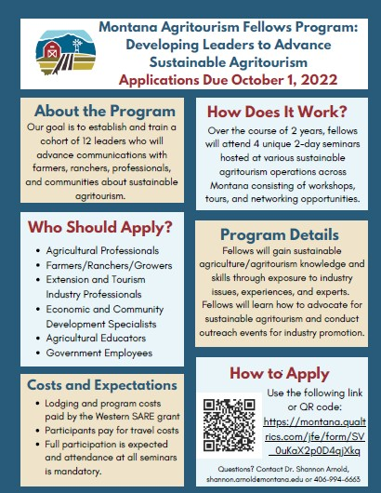
Western SARE
PDP Grant
The program goal is to establish a cohort of leaders, the Fellows, who can effectively educate others on:
Diversification opportunities
Sustainable practices
The economic, environmental, and social impacts of agritourism.

Slide 7
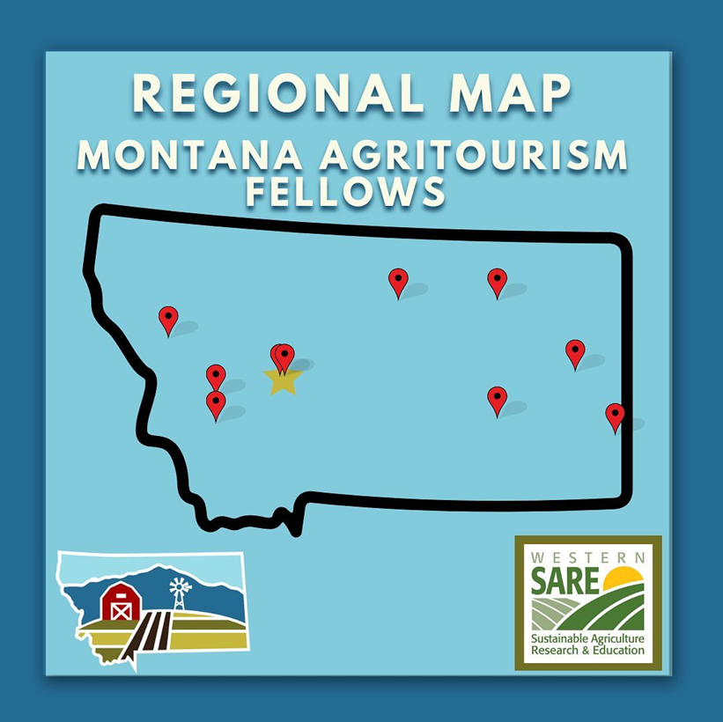
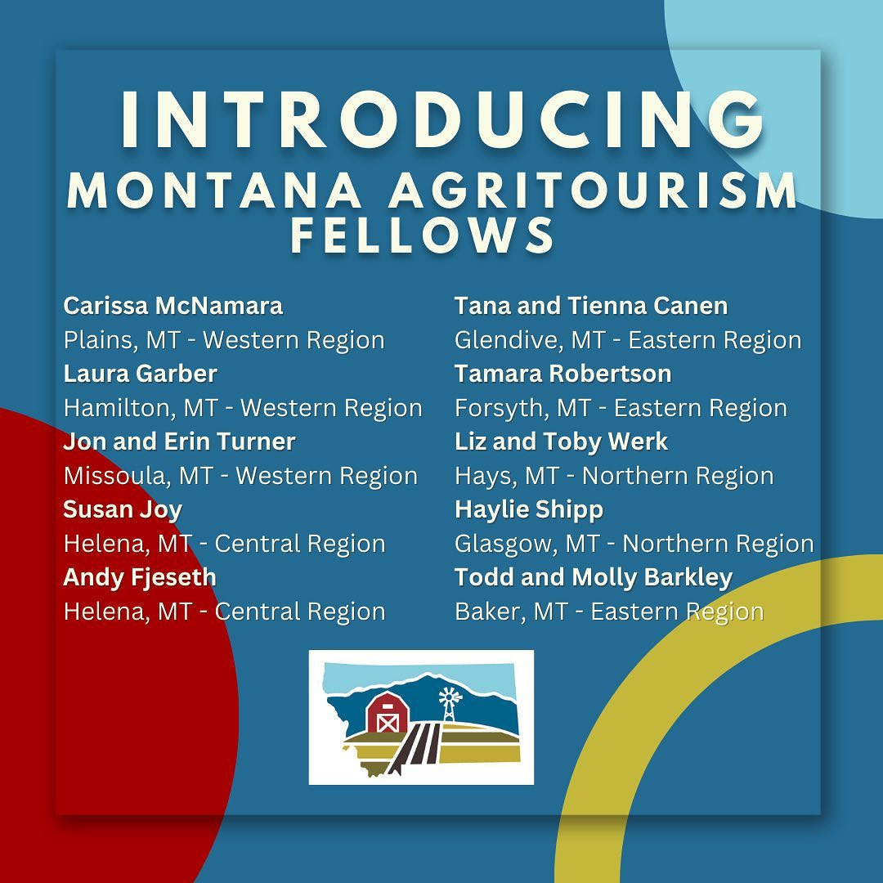

Slide 8
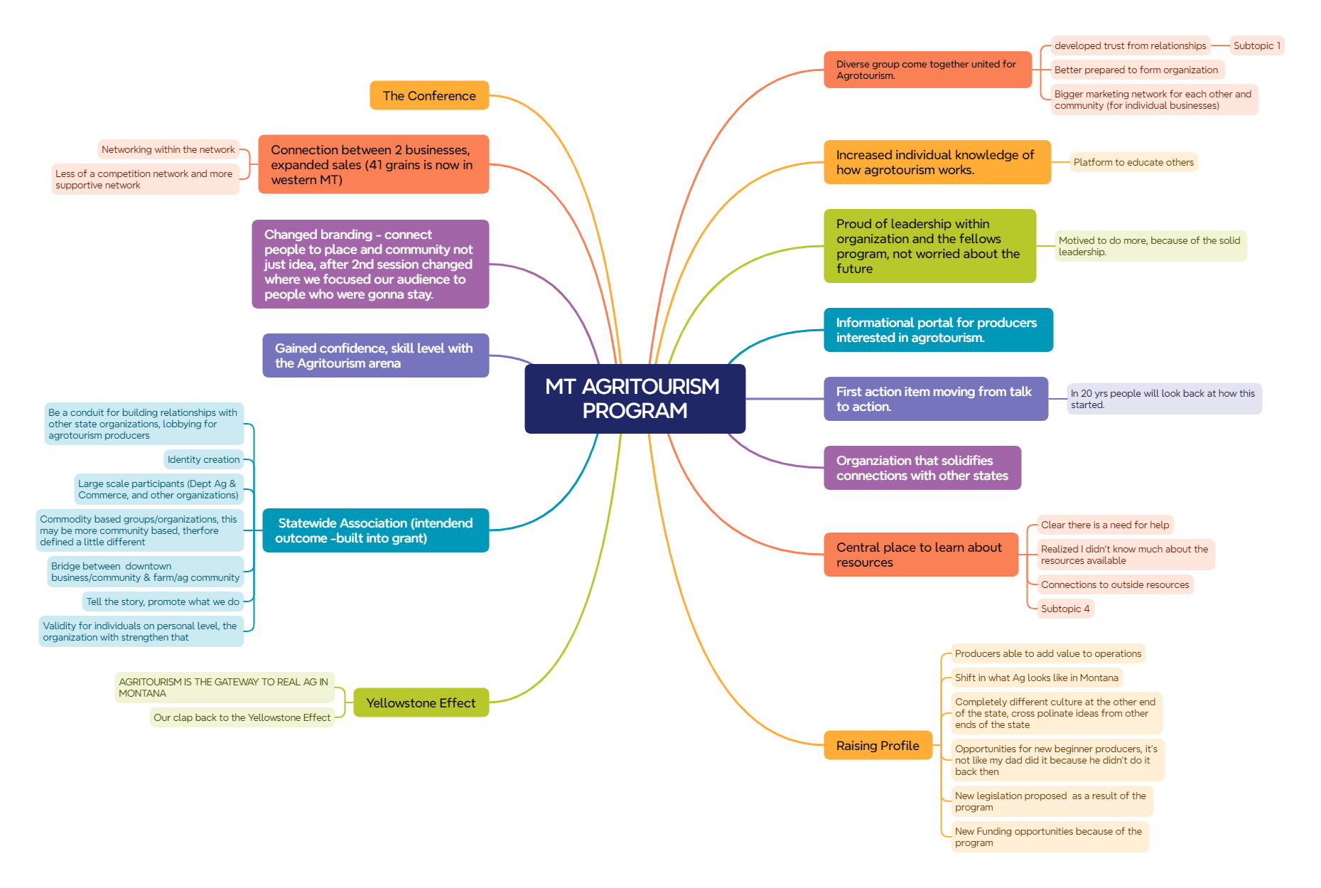
Fellows Program IN Action
Video

Slide 9
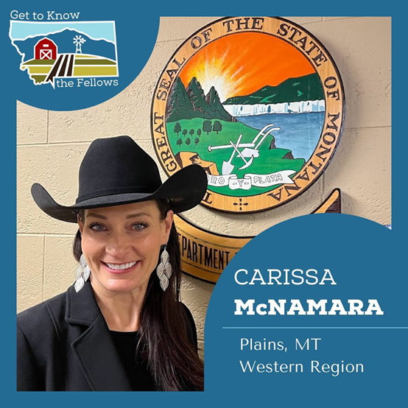
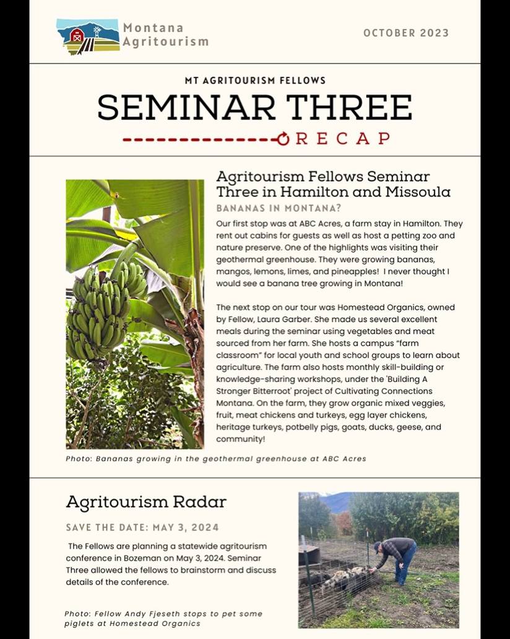
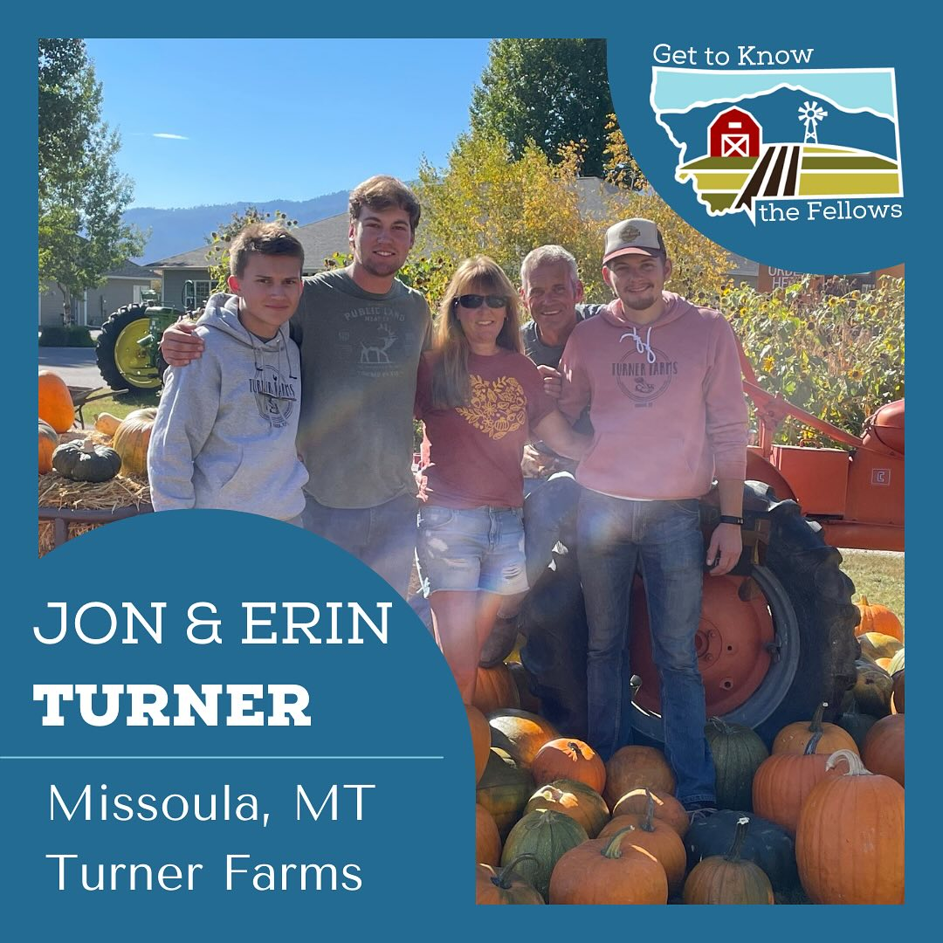
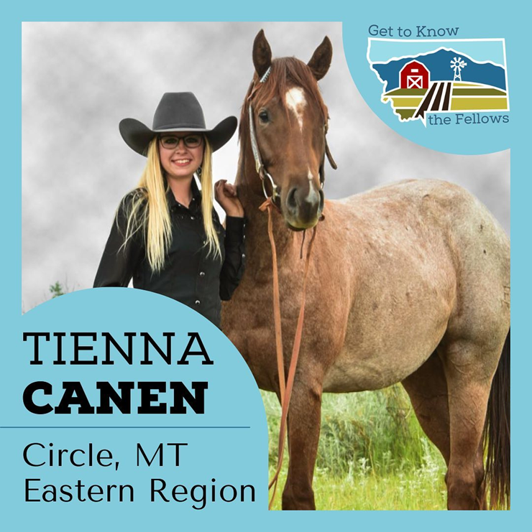

Slide 10
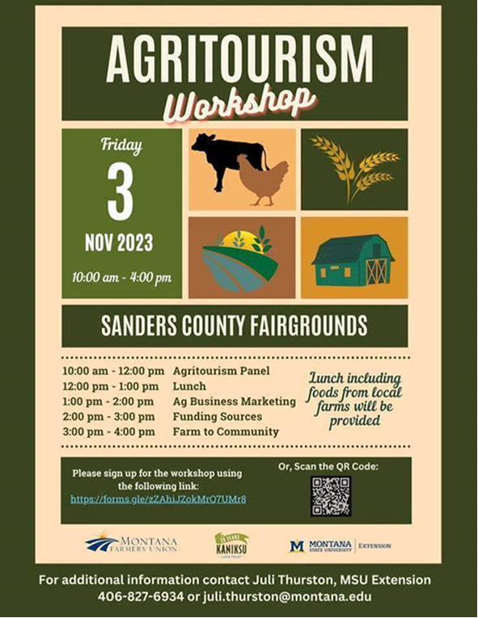
Moving Forward with MT Agritourism
National Extension Tourism Conference
Governor’s Conference on Tourism
Farming Entrepreneurship Podcast and Governor’s Farm Visit
Montana Ag Live Episode
Western Montana Sheep and Goat Workshop
Department of Commerce and Agriculture grants
Global Agritourism Network and International Agritourism Conference
Wall Street Journal
Montana’s Next Generation Conference
And Many More!

Slide 11
Agritourism in Your Area
Current agritourism initiatives in your county?
Opportunities for agritourism in your county?
How could you collaborate with agritourism operations in your area?

