Slide 1
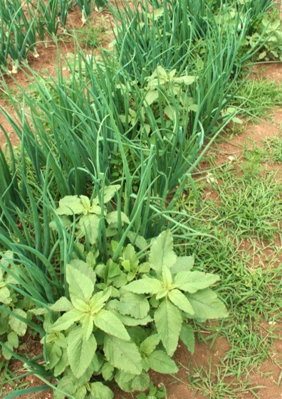
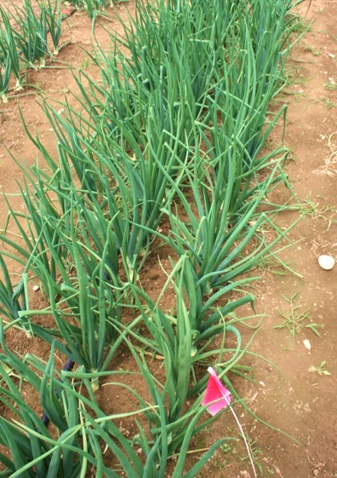
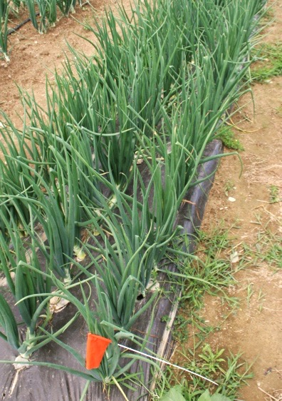
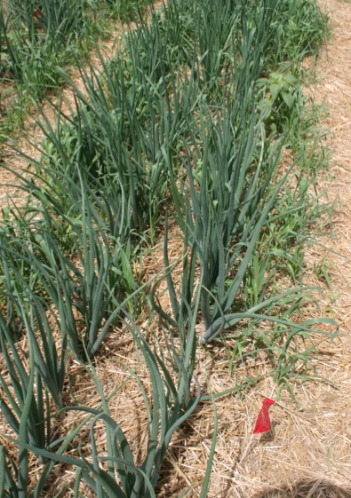


A systems comparison of cultivation-based versus mulch-based weed control in yellow onion (Allium cepa)
Bryan Brown & Eric Gallandt, University of Maine
Which Strategy to Choose?
gy
Critical Weed Free Period
Cultivate only when the crop is in its sensitive adolescent stage.
Zero Seed Rain
Cultivate frequently so weeds do not set seed. This reduces weed pressure in subsequent years.
Plastic Mulch
Suppresses weeds with a layer of plastic film.
Organic Mulch
Suppresses weeds and builds soil.
Results
We implemented each of these strategies using onions as a test crop. We recorded labor, expenses, yield, weed and insect pest pressure, and several measures of soil quality. These measures have allowed us to generate the following star diagrams that demonstrate the economic and biological strengths of each strategy. The larger the area the more favorable the strategy. Values separated by the grey band are significantly different (Tukey’s HSD, alpha=0.05, df=23).
Economics
Biology
Critical Weed Free Period
Zero Seed Rain
Plastic Mulch
Organic Mulch
Harvesting Labor
Soil Nitrogen
Materials Costs
Conclusions
As expected, the Critical Weed Free Period was the least costly strategy but least beneficial to biological health, while the reverse was true of the Organic Mulch strategy. Unexpected results included the underperforming yield of the Critical Weed Free Period and Plastic Mulch strategies. It was also unexpected that the Zero Seed Rain and Organic Mulch strategies would be the most profitable strategies in their first year of implementation since they are the most labor intensive and are focused on achieving long-term biological benefits.
Acknowledgements
Special thanks to field technician Thomas Macy and farm manager Joseph Cannon. Partial funding for the work reported here was provided by the USDA Sustainable Agriculture Research and Education Program and a MAFES Graduate Student IPM Initiative Grant.

