Slide 1
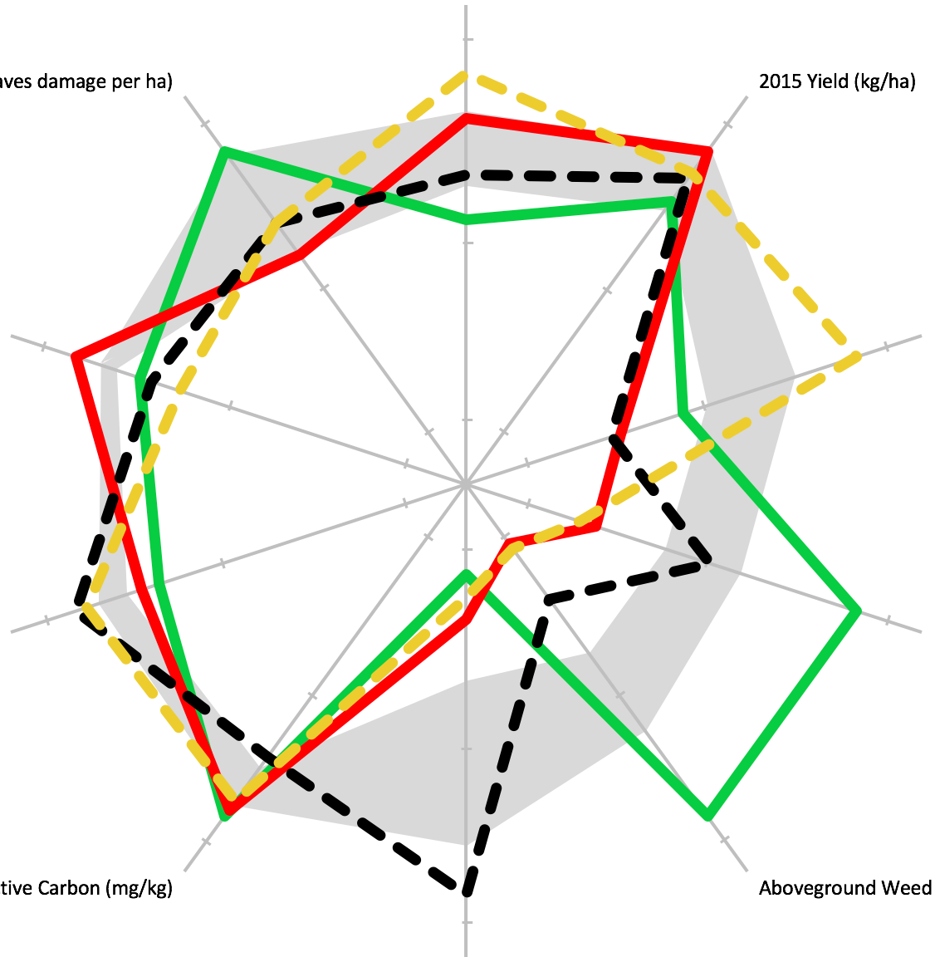
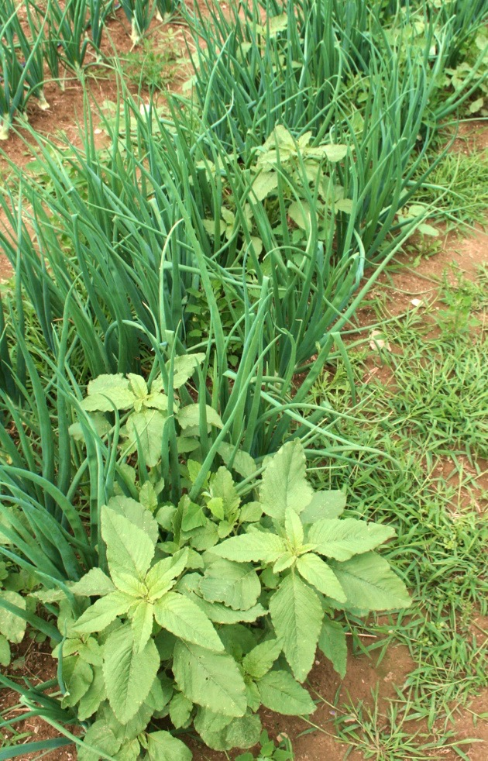
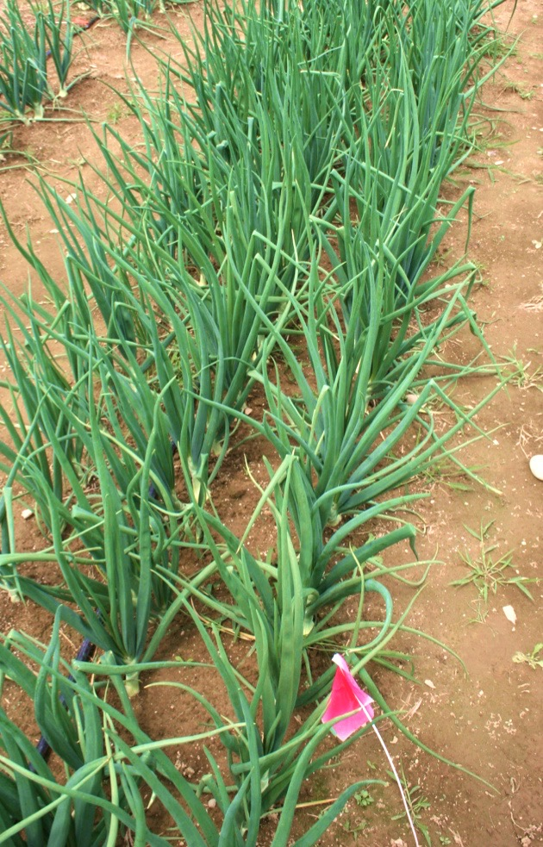
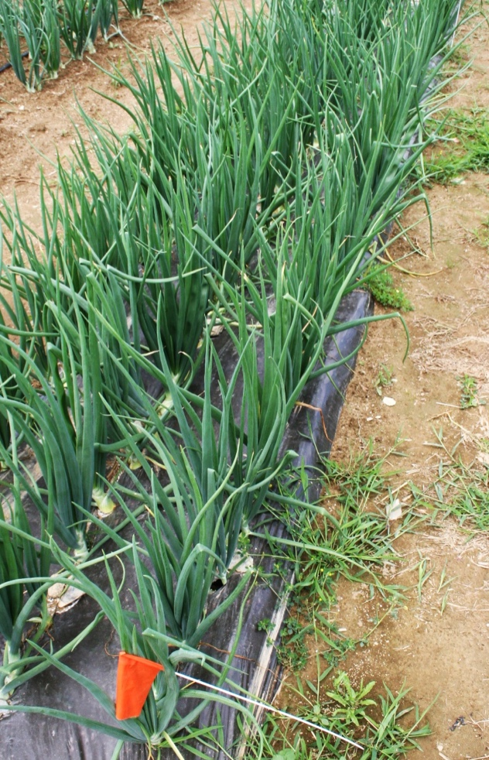
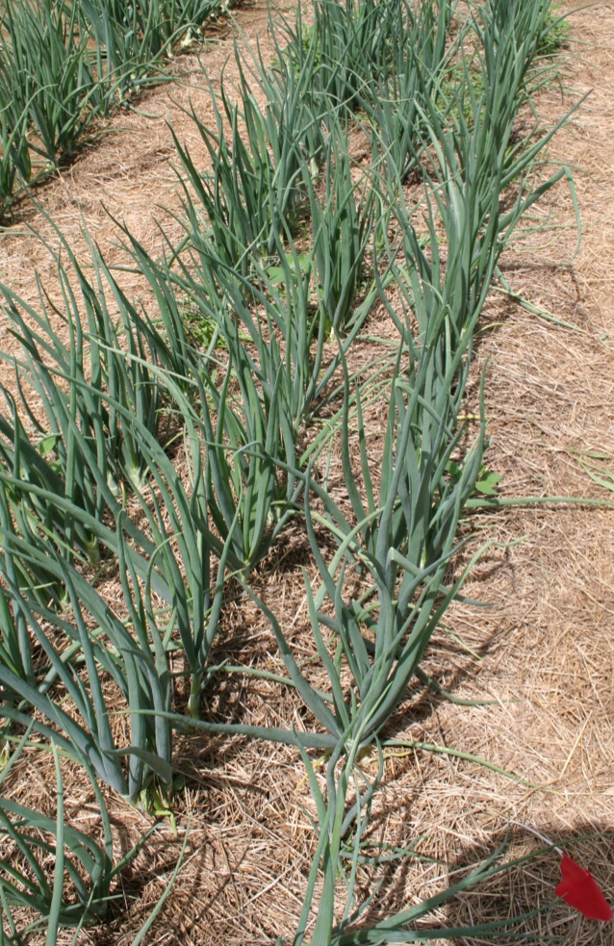
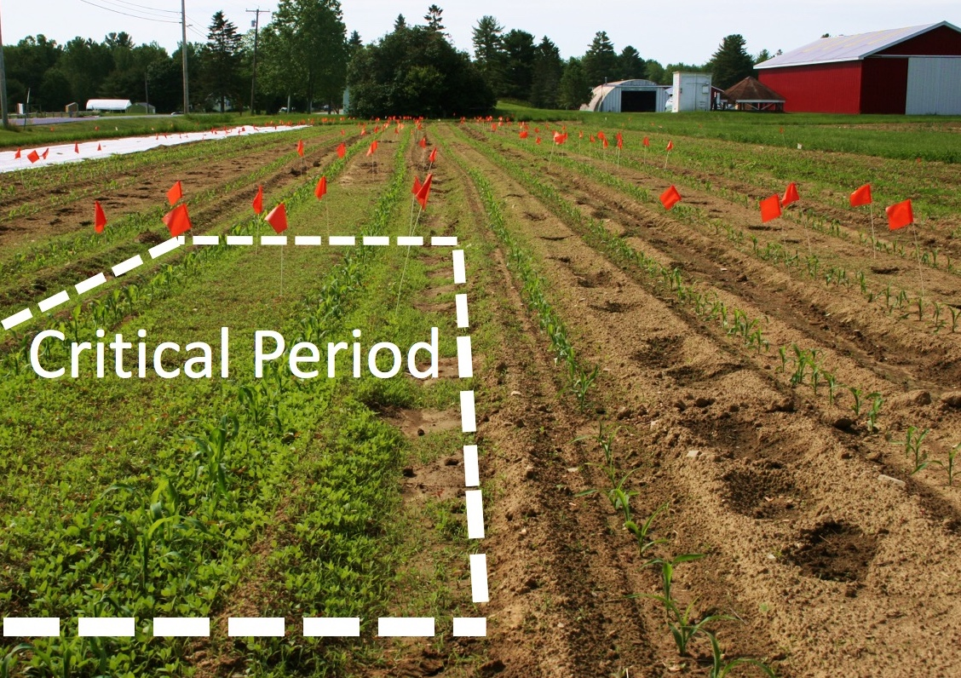
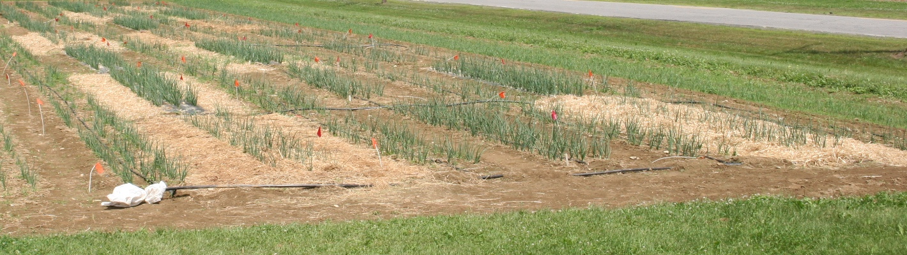
Improve Soil Quality, Decrease Costs, or Reduce the Weed Seedbank? Insights from a Systems Comparison of Prominent Organic Weed Management Strategies
Bryan Brown and Eric Gallandt
Results and Discussion
The experiment was successful in characterizing multiple aspects of each strategy (Figure 1). Yield was affected by weeds more strongly in 2014 than 2015. Greater earthworm populations in Hay Mulch may have been due to the food source (Schonbeck & Evanylo 1998). Carabid results may be explained by the habitat (Birthisel et al. 2014) offered by weeds. As expected, end of season aboveground weed biomass was greatest in Critical Period plots. Black Plastic plots had greatest NO3-N, likely due to reduced leaching (Schonbeck & Evanylo 1998) but decreased microbial biomass. Mulched plots had less compacted soil, likely due to decreased foot traffic and rainfall impact. Workload over the season was most uneven for Hay Mulch (consistent with Schonbeck 1998) and most even for Zero Seed Rain. Greater disease damage in Critical Period plots may have been due to reduced humidity levels caused by the weeds (McDonald et al. 2013). Zero Seed Rain and Hay Mulch required more labor but were more profitable than Critical Period Weed Control (Figure 2) due to higher yields. Consistent with previous study (Bond et al. 1998), one season of Critical Period Weed Control increased the weed germination 10x that of the other strategies the following year (Figure 3), and was the likely cause of the yield loss of Sweet Corn grown in these plots.
Introduction
Weed competition has its greatest impact during the adolescent crop stage; consequently, many farmers will focus weeding efforts in that “critical period” (Hewson & Roberts 1971). But considering that lax weed control can increase the weed seedbank fifteen-fold (Bond et al. 1998), more extensive cultivation may be desired to keep weeds from “raining” seed, which may provide labor savings in the long-term (Norris 1999). As an alternative to cultivation-based management, some crops are amenable to mulching which can prevent weed growth and benefit soil quality (Schonbeck & Evanylo 1998). Given that each of these weed management strategies can be successful, our objective was to quantify the economic and ecological benefits and drawbacks of each strategy to help farmers decide which one is best for their farm. More detail on the strategies:
Critical Period
Zero Seed Rain
Black Plastic
Hay Mulch
Fisher’s LSD (α = 0.05)
2014 Onion Yield (kg ha⁻¹)
2000
(a)
a
ab
a
Disease and Insect Damage (leaves damaged ha⁻¹)
60,000
Labor (hours/hectare)
b
Mulching
2015 Onion Yield (kg ha⁻¹)
1000
Harvesting
8,000
50,000
Planting
Weeding
30,000
(b)
a
a
Workload Evenness (Shannon Index)
4,000
25,000
Earthworms (worms m⁻²)
$20,000
ab
2
150
Net Profit (dollars/hectare)
b
Figure 2.
Bar graphs of total labor by activity (a) and net profit (b) for each strategy.
1
75
$10,000
Critical Period
Weed Control
Cultivate only when the crop is in its sensitive adolescent stage. For onions this period is the first eight weeks after transplanting (Grundy et al. 2003).
Zero Seed Rain
Cultivate frequently so weeds do not set seed. This reduces weed abundance in subsequent years.
Black Plastic Mulch
Suppresses weeds and warms soil with a layer of plastic film. Paths are cultivated to control weeds.
Hay Mulch
Suppresses weeds in beds and paths. Keeps soil moist and builds soil organic matter. A rate of 20 Mg ha⁻¹ is necessary for weed suppression (Schonbeck 1998).
20
4
Critical Period
Zero Seed Rain
Black Plastic
Hay Mulch
40
8
Carabids
(beetles pitfall⁻¹ day⁻¹)
Weed Management Strategy
Penetrometer Depth at 300psi (cm)
30
250
45
Figure 3. Image of the high weed germination the year after Critical Period Weed Control was implemented.
60
500
Aboveground Weed Biomass (g m⁻²)
Microbial Biomass (mg kg⁻¹)
90
NO3-N (mg kg⁻¹)
Materials and Methods
Figure 1. Radar plot of late-season results of each strategy.
Conclusions
Zero Seed Rain and Hay Mulch were most profitable in the short-term, which was unexpected since they are thought of as investments that pay off over time with decreased weed seedbanks (Norris 1999) or boosted soil quality (Lalande et al. 1998), respectively. Therefore, we recommend that farmers implement Zero Seed Rain or Hay Mulch for weed sensitive crops like onions. Zero Seed Rain may be best for farmers that have a steady labor source and grow mostly short-season crops or crops that cannot be mulched. Farmers with access to inexpensive hay should consider mulching their long-season vegetables, especially if their soil organic matter is low and they have the labor (or mechanical spreader) to apply it in the early season. Critical Period Weed Control should only be used if reducing labor is the main goal and future weed competition is not important. Black Plastic can be used if soil warming or nitrate conservation is desired.
To pursue our objective of quantifying the benefits and drawbacks of each strategy, we implemented each strategy in a side-by-side systems comparison in Old Town, ME, USA. Yellow onion was used as a test crop since it is commonly used in each strategy and is sensitive to changes in weed management. Plots were 7 m long by 2 m wide separated by buffer beds in a randomized complete block design with four replicates. Onions were grown on separate fields in 2014 and 2015. Onions were transplanted in mid-May with two plants per hole every 15 cm and three rows per bed. Aside from tillage and application of plastic mulch, all activities were done by hand. Hoeing occurred about every 10 days for Critical Period plots through the end of July, all season for Zero Seed Rain and Black Plastic paths, and twice pre-mulching for Hay Mulch. Hay was applied in late June since warm soil and sufficiently large onions are required for mulching. Black Plastic was handweeded three times and Hay Mulch once. Drip irrigation was used to maintain optimal soil moisture for each treatment. Harvest occurred in September. All labor and materials costs were recorded as well as measures of weeds, pests, soil quality, and yield. Net profit was calculated by estimating sales at $1.10 kg⁻¹ and subtracting material costs and labor costs at $10 hr⁻¹. In 2015, sweet corn followed the 2014 onions and was managed uniformly with weed control achieved be one harrowing, three row cultivations, and two hillings. All statistical analyses were completed using Fisher’s Protected LSD.
Future Research
Simulation modeling will be used to expand our results to other crops, scales, and durations of implementation. When results were presented to farmers, they asked how the quality of hay would affect yield, how the effectiveness of the strategies compared to cover cropping alone, and how long it would take to build soil organic matter using hay.
Literature Cited
Bond, W., Burston, S., & Moore, H. C. (1998). Changes in the Weed Seedbank Following Different Weed Control Treatments in Transplanted Bulb Onions. Aspects of
Applied Biology, 51, 273–296.
Birthisel, S. K., Gallandt, E. R., & Jabbour, R. (2014). Habitat effects on second-order predation of the seed predator Harpalus rufipes and implications for weed
seedbank management. Biological Control, 70, 65–72.
Grundy, A.C., Knott, C., Lutman P.J.W., Marshall, J., Sunderland, K., Smith, B. and Fenlon, J. (2003) The Impact of Herbicides on Weed Abundance and Biodiversity in
Horticulture. Department for Environment, Food and Rural Affairs, UK, project HH3403sx Final Report
Hewson, R. T. and H. A. Roberts. (1971). The effects of weed removal at different times on the yield of bulb onions. J. Hort Sci. 46; 471-483.
Lalande, R., V. Furlan, D.A. Angers, and G. Lemieux. (1998) Soil improvement following addition of chipped wood from twigs. Amer. J. Alternative Agr. 13(3):132–137.
McDonald, M. R., Gossen, B. D., Kora, C., Parker, M., & Boland, G. (2013). Using crop canopy modification to manage plant diseases. European Journal of Plant
Pathology, 135(3), 581–593.
Norris, R. (1999). Ecological Implications of Using Thresholds for Weed Management. Journal of Crop Production, 2(1), 31–58.
Schonbeck, M. W. (1998). Weed Suppression and Labor Costs Associated with Organic, Plastic, and Paper Mulches. Journal of Sustainable Agriculture, 13(2), 13–33.
Schonbeck, M. W., & Evanylo, G. K. (1998). Effects of Mulches on Soil Properties and Tomato Production. Plant-Available Nitrogen, Organic Matter Input, and Tilth-
Related Properties. Journal of Sustainable Agriculture, 13(1), 83–100.
Acknowledgements
I would like to thank Joe Cannon, Thomas Macy, and Anthony Codega for their help implementing this study. Funding for the work reported here was provided by the USDA Sustainable Agriculture Research and Education Program and the University of Maine.

