Slide 1


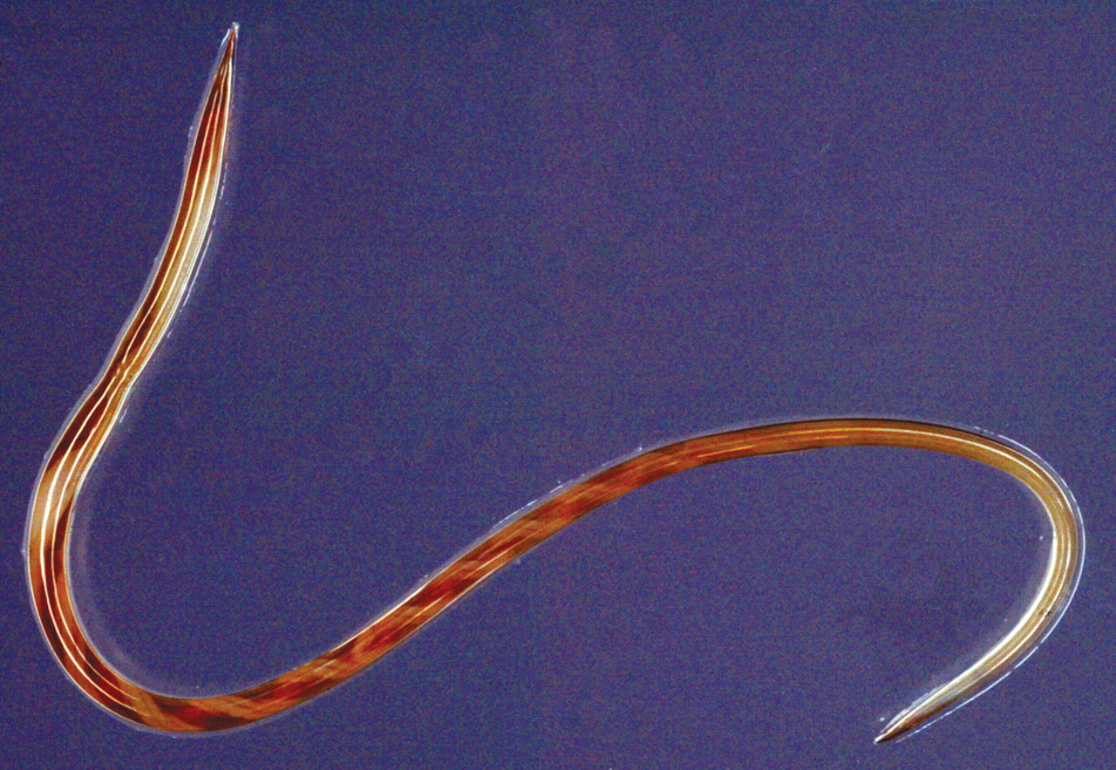
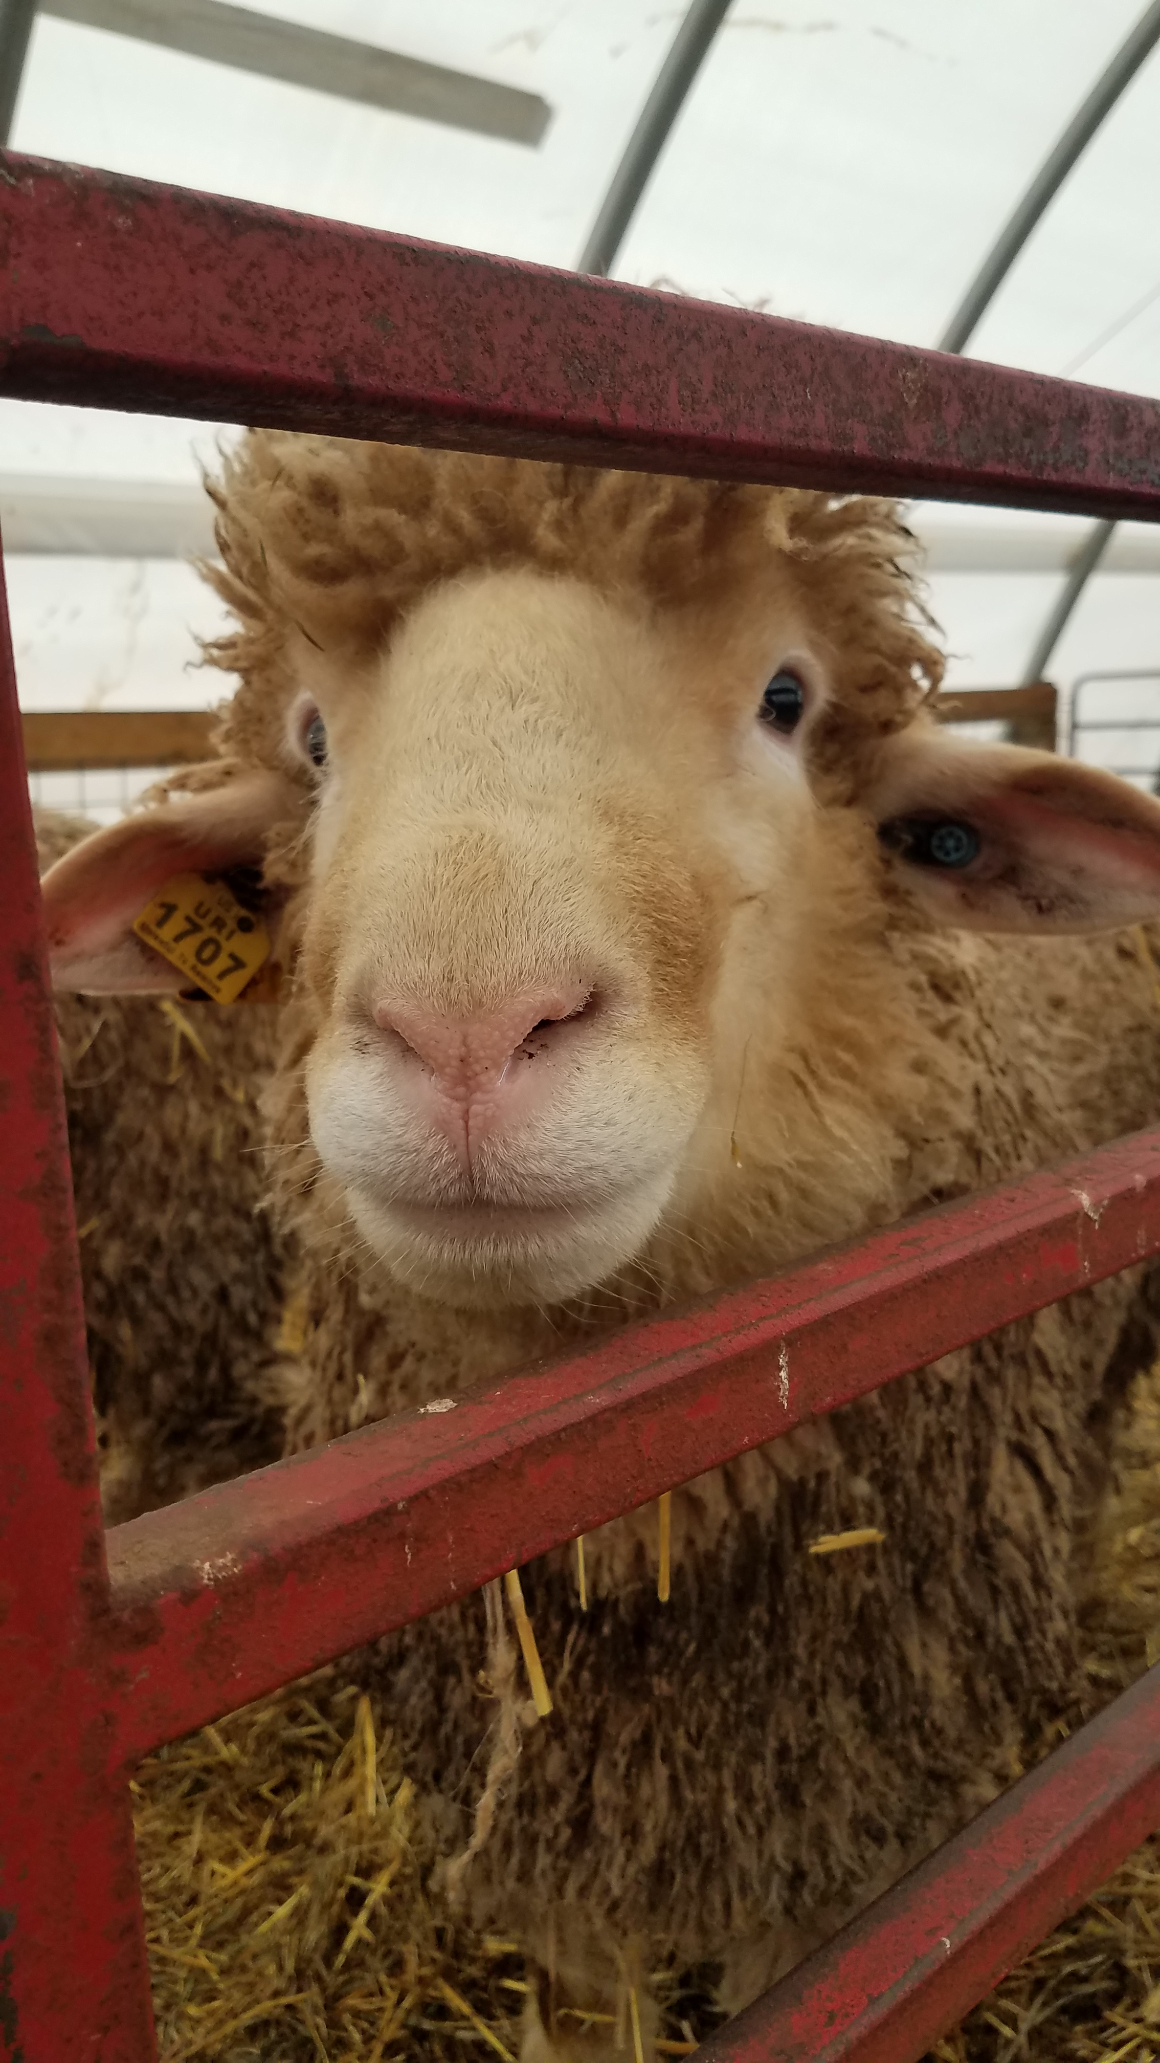
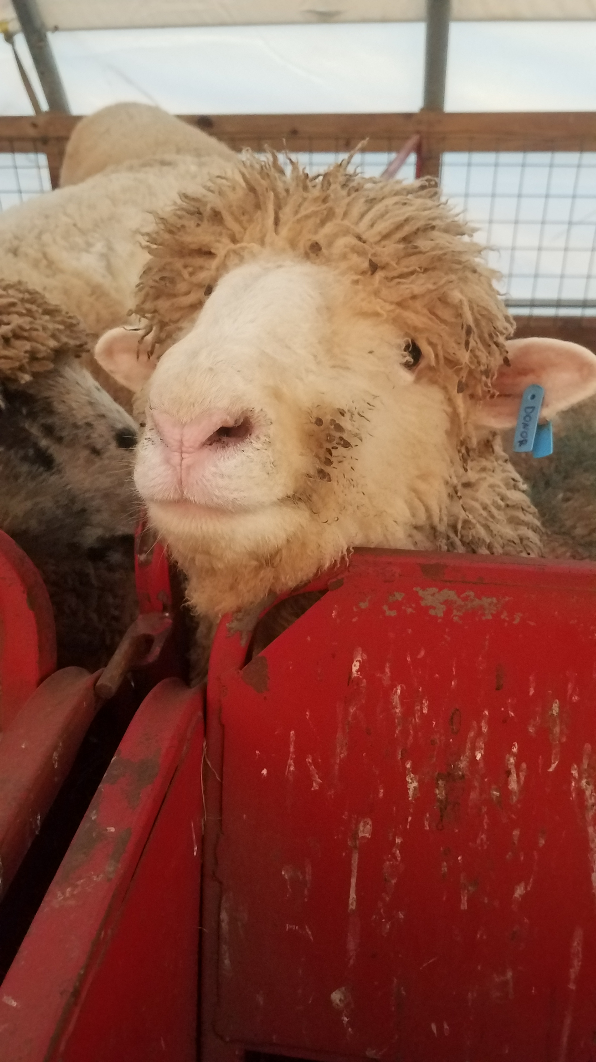
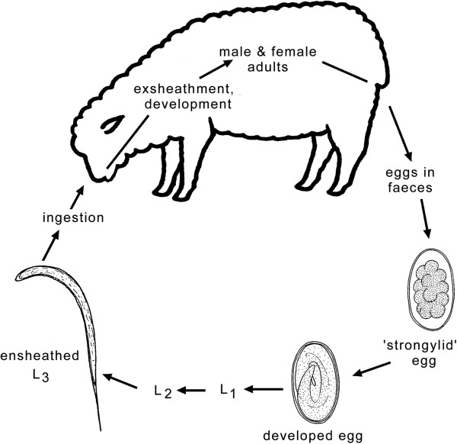
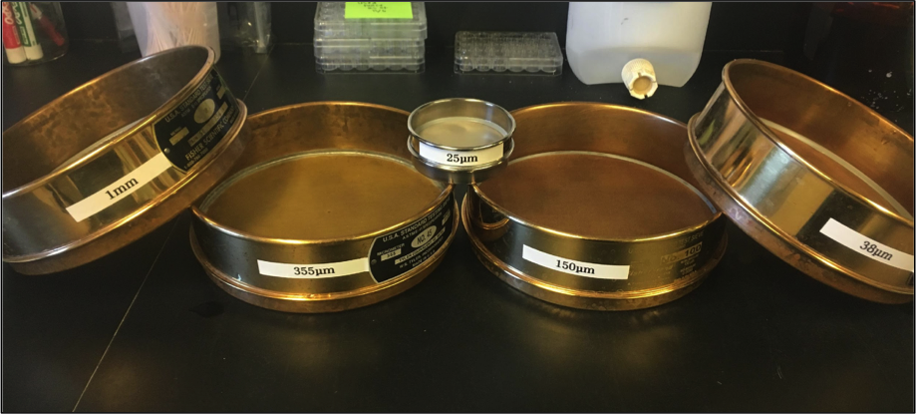
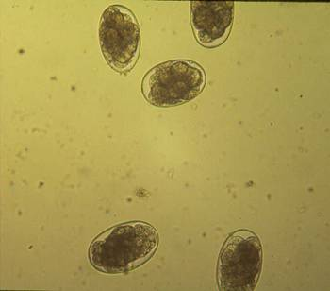
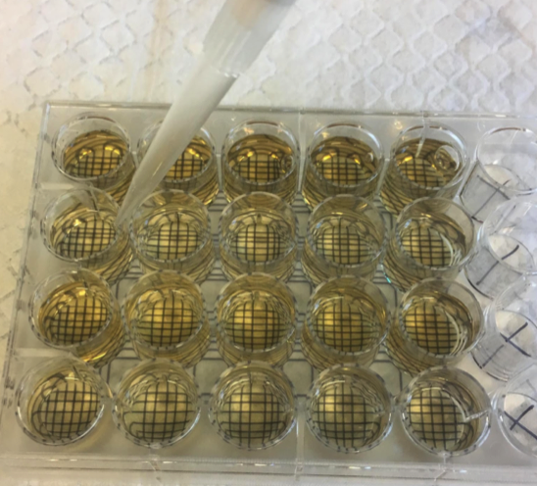
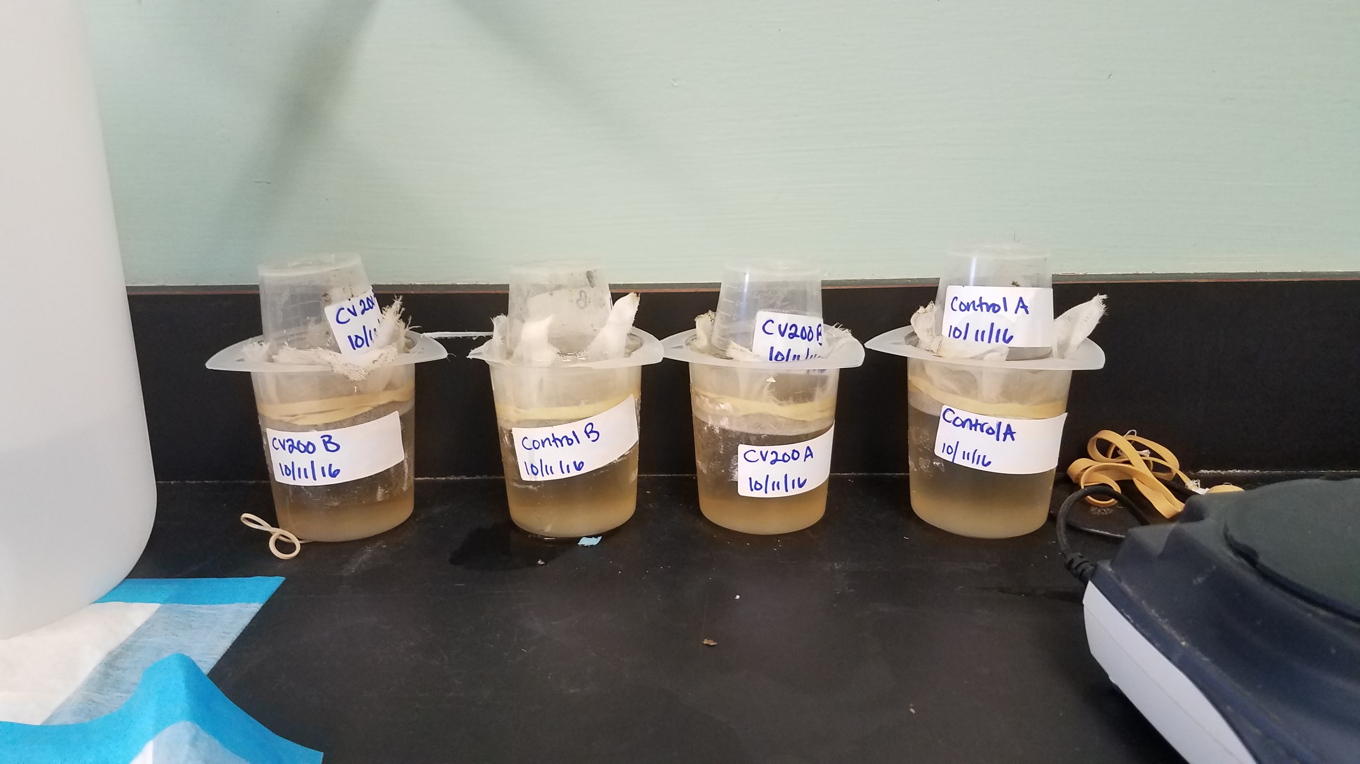
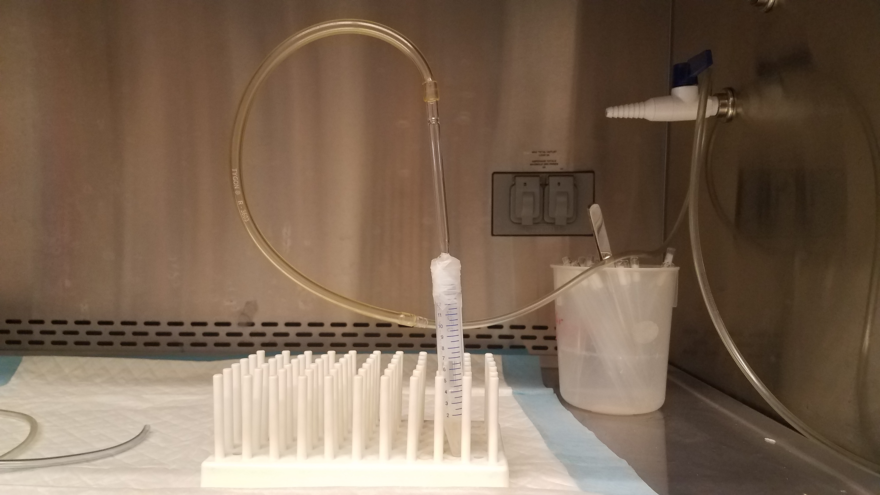
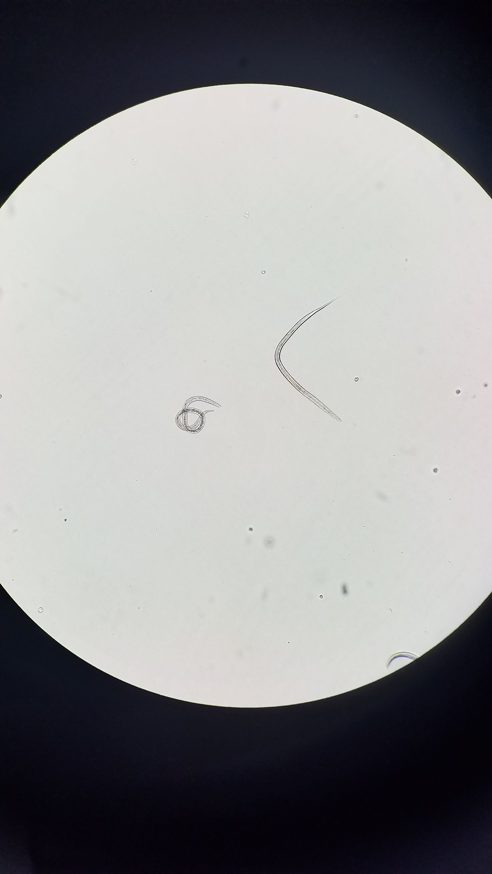

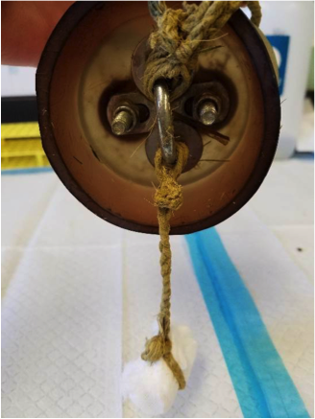
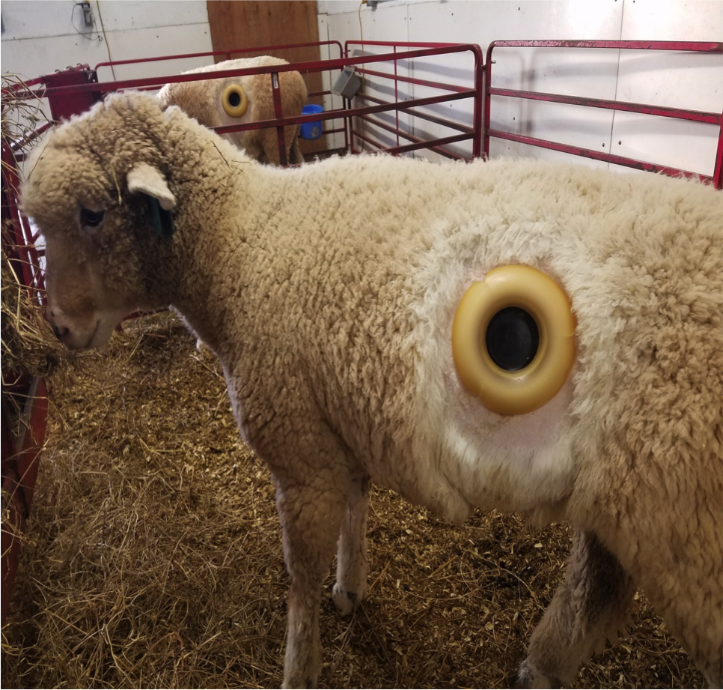
The effect of season upon the life cycle and development of Haemonchus contortus in experimentally infected lambs
Marissa Brummett*¹, Bailey Chalut¹, Amy Vigneau¹, Carly Barone², Anne Zajac³ and Katherine Petersson.¹
¹University of Rhode Island, Kingston, RI. ²Agricultural Research Service, USDA, Beltsville, Maryland. ³Virginia Tech, Blacksburg, VA.
Introduction
Materials and Methods
Results
Gastrointestinal nematode (GIN) infections, particularly Haemonchus contortus, pose a threat to the health of small ruminants and are a major limitation for pasture-based production (Hoste et al. 2006; Veríssimo et al., 2012) (Figure 1). H. contortus has life cycle stages that are commonly studied in relation to infection
Donor Lambs
In vitro Exsheathment
- A total of 8 donor lambs were used for the trial (Figure 3).
Fall: 2 twin male Dorset lambs (6 months old)
Winter: 2 twin male Dorset lambs (9 months old)
Spring: 2 twin female Dorset cross lambs (6 months old)
Summer: 2 genetically related female Dorset cross lambs (9 months old)
Figure 1. Haemonchus contortus
- Fecal egg counts (FEC) were conducted weekly to monitor infection and to determine the quantity of feces needed for the egg hatch assay and culture preparation
Figure 11. The effect of season and age on % live exsheathment using the in vitro method. Average exsheathment was calculated for 2-3 replicates per donor lamb (N=2) for each month. Mean ± SEM. + p ≤ 0.05 vs. Fall cycle month 2; * p ≤ 0.05 vs. Fall cycle month 4.
development, including in vitro egg hatch and in vitro and in vivo L3 exsheathment (Figure 2).
The effect of refrigerated storage on experimentally obtained L3 is well known, with most published studies noting that larvae had not been in storage for more than three months (Hertzberg, et al. 2002; Brunet, et al. 2007). It is also known that H.contortus larvae
Figure 3. Donor lambs
In vivo Exsheathment
Egg Recovery and Egg Hatch Assay
- Feces from each lamb were combined with water. This mixture was poured over sieves of decreasing sizes (Figure 4).
- Eggs were collected in a water solution (Figure 5).
Figure 2. H. contortus life cycle
- The egg hatch assay was conducted using established procedures (Assis et al. 2003; Marie-Magdeleine et al. 2009).
- Briefly, eggs were added to a 24-well flat-bottomed microtitre plate with water and DMSO (Figure 6). The wells were incubated at 26°C for 24 hours and read to determine % egg hatchability.
transition into a hypobiotic state, allowing them to survive harsh weather conditions (Gatongi, et al. 1998). Previous work has also been conducted to explore the effect of age of L3 as a factor in the in vitro assesment of anthelmintic properties of tannin containing plant extracts, showing a negative correlation between larval motility and age of larvae (Castañeda-Ramírez et al., 2017). A considerable amount of variability has been observed across previous in vivo studies in relation to amount of time for exsheathment to occur (Brunet et al. 2007; Hertzberg et al. 2002). The variability in previous work as well as in our laboratory has indicated a need for research to focus on environmental factors influencing larval development (Lonngren 2017). Understanding external factors that potentially influence larval life cycle stages can improve research practices and inform current recommendations for the control of these parasites.
Figure 12. The effect of season and age on % live exsheathment using the in vivo method. Average exsheathment was calculated for 4 replicates per donor lamb (N=2) using 4 ruminally fistulated ewes for each month. Mean ± SEM.
Figure 4. Sieves of decreasing sizes (1 mm, 355, 150, 38 and 25 μm)
In vitro vs. In vivo Exsheathment (Season)
Larval Recovery
Figure 5. H. contortus eggs
Figure 6. Egg hatch well plate
- Feces were collected for culture preparation (Figure 7).
Figure 13. Comparison of in vitro and in vivo exsheathment methods corresponding to season. Averages for in vivo data were calculated for 4 replicates per donor lamb (N=2) using 4 ruminally fistulated ewes for 4-5 months. Averages for in vitro data were calculated for 2-3 replicates per donor lamb for 4-5 months. Mean ± SEM. Means with different superscripts differ significantly p≤ 0.001.
- The cultures were incubated at 25-30°C for 1-2 weeks. The samples were flooded with water to obtain a concentrated larvae solution
In vitro vs. In vivo Exsheathment (Age)
Objectives
Figure 7. Fecal cultures
In vitro CO₂ Exsheathment Assay
1. Determine if age of the adult worm affects the ability of eggs to hatch as well as exsheathment of third stage H. contortus larvae in vitro and in vivo.
2. Determine the effect of season on the adult worms in the host animal and on the ability of eggs from these worms to hatch at varying times of year as well as exsheathment of the resulting L3 H. contortus larvae in vitro and in vivo.
- 2,000 larvae were added to a polypropylene tube with water and Earle’s Balanced Salt Solution
- The L3 tubes were exposed to CO₂ treatment for 15 minutes and sealed using a modified version of the technique by Conder and Johnson (1996 ) (Figure 8). The capped tubes were incubated at 37°C for 18 hours.
Figure 8. CO₂ treatment
Figure 14. Comparison of in vitro and in vivo exsheathment methods corresponding to worm age. Averages for in vivo data were calculated for 4 replicates per donor lamb (N=2) using 4 ruminally fistulated ewes for 3 seasonal cycles. Averages for in vitro data were calculated for 2-3 replicates per donor lamb for 3 seasonal cycles. Mean ± SEM. Means with different superscripts differ significantly p≤ 0.001.
- Egg hatchability was ≥ 94% across all three cycles for all months of testing.
Study Design
- After incubation, larvae were observed for presence of sheath to determine percent live exsheathment (# live exsheathed L3/total live L3)
Conclusions
Figure 9. exsheathed vs. ensheathed larva
Statistically significant differences for in vitro data show both a seasonal and age of worm effect. This pattern is not seen for in vivo data, suggesting that the two assays do not correlate accurately. Variability for in vitro data may suggest that the in vivo assay yields more reliable results.
September 2017-December 2018
In vivo Exsheathment Assay
- Four ruminally fistulated ewes were used for this assay
2,000 ensheathed L3 were added to a capsule composed of a piece Tygon® tubing and two 8 μm NuncTM Cell Culture Inserts. One capsule from each donor was placed in each of 4 fistulated ewes- 8 capsules total. The capsules were tied to a 20 cm cord and suspended in the rumen (Figure 10).
Acknowledgements
S
O
N
D
J
F
M
A
M
J
J
A
S
O
N
D
Funding for this project was provided by USDA NESARE grant (LNE15-342), as well as funding from a NESARE graduate student grant (GNE17-145-31064) awarded in 2017. An extensive thank you to my advisor, Dr. Katherine Petersson, as well as my fellow graduate student, Bailey Chalut. Thank you to all undergraduate students who have assisted with this project. Thank you also Dr. Anne Zajac as well as farm manager, Nick Miniter.
Key
- The capsules were removed after 8 hours and larvae were counted to determine % live exsheathment as described above.
= Infect 2 donor lambs with 10,000 L3
= Fall Cycle
References
= Egg hatch assay
= Winter Cycle
Assis, L.M., Bevilaqua, C.M.L., Morais, S.M., Vieira, L.S., Costa, C.T.C., Souza, J.A.L., 2003. Ovicidal and larvicidal activity in vitro of Spigelia anthelmia Linn. extracts on Haemonchus contortus. Vet. Parasitol. 117 (1–2), 43-49.
Brunet, S., Aufrere, J., El Babili, F., Fouraste, I., Hoste, H., 2007. The kinetics of exsheathment of infective nematode larvae is disturbed in the presence of a tannin- rich plant extract (sainfoin) both in vitro and in vivo. Parasitology. 134, 1253– 1262.
Castañeda-Ramírez, G. S., C. Mathieu, G. Vilarem, H. Hoste, P. Mendoza-de-Gives, P. G. González-Pech, J. F. J. Torres-Acosta, and C. A. Sandoval-Castro. 2017. Age of Haemonchus contortus third stage infective larvae is a factor influencing the in vitro assessment of anthelmintic properties of tannin containing plant extracts. Vet. Parasitol. 243:130–134. doi:10.1016/j.vetpar.2017.06.019.
Conder, G.A., Johnson, S.S., 1996. Viability of infective larvae of Haemonchus contortus, Ostertagia ostertagi, and Trichostrongylus colubriformis following exsheathment by various techniques. J. Parasitol. 82, 100–102.
Gatongi, P.M., Prichard, R.K., Ranjan, S., Gathuma, J.M., Munyua, W.K., Cheruiyot, H., Scott, M.E., 1998. Hypobiosis of Haemonchus contortus in natural infections of sheep and goats in a semi-arid area of Kenya. Vet. Parasitol. 77, 49–61.
Hertzberg, H., Huwyler, U., Kohler, L., Rehbein, S., Wanner, M., 2002. Kinetics of exsheathment of infective ovine and bovine strongylid larvae in vivo and in vitro. Parasitology. 125, 65–70.
Hoste, H., Jackson, F., Athanasiadou, S., Thamsborg, S.M., Hoskin, S.O., 2006. The effects of tannin-rich plants on parasitic nematodes in ruminants. Trends Parasitol. 22 (6), 253-261, S1471-4922(06)00099-7.
Lonngren, K., 2017. Effect of birdsfoot trefoil on exsheathment of haemonchus contortus in rumen fistulated sheep. University of Rhode Island
Marie-Magdeleine, C., Hoste, H., Mahieu, M., Varo, H., Archimede, H., 2009. In vitro effects of Cucurbita moschata seed extracts on Haemonchus contortus. Vet. Parasitol. 161 (1-2), 99-105.
= Exsheathment assays
= Spring Cycle
Statistical Analysis
Figure 10. in vivo assay setup
= Summer Cycle
- Data was analyzed using ANOVA and means were separated with Dunnett’s t-test using the GLM procedure in SAS
Notes:
Copyright Colin Purrington (http://colinpurrington.com/tips/academic/posterdesign).

