Slide 1
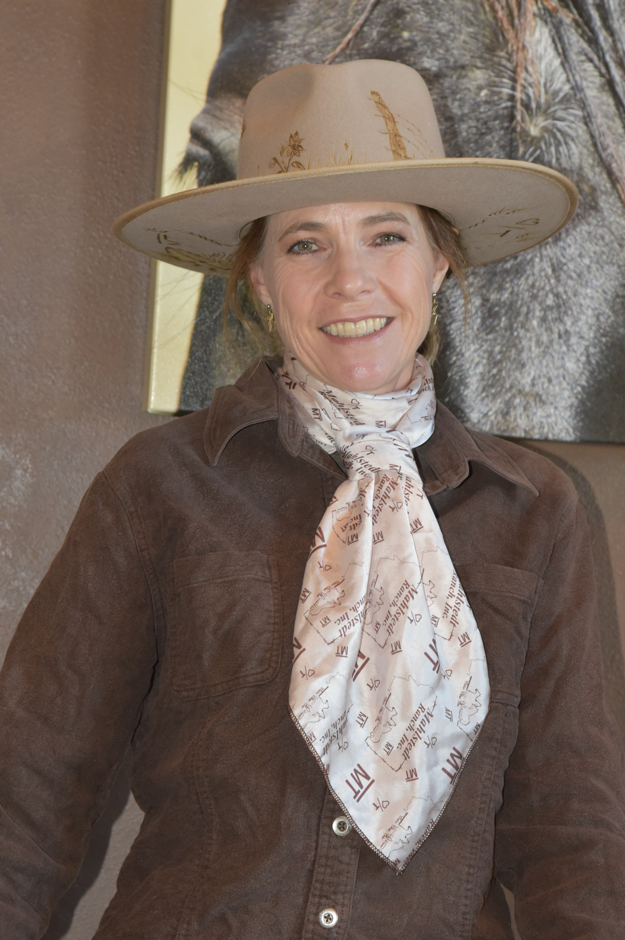
Welcome to the Agritourism Panel
Moderator:
Dr. Shannon Arnold, Professor in Agricultural Education
Panelists
Tana Canen, Mahlstedt Ranch Inc.
Tamara Robertson, Wandering Acres LLC
Rayner Smith, Bodhi Farms

Slide 2
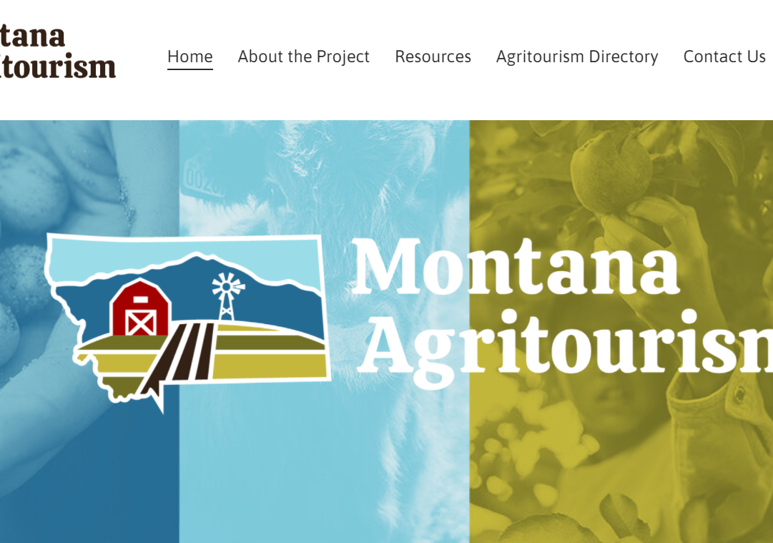
Defining Agritourism
MT HB 342 (2017) “Agritourism means a form of commercial enterprise that links agriculture production or agricultural processing with tourism in order to attract visitors to a farm, ranch or other agricultural business for purposes of entertaining or educating visitors.”
Notes:
HB 342 officially added agritourism to the list of MT Recreational activities opening up opportunites to develop the industry
2017 Montana Agritourism Manual
AERO, MT Department of Ag and Commerce, MSU Extension, Governor’s Office for Economic Development, FADS, Montana Farmer’s Union, USDA Farmer’s Market Promotion program, and Agritourism Working Group
AERO has recently released Developing Montana’s Agritourism: A Resource Manual, the first of its kind in the state, to help Montana’s farmers, ranchers, and producers explore agritourism as a product offering and economic opportunity.
have been found to be strong motivators for starting an agritourism business on an existing farm or ranch (McGehee & Kim, 2004; Schilling et al., 2006).
Education of urban and suburban audiences
Motivators
Additional income stream
The ability to diversify operations

Slide 3
Agritourism Framework (Chase et al., 2018)
Core Activities:
Classical Agritourism activities on-the-farm connected to agricultural production and marketing
Peripheral Activities:
Non-Traditional activities on-farm but direct lack connection to agriculture
Notes:
An activity could be in either the core or peripheral category based on location, i.e., on-farm vs. off-farm, or how that activity is connected to traditional agriculture. Chase et al. (2018) defined core activities as “those that take place on a working farm or ranch and have deep connection to agricultural production and the marketing of a farm’s products”
Peripheral activities are defined as those that “may take place on a working farm, but they may lack deep connection to the actual farm or ranch, so they may be considered as peripheral activities and are located on the outer ring of the chart” (p. 17).

Slide 4
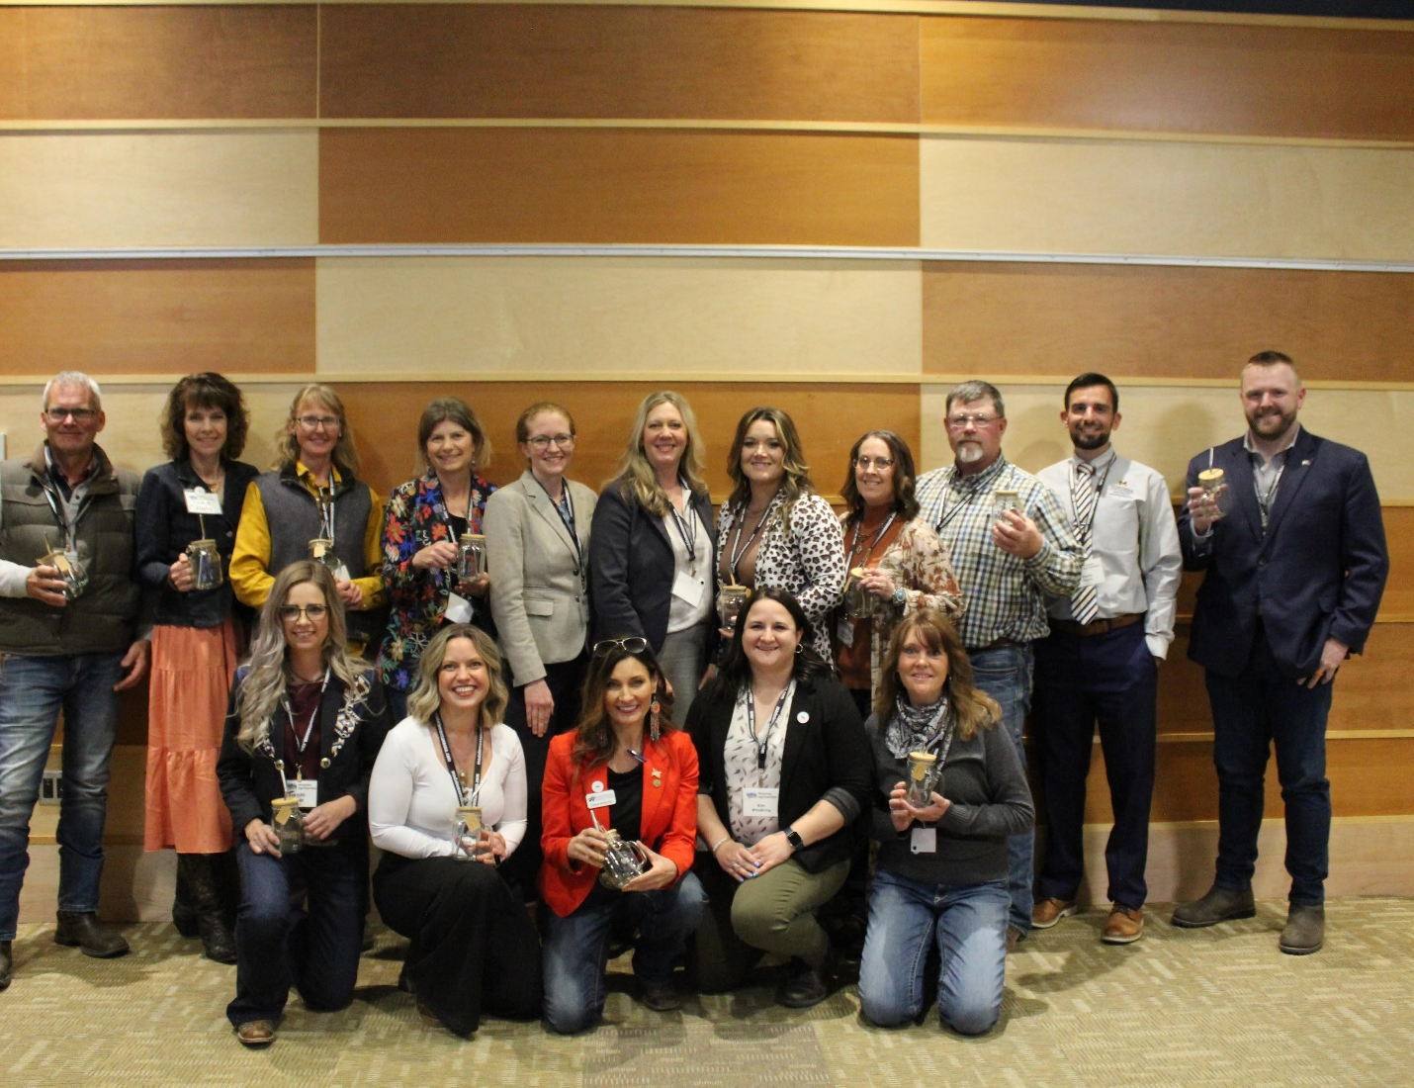
Agritourism in Montana
National Extension Tourism Conference
Governor’s Conference on Tourism
Global Agritourism Network and International Agritourism Conference
Farming Entrepreneurship Podcast
Governor’s Farm Visits
Wall Street Journal
Agritourism Directory on Abundant Montana
Agritourism Annual Conference
Listening Sessions
AgCorps Agritourism Specialist Position
Agritourism Panels
Agritourism Course

Slide 5
What are the sustainable benefits of agritourism?
Economic
Additional income stream
Increase opportunities for family employment
Increase traffic to the community
Social
Reconnect the public with our food system
Provide visitors with authentic agricultural experiences
Bridge the growing gap of knowledge between consumer and producer
Environmental
The ability to diversify operations
Stewardship and preservation of natural resources
Use the existing infrastructure

Slide 6
Characteristics of an Effective
Agritourism Operation
MT Dept of Ag Specialty Crop Block Grant
Logos, Website, Video Stories, Expert Interview Series, Data Visualization, and Social Media Presence
Notes:
Created
MT Department of Ag Specialty Crop Block Grant: Explore the industry
Develop an effective educational platform
Increase knowledge of agritourism for a wide population
Increase understanding of communication methods
Outcomes: Created Logos, Website, Video Stories, Expert Interview Series, Data Visualization, and Social Media Presence
For each episode, the project directors will invite current and prospective agritourism operators in Montana to discuss their challenges and questions. Then, industry experts, researchers and Extension professionals, and experienced agritourism operators from nearby states will be invited to respond to the questions and provide insights about overcoming specific challenges to be successful. A complementary website to host the podcast series and informational resources will significantly aid in expediting the development of a successful agritourism industry in Montana. The innovative podcast delivery mechanism is intended to engage groups of younger, potentially economically disadvantaged producers who are most likely to begin an agritourism business but are also more challenging to reach with more traditional educational efforts. This project will use a portfolio of marketing strategies—ranging from traditional press releases to targeted social media strategies—to maximize reach across varying demographic and socioeconomic groups. By tracking analytics, the project will provide insights about which communications and marketing strategies are most effective.
This communication approach seeks to engage varying demographic and socioeconomic groups
Recording is the easy part! Now what?
Post-Editing, Transcribing, and Text Analysis
Descript
Machine learning transcription service: 1 hour podcast = 5 minutes to transcribe = 95% accuracy
$199 year
Text Analysis
Nvivo- Qualitative Analysis Software
Post-Editing
Hired a Marketing and Consulting Company

Slide 7
Montana Agritourism Steering Committee
Our Mission
Dedicated to promoting the Agritourism industry in Montana by working collaboratively with state and industry partners, providing resources, research, and education, and connecting our producers and community stakeholders with local, state, and global agritourism markets.
Core Values and Goals
Targeted marketing and branding.
Effective industry-driven networks.
Amended policies.
Regulatory Issues.
Meaningful standards.
Strengthen economic diversification.
Our Vision
Combining the essential elements of tourism and agriculture industries will attract the public, increase agricultural income, and provide recreation and/or educational experiences for visitors.
Notes:
Our Mission
Dedicated to promoting the Agritourism industry in Montana by working collaboratively with state and industry partners, providing resources, research, and education, and connecting our producers and community stakeholders with local, state, and global agritourism markets.
Montana’s strategic agritourism marketing plan combined with culinary tourism marketing and value-added products will put the spotlight on Montana as a world-class destination for interesting, fun and life-changing agriculture-based experiences.
. The goal is to develop and sustain an agritourism affiliation for the purposes of creating relationships, assisting operators with marketing, and learning best practices with an emphasis on stewardship.
To clarify and improve the state and local regulatory framework so agritourism businesses are compatible with the intent of land-use law and public health regulations and operating smoothly.
To lessen the barriers to entry by addressing inherent risks, limited liability laws, and insurance coverage needed to operate.
To collaborate with industry partners advocating for a bill that would provide Limited Liability for Agritourism Providers so that Montanans can afford to provide agritourism opportunities and do so with some peace of mind.
To pave the way for locals and visitors to discover agritourism products and services vetted for authenticity and quality.
We are committed to making resources readily available and providing advice and support for producers interested in growth and value-added opportunities in agritourism.

Slide 8
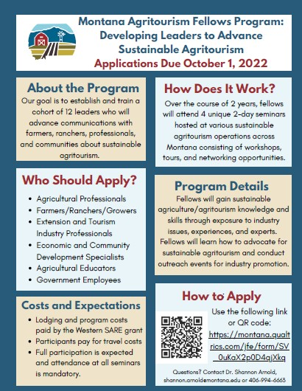
Western SARE PDP Grant
The program goal is to establish and train a cohort of leaders, the Fellows, who can effectively educate others on:
Diversification opportunities
Sustainable practices
The economic, environmental, and social impacts of sustainable agritourism.
Notes:
At its heart, agritourism connects farms to communities.
Fellows will gain sustainable agritourism knowledge and skills transferable to Montana communities through exposure to
In the Abundant Montana Directory,
there are many types of agritourism activities
listed including farm and business tours, farm-to-table
dinners, farm stays, workshops, internships and volunteer
opportunities, and special events such as weddings.
We took the approach of those enterprises that connect agriculture and education to condense the sample.
Program content and experiences will emphasize:
Sustainable agriculture operations
Integration strategies with agritourism

Slide 9
Montana Agritourism Fellows Program Objectives and Outcomes
Program Objectives
Program Outcomes
Increase knowledge of agritourism
Increase your agritourism network
Increase communication, teaching, and leadership skills
Increase strategies to create a sustainable agritourism enterprise
(1) Create a plan to educate others about agritourism
(2) Build a community collection of educational resources- Fact Sheets
(3) Assist in the initial formation of a state agritourism association
(4) Assist in hosting a statewide agritourism conference
Notes:
Fellows were nominated and chosen based on:
Community leadership
Occupation­—with preference for agriculture, tourism, and educators
Dedication to sustainable agriculture
Interest in agritourism
participants will work to create an open-access digital repository for community outreach. The evidence-based repository will consist of information collected from program content, reflection, journaling, and experiences and engaging with the civic rhetoric model. The repository will be used as an open resource to educate farmers, ranchers, and communities interested in learning more about sustainable agritourism as a business alternative. Repository materials will aim to increase knowledge in agritourism, sustainable agriculture, safety and risk management, liabilities and insurance, communication and marketing, and business practices. Information may include best practices, barriers to growth, characteristics, and motivating factors to participating in sustainable agritourism. The goal of the digital repository is to serve as a clearinghouse to aid in delivering community outreach programs geared toward making knowledge and ideas accessible to the public.

Slide 10
Fellows Program IN Action
Video

Slide 11
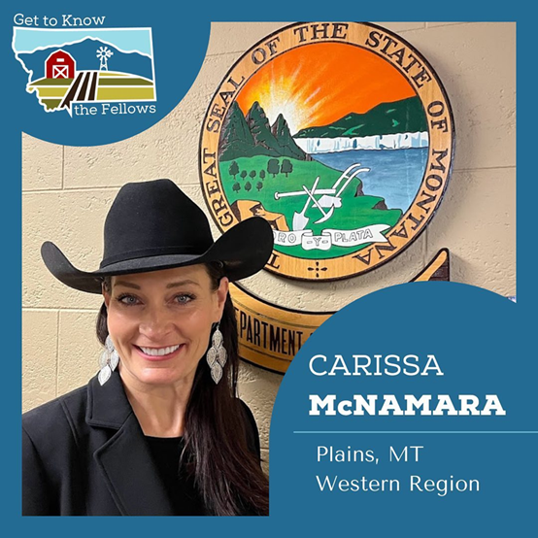
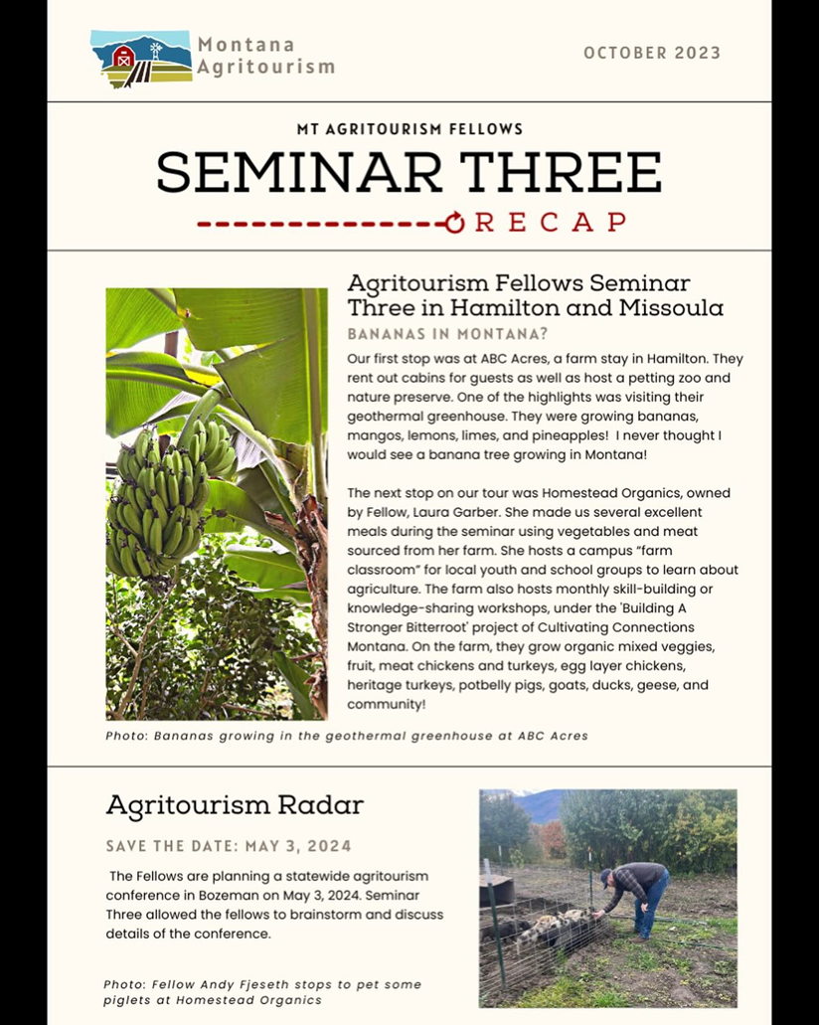
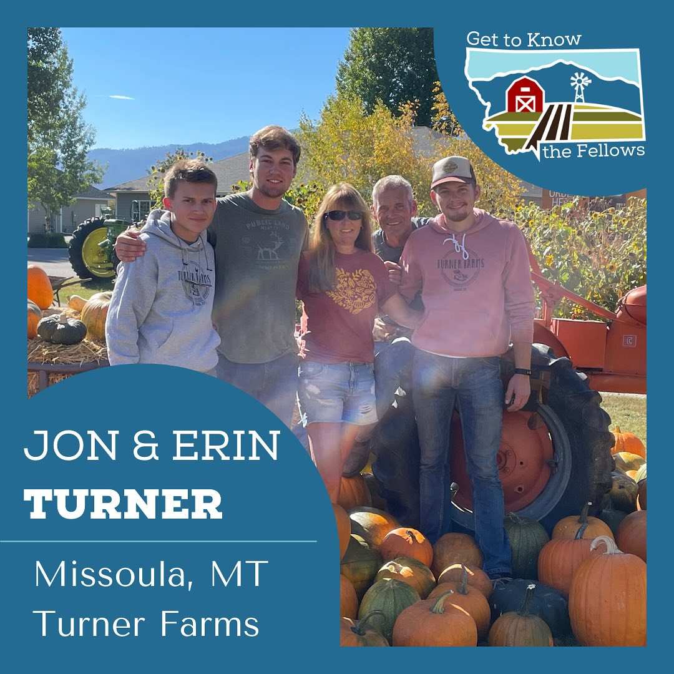

Slide 12
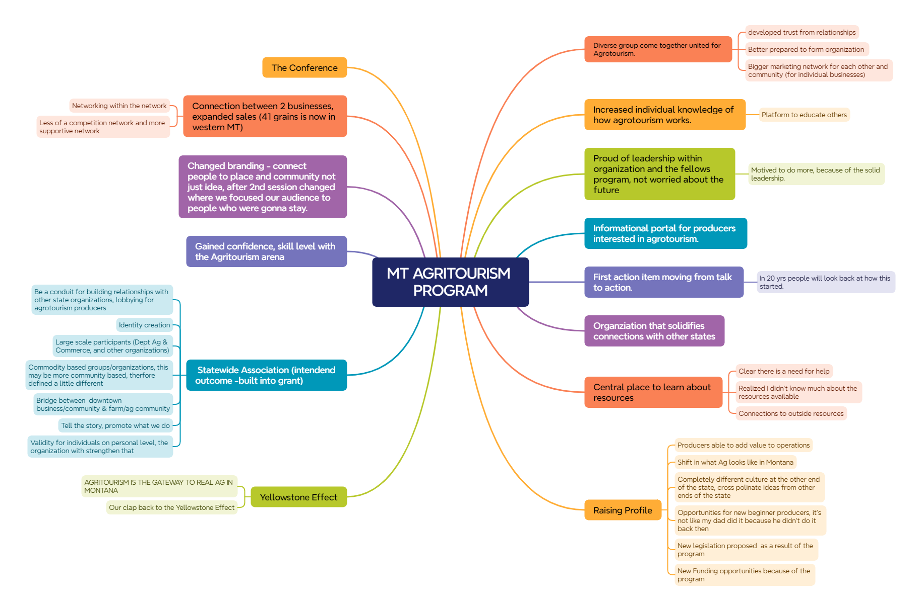

Slide 13
Partnerships Built

Slide 14
Agritourism in Your Area
Current agritourism initiatives in your county?
Opportunities for agritourism in your county?
How could you engage producers in your area with agritourism?

Slide 15
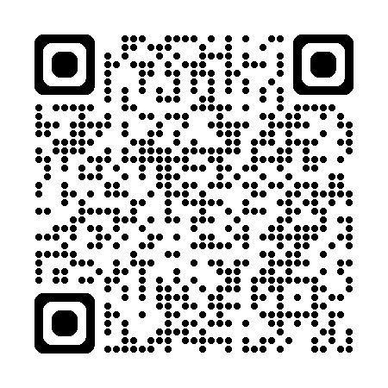
Thank you!
Check out the Montana Agritourism website!

