Slide 1

CARAT:
Career Awareness Recognizing Agricultural Sciences through Tower (Vertical) Gardening
Nancy Zenger-Beneda Ed.S.
nancy@ksagclassroom.org
Katie Hutchison
katie.hutchison@usd497.org
KFAC Curriculum Development Team

Slide 2


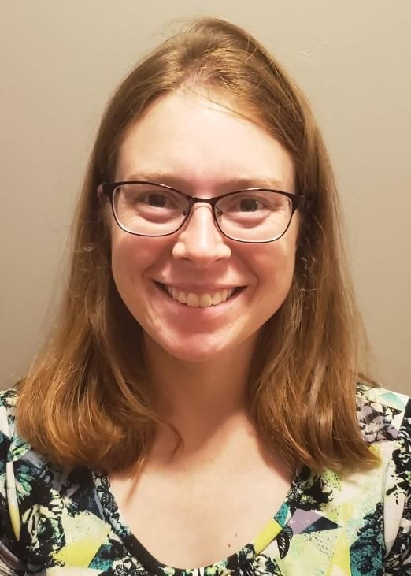

Introductions
Katie Hutchison (she/her)
Biology, Chemistry & ESOL Teacher
Lawrence High School USD 497
Education and Credentials
-EdM Curriculum & Instruction: Language and Literacy
University of Illinois at Urbana-Champaign
-BA Biology, Pre-Medicine and Spanish
Augustana College, IL
Nancy Zenger-Beneda
Executive Director of Kansas Foundation for Ag in the Classroom
Education and Credentials
-Ed.S. Educational Leadership
Fort Hays State University
-MA Speech
Kansas State University

Slide 3

What is CARAT?
CARAT (Career Awareness Recognizing Agricultural Sciences through Tower (Vertical) Gardening) was started in 2022 for the purpose of:
-Raising awareness of vertical gardening as a sustainable farming practice
-Developing NGSS and National Agriculture Literacy Outcome-aligned lessons to facilitate high quality instruction in life science classrooms
-Connecting students to career opportunities in agriculture
This work is supported by the Secondary Challenge Program, project award no. 2022-04317, from the U.S. Department of Agriculture’s National Institute of Food and Agriculture.

Slide 4
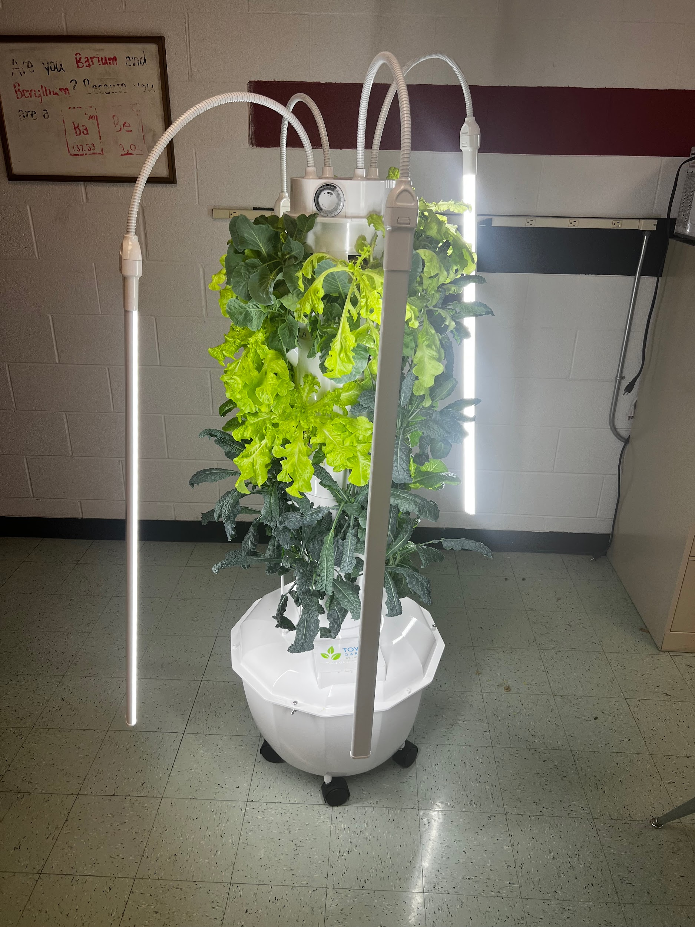



Today’s Objectives
Provide a brief overview of curriculum materials you can integrate into your classroom.
Discuss what resources you need to successfully integrate agricultural education into your classroom.

Slide 5
Our Driving Questions
Throughout today’s session if you think of a question please add it to this board and we will address it during our Q & A at the end of our session.
Terms you’d like to review:
-
-
-
-
-
-
-
Notes:
Ask Nancy to print several of these and bring stick notes so participants can add to them.

Slide 6
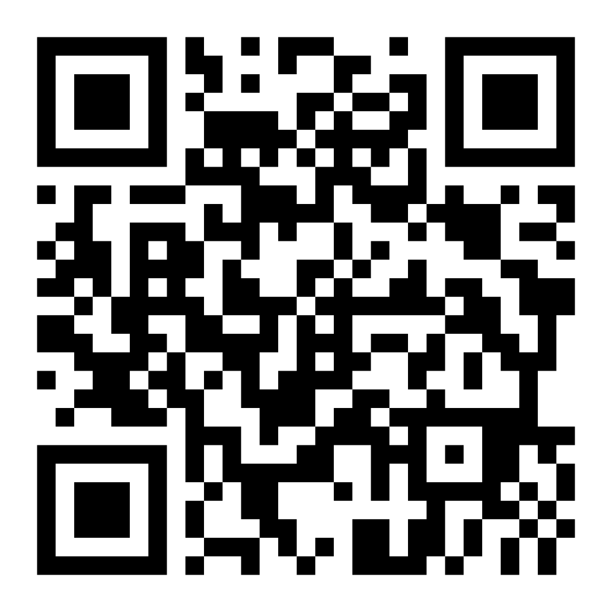

How can we engage our students?
-Make it personally relevant
-Use current local/regional data
-Share a real-world problem that they can help solve
-Collaboratively set goals and propose solutions
Notes:
Add QR code for Journey 2050 (app, browser-based, can play offline)

Slide 7
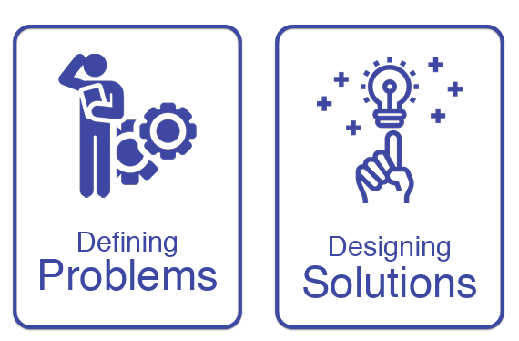
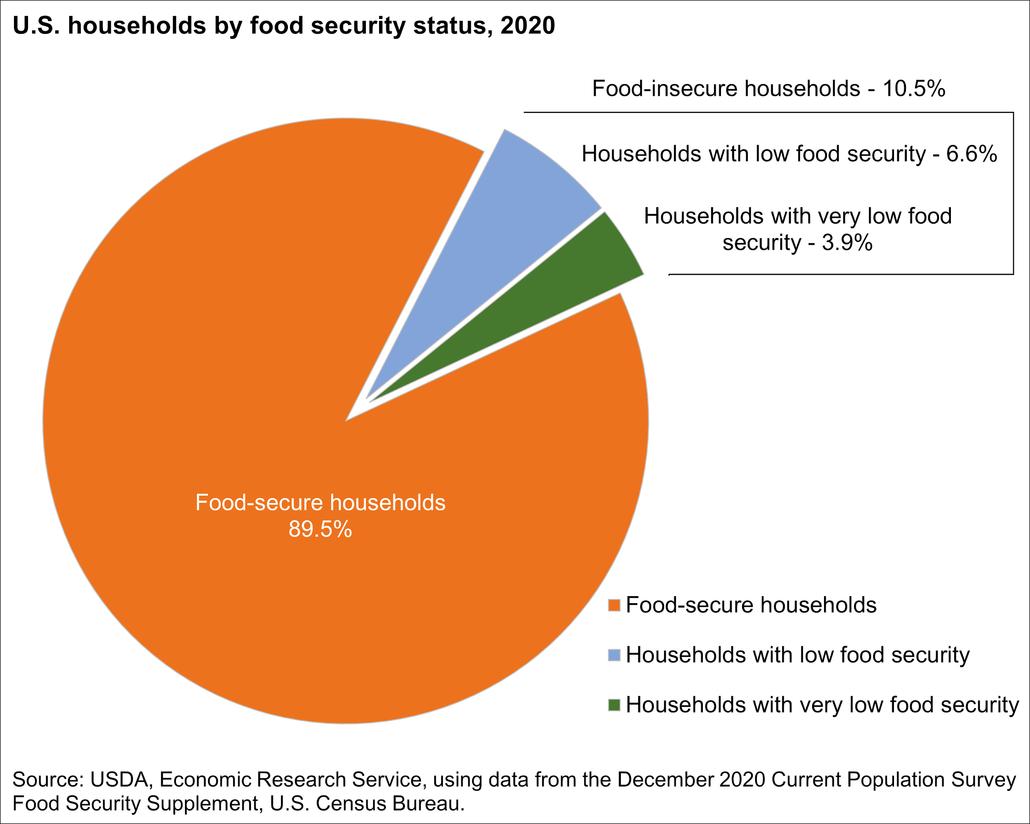

9th Grade Student Example
How many people are affected by food insecurity?
More than 44 million people in the US face hunger, including 1 in 5 children. Millions of people in the US don't have enough food to eat or don’t have the access to healthy food. This is a big problem!! But together, we can solve it.
source: feedingamerica.org, Nepm.org.
Notes:
NGSS print your own poster link: NGSSposters2.pdf Website Print-It-Yourself NGSS Classroom Posters | Project NEURON | University of Illinois
Wonder of science NGSS cards: NGSS+Planning+Cards.pdf

Slide 8
Engineering Challenge
Goal: Design and build a low-cost vertical garden
Parameters:
-Work in teams of 2-3 people
-Time= 5 minutes to plan, 10 minutes to build
-Must only use the items provided in the bag
Your design
*Must be drawn to scale (1 inch = 1 foot) and labeled (base, top, materials, etc)
* You CAN have multiple designs and you can make changes as you build.

Slide 9
Rubric
Goal: Design and build a low-cost vertical garden
Expert
Has 3+ levels, 3+ different crops
Diagram is labeled and drawn to scale
Intermediate
Has 2 levels, 2 different crops
Diagram is mostly labeled and drawn to scale
Novice
Has 1 level, designed for 1 type of crop
Diagram is somewhat labeled and drawn to scale

Slide 10
Reflection
Was your team successful? Why or why not?
What skills did you utilize? List 3 or more.
What careers could you connect to this learning activity?

Slide 11
Vertical Gardening Curriculum and Essential Questions
How can we improve food production in our community?
What are the essential components of a vertical garden?
What career opportunities are available for me in agriculture?
Community Engagement
Agriculture Practices
Careers

Slide 12
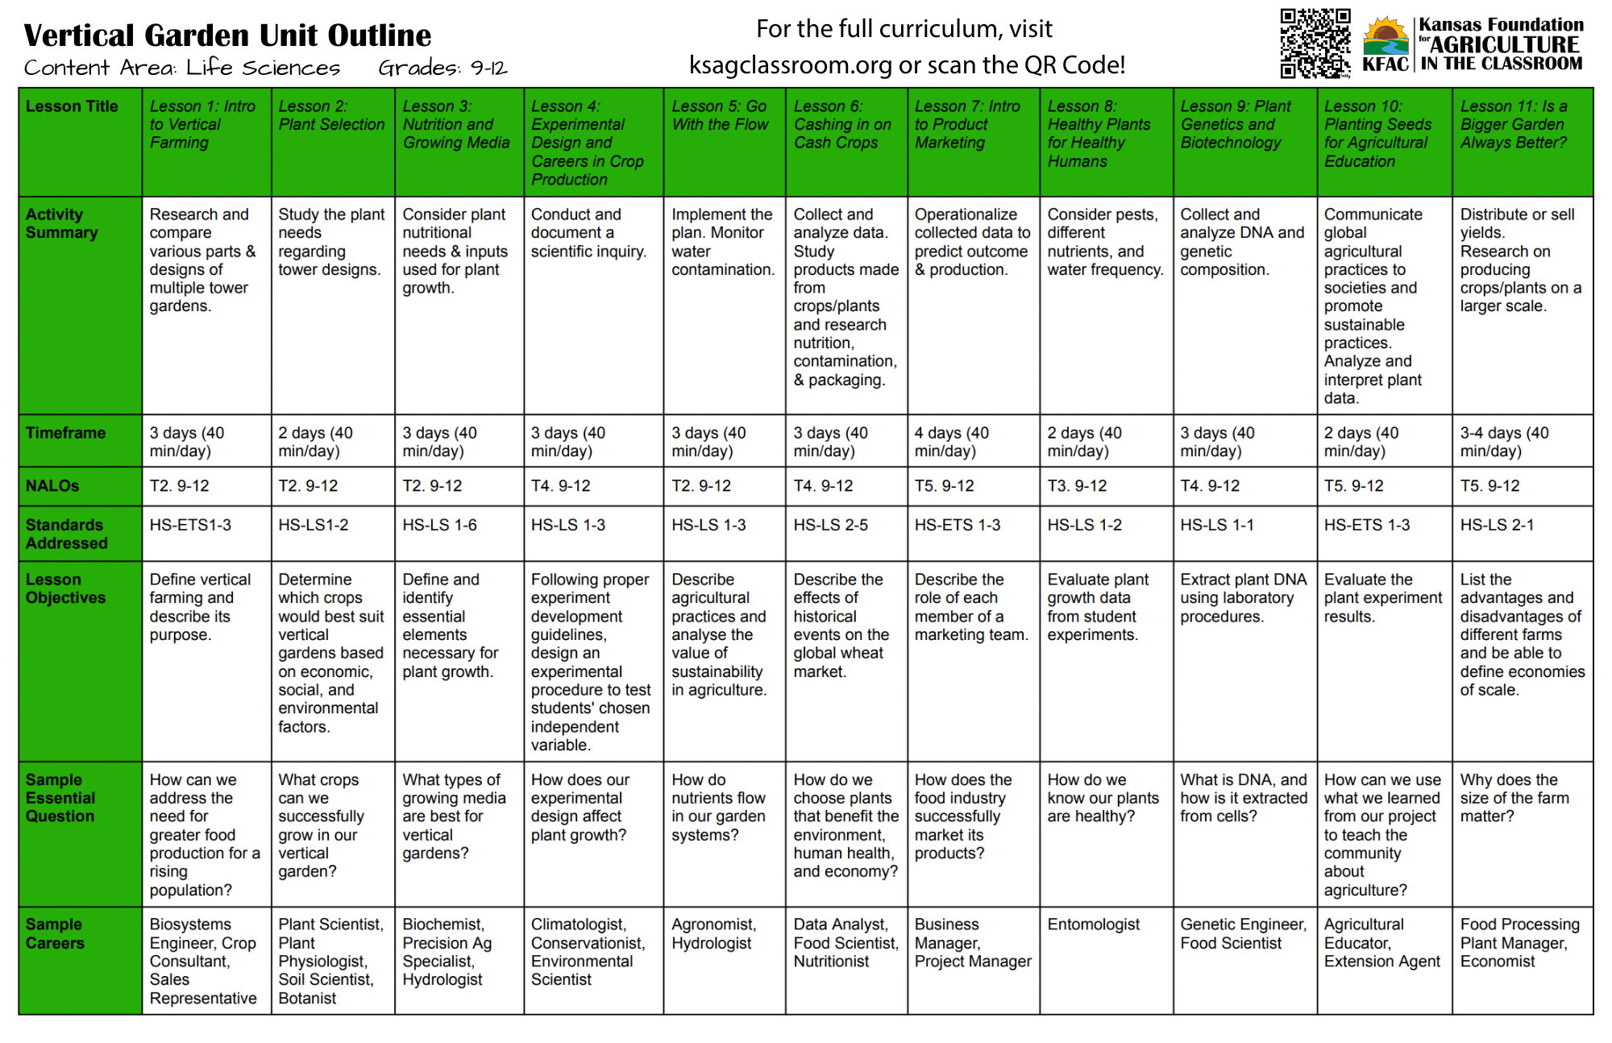
Vertical Gardening Curriculum Overview
-11 Lessons
-Student handouts
-Sample assessments
-Customizable
-Notes and teaching tips
-Instructional support available

Slide 13
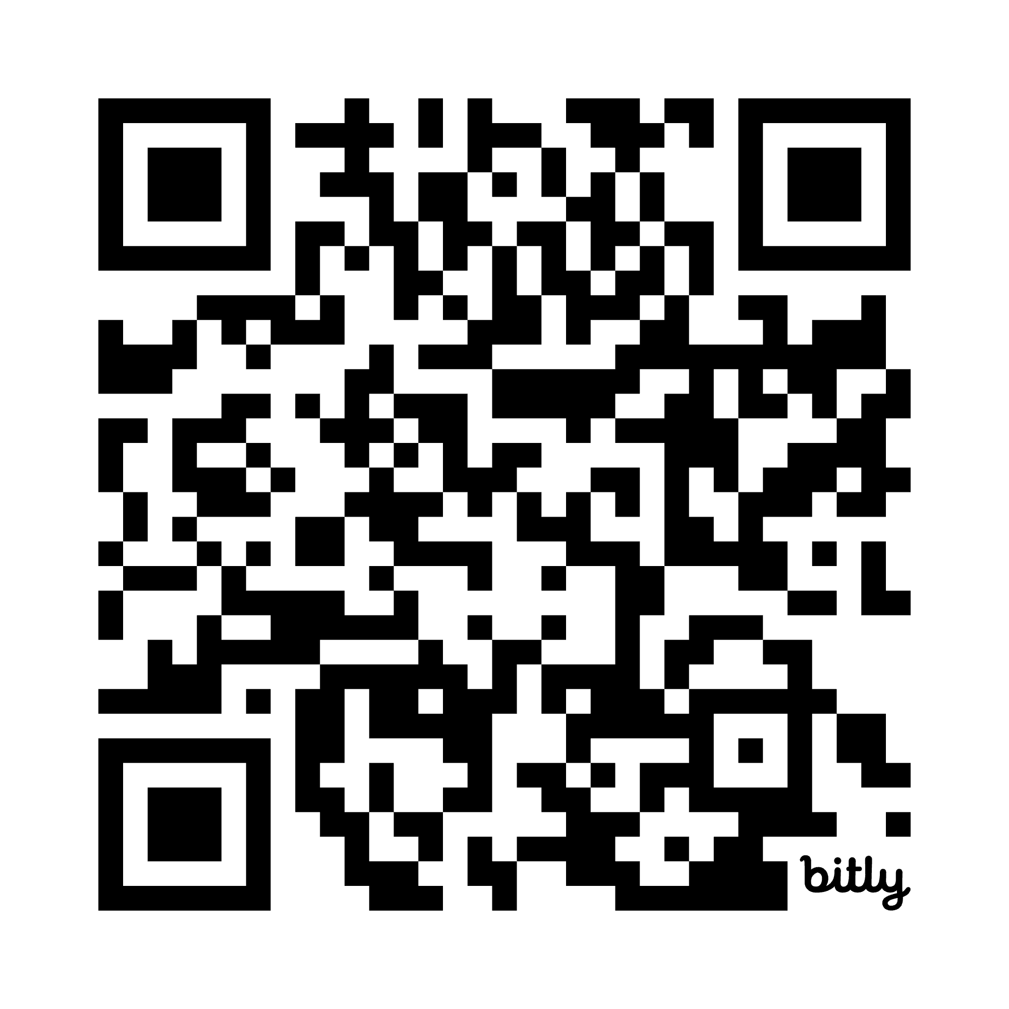
Time to Explore
Your Choices:
Digital curriculum materials
3D Virtual Tour of a Tower Garden
Career Resources
Questions for Nancy (Materials) and Katie (Instruction)
https://bit.ly/4l63j5R

Slide 14
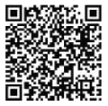


Resources
Tower Garden Giveaway- KFAC will be awarding 3 Tower Gardens to eligible applicants supporting the use of this curriculum in teaching regenerative and sustainable agriculture. The Tower Gardens were obtained through a grant from North Central SARE.
Check out the KFAC
newsletter
to learn more:
This material is based upon work that is supported by the National Institute of Food and Agriculture, U.S. Department of Agriculture, under coop agreement 2024-38640-42989 through the North Central Region SARE program under project number YENC25-243.
NGSS Posters
NGSS Cards
NALO’s
Tower Garden Website
Vertical Gardening 101
Budget Vertical Garden
Vertical Garden Crops

Slide 15
Q and A’s and Takeaways
Nancy Zenger-Beneda Ed.S.
nancy@ksagclassroom.org
Katie Hutchison
katie.hutchison@usd497.org
*Please complete the brief exit survey before you leave. Thank you!

