Slide 1

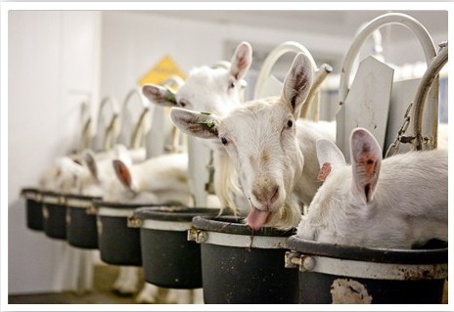

CHEESE MAKING STEP BY STEP

Slide 2
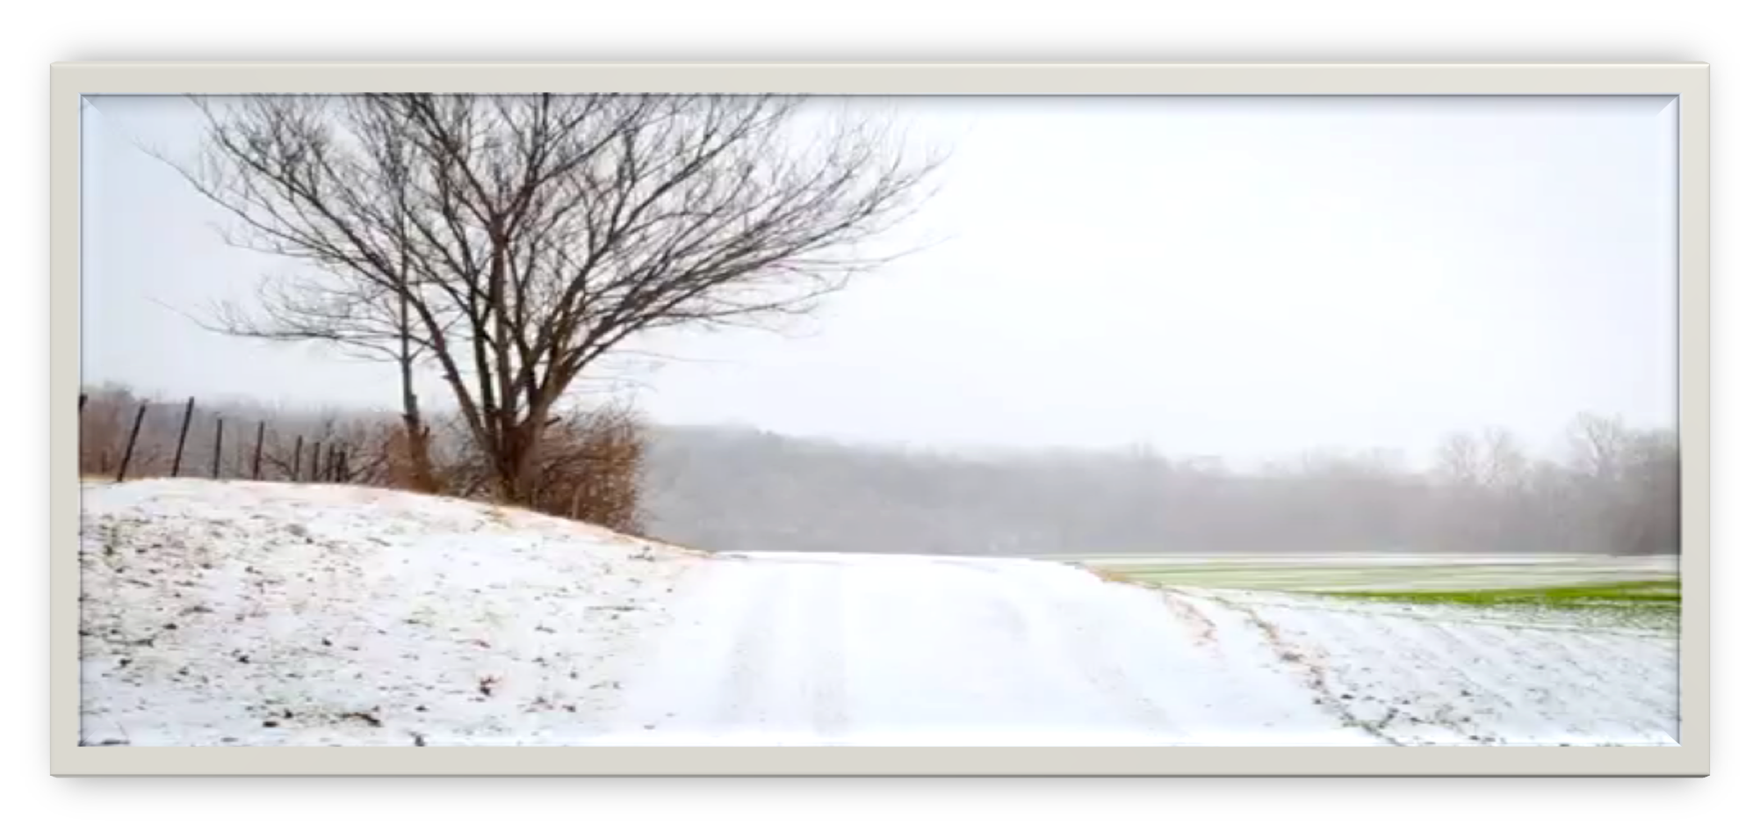
WELCOME TO BAETJE FARMS

Slide 3

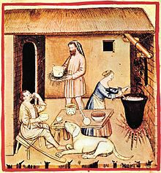
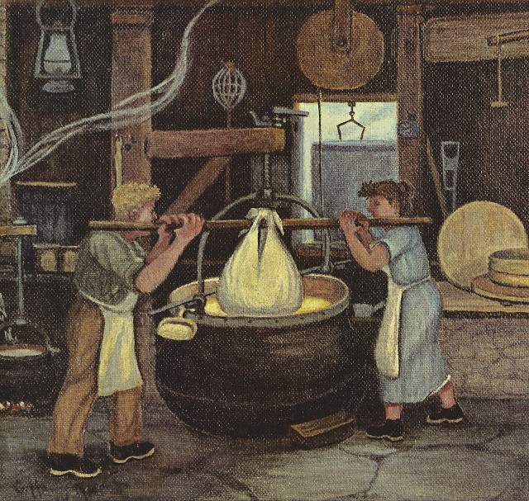
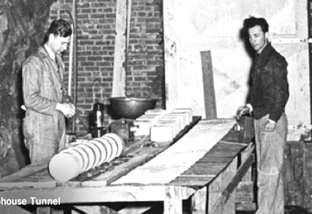
CHEESE HISTORY

Slide 4

CLASSIFICATION OF CHEESE: TWO POINTS OF VIEW
Texture criterion: Soft Versus hard cheese
Very simple classification based on a dominant sensory characteristic, texture
Technological processing criteria
More complex
classification
Commonly used in South Europe

Slide 5


















~CHEESE CLASSIFICATION~
FRESH CHEESE
HALF COOKED CHEESE
SOFT CHEESE
PRESSED CHEESE
COOKED CHEESE
With openness
Without openness
NO RIPENING
MUNSTER/PONT L’EVEQUE
ROQUEFORT/ FOURME
CAMENBERT/ BRIE
TOMME DE SAVOIE
CANTAL/CHEDDAR
FRESH CHEVRE
SPREAD CHEESE PETIT SUISSE
REBLOCHON
EMMENTAL
BEAUFORT
COMTE

Slide 6
CLASSIFICATION OF CHEESE: FOR WHAT?
INTERNATIONAL TRADE
TO PROTECT CONSUMERS
TO MANAGE MANUFACTURING PROCESS TO CONTROL SAFETY AND QUALITY
TO TEACH AND TO INNOVATE

Slide 7
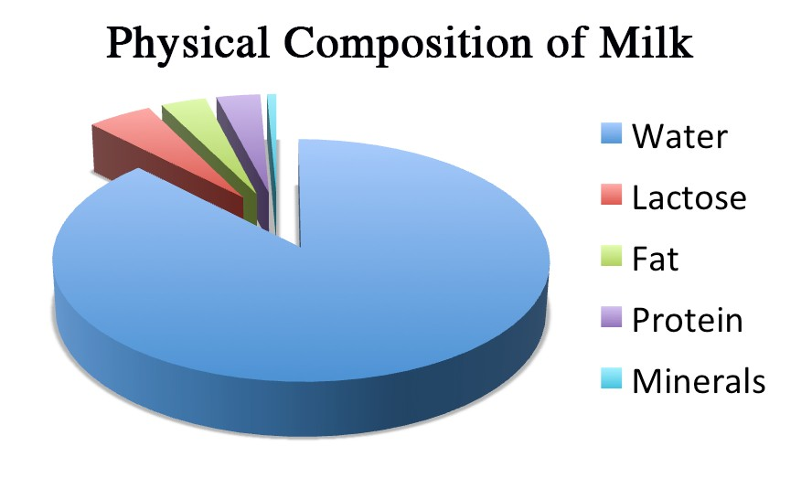

Slide 8
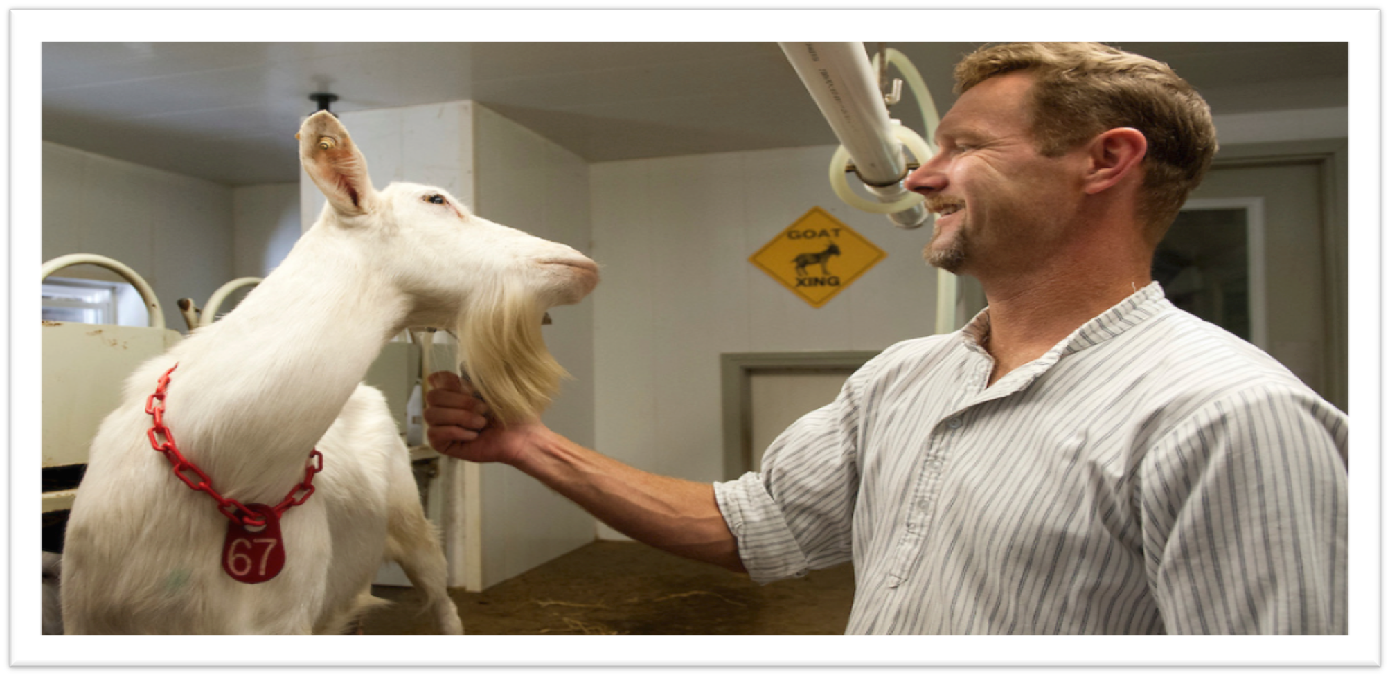
FROM FARM TO FORK

Slide 9
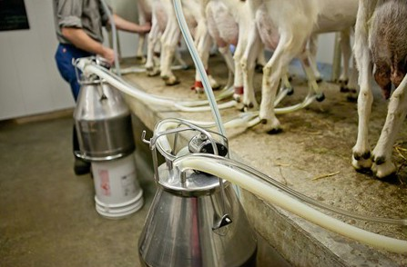
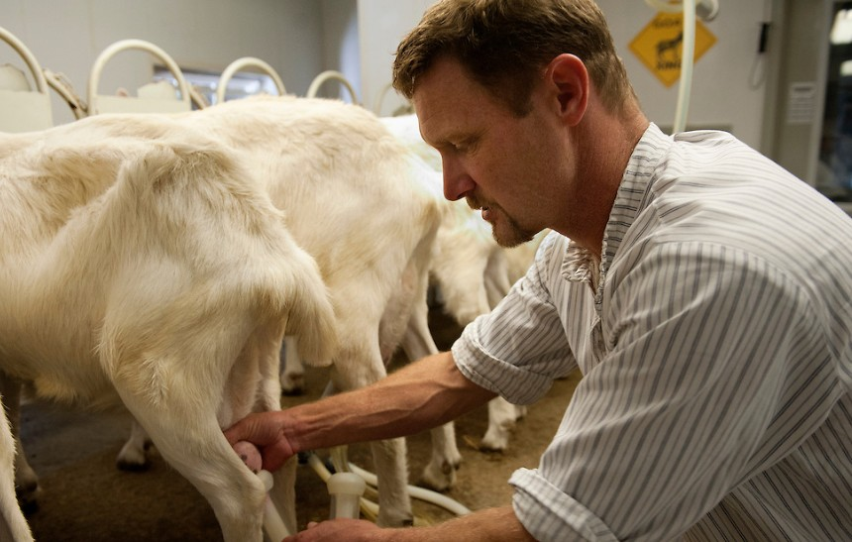
AUTOMATIC
SEMIAUTOMATIC
MILKING

Slide 10
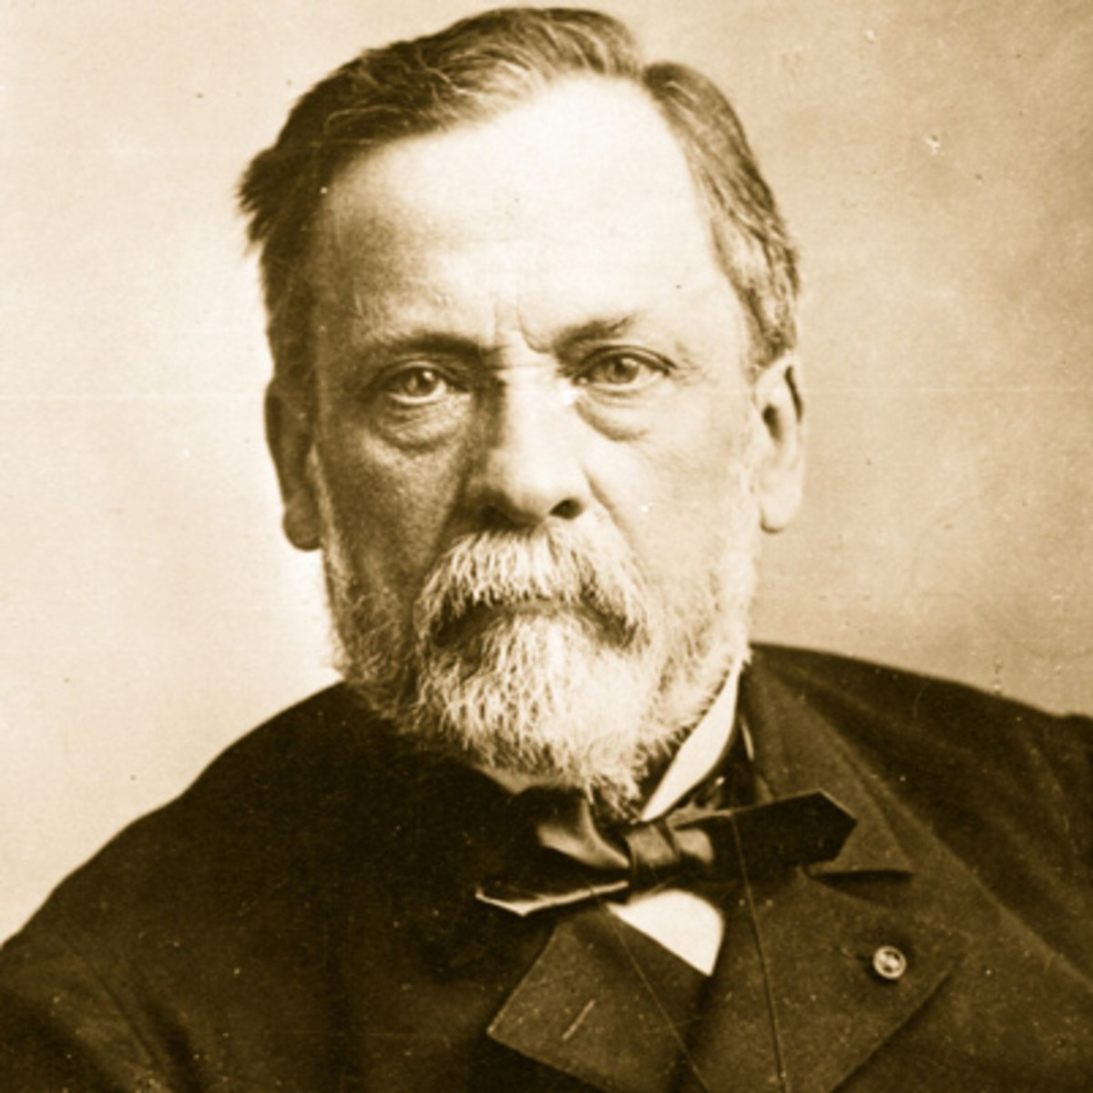




PASTEURISATION
_{LOUIS PASTEUR}
Pasteurization or pasteurisation is a process that kills microbes (mainly bacteria) in food and drink such as milk, juice, canned food and others by heating.
1864
RAW MILK
THERMISATION
N/ STERILIZATION APERTIZATION
#MILK STANDARDIZATION : ALLOW THE MILK TO FOLLOW THE STANDARD OF IDENTITY AND A CONSISTENT CHEESE ALL YEAR LONG

Slide 11
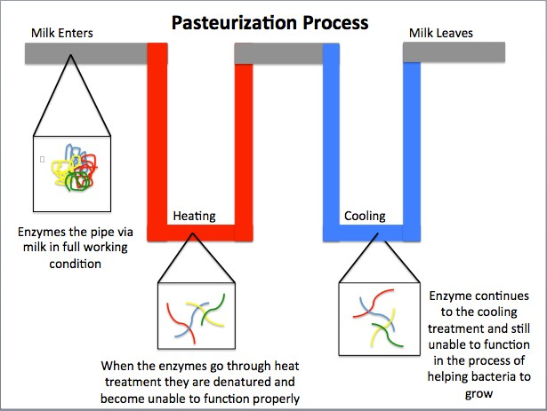

Slide 12

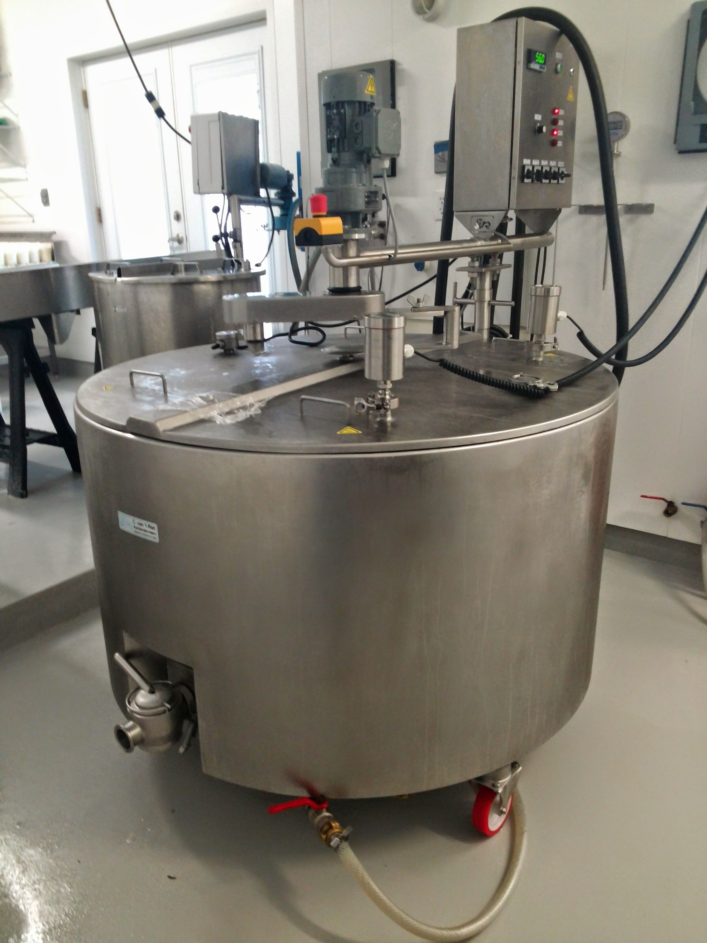



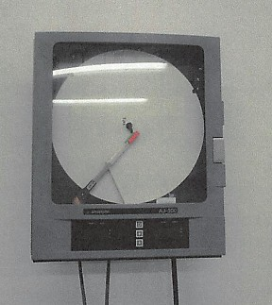


PASTEURISATION
AIR 150°F/30
MILK SPACE 150°F/30
min
CONTROL RECORD
* Vat with Pasteurisation System

Slide 13
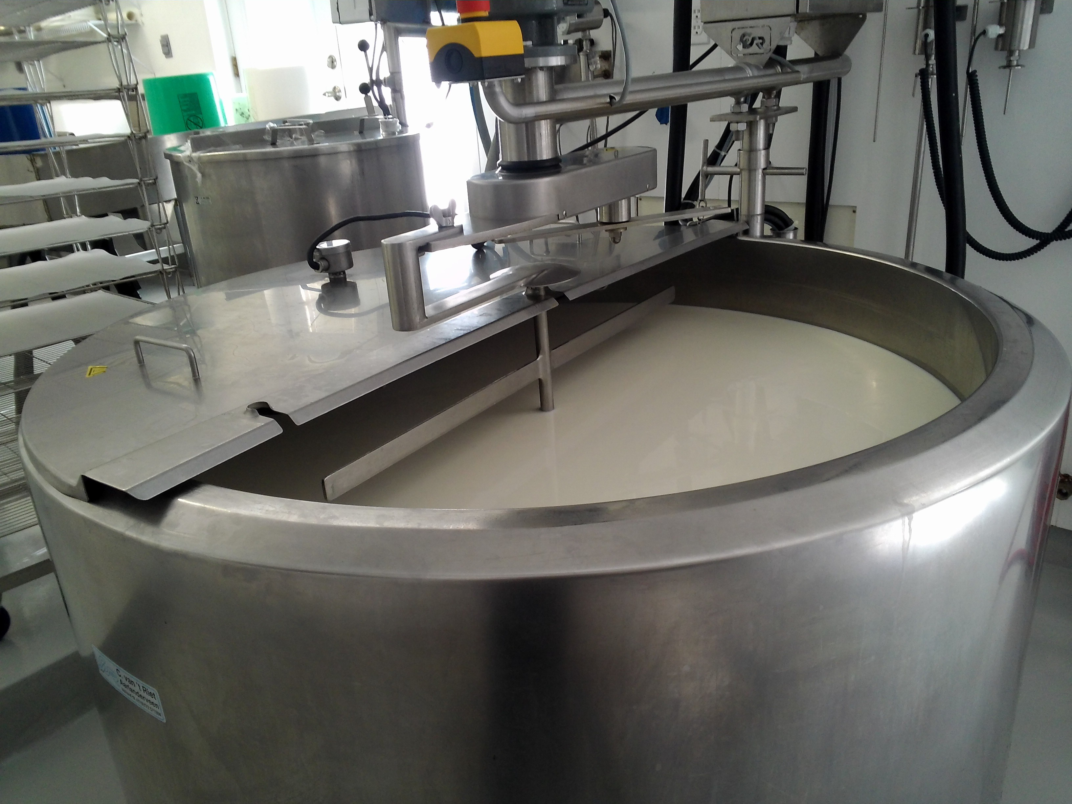



RIPENING
Allowed the micro organisms to adapt themselves to their new environment (LAG PHASE)
In order to reach out
the set pH
TEXTURE, RIND, AROMA,
COLOR

Slide 14
RIPENING: CHEESE TECHNOLOGY
MILK+ FERMENTING AGENTS = ACIDIFICATION
ACIDIFICATION = COAGULATION

Slide 15
CHEESE TECHNOLOGY
ONE KIND OF FERMENTATION
LACTIC FERMENTATION/ LACTO FERMENTATION
ALCOHOLIC FERMENTATION: BREAD, BEER
MALOLACTIQUE: WINE
BUTYRIQUE: CLOSTRIDIUM CANNING EXTREMELY PATHOGENIC
ACETIQUE: VINAIGRE
CHEMICAL REACTION
ELIMINATION OF POTENTIAL PATHOGENS
BACTERIA
BRING THE MILK TO AN ACID pH

Slide 16











LACTIQUE FERMENTATION
C6H12O6 + 2NAD + 2Pi è 2 C3H6O3 + 2ATP
ENZYME
PYRUVATE
LACTATE
GLUCOSE
ENERGY

Slide 17


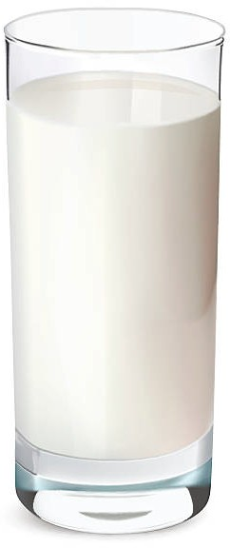



REUSED BY THE CULTURE
FERMENTING AGENTS
ATP = ENERGY
GLUCOSE
LACTOSE
PYRUVATE = LACTATE
ACIDIFICATION pH DROP
GALACTOSE
The obtention of a solid without the addition of fermenting agent cannot be called CHEESE, and the result of the long and uncontrolled acidification affects the organoleptical faculty
COAGULATION

Slide 18
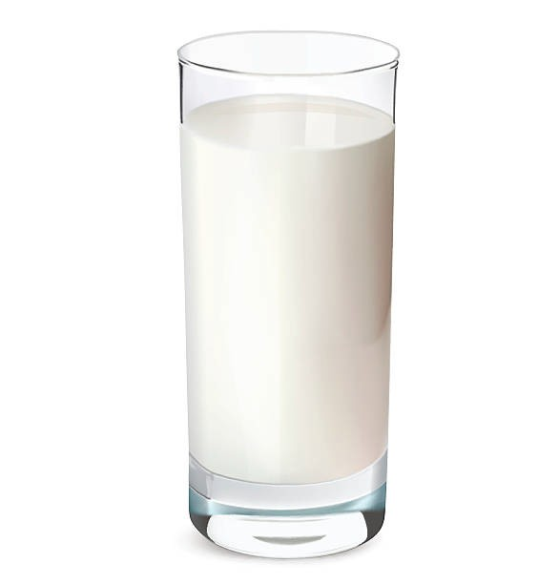
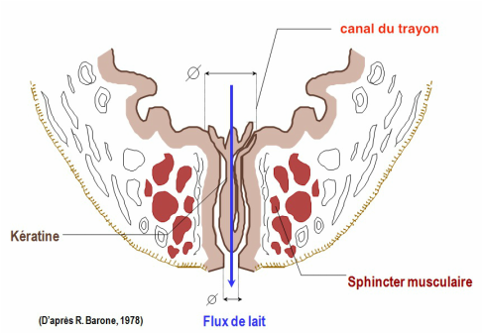

FERMENTING AGENTS NATURALLY PRESENT IN THE MILK
BUT NOT ENOUGH TO START A SAFE ACIDIFICATION
WHERE ARE THEY COMING FROM?

Slide 19






STREPTOCOCCUS LACTIS
STREPTOCOCCUS CREMORIS
WHO ARE THEY?
TURN GLUGLOSE IN ACID LACTIC (LACTATE)
SAME ABILITY

Slide 20
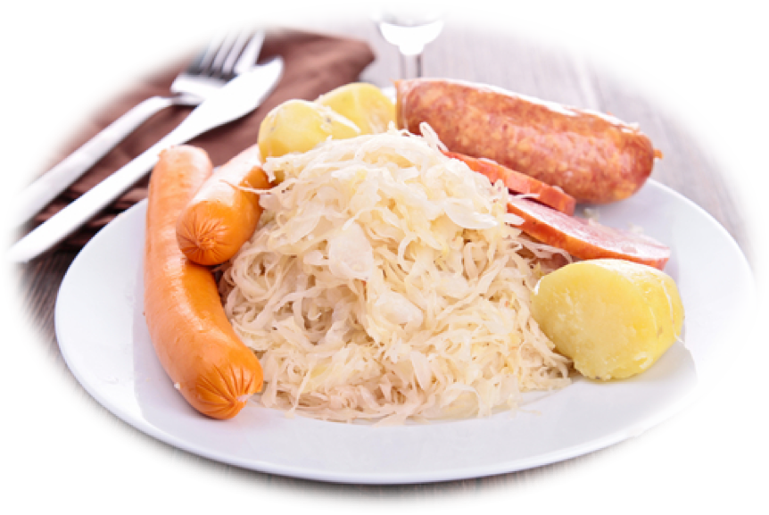
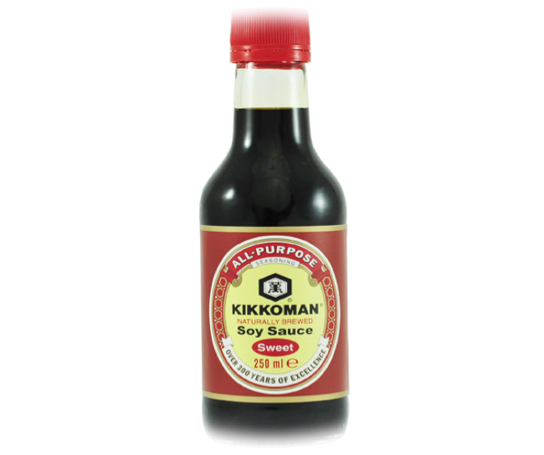
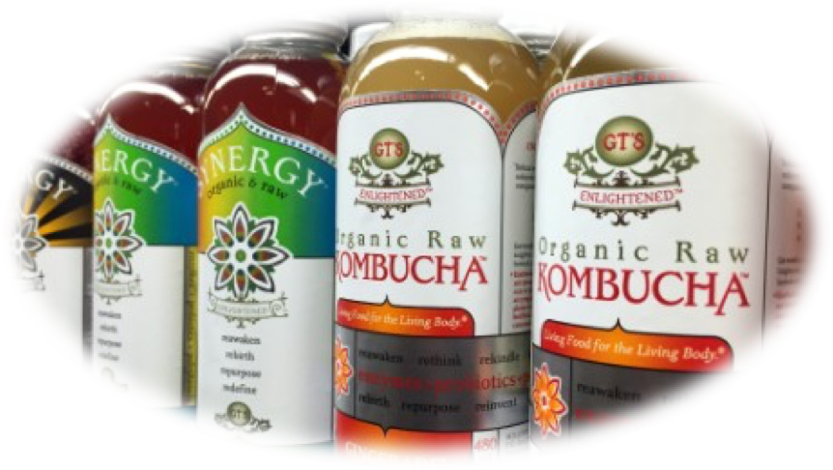
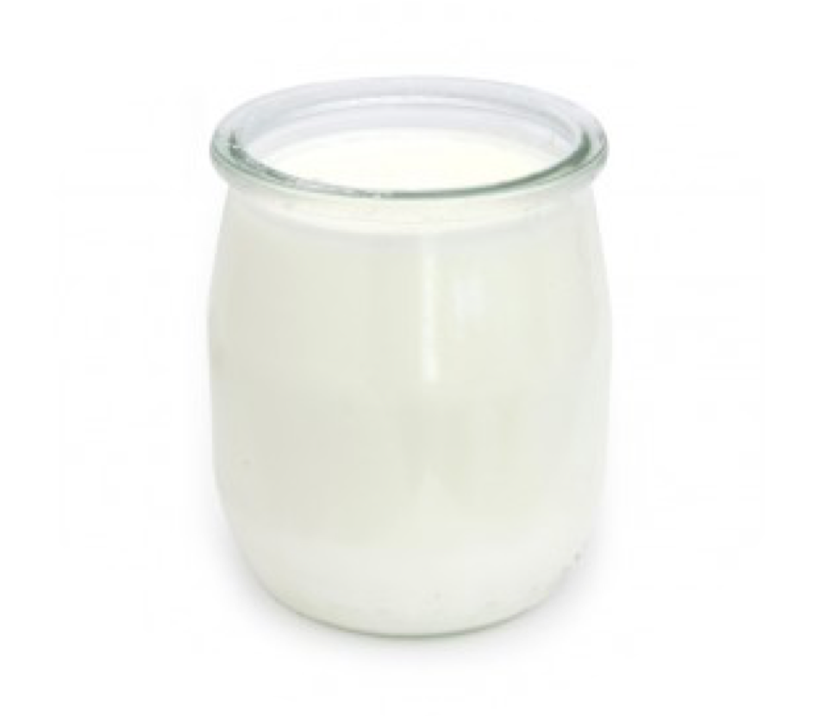
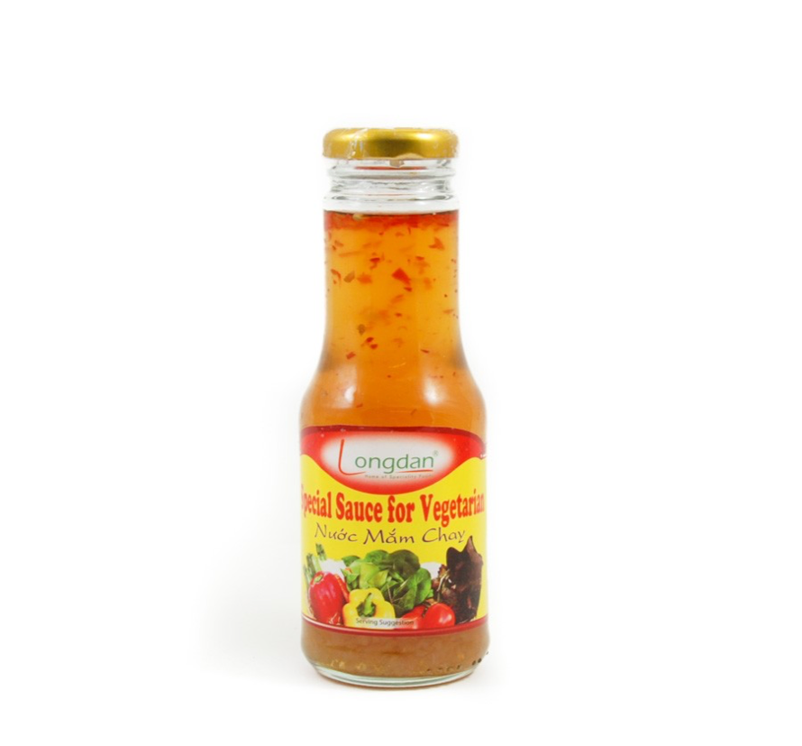
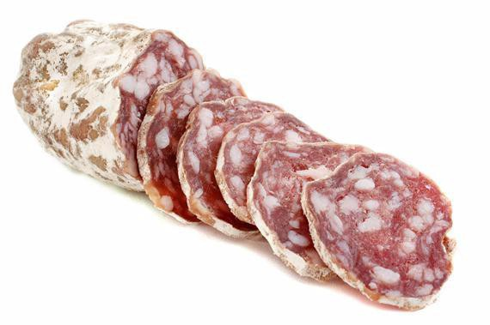
LACTIC FERMENTATION IN FOOD

Slide 21
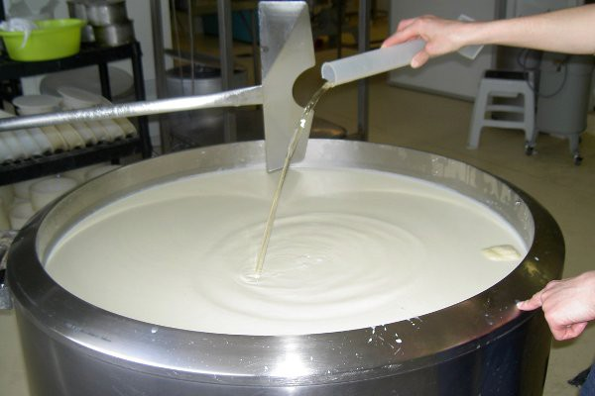


COAGULATION
2
TYPES
LACTIC
COAGULATION
ENZYMATIC
COAGULATION
Fermenting
agent
Fermenting agent RENNET
In order to create a protein network that will capture the fat and will let a certain amount of whey drain depending on its permeability

Slide 22























LACTIC COAGULATION
pH
COAGULATION
4.6
LACTOSE
FAT
CASEINE K
CULTURE
ACID/ LACTATE

Slide 23
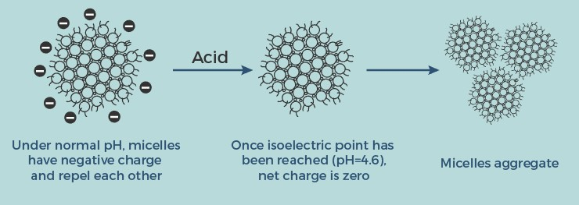
LACTIC COAGULATION

Slide 24
ENZYMATIC COAGULATION
WHAT IS RENNET?
1. General term for enzymes used to coagulate milk
2. Technically restricted
to enzymes derived from ruminant stomachs
3. All are protein degrading

Slide 25
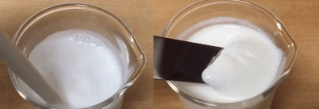
ENZYMATIC COAGULATION
As mentioned in the milk chemistry post, the protein of most interest in cheese making is casein. Casein micelles are covered with a negatively-charged “hairy” layer of κ-casein.

Slide 26
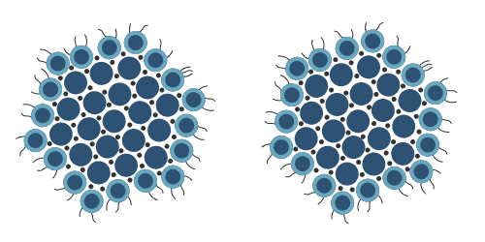
ENZYMATIC COAGULATION
In milk, these casein micelles float around and bounce off each other. Those κ-casein hairs get in the way and prevent the casein from sticking and aggregating. Our goal in cheese making is to make those casein micelles stick together somehow. Once they stick together, a domino effect occurs, and eventually you form a mesh of casein micelles that form the structure/body of the cheese.

Slide 27
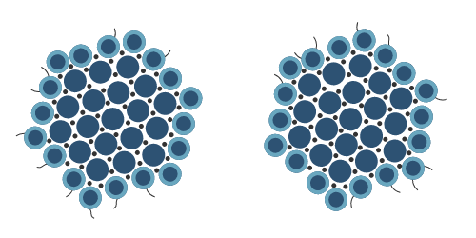
ENZYMATIC COAGULATION
How we get those micelles to stick together is what coagulation is all about! The coagulation (or “clotting”) process is done to encourage those casein micelles to stick together somehow. Enzymes (rennets), acid, and acid/heat can all be used to encourage this process. The exact mechanism of each differs and will be discussed below.

Slide 28
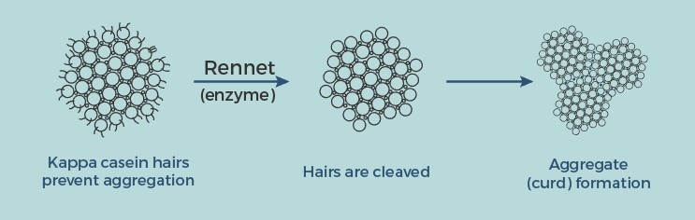
ENZYMATIC COAGULATION
Rennet enzymes act like a razor and shave off the κ-casein hairs. Without the hairs, the micelles can now stick, aggregate, and form the backbone of cheese structure. An interesting property of enzymes is that they are re-used in chemical reactions.

Slide 29
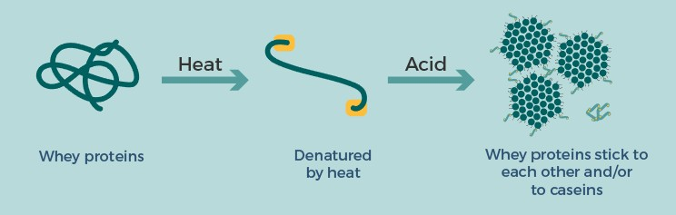
ENZYMATIC COAGULATION

Slide 30
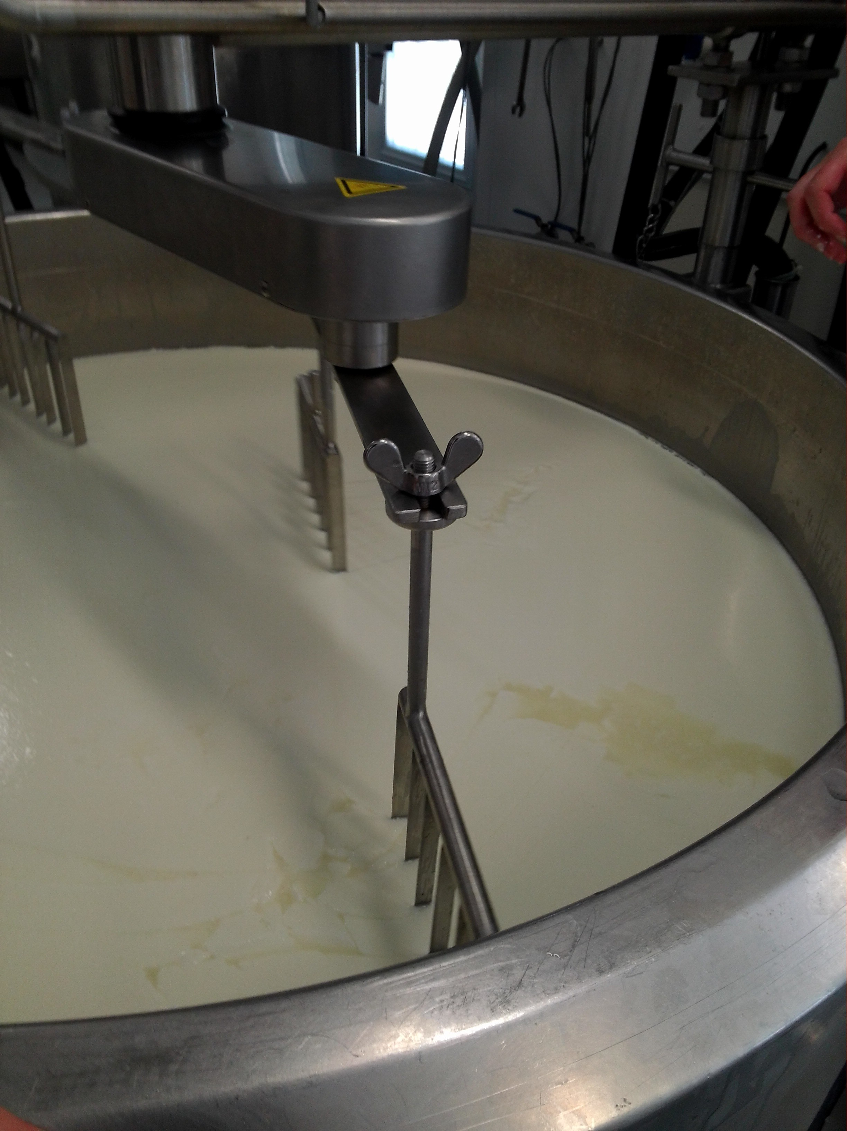


CUTTING
Allow to increase the surface area for draining
Test : clean cut
Size: cube, Hazelnut, walnut, nut, corn, rice

Slide 31
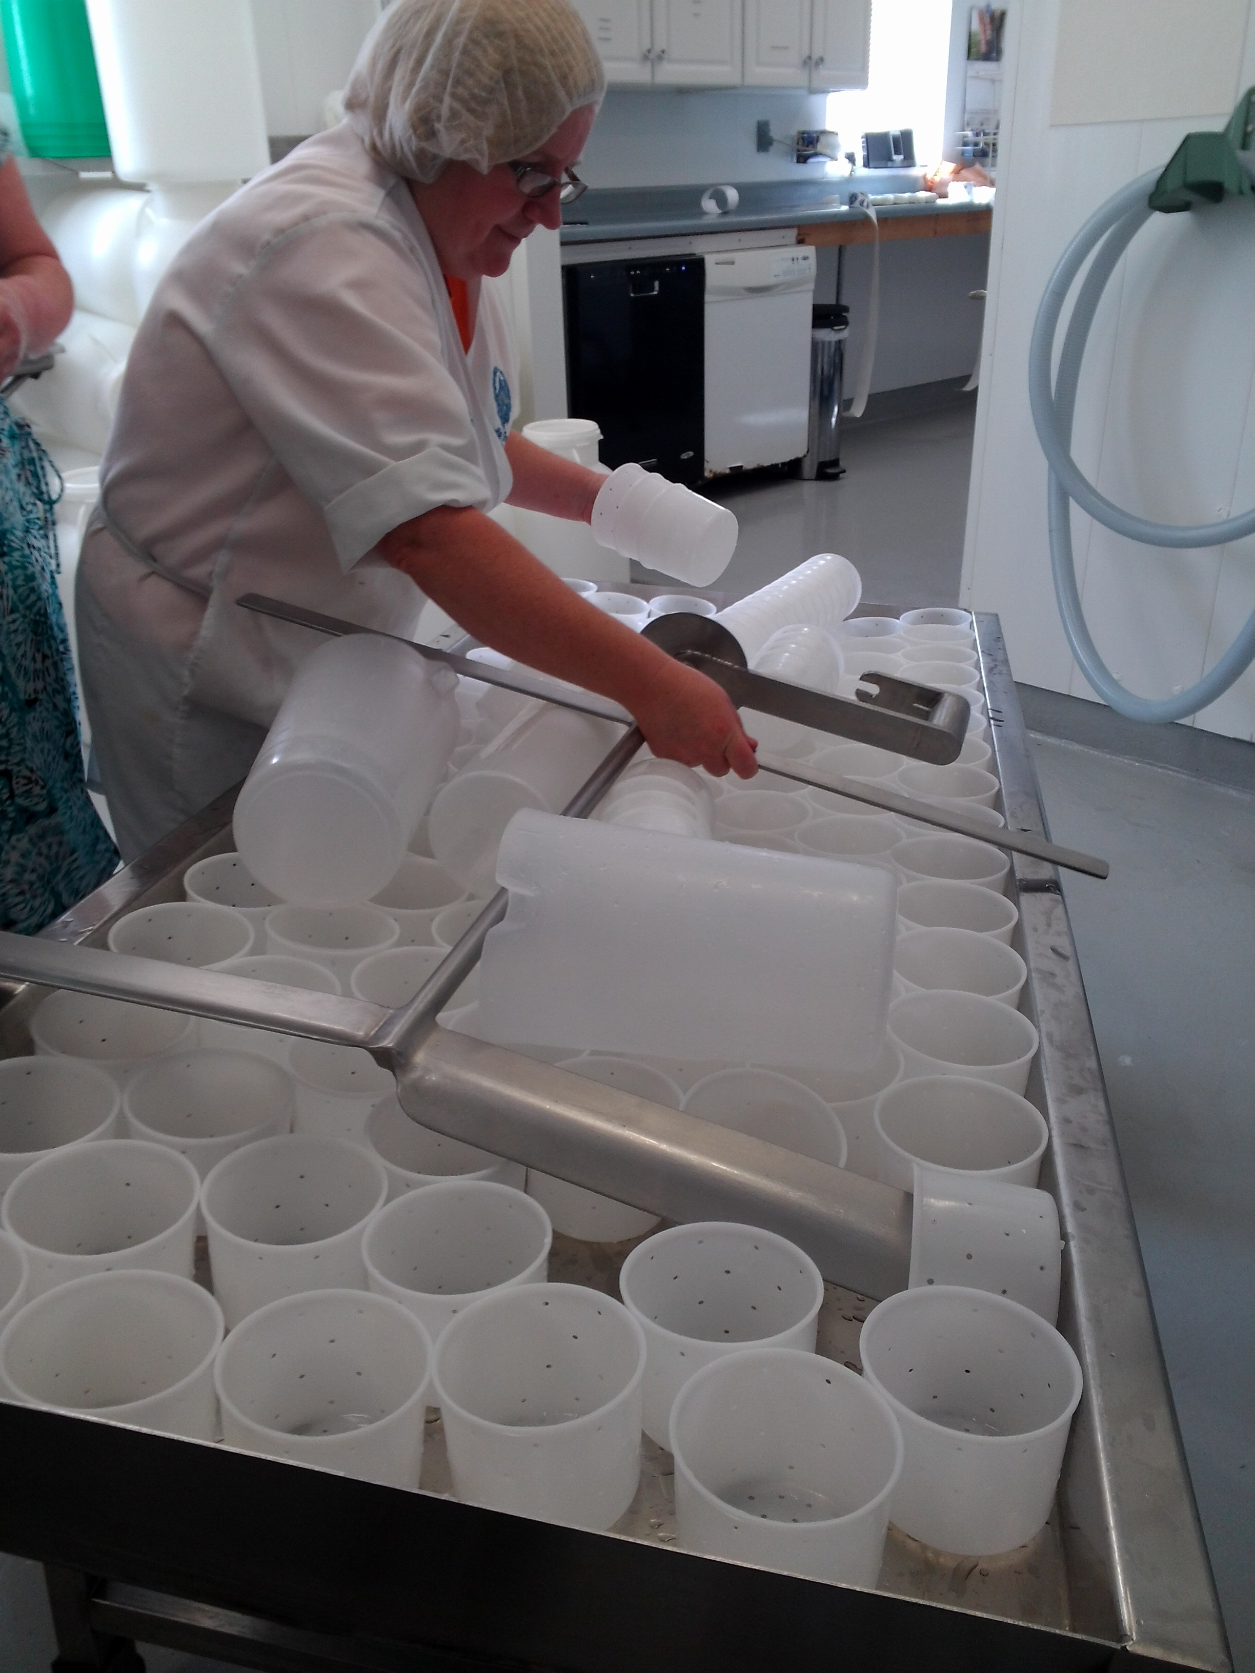

MOULDING
Gives the shape
Respond to a certain
Start of Draining process

Slide 32
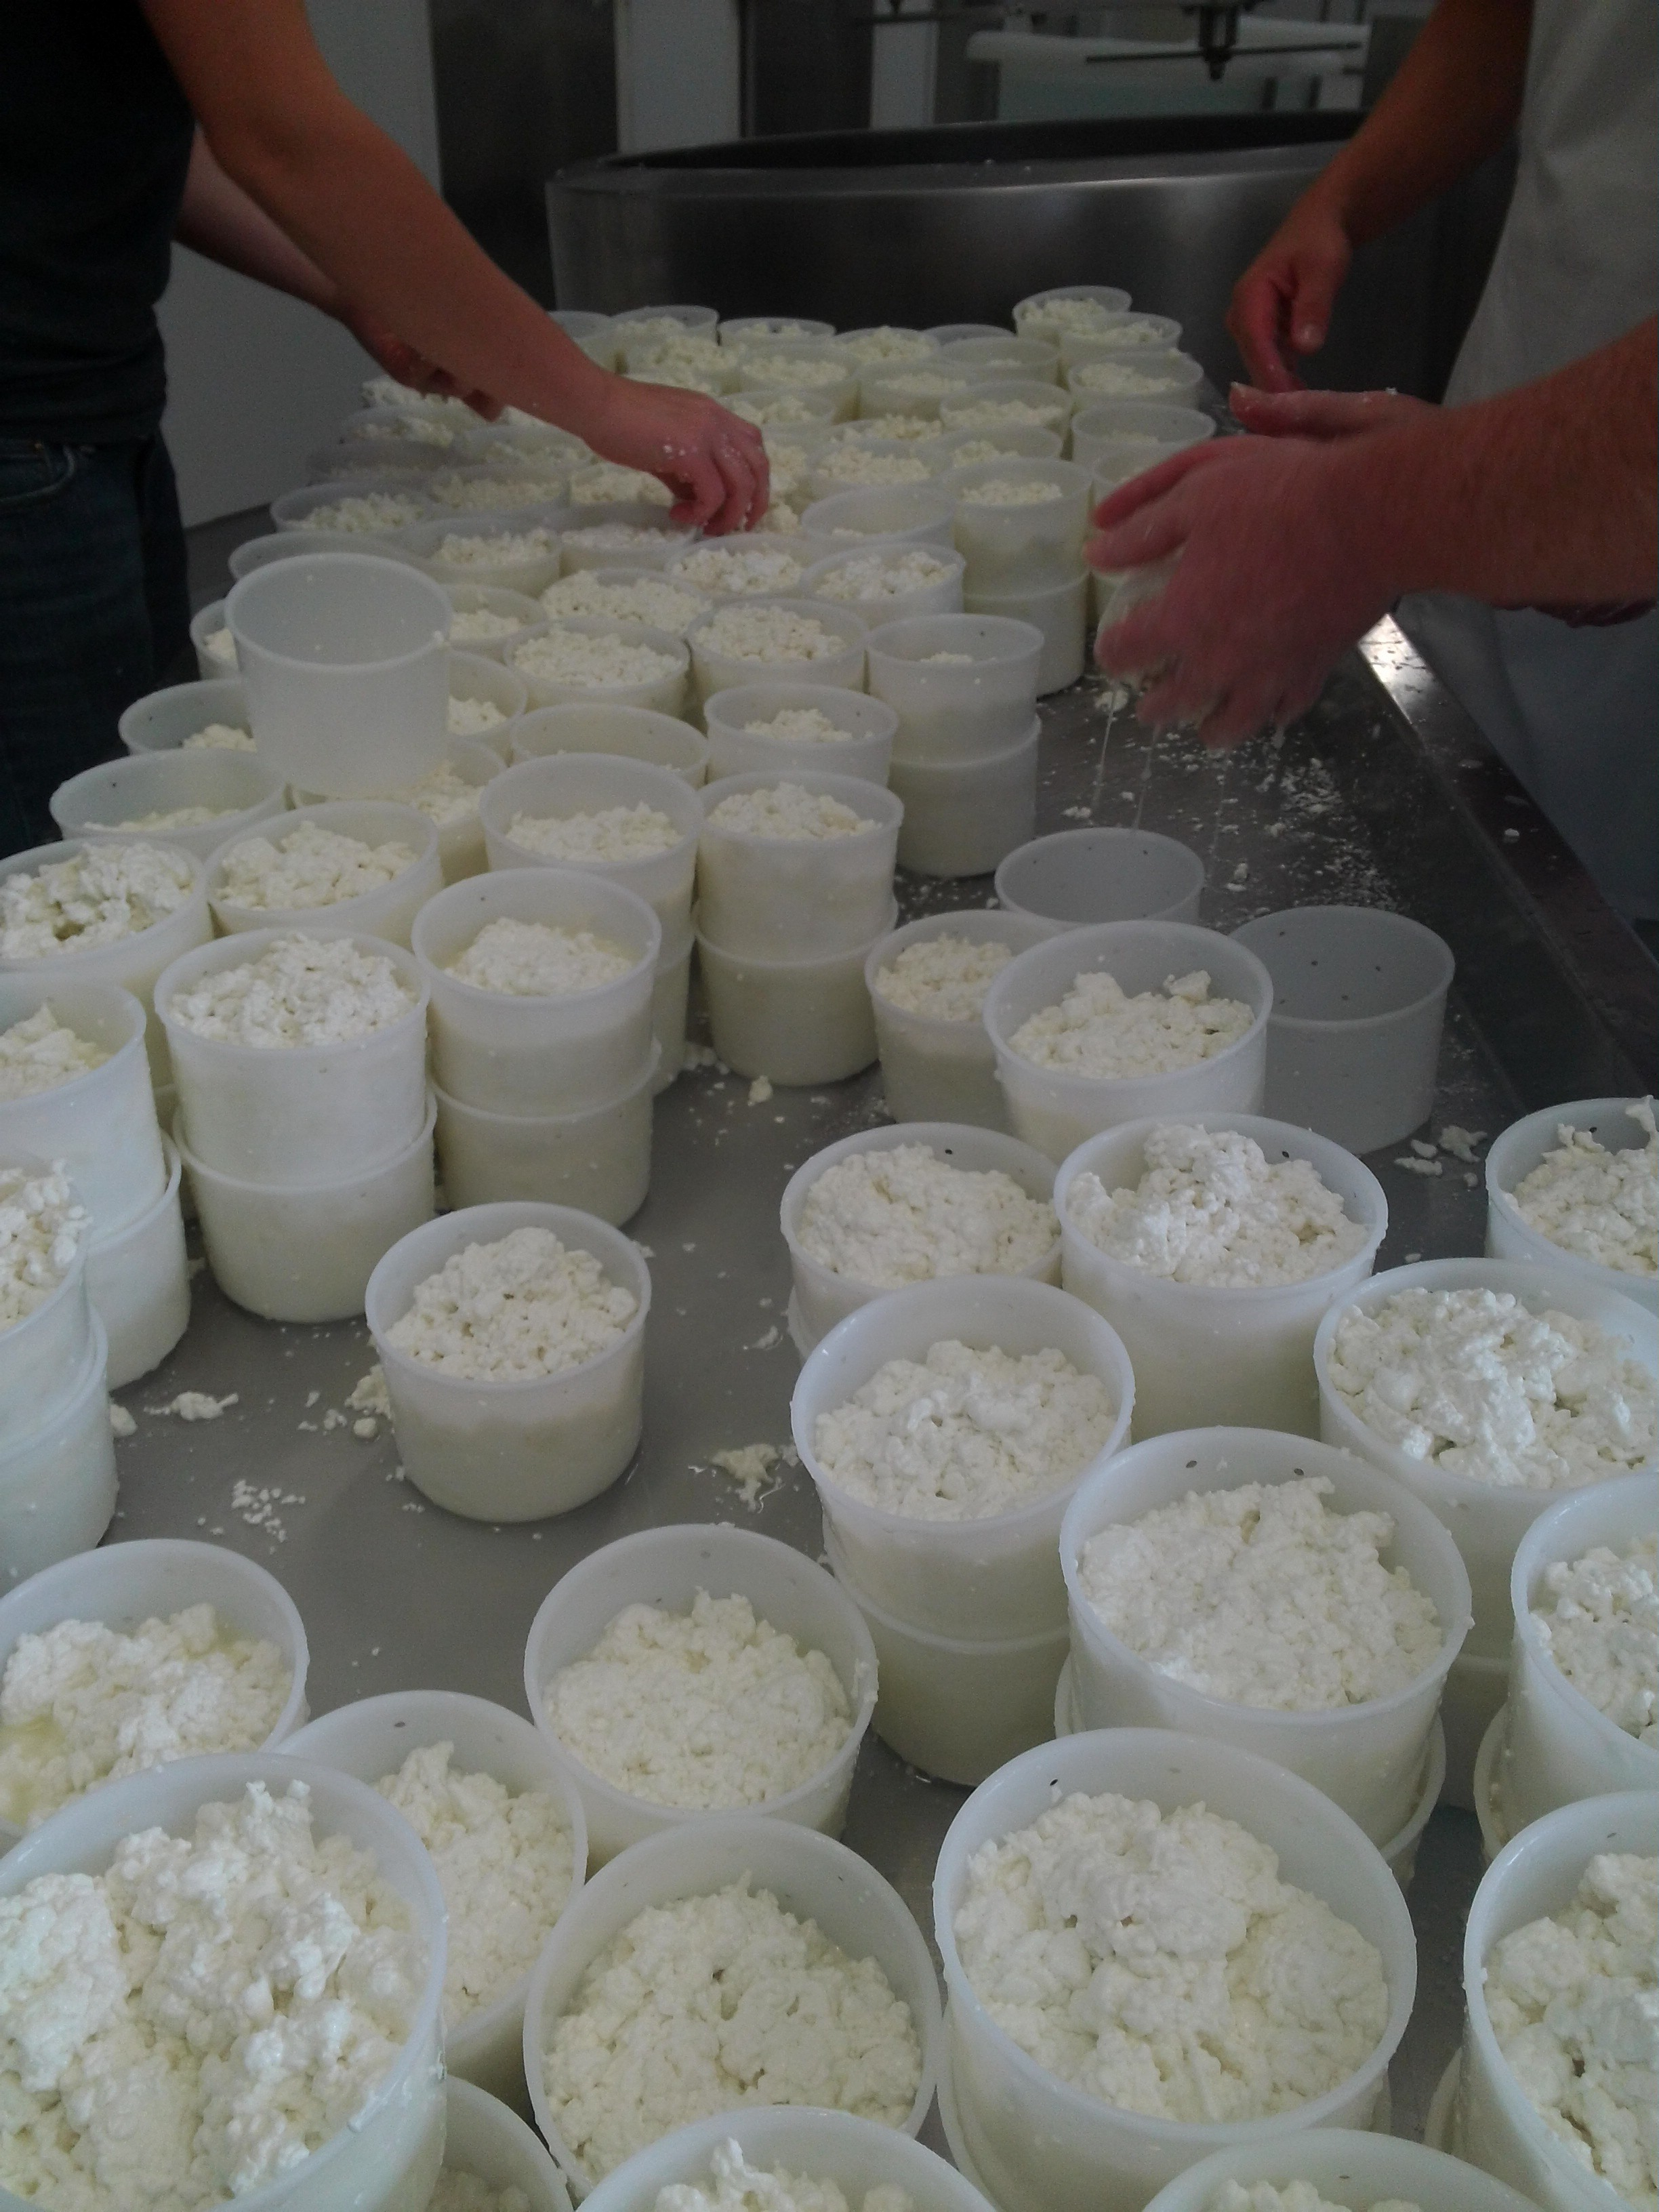

PRESSING
Increase the draining
Give the paste a certain type of classification

Slide 33
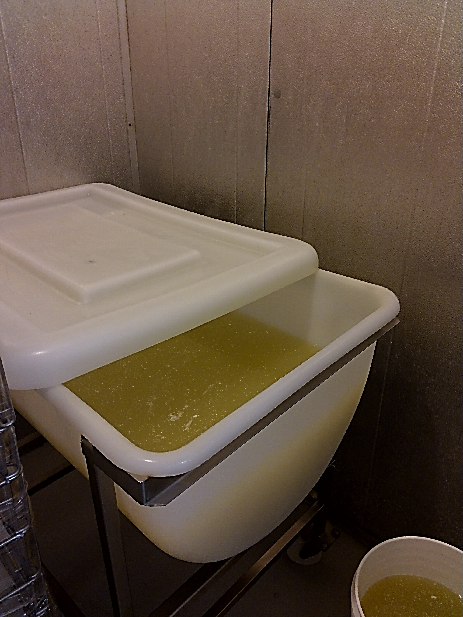

BRINING
Decrease the AW
Salt the cheese
Increase the shelf life

Slide 34
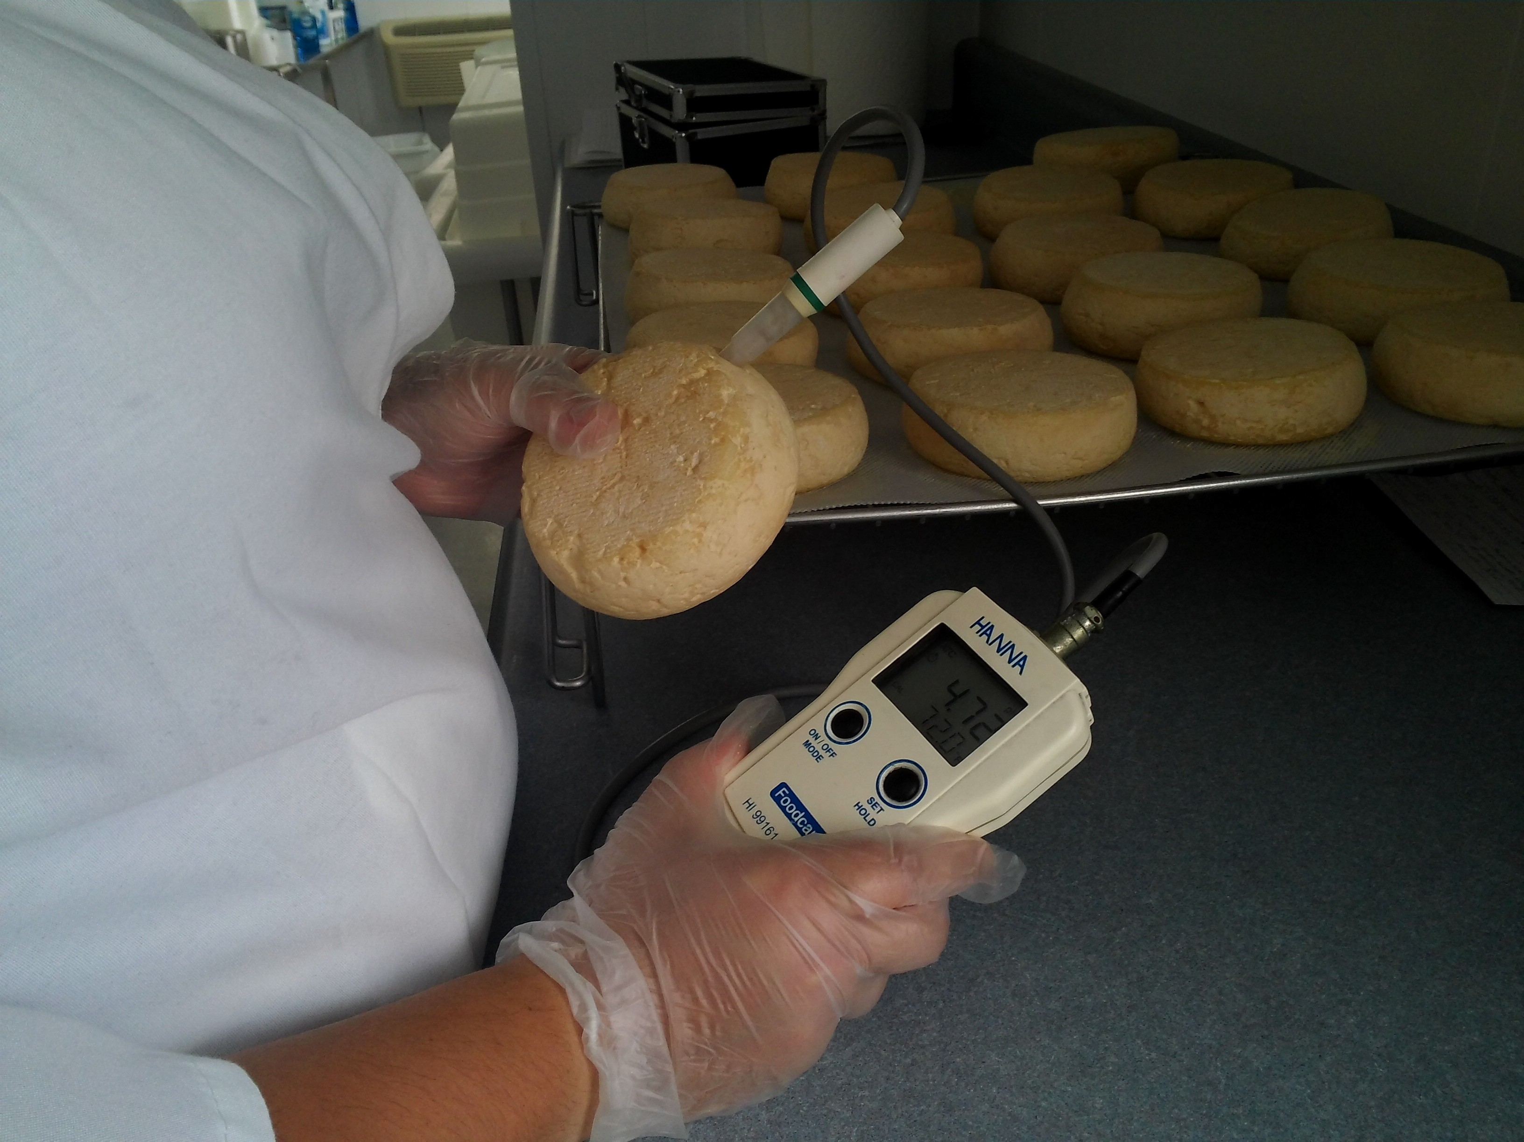

AGING
One Day to several years
Different techniques give the cheese its identity
Washing; brine, beer, wine
Morge
Waxing
Seasoning

Slide 35


Slide 36
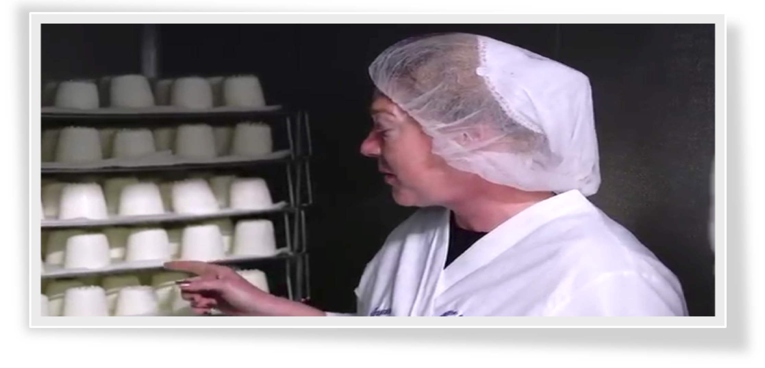

QUESTIONS?

