Slide 1
Control of Canada Thistle in an Organic Apple Orchard
Chris McGuire, Two Onion Farm

Slide 2
Two Onion Farm
Apples: 2 acres
Ribes: ½ acre
Certified organic
CSA, stores, other farms
Fresh fruit, value-added products

Slide 3
Mulching at Two Onion Farm
Dwarf trees
6.5-8 foot band of mulch
Weed control
Erosion
Build organic matter
Discourage rodents

Slide 4
Canada Thistle Invades
Grow from seed or by spread from adjacent areas
Deep rhizomes
Very hard to eradicate once established

Slide 5
Killing Perennial Weeds
Impossible to dig
Repeatedly kill shoots
Proper interval is key

Slide 7
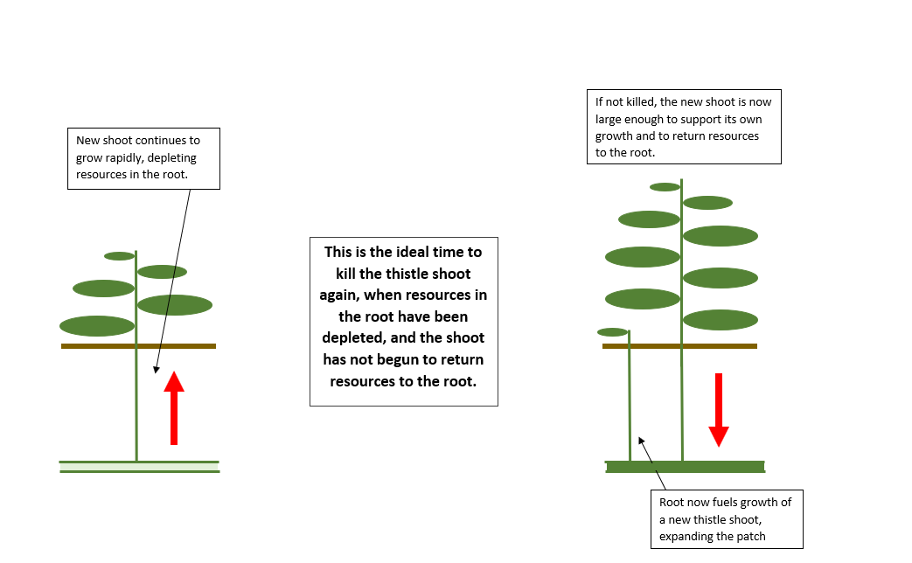

Slide 8
Canada Thistle Control
USDA-SARE Farmer Rancher Grant
Hand pulling
Hoeing with diamond hoe
String trimmer
Avenger organic herbicide
All treatments without and without cardboard mulch

Slide 10
Cost Per Tree of Applying Treatments To Eradicate Canada Thistle
Treatment | Labor To Cut Thistles and other weeds | Labor To Apply Cardboard | Cost Of Materials | Total Cost
Cardboard-Trim | $1.57 | $2.28 | $0.03 | $3.87
Cardboard-Spray | $1.14 | $2.28 | $3.07 | $6.48
Cardboard-Hoe | $1.67 | $2.28 |  | $3.94
Cardboard-Hand pull | $3.21 | $2.28 |  | $5.49
No cardboard-Trim | $2.07 |  | $0.04 | $2.11
No cardboard-Spray | $1.90 |  | $5.96 | $7.86
No cardboard-Hoe | $2.64 |  |  | $2.64
No cardboard-Hand pull | $4.96 |  |  | $4.96

Slide 11
Other considerations
Hoe and string trimmer degrade mulch
String trimmer not good against low-growing weeds
String trimmer issues: vibration, noise, maintenance

Slide 12
Questions?
Chris McGuire
Two Onion Farm
twoonionfarm@gmail.com

